Slide 1
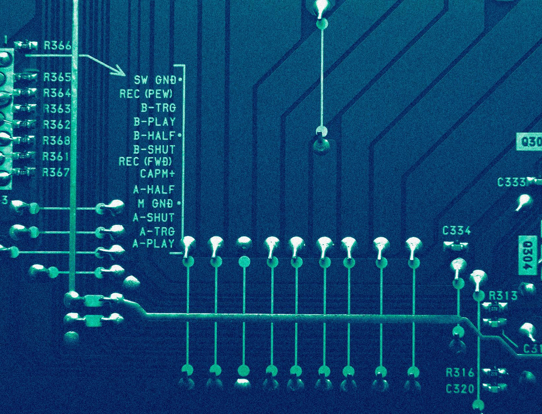
RadixSort,MergeSort,ShellSort,QuickSort,CountingSort
STRUCTURI DE DATE
TEMA 1
Lapadus Daria

Slide 2
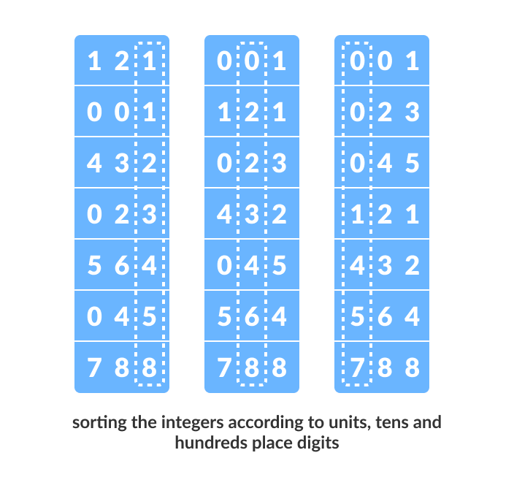
Radix Sort Algorithm
01

Slide 3
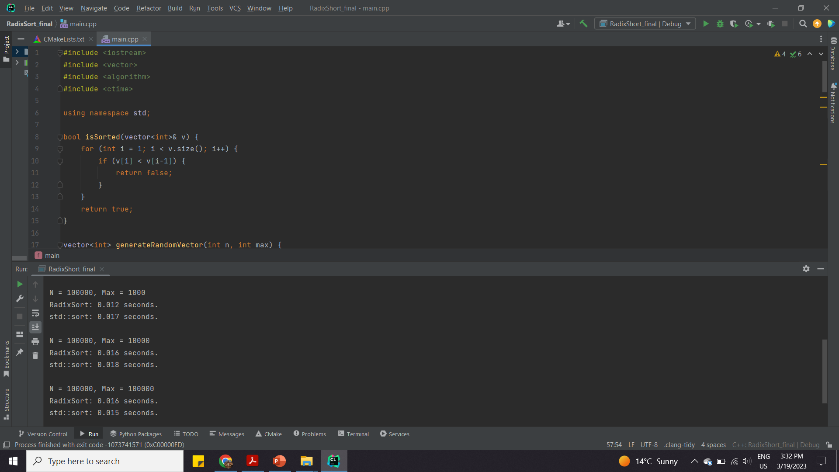
Radix Sort Algorithm

Slide 5
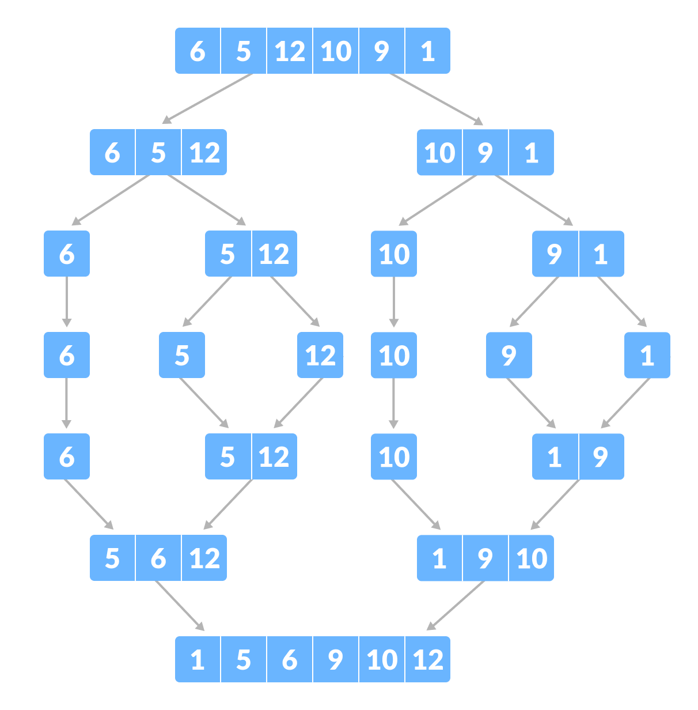
Merge Sort Algorithm
02

Slide 6
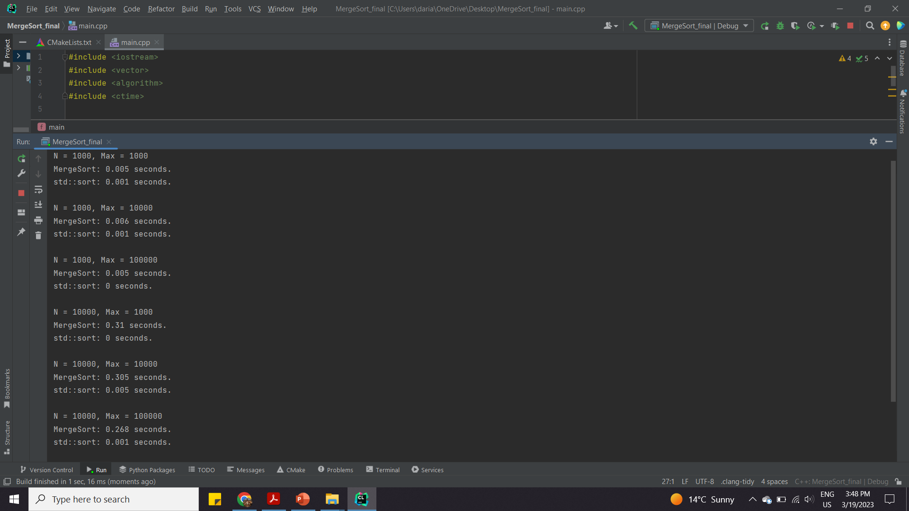
Merge Sort Algorithm

Slide 8
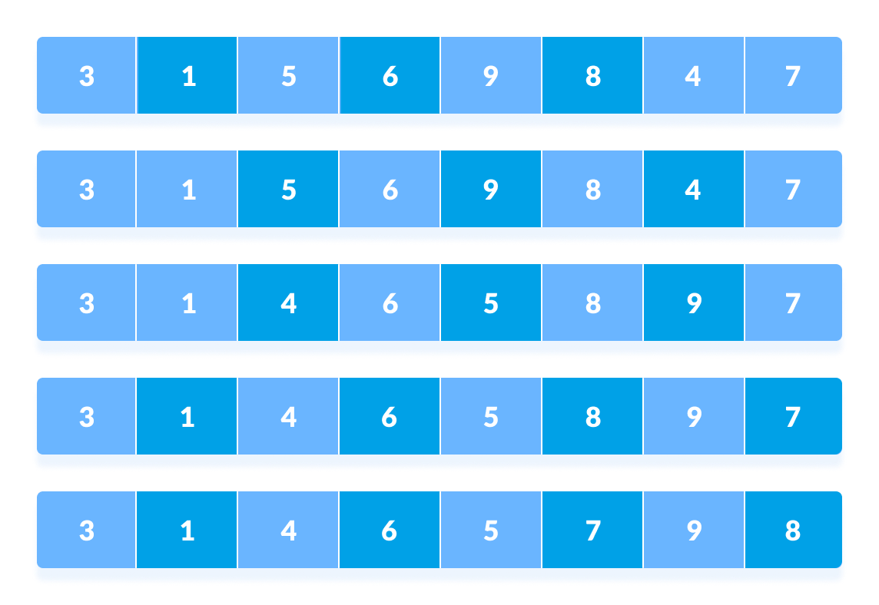

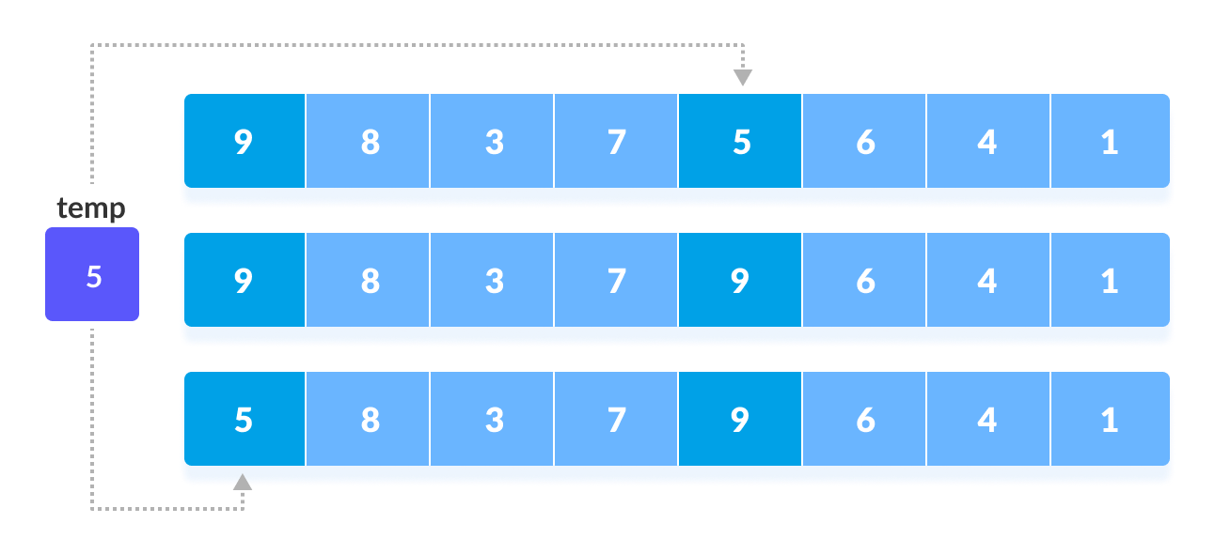
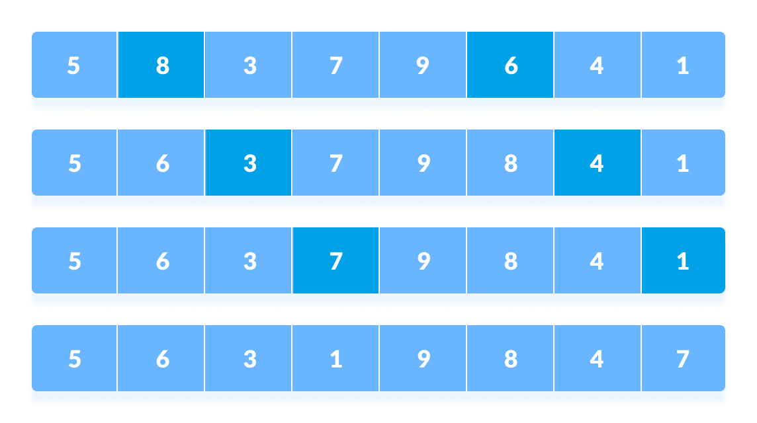

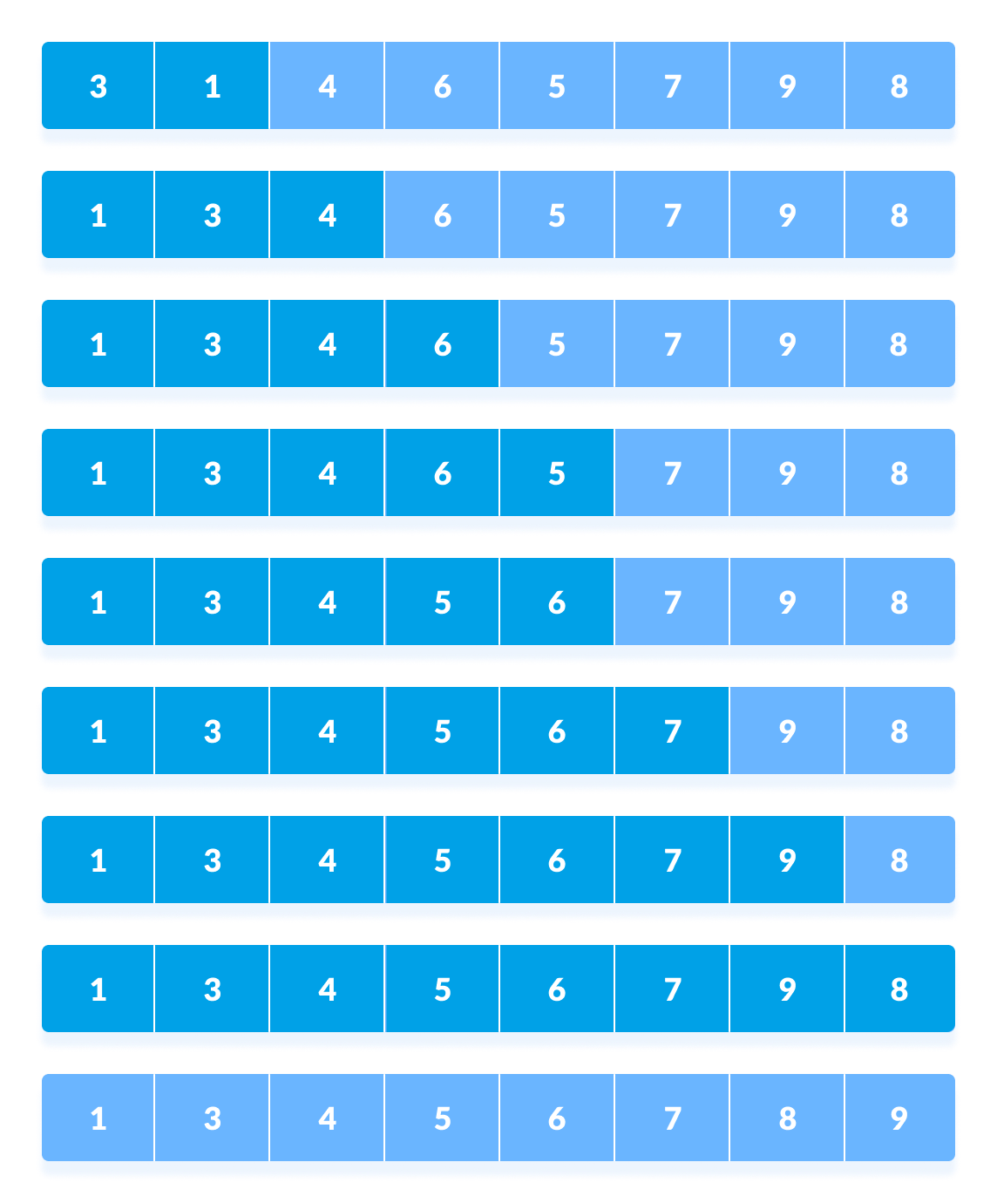

Shell Sort Algorithm
03

Slide 9
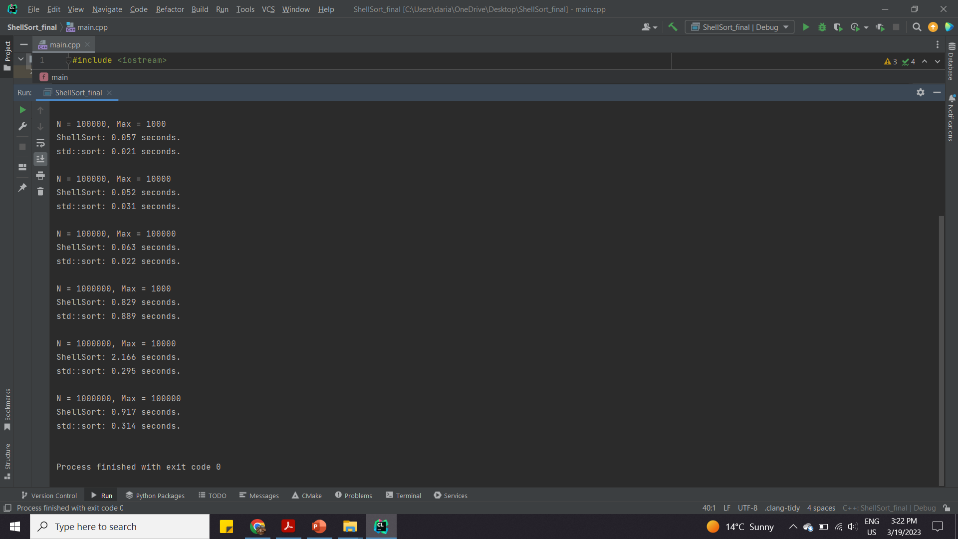
Shell Sort Algorithm

Slide 11
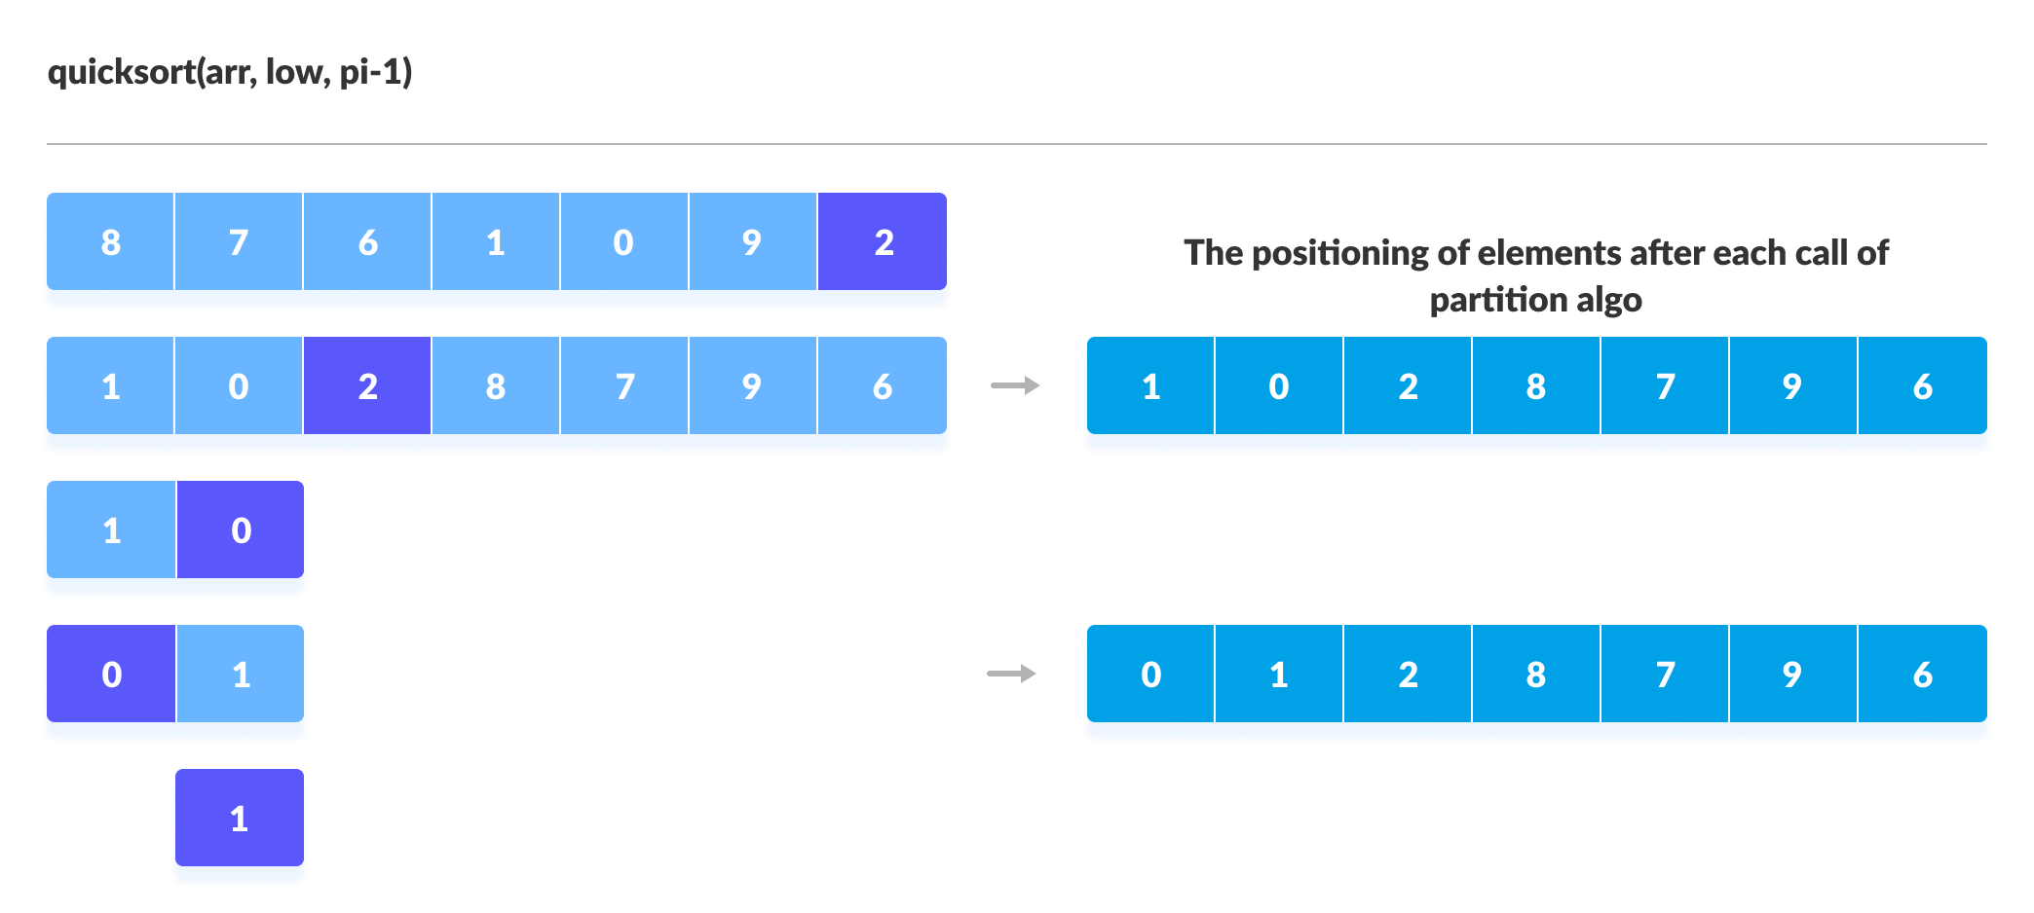
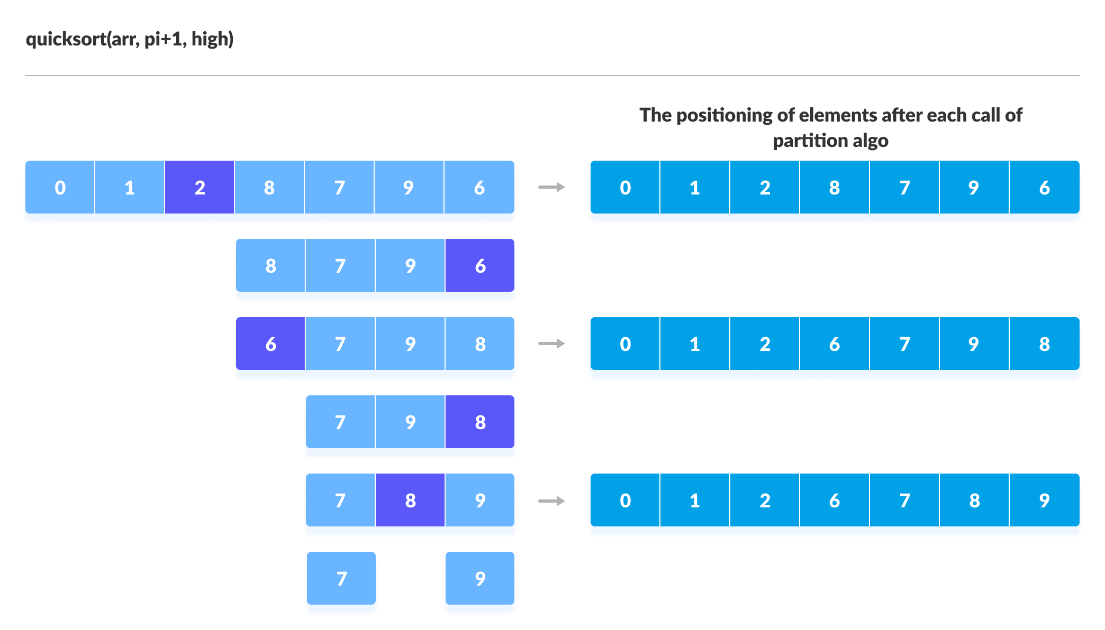
QuickSort Algorithm
04

Slide 12
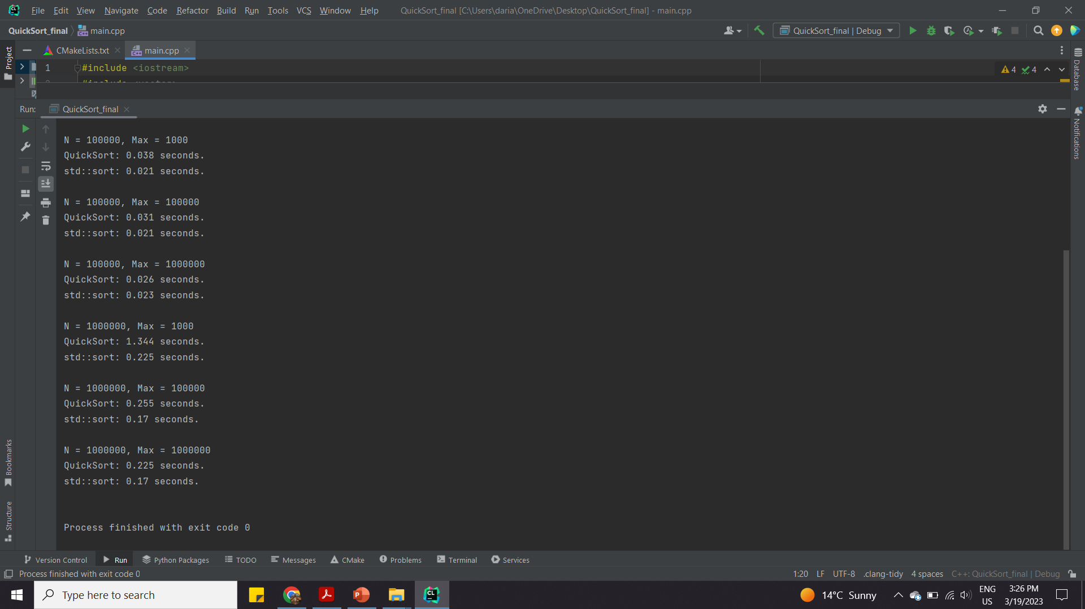
QuickSort Algorithm

Slide 14
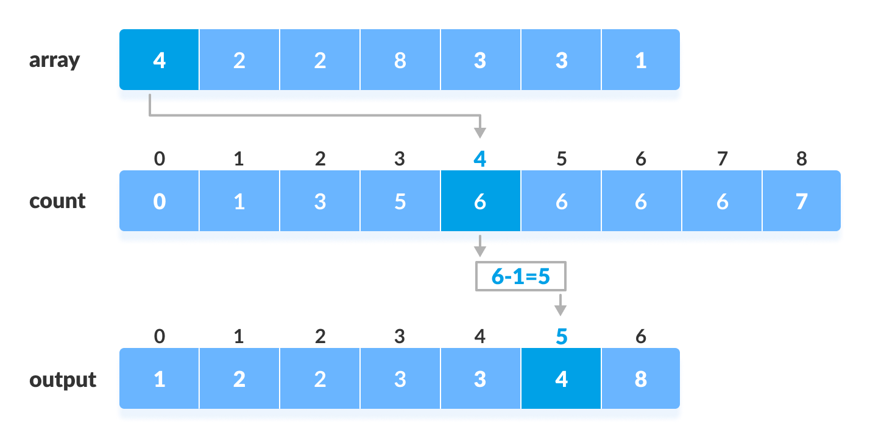
Counting Sort Algorithm
05

Slide 15
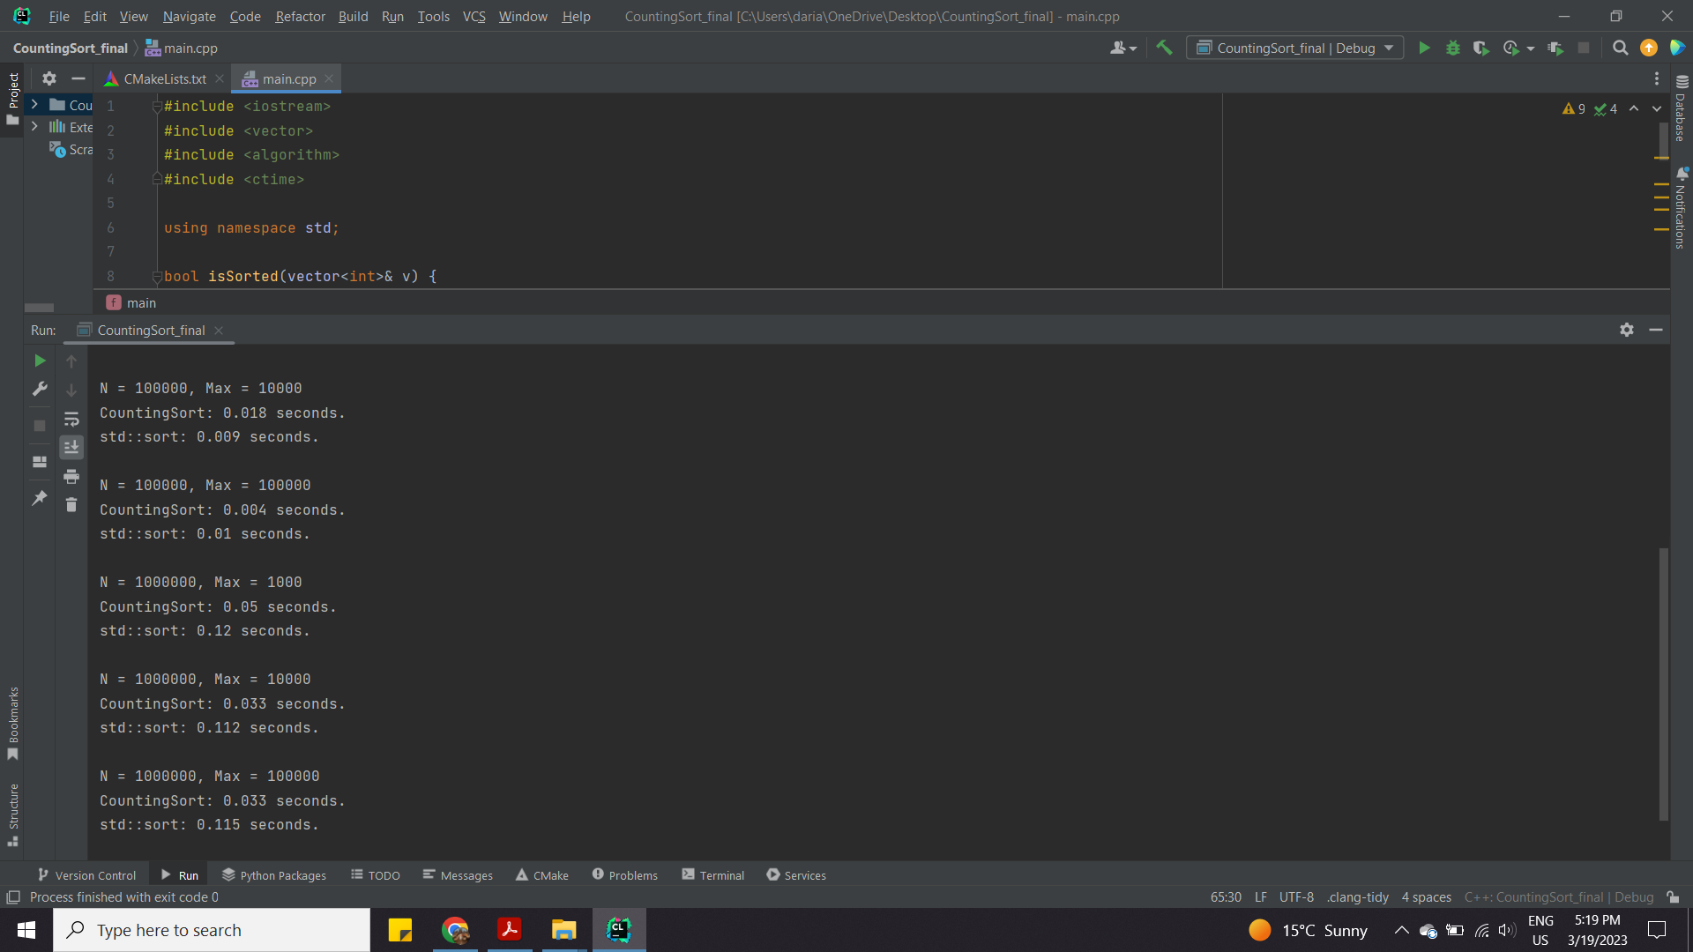
Counting Sort Algorithm

