Slide 1

CPSC 641 Computer Graphics:
Animation with Motion Capture
Jinxiang Chai

Slide 2
Data Process
3D marker positions (.c3d file)
Fill in missing data
Filter mocap data
Complete 3D marker trajectories (.c3d file)
Inverse Kinematics
How to represent motion data in joint angle space?
Joint angle data (.amc file)

Slide 3
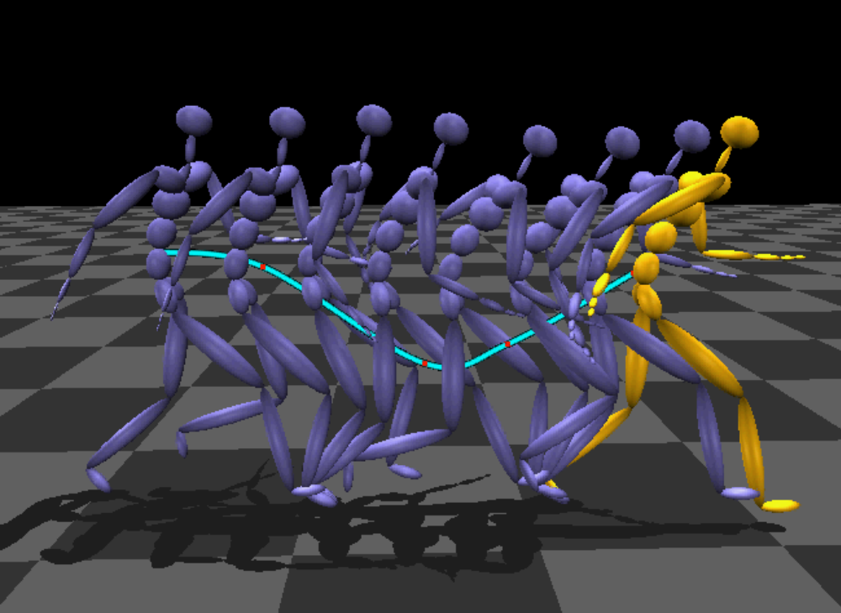
How to represent human motions?

Slide 4
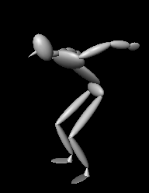
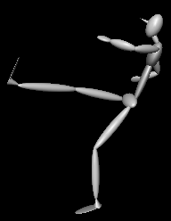
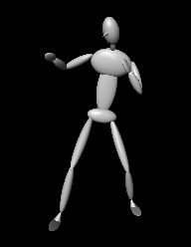
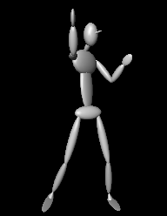
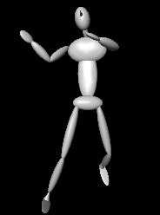
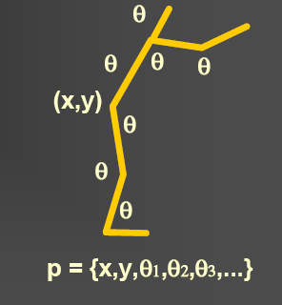
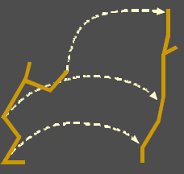
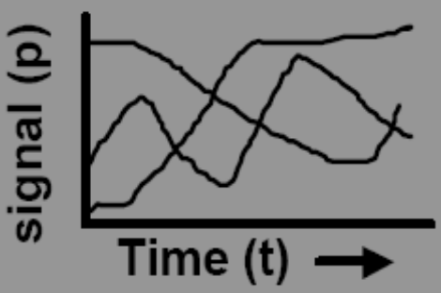
Human motion representation
A sequence of poses: q₁,q₂,…q_{T}
Each pose is represented as a high-dimensional vector q_{t}: R^{n}
Pose q_{t}
Motion q₁,…q_{T}
Motion trajectories
Notes:
An ideal animation system should also deal with various spatial-temporal constraints. The constraints from the user might be key frames, key trajectories or the combination of both.

Slide 5
How to represent human motions?

Slide 6
How to represent human motions?
The body proportion and size of characters
the joint angle values across the entire sequence

Slide 7
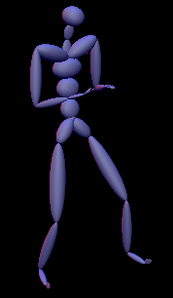
Motion Capture Data Files
Each sequence of human motion data contains two files:
  Skeleton file (.asf): Specify the skeleton model of a character
  Motion data file (.amc): Specify the joint angle values over the frame/time
  Both files are generated by Vicon software

Slide 8
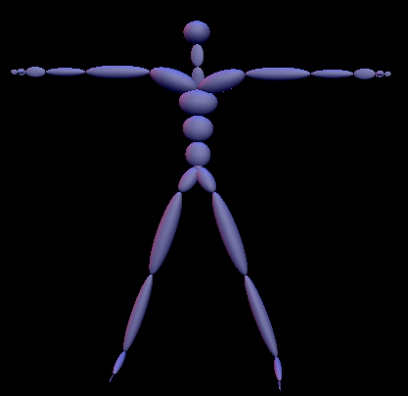
Human skeletal file
Described in a default pose

Slide 9
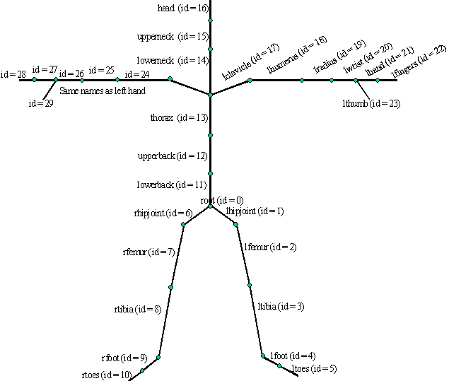
Human skeletal model
This is still a tree!

Slide 10
Human skeletal model
How to describe the skeletal model?
What should you know about each bone?
This is still a tree!

Slide 11
Human skeletal file (.asf)
individual bone information
- length of the bone
- direction of the bone
- local coordinate frame
- number of Dofs
- joint limits
bone hierarchy/connections

Slide 12
Individual bone information
begin
id bone_id /* Unique id for each bone */
name bone_name /* Unique name for each bone */
direction dX dY dZ /* Vector describing direction of the bone in world */ coor. system
length 7.01722 /* Length of the bone*/
axis 0 0 20 XYZ /* Rotation of local coordinate system for
this bone relative to the world coordinate
system. In .AMC file the rotation angles
for this bone for each time frame will be
defined relative to this local coordinate
system**/
dof rx ry rz /* Degrees of freedom for this bone.
limits (-160.0 20.0) /* joint limits*/
(-70.0 70.0)
(-60.0 70.0)
end

Slide 13
Individual bone information
begin
id 2
name lfemur
direction 0.34 -0.93 0
length 7.01722
axis 0 0 20 XYZ
dof rx ry rz
limits (-160.0 20.0)
(-70.0 70.0)
(-60.0 70.0)
end
y_{w}
x_{w}
z_{w}

Slide 14
Individual bone information
begin
id 2
name lfemur
direction 0.34 -0.93 0
length 7.01722
axis 0 0 20 XYZ
dof rx ry rz
limits (-160.0 20.0)
(-70.0 70.0)
(-60.0 70.0)
end
y_{w}
x_{w}
z_{w}

Slide 15
Individual bone information
begin
id 2
name lfemur
direction 0.34 -0.93 0
length 7.01722
axis 0 0 20 XYZ
dof rx ry rz
limits (-160.0 20.0)
(-70.0 70.0)
(-60.0 70.0)
end
y_{w}
x_{w}
z_{w}

Slide 16
Individual bone information
begin
id 2
name lfemur
direction 0.34 -0.93 0
length 7.01722
axis 0 0 20 XYZ
dof rx ry rz
limits (-160.0 20.0)
(-70.0 70.0)
(-60.0 70.0)
end
y_{k}
x_{k}
z_{k}
y_{w}
x_{w}
z_{w}
Euler angle representation:
R_{k}=R_{z}(γ)R_{y}(β)R_{x}(α)

Slide 17
Individual bone information
begin
id 2
name lfemur
direction 0.34 -0.93 0
length 7.01722
axis 0 0 20 XYZ
dof rx ry rz
limits (-160.0 20.0)
(-70.0 70.0)
(-60.0 70.0)
end
y_{k}
x_{k}
z_{k}
y_{w}
x_{w}
z_{w}
- The number of dof for this joint
- The minimal and maximum joint angle for each dof

Slide 18
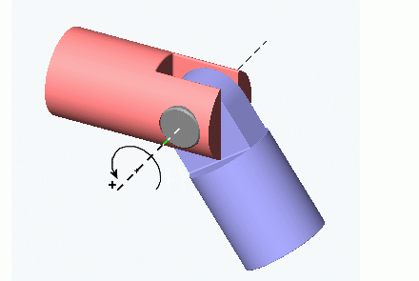
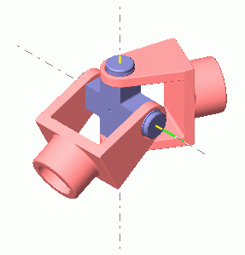
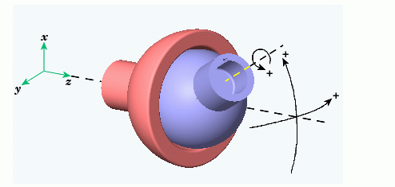
Individual bone information
begin
id 2
name lfemur
direction 0.34 -0.93 0
length 7.01722
axis 0 0 20 XYZ
dof rx ry rz
limits (-160.0 20.0)
(-70.0 70.0)
(-60.0 70.0)
end
y_{k}
x_{k}
z_{k}
y_{w}
x_{w}
z_{w}
1-dof joint
2-dof joint
3-dof joint

Slide 19
Individual bone information
begin
id 2
name lfemur
direction 0.34 -0.93 0
length 7.01722
axis 0 0 20 XYZ
dof rx ry rz
limits (-160.0 20.0)
(-70.0 70.0)
(-60.0 70.0)
end
y_{k}
x_{k}
y_{k+1}
z_{k}
X_{k+1}
begin
id 3
name ltibia
direction 0.34 -0.93 0
length 7.2138
axis 0 0 20 XYZ
dof rx
limits (-10.0 170.0)
end
z_{k+1}

Slide 20
Individual bone information
begin
id 2
name lfemur
direction 0.34 -0.93 0
length 7.01722
axis 0 0 20 XYZ
dof rx ry rz
limits (-160.0 20.0)
(-70.0 70.0)
(-60.0 70.0)
end
y_{k}
x_{k}
y_{k+1}
z_{k}
X_{k+1}
begin
id 3
name ltibia
direction 0.34 -0.93 0
length 7.2138
axis 0 0 20 XYZ
dof rx
limits (-10.0 170.0)
end
z_{k+1}
What do we miss?

Slide 21
Individual bone information
begin
id 2
name lfemur
direction 0.34 -0.93 0
length 7.01722
axis 0 0 20 XYZ
dof rx ry rz
limits (-160.0 20.0)
(-70.0 70.0)
(-60.0 70.0)
end
y_{k}
x_{k}
y_{k+1}
z_{k}
X_{k+1}
begin
id 3
name ltibia
direction 0.34 -0.93 0
length 7.2138
axis 0 0 20 XYZ
dof rx
limits (-10.0 170.0)
end
z_{k+1}
What do we miss?
- global position
- global orientation

Slide 22
Root representation
:root
order TX TY TZ RX RY RZ
axis XYZ
position 0 0 0
orientation 0 0 0
y_{w}
x_{w}
z_{w}

Slide 23
Root representation
:root
order TX TY TZ RX RY RZ
axis XYZ
position 0 0 0
orientation 0 0 0
y_{w}
x_{w}
z_{w}
How to compute the coordinate of a joint in the world coordinate frame?

Slide 24
Root representation
:root
order TX TY TZ RX RY RZ
axis XYZ
position 0 0 0
orientation 0 0 0
y_{w}
x_{w}
z_{w}
How to compute the coordinate of a joint in the world coordinate frame?

Slide 25
Hierarchy/Bone Connections
:hierarchy
begin
root lhipjoint rhipjoint lowerback
lhipjoint lfemur
lfemur ltibia
ltibia lfoot
lfoot ltoes
rhipjoint rfemur
rfemur rtibia
rtibia rfoot
rfoot rtoes
lowerback upperback
upperback thorax
thorax lowerneck lclavicle rclavicle
…
end

Slide 26
Hierarchy/Bone Connections
:hierarchy
begin
root lhipjoint rhipjoint lowerback
lhipjoint lfemur
lfemur ltibia
ltibia lfoot
lfoot ltoes
rhipjoint rfemur
rfemur rtibia
rtibia rfoot
rfoot rtoes
lowerback upperback
upperback thorax
thorax lowerneck lclavicle rclavicle
…
end
lowerback
root
rhipjoint

Slide 27
Hierarchy/Bone Connections
:hierarchy
begin
root lhipjoint rhipjoint lowerback
lhipjoint lfemur
lfemur ltibia
ltibia lfoot
lfoot ltoes
rhipjoint rfemur
rfemur rtibia
rtibia rfoot
rfoot rtoes
lowerback upperback
upperback thorax
thorax lowerneck lclavicle rclavicle
…
end
lowerback
root
rhipjoint
lhipjoint
lfemur
ltibia

Slide 28
Hierarchy/Bone Connections
:hierarchy
begin
root lhipjoint rhipjoint lowerback
lhipjoint lfemur
lfemur ltibia
ltibia lfoot
lfoot ltoes
rhipjoint rfemur
rfemur rtibia
rtibia rfoot
rfoot rtoes
lowerback upperback
upperback thorax
thorax lowerneck lclavicle rclavicle
…
end
lowerback
root
rhipjoint
lhipjoint
lfemur

Slide 29
Hierarchy/Bone Connections
:hierarchy
begin
root lhipjoint rhipjoint lowerback
lhipjoint lfemur
lfemur ltibia
ltibia lfoot
lfoot ltoes
rhipjoint rfemur
rfemur rtibia
rtibia rfoot
rfoot rtoes
lowerback upperback
upperback thorax
thorax lowerneck lclavicle rclavicle
…
end
lowerback
root
rhipjoint
lhipjoint
lfemur
ltibia
lfoot

Slide 30
Hierarchy/Bone Connections
:hierarchy
begin
root lhipjoint rhipjoint lowerback
lhipjoint lfemur
lfemur ltibia
ltibia lfoot
lfoot ltoes
rhipjoint rfemur
rfemur rtibia
rtibia rfoot
rfoot rtoes
lowerback upperback
upperback thorax
thorax lowerneck lclavicle rclavicle
…
end
lowerback
root
rhipjoint
lhipjoint
lfemur
ltibia
lfoot
ltoe

Slide 31
What can we do with .asf file?
We can visualize the default pose
We can compute various transforms in the default pose
- between world coordinate frame and local coordinate
- between parent coordinate frame and child coordinate frame

Slide 32
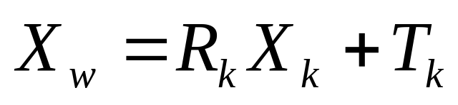
From local coordinate to world coordinate
y_{w}
x_{w}
z_{w}
y_{k}
x_{k}
z_{k}

Slide 33
From local coordinate to world coordinate
y_{w}
?
?
x_{w}
z_{w}
y_{k}
x_{k}
z_{k}

Slide 34
From local coordinate to world coordinate
y_{w}
x_{w}
z_{w}
y_{k}

Slide 35
From local coordinate to world coordinate
y_{w}
x_{w}
z_{w}
y_{k}
x_{k}
z_{k}

Slide 36
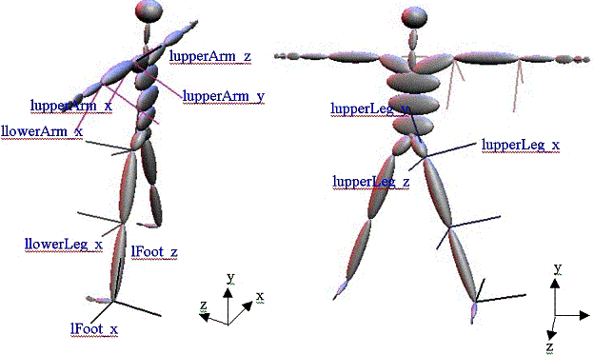
From child to parent node
How to Compute the transformation T_{k}^{k-1} from a child local coordinate frame to its parent local coordinate frame
T_{k}^{k-1}
x

Slide 37

Bone transform
parent
world
T_{k}^{k-1}?
child

Slide 38

Bone transform
parent
world
T_{k}^{k-1}?
child

Slide 39

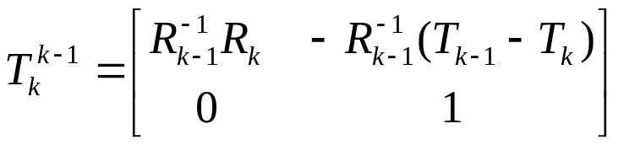
Bone transform
parent
world
T_{k}^{k-1}?
child

Slide 40
Forward kinematics
How to compute the coordinate of a joint in the world coordinate frame?
y_{w}
x_{w}
z_{w}

Slide 41
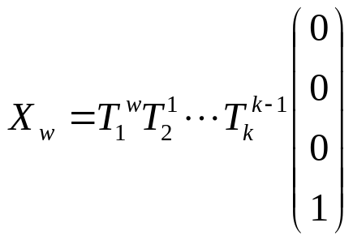
Forward kinematics
How to compute the coordinate of a joint in the world coordinate frame?
y_{w}
x_{w}
z_{w}

Slide 42
Forward kinematics
How to compute the coordinate of a joint in the world coordinate frame?
y_{w}
x_{w}
z_{w}

Slide 43
Forward kinematics
How to compute the coordinate of a joint in the world coordinate frame?
y_{w}
x_{w}
z_{w}
We need to consider joint angle values!

Slide 44
Motion data file (.amc)
i // frame number
root 2.36756 16.4521 12.3335 -165.118 31.188 -179.889 // root position and orientation
lowerback -17.2981 -0.243065 -1.41128 // joint angles for lowerback joint
upperback 0.421503 -0.161394 2.20925 // joint angles for thorax joint
thorax 10.2185 -0.176777 3.1832
lowerneck -15.0172 -5.84786 -7.55529
upperneck 30.0554 -3.19622 -4.68899
head 12.6247 -2.35554 -0.876544
rclavicle 4.77083e-014 -3.02153e-014
rhumerus -23.3927 30.8588 -91.7324
rradius 108.098
rwrist -35.4375
rhand -5.30059 11.2226
rfingers 7.12502
rthumb 20.5046 -17.7147
lclavicle 4.77083e-014 -3.02153e-014
lhumerus -35.2156 -19.5059 100.612

Slide 45

Motion data file (.amc)
i // frame number
root 2.36756 16.4521 12.3335 -165.118 31.188 -179.889 // root position and orientation
lowerback -17.2981 -0.243065 -1.41128 // joint angles for lowerback joint
upperback 0.421503 -0.161394 2.20925 // joint angles for thorax joint
thorax 10.2185 -0.176777 3.1832
lowerneck -15.0172 -5.84786 -7.55529
upperneck 30.0554 -3.19622 -4.68899
head 12.6247 -2.35554 -0.876544
rclavicle 4.77083e-014 -3.02153e-014
rhumerus -23.3927 30.8588 -91.7324
rradius 108.098
rwrist -35.4375
rhand -5.30059 11.2226
rfingers 7.12502
rthumb 20.5046 -17.7147
lclavicle 4.77083e-014 -3.02153e-014
lhumerus -35.2156 -19.5059 100.612
- Rotation described in local coordinate frame
- Euler angle representation x-y-z

Slide 46
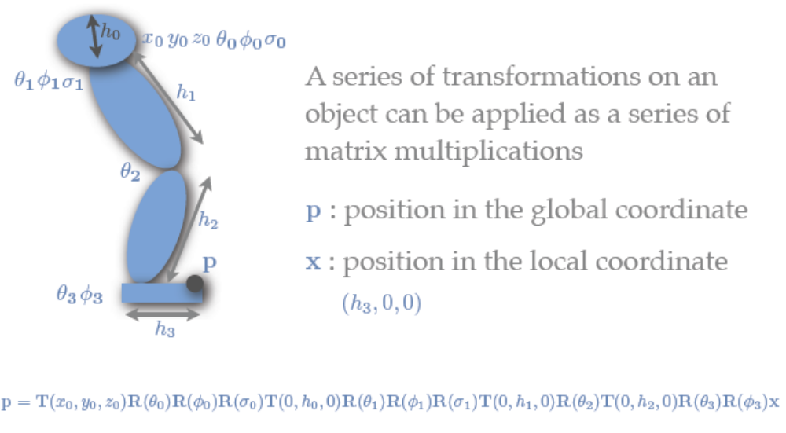
Composite 3D Transformation
From .asf file

Slide 47
Composite 3D Transformation
From .amc file

Slide 48
Composite 3D Transformation

Slide 49
Composite 3D Transformation

Slide 50
Composite 3D Transformation

Slide 51
Composite 3D Transformation

Slide 52
Motion capture data
http://mocap.cs.cmu.edu/

Slide 53
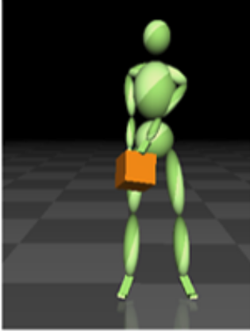
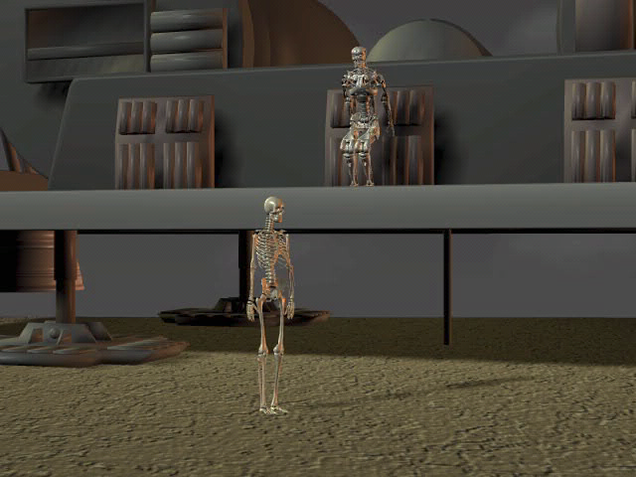
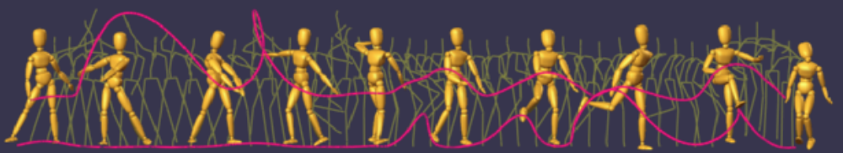
Some character models

Slide 54
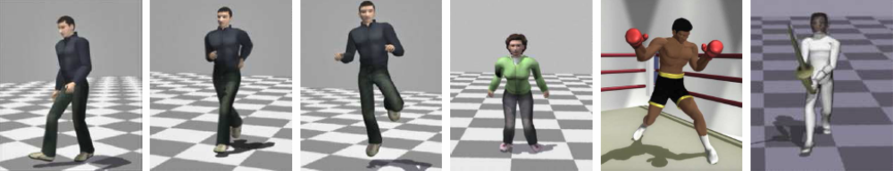
More complex models

Slide 55
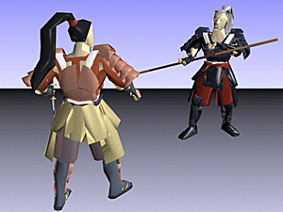
Mesh skinning
Skinning is the process of binding a skeleton to a single mesh object
Skinning deformation is the process of deforming the mesh as the skeleton is animated or moved.

Slide 56
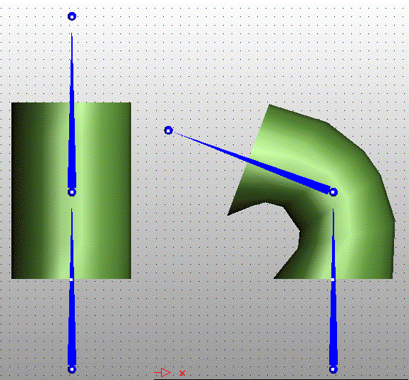
Mesh skinning
Cylinder Being Deformed by Two Bones

Slide 57
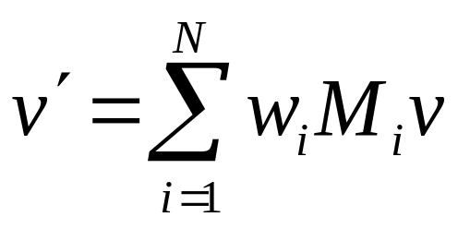
Skinning basics
For each vertex, compute the position by

Slide 58
Skinning basics
For each vertex, compute the position by
v: undeformed vertex position

Slide 59
Skinning basics
For each vertex, compute the position by
v: undeformed vertex position
v’: deformed vertex position

Slide 60
Skinning basics
For each vertex, compute the position by
v: undeformed vertex position
v’: deformed vertex position
M_{i}: articulated motion

Slide 61
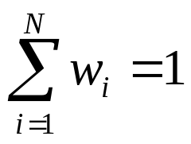
Skinning basics
For each vertex, compute the position by
v: undeformed vertex position
v’: deformed vertex position
M_{i}: articulated motion
w_{i}: blending weight

Slide 62
Skinning basics
For each vertex, compute the position by
From mesh model
v: undeformed vertex position
v’: deformed vertex position
M_{i}: articulated motion
w_{i}: blending weight
From mocap data
Specified by artists

Slide 63
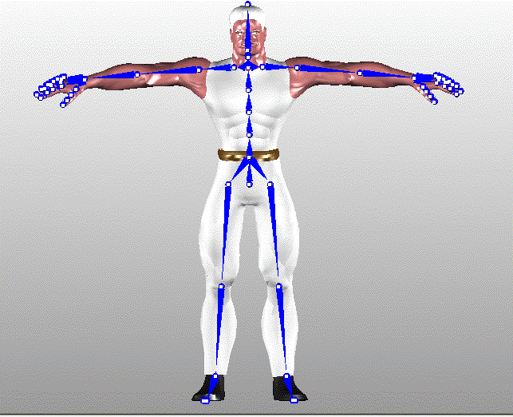
The "Bind Pose”

Slide 64
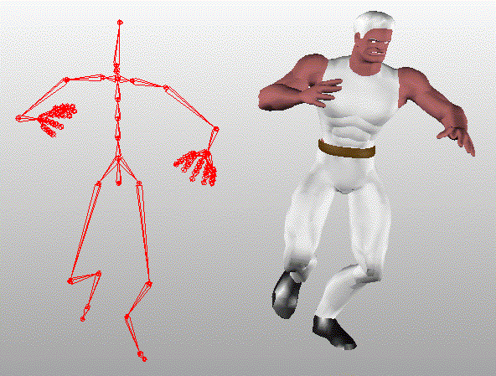
Mesh skinning
Skeleton causing deformation of a single skin mesh

