Slide 1
Lecture 5
Jinxiang Chai

Slide 2
Outline
Motion capture data format
Class homepage & paper assignment
Presentation tips

Slide 3
Vicon Motion Capture Data Files
Each sequence of human motion data contains two files:
  Skeleton file (.asf):
Specify the skeleton model of character
  Motion data file (.amc):
  Specify the joint angle values over the frame/time
  Both files are generated by Vicon softwares

Slide 4
Skeleton File
.asf file
  individual bone information (number of dofs, size, direction, joint limits)
  bone hierarchy/connections

Slide 5
Skeleton File:
Bone Info
For each bone
begin
id bone_id //Unique id for each bone
name bone_name //Unique name for each bone
direction dX dY dZ //Vector describing direction of the bone in world coor. system
length 7.01722 //Length of the bone
axis 0 0 20 XYZ //Rotation of local coordinate system for
//this bone relative to the world coordinate
//system. In .AMC file the rotation angles
//for this bone for each time frame will be
//defined relative to this local coordinate
//system
dof rx ry rz //Degrees of freedom for this bone.
limits (-160.0 20.0)
(-70.0 70.0)
(-60.0 70.0)
end

Slide 6
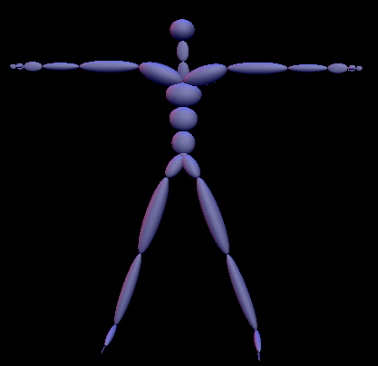
Skeleton File:
Bone Info
For each bone
begin
id 2
name lfemur
direction 0.34 -0.93 0
length 7.01722
axis 0 0 20 XYZ
dof rx ry rz
limits (-160.0 20.0)
(-70.0 70.0)
(-60.0 70.0)
end

Slide 7
Skeleton File:
Bone Info
For each bone
begin
id 2
name lfemur
direction 0.34 -0.93 0
length 7.01722
axis 0 0 20 XYZ
dof rx ry rz
limits (-160.0 20.0)
(-70.0 70.0)
(-60.0 70.0)
end
begin
id 3
name ltibia
direction 0.34 -0.93 0
length 7.2138
axis 0 0 20 XYZ
dof rx
limits (-10.0 170.0)
end

Slide 8
Skeleton File:
Hierarchy/Bone Connections
:hierarchy
begin
root lhipjoint rhipjoint lowerback
lhipjoint lfemur
lfemur ltibia
ltibia lfoot
lfoot ltoes
rhipjoint rfemur
rfemur rtibia
rtibia rfoot
rfoot rtoes
lowerback upperback
upperback thorax
thorax lowerneck lclavicle rclavicle
…
end

Slide 9
Skeleton File:
Hierarchy/Bone Connections
:hierarchy
begin
root lhipjoint rhipjoint lowerback
lhipjoint lfemur
lfemur ltibia
ltibia lfoot
lfoot ltoes
rhipjoint rfemur
rfemur rtibia
rtibia rfoot
rfoot rtoes
lowerback upperback
upperback thorax
thorax lowerneck lclavicle rclavicle
…
end
lowerback
root
rhipjoint
lhipjoint

Slide 10
Skeleton File:
Hierarchy/Bone Connections
:hierarchy
begin
root lhipjoint rhipjoint lowerback
lhipjoint lfemur
lfemur ltibia
ltibia lfoot
lfoot ltoes
rhipjoint rfemur
rfemur rtibia
rtibia rfoot
rfoot rtoes
lowerback upperback
upperback thorax
thorax lowerneck lclavicle rclavicle
…
end
lowerback
root
rhipjoint
lhipjoint
femur

Slide 11
Skeleton File:
Hierarchy/Bone Connections
:hierarchy
begin
root lhipjoint rhipjoint lowerback
lhipjoint lfemur
lfemur ltibia
ltibia lfoot
lfoot ltoes
rhipjoint rfemur
rfemur rtibia
rtibia rfoot
rfoot rtoes
lowerback upperback
upperback thorax
thorax lowerneck lclavicle rclavicle
…
end
lowerback
root
rhipjoint
lhipjoint
femur

Slide 12
Skeleton File:
Hierarchy/Bone Connections
:hierarchy
begin
root lhipjoint rhipjoint lowerback
lhipjoint lfemur
lfemur ltibia
ltibia lfoot
lfoot ltoes
rhipjoint rfemur
rfemur rtibia
rtibia rfoot
rfoot rtoes
lowerback upperback
upperback thorax
thorax lowerneck lclavicle rclavicle
…
end
lowerback
root
rhipjoint
lhipjoint
femur

Slide 13
Skeleton File
.asf file
  individual bone information (number of dofs, size, direction, joint limits)
  bone hierarchy/connections

Slide 14
Motion Data File (.amc)
Motion Data File (.amc)
For each frame
i // frame number
root 2.36756 16.4521 12.3335 -165.118 31.188 -179.889 // root position and orientation
lowerback -17.2981 -0.243065 -1.41128 // joint angles for lowerback joint
upperback 0.421503 -0.161394 2.20925 // joint angles for thorax joint
thorax 10.2185 -0.176777 3.1832
lowerneck -15.0172 -5.84786 -7.55529
upperneck 30.0554 -3.19622 -4.68899
head 12.6247 -2.35554 -0.876544
rclavicle 4.77083e-014 -3.02153e-014
rhumerus -23.3927 30.8588 -91.7324
rradius 108.098
rwrist -35.4375
rhand -5.30059 11.2226
rfingers 7.12502
rthumb 20.5046 -17.7147
lclavicle 4.77083e-014 -3.02153e-014
lhumerus -35.2156 -19.5059 100.612

Slide 15
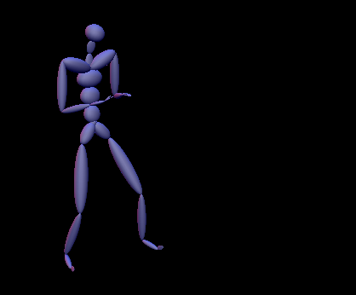
Motion Data File (.amc)
Motion Data File (.amc)
For each frame
i // frame number
root 2.36756 16.4521 12.3335 -165.118 31.188 -179.889 // root position and orientation
lowerback -17.2981 -0.243065 -1.41128 // joint angles for lowerback joint
upperback 0.421503 -0.161394 2.20925 // joint angles for thorax joint
thorax 10.2185 -0.176777 3.1832
lowerneck -15.0172 -5.84786 -7.55529
upperneck 30.0554 -3.19622 -4.68899
head 12.6247 -2.35554 -0.876544
rclavicle 4.77083e-014 -3.02153e-014
rhumerus -23.3927 30.8588 -91.7324
rradius 108.098
rwrist -35.4375
rhand -5.30059 11.2226
rfingers 7.12502
rthumb 20.5046 -17.7147
lclavicle 4.77083e-014 -3.02153e-014
lhumerus -35.2156 -19.5059 100.612

Slide 16
Class Homepage & Paper Assignment
http://faculty.cs.tamu.edu/jchai/CPSC

Slide 17
Paper Presentation
Before the talk
  Visit project webpage
  Might email to ask for videos (maybe slides)
20 -- 25 minutes talk
Focus on important things
Meet me two days before the presentation

Slide 18
Chai’s Talk/Paper Style
Introduction
  What?
  Why?
  How?
Related work or background
Algorithms overview
Describe each step of the algorithm
Experiments & results
Discussion & future work

