Slide 1
Introduction to Pytorch
Hatice GOKCAN
February 1, 2023
Notes:
Main title: 40 pt. Arial
Presenter Name: 16 pt. Arial
Presenters Title: 16 pt. Arial Italic

Slide 2
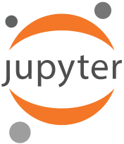
Jupyter Notebook
Open-source web application that allows you to create and share documents that contain
live code,
equations,
visualizations and
narrative tex
Supports over 40 programming languages, including Python, R, Julia, and Scala.
Notebooks can be shared with others using email, Dropbox, GitHub and the Jupyter Notebook Viewer

Slide 3

Google Colaboratory
Colaboratory is a free Jupyter notebook environment that requires no setup and runs entirely in the cloud
You can write and execute code,
Save and share your analyses, and
Access computing resources;
TPU
GPU

Slide 4
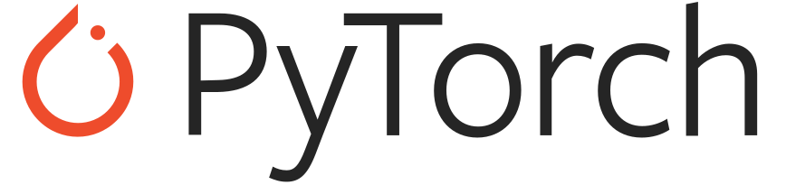
Pytorch
Python-based library that provides maximum flexibility and speed
An open-source machine learning framework
PyTorch is quite similar to Python; especially NumPy
NumPy → multi-dimensional arrays
PyTorch → tensors
Tensors are multidimensional arrays that can be used on a GPU (NumPy arrays ☹ )

Slide 5
Pytorch Tutorial with Google Colab
Tensors and Tensor operations
NumPy bridge
CUDA tensors
Autograd Package
Neural Networks
https://tinyurl.com/yc4r22m4
Download File (File → Download .ipynb)
Open file in Google Colab (Go to Google Colab webpage (https://colab.research.google.com/) , under upload tab choose the file that you have downloaded)
To run on GPU: Runtime → Change runtime type → Choose GPU as Hardware accelerator → Save

