Slide 1
D1D2 Stability Run MSM

Slide 2
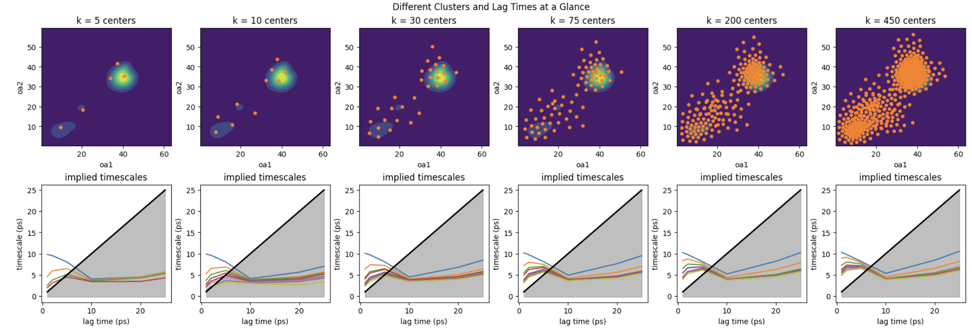
Initial run before organizing input data chronologically, no tICA before clustering
Notes:
Strange results on ITS plots, could be multiple timescales, most likely due to non chronologically ordered input data.

Slide 3
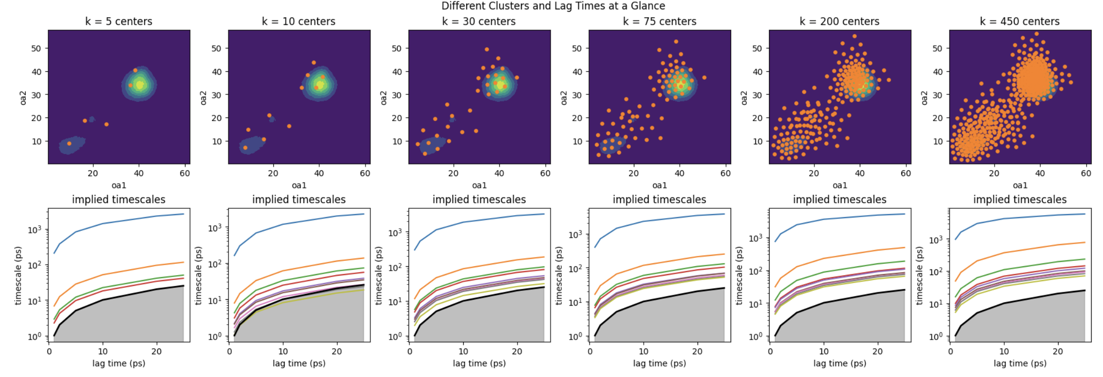
Much better with re-org, also here using 10x less data

Slide 4
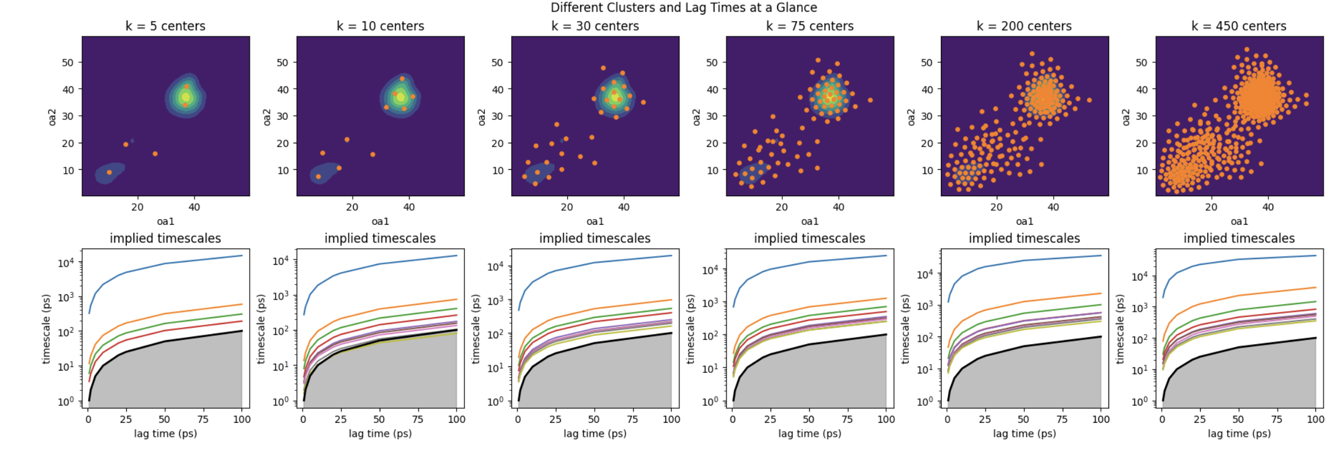
Now with full dataset but using more lag times and with the first 300ns of bstate relaxation cut
Notes:
Better cluster dist with the cut

Slide 5
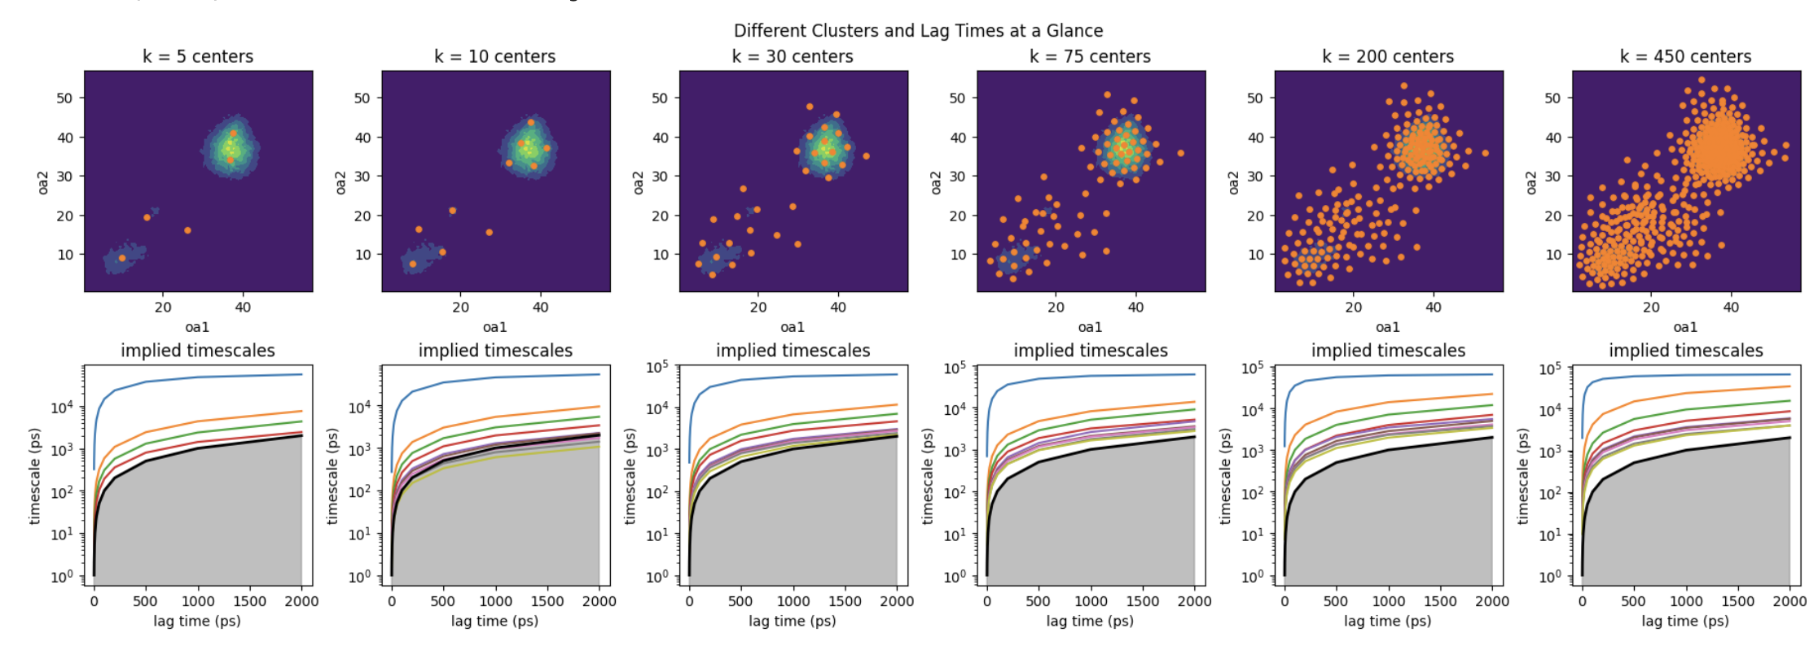
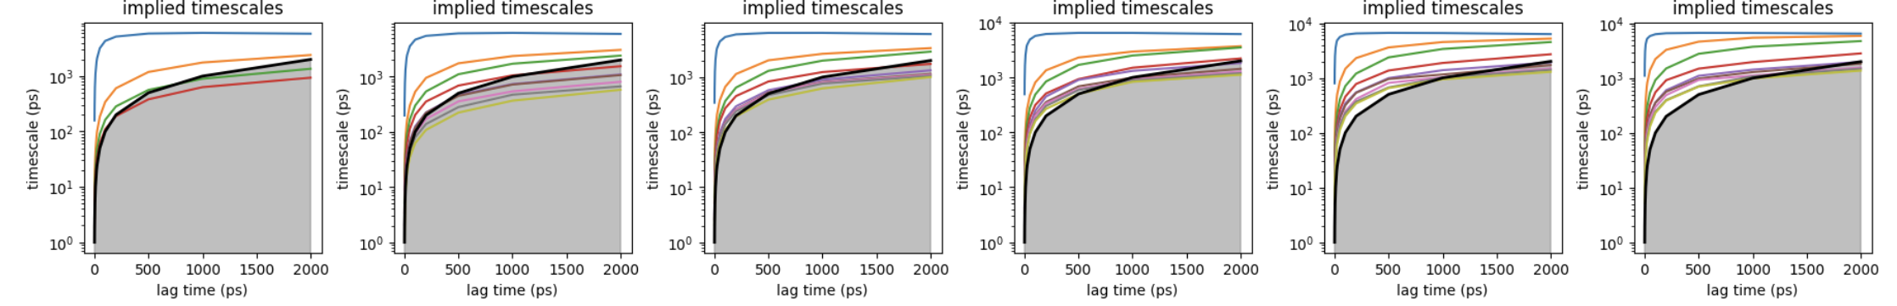
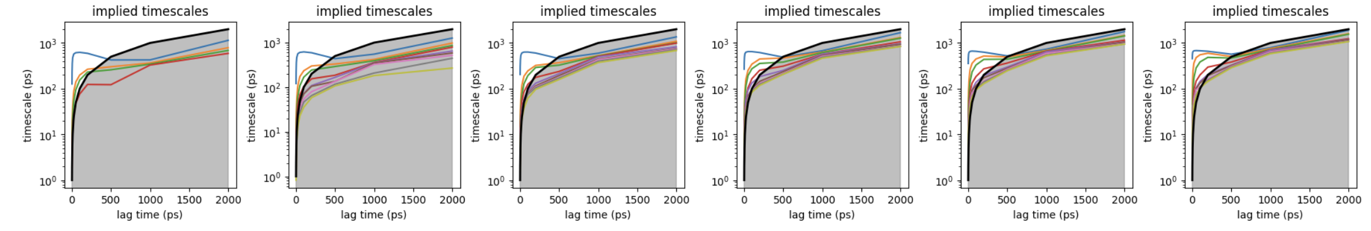
Notes:
Do the results change when using 10x less data on the bottom and 10x less below that? It should cause the lagtimes are by the frames
Indeed it does. Essentially these made the lagtimes scale 10x, so instead of 20ns max in top, 200ns, and 2000ns (hence why it makes no sense since it is over the length of the trajectory).

Slide 6
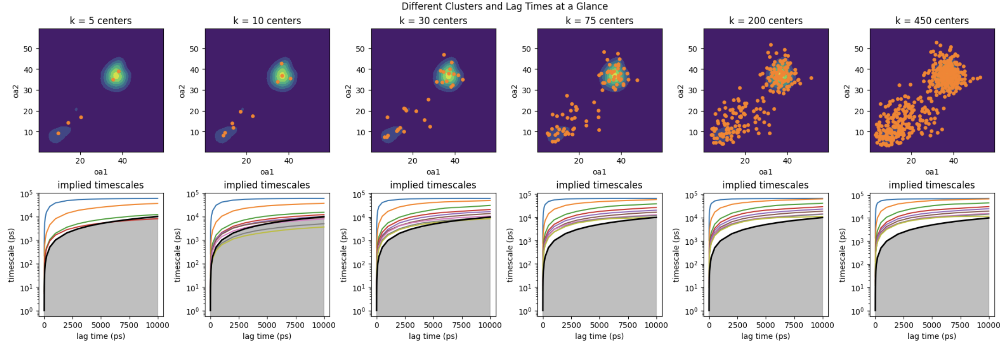
Notes:
Top is with oa1 oa2 and tt
Bottom is also with chi1 M1/M2 and c2

Slide 7
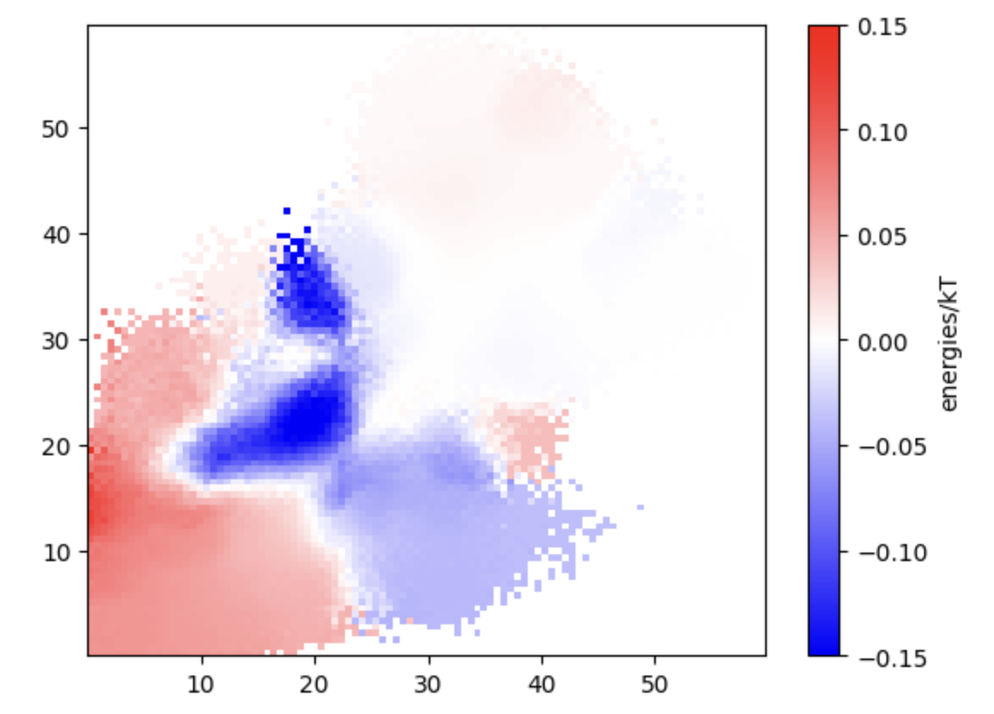
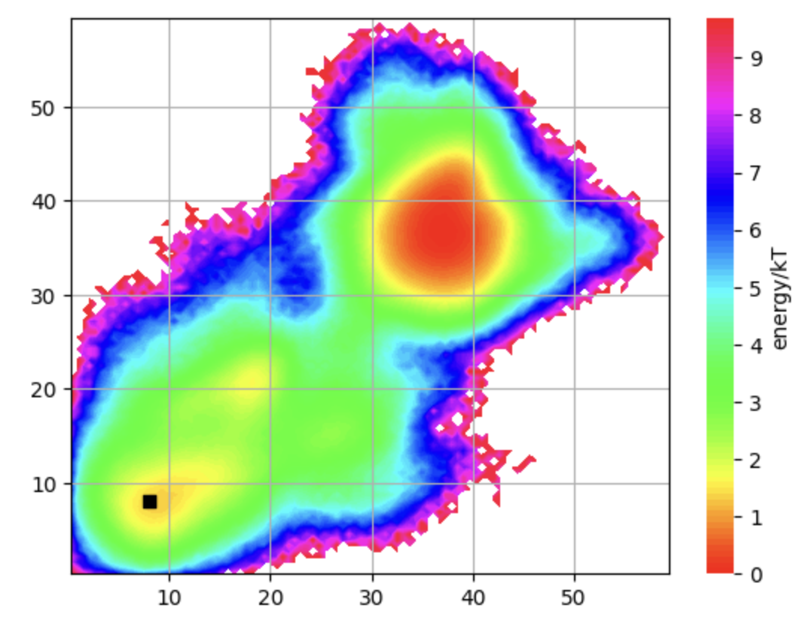
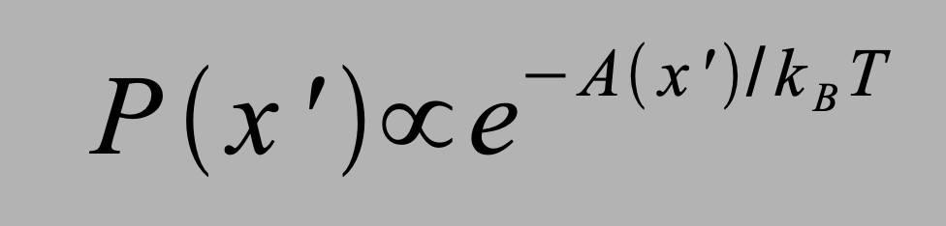
With 300ns cut of 1us and full_ts_feats (no dim red)
Using lagtime of 5000 units (10ps timestep) and 450 clusters
Change in energy from original:
Reweighted – original energies
∆kT = 1.31 (originally 1.25 (before reweighting))
After reweighting
∆
Expected with 0.15 D2 population or probability = 1.9/kT
From –ln(P(D2)) = Energy/kT
Notes:
93% D1 from Byeon 2012 JACS paper
But this is variable, I think 10-15% is close to what I’ve seen

Slide 8
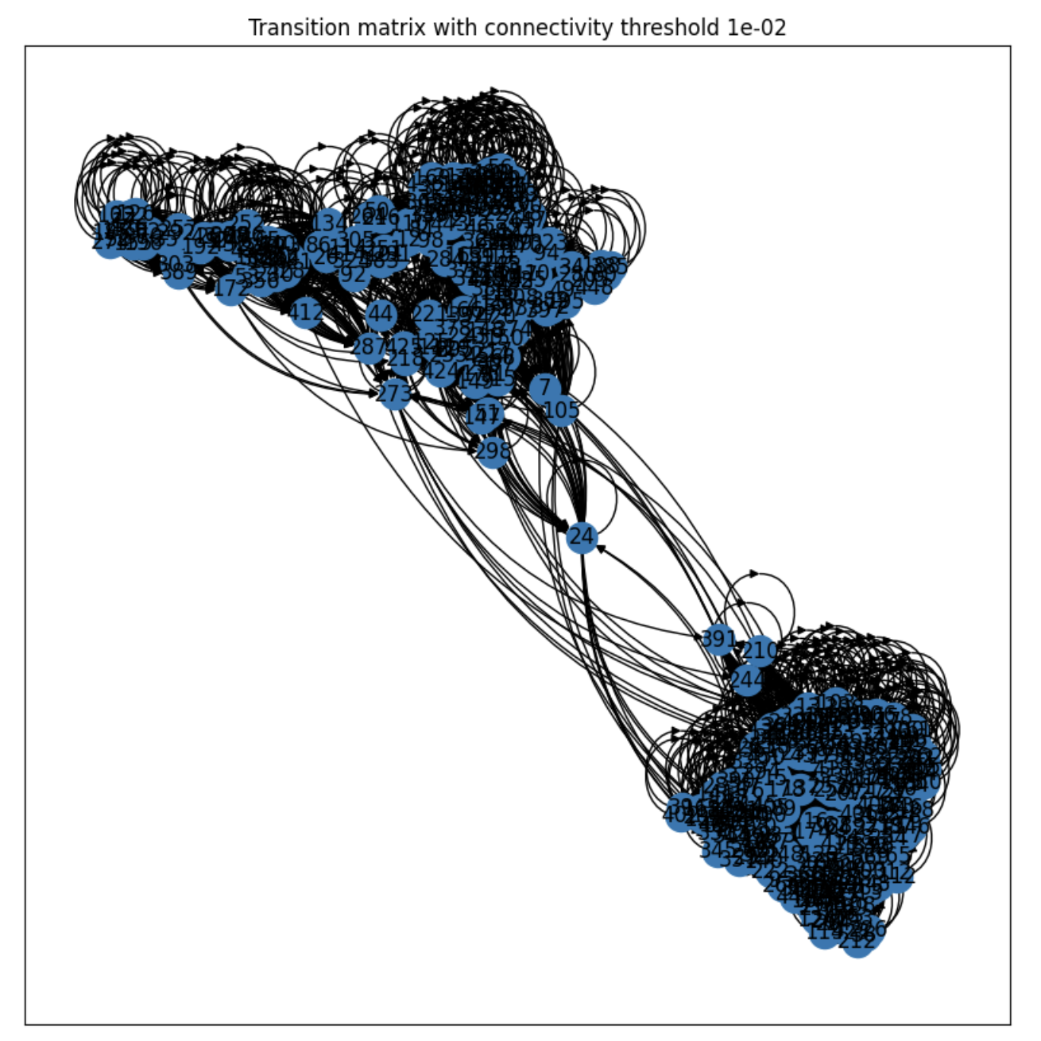
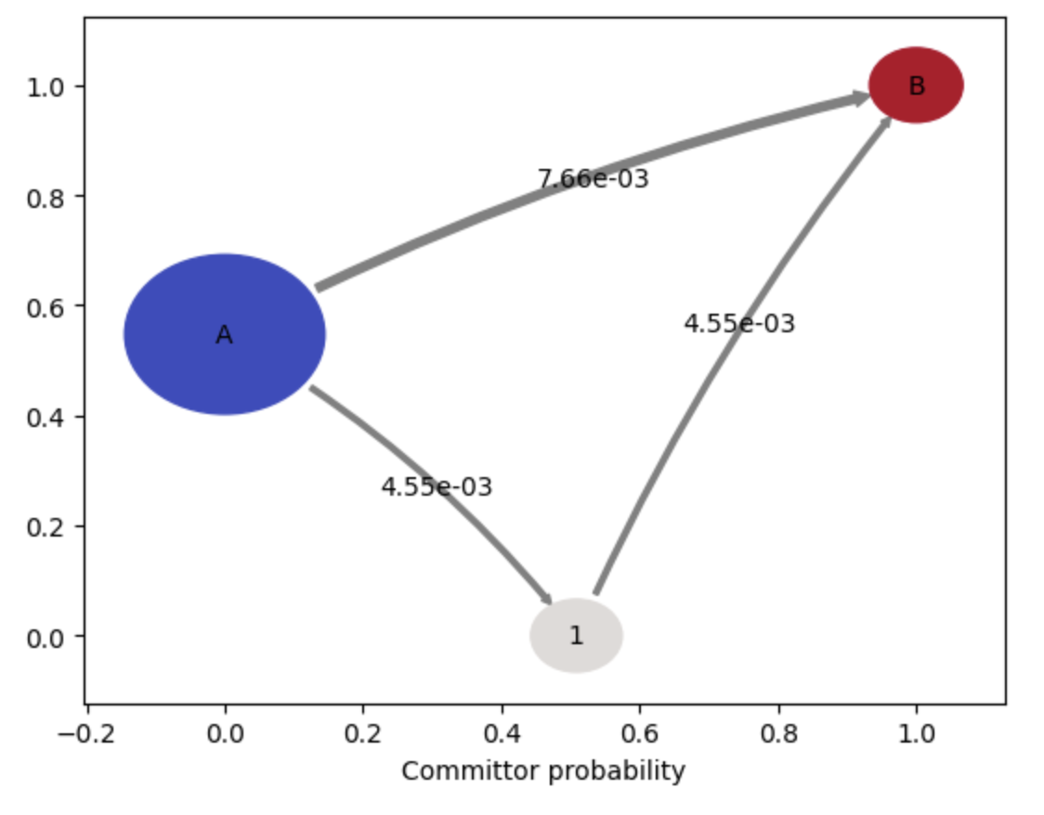
CA CTD | ¹⁹F NMR vs MSM Rates
 | k₁₂ (s⁻¹) | k₂₁ (s⁻¹) | K_{eq}
4F | 59.54 ± 3.3 | 134.42 ± 8.3 | 0.44 ± 0.04
7F | 24.58 ± 1.1 | 178.67 ± 8.8 | 0.14 ± 0.01
MSM | 0.0157 | 0.0539 | 0.292

Slide 9
After standard scaling

Slide 10
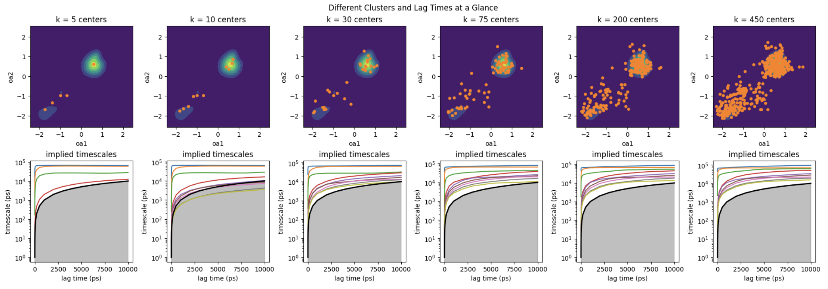
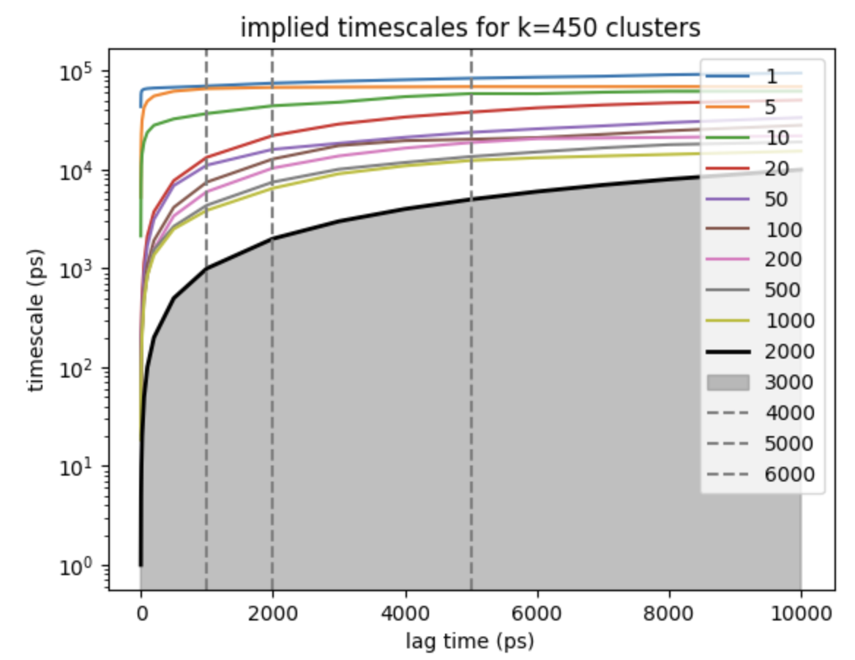
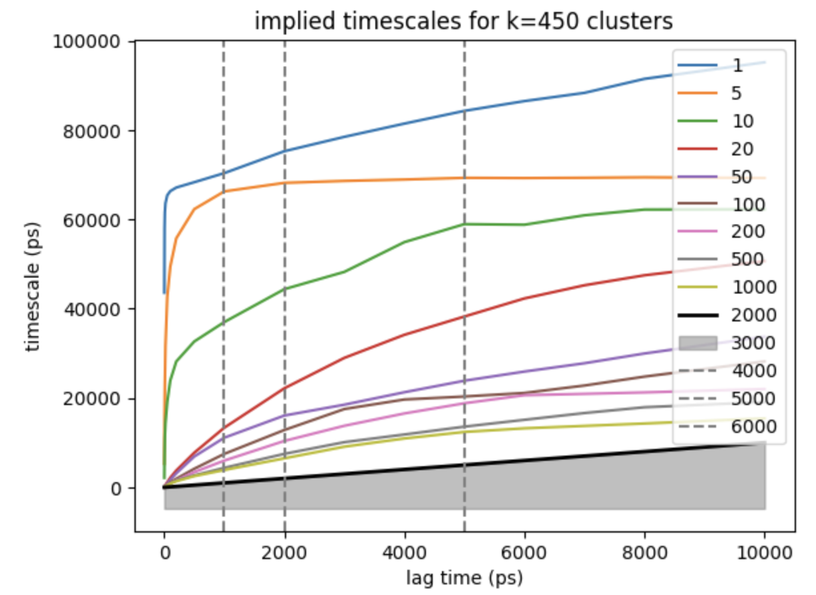

Slide 11
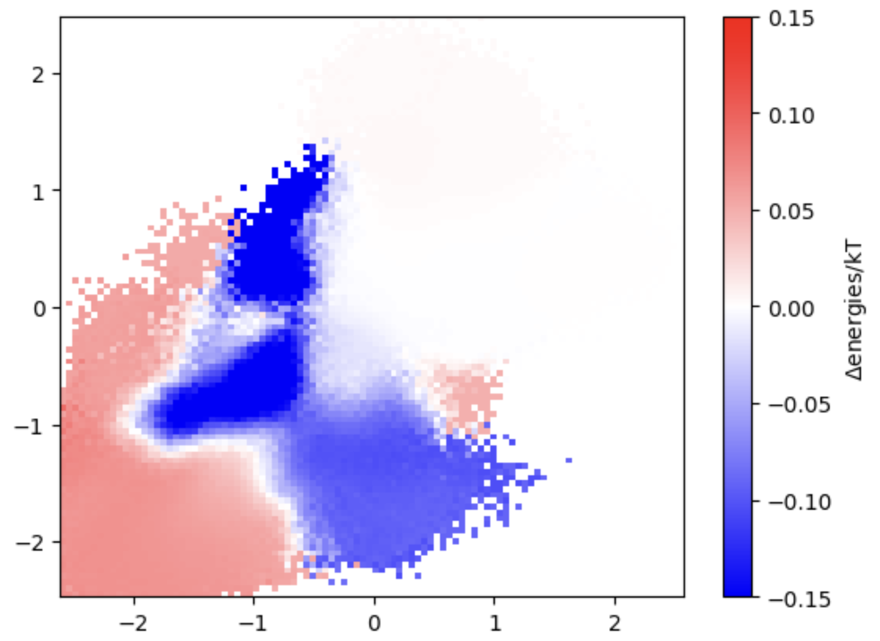
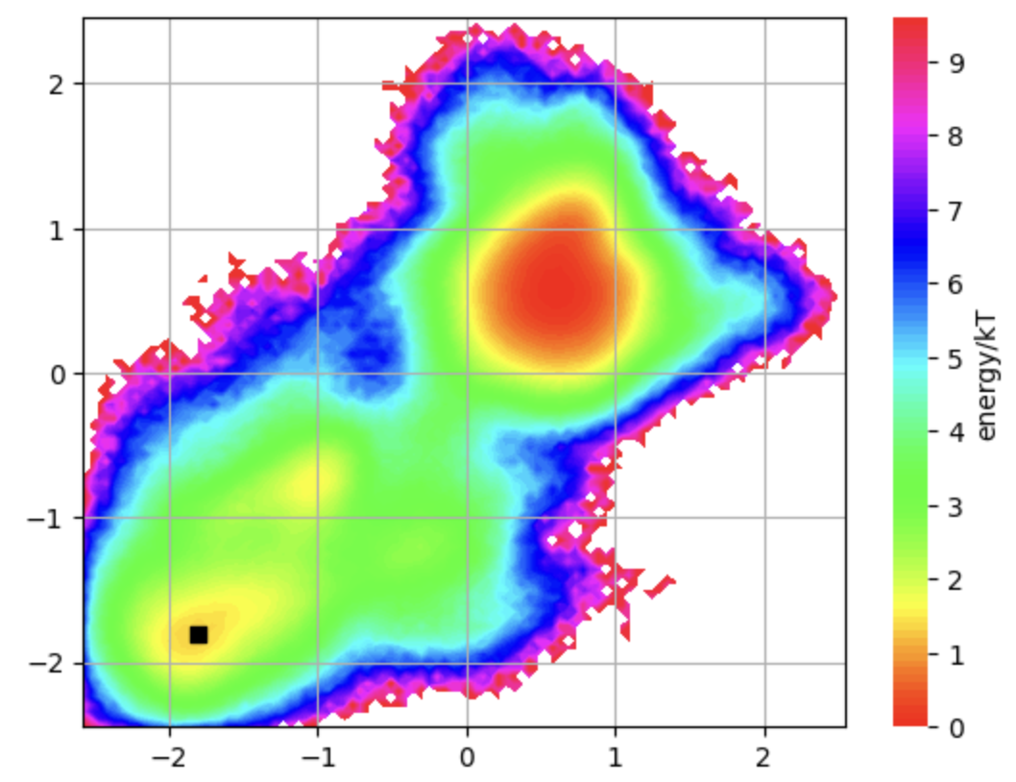
With 300ns cut of 1us and full_ts_feats (no dim red)
Using lagtime of 5000 units (10ps timestep) and 450 clusters
Change in energy from original:
Reweighted – original energies
∆kT = 1.44 (originally 1.25 (before reweighting))
After reweighting
Expected with 0.15 D2 population or probability = 1.9/kT
From –ln(P(D2)) = Energy/kT
Notes:
93% D1 from Byeon 2012 JACS paper
But this is variable, I think 10-15% is close to what I’ve seen

Slide 12
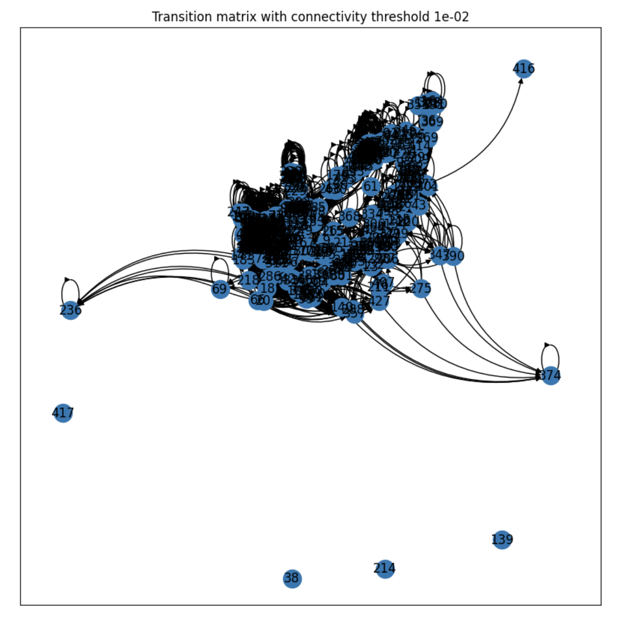
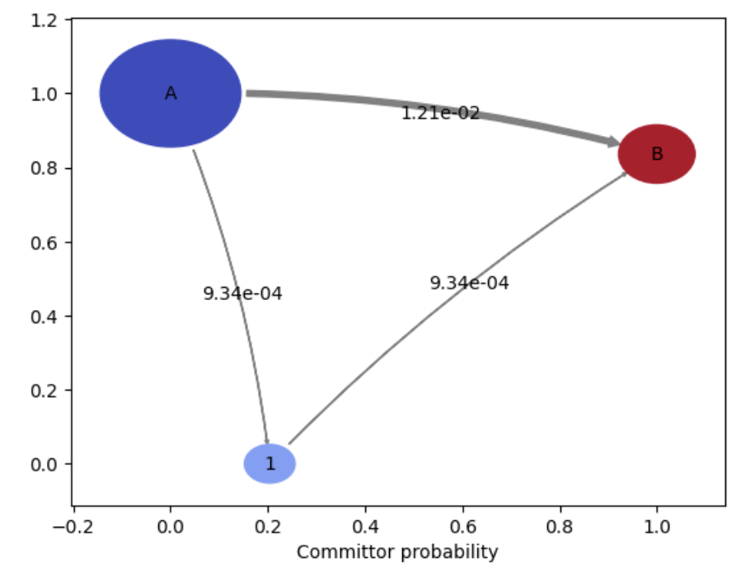
Similar rates

Slide 13
Min-max scaling, similar results

