Slide 1
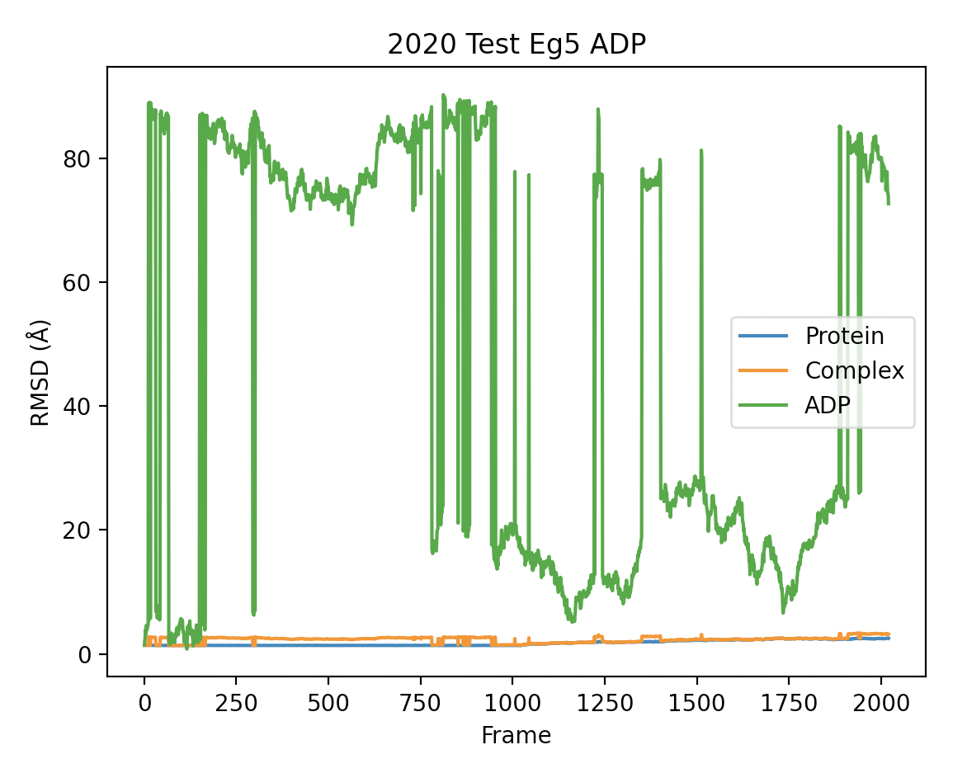
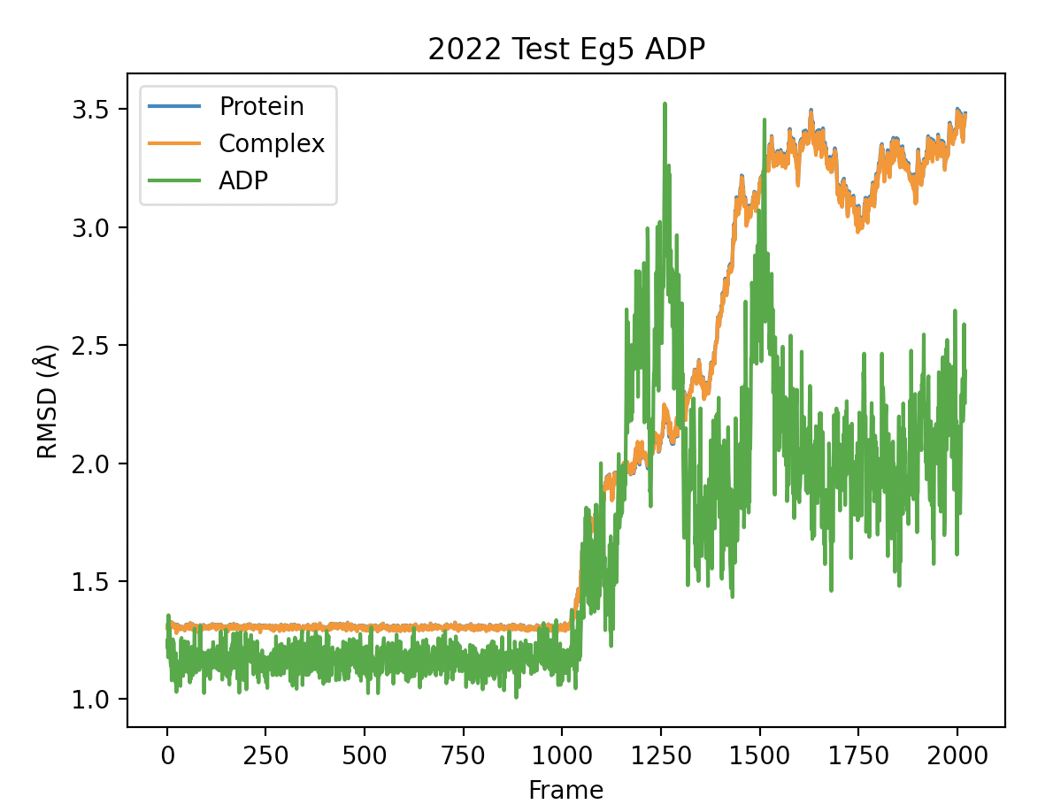
2020 vs 2022 system

Slide 2
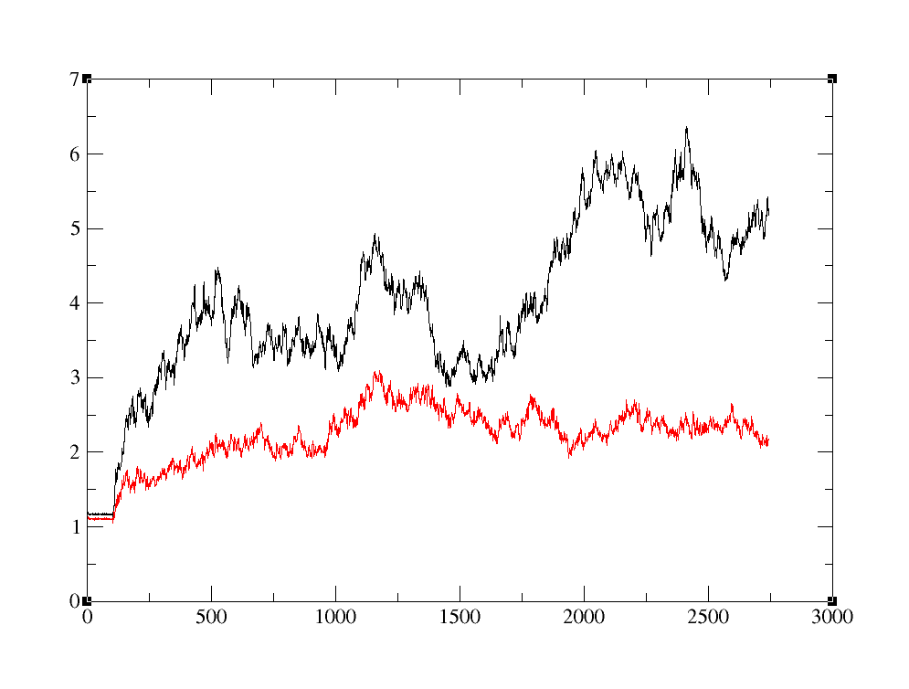
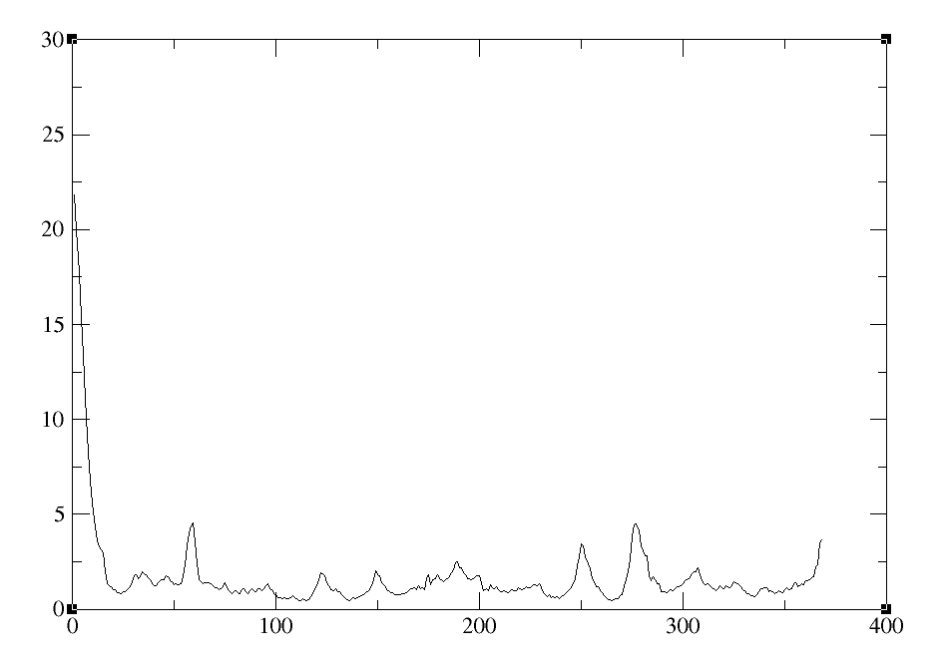
RMSD of ASN18-GLU364
All residues
RMSF (Å)
RMSD (Å)
18-364
Frame
Residue

Slide 3
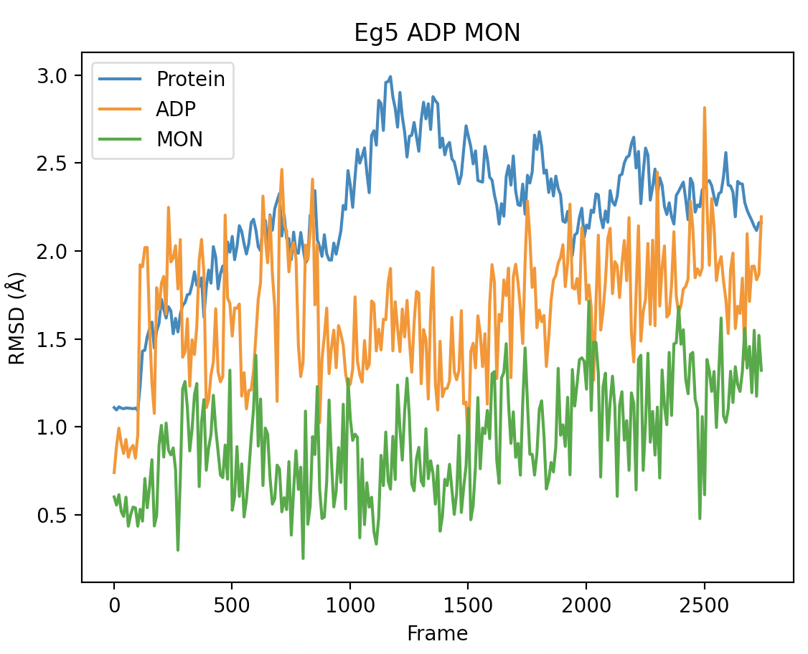
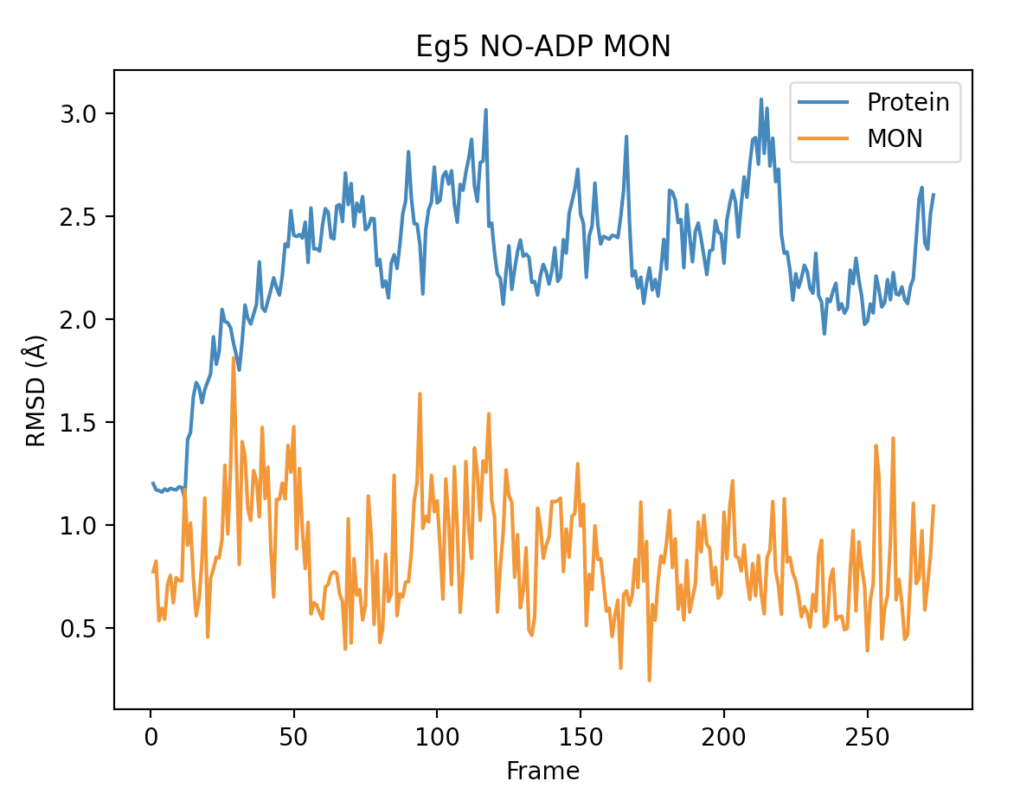
25µs of ADP bound and no ADP Eg5

