Slide 1
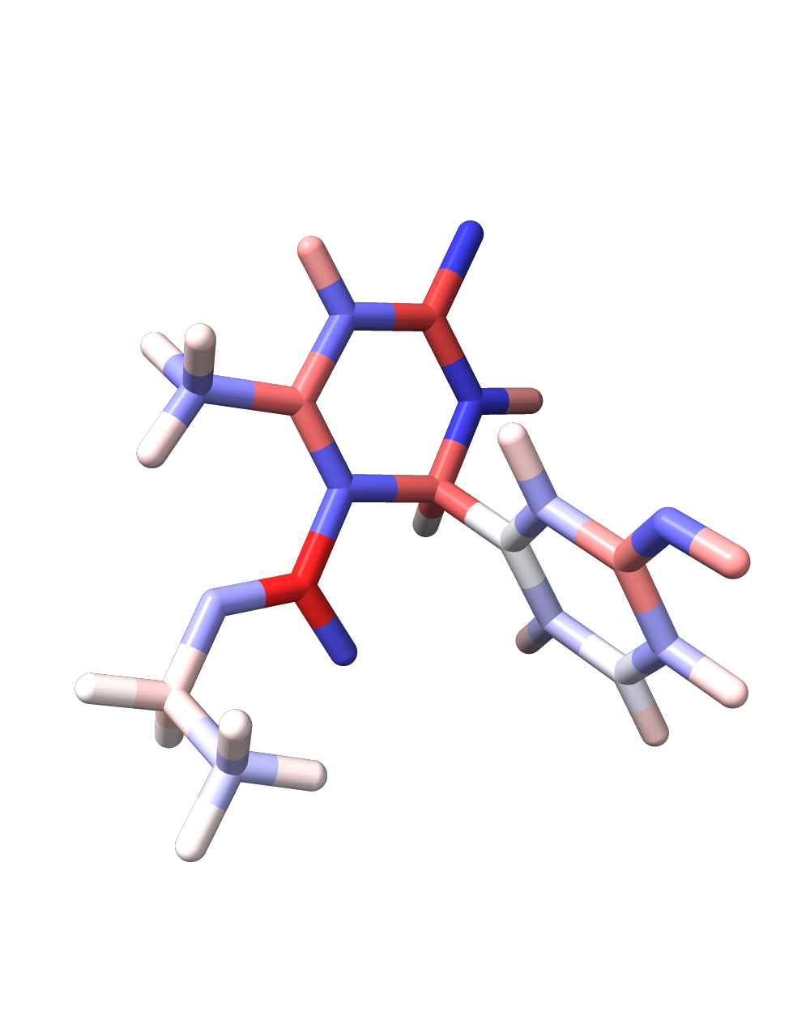
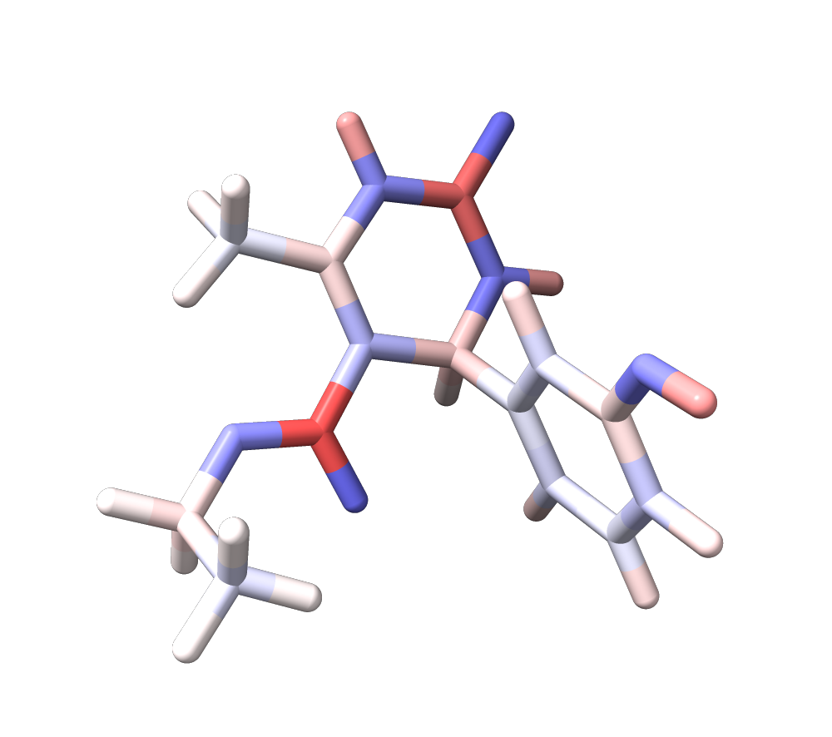
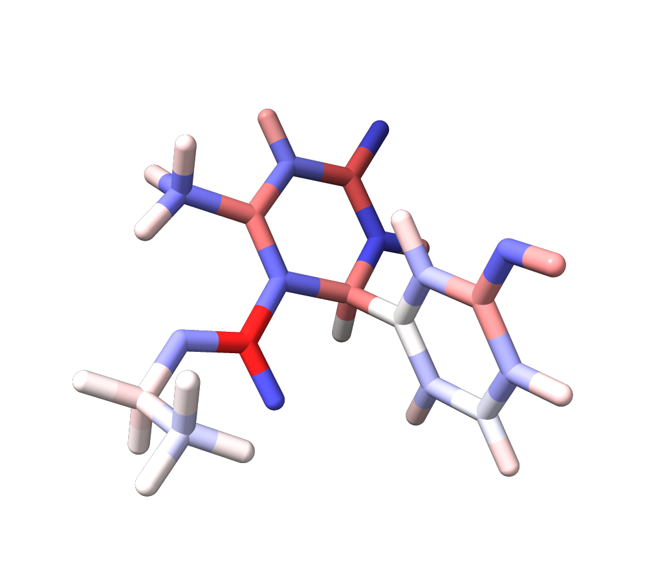
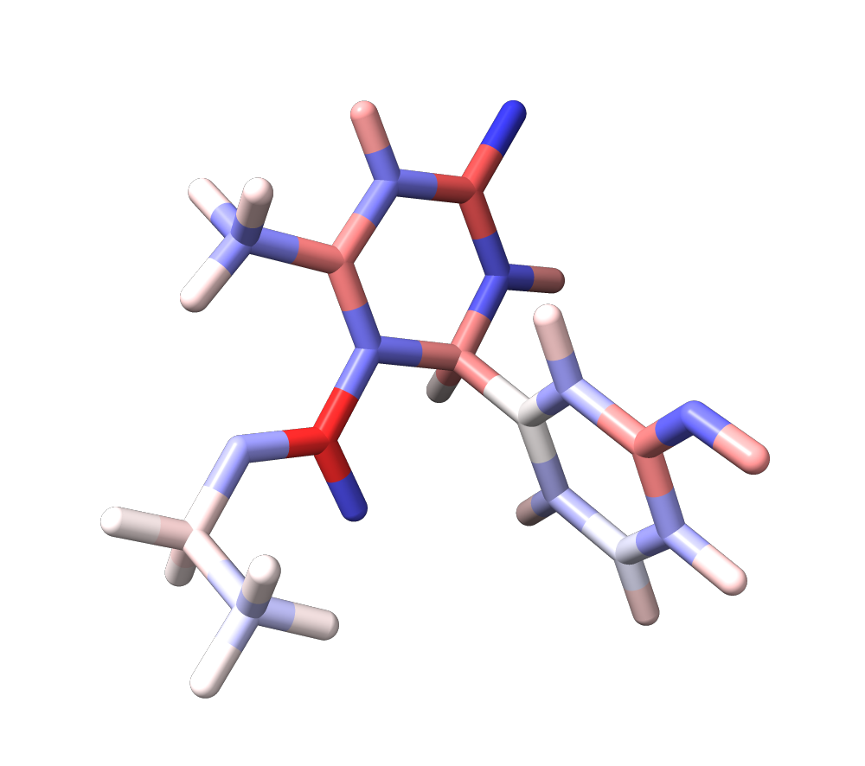
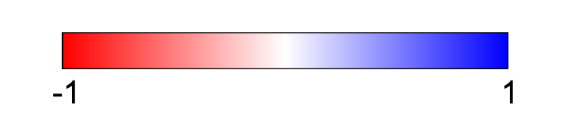
Monastrol | AM1-BCC | Iteration 00 | Iteration 01 | Iteration 02
Percent Deviation | - | 33.03% | 7.82% | 7.91%
eV
Notes:
Note the colors are reversed

Slide 2
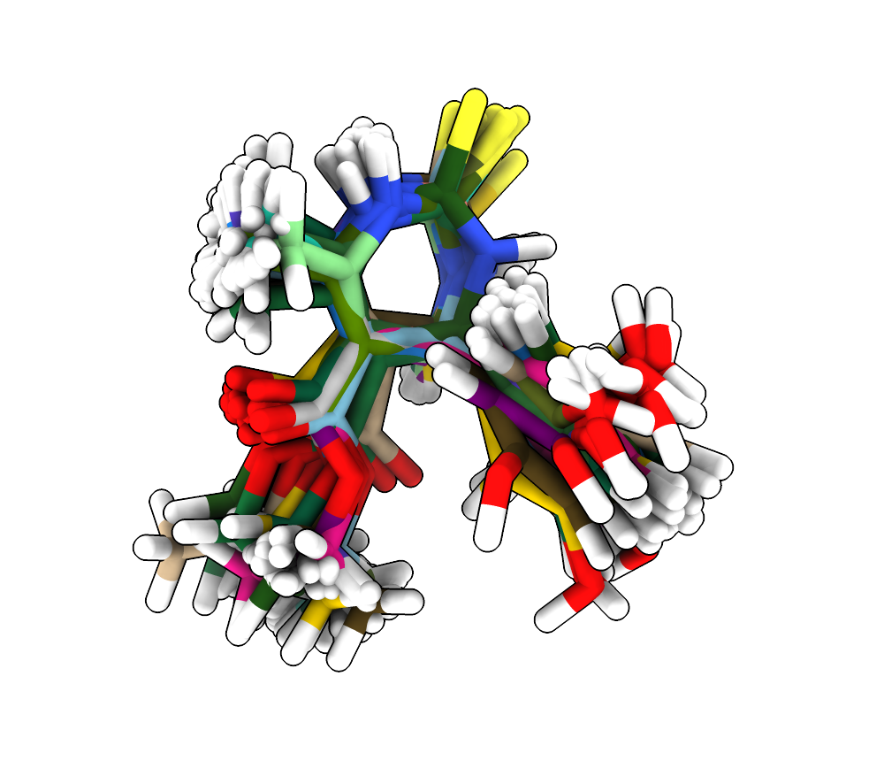
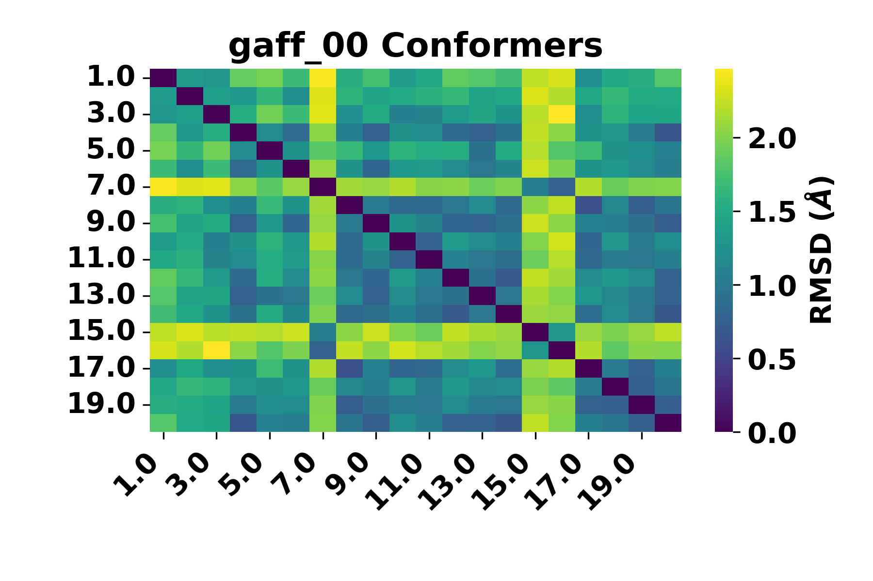
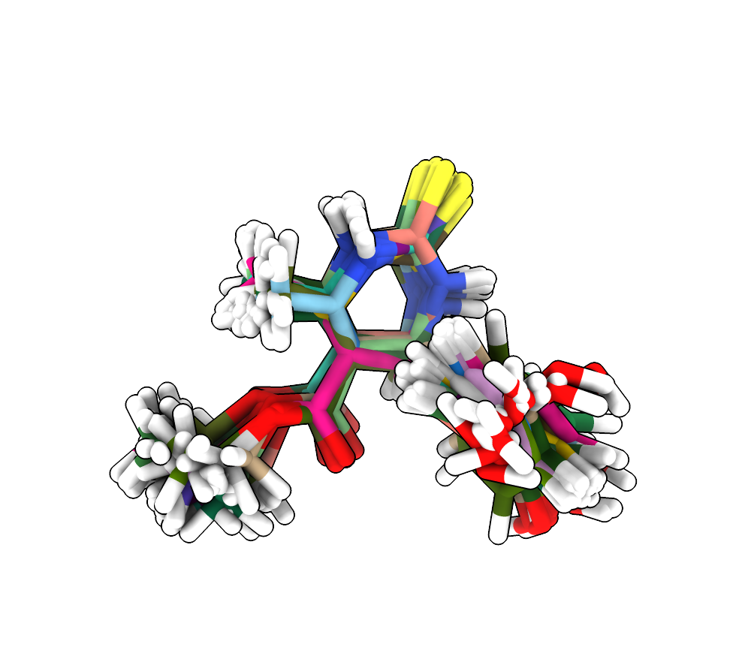
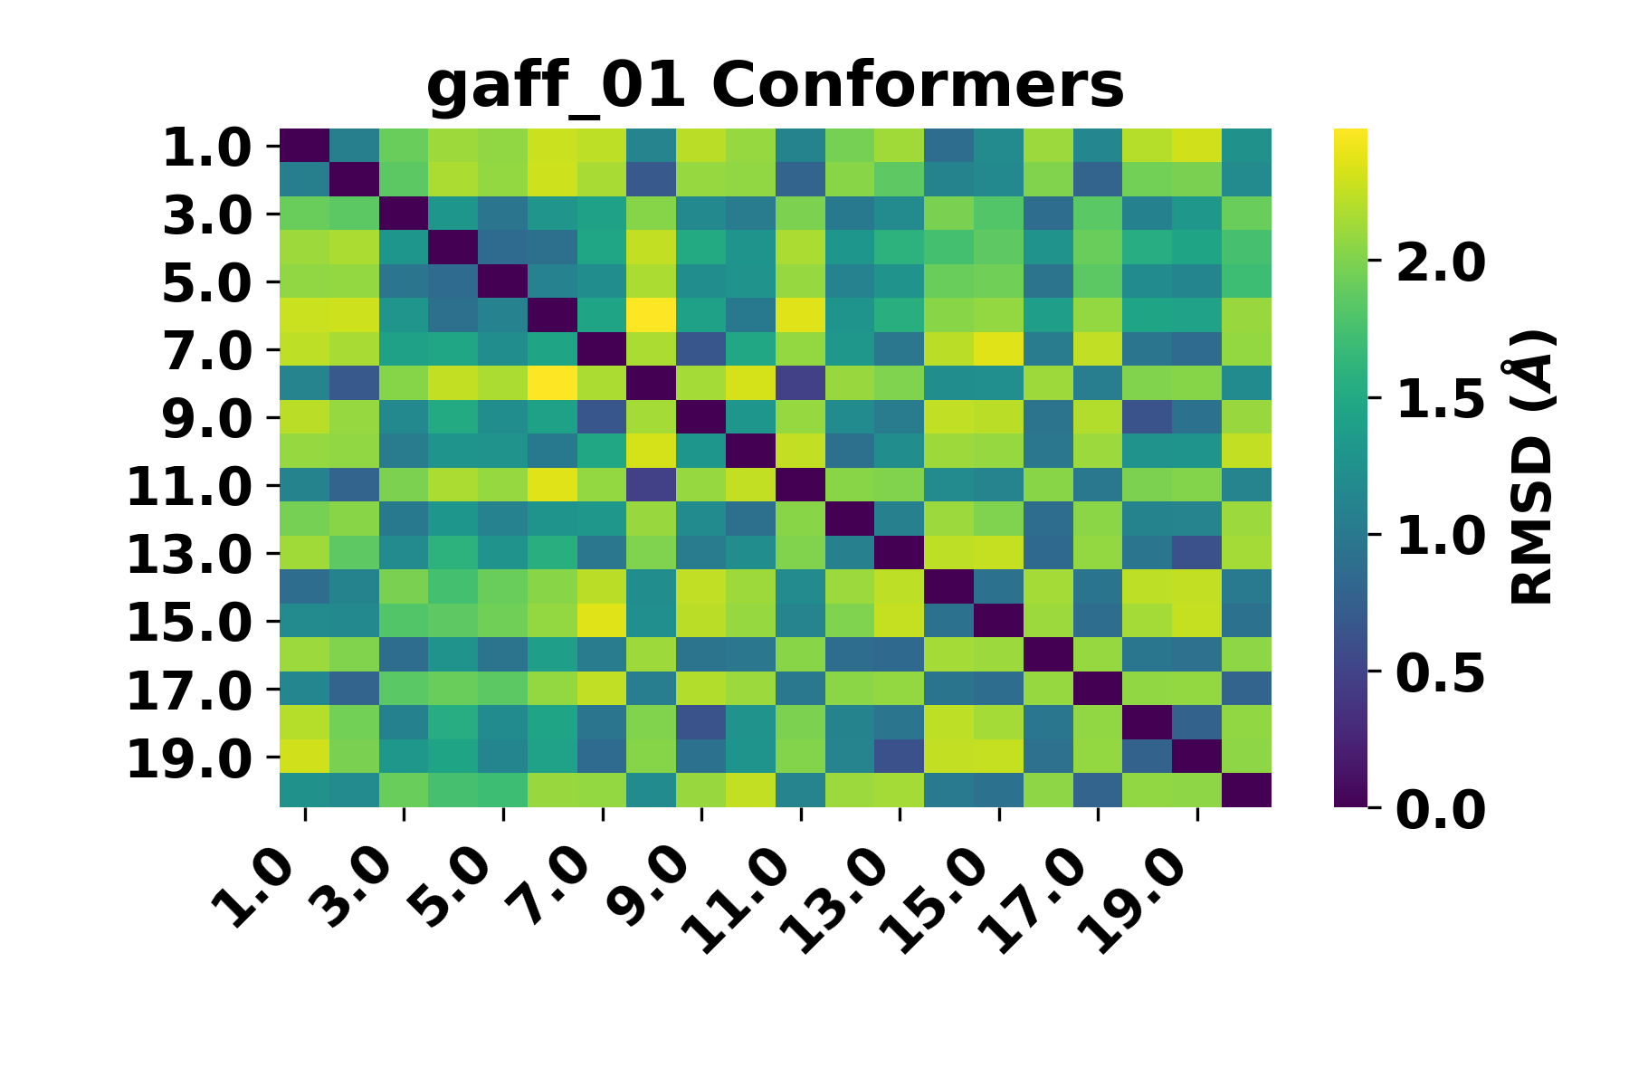

Slide 3
Monastrol | Original | Iteration 00 | Iteration 01
RMSE (kcal/mol) | 3.39 | 2.25 | 2.19

