Slide 1
GB1

Slide 2
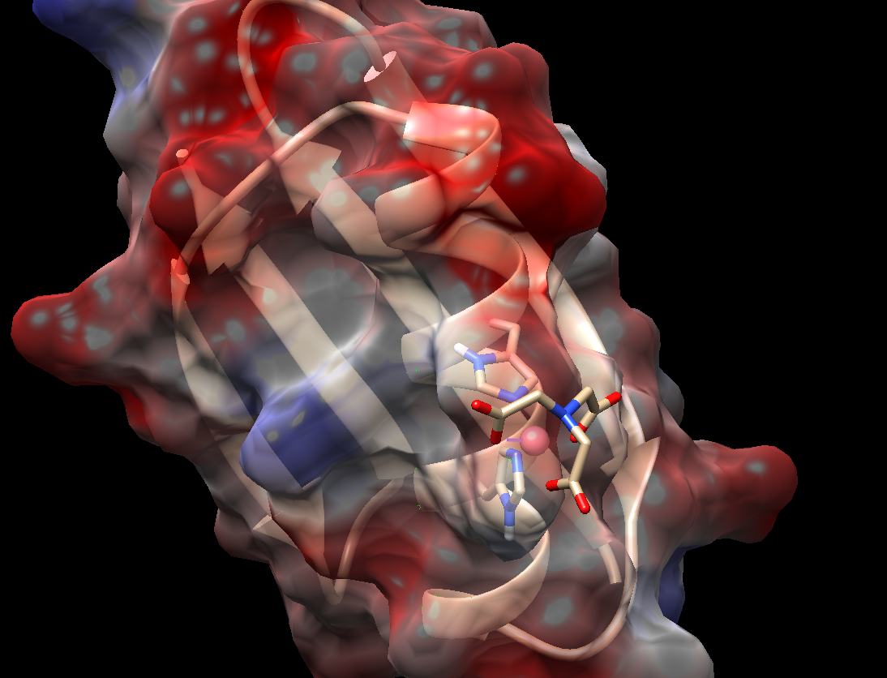
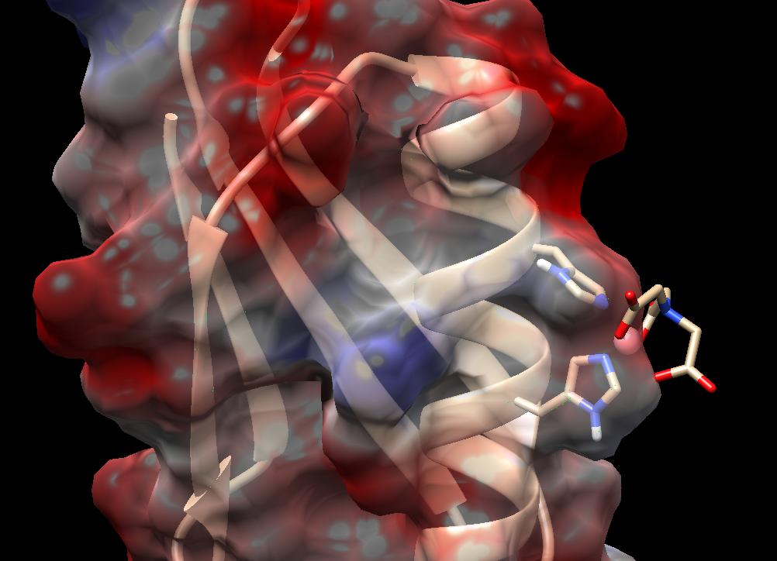
Electrostatics near HIS with He and He

Slide 3
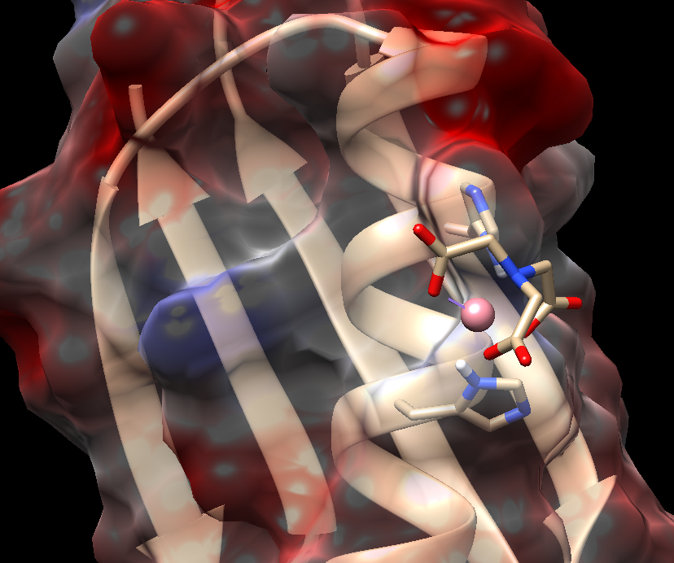
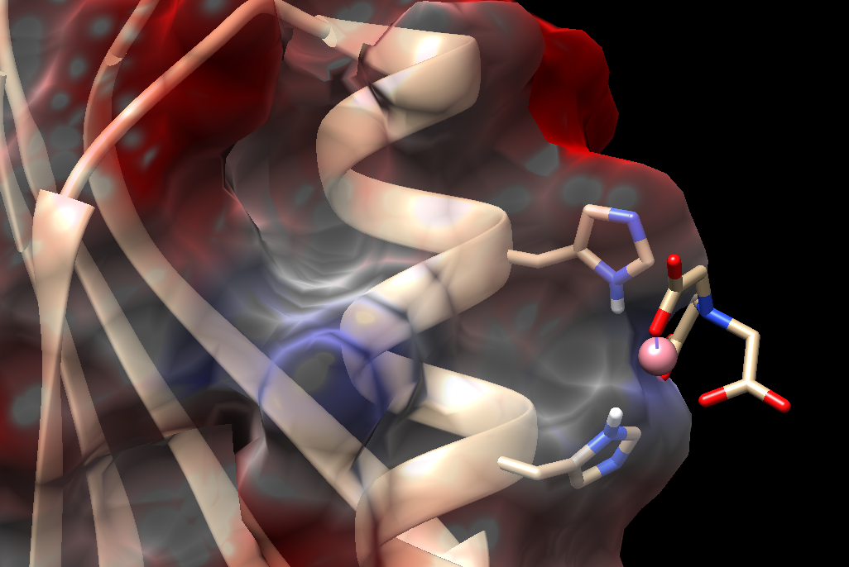
Electrostatics near HIS with Hd and Hd

Slide 4
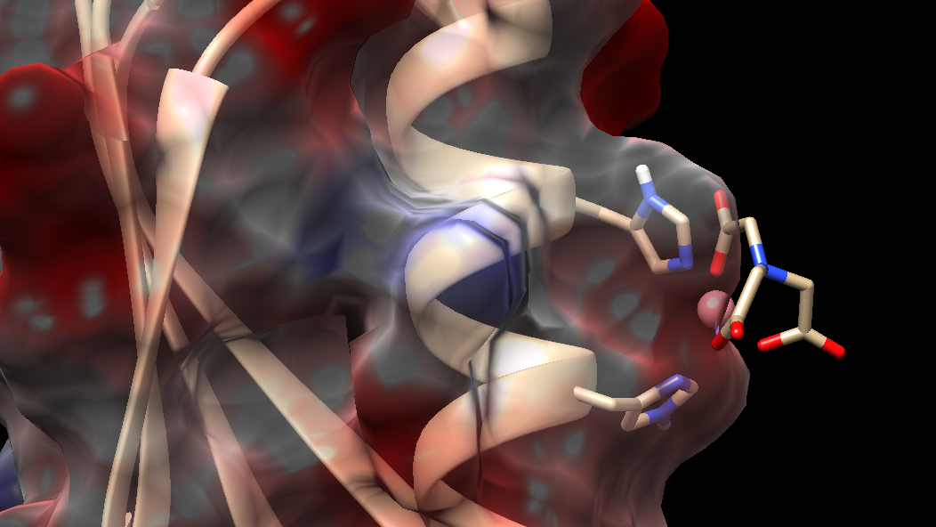
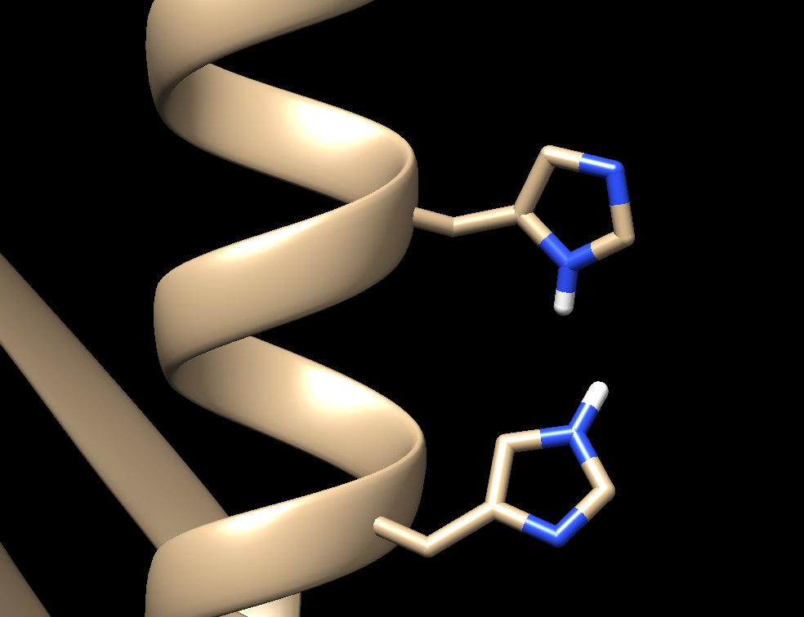
Best guess starting configuration (He and Hd)
Opposite with Hd and He

