Slide 1
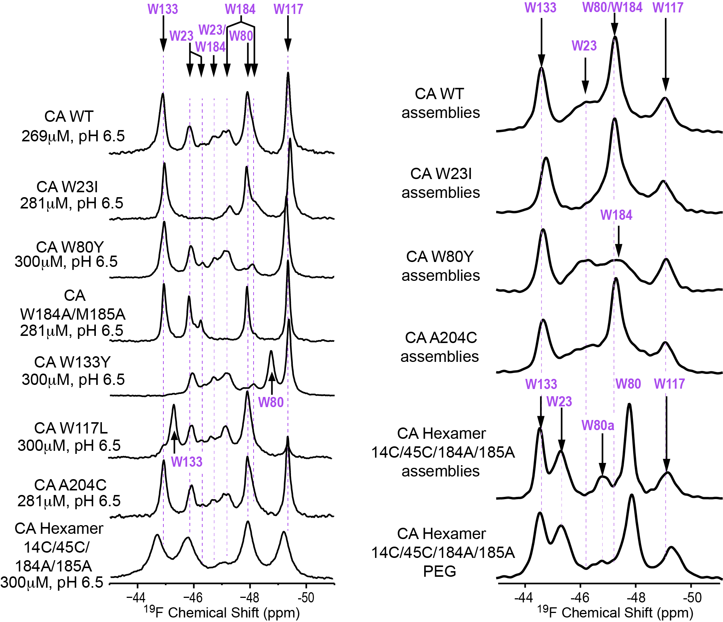
¹⁹F NMR of CA and Assemblies: Peak Assignments by Mutagenesis
Solution NMR: monomer
MAS NMR: assembled

