Slide 1
WERL

Slide 2
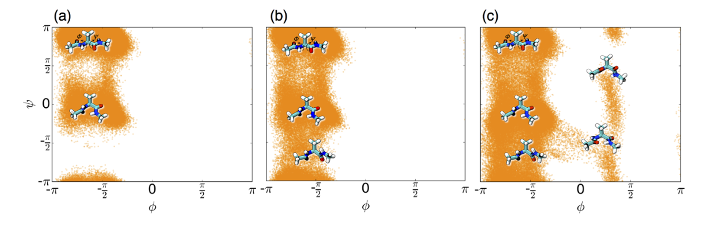
Weighted Ensemble Reinforcement Learning (WERL)
RL and MD: Reward or goal oriented adaptive sampling, e.g. FAST (RMSD only)
  Start multiple trajectories
  Choosing which to continue sampling based on reward function and least counts (LC)
  To get accurate physics*: MSM
RL + WE (WERL):
  Reward-based split/merge in binless framework
  Ideally adjust to focus on cumulative rewards (recycling)
  No inherent need for MSM (normally due to sampling bias)
cMD
Least Counts
REAP

Slide 3
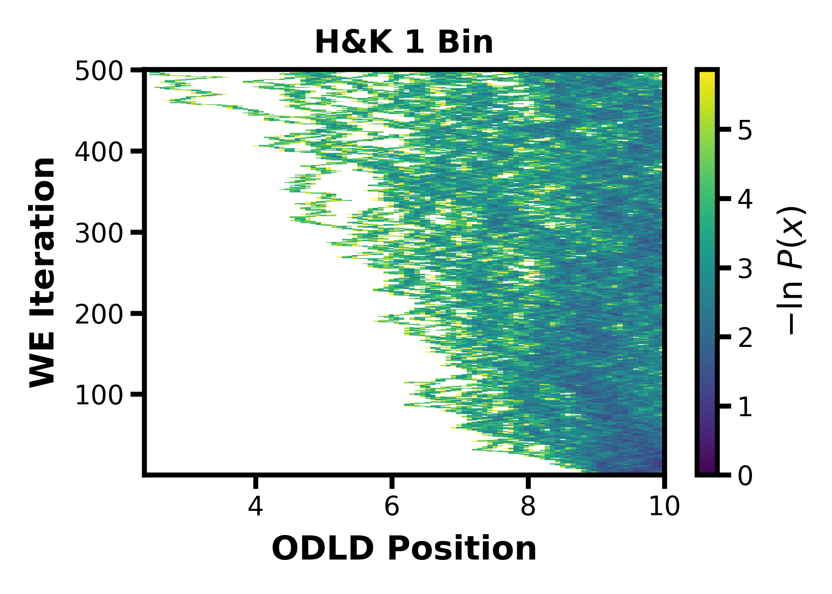
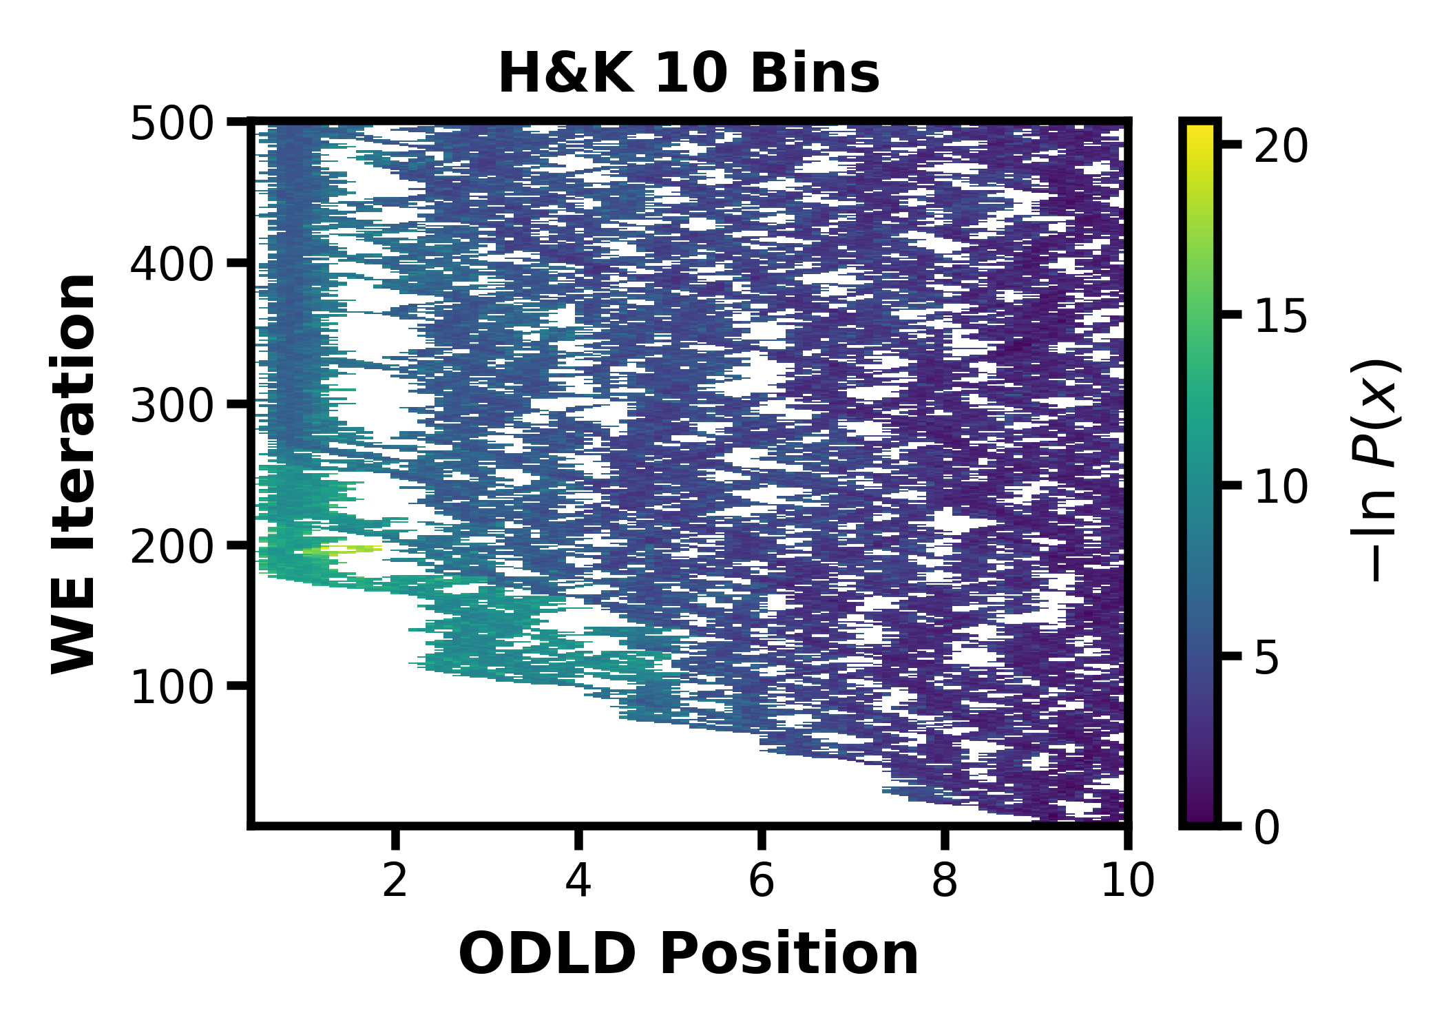
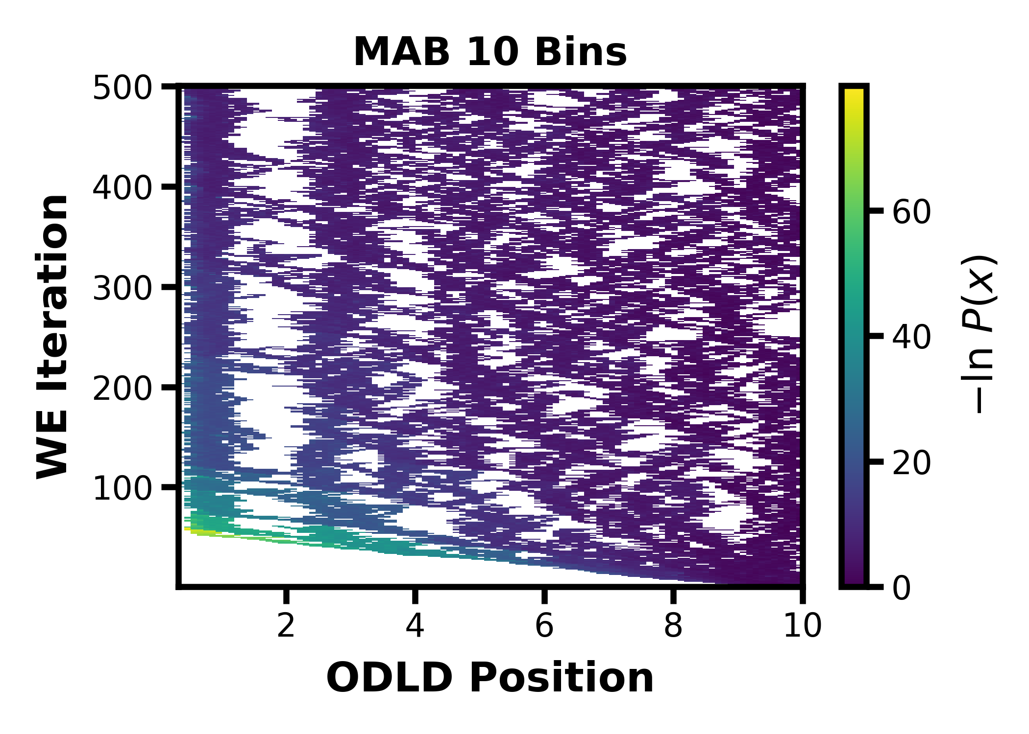
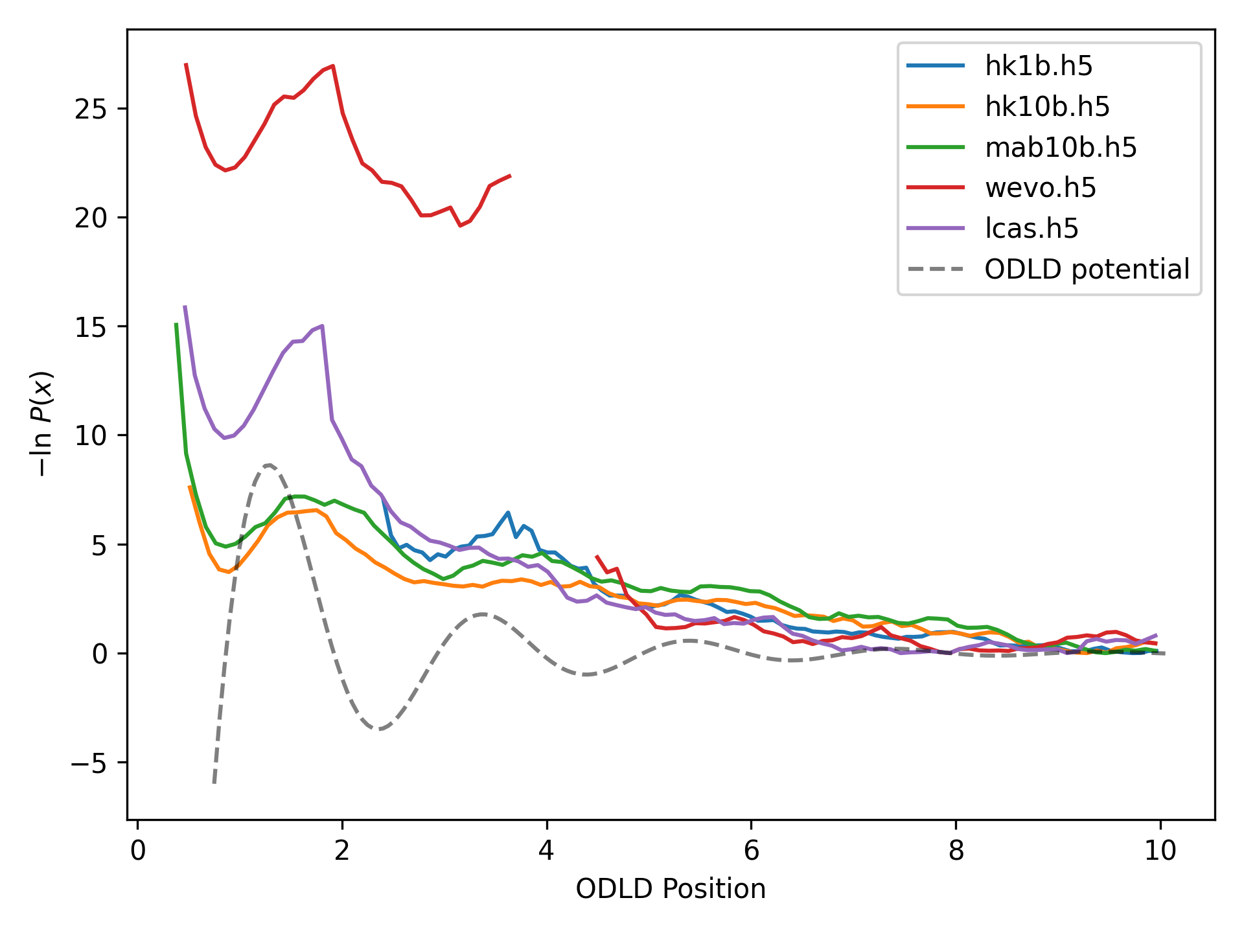
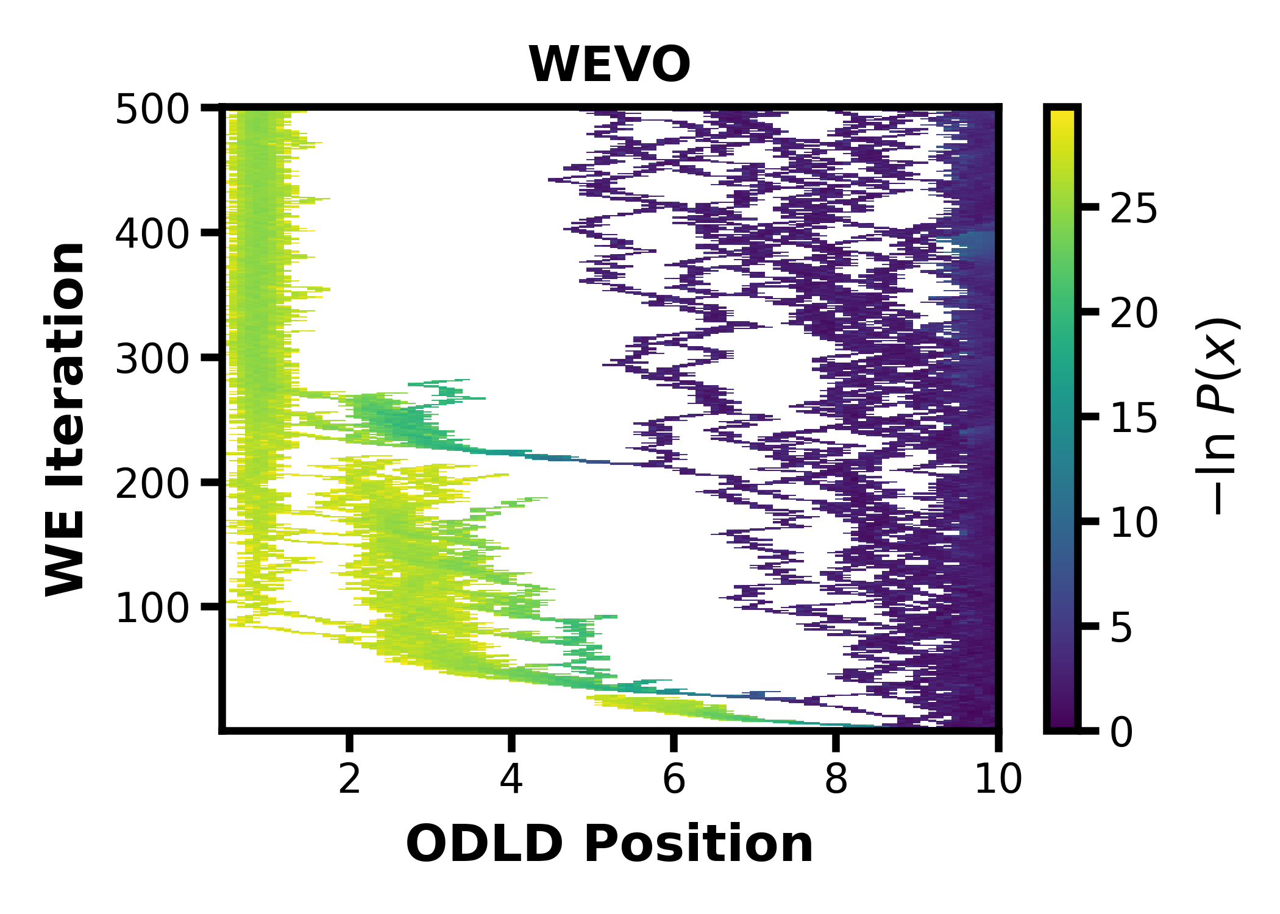
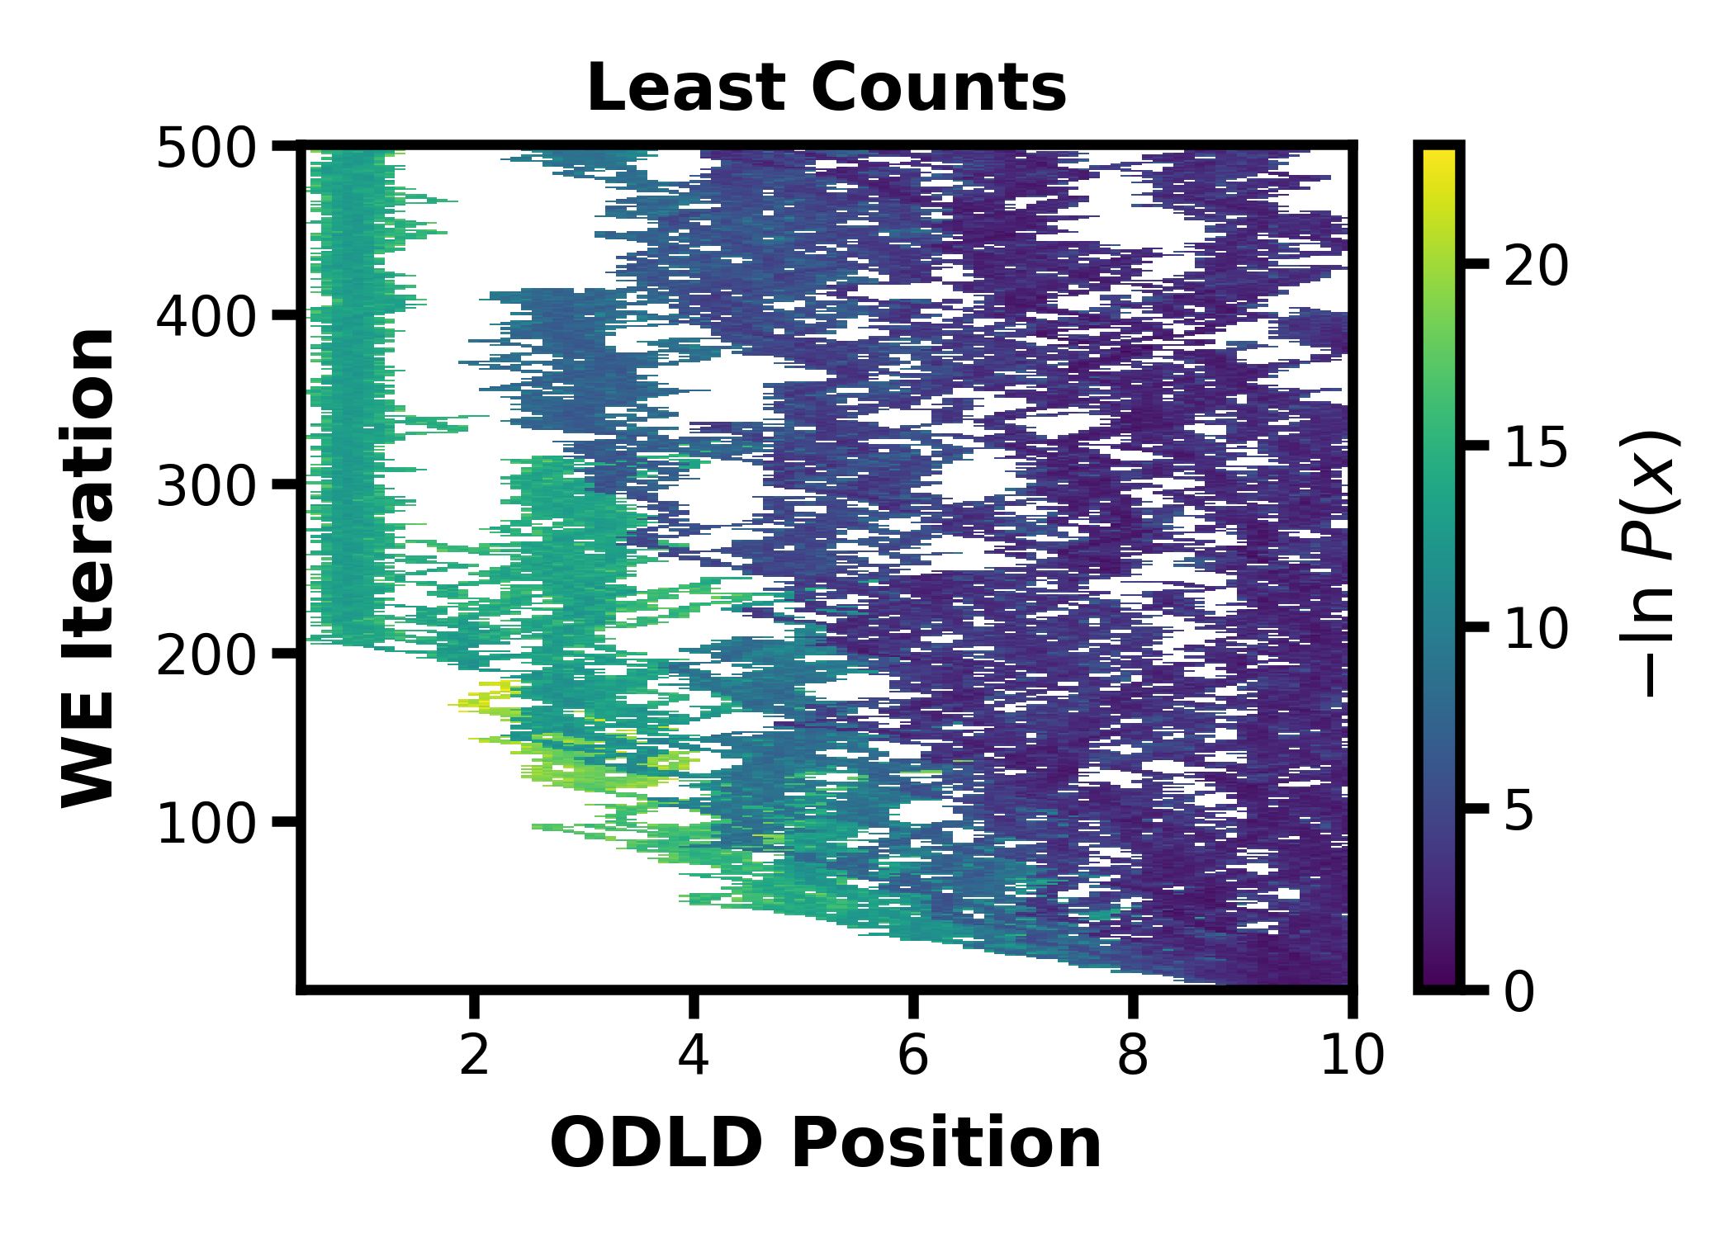
(cMD)
Notes:
H&K 10b is ~20% less simulation time

Slide 4
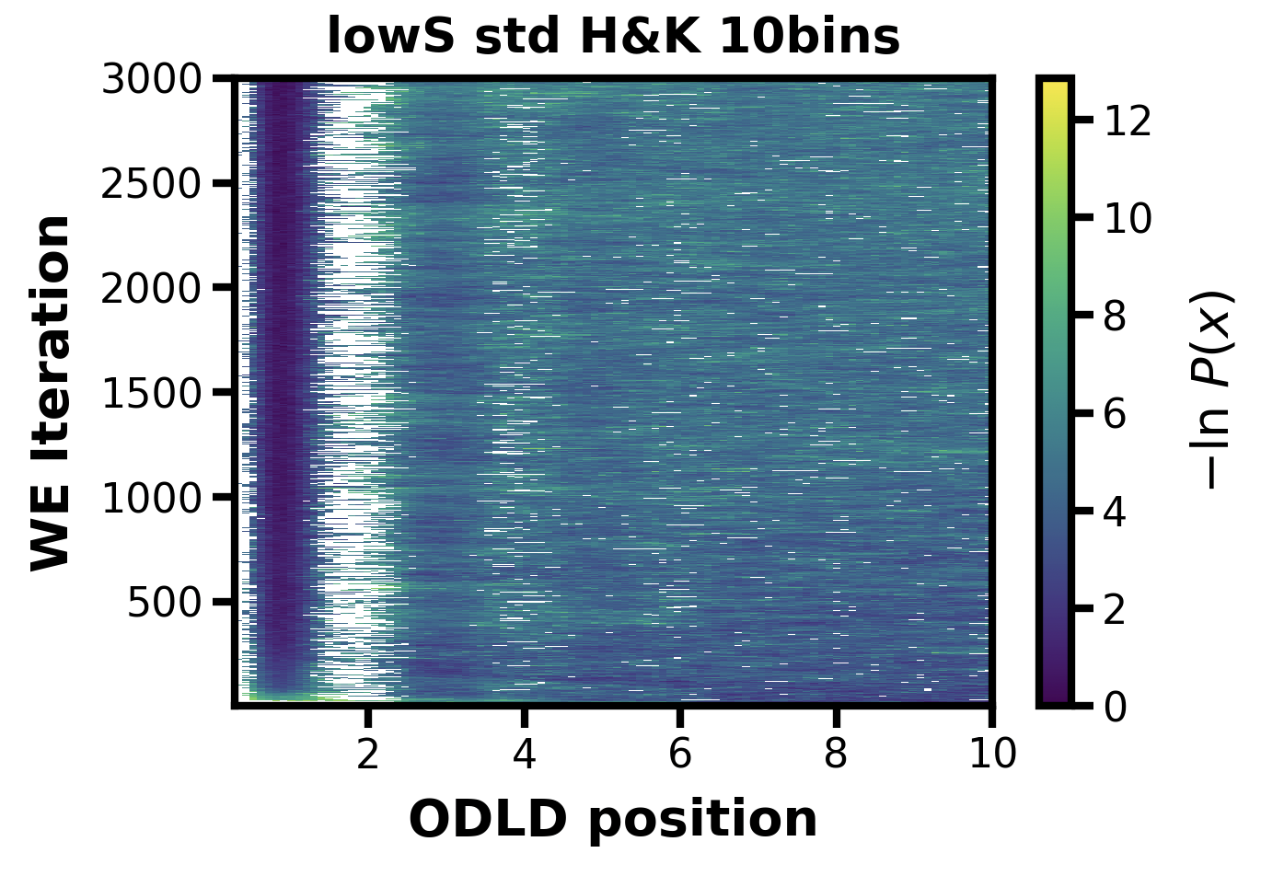
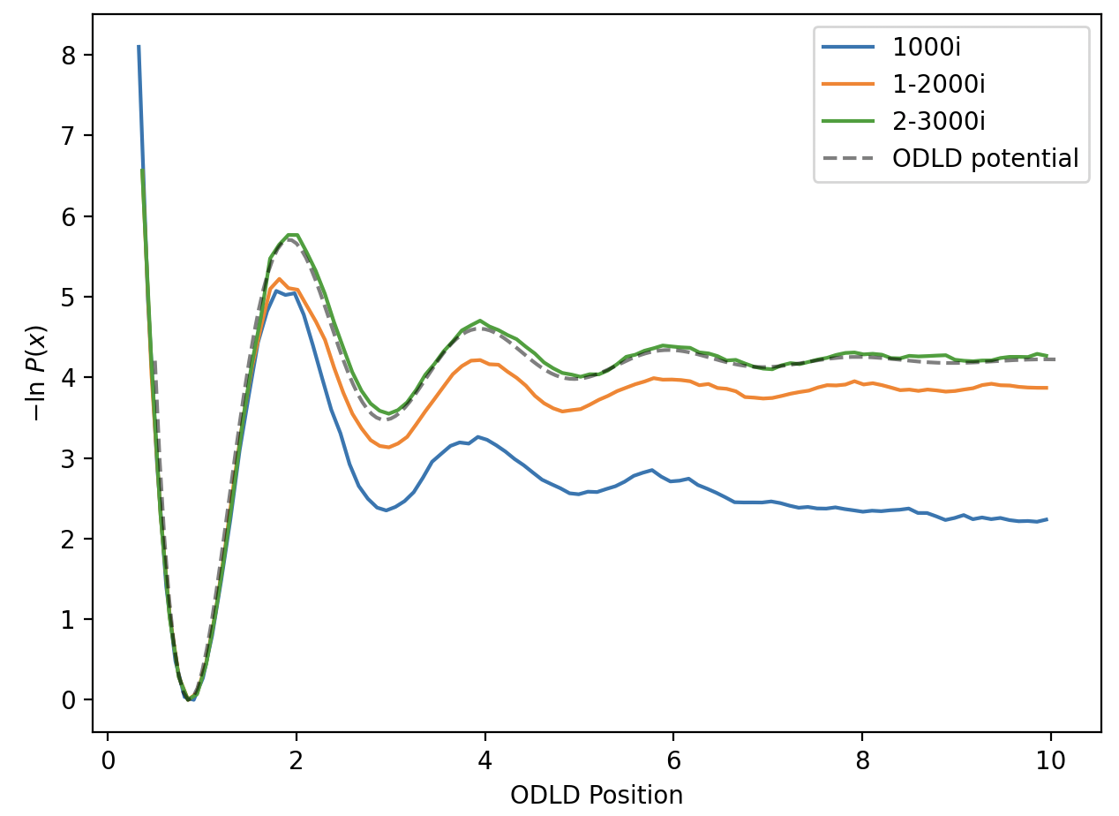
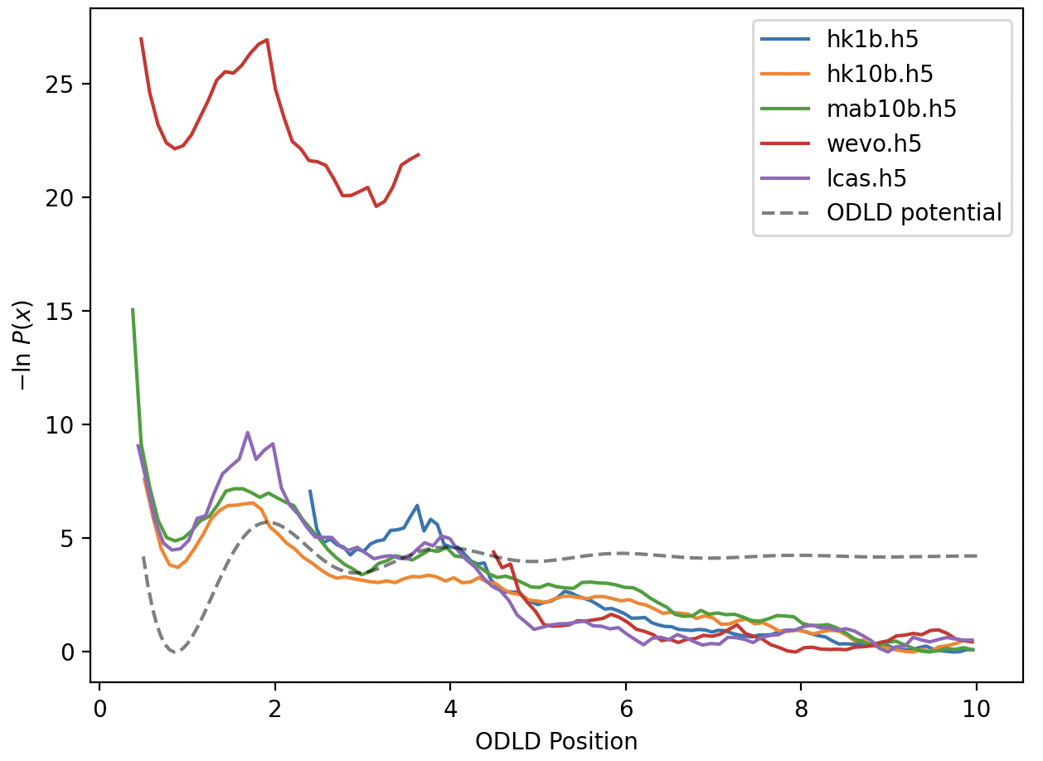
With updated 1000i lowS run std 10bin H&K and updated ODLD potential plot

Slide 5
MM 2D Potentials

Slide 6
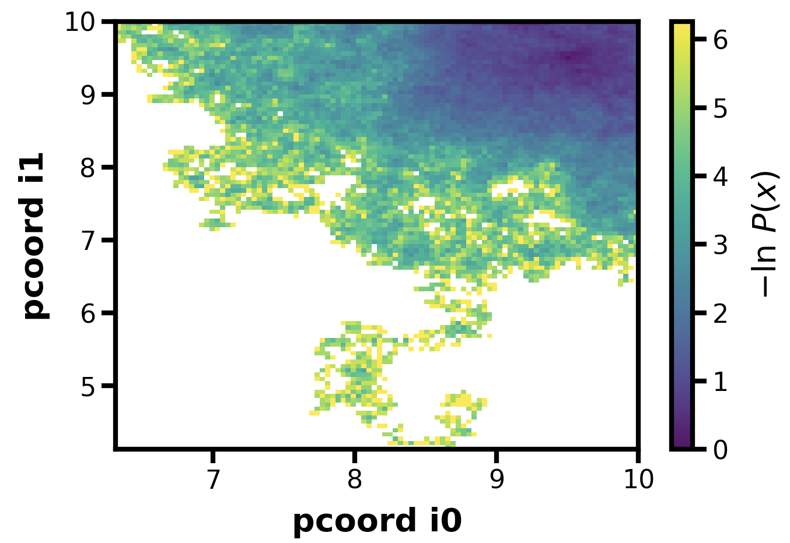
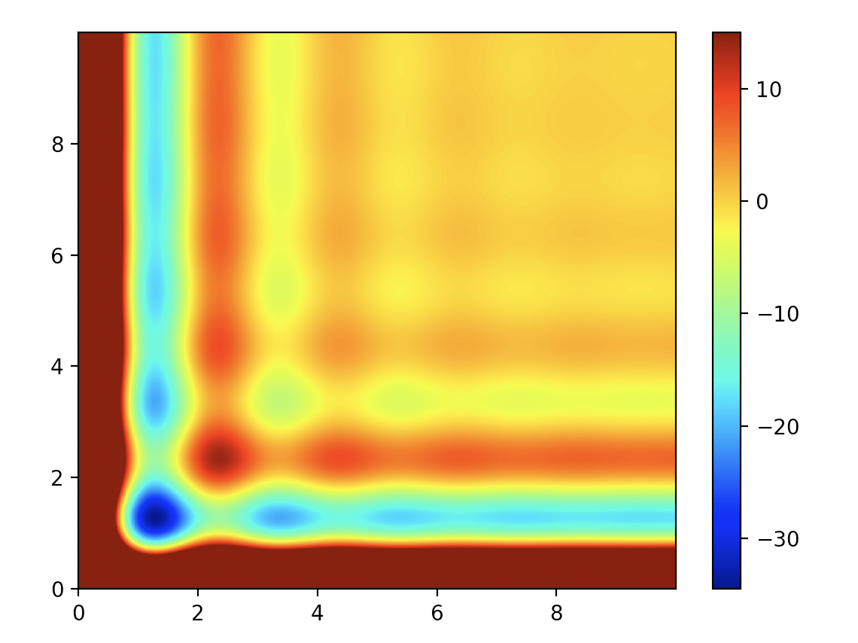
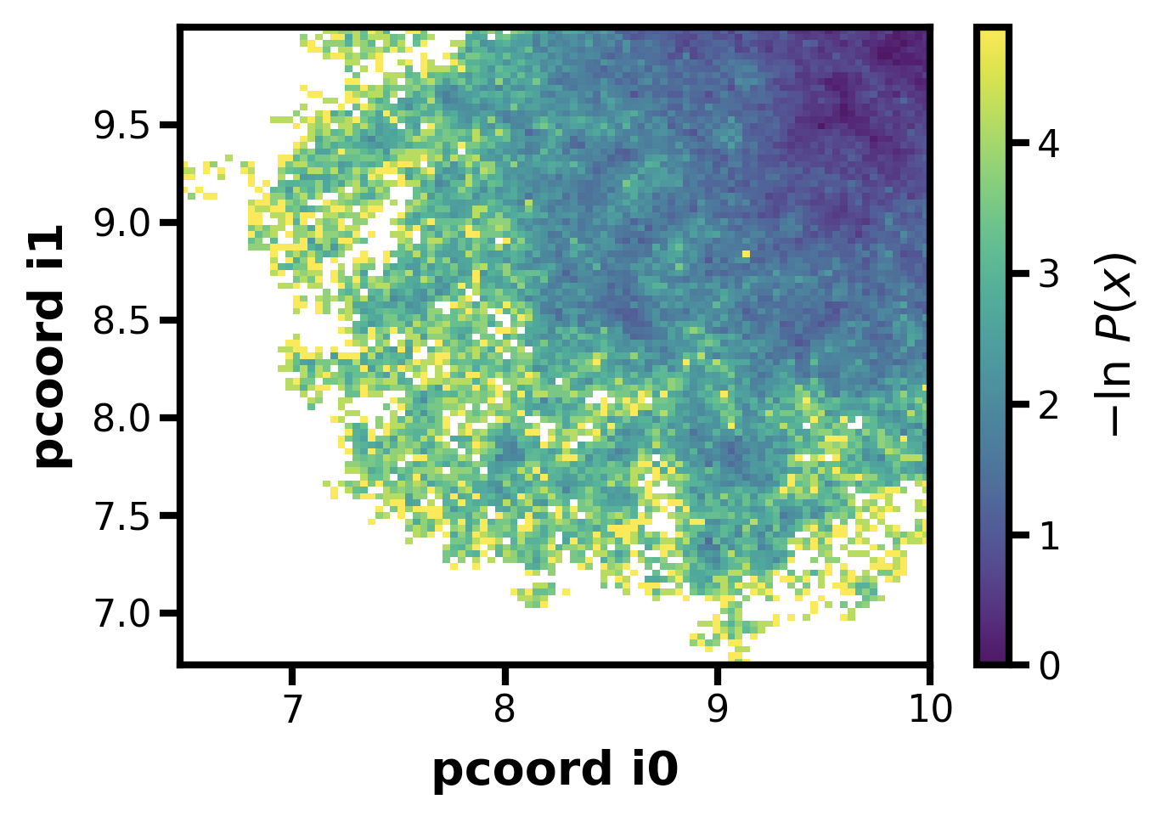
500i, stdMD, 100 walkers, ATB version
ATB made 2D ODLD
My updated version, should be the same

Slide 7
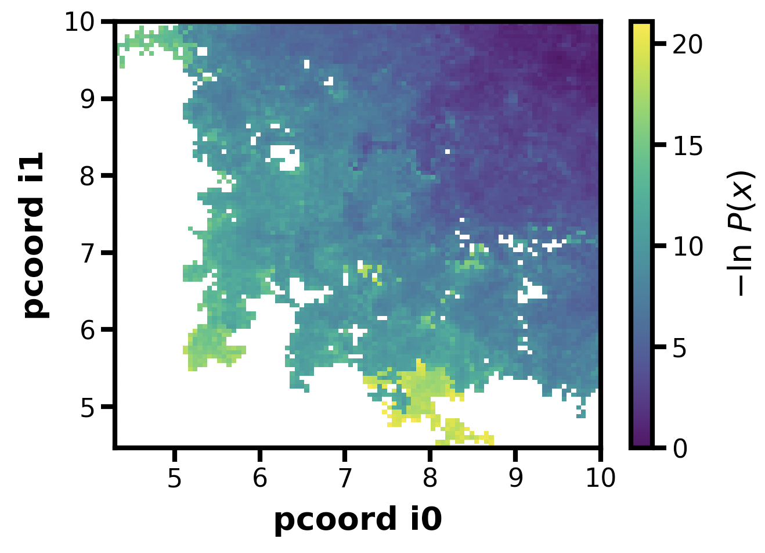
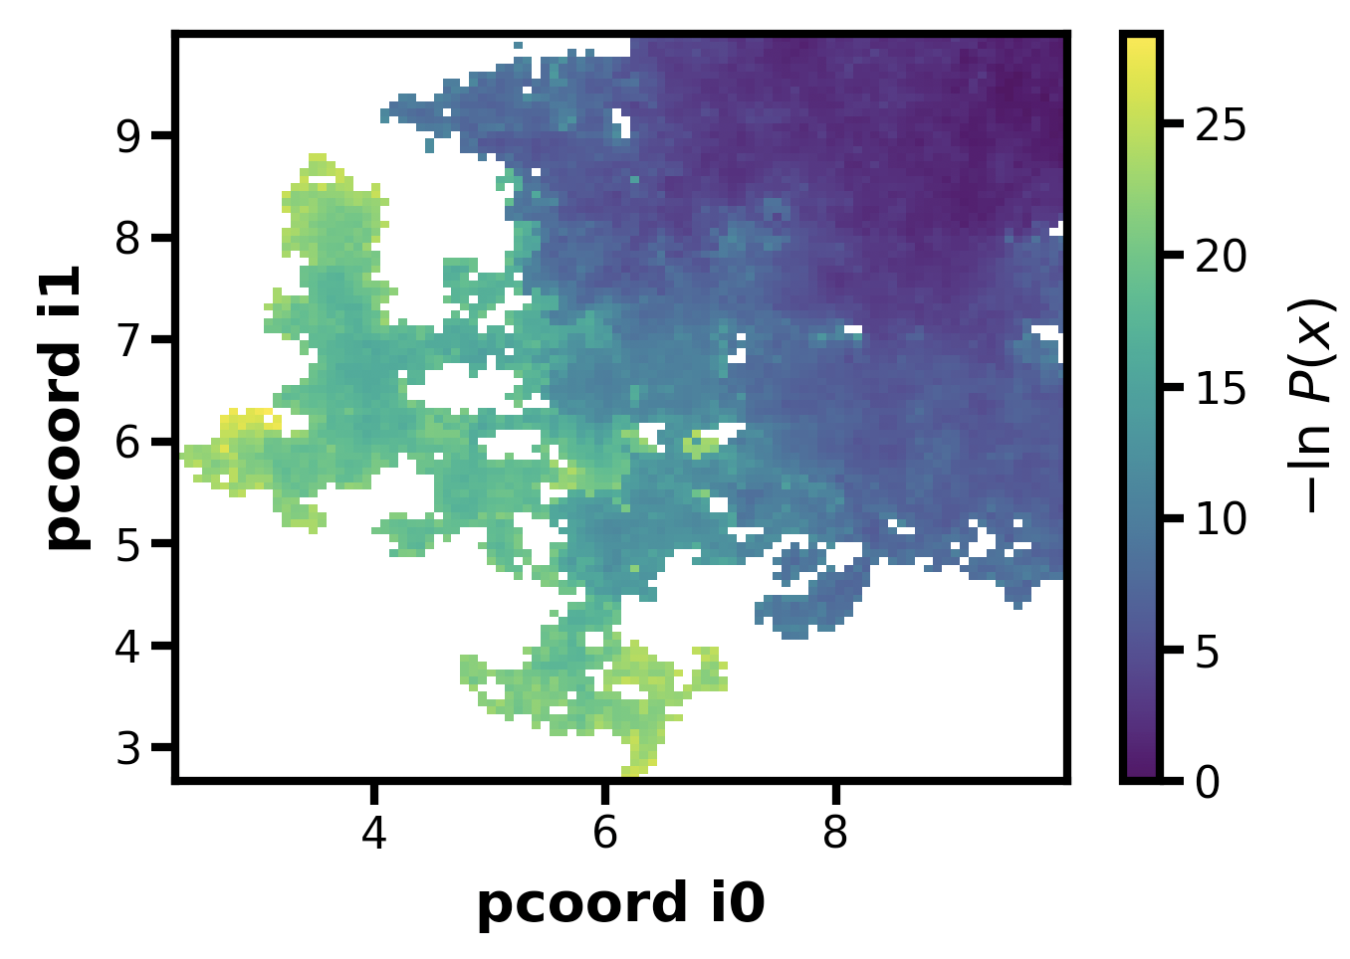
500i, H&K 10 bins, 5 walkers per bin, ATB version
ATB made 2D ODLD
My updated version, same params, should be the same
Looks good!

Slide 8
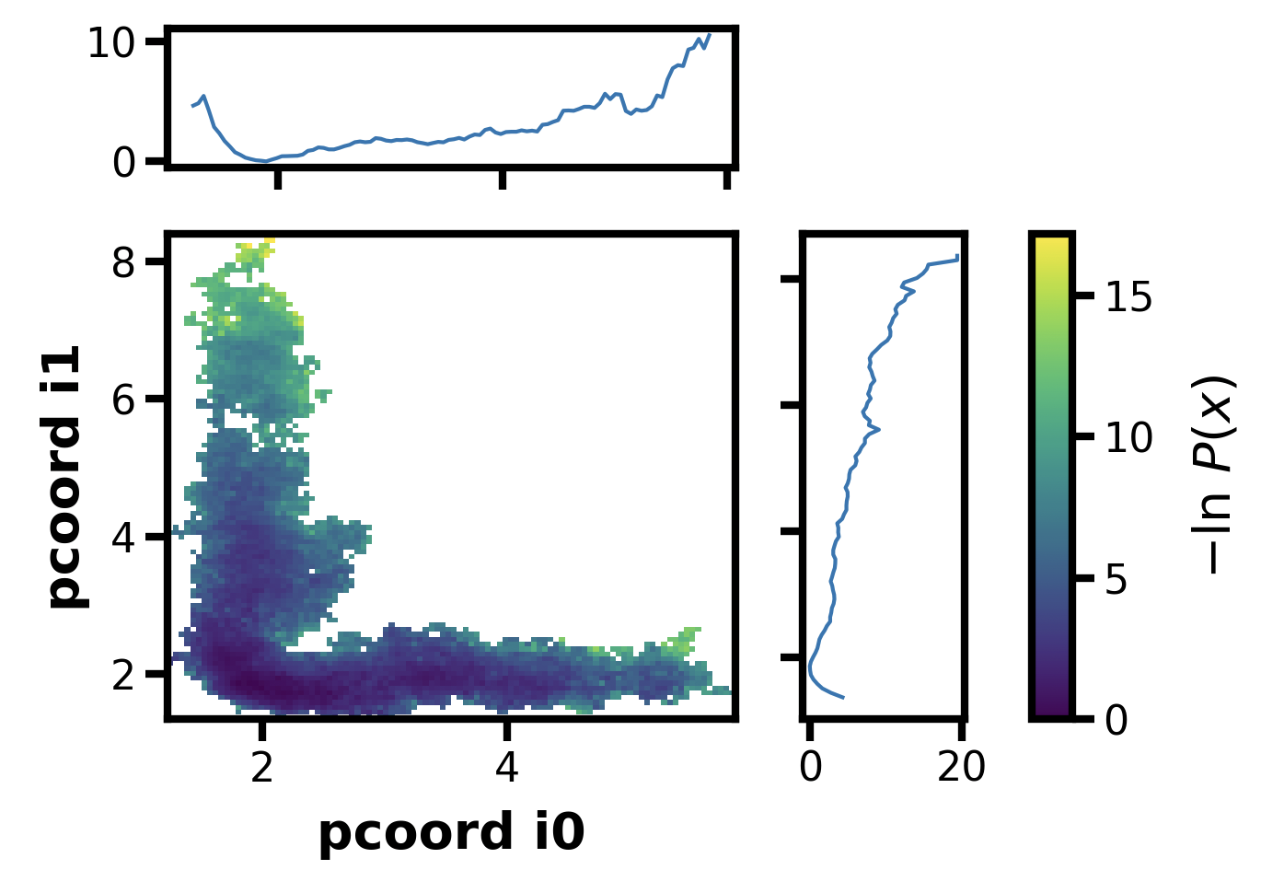
300i, H&K 10 bins, 5 walkers per bin, my version
Testing starting from 1.8, 1.8, should be stuck (ish)
ATB made 2D ODLD

Slide 9
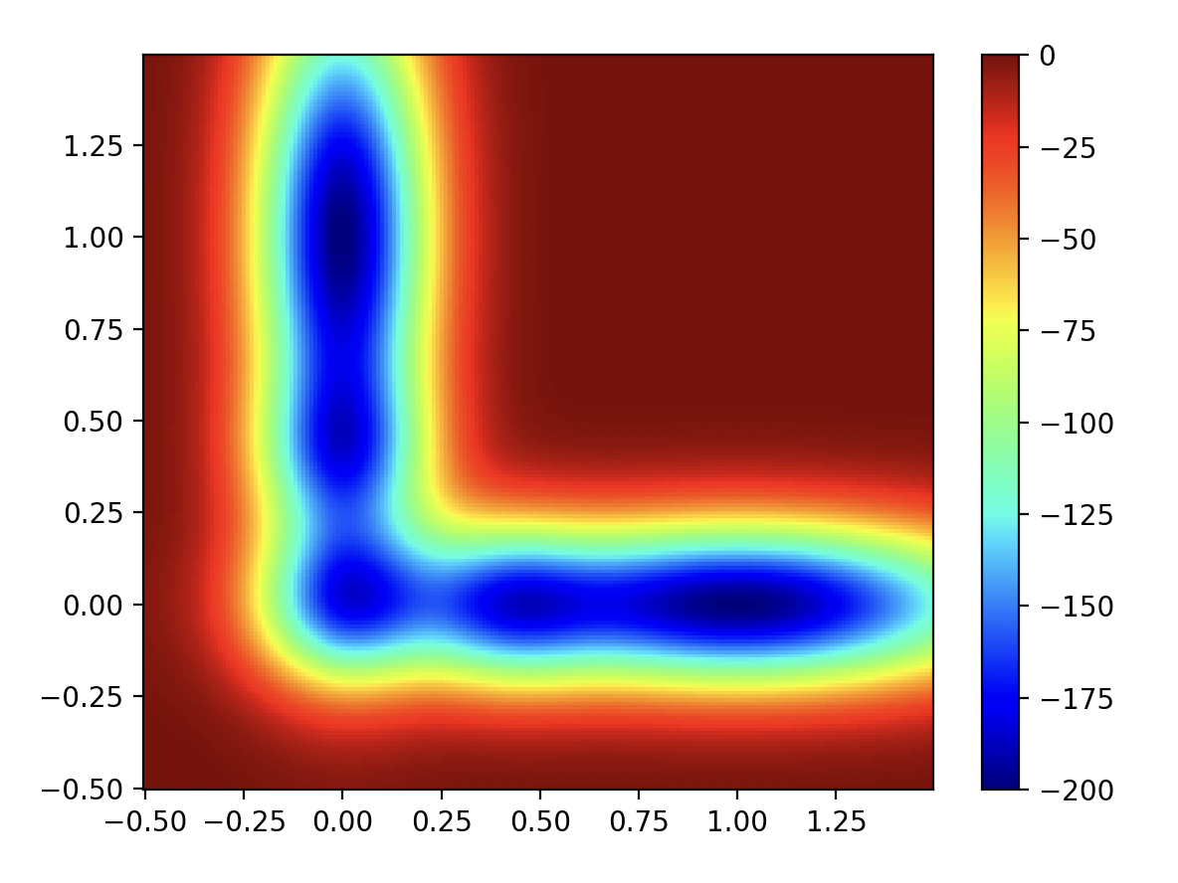
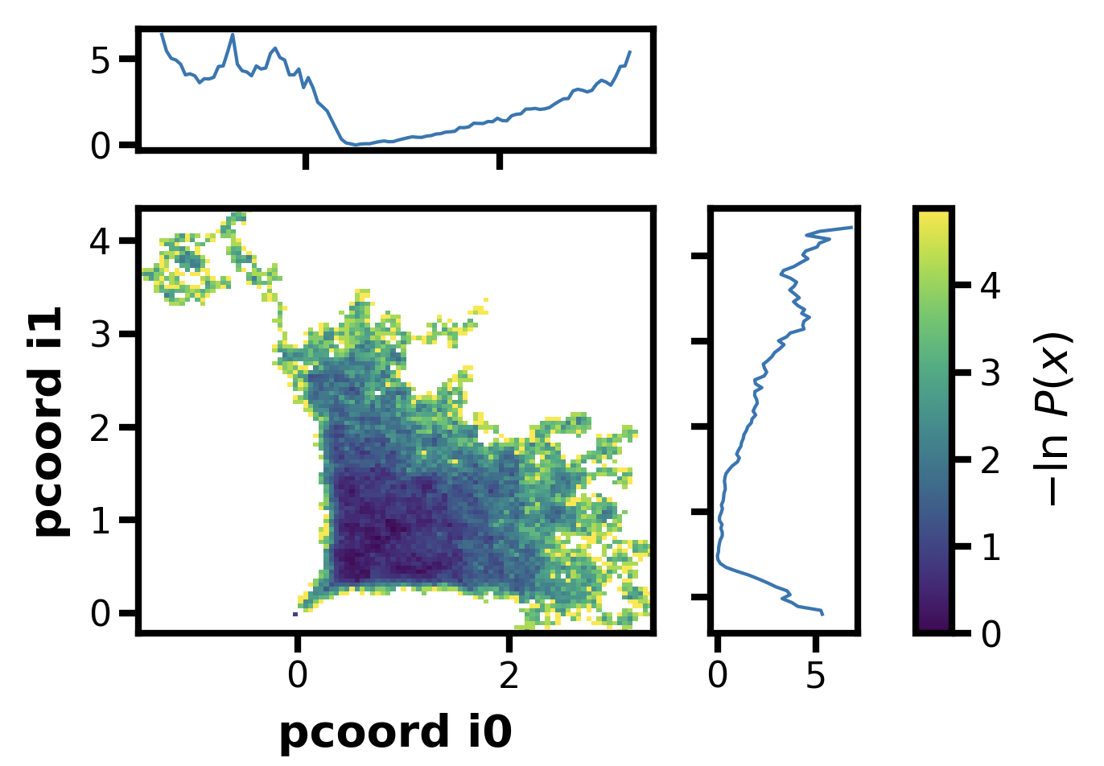
300i, 1 bin, 50 walkers per bin
No good…

Slide 10
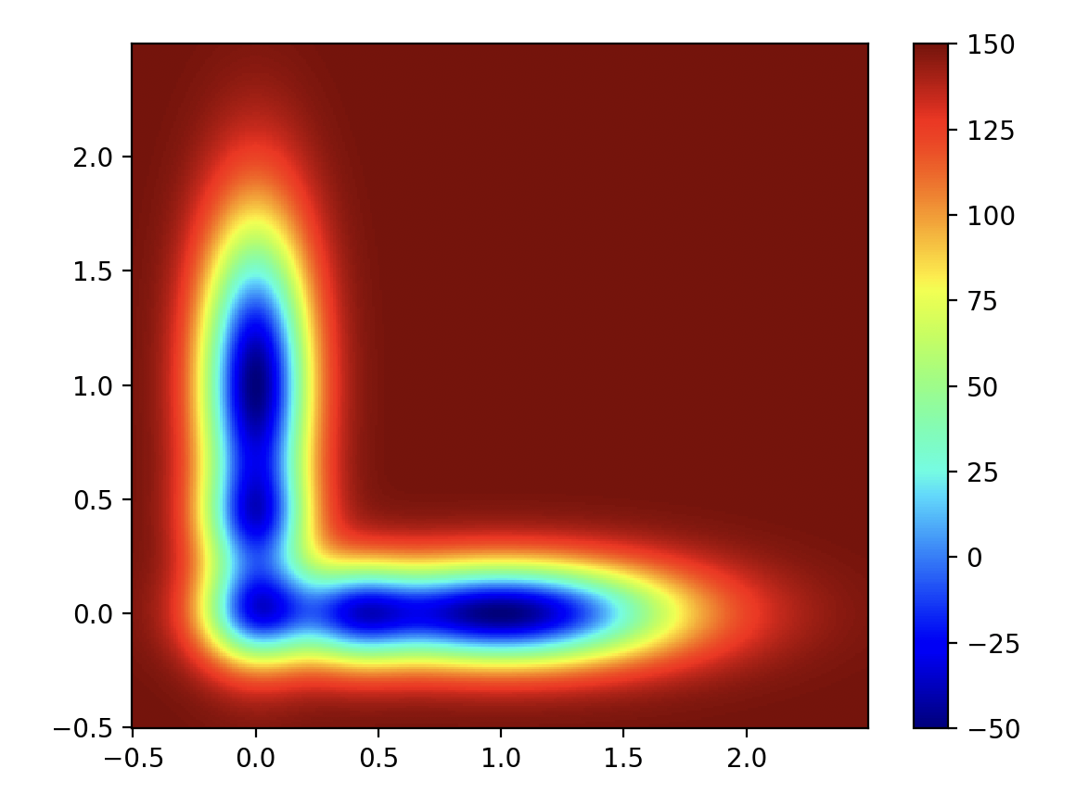
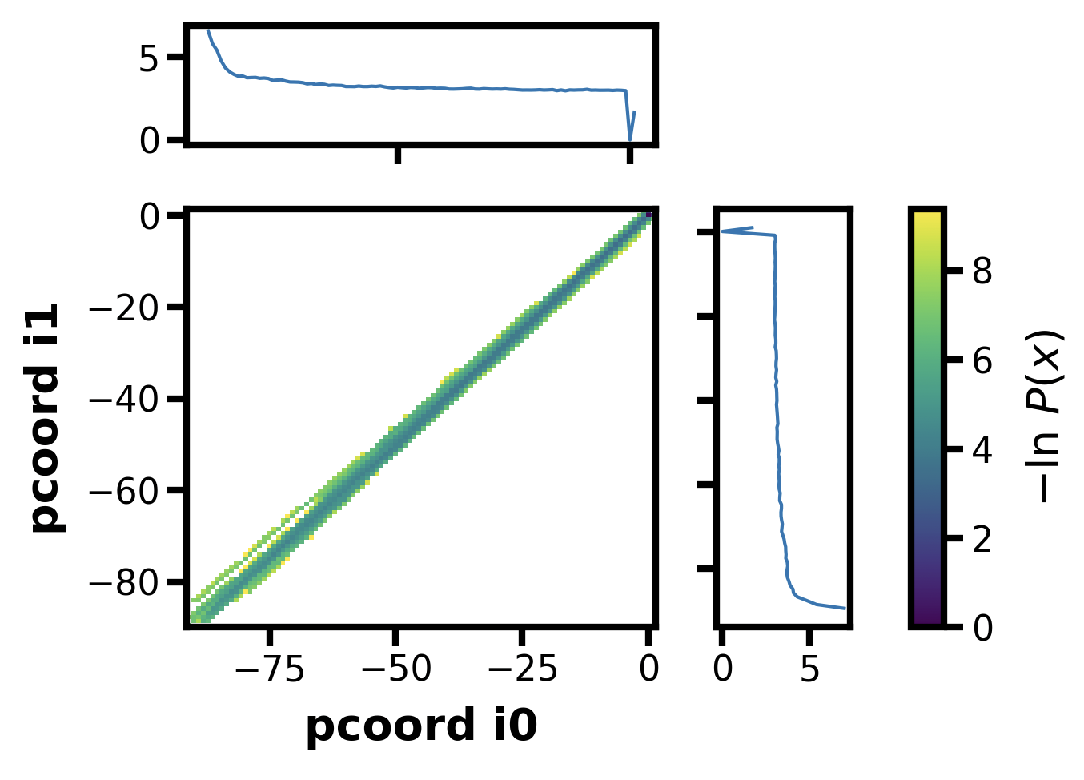
What if I adjust the numbers to be more like 2D ODLD?
300i, 1 bin, 50 walkers per bin
Nope…

Slide 11
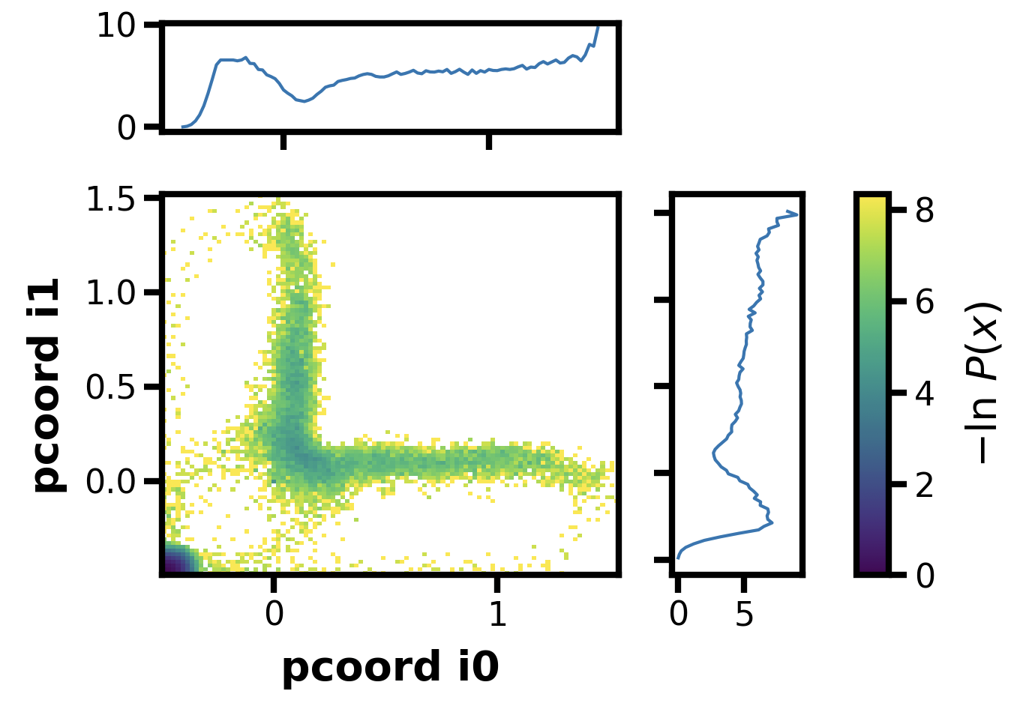
What if I also include reflecting barriers?
At -0.5, -0.5 and 2.5, 2.5
300i, 1 bin, 50 walkers per bin
Huh…. Interesting, it’s almost working

Slide 12
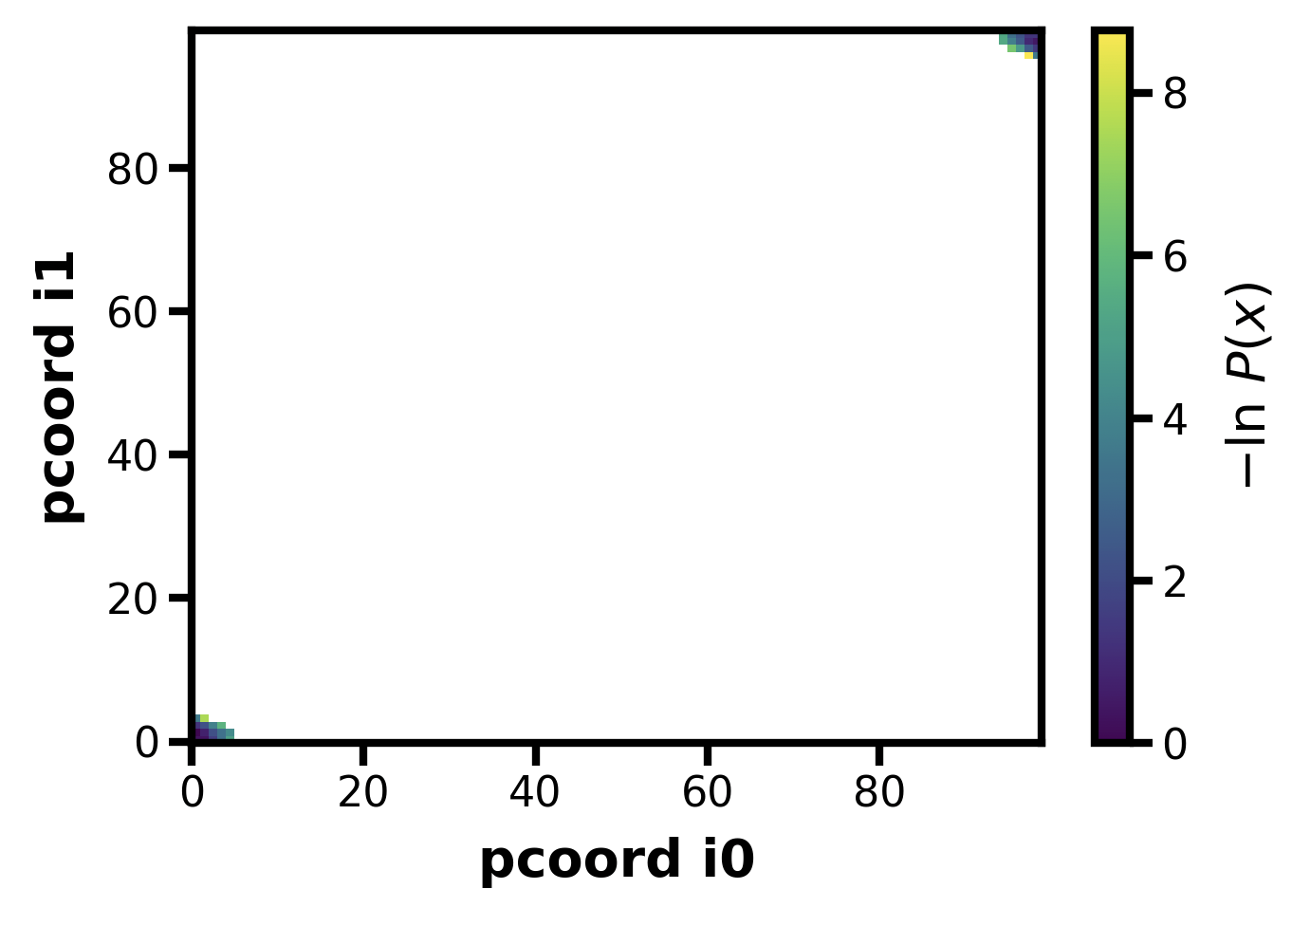
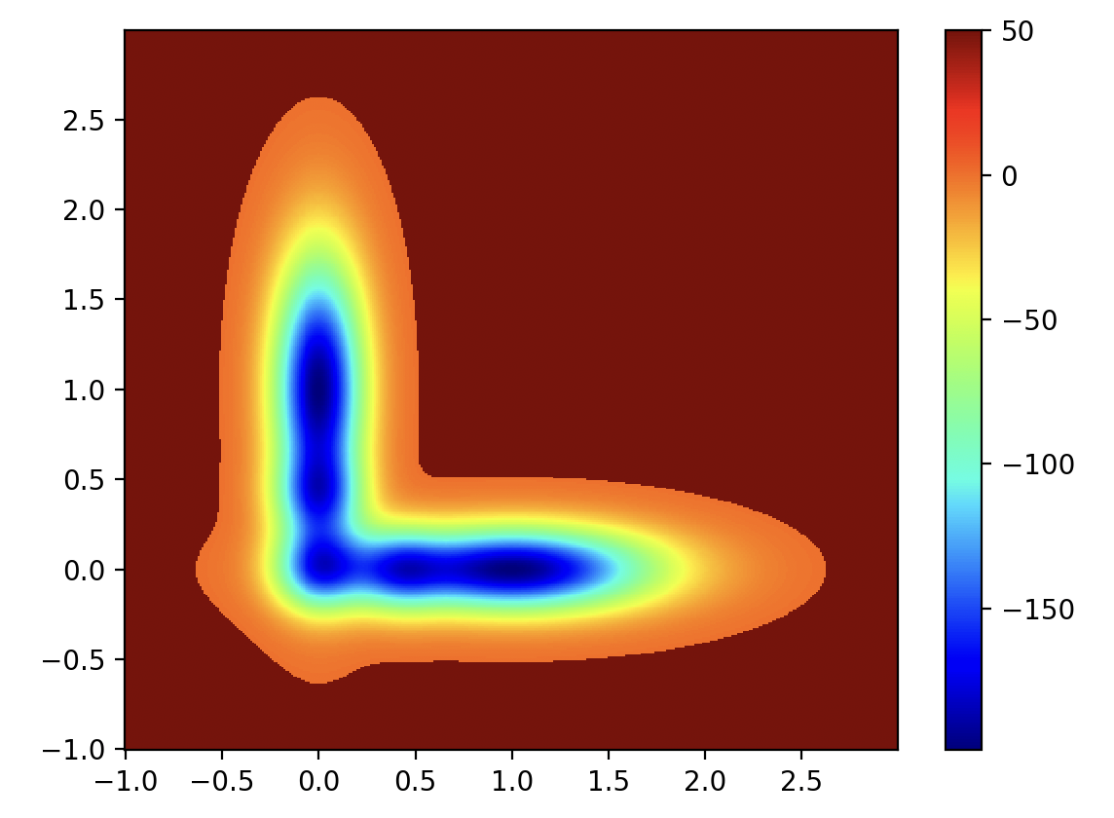
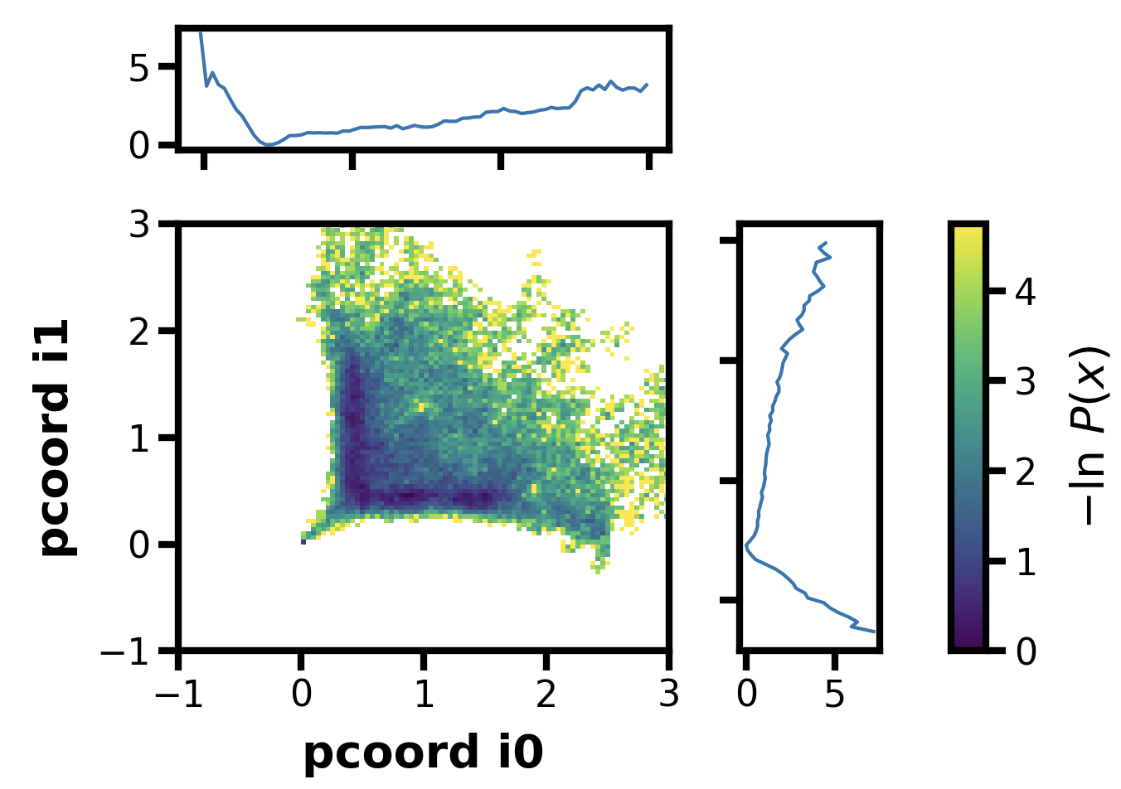
300i, 1 bin, 50 walkers per bin
Final idea, maybe I can make the high limit extreme, in the 2D ODLD it’s at 200000, let’s try that
Still not working…

Slide 13
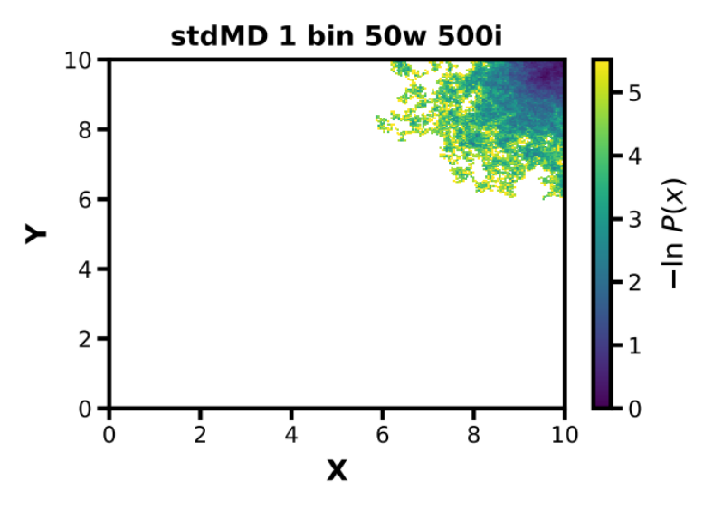
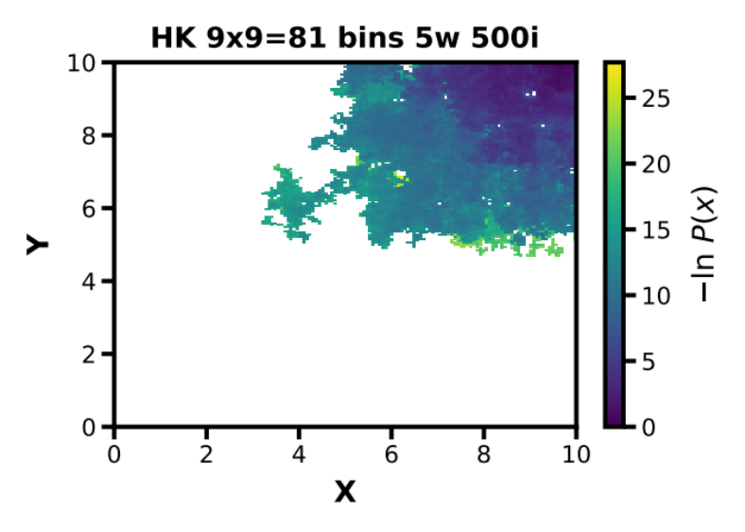
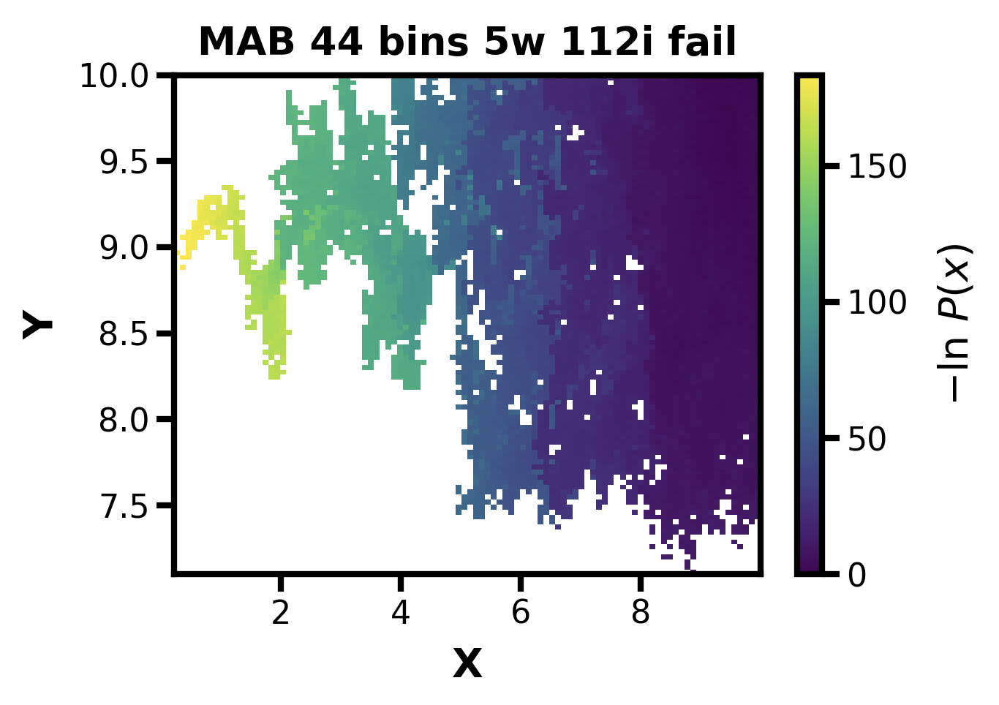
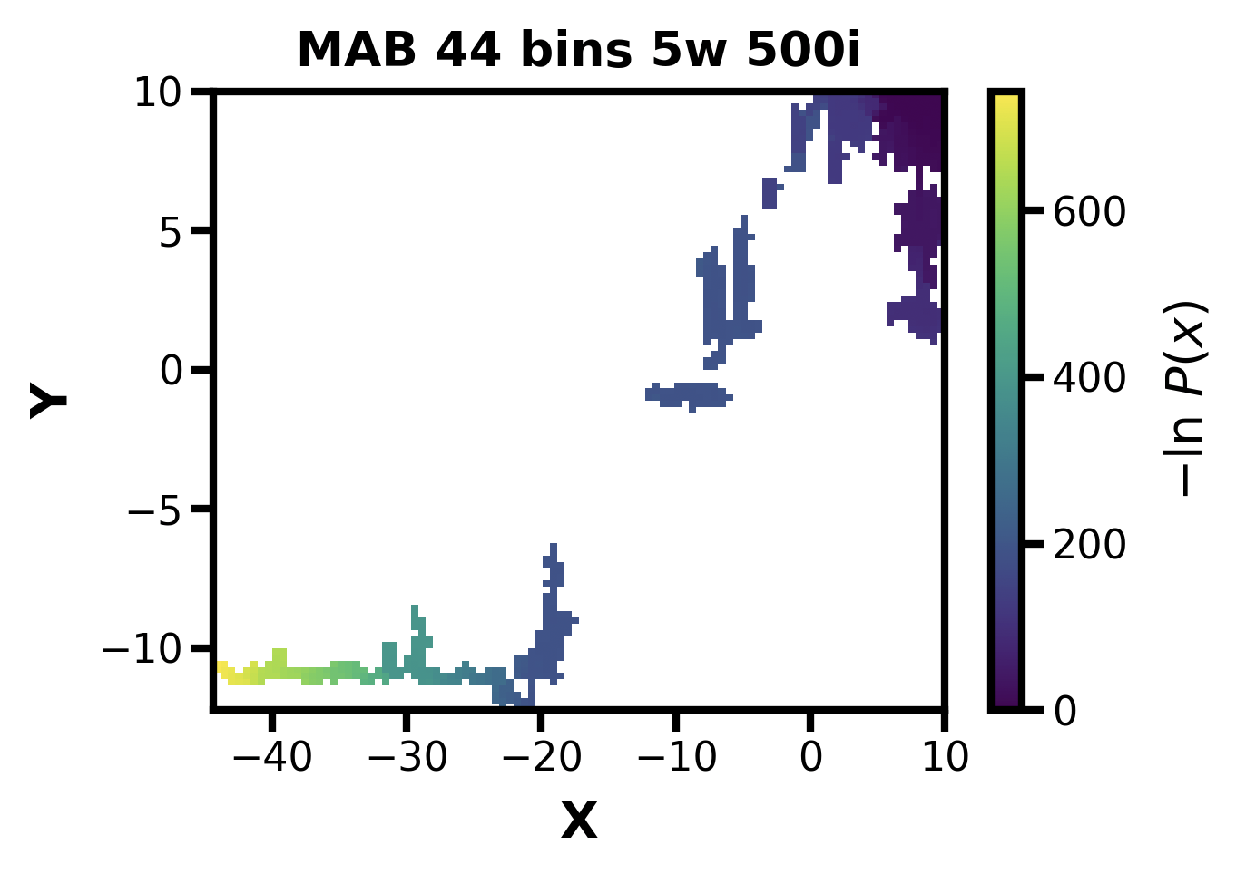
Let’s just use this 2D for now
Seems there is still a boundary issue, I updated the possible bin placements and tried again
Ahh, but I forgot to also include reflection at 0 and the extra inf bounds:
Hmmm, still didn’t work

Slide 14
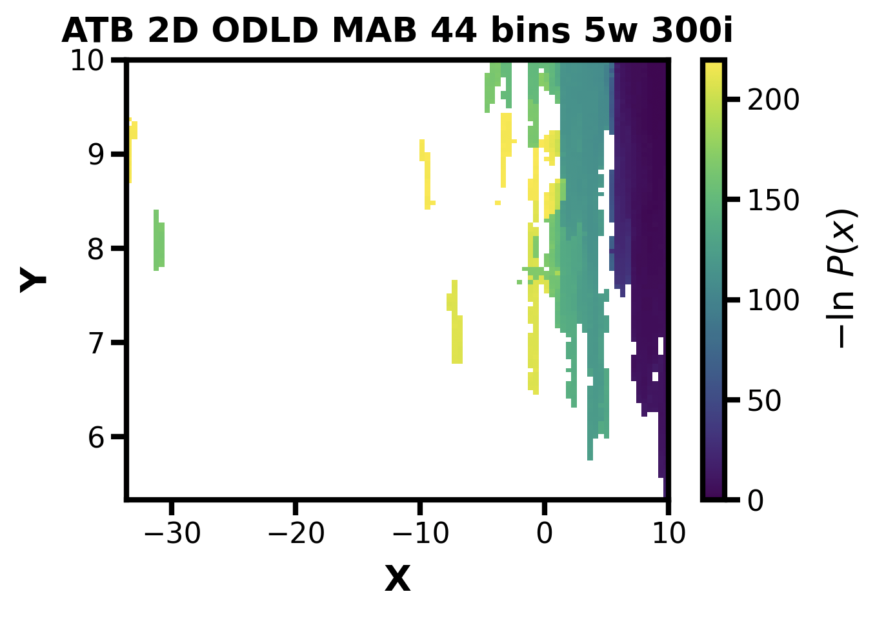
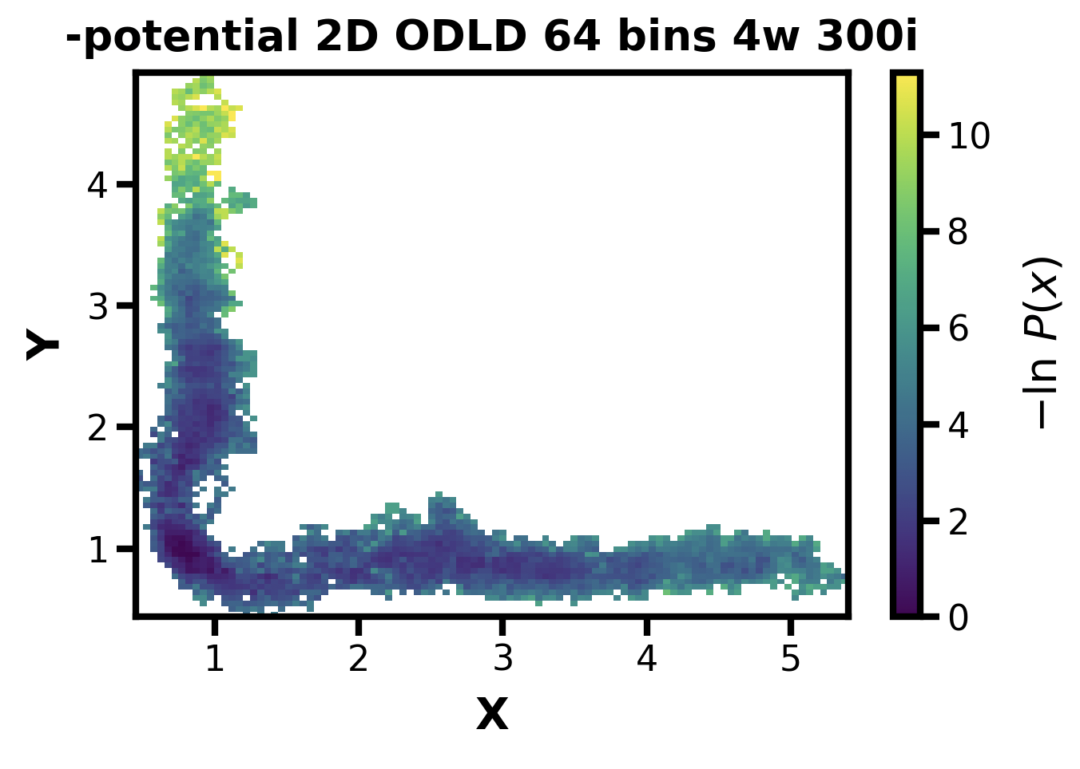
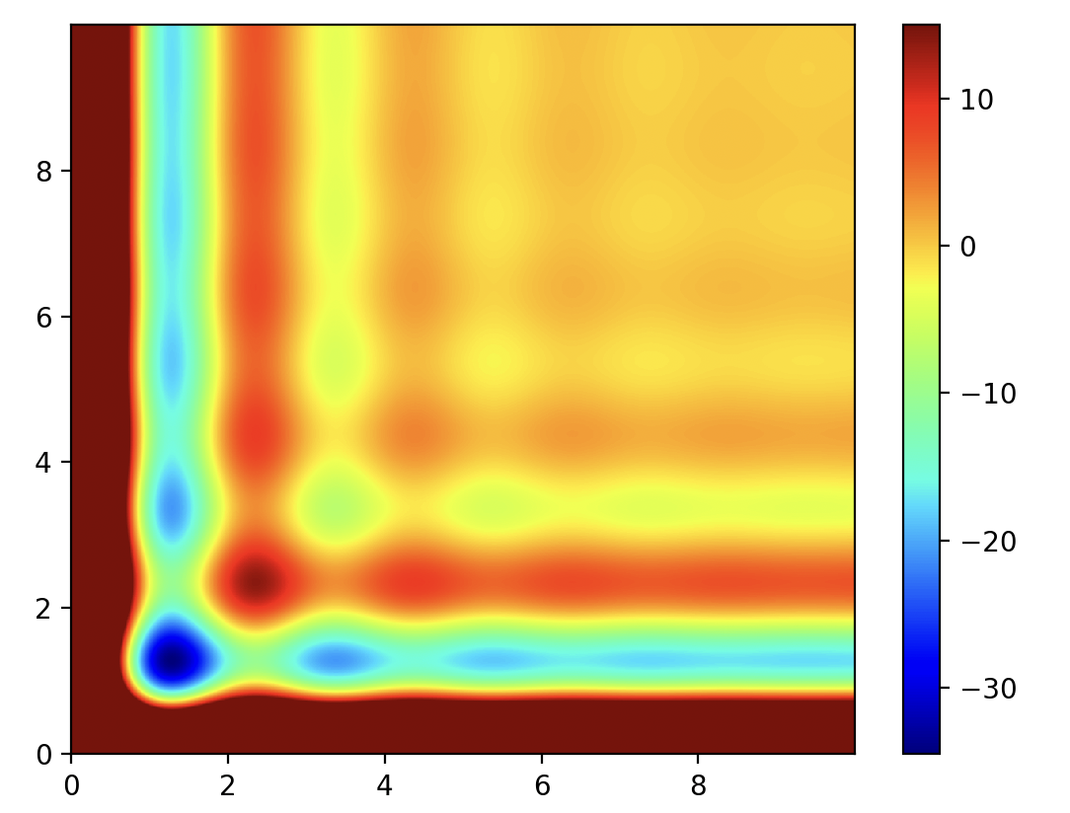
ATB style 2Dodld also didn’t work with MAB bins
Okay so I then tried without MAB and again it seems to be working fine (the reflecting boundary conditions)
When doing this I stumbled on a potentially interesting finding: maybe the potentials were inverse? Testing this using the negative return of the potential function (because it seemed like it was actually sampling this inverse space)
It worked!!! See below
Before I was actually sampling this
And not what I thought which was this
Started at 1,1

Slide 15
It’s basically working, but this was just 100 iterations with 40 walkers in one inf bin, so this system is too easy, though compared to the 2d odld the barrier is lower
Can I also do this to fix the L potential?
Trying with a negative mod plus a 100 offset to center it around 0
Reflections at -0.5 and 2
Now what if I use a higher sigma/friction?
From 0.001 ** (0.5) to 0.0001 ** (0.5)
Same other params as above:
Not bad…

Slide 16
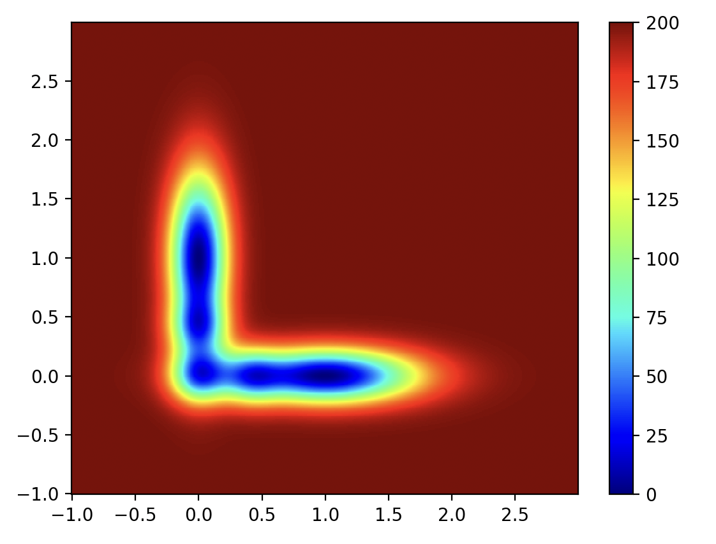
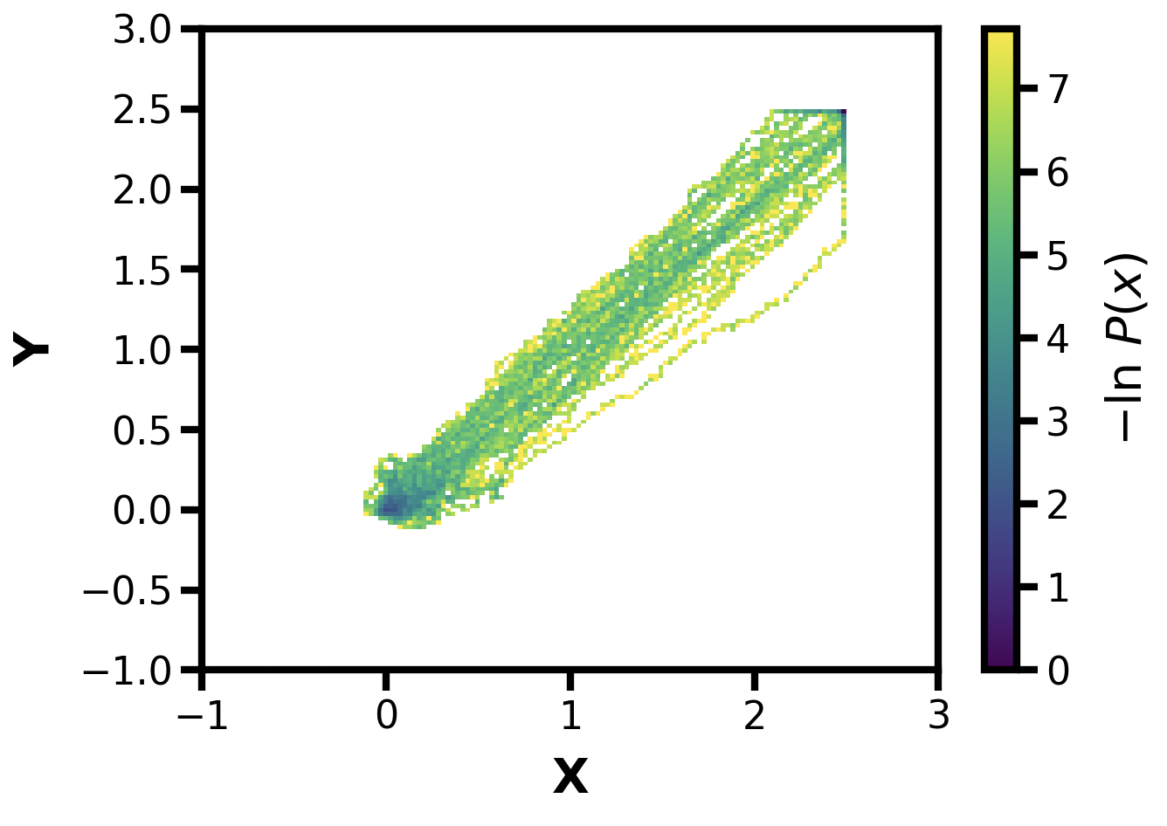
I feel like it was still sampling the region near 0 on the potential
I wonder if the negative region was also being treated as positive from some part of the code?
Trying again with an all positive L potential
This did not work

Slide 17
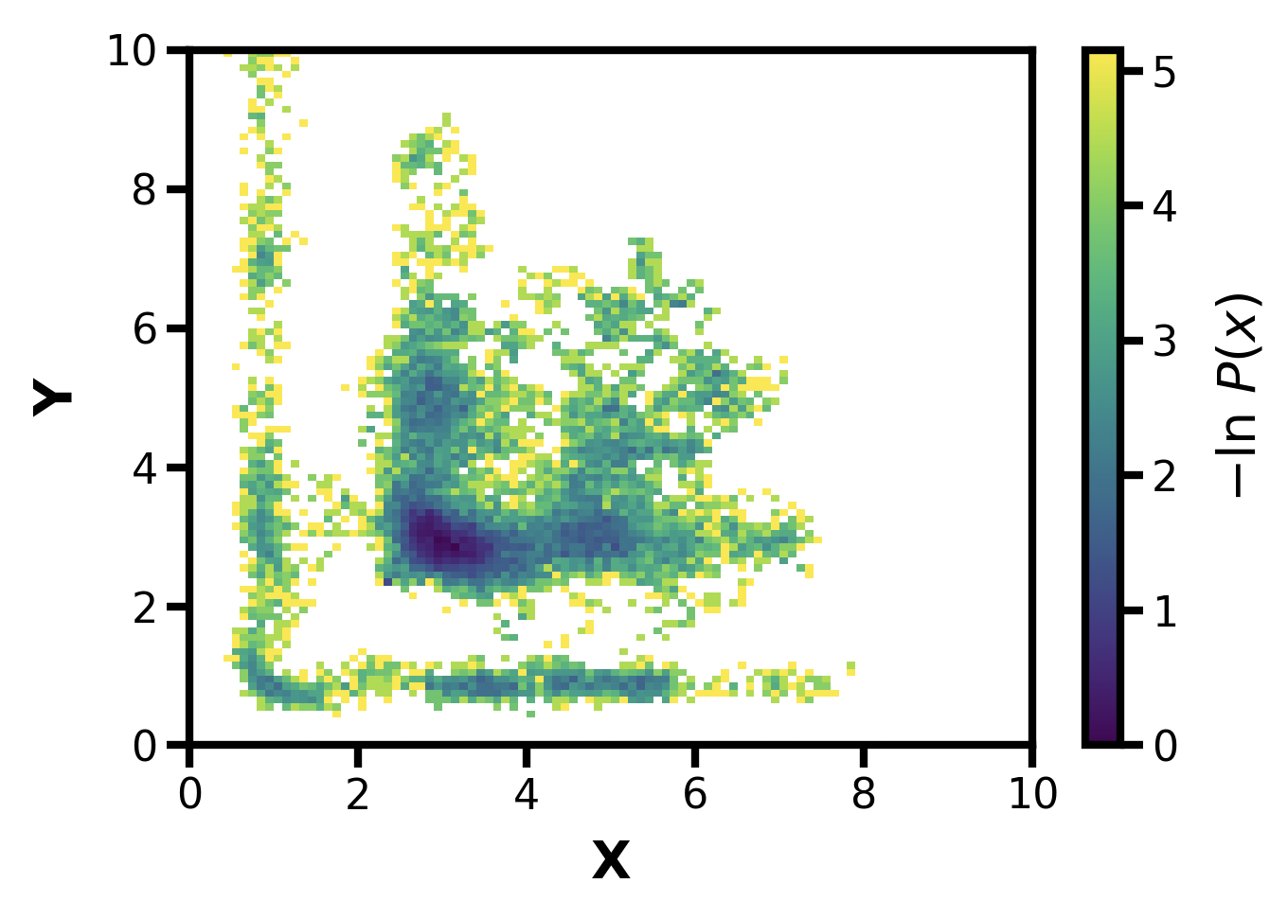
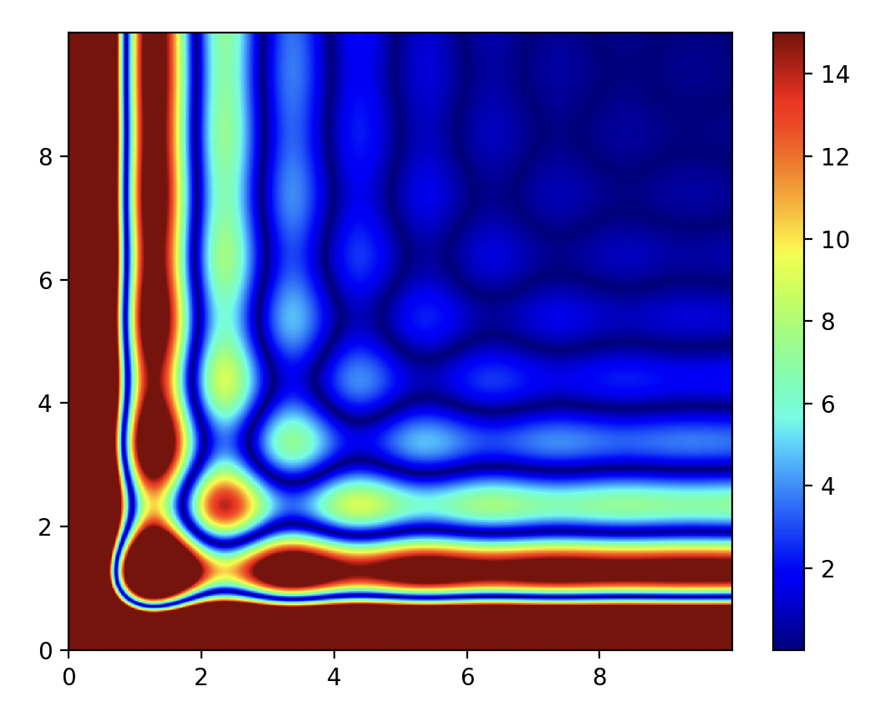
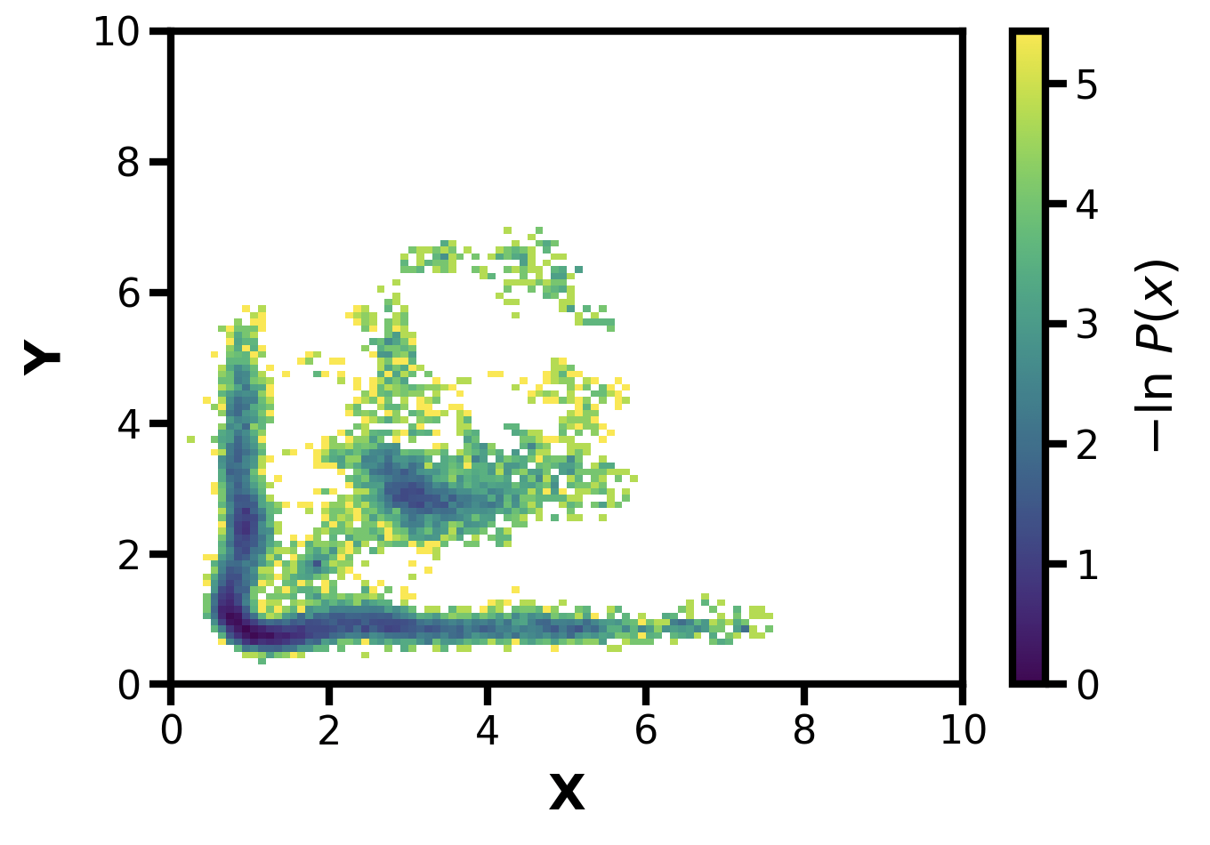
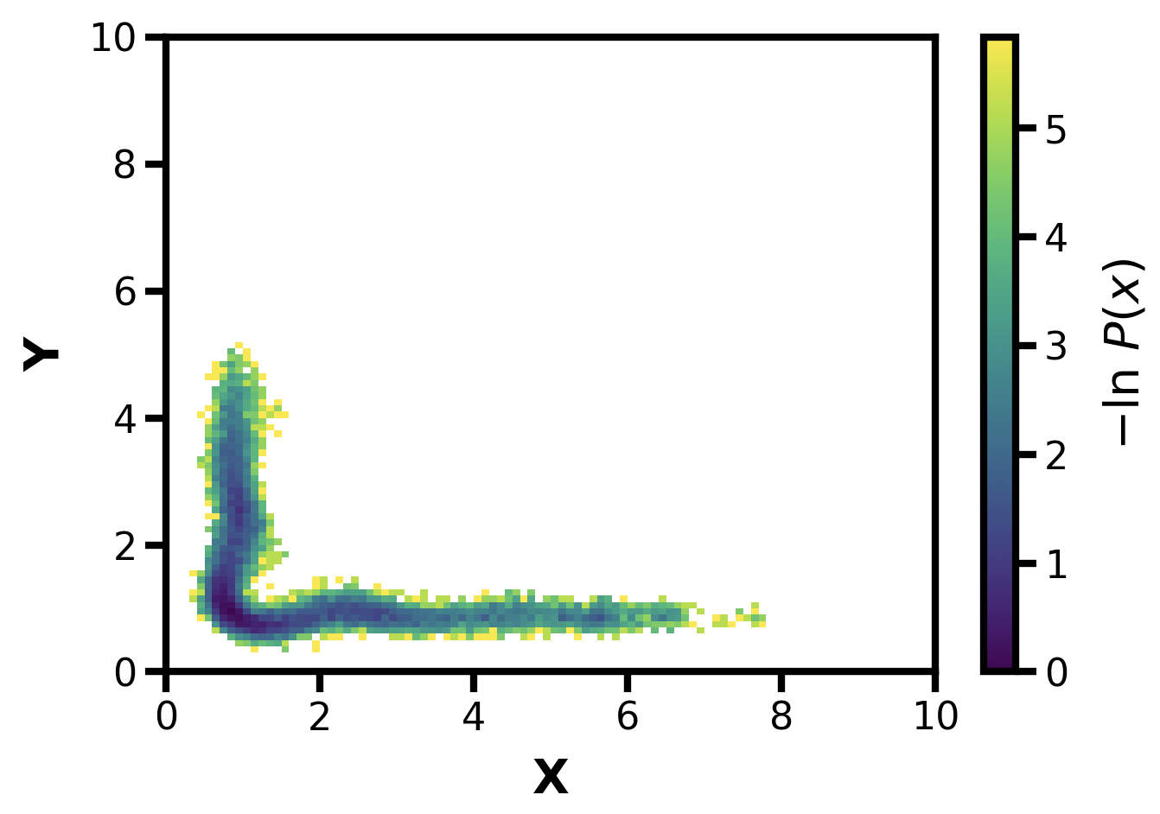
Let’s test by starting a sim at 2.4 2.4, on peak
Friction to 0.01 to make it easier
Wait, not I’m not sure, let’s go back to the 2D ODLD
I feel like I was actually sampling the abs of Z
1,1 with the lower friction
Okay, now what about at 1.9 1.9, on valley
Or it was these?

Slide 18
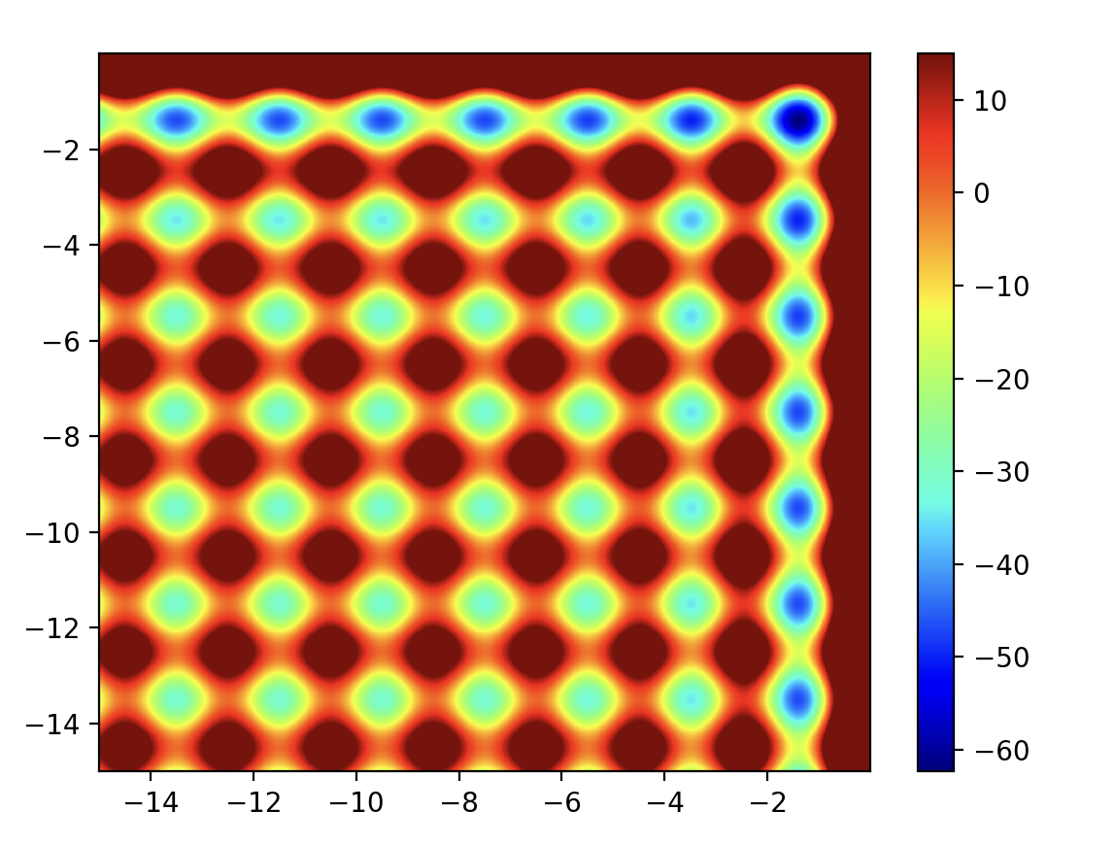

Slide 19
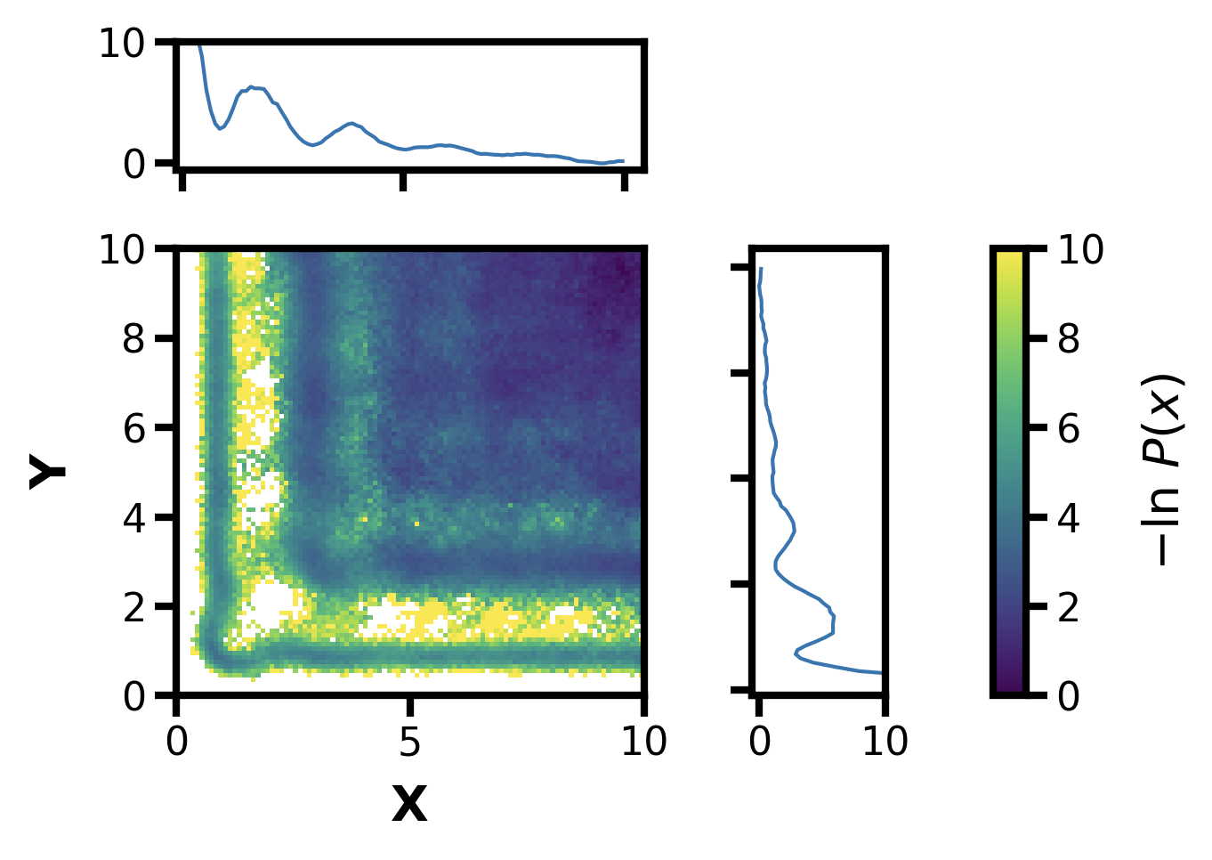
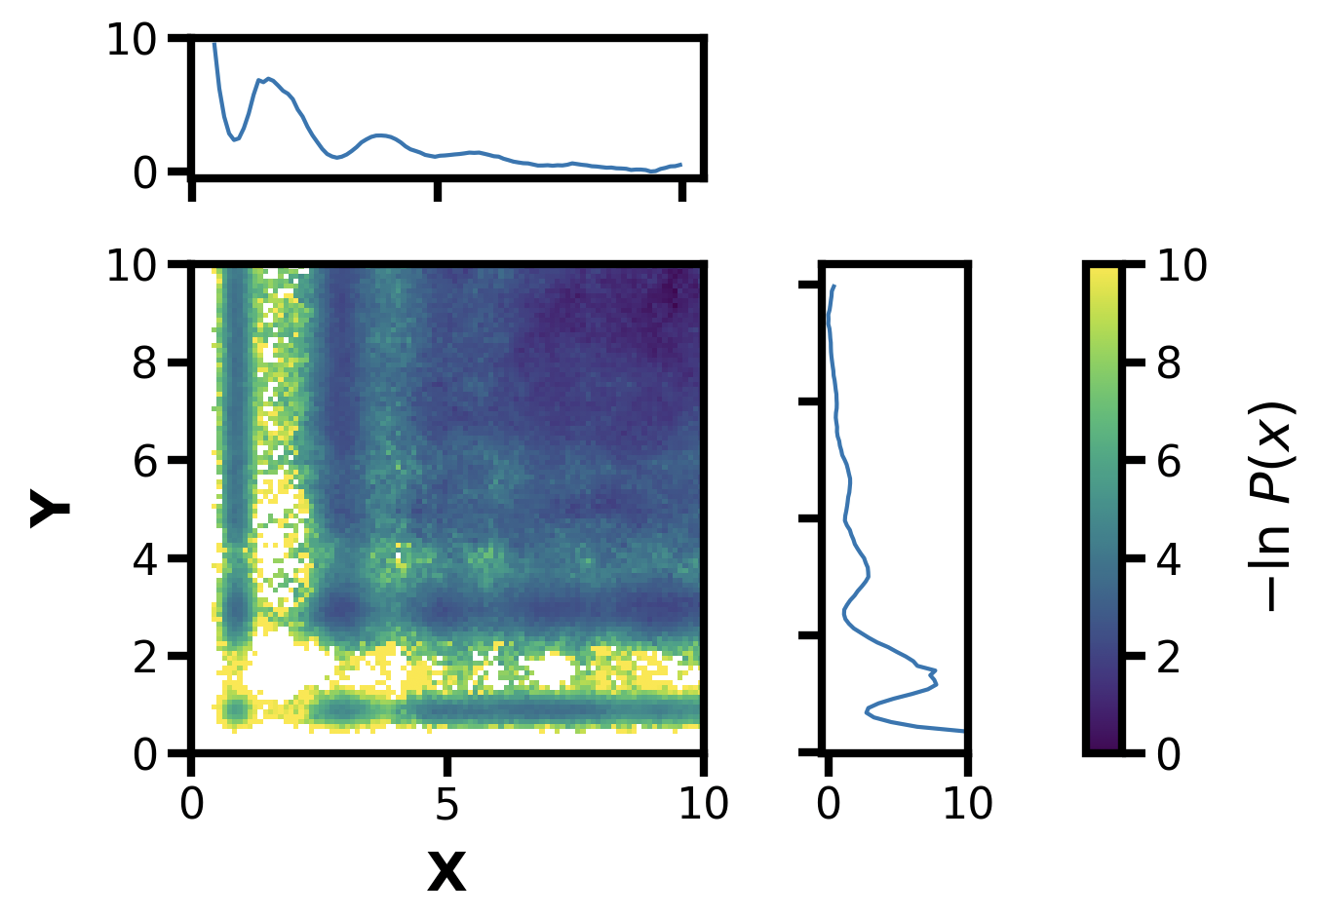
Note that both I changed the gradient to output negative V
With 64 regular bins and 500i, my 2D odld code
Using 0.01 (lower friction)
Same with ATB ODLD code

Slide 20
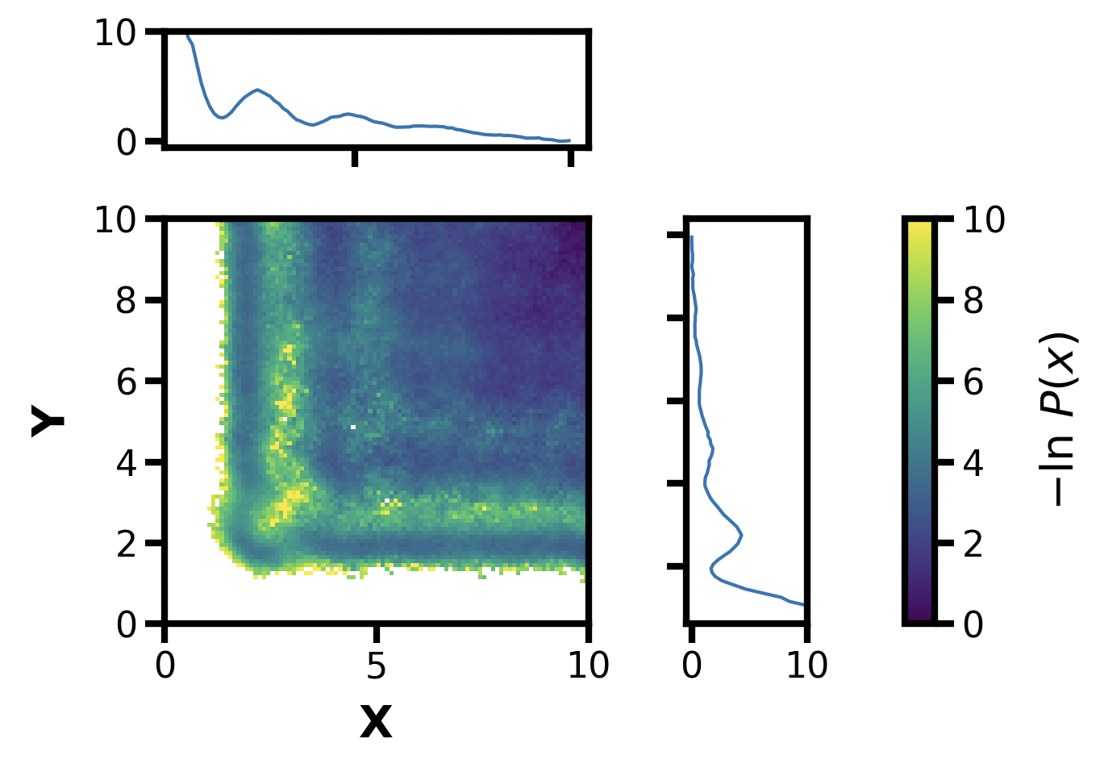
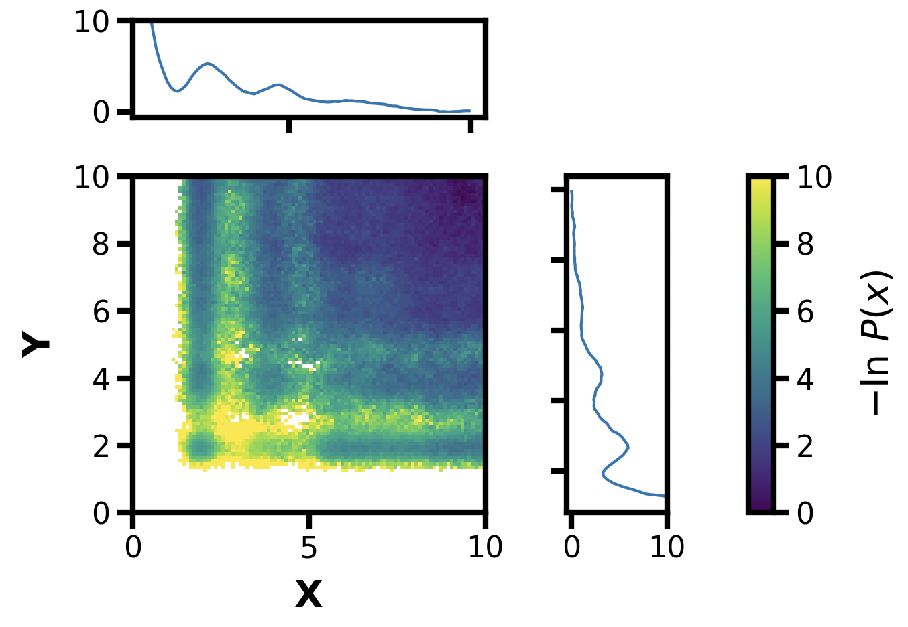
Same thing but with the positive potential, the standard one from before:
ATB

Slide 21
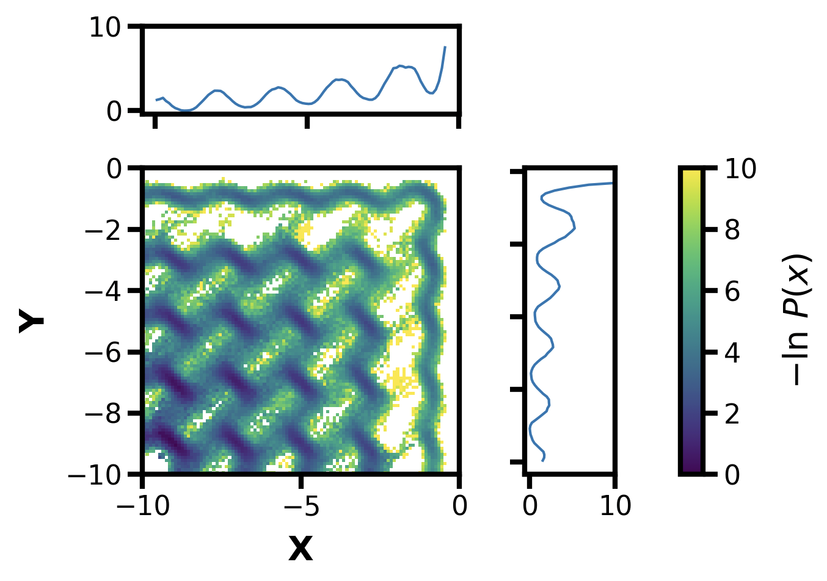
I’m curious what the egg carton looks like, so trying from -10 to 0 with corresponding reflections
81 standard linear bins from -10 to -2, 0 in 2D, at this point no need to also run ATB 2D odld to compare

Slide 22
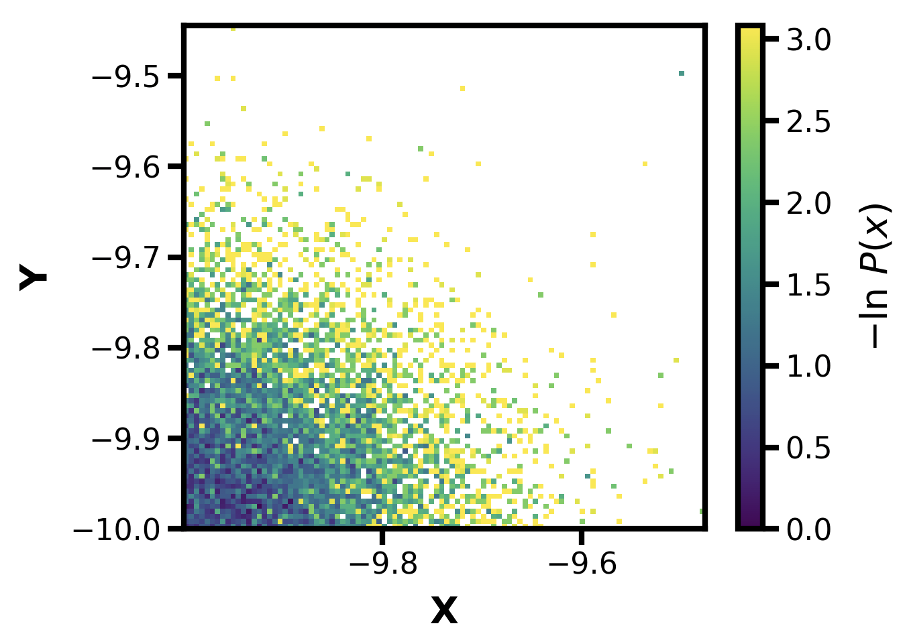
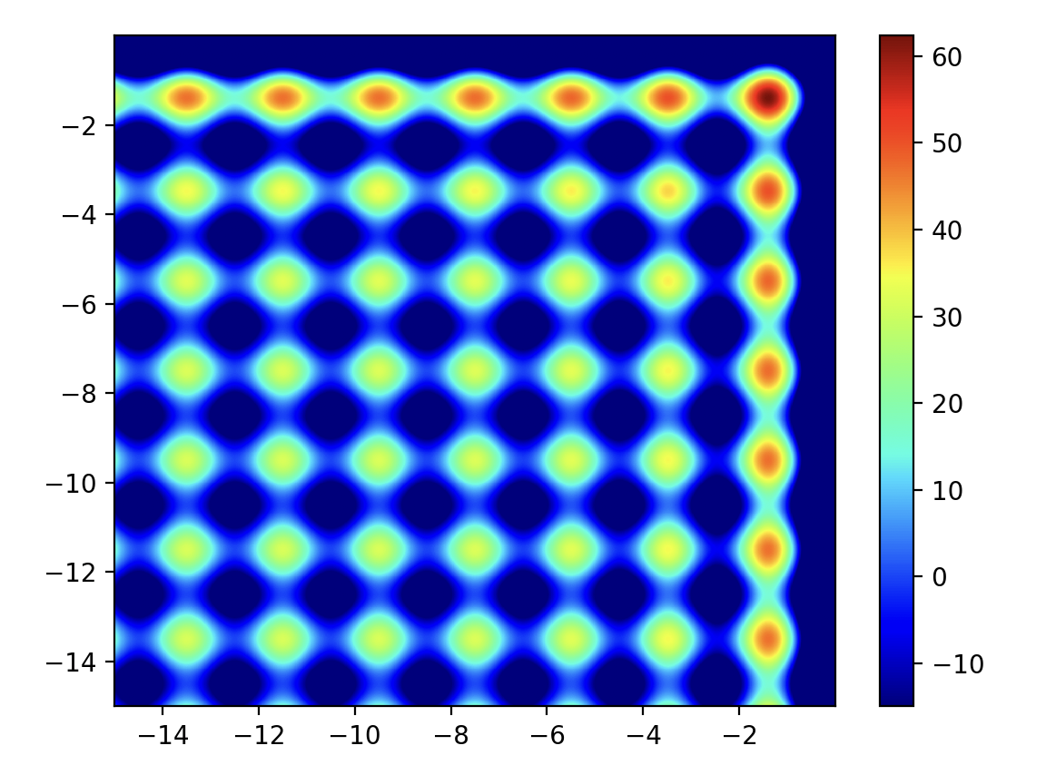
I’m curious what the egg carton looks like, so trying from -10 to 0 with corresponding reflections
81 standard linear bins from -10 to -2, 0 in 2D, at this point no need to also run ATB 2D odld to compare
What about the negative of this?
Couldn’t really explore it

Slide 23
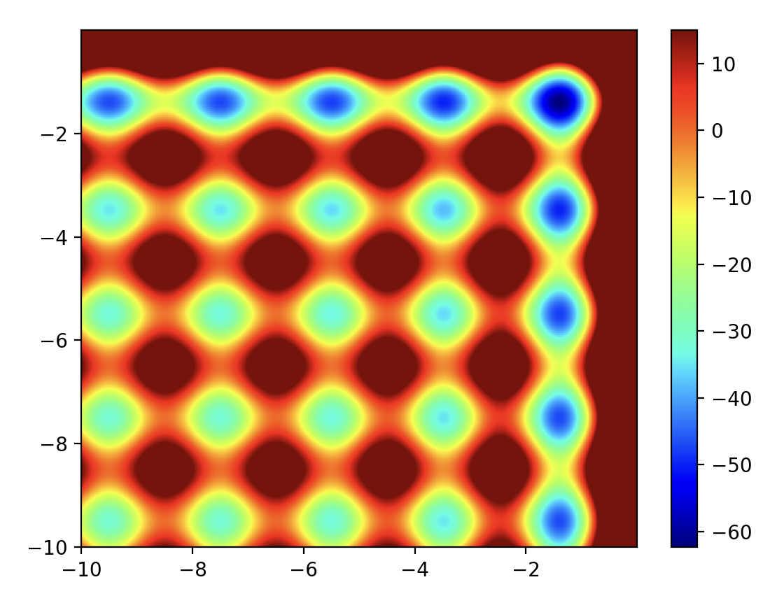
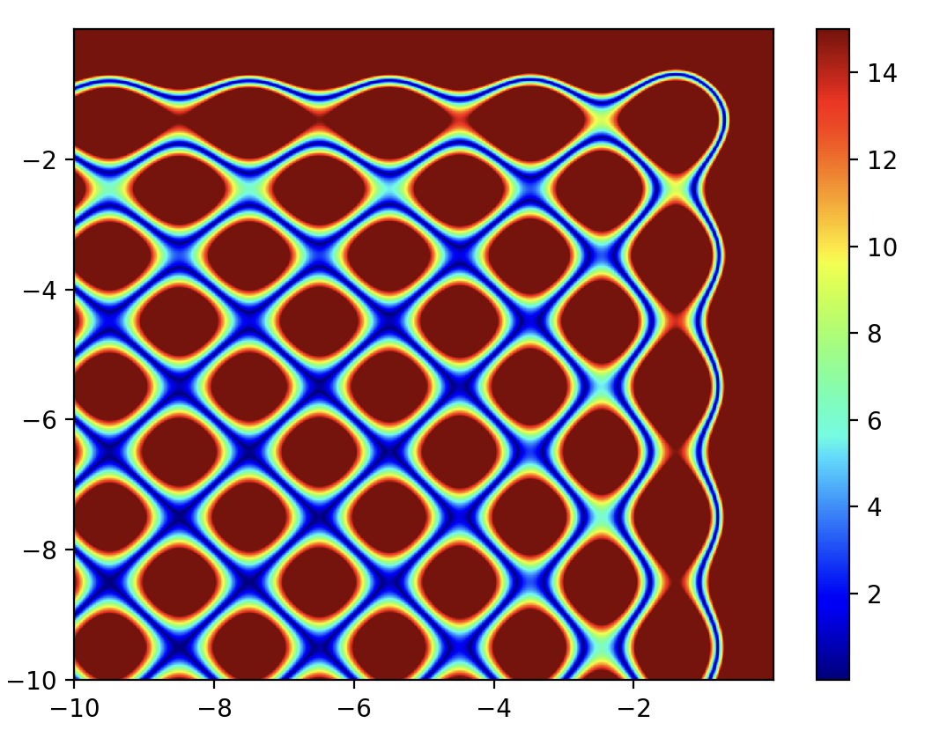
Overall, this could be a good 2D test system for REAP/WERL

Slide 24
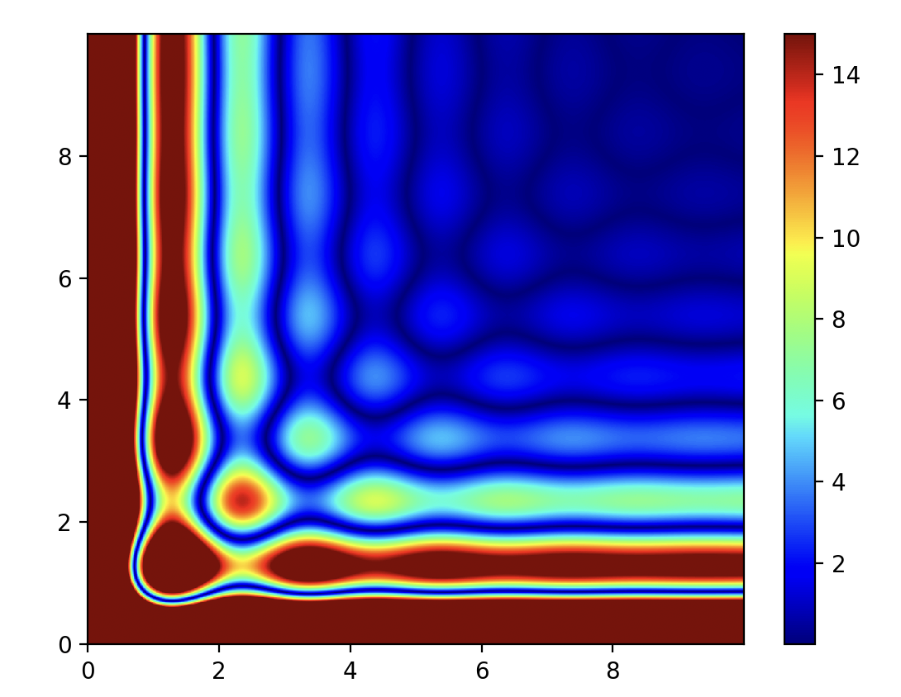
Or the other / standard side of the 2D odld

Slide 25
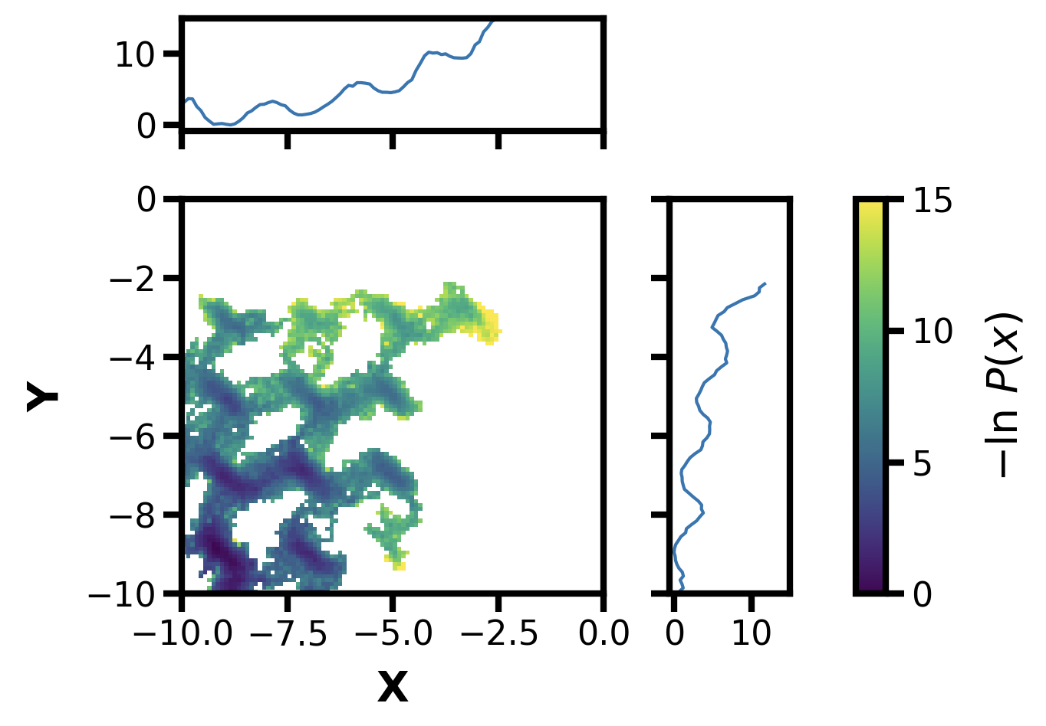
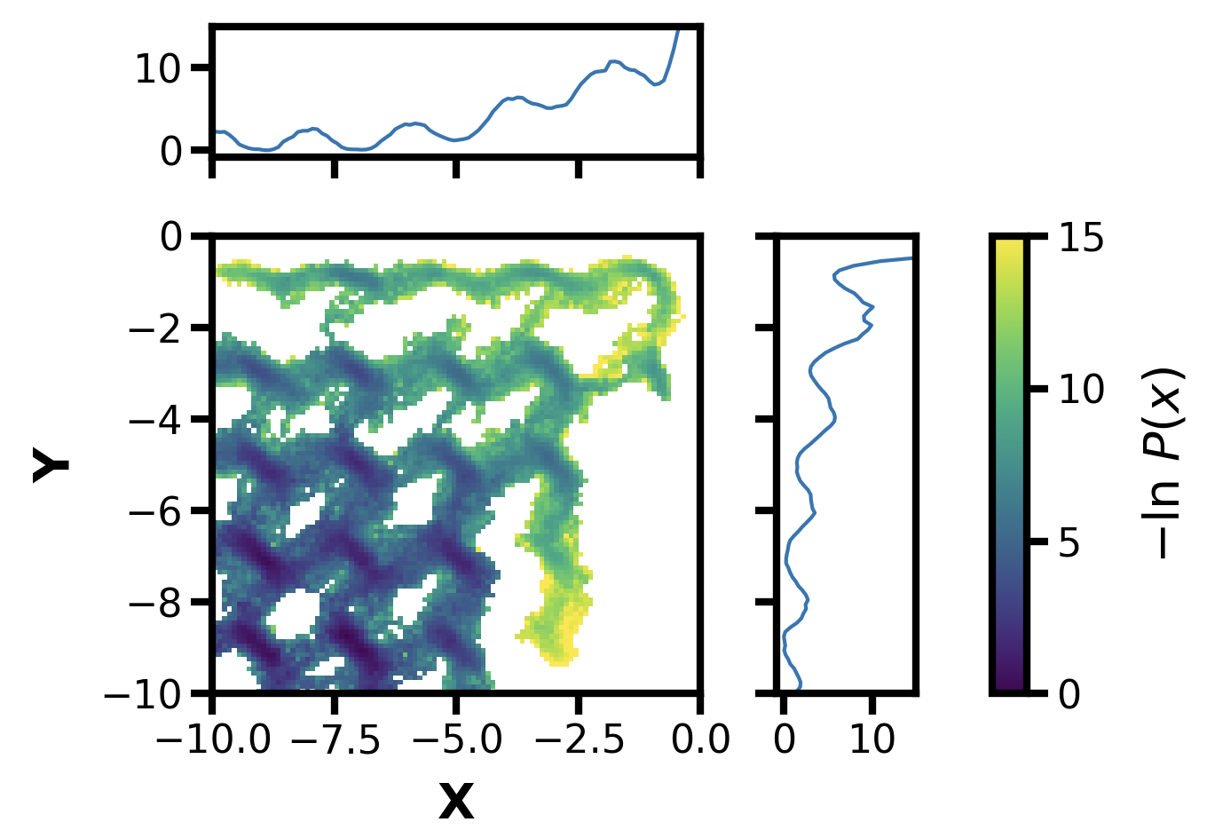
Same standard binning with normal friction (0.001)
1-500i
500-1000i

Slide 26




All: 500 iterations
Notes:
Did Tom Dixon use this potential?
Also Dan has a 1D and 2D potential that is similar

Slide 27

Now that I figured out the grad vs energy plotting, it all makes sense:
I was using this landscape
Hence this result

Slide 28




Let’s get a baseline for 2D ODLD now:
Raw potential (normed)
21 steps, using lower 0.01**0.5 sigma
Std H&K 10x10 binning, 1000i, last 50%

Slide 29
Decided to use just last frame of pcoord array

Slide 30








Std MD
LCAS
REAP
Std HK
w/thresholds

Slide 31




REAP
REAP
REAP: no thresholds, but
delta from 0.02 to 0.2
No thresholds
w/thresholds

Slide 32


Low friction, stdMD
Using return of (gradx, grady) instead of gradx + grady
This is still gradx+grady

Slide 33








100i stdMD
LCAS
REAP
stdHK
500i stdMD
LCAS
REAP
stdHK

Slide 34



REAP 100i
Same but w/thresholds
REAP 500i

Slide 35






Multi-agent LCAS: 80 walkers, 20 steps, 20 n_clusters/n_splits, thresh 0.1/1e-12
1 agent, 100i
2 agents, 100i
4 agents, 100i
1 agent, 500i
2 agents, 500i
4 agents, 500i

Slide 36



29Apr2024
Updated REAP to record weights, now using altered Z potential in OpenMM

Slide 37





StdMD
HK-2D
HK-1D
LCAS
WERL
Notes:
All using ~1000 segments

Slide 38





StdMD
HK-2D
HK-1D
LCAS
WERL
Notes:
All using ~2000 segments

Slide 39



WERL
25 Iters
WERL i0-7
WERL i7-14
WERL i14-21

Slide 40


WERL i0-7
WERL i7-14
WERL i14-21
WERL i21-28
WERL i28-35
WERL i35-42

Slide 41
Weighted Ensemble Reinforcement Learning (WERL)
RL and MD: Reward or goal oriented adaptive sampling
  Start multiple trajectories
  Choosing which to continue sampling based on reward function and/or least counts (LC)
  To get accurate physics*: MSM
RL + WE (WERL):
  Reward-based split/merge in binless framework
  No inherent need for MSM (normally due to sampling bias)
  We can keep track of trajectory weights instead
  Adaptively adjust pcoord dimensions
y
Potential Energy
x

Slide 42


Methodology
N trajectories per WE iteration → n clusters (C)
WE + least-counts adaptive sampling (LCAS) → splitting from least-count cluster, merging highest count
WE-REAP (WERL):
  Calculate “reward” (R) of set of least-count clusters (C → C_{p}) with c_{m} ∈ C_{p}
  Optimizing (“learning”) multiple pcoord (θ_{i}) weights (w_{i}) to max reward
  Splitting from highest reward (merging lowest reward or highest count):
Can we improve/automate parts of WE by integrating reinforcement learning-based adaptive sampling?

Slide 43
Fixed LC set aspect of REAP algo
Also including recycling now with vectorized functional bin mapper

Slide 44




Slide 45


Slide 46



