Slide 1

Additive Groves of Regression Trees
Daria Sorokina
Rich Caruana
Mirek Riedewald

Slide 2
Groves of Trees
New regression algorithm
  Ensemble of regression trees
Based on
  Bagging
  Additive models
  Combination of large trees and additive structure
Outperforms state-of the-art ensembles
  Bagged trees
  Stochastic gradient boosting
  Most improvement on complex non-linear data

Slide 3
Additive Models
Input X
Model 1
Model 2
Model 3
P₁
P₂
P₃
Prediction = P₁ + P₂ + P₃

Slide 4
Classical Training of Additive Models
Training Set: {(X,Y)}
Goal: M(X) = P₁ + P₂ + P₃ ≈ Y
{(X,Y)}
{(X,Y-P₁)}
{(X,Y-P₁-P₂)}
Model 1
Model 2
Model 3
{P₁}
{P₂}
{P₃}

Slide 5
Classical Training of Additive Models
Training Set: {(X,Y)}
Goal: M(X) = P₁ + P₂ + P₃ ≈ Y
{(X, Y-P₂-P₃)}
{(X,Y-P₁)}
{(X,Y-P₁-P₂)}
Model 1
Model 2
Model 3
{P₁’}
{P₂}
{P₃}

Slide 6
Classical Training of Additive Models
Training Set: {(X,Y)}
Goal: M(X) = P₁ + P₂ + P₃ ≈ Y
{(X, Y-P₂-P₃)}
{(X, Y-P₁’-P₃)}
{(X,Y-P₁-P₂)}
Model 1
Model 2
Model 3
{P₁’}
{P₂’}
{P₃}

Slide 7
Classical Training of Additive Models
Training Set: {(X,Y)}
Goal: M(X) = P₁ + P₂ + P₃ ≈ Y
{(X, Y-P₂-P₃)}
{(X, Y-P₁’-P₃)}
Model 1
Model 2
…
(Until convergence)
{P₁’}
{P₂’}

Slide 8
Bagged Groves of Trees
Grove is an additive model where every single model is a tree
Just as single trees, Groves tend to overfit
Solution – apply bagging on top of grove models
  Draw bootstrap samples (subsamples with replacement) from the train set, train different models on them, average results of those models
  We use N=100 bags in most of our experiments
(1/N)·
+…+
+ (1/N)·
+…+
+…+ (1/N)·
+…+

Slide 9
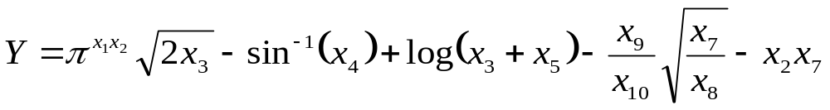
A Running Example:
Synthetic Data Set
  (Hooker, 2004)
  1000 points in the train set
  1000 points in the test set
  No noise

Slide 10
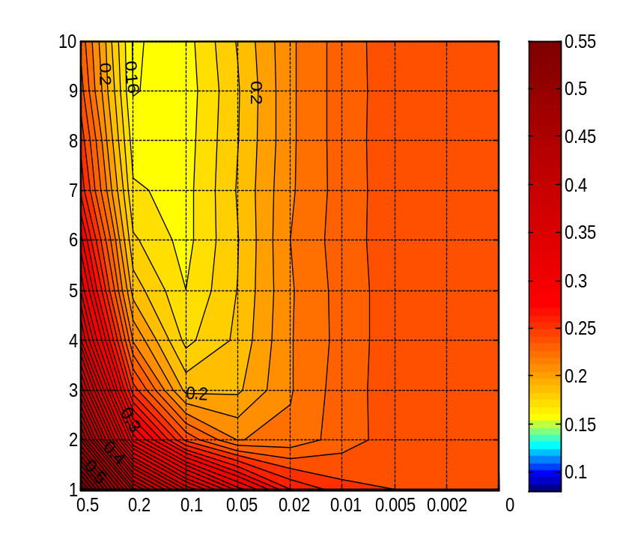
Experiments: Synthetic Data Set
100 bagged Groves of trees trained as classical additive models
Number of trees in a Grove
Note that large trees perform worse
Bagged additive models still overfit!
Note that large trees perform worse
Bagged additive models still overfit!
Large ← Size of Leaves → Small
Small ← Size of Trees → Large

Slide 11
Training Grove of Trees
Big trees can use the whole train set before we are able to build all trees in a grove
{(X,Y)}
{(X,Y-P₁=0)}
Oops! We wanted several trees in our grove!
Empty
Tree
{P₁=Y}
{P₂=0}

Slide 12
Grove of Trees: Layered Training
Big trees can use the whole train set before we are able to build all trees in a grove
Solution: build grove of small trees and gradually increase their size
+
+ … +
Not only large trees perform as well as small ones now, the maximum performance is significantly better!

Slide 13
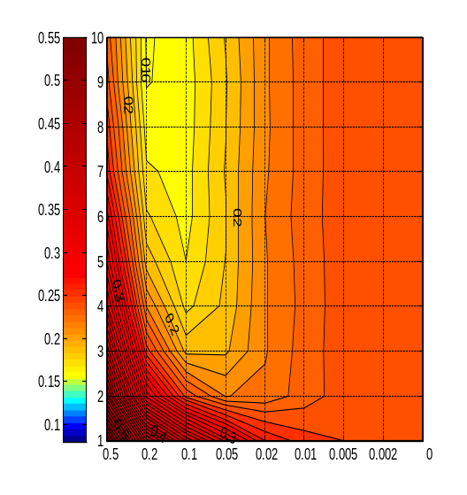
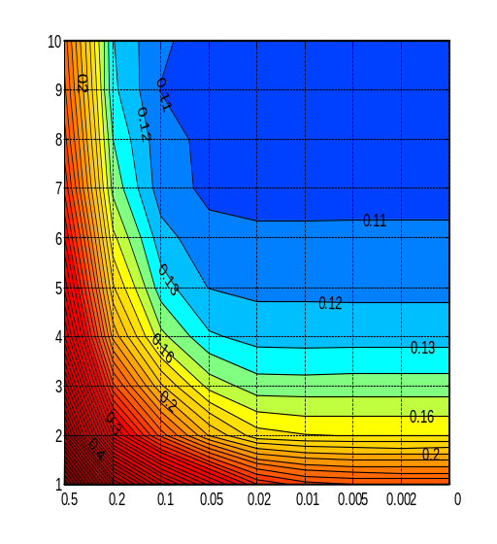
Experiments: Synthetic Data Set
X axis – size of leaves (~inverse of size of trees)
Y axis – number of trees in a grove
Bagged Groves trained as classical additive models
Layered training

Slide 14
Problems with Layered Training
Now we can overfit by introducing too many additive components in the model
+
+
+
+
+ … +
is not always better than
+

Slide 15
“Dynamic Programming” Training
Consider two ways to create a larger grove from a smaller one
  “Horizontal”
  “Vertical”
Test on validation set which one is better
  We use out-of-bag data as validation set
+
+
+
+

Slide 16
“Dynamic Programming” Training
+
+
+
+
+
+
+
+
+

Slide 17
“Dynamic Programming” Training
+
+
+

Slide 18
“Dynamic Programming” Training
+
+
+
+

Slide 19
“Dynamic Programming” Training
+
+
+
+
+
+
+
+
+

Slide 20
Experiments: Synthetic Data Set
X axis – size of leaves (~inverse of size of trees)
Y axis – number of trees in a grove
10
9
0.12
0.13
8
0.16
0.1
0.1
7
0.11
6
0.2
0.11
5
0.3
0.12
0.12
4
0.16
0.13
0.13
3
0.4
2
0.2
0.16
0.5
0.3
0.2
1
0.5
0.2
0.1
0.05
0.02
0.01
0.005
0.002
0
Bagged Groves trained as classical additive models
Dynamic programming
Layered training

Slide 21
Randomized “Dynamic Programming”
What if we fit train set perfectly before we finish?
Take a new train set - we are doing bagging anyway!
- new bag of data
+
+
+
+
+
+
+
+
+

Slide 22
Experiments: Synthetic Data Set
X axis – size of leaves (~inverse of size of trees)
Y axis – number of trees in a grove
10
9
0.12
0.13
8
0.16
0.1
0.1
7
0.11
6
0.2
0.11
5
0.12
0.12
10
0.11
0.3
9
0.12
0.13
0.13
0.09
4
0.16
0.13
8
0.1
0.09
0.2
7
0.16
3
0.4
6
0.1
5
0.11
2
0.2
0.16
0.3
0.12
0.11
4
0.13
0.12
0.5
0.2
3
0.2
0.13
1
0.3
2
0.16
0.16
0.5
0.2
0.1
0.05
0.02
0.01
0.005
0.002
0
0.4
0.2
0.5
0.3
1
0.5
0.2
0.1
0.05
0.02
0.01
0.005
0.002
0
Bagged Groves trained as classical additive models
Dynamic programming
Randomized dynamic programming
Layered training

Slide 23
Main competitor –
Stochastic Gradient Boosting
Introduced by Jerome Friedman in 2001 & 2002
Is a state-of-the-art technique: winner and runner-up on several PAKDD and KDD Cup competitions
Also known as MART, TreeNet, gbm
Is an ensemble of additive trees
Differs from bagged Groves:
  Never discards trees
  Builds trees of the same size
  Prefers smaller trees
  Can overfit
Parameters to tune:
  Number of trees in the ensemble
  Size of trees
  Subsampling parameter
  Regularization coefficient

Slide 24
Experiments
2 synthetic and 5 real data sets
10-fold cross validation: 8 folds train set, 1 fold validation set, 1 fold test set
Best values of parameters both for Groves and for Gradient boosting are defined on the validation set
Max size of the ensemble - 1500 trees (15 additive models X 100 bags for Groves)
We also did experiments for 1500 bagged trees for comparison

Slide 25
Synthetic Data Sets
 | Pure | With noise
Groves | 0.087 ±0.007 | 0.483 ±0.012
Gradient boosting | 0.148 ±0.007 | 0.495 ±0.010
Bagged trees | 0.276 ±0.006 | 0.514 ±0.011
Improvement | 40% | 2%
The data set contains non-linear elements
Without noise the improvement is much better

Slide 26
Real Data Sets
 | California Housing | Elevators | Kinematics | Computer Activity | Stock
Groves | 0.380 ±0.015 | 0.309 ±0.028 | 0.364 ±0.013 | 0.117 ±0.009 | 0.097 ±0.029
Gradient boosting | 0.403 ±0.014 | 0.327 ±0.035 | 0.457 ±0.012 | 0.121 ±0.01 | 0.118 ±0.05
Bagged trees | 0.422 ±0.013 | 0.440 ±0.066 | 0.533 ±0.016 | 0.136 ±0.012 | 0.123 ±0.064
Improvement | 6% | 6% | 20% | 3% | 18%
California Housing – probably noisy
Elevators – noisy (high variance of performance)
Kinematics – low noise, non-linear
Computer Activity – almost linear
Stock – almost no noise (high quality of predictions)

Slide 27
Groves work much better when:
Data set is highly non-linear
  Because Groves can use large trees (unlike boosting)
  But Groves still can model additivity (unlike bagging)
…and not too noisy
  Because noisy data looks almost linear

Slide 28
Summary
We presented Bagged Groves - a new ensemble of additive regression trees
It shows stable improvements over other ensembles of regression trees
It performs best on non-linear data with low level of noise

Slide 29
Future Work
Publicly available implementation
  by the end of the year
Groves of decision trees
  apply similar ideas to classification
Detection of statistical interactions
  additive structure and non-linear components of the response function

Slide 30
Acknowledgements
Our collaborators in Computer Science department and Cornell Lab of Ornithology:
  Daniel Fink
  Wes Hochachka
  Steve Kelling
  Art Munson
This work was supported by NSF grants 0427914 and 0612031

