Slide 1


Modeling Additive Structure and Detecting Interactions with Additive Groves of Regression Trees
Daria Sorokina
Joint work with:
Rich Caruana, Mirek Riedewald
Artur Dubrawski, Jeff Schneider

Slide 2

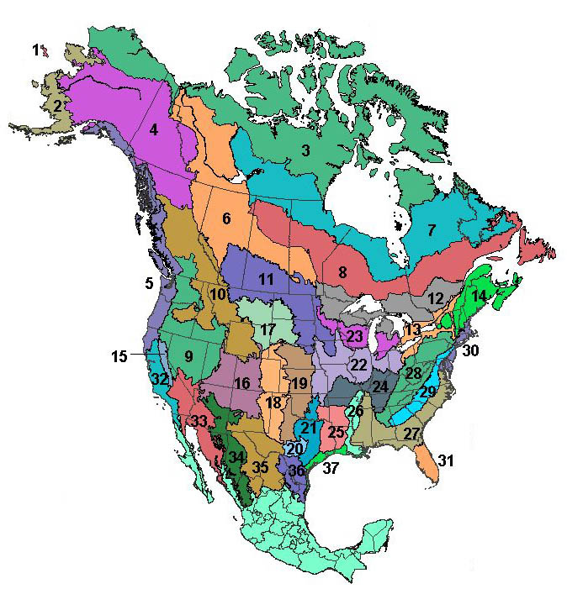

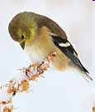

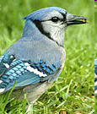

Motivation: Cornell Lab of O
Domain scientists want:
Good models
Domain knowledge
Can they get both?
Daria Sorokina
Additive Groves: Modeling Additive Structure and Detecting Statistical Interactions

Slide 3
Which models are the best?
Recent major comparison of classification algorithms
  (Caruana & Niculescu-Mizil, ICML’06)
Boosted Trees | 0.899
Random Forest | 0.896
Bagged Trees | 0.885
SVMs | 0.869
Neural Networks | 0.844
K-Nearest Neighbors | 0.811
Boosted Stumps | 0.792
Decision Trees | 0.698
Logistic Regression | 0.697
Naïve Bayes | 0.664
Trees!
Daria Sorokina
Additive Groves: Modeling Additive Structure and Detecting Statistical Interactions

Slide 4
Which models are the best?
Recent major comparison of classification algorithms
  (Caruana & Niculescu-Mizil, ICML’06)
Boosted Trees | 0.899
Random Forest | 0.896
Bagged Trees | 0.885
SVMs | 0.869
Neural Networks | 0.844
K-Nearest Neighbors | 0.811
Boosted Stumps | 0.792
Decision Trees | 0.698
Logistic Regression | 0.697
Naïve Bayes | 0.664
Random Forest
Average many large independent trees
Daria Sorokina
Additive Groves: Modeling Additive Structure and Detecting Statistical Interactions

Slide 5
Which models are the best?
Recent major comparison of classification algorithms
  (Caruana & Niculescu-Mizil, ICML’06)
Boosted Trees | 0.899
Random Forest | 0.896
Bagged Trees | 0.885
SVMs | 0.869
Neural Networks | 0.844
K-Nearest Neighbors | 0.811
Boosted Stumps | 0.792
Decision Trees | 0.698
Logistic Regression | 0.697
Naïve Bayes | 0.664
Boosting
+
+
…
Small trees, based on additive models
Daria Sorokina
Additive Groves: Modeling Additive Structure and Detecting Statistical Interactions

Slide 6
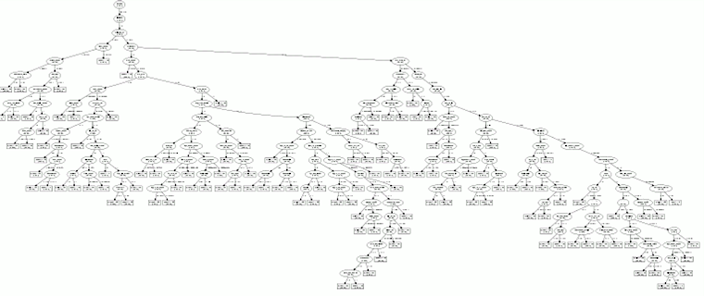
Trees in real-world models
Tree ensembles are hard to interpret
  This is a 1/100 of a real decision tree
  There can be ~500 trees in the ensemble
Separate techniques are needed to infer domain knowledge
Daria Sorokina
Additive Groves: Modeling Additive Structure and Detecting Statistical Interactions

Slide 7
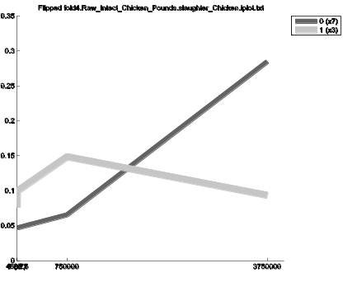
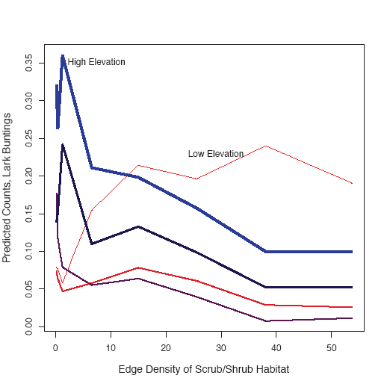
Additive Groves
High predictive performance
Domain knowledge extraction tools
Additive Groves
Boosted Trees
Random Forest
Bagged Trees
Daria Sorokina
Additive Groves: Modeling Additive Structure and Detecting Statistical Interactions

Slide 8
Introduction: Domain Knowledge
Which features are important?
  Feature selection techniques
What effects do they have on the response variable?
  Effect visualization techniques
  Is it always possible to visualize an effect of a single variable?
Toy example: seasonal effect on bird abundance
# Birds
Season
Daria Sorokina
Additive Groves: Modeling Additive Structure and Detecting Statistical Interactions

Slide 9
Visualizing effects of features
Toy example 1: # Birds = F(season, #trees)
Many trees
Few trees
Averaged seasonal effect
# Birds
# Birds
Season
Season
Season
Toy example 2: # Birds = F(season, latitude)
South
North
Averaged seasonal effect ?
Interaction
# Birds
# Birds
Season
Season
Season
Daria Sorokina
Additive Groves: Modeling Additive Structure and Detecting Statistical Interactions

Slide 10
!
Statistical interactions are NOT correlations
!
Daria Sorokina
Additive Groves: Modeling Additive Structure and Detecting Statistical Interactions

Slide 11
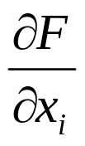
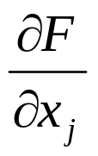
Statistical Interaction
F (x₁,…,x_{n}) has an interaction between x_{i} and x_{j} when
or — for nominal and ordinal attributes —
…when difference in the value of F(x₁,…,x_{n}) for different values of x_{i} depends on the value of x_{j}
( ≡
)
depends on x_{j}
depends on x_{i}
Daria Sorokina
Additive Groves: Modeling Additive Structure and Detecting Statistical Interactions

Slide 12
Statistical Interactions
Statistical interactions ≡ non-additive effects among
two or more variables in a function
F (x₁,…,x_{n}) shows no interaction between x_{i} and x_{j} when
F (x₁,x₂,…x_{n}) =
G (x₁,…,x_{i-1},x_{i+1},…,x_{n}) + H (x₁ ,…,x_{j-1},x_{j+1},…, x_{n}),
i.e., G does not depend on x_{i}, H does not depend on x_{j}
Example:
F(x₁,x₂,x₃) = sin(x₁+x₂) + x₂·x₃
  x₁, x₂ interact
  x₂, x₃ interact
  x₁, x₃ do not interact
Daria Sorokina
Additive Groves: Modeling Additive Structure and Detecting Statistical Interactions

Slide 13
How to test for an interaction:
(Sorokina, Caruana, Riedewald, Fink; ICML’08)
Build a model from the data.
Build a restricted model – do not allow interaction of interest.
Compare their predictive performance.
  If the restricted model is as good as the unrestricted – there is no interaction.
  If it fails to represent the data with the same quality – there is interaction.
Daria Sorokina
Additive Groves: Modeling Additive Structure and Detecting Statistical Interactions

Slide 14
Learning Method Requirements
Non-linearity
  If unrestricted model does not capture interactions, there is no chance to detect them
Restriction capability (additive structure)
  The performance should not decrease after restriction when there are no interactions
Most existing prediction models do not fit both requirements at the same time
  We had to invent our own algorithm that does
Daria Sorokina
Additive Groves: Modeling Additive Structure and Detecting Statistical Interactions

Slide 15
Additive Groves
Daria Sorokina
Additive Groves: Modeling Additive Structure and Detecting Statistical Interactions

Slide 16
Additive Groves of Regression Trees
(Sorokina, Caruana, Riedewald;
Best Student Paper ECML’07)
New regression algorithm
  Ensemble of regression trees
Based on
  Bagging
  Additive models
  Combination of large trees and additive structure
Useful properties
  High predictive performance
  Captures interactions
  Easy to restrict specific interactions
Daria Sorokina
Additive Groves: Modeling Additive Structure and Detecting Statistical Interactions

Slide 17
Additive Models
Input X
Model 1
Model 2
Model 3
P₁
P₂
P₃
Prediction = P₁ + P₂ + P₃
Daria Sorokina
Additive Groves: Modeling Additive Structure and Detecting Statistical Interactions

Slide 18
Classical Training of Additive Models
Training Set: {(X,Y)}
Goal: M(X) = P₁ + P₂ + P₃ ≈ Y
{(X,Y)}
{(X,Y-P₁)}
{(X,Y-P₁-P₂)}
Model 1
Model 2
Model 3
{P₁}
{P₂}
{P₃}
Daria Sorokina
Additive Groves: Modeling Additive Structure and Detecting Statistical Interactions

Slide 19
Classical Training of Additive Models
Training Set: {(X,Y)}
Goal: M(X) = P₁ + P₂ + P₃ ≈ Y
{(X, Y-P₂-P₃)}
{(X,Y-P₁)}
{(X,Y-P₁-P₂)}
Model 1
Model 2
Model 3
{P₁’}
{P₂}
{P₃}
Daria Sorokina
Additive Groves: Modeling Additive Structure and Detecting Statistical Interactions

Slide 20
Classical Training of Additive Models
Training Set: {(X,Y)}
Goal: M(X) = P₁ + P₂ + P₃ ≈ Y
{(X, Y-P₂-P₃)}
{(X, Y-P₁’-P₃)}
{(X,Y-P₁-P₂)}
Model 1
Model 2
Model 3
{P₁’}
{P₂’}
{P₃}
Daria Sorokina
Additive Groves: Modeling Additive Structure and Detecting Statistical Interactions

Slide 21
Classical Training of Additive Models
Training Set: {(X,Y)}
Goal: M(X) = P₁ + P₂ + P₃ ≈ Y
{(X, Y-P₂-P₃)}
{(X, Y-P₁’-P₃)}
Model 1
Model 2
…
{P₁’}
{P₂’}
Daria Sorokina
Additive Groves: Modeling Additive Structure and Detecting Statistical Interactions

Slide 22
Additive Groves
Additive models fit additive components of the response function
A Grove is an additive model where every single model is a tree
Additive Groves applies bagging on top of single Groves
(1/N)·
+…+
+ (1/N)·
+…+
+…+ (1/N)·
+…+
Daria Sorokina
Additive Groves: Modeling Additive Structure and Detecting Statistical Interactions

Slide 23
Training Grove of Trees
Big trees can use the whole train set before we are able to build all trees in a grove
{(X,Y)}
{(X,Y-P₁=0)}
Oops! We wanted several trees in our grove!
Empty
Tree
{P₁=Y}
{P₂=0}
Daria Sorokina
Additive Groves: Modeling Additive Structure and Detecting Statistical Interactions

Slide 24
Additve Groves: Layered Training
Solution: build Grove of small trees and gradually increase their size
+
+ … +
Daria Sorokina
Additive Groves: Modeling Additive Structure and Detecting Statistical Interactions

Slide 25
Training an Additive Grove
Consider two ways to create a larger grove from a smaller one
  “Vertical”
  “Horizontal”
Test on validation set which one is better
  We use out-of-bag data as validation set
+
+
+
+
Daria Sorokina
Additive Groves: Modeling Additive Structure and Detecting Statistical Interactions

Slide 26
Training an Additive Grove
+
+
+
+
+
+
+
+
+
Daria Sorokina
Additive Groves: Modeling Additive Structure and Detecting Statistical Interactions

Slide 27
Training an Additive Grove
+
+
+
Daria Sorokina
Additive Groves: Modeling Additive Structure and Detecting Statistical Interactions

Slide 28
Training an Additive Grove
+
+
+
+
Daria Sorokina
Additive Groves: Modeling Additive Structure and Detecting Statistical Interactions

Slide 29
Training an Additive Grove
+
+
+
+
+
+
+
+
+
Daria Sorokina
Additive Groves: Modeling Additive Structure and Detecting Statistical Interactions

Slide 30
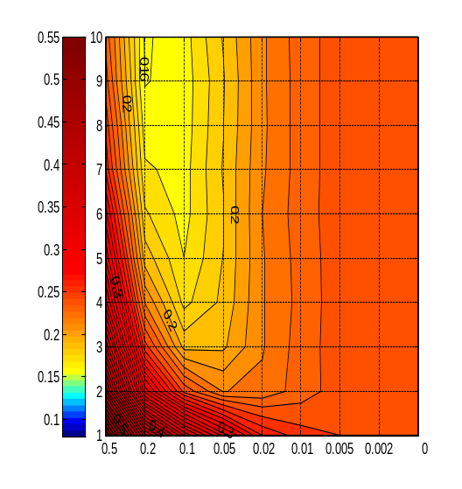
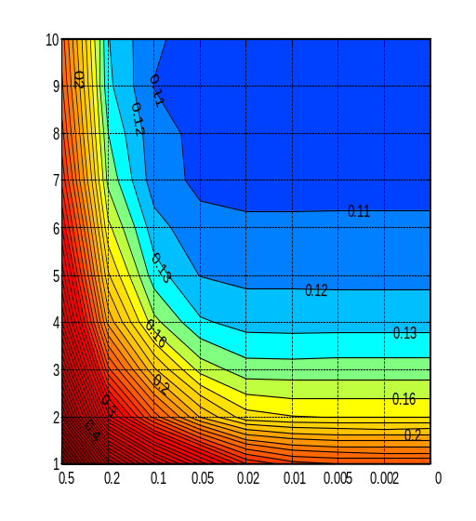
Experiments: Synthetic Data Set
X axis – size of leaves (~inverse of size of trees)
Y axis – number of trees in a grove
10
9
0.12
0.13
8
0.16
0.1
0.1
7
0.11
6
0.2
0.11
5
0.12
0.12
10
0.11
0.3
9
0.12
0.13
0.13
0.09
4
0.16
0.13
8
0.1
0.09
0.2
7
0.16
3
0.4
6
0.1
5
0.11
2
0.2
0.16
0.3
0.12
0.11
4
0.13
0.12
0.5
0.2
3
0.2
0.13
1
0.3
2
0.16
0.16
0.5
0.2
0.1
0.05
0.02
0.01
0.005
0.002
0
0.4
0.2
0.5
0.3
1
0.5
0.2
0.1
0.05
0.02
0.01
0.005
0.002
0
Bagged Groves trained as classical additive models
Dynamic programming
Randomized dynamic programming
Layered training
Daria Sorokina
Additive Groves: Modeling Additive Structure and Detecting Statistical Interactions

Slide 31
Comparison on Regression Data Sets
10-Fold Cross Validation, RMSE
 | California Housing | Elevators | Kinematics | Computer Activity | Stock
Additive Groves | 0.380 ±0.015 | 0.309 ±0.028 | 0.364 ±0.013 | 0.117 ±0.009 | 0.097 ±0.029
Gradient boosting | 0.403 ±0.014 | 0.327 ±0.035 | 0.457 ±0.012 | 0.121 ±0.01 | 0.118 ±0.05
Random Forests | 0.420 ±0.013 | 0.427 ±0.058 | 0.532 ±0.013 | 0.131 ±0.012 | 0.098 ±0.026
Improvement v.r. GB | 6% | 6% | 20% | 3% | 18%
Improvement v.r. RF | 10% | 28% | 32% | 11% | 1%
Daria Sorokina
Additive Groves: Modeling Additive Structure and Detecting Statistical Interactions

Slide 32
Additive Groves outperform…
…Gradient Boosting
  because of large trees – up to thousands of nodes (complex non-linear structure)
… Random Forests
  because of modeling additive structure
Most existing algorithms do not combine these two properties
Daria Sorokina
Additive Groves: Modeling Additive Structure and Detecting Statistical Interactions

Slide 33
…and now back to interaction detection
Daria Sorokina
Additive Groves: Modeling Additive Structure and Detecting Statistical Interactions

Slide 34
Interaction detection:
Learning Method Requirements
Non-linearity
Restriction capability (additive structure)
Daria Sorokina
Additive Groves: Modeling Additive Structure and Detecting Statistical Interactions

Slide 35
How to test for an interaction:
Build a model from the data (no restrictions).
Build a restricted model – do not allow the interaction of interest.
Compare their predictive performance.
  If the restricted model is as good as the unrestricted – there is no interaction.
  If it fails to represent the data with the same quality – there is interaction.
Daria Sorokina
Additive Groves: Modeling Additive Structure and Detecting Statistical Interactions

Slide 36
Training Restricted Grove of Trees
The model is not allowed to have interactions between features A and B
Every single tree in the model should either not use A or not use B
+ +
Daria Sorokina
Additive Groves: Modeling Additive Structure and Detecting Statistical Interactions

Slide 37
Training Restricted Grove of Trees
The model is not allowed to have interactions between features A and B
Every single tree in the model should either not use A or not use B
Evaluation on the separate validation set
no A
no B
vs.
?
+ +
Daria Sorokina
Additive Groves: Modeling Additive Structure and Detecting Statistical Interactions

Slide 38
Training Restricted Grove of Trees
The model is not allowed to have interactions between features A and B
Every single tree in the model should either not use A or not use B
Evaluation on the separate validation set
no A
no B
vs.
?
+ +
Daria Sorokina
Additive Groves: Modeling Additive Structure and Detecting Statistical Interactions

Slide 39
Training Restricted Grove of Trees
The model is not allowed to have interactions between features A and B
Every single tree in the model should either not use A or not use B
no A
no B
vs.
…
+ +
Daria Sorokina
Additive Groves: Modeling Additive Structure and Detecting Statistical Interactions

Slide 40
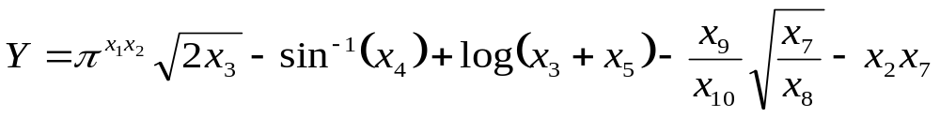
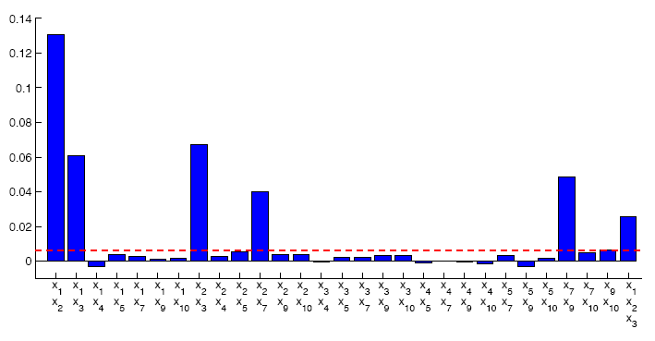
Experiments: Synthetic Data
1,2
1,2,3
2,3
1,3
2,7
7,9
Daria Sorokina
Additive Groves: Modeling Additive Structure and Detecting Statistical Interactions

Slide 41
Experiments: Synthetic Data
X₄ is not involved in any interactions
Daria Sorokina
Additive Groves: Modeling Additive Structure and Detecting Statistical Interactions

Slide 42


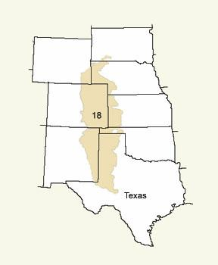
Birds Ecology Application
Data: Rocky Mountains Bird Observatory Data Set
  30 species of birds inhabiting shortgrass prairies
  700 features describing the habitat
Goal: describe how environment influences bird abundance
Problems: really noisy real-world data
Daria Sorokina
Additive Groves: Modeling Additive Structure and Detecting Statistical Interactions

Slide 43
Problems of Analyzing Real-World Data
Too many features
  Most of them useless
  Wrapper feature selection methods are too slow
  Solution: fast feature ranking method
Daria Sorokina
Additive Groves: Modeling Additive Structure and Detecting Statistical Interactions

Slide 44
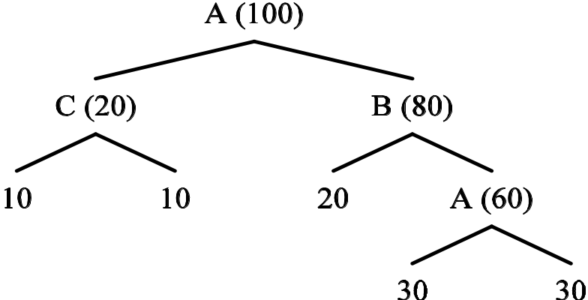
“Multiple Counting” – feature importance ranking for ensembles of bagged trees
(Caruana et al; KDD’06)
How many times per data point per tree each feature is used?
Imp(A) = 1.6, Imp(B) = 0.8, Imp(C) = 0.2
500 times faster than sensitivity analysis!
Daria Sorokina
Additive Groves: Modeling Additive Structure and Detecting Statistical Interactions

Slide 45
Problems of Analyzing Real-World Data
Correlations between the variables hurt interaction detection quality
  Need a small set of truly important features
    Performance drops significantly if you remove any one of them
  Solution: 2nd round of feature selection by backward elimination
    Eliminate least useful features one-by-one
    Correlations will be removed
Daria Sorokina
Additive Groves: Modeling Additive Structure and Detecting Statistical Interactions

Slide 46
Problems of Analyzing Real-World Data
parameter values for best performance
≠
  best parameter values for interaction detection
(Additive Groves have two parameters controlling the complexity of the model – size of trees and number of trees)
Daria Sorokina
Additive Groves: Modeling Additive Structure and Detecting Statistical Interactions

Slide 47
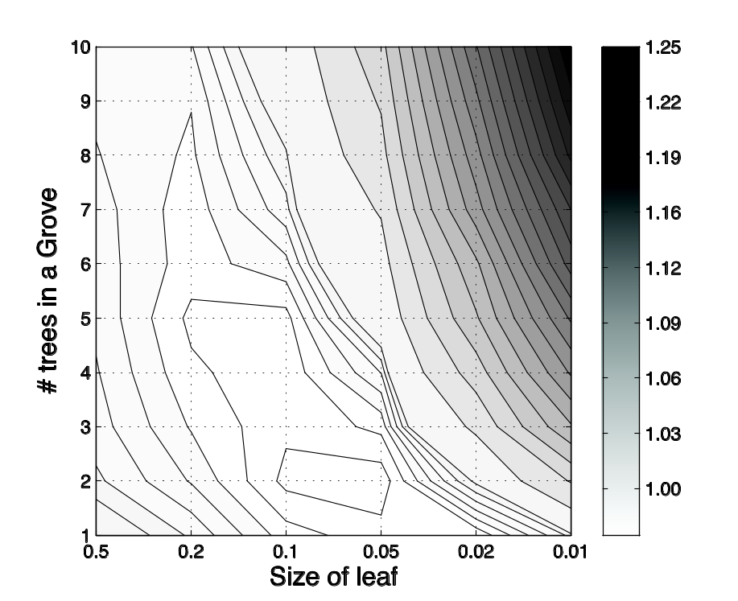
Choosing parameters for interaction detection
Our choice for interaction detection
Need many additive components
  (N≥6)
Predictive performance close to the best model
  (~ 8σ difference)
Better to underfit than to overfit
  (Favor left and lower grid points)
Best predictive performance
Daria Sorokina
Additive Groves: Modeling Additive Structure and Detecting Statistical Interactions

Slide 48
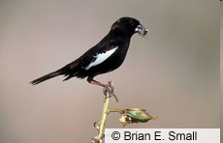
RMBO data. Lark Bunting.
Interaction: Elevation & Scrub/Shrubs Habitat
Fewer birds when more shrubs on high elevation, but more birds when more shrubs on low elevation
Scrub/shrub habitat contains different plant species in different regions of Rocky Mountains
Daria Sorokina
Additive Groves: Modeling Additive Structure and Detecting Statistical Interactions

Slide 49
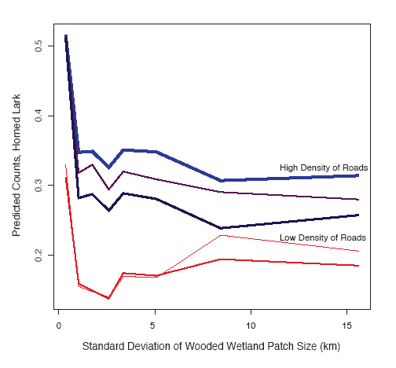

RMBO data. Horned Lark.
Interaction:
Density of Roads & Wooded Wetland Habitat
More horned larks around roads
  Previous knowledge
Fewer horned larks in woods
  Previous knowledge
The effect of woods is diminished by presence of roads
  New knowledge!
Daria Sorokina
Additive Groves: Modeling Additive Structure and Detecting Statistical Interactions

Slide 50


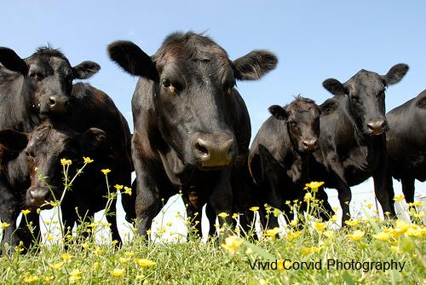
Food Safety Application
USDA data: inspections conducted at meat processing plants
Goals:
  Predict risk of Salmonella contamination
  Identify most important factors
Constraint:
  White-box models only
Model:
  Logistic regression with built-in interactions
Daria Sorokina
Additive Groves: Modeling Additive Structure and Detecting Statistical Interactions

Slide 51
Interaction Detection Results
Detected 5 interactions
4 of them included slaughter_chicken variable
Decision – split the data based on slaughter_chicken value
  Build two LR models: one for plants that slaughter chickens and one for plants that do not
Daria Sorokina
Additive Groves: Modeling Additive Structure and Detecting Statistical Interactions

Slide 52
Different Sets of Features
Chicken slaughter present Chicken slaughter absent
past_Salmonella_w84
Meat_Processing
Citation_xxx_w56
region_Mid_Atlantic
past_Salmonella_w28
Citation_xxx_w168
region_West_North_Central
region_West_South_Central
Citation_xxx_w28
Citation_xxx_w7
past_Salmonella_w168
slaughter_Cattle
aggr.Citation_xxx_w84
slaughter_Turkey
Citation_xxx_w168
past_Salmonella_w14
Citation_xxx_w168
aggr. Citation_xxx_w84
Meat_Slaughter
Citation_xxx_w56
Daria Sorokina
Additive Groves: Modeling Additive Structure and Detecting Statistical Interactions

Slide 53


Competitions
KDD Cup’09 “Small” data set:
  3 CRM problems: churn, appetency, upselling
  Fast feature selection
  Additive Groves
  Best result on appetency
ICDM’09 Data Mining Contest
  Brain fibers classification
  9 Additive Groves models
  Third place in the supervised challenge
Daria Sorokina
Additive Groves: Modeling Additive Structure and Detecting Statistical Interactions

Slide 54
TreeExtra package
A set of machine learning tools
  Additive Groves ensemble
  Bagged trees with fast feature ranking
  Descriptive analysis
    Feature selection (backward elimination)
    Interaction detection
    Effect visualization
www.additivegroves.net

Slide 55
Contributions
A new ensemble, Additive Groves of Regression Trees, combines additive structure and large trees
  (Sorokina et al, ECML’07)
Novel interaction detection technique based on comparing restricted and unrestricted Additive Groves models
  (Sorokina et al, ICML’08)
Fast feature selection methods
  (Caruana et al, KDD’06)
Contribution to bird ecology
  (Sorokina et al, DDDM workshop at ICDM’09)
  (Hochachka et al, Journal of Wildlife Management, 2007)
Contribution to food safety
  (Dubrawski et al, ISDS’09)
Data mining competitions
  (Sorokina, KDD Cup’09 workshop)
Software package
  www.cs.cmu.edu/~daria/TreeExtra.htm
Daria Sorokina
Additive Groves: Modeling Additive Structure and Detecting Statistical Interactions

Slide 56
Acknowledgements
Rich Caruana
Mirek Riedewald
Giles Hooker
Daniel Fink
Steve Kelling
Wes Hochachka
Art Munson
Alex Niculescu-Mizil
Artur Dubrawski
Jeff Schneider
Karen Chen
Daria Sorokina
Additive Groves: Modeling Additive Structure and Detecting Statistical Interactions

Slide 57
Appendix
Statistical interaction – alternative definition
Higher-order interactions
  Definition
  Restriction algorithm
  Reducing number of tests
Quantifying interaction size
Regression trees
Gradient Groves for binary classification
Daria Sorokina
Additive Groves: Modeling Additive Structure and Detecting Statistical Interactions

Slide 58
Statistical Interaction
F (x₁,…,x_{n}) has an interaction between x_{i} and x_{j} when
or — for nominal and ordinal attributes —
…when difference in the value of F(x₁,…,x_{n}) for different values of x_{i} depends on the value of x_{j}
( ≡
)
depends on x_{j}
depends on x_{i}
Daria Sorokina
Additive Groves: Modeling Additive Structure and Detecting Statistical Interactions

Slide 59
Higher-Order Interactions
F(x) shows no K-way interaction between x₁, x₂, …, x_{K} when
F(x) = F₁(x_{\1}) + F₂(x_{\2}) + … + F_{K}(x_{\K}),
where each F_{i} does not depend on x_{i}
(x₁+x₂+x₃)⁻¹ – has a 3-way interaction
x₁+x₂+x₃ – has no interactions (neither 2 nor 3-way)
x₁x₂ + x₂x₃ + x₁x₃ – has all 2-way interactions, but no 3-way interaction
Daria Sorokina
Additive Groves: Modeling Additive Structure and Detecting Statistical Interactions

Slide 60
Higher-Order Interactions
F(x) shows no K-way interaction between x₁, x₂, …, x_{K} when
F(x) = F₁(x_{\1}) + F₂(x_{\2}) + … + F_{K}(x_{\K}),
where each F_{i} does not depend on x_{i}
K-way restricted Grove: K candidates for each tree
no x₁
no x₂
no x_{K}
vs.
vs. … vs.
?
+ + +
Daria Sorokina
Additive Groves: Modeling Additive Structure and Detecting Statistical Interactions

Slide 61
Higher-Order Interactions
F (x) shows no K-way interaction between x₁, x₂, …, x_{K} when
F(x) = F₁(x_{\1}) + F₂(x_{\2}) + … + F_{K}(x_{\K}),
where each F_{i} does not depend on x_{i}
K-way interaction may exist only if all corresponding (K-1)-way interactions exist
Very few higher order interactions need to be tested in practice
x₃
x₃
x₃
x₃
⇒
⇒
x₁
x₂
x₁
x₂
x₁
x₂
x₁
x₂
Daria Sorokina
Additive Groves: Modeling Additive Structure and Detecting Statistical Interactions

Slide 62
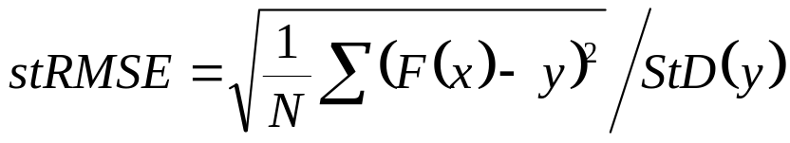
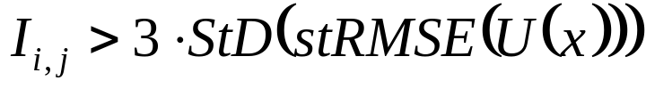
Quantifying Interaction Strength
Performance measure: standardized root mean squared error
Interaction strength: difference in performances of restricted and unrestricted models
Significance threshold: 3 standard deviations of unrestricted performance
  Randomization comes from different data samples (folds, bootstraps…)
Daria Sorokina
Additive Groves: Modeling Additive Structure and Detecting Statistical Interactions

Slide 63
Regression trees used in Groves
Each split optimizes RMSE
Parameter α controls the size of the tree
  Node becomes a leaf if it contains ≤ α·|trainset| cases
  0 ≤ α ≤ 1, the smaller α, the larger the tree
  (Any other type of regression tree could be used.)
Daria Sorokina
Additive Groves: Modeling Additive Structure and Detecting Statistical Interactions

Slide 64
Gradient Groves: Merging Additive Groves with Gradient Boosting
From Gradient Boosting (Friedman, 2001)
  Training each tree as a step of a gradient descent in a functional space
  Optimizing log-likelihood loss
From Additive Groves
  Retraining trees
  Stepwise increase of grove complexity
  Bagging of (generalized) additive models
  Benefits from large trees
Daria Sorokina
Additive Groves: Modeling Additive Structure and Detecting Statistical Interactions

Slide 65
Gradient Groves: Modifications after Merging Groves with Gradient Boosting
Large trees can have pure nodes with predictions (log odds of ±1) equal to ±∞
  Special case, extra math
With infinite predictions, variance is too high
  Threshold on max prediction, new parameter Γ
Large tree
-
+
+Inf
+
-
-Inf
Daria Sorokina
Additive Groves: Modeling Additive Structure and Detecting Statistical Interactions

Slide 66
Empirical comparison on real data
Gradient Groves | 0.909
Boosted Trees | 0.899
Random Forest | 0.896
Bagged Trees | 0.885
SVMs | 0.869
Neural Networks | 0.844
K-Nearest Neighbors | 0.811
Boosted Stumps | 0.792
Decision Trees | 0.698
Logistic Regression | 0.697
Naïve Bayes | 0.664
Recent major comparison of classification algorithms
  (Caruana & Niculescu-Mizil, ICML’06)
Results averaged over 8 performance measures and 11 data sets.
Gradient Groves were not always best, but never much worse than top algorithms.
Daria Sorokina
Additive Groves: Modeling Additive Structure and Detecting Statistical Interactions

