Slide 1

Detecting Statistical Interactions with Additive Groves of Trees
Daria Sorokina, Rich Caruana,
Mirek Riedewald, Daniel Fink

Slide 2
Domain Knowledge Questions
Which features are important?
What effects do they have on the response variable?
  Effect visualization techniques
  Is it always possible to visualize an effect of a single variable?
Toy example: seasonal effect on bird abundance
# Birds
Season

Slide 3
Visualizing effects of features
Toy example 1: # Birds = F(season, #trees)
Many trees
Few trees
Averaged seasonal effect
# Birds
# Birds
Season
Season
Season
Toy example 2: # Birds = F(season, latitude)
South
North
Averaged seasonal effect ?
Interaction
# Birds
# Birds
Season
Season
Season

Slide 4
!
Statistical interactions are NOT correlations
!

Slide 5
Statistical Interactions
Statistical interactions ≡ non-additive effects among
two or more variables in a function
F (x₁,…,x_{n}) shows no interaction between x_{i} and x_{j} when
F (x₁,x₂,…x_{n}) =
G (x₁,…,x_{i-1},x_{i+1},…,x_{n}) + H (x₁ ,…,x_{j-1},x_{j+1},…, x_{n}),
i.e., G does not depend on x_{i}, H does not depend on x_{j}
Example:
F(x₁,x₂,x₃) = sin(x₁+x₂) + x₂·x₃
  x₁, x₂ interact
  x₂, x₃ interact
  x₁, x₃ do not interact

Slide 6
Interaction Detection Approach
How to test for an interaction:
Build a model from the data (no restrictions).
Build a restricted model – this time do not allow interaction of interest.
Compare their predictive performance.
  If the restricted model is as good as the unrestricted – there is no interaction.
  If it fails to represent the data with the same quality – there is interaction.

Slide 7
Learning Method Requirements
Non-linearity
  If unrestricted model does not capture interactions, there is no chance to detect them
Restriction capability (additive structure)
  The performance should not decrease after restriction when there are no interactions
Most existing prediction models do not fit both requirements at the same time
  We had to invent our own algorithm that does

Slide 8
Additive Groves of Regression Trees
(Sorokina, Caruana, Riedewald; ECML’07)
New regression algorithm
  Ensemble of regression trees
Based on
  Bagging
  Additive models
  Combination of large trees and additive structure
Useful properties
  High predictive performance
  Captures interactions
  Easy to restrict specific interactions

Slide 9
Additive Groves
Additive models fit additive components of the response function
A Grove is an additive model where every single model is a tree
Additive Groves applies bagging on top of single Groves
(1/N)·
+…+
+ (1/N)·
+…+
+…+ (1/N)·
+…+

Slide 10
Interaction Detection Approach
How to test for an interaction:
Build a model from the data (no restrictions).
Build a restricted model – do not allow the interaction of interest.
Compare their predictive performance.
  If the restricted model is as good as the unrestricted – there is no interaction.
  If it fails to represent the data with the same quality – there is interaction.

Slide 11
Training Restricted Grove of Trees
The model is not allowed to have interactions between features A and B
Every single tree in the model should either not use A or not use B
+ + +

Slide 12
Training Restricted Grove of Trees
The model is not allowed to have interactions between attributes A and B
Every single tree in the model should either not use A or not use B
Evaluation on the separate validation set
no A
no B
vs.
?
+ + +

Slide 13
Training Restricted Grove of Trees
The model is not allowed to have interactions between attributes A and B
Every single tree in the model should either not use A or not use B
Evaluation on the separate validation set
no A
no B
vs.
?
+ + +

Slide 14
Training Restricted Grove of Trees
The model is not allowed to have interactions between attributes A and B
Every single tree in the model should either not use A or not use B
Evaluation on the separate validation set
no A
no B
vs.
?
+ + +

Slide 15
Training Restricted Grove of Trees
The model is not allowed to have interactions between attributes A and B
Every single tree in the model should either not use A or not use B
no A
no B
vs.
…
+ + +

Slide 16
Higher-Order Interactions
F(x) shows no K-way interaction between x₁, x₂, …, x_{K} when
F(x) = F₁(x_{\1}) + F₂(x_{\2}) + … + F_{K}(x_{\K}),
where each F_{i} does not depend on x_{i}
(x₁+x₂+x₃)⁻¹ – has a 3-way interaction
x₁+x₂+x₃ – has no interactions (neither 2 nor 3-way)
x₁x₂ + x₂x₃ + x₁x₃ – has all 2-way interactions, but no 3-way interaction

Slide 17
Higher-Order Interactions
F(x) shows no K-way interaction between x₁, x₂, …, x_{K} when
F(x) = F₁(x_{\1}) + F₂(x_{\2}) + … + F_{K}(x_{\K}),
where each F_{i} does not depend on x_{i}
K-way restricted Grove: K candidates for each tree
no x₁
no x₂
no x_{K}
vs.
vs. … vs.
?
+ + +

Slide 18
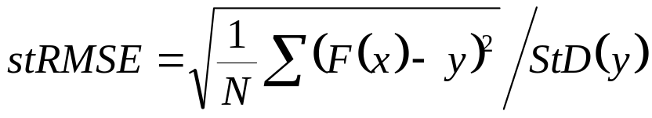
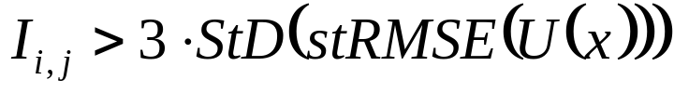
Quantifying Interaction Strength
Performance measure: standardized root mean squared error
Interaction strength: difference in performances of restricted and unrestricted models
Significance threshold: 3 standard deviations of unrestricted performance
  Randomization comes from different data samples (folds, bootstraps…)

Slide 19
Correlations and Feature Selection
Correlations between the variables hurt interaction detection
Solution: feature selection.
  Correlated features will be removed
Also, feature selection will leave few variable pairs to check for interactions
  As opposed to N²

Slide 20
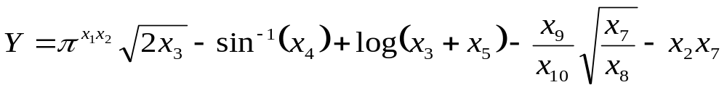
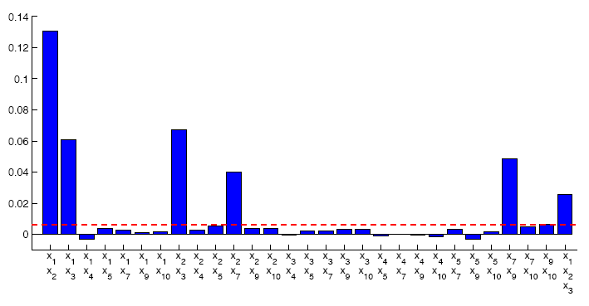
Experiments: Synthetic Data
Interactions

Slide 21
Experiments: Synthetic Data
1,2
1,2,3
2,3
1,3

Slide 22
Experiments: Synthetic Data
2,7
7,9

Slide 23
Experiments: Synthetic Data
x₅, x₈, x₁₀ have small ranges by construction and do not influence response much. Interactions of all other variables are detected.
9,10
7,10
3,5

Slide 24
Experiments: Synthetic Data
X₄ is not involved in any interactions

Slide 25
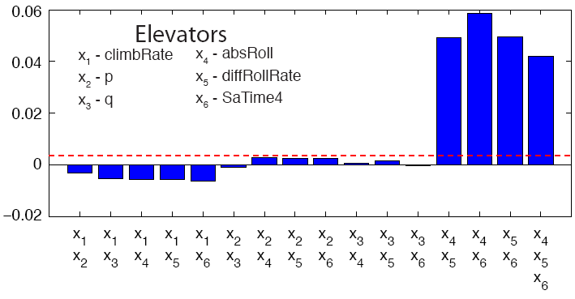
Experiments: Elevators
Airplane control data set: predict required position of elevators
1 strong 3-way interaction
  absRoll – absolute value of the roll angle
  diffRollRate – roll angular acceleration
  SaTime4 – position of ailerons 4 time steps ago

Slide 26
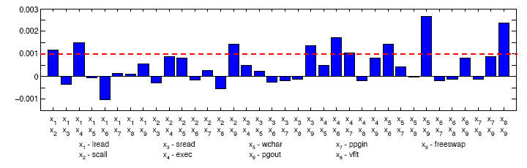
Experiments: CompAct
Predict CPU activity from other computer system parameters
A very additive, almost linear data set
All detected interactions were fairly small and non-stable

Slide 27
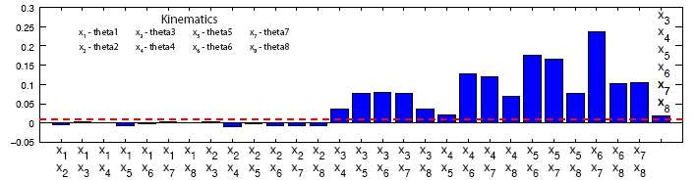
Experiments: Kinematics
Simulation of an 8-link robotics arm movements
Predict distance between the end and the origin from values of joints angles
Highly non-linear data set, contains a 6-way interaction

Slide 28
Experiments:
House Finch Abundance Data
Interaction (year, latitude)
  corresponds to an eye-disease that affected house finches during the decade covered by the dataset

Slide 29
Summary
Statistical interaction detection shows which features should be analyzed in groups
We presented a novel technique, based on comparing restricted and unrestricted models
Additive Groves is an appropriate learning method for this framework

Slide 30
Acknowledgements
Our collaborators in Computer Science department and Cornell Lab of Ornithology:
  Wes Hochachka
  Steve Kelling
  Art Munson

Slide 31
Appendix
Related work
  Statistical methods
  (Friedman & Popescu, 2005)
  (Hooker, 2007)
Regression trees
Trying to restrict bagged trees

Slide 32
Regression trees used in Groves
Each split optimizes RMSE
Parameter α controls the size of the tree
  Node becomes a leaf if it contains ≤ α·|trainset| cases
  0 ≤ α ≤ 1, the smaller α, the larger the tree
  (Any other type of regression tree could be used.)

Slide 33
Related work: early statistical methods
(Neter et. al., 1996) (Ott & Longnecker, 2001)
Build a linear model with an interaction term
  α₁x₁ + α₂x₂ + … + α_{n}x_{n} + βx₁·x₂
Test whether β is significantly different from 0
Problem: limited types of interaction
Collect data for all combination of parameter values
Find value of interaction term for each combination
Test whether interaction is significant
Problem: not useful for high-dimensional data sets

Slide 34
Related Work: Partial Dependence Functions
(Friedman & Popescu, 2005)
No interaction ≡ E_{\x}(F()) + E_{\z}(F()) = E_{\{x,z}}(F()) + E(F())
  But only if x and z are distributed independently
Create “fake” data points in the data set
Check for interactions in the resulting data
Problem: fake interactions in the fake data
  (Hooker, Generalized Functional ANOVA diagnostics, 2007)
Real data
Real and fake data

Slide 35
Related Work: Generalized Functional ANOVA Diagnostics (Hooker, 2007)
Improvement on partial dependence functions algorithm
Estimates joint distribution and penalizes the areas with small density
Produces results based on real data
High complexity
  Dense grid
  External density estimation

Slide 36
Would other ensembles work?
Let’s try to restrict bagging in the same way.
Assume
  A and B are both important
  A is more important than B
  There is no interaction between A and B
First tree:
  A is more important, the tree without B performs better. Choose the tree without B
Second tree:
  A is more important, the tree without B performs better. Choose the tree without B
N-th tree:
  …
Now the whole ensemble consists of trees without B!
B is important, so the performance dropped
  But there was no interaction…

