Slide 1
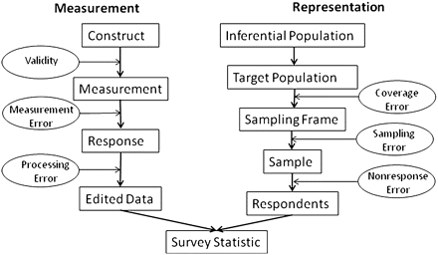

Figure 3. Total Survey Error Components Linked to Steps in the Measurement and Representational Inference Process ...
Notes:
Figure 3. Total Survey Error Components Linked to Steps in the Measurement and Representational Inference Process (Groves et al. 2004).
Unless provided in the caption above, the following copyright applies to the content of this slide: © The Author 2011. Published by Oxford University Press on behalf of the American Association for Public Opinion Research. All rights reserved. For permissions, please e-mail: journals.permissions@oup.com

