Slide 1
Cloud-Based Orchestration of Grid Monitoring Systems
Dario Bagnara

Slide 2
Thesis description
The thesis was developed in collaboration with RSE, a company specializing in research on the energy system.
It aims to determine the optimal placement of a PDC in order to ensure minimum latency between a PMU and the control node.
PMU: generates data in the form of phasors and routes them toward the control node.
PDC: receives data from a downstream PDC (or from a PMU) and forwards them to upstream PDCs or to the control node.

Slide 3
Thesis description
Why?
There are synchronization constraints between applications
An application that receives data too slowly cannot make a contribution
With the proper synchronization interval is critical for correct data analysis.

Slide 4
Thesis phases
Modeling
Graph model & algorithms
Infrastructure
Deployment
Integration
Orchestrator to reach final goal

Slide 5
Modeling phase
Graph nodes and algorithms

Slide 6
Graph model and algorithms
A graph can effectively represent our environment
The nodes act as computational unit within the network.
Attributes have been assigned to each node and edge to quantify their contribution to latency :
Latency of an edge
Node processing time
To determine where to place the PDCs, three algorithms were analyzed:
Greedy
Random approach
Brute force

Slide 7
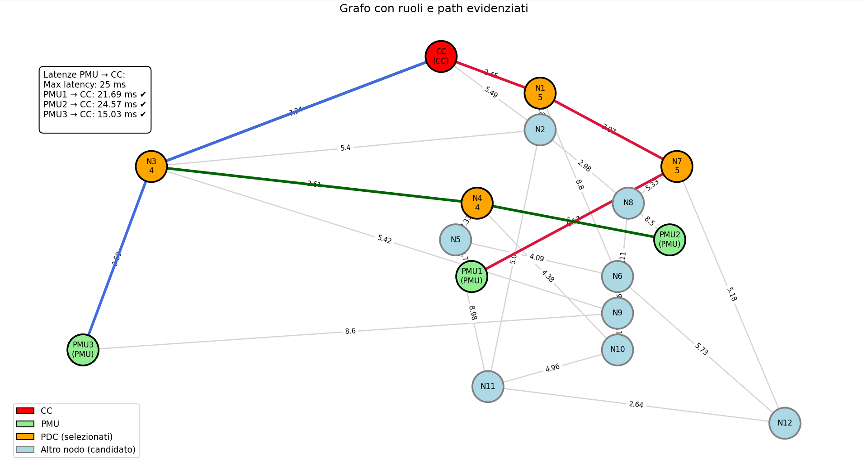
Greedy ( Dijkstra )
Starting from each leaf node, the algorithm searches for the shortest path to the central controller (CC) using only edge latency as the metric. Once found, it evaluates the path by summing the latencies of the edges and the processing times of the PDC nodes along the way
Good efficiency
With each change (depending on the architecture), a different number of PDCs may be placed.
Test and initial consideration

Slide 8
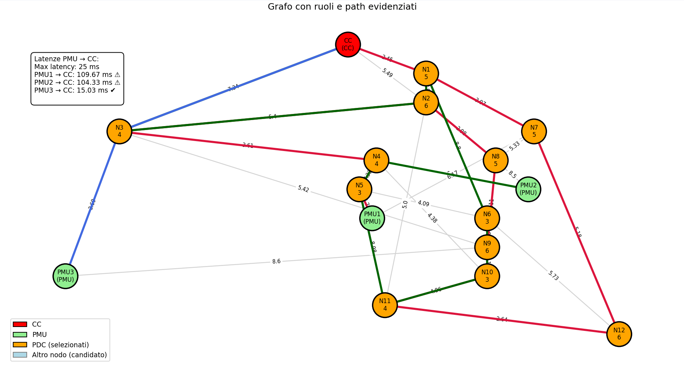
Random approach
For each PMU, a path is built towards the central node (CC) by randomly selecting valid adjacent nodes (online, connected by 'up' edges, and not PMUs); each candidate node traversed is marked as a PDC, and the process continues until the CC is reached, summing edge latency and PDC processing times
Tends to place too many PDCs Increases total path latency
Resource waste and possible bandwidth saturation
Test and initial consideration

Slide 9
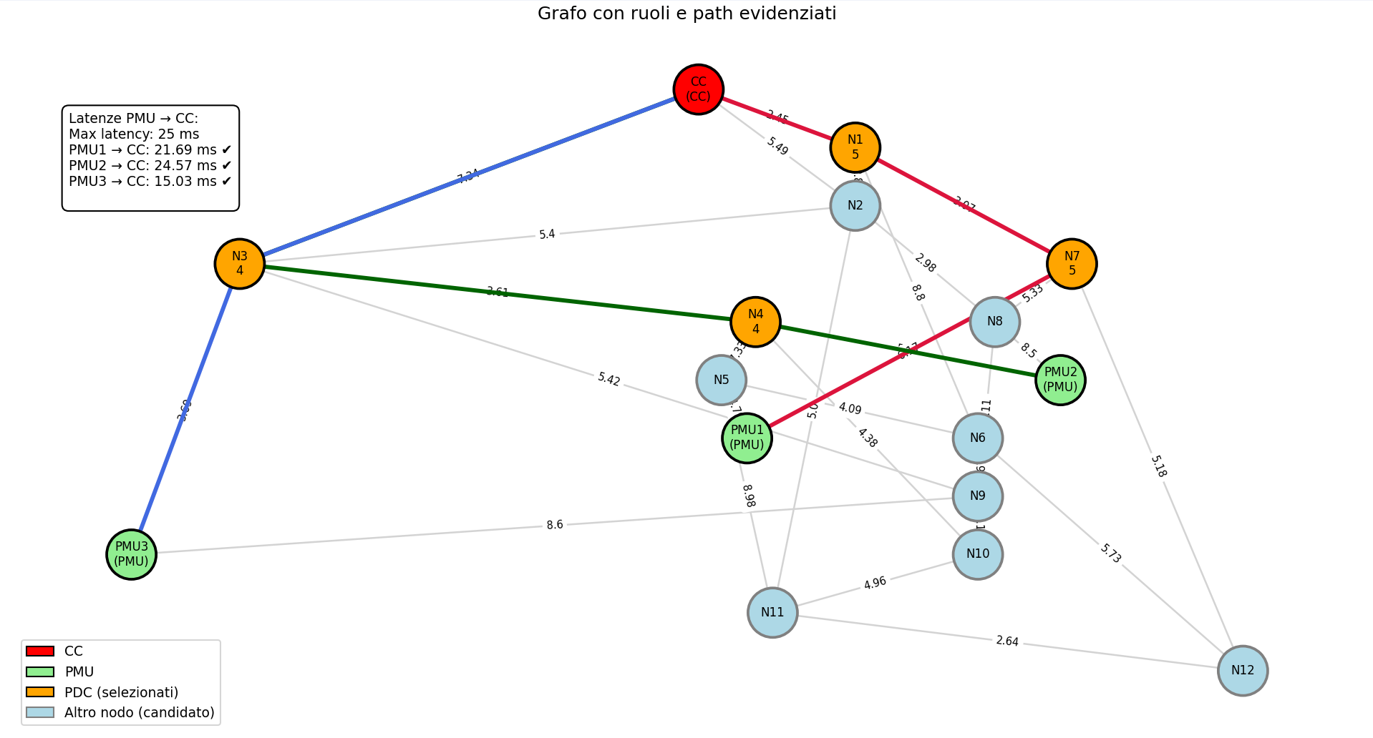
Brute Force
The algorithm starts by placing a single PDC and checking all possible paths from each PMU to the CC with that placement, saving the fastest valid paths when they exist. The process continues by gradually adding more PDCs, up to the maximum (i.e., all candidate nodes).
The brute force approach is effective as it always finds the optimal solution
It introduces the highest overhead since it explores all possible (and invalid) configurations
Test and initial consideration

Slide 10
Deployment phase
Deployment and automation

Slide 11
Deployment description
What do we need?
K3s cluster
PDCs deployment
With the appropriate ports exposed
PMUs deployment
Percona database:
To ensure resilience and centralized management.

Slide 12
How to achieve an automatic PDC configuration?
Currently, the configuration of the PDCs is done via a GUI:
Not very intuitive
Time-consuming
not practical to do from K8s
How to make the whole process simpler and more automatic?
Extract the queries executed by the PDC to configure the database
Create a dedicated CLI

Slide 13
Integration phase
Deployment + algorithms

Slide 14
Next steps
Develop the orchestrator to optimally place and configure the PDCs, using the CLI commands as a model.
Perform tests on the algorithms

Slide 15
Thank you for your attention

