Slide 1
Modeling Phase
Bagnara Dario

Slide 2
Main steps:
Graph model
Nodes and edges attributes
Algorithm
Test
Testing and considerations
Definition of positioning algorithms

Slide 3
Attributes of nodes and edges
Nodes
Group | The logical/physical group to which the node belongs
Level | A hierarchical or functional level of the node
Processing | The node's processing time in milliseconds
Memory | Amount of available RAM memory in the node
Storage | Available storage capacity in GB
Status | Operational status of the node.
Energy | Energy consumption
Role | The role of the node in the system: PMU, CC or candidate PDC

Slide 4
Attributes of nodes and edges
Edges
Latency | The transmission delay (in milliseconds) for sending data through the link
Bandwidth | The maximum data transfer rate supported by the link ( in Mbps )
Status | The operational status of the link: “up” or “down”
Link Type | The physical or logical medium of the link: fiber, ethernet, wireless

Slide 5
Three currently main algorithms:
Greedy ( Dijkstra ):
Starting from each leaf node, the algorithm searches for the shortest path to the central controller (CC) using only edge latency as the metric. Once found, it evaluates the path by summing the latencies of the edges and the processing times of the PDC nodes along the way.
Random approach:
For each PMU, a path is built towards the central node (CC) by randomly selecting valid adjacent nodes (online, connected by 'up' edges, and not PMUs); each candidate node traversed is marked as a PDC, and the process continues until the CC is reached, summing edge latency and PDC processing times.
Brute force:
The algorithm starts by placing a single PDC and checking all possible paths from each PMU to the CC with that placement, saving the fastest valid paths when they exist. The process continues by gradually adding more PDCs, up to the maximum (i.e., all candidate nodes).

Slide 6
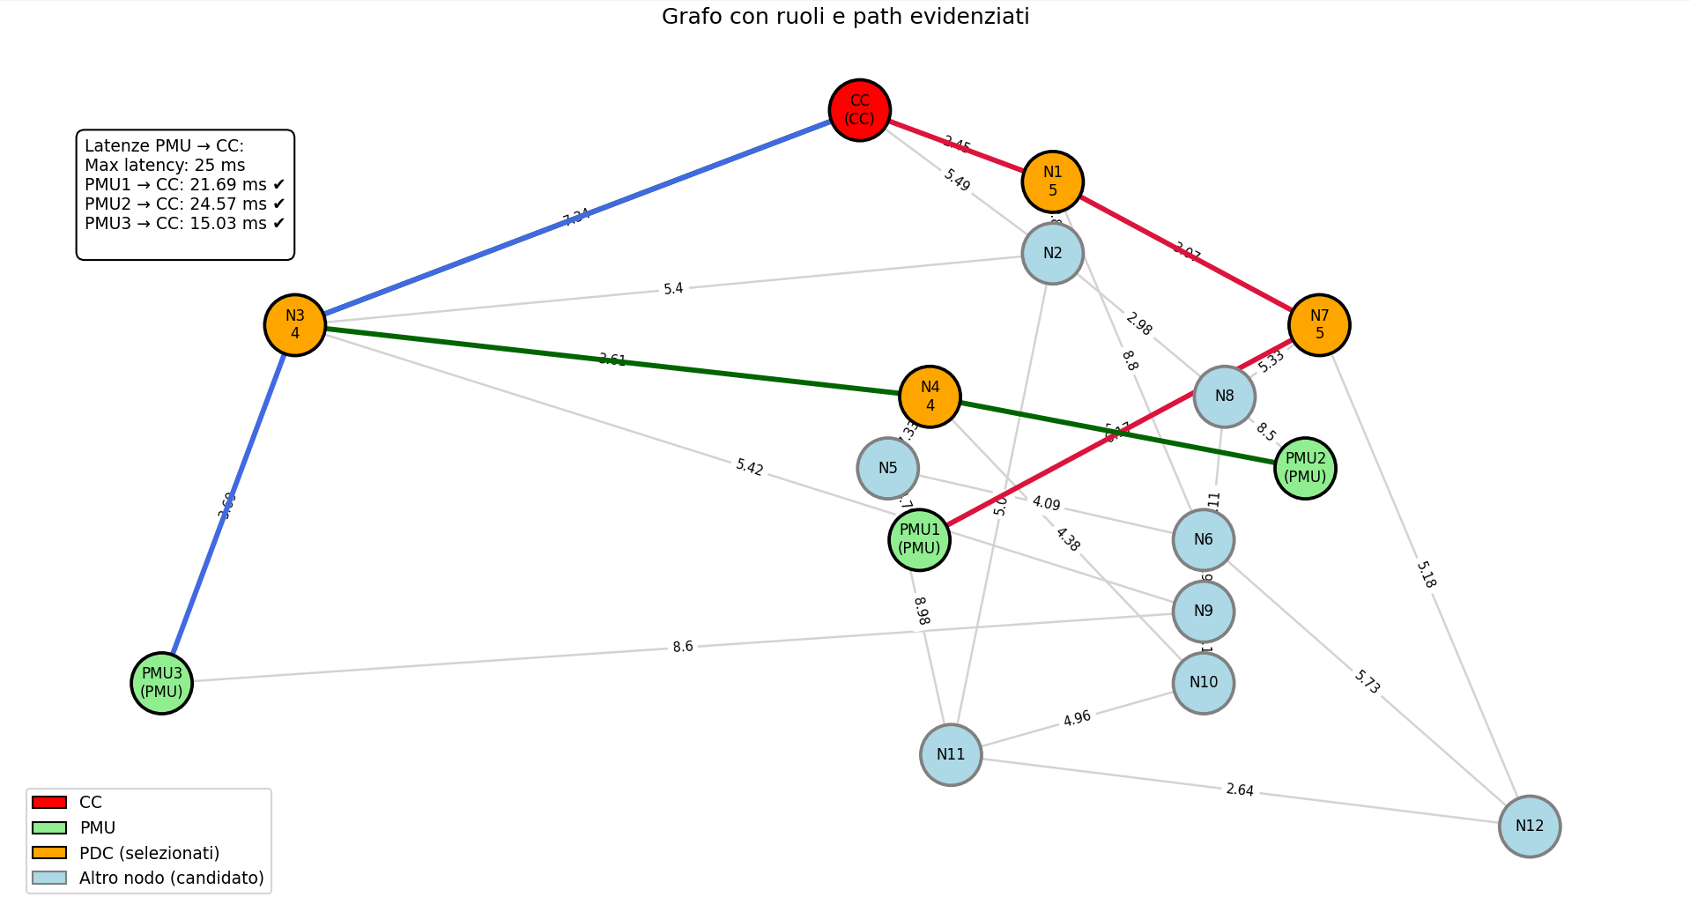
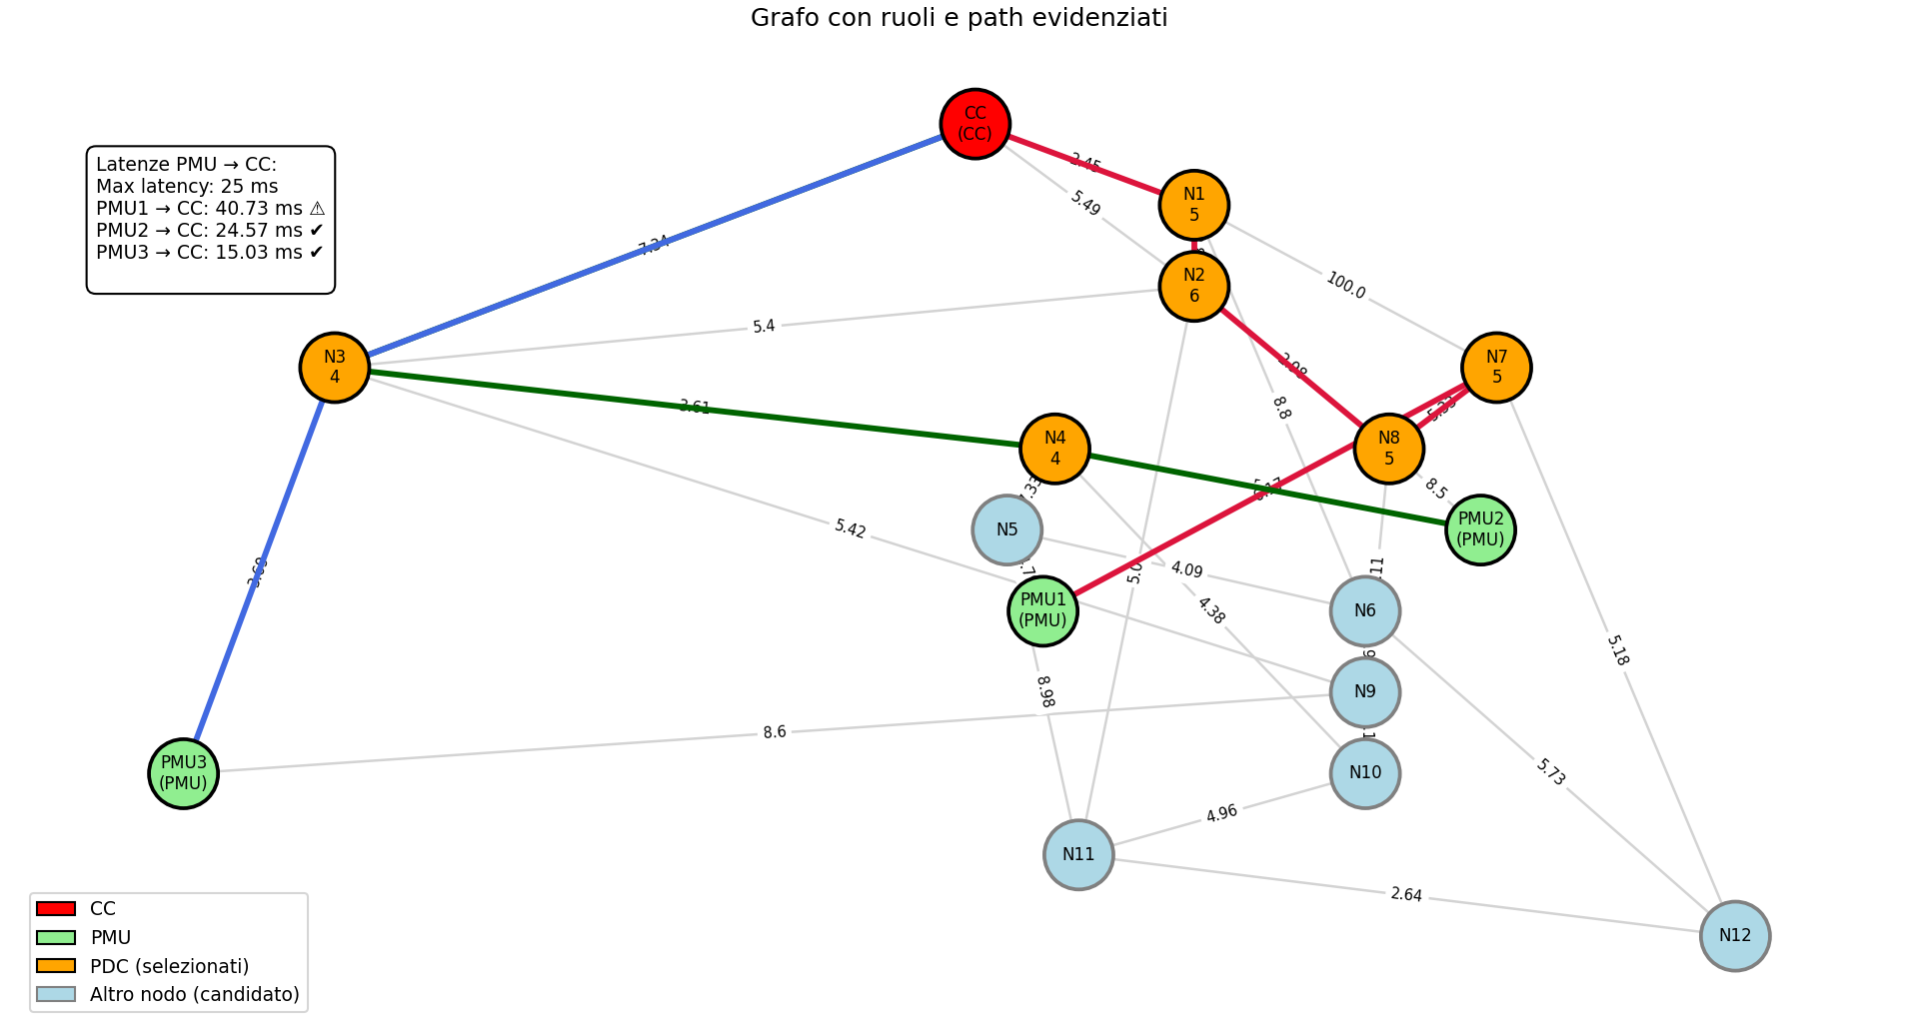
Greedy ( Dijkstra )
Starting from each leaf node, the algorithm searches for the shortest path to the central controller (CC) using only edge latency as the metric. Once found, it evaluates the path by summing the latencies of the edges and the processing times of the PDC nodes along the way.
Application of the algorithm
Application of the algorithm after changing the latency N1-N7

Slide 7
Greedy ( Dijkstra )
Down links ⇒ more PDCs placed
Increases total path latency
Higher resource usage and system complexity
Example: higher latency on N1–N7 ⇒ new PDC + higher delay
Test and initial consideration

Slide 8
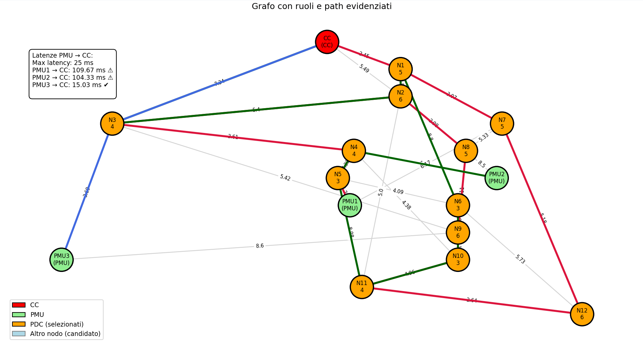
Random approach
For each PMU, a path is built towards the central node (CC) by randomly selecting valid adjacent nodes (online, connected by 'up' edges, and not PMUs); each candidate node traversed is marked as a PDC, and the process continues until the CC is reached, summing edge latency and PDC processing times
Application of the algorithm

Slide 9
Random approach
Tends to place too many PDCs Increases total path latency
Different paths converge on shared PDCs Example: higher latency on N1–N7 ⇒ new PDC + higher delay
Resource waste and possible bandwidth saturation
Added constraint: shared PDC chain to CC after convergence
Example: as shown in the previous image, all paths converge at node N3.
Test and initial consideration

Slide 10
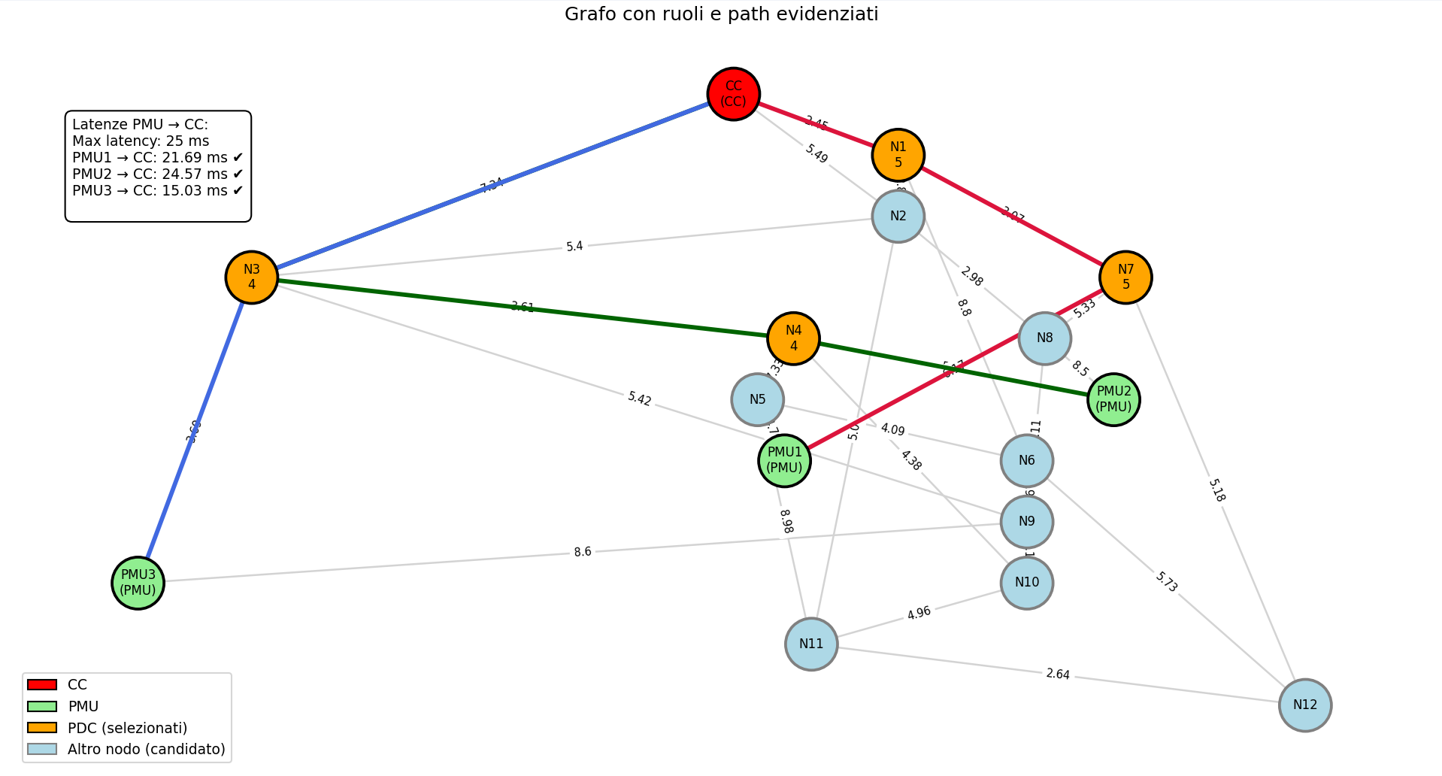
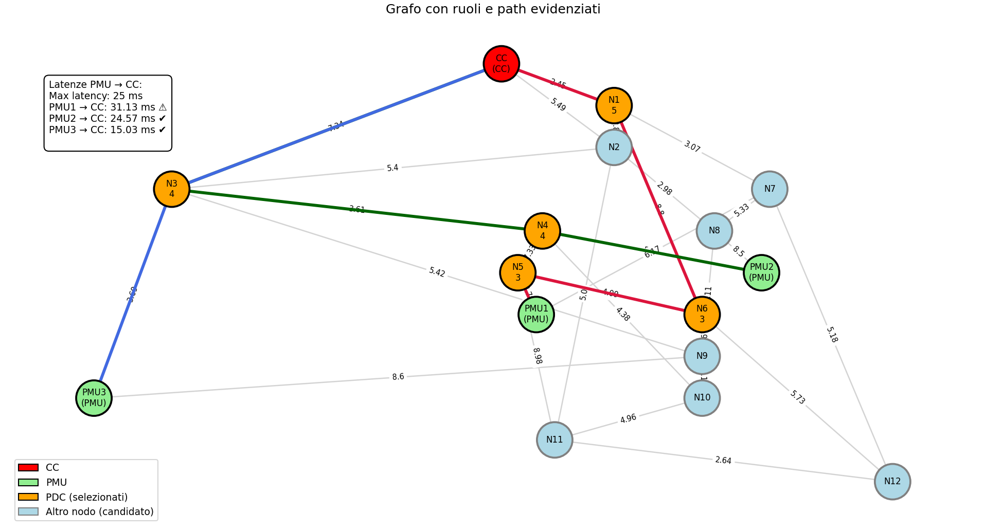
Brute force
The algorithm starts by placing a single PDC and checking all possible paths from each PMU to the CC with that placement, saving the fastest valid paths when they exist. The process continues by gradually adding more PDCs, up to the maximum (i.e., all candidate nodes).
Application of the algorithm
Application of the algorithm after changing the edge’s status N1-N7

Slide 11
Brute force
The brute force approach is effective as it always finds the optimal solution.
However, it introduces the highest overhead since it explores all possible (and invalid) configurations.
It should therefore be used only with small, sparsely connected graphs to reduce the number of valid paths from PMU to CC.
Test and initial consideration

Slide 12
Thank you for your attention

