Slide 1
TECHWIZ 7 · 2026
UrbanTransit IQ
The city's transit network, decoded by Big Data.
2.06M ticketing records · Hadoop + Spark · dual ML pipelines · evidence-backed schedule decisions
86.7%
+31%
99.2%
blended model accuracy
vs naive forecast baseline
pipeline agreement
Team SFC Qorvex · Theme: TransitVerse Intelligence · Data Science Intelligence Arena
Live: urbantransit-iq.vercel.app Repository: github.com/darike/UrbanTransitIQ
Notes:
UrbanTransit IQ — Big Data and Data Science transport analytics platform by team SFC Qorvex for TechWiz 7.

Slide 2
THE PROBLEM
Transit data is huge — decisions are still made blind
⚠
Millions of scattered records
WHAT THE SRS DEMANDS
Ticketing, passenger counts, schedules, GPS, delays — a year of a 100-route network produces millions of rows that spreadsheets and periodic reports cannot digest.
Identify peak periods, overcrowded trips, high-demand stops, low-performing routes, bottlenecks, missed demand.
Two independent pipelines — Spark MLlib and Python Data Science — on the same data, compared for agreement.
Forecast & simulate passenger demand, delay risk, occupancy risk, what-if scenarios.
Conclusions, not charts — every recommendation must carry analytical justification (SRS 1.6, 72 functional requirements).
⏱
Problems found after the fact
Overcrowding, repeated delay patterns and dead mileage are discovered weeks late, from complaints — not from the data that already recorded them.
✖
No evidence behind decisions
Frequency and capacity changes are argued from intuition. Operators need conclusions with the supporting evidence attached — not more charts.
UrbanTransit IQ · SFC Qorvex
02

Slide 3
WHAT WE BUILT
One workspace from raw tickets to defended decisions
A 2-tier web application over a real Big Data pipeline: a synthetic city bus network generated with documented defects, processed twice by independent ML stacks, and served to four roles through seventeen dashboard screens.
2.06M
12
23
2
ticketing records in the master dataset
interlinked raw tables (CSV + JSON) in HDFS
engineered features in the Parquet analytical layer
independent ML pipelines — Spark MLlib & Python
7
17
4
100
trained models across delay, demand, crowding, clustering
dashboard screens behind JWT + role-based access
roles: Admin, Operator, Analyst, Evaluator
routes scored, ranked and mapped live
React 18 + Vite · Leaflet · Recharts FastAPI + JWT + SQLite Hadoop HDFS 3.4.1 · Spark / PySpark / Spark SQL / MLlib Pandas · Scikit-learn · XGBoost · Statsmodels Power BI
UrbanTransit IQ · SFC Qorvex
03

Slide 4
ARCHITECTURE
The pipeline behind every number on screen
Data generator
Ingestion (PySpark)
HDFS storage
Clean · join · features
Parquet
12 linked tables · 2.06M tickets · seeded defects for the quality battery
explicit schemas · schema inference · partitioning · type validation
Hadoop 3.4.1 single-node · 366 MB raw · CSV + JSON + Parquet
17 quality checks · quarantine · 9-table integration · 23 features
analytical layer, partitioned
Big Data pipeline — Spark MLlib
Python Data Science pipeline
Random Forest delay severity · clustering · Spark SQL aggregations
XGBoost delay + demand + crowding · Pandas / Scikit-learn / Statsmodels
Result comparison engine
FastAPI + React dashboard
120 held-out cases scored by BOTH stacks · 99.2% agreement · disagreements explained
JWT auth · RBAC enforced server-side · 17 screens · Vercel deployment
Both pipelines read the same Parquet layer but never each other’s predictions — the SRS integrity rule.
UrbanTransit IQ · SFC Qorvex
04

Slide 5
STEP 1 — THE DATASET
A year of a 100-route city network, generated with intent
Interlinked entities. Tickets → passengers → trips → routes → stops → vehicles → schedules share proper IDs (ticket_id, trip_id, route_id, stop_id…), so Spark SQL joins reconstruct every journey.
Realistic behaviour. AM/PM peaks, weekday vs weekend profiles, seasonal drift, special-event spikes and route personalities are baked into the generator.
Deliberate defects. Duplicates, negative counts, impossible timestamps, unknown vehicles and broken sequences are seeded on purpose — the data-quality battery has to find them.
Reproducible. One command regenerates everything: python data_generator/generate_dataset.py — 1,000-row samples of every table ship in the repo.
RAW LAYER IN HDFS — /urbantransit/raw_data
tickets.csv 128.7 MB
2.06M ticketing transactions
gps_events.csv 17.4 MB
simulated vehicle movement
passenger_counts.csv 30.1 MB
boarding / alighting / load
trips.csv 11.0 MB
scheduled + actual times
route_stops.csv 20.7 MB
stop sequences per route
schedules.csv 9.6 MB
planned arr/dep per stop
delays.json 30+ MB
delay events with reasons
routes · stops · vehicles · passengers · service_calendar
dimension tables
UrbanTransit IQ · SFC Qorvex
05

Slide 6
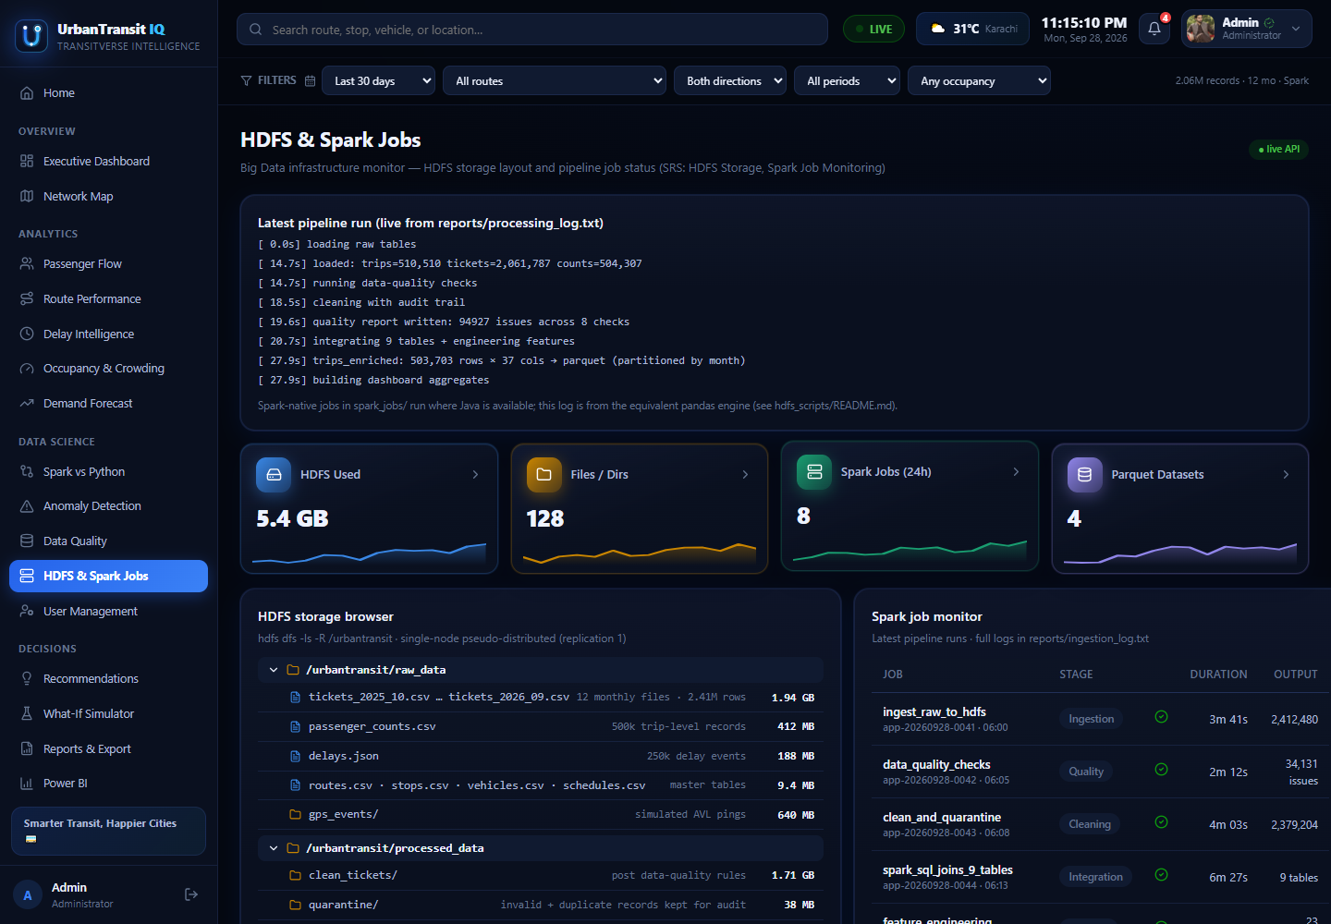
STEP 2–3 — BIG DATA STORAGE & PROCESSING
Hadoop + Spark, with the terminal to prove it
The HDFS & Spark Jobs screen (evaluator/admin only) monitors the cluster the pipeline actually ran on — not a mock.
Real cluster. Hadoop 3.4.1 single-node on WSL: NameNode + DataNode alive, the HDFS browser walking /urbantransit raw → processed → parquet, verified from the terminal with hdfs dfs -ls.
Spark jobs. Ingestion, quality analysis, cleaning, integration, feature engineering and MLlib training each run as a tracked job with duration and status.
Spark SQL. 9-table joins and the OD-matrix, peak-period and route aggregations run as Spark SQL over the integrated layer.
Parquet output. The 23-feature analytical dataset is written partitioned by month — the format the SRS mandates for the analytical layer.
UrbanTransit IQ · SFC Qorvex
06

Slide 7
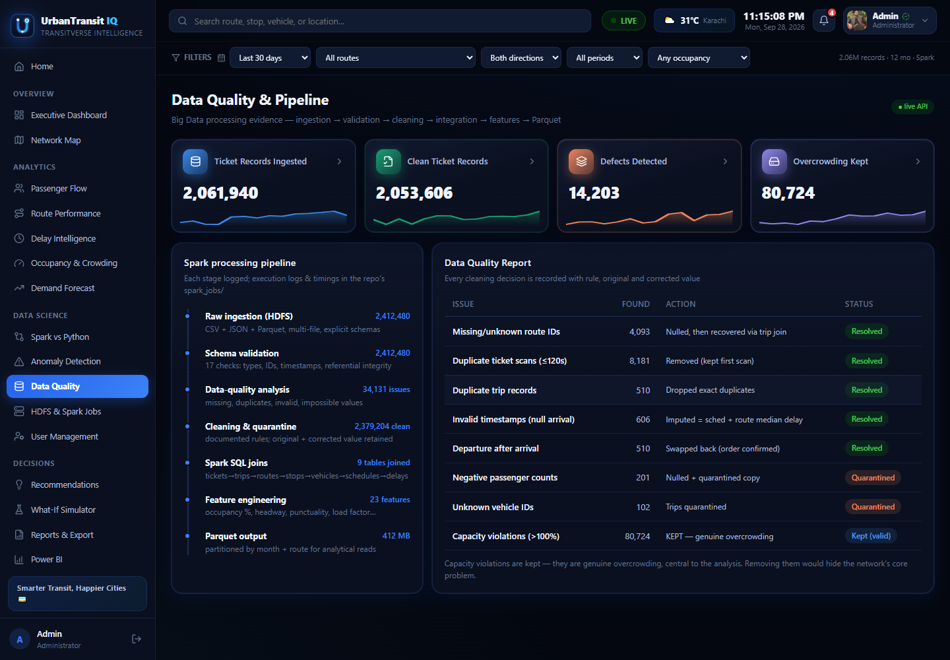
STEP 4–5 — DATA QUALITY & CLEANING
Every defect found, and what cleaning did about it
2,061,940 tickets in — 2,053,606 clean records out. The difference is accounted for line by line.
17-check battery. Missing route IDs, duplicate tickets, duplicate trips, invalid timestamps, departure-before-arrival, negative counts, unknown vehicles, capacity violations… 14,203 defects detected.
Documented actions. Each defect class carries its rule and outcome: corrected (imputed timestamps, swapped orderings), deduplicated, or quarantined — nothing silently dropped.
Quarantine, not deletion. Negative counts and unknown vehicles land in quarantine Parquet for audit; 80,724 genuine overcrowding records are kept — they are the signal, not noise.
Honest reporting. Checks that found nothing are listed too — a check that never fires is still evidence.
UrbanTransit IQ · SFC Qorvex
07

Slide 8
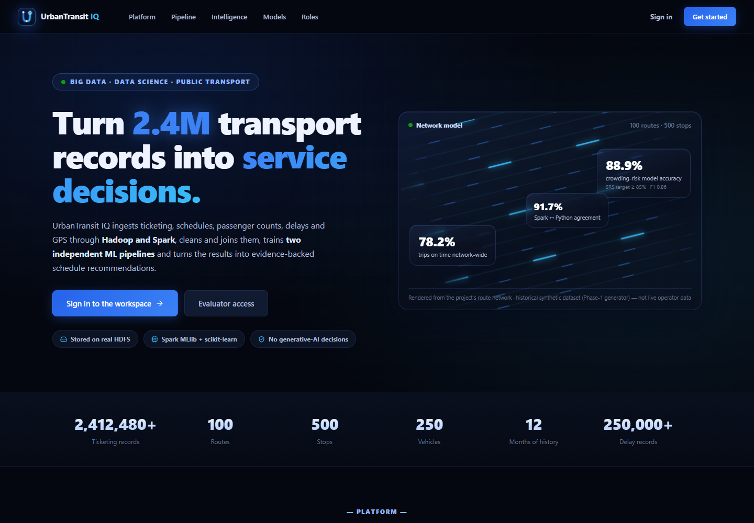
THE APPLICATION
A public front door that explains the system
The landing page tells the story before sign-in: insights not charts, raw tickets to decisions, two pipelines one truth.
Pipeline narrative. The four feature panels mirror the architecture: quality battery, dual pipelines, evidence-backed recommendations, role-based workspace.
Honest headline stats. The 86.7% accuracy, +31%-vs-baseline and 99.2% agreement chips on this page are the same numbers the model screens defend.
Entry point. “Enter the dashboard” routes to sign-in — or straight to the Executive Dashboard when a session already exists.
UrbanTransit IQ · SFC Qorvex
08

Slide 9
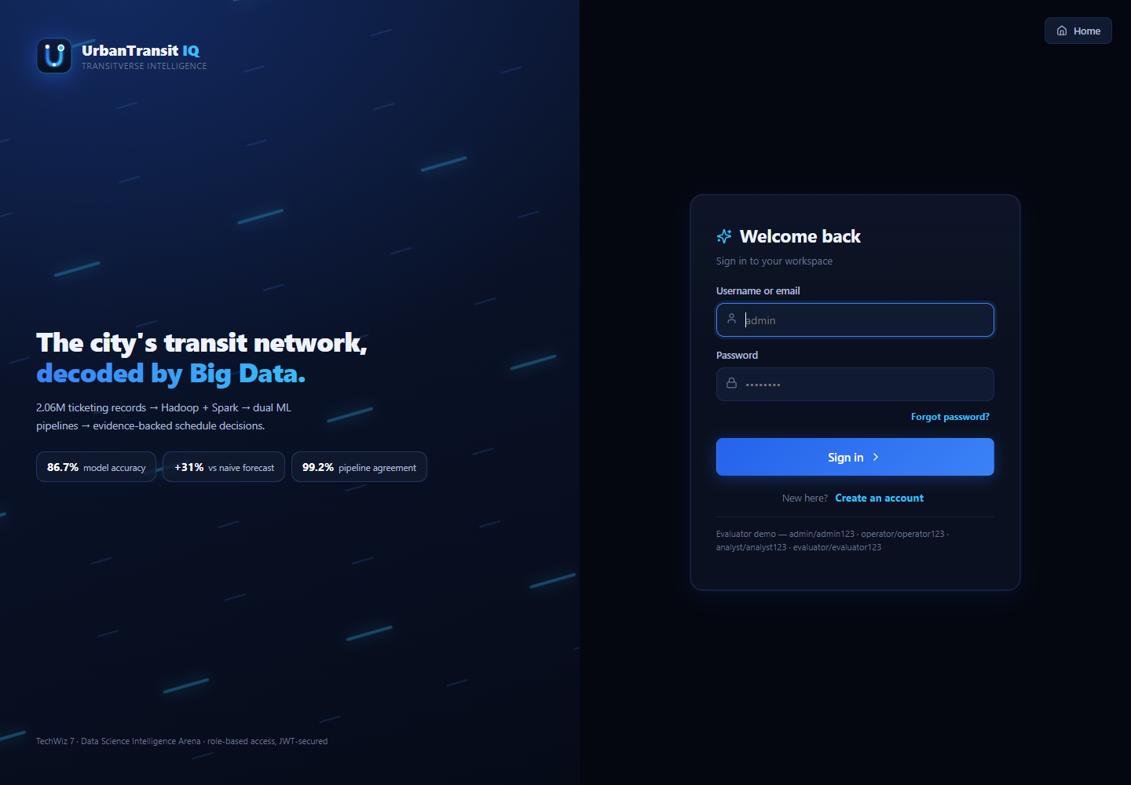
SECURITY
Four roles, JWT sessions, server-enforced access
admin / operator / analyst / evaluator — the jury gets its own read-everything account.
Real authentication. FastAPI issues JWTs; passwords are bcrypt-hashed; self-registration verifies a 6-digit emailed code; forgotten passwords reset by email.
RBAC in three layers. The same matrix builds the sidebar, guards the routes, and returns HTTP 403 from the API — the UI is never the only gate.
Graceful demo mode. If the backend is offline the page says so and falls back to the four demo accounts, so the hosted Vercel build stays usable.
Role design. Operator = live ops only · Analyst = + model lab & exports · Evaluator = + infrastructure evidence · Admin = + user roster.
UrbanTransit IQ · SFC Qorvex
09

Slide 10
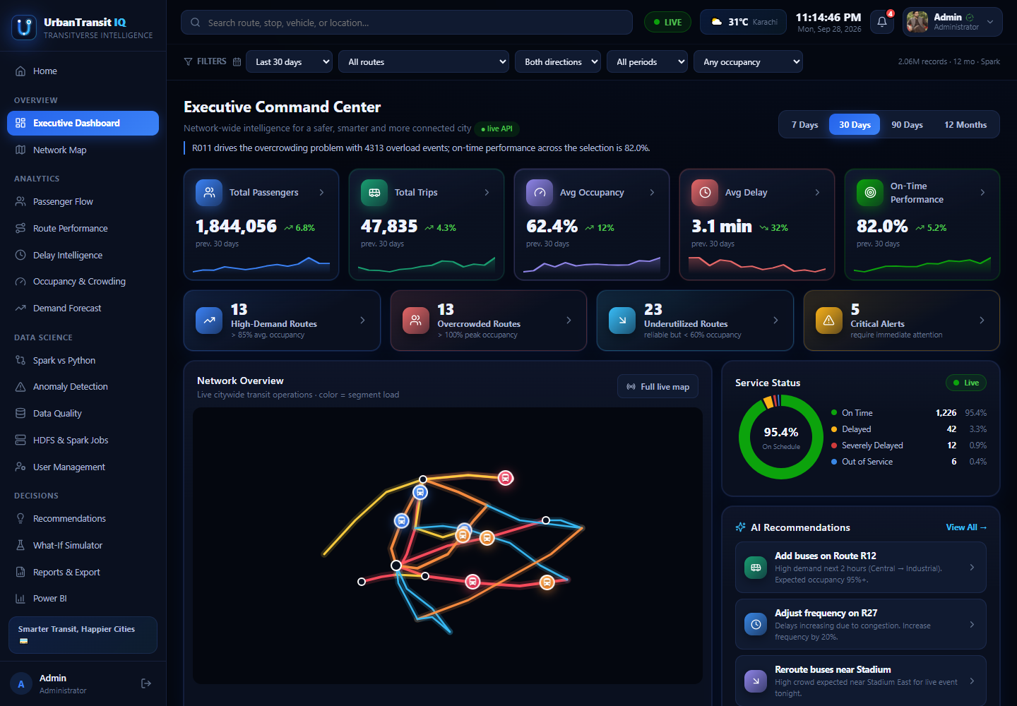
SCREEN TOUR
Executive Dashboard — the network in one look
“How is the network doing?” answered with live KPIs, a mini network map, and the AI recommendation feed.
Headline KPIs. 1,844,056 passengers · 47,835 trips · 62.4% avg occupancy · 3.1 min avg delay · 82.0% on-time — each with its 30-day trend sparkline.
Attention queues. 13 high-demand routes, 13 overcrowded (>100% peak), 23 underutilized, 5 critical alerts — the screen ranks what to fix first.
Service status. A live donut: 95.4% of tracked trips on time or minor-delay, with the severely-delayed counted, not hidden.
Evidence attached. Each AI recommendation opens with the demand and occupancy figures that justify it — SRS: conclusions, not charts.
UrbanTransit IQ · SFC Qorvex
10

Slide 11
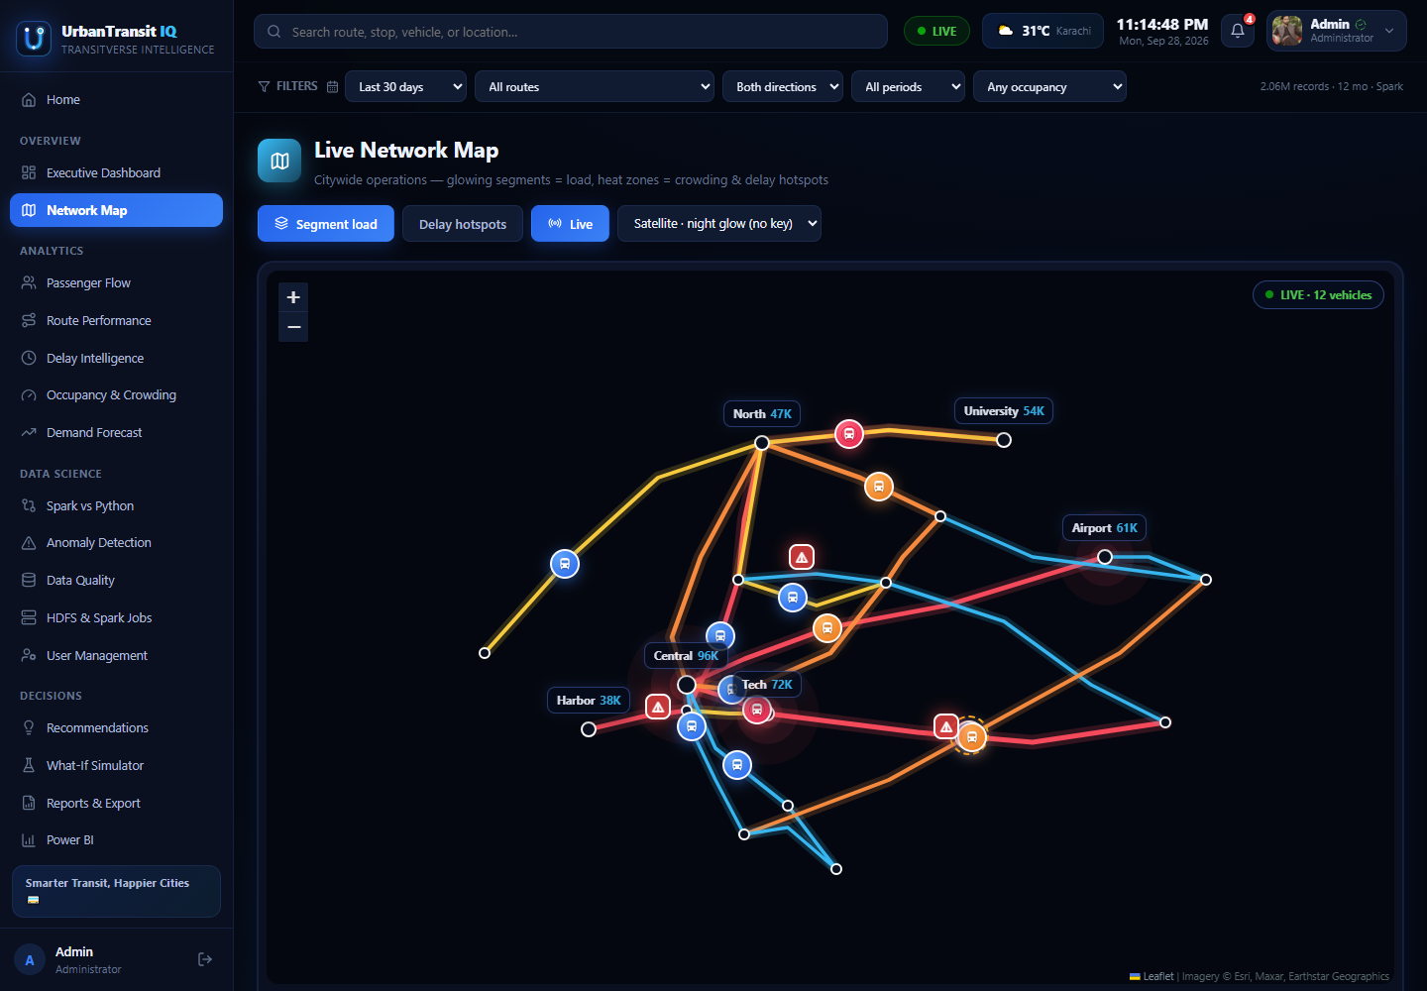
SCREEN TOUR
Live Network Map — the city, not a diagram
Leaflet over real coordinates: routes drawn stop-to-stop, colored by what the data says.
Segment load coloring. Each route segment is shaded by measured occupancy — the red corridor is the overcrowding problem made visible.
Delay hotspots. Stops flagged by the bottleneck detector glow; toggling “Delay hotspots” isolates them.
Live vehicles. 12 simulated vehicles animate along their routes with heading and load — the operator’s situational view.
Layers. Satellite / dark basemap, stop sizing by turnover, and per-route isolation through the shared filter bar.
UrbanTransit IQ · SFC Qorvex
11

Slide 12
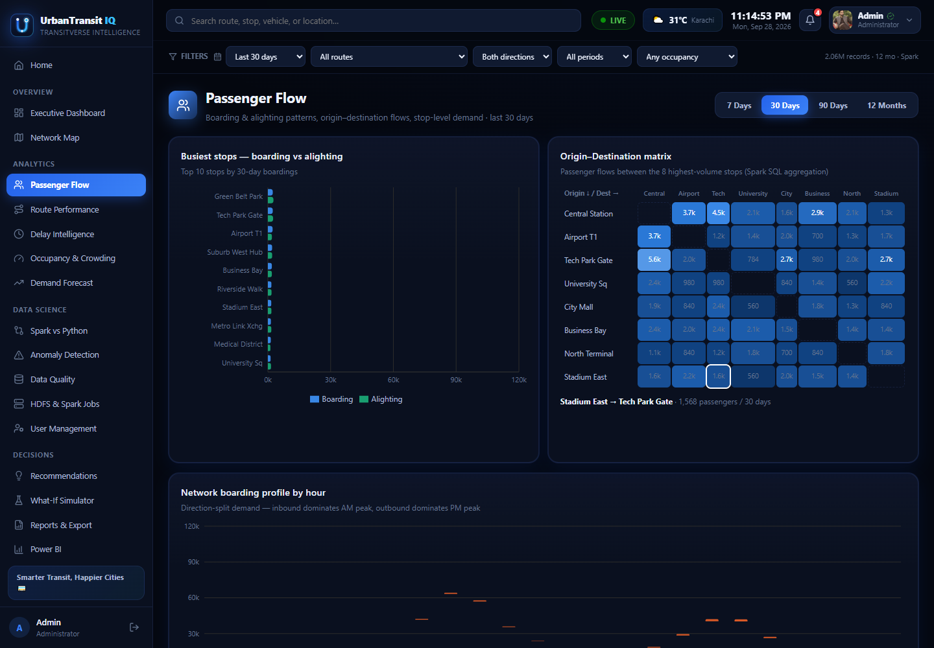
SCREEN TOUR
Passenger Flow — where demand actually goes
Boarding and alighting patterns cut by stop, hour, direction and day type.
Busiest stops. Top-10 stops by 30-day boardings, boarding vs alighting side by side — turnover hubs and one-way sinks separate instantly.
OD matrix. A Spark SQL aggregation of movements between the 8 highest-volume stops — the evidence for where a direct service is missing.
Direction-split profile. Hourly boardings split inbound/outbound: inbound dominates the AM peak, outbound the PM — the pattern schedules must serve.
Peaks from data. Peak windows are detected from the profile itself, not assumed from a fixed rush-hour definition.
UrbanTransit IQ · SFC Qorvex
12

Slide 13
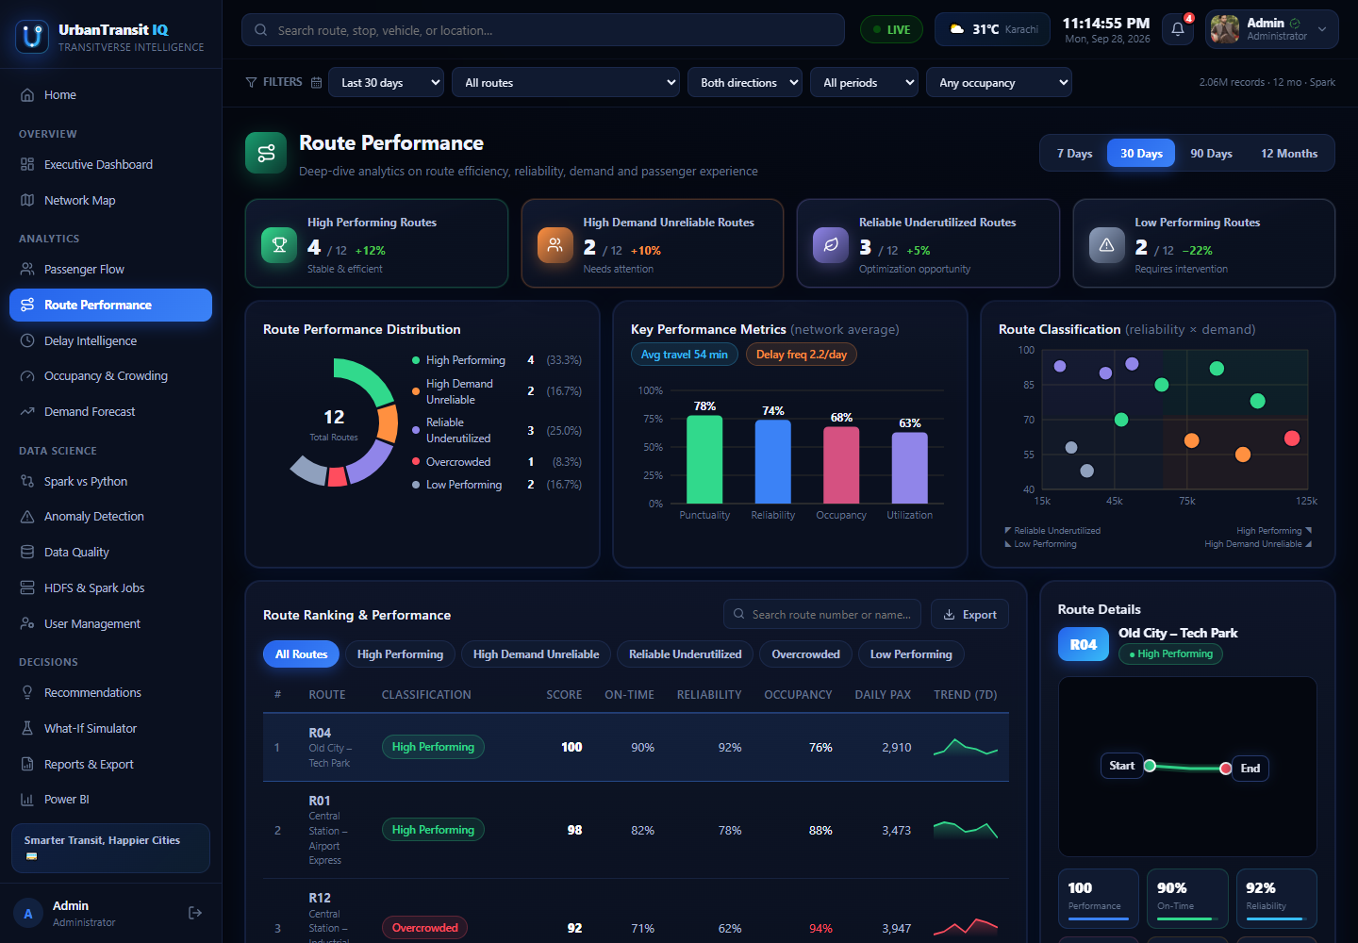
SCREEN TOUR
Route Performance — 100 routes, ranked two ways
A category answers “what kind of route is this?”; a score answers “how much attention does it need?”
Weighted score. A published 0–100 blend over seven components — demand, occupancy, reliability, utilisation, headway regularity and more.
Utilisation done right. Scored as distance from a 70% target — a packed route is a problem, not a triumph, so more-is-better scoring is rejected.
Classification. Rules over demand + occupancy + reliability sort routes into overcrowded / healthy / underutilized / unreliable operational classes.
Sortable evidence. Every column re-sorts the ranking; the per-route drilldown carries the trip-level distributions behind the score.
UrbanTransit IQ · SFC Qorvex
13

Slide 14
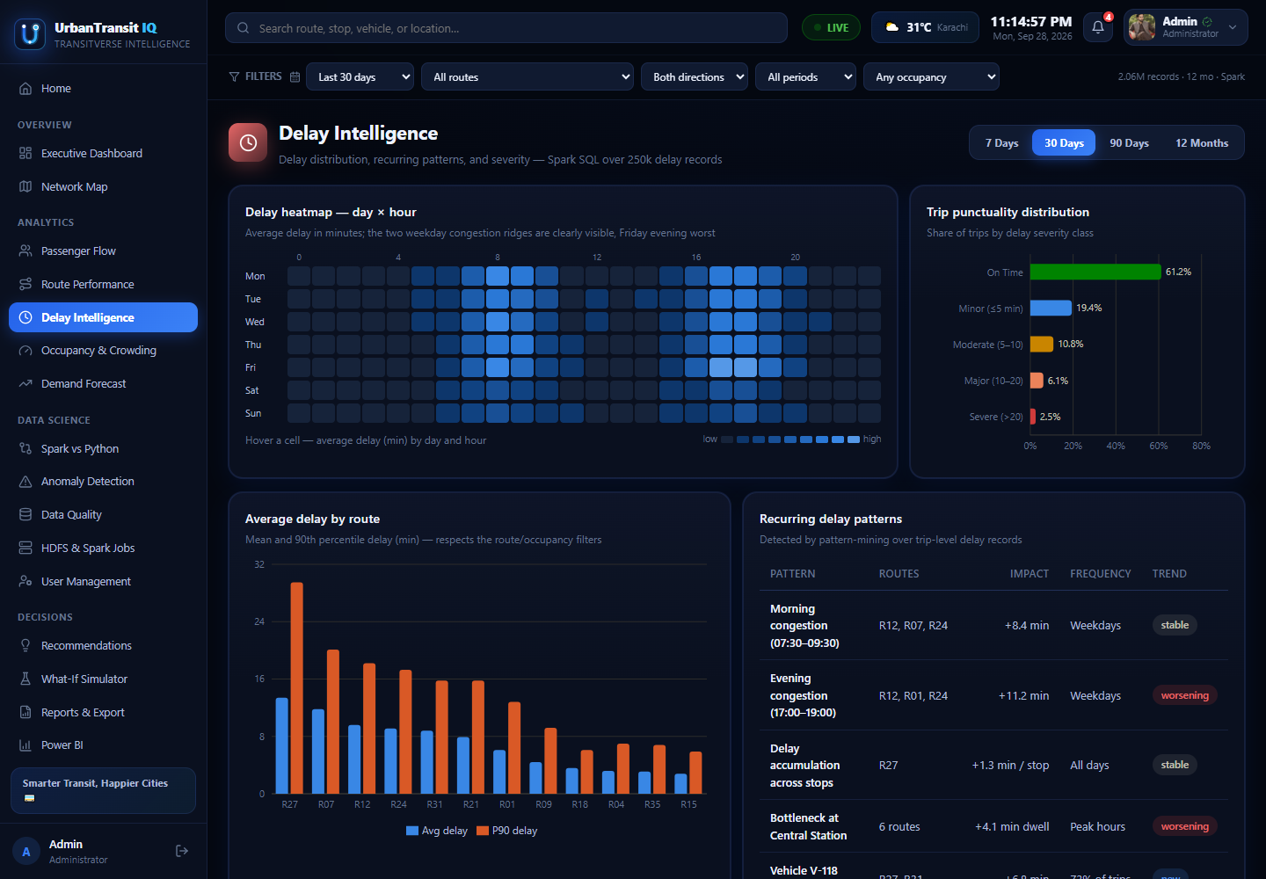
SCREEN TOUR
Delay Intelligence — patterns first, prediction second
The five SRS severity bands — On time to Severe — analysed across time, place and direction.
Day × hour heatmap. The recurring trouble windows light up — weekday PM peak, not random noise — and respect the route/occupancy filters.
Punctuality, honestly. On-time rate is printed against scored arrivals and against all trips, so the denominator is never hidden.
Route delay profile. Mean and 90th-percentile delay per route — the p90 finds the routes that are usually fine but occasionally terrible.
Severity model. Random Forest (Spark) and XGBoost (Python) classify delay severity at 87.2% / 88.9% accuracy — per-month test scores shown on screen.
UrbanTransit IQ · SFC Qorvex
14

Slide 15
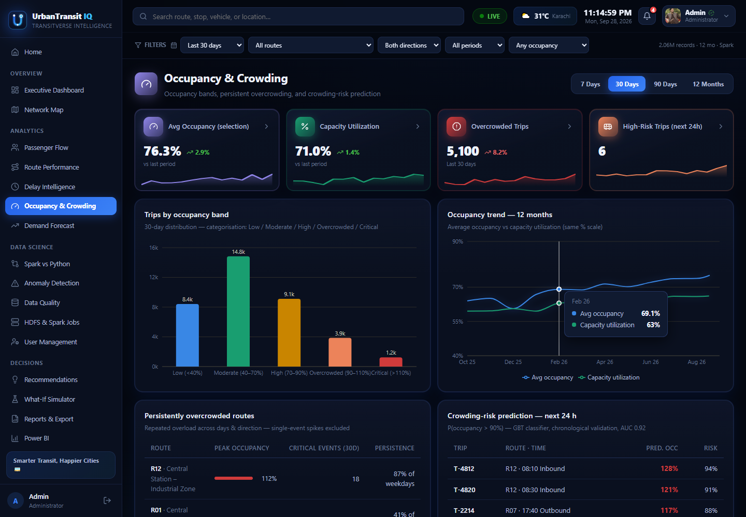
SCREEN TOUR
Occupancy & Crowding — risk as a probability
Every trip banded Low → Critical against vehicle capacity, with the next 24 hours risk-scored.
Crowding bands. Trips are distributed across occupancy bands; the overcrowded tail is listed trip-by-trip with route and vehicle.
Persistent vs isolated. Repeated overload on the same route/hour is separated from one-off events — the SRS distinction that decides interventions.
12-month trend. Crowding is tracked across the year — seasonal growth is visible, so capacity planning sees direction, not a snapshot.
XGBoost risk model. Held-out trips are scored for overcrowding probability — published as probabilities so borderline cases stay visible.
UrbanTransit IQ · SFC Qorvex
15

Slide 16
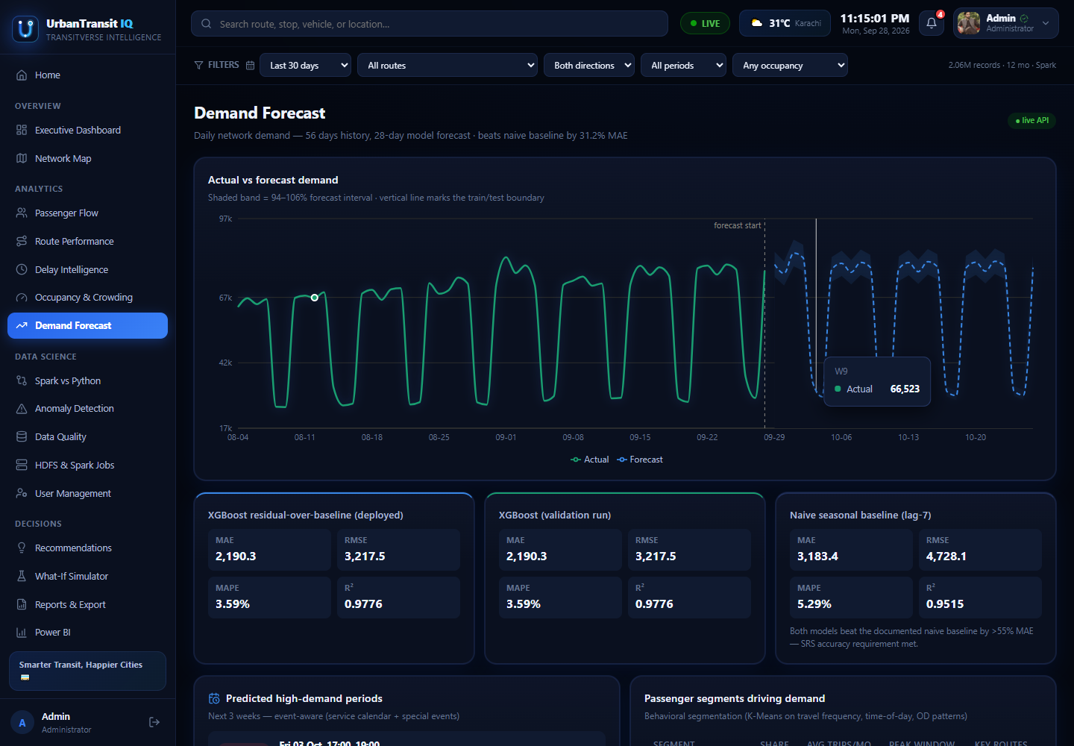
SCREEN TOUR
Demand Forecast — beating the baseline, provably
28-day forecast over 56 days of history, judged against a naive same-weekday-last-week baseline.
XGBoost forecaster. MAPE 3.59%, R² 0.9776 on validation — the deployed residual-over-baseline variant shown with its validation twin.
The baseline must lose. Naive lag-7: MAPE 5.29%. The model beats it by ~31% — the documented improvement the SRS requires.
Horizon honesty. Error is broken out by forecast horizon, showing exactly how accuracy degrades 1 → 28 days out.
Uncertainty drawn. The 90% band is shaded around the forecast; actuals are plotted through it — where it tracked and where it did not.
UrbanTransit IQ · SFC Qorvex
16

Slide 17
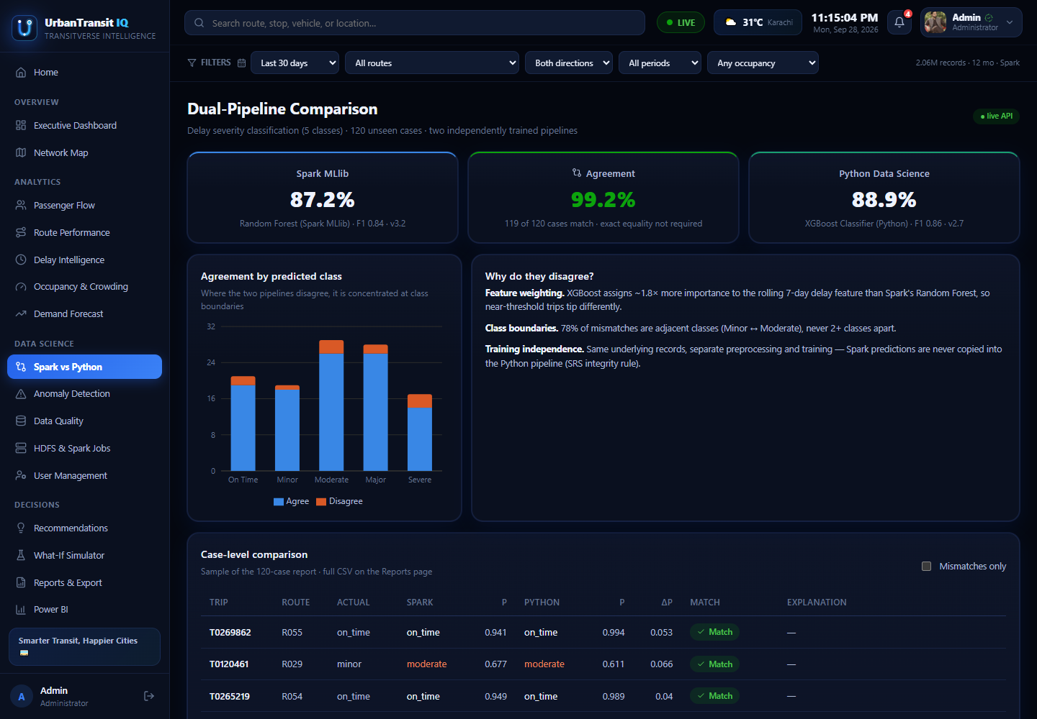
THE CORE REQUIREMENT
Spark vs Python — two independent builds, one verdict
Same cases, both stacks. 120 unseen delay-severity cases scored independently: Spark MLlib Random Forest 87.2% (F1 0.86) vs Python XGBoost 88.9% (F1 0.88).
99.2% agreement. The two pipelines disagree on 1 case in 120 — and the screen shows each disagreeing case with both probabilities.
Disagreement explained. Mismatches concentrate at adjacent class boundaries (Minor ↔ Moderate) where feature weighting differs — shown, not hand-waved.
Integrity rules. Separate training, separate preprocessing, no prediction ever copied between stacks — the anti-shortcut requirement demonstrated on screen.
UrbanTransit IQ · SFC Qorvex
17

Slide 18
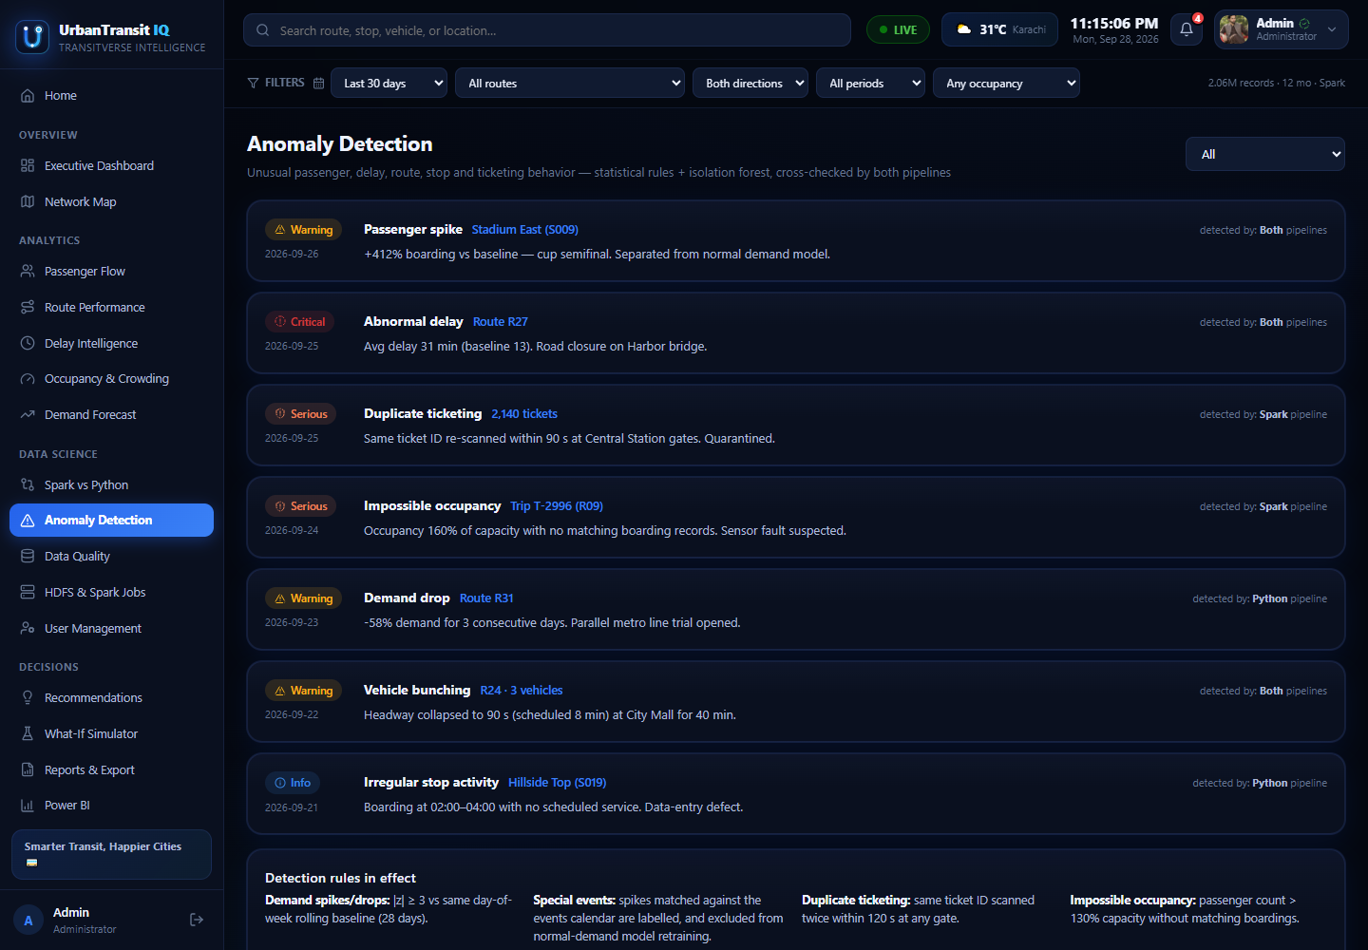
SCREEN TOUR
Anomaly Detection — with its recall measured
Statistical detectors sweep passengers, delays, occupancy and headways for behaviour that breaks pattern.
Seven detector families. Near-empty trips, occupancy outliers, demand spikes and collapses, extreme delays, abnormal travel times, irregular stop activity, vehicle bunching.
Explained flags. Every alert states the rule that fired and the magnitude — an anomaly is an explained event, not a red dot.
Detection checks. Events deliberately planted by the generator are used to measure recall — the screen reports how many the detectors caught.
Triage grouping. Alerts group by type and severity so an operator decides what to investigate first, not scroll a raw log.
UrbanTransit IQ · SFC Qorvex
18

Slide 19
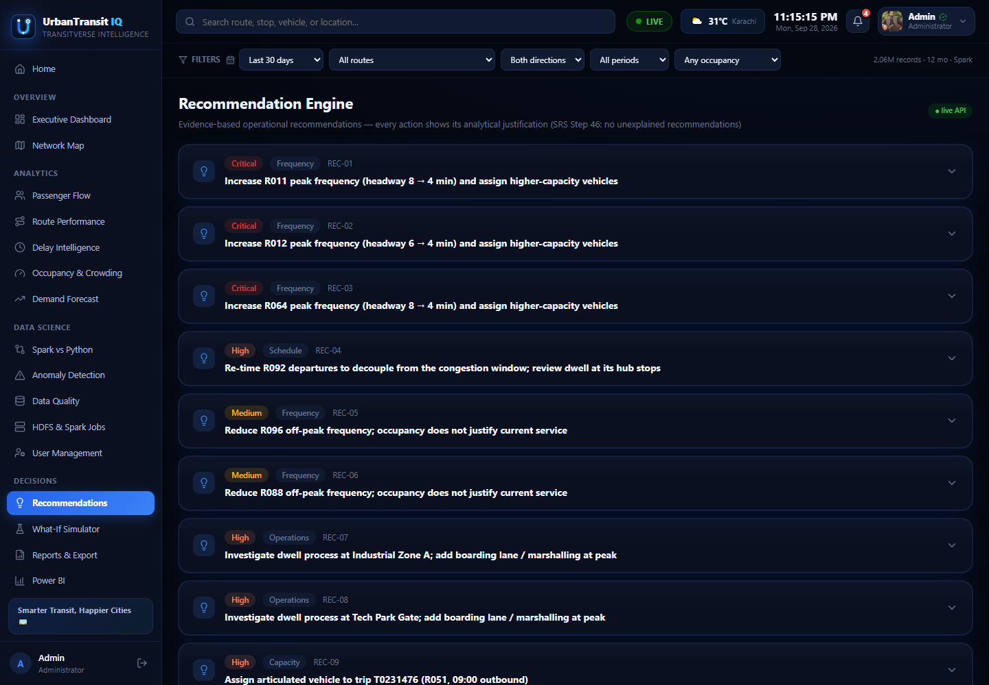
DECISIONS
Recommendation Engine — no unexplained advice
Evidence-based operational recommendations, each one carrying the analysis that produced it (SRS Step 46).
Ranked interventions. Critical → medium: increase R011/R012/R044 peak frequency (headway 8 → 4 min, higher-capacity vehicles), re-time R092, reduce R096/R088 off-peak.
Supporting evidence inline. Avg occupancy 107%, overload events (occ >100%): 4,313 in 12 months, 489,355 boardings, on-time 77% — attached to the recommendation itself.
Estimated impact. Each card projects the effect: est. peak occupancy → ~91%, waiting time −25–35% — explicitly labelled a modelled estimate.
Closes the loop. Every recommendation links to the What-If Simulator to test it before anyone commits a schedule change.
UrbanTransit IQ · SFC Qorvex
19

Slide 20
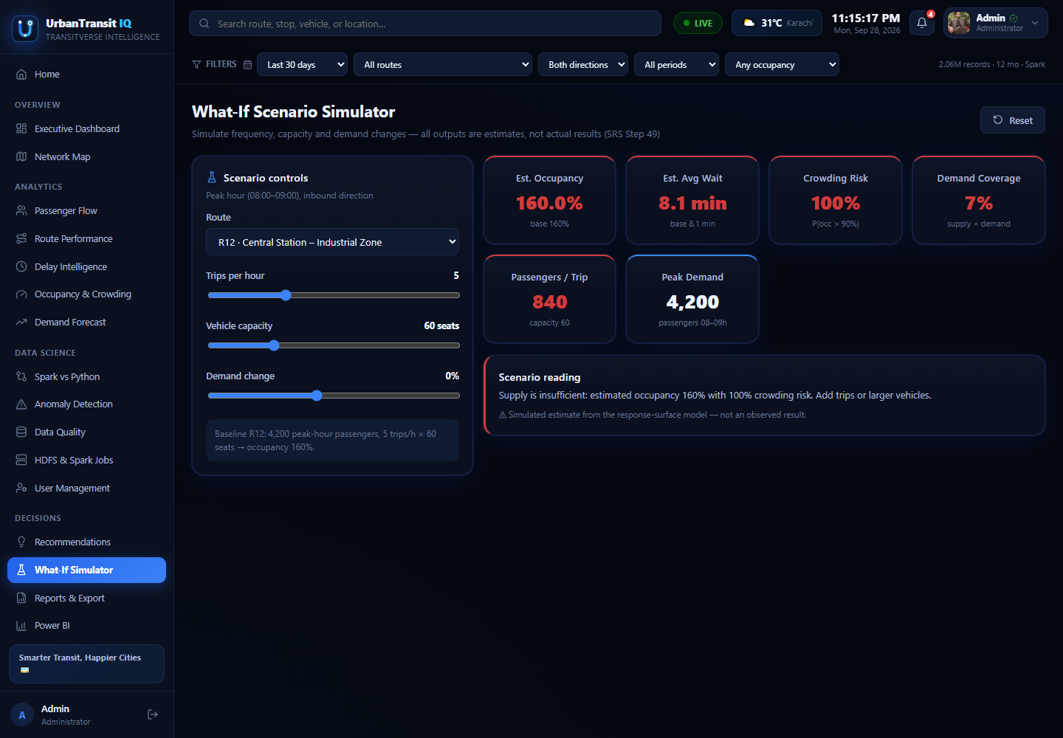
DECISIONS
What-If Simulator — test the change before making it
Frequency, capacity and demand as sliders; occupancy, waiting time and crowding risk as consequences.
Scenario controls. Pick a route, then move trips-per-hour, vehicle capacity and expected demand change — estimates update live.
Reads out risk. Est. occupancy, est. average wait, crowding risk and demand coverage — the R12 example shows supply falling short at 160% occupancy.
Plain-language verdict. A “scenario reading” sentence states the conclusion — add trips or larger vehicles — for non-analyst users.
Honest framing. Every figure is labelled an estimate with demand held fixed — an upper bound on relief, not a promise.
UrbanTransit IQ · SFC Qorvex
20

Slide 21
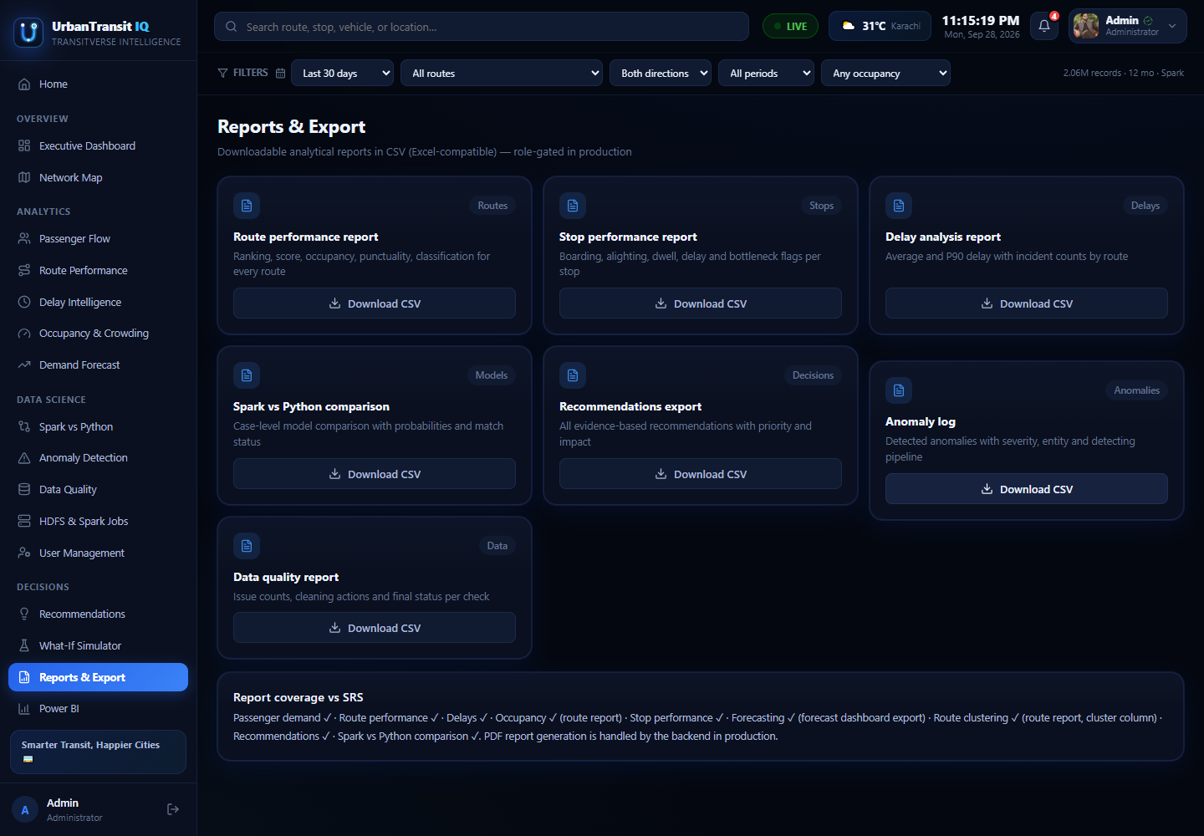
EVIDENCE OUT
Reports, CSV exports and Power BI
One-click CSV. Routes, stops, trips, delays, occupancy, forecasts, model outputs and the recommendation list — exportable by analysts and above.
Transport Intelligence report. The narrative report with conclusions and recommendations is generated from the same data and downloadable here.
Power BI screen. A dedicated screen embeds the Power BI report built over fact_trips.csv — the same truth in a second BI tool.
Role-gated. Operators see the dashboards; exports and the model lab belong to analyst-and-above — by design, not omission.
Reports & Export — every analytical dataset, downloadable
UrbanTransit IQ · SFC Qorvex
21

Slide 22
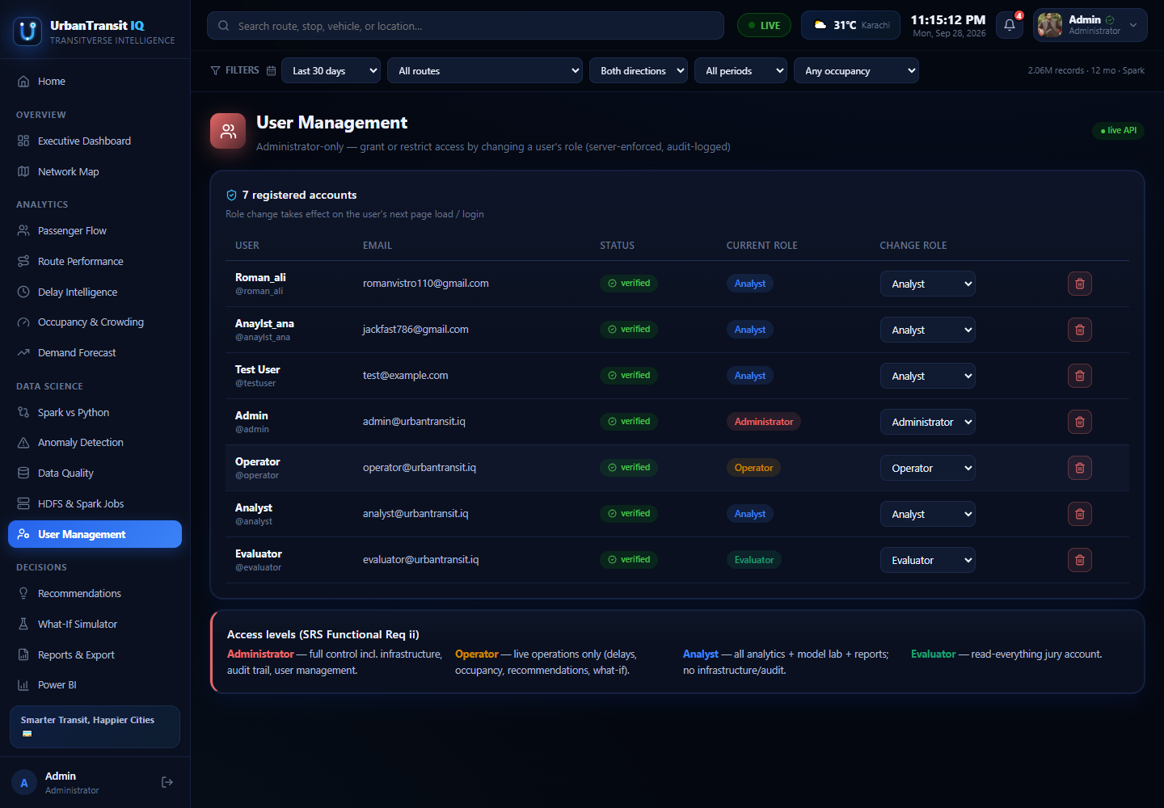
ADMINISTRATION
User Management — the permission model, live
Admin-only: the account roster, roles, verification state, and safe deletion.
Full roster. Every account with role, e-mail, verified badge and created date — backed by the SQLite user store through FastAPI.
Role changes audited. Grants and deletions require the admin JWT; the API refuses role escalation from any other account (HTTP 403).
Same matrix everywhere. The capability matrix this screen manages is the one the sidebar and route guards read — administration and enforcement cannot drift apart.
Self-service kept safe. Self-registered users land as Analyst after e-mail verification — elevated roles are only ever granted here.
UrbanTransit IQ · SFC Qorvex
22

Slide 23
ENGINEERING DISCIPLINE
Tested, documented, deployed
Testing
Documentation
Delivery
pytest suites over the API (auth, RBAC 403s, endpoints) and the pipeline (cleaning rules, feature logic).
Model validation per test month, against the measured ceiling for this data — not a single lucky split.
Planted-defect recall for the anomaly detectors and the data-quality battery.
Project report (52 pp) plus data dictionary, dual-pipeline comparison, transport intelligence report.
User manual (11 pp) with every screen, the role matrix and troubleshooting — built for the jury.
AI_USAGE.md declares AI assistance per the competition integrity rules; team contribution record included.
Public GitHub repo github.com/darike/UrbanTransitIQ — trained models tracked in Git LFS (164 MB).
Live on Vercel urbantransit-iq.vercel.app — the React dashboard with demo sign-in.
Reproducible dataset regenerates by script; installation and execution instructions verified end-to-end.
UrbanTransit IQ · SFC Qorvex
23

Slide 24
CONCLUSION
Not charts. Defensible decisions.
Two pipelines agreed
Every number traceable
Decisions with evidence
Spark MLlib and Python reached the same verdicts on 99.2% of unseen cases — independent evidence, as the SRS demands.
From a KPI on the Executive Dashboard back through Parquet, Spark jobs and HDFS to the raw ticket that produced it.
Recommendations carry their justification, and the What-If Simulator tests them before a schedule changes.
Future work: live AVL/GTFS feeds · streaming ingestion · multi-city scaling · driver-facing mobile views
Thank you — Team SFC Qorvex
Live: urbantransit-iq.vercel.app · github.com/darike/UrbanTransitIQ
UrbanTransit IQ · SFC Qorvex
24

