Slide 1

SMART INDIA HACKATHON 2026
TITLE PAGE
Problem Statement ID – 26117
Problem Statement Title- Sovereign On-Premise Agentic AI Workbench using Open-Weight Multimodal LLMs for Confidential Industrial Work
Theme-Smart Automation
PS Category- Software
Team ID-
Team Name- Neoteric

Slide 2




L.U.M.I. — Local Unified Multimodal Intelligence
Neoteric
Problem
🔐
🤖
On-Premise &
Air-Gapped
Why Different?
Agentic AI
Refineries, PSUs, Defence units, and Government offices handle highly confidential documents and knowledge work and Cloud AI tools cannot be used because sensitive nature of the data Manual processing is Slow and inefficient, and existing ai solutions lacks deployable multi-model, agentic, multimodal, fully local workbench.
Data stays fully within the organization.
Plans, acts, verifies, and delivers.
🔐 Data Sovereignty:
Fully on-premise & air-gapped.
Our Solution
🧠
👁️
Multimodal Intelligence
🧠
Private RAG + Multi-Model AI
🏭 Industrial Workbench:
RAG, OCR/VLM, tools & document automation.
Right model for every task.
Handles PDFs, scans, images & drawings.
Right model for every task.
🤖 Agentic AI: Plans, executes, verifies & delivers.
How it addresses the problem statement
🧠 Multi-Model AI :
Right model for text, code, images & engineering tasks.
Rather than a basic chatbot, its agentic workflow uses local tools and RAG to execute tasks, run code in sandboxes, and export verified Office deliverables without the possibility of data leaks

Slide 3
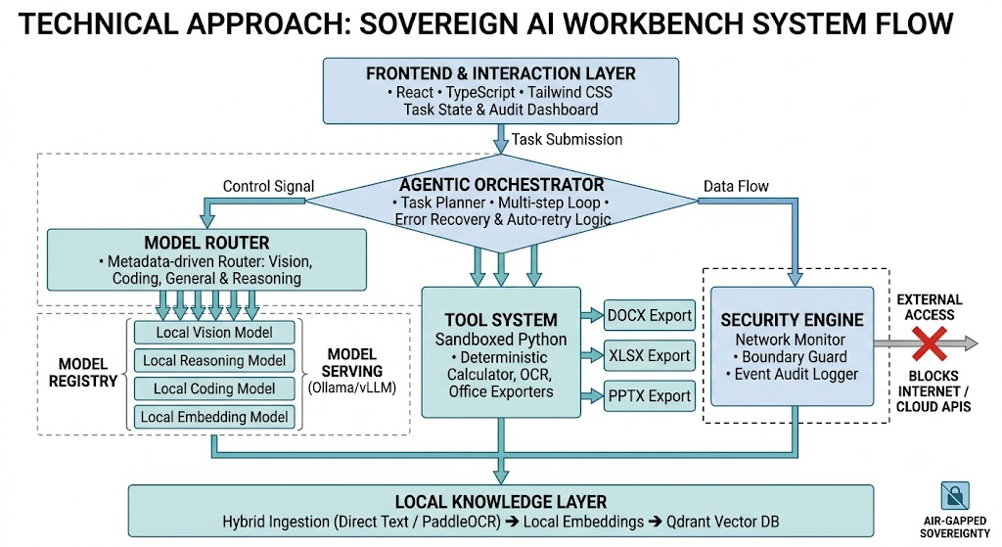
TECHNICAL APPROACH
Neoteric
Local Model Serving & Inference
Open-weight Model Registry: Qwen3-14B — Q4_K_M GGUF Main agent, reasoning, planning, document analysis, RAG synthesis.
Qwen2.5-Coder-7B-Instruct — Q4_K_M GGUF Coding agent, Python generation, debugging, data analysis.
Qwen3-VL-8B-Instruct — Q4_K_M GGUF Vision, scanned documents, images, P&IDs, engineering drawings.
mmproj-Qwen3VL-8B-Instruct-F16.gguf Qwen3-Embedding-0.6B Local embeddings for the RAG system. Qwen3-Reranker-0.6B
Backend API
Python FastAPI
OCR & Computer Vision
PaddleOCR / Tesseract OpenCV

Slide 4
FEASIBILITY AND VIABILITY
Neoteric
Feasibility of Idea
Potential challenges and risk
VRAM Bottlenecks: Concurrent model loading can exceed GPU memory.
Accuracy & Hallucinations: LLMs may miscalculate or misinterpret technical diagrams.
Sandbox Breaches: Unsecured code execution risks exposing host filesystems.
TECHNICAL FEASBILITY
The technical feasibility relies on running quantized open-weight models, local OCR, and vector search entirely on-premise using a single mid-range GPU, while safely executing code in isolated Docker containers to generate real Office deliverables.
Strategy for overcoming these Challenges
Sequential VRAM Swapping: Load models on-demand and unload inactive ones to stay under GPU memory limits.
Deterministic Code Execution: Offload math to sandboxed Python scripts and mandate human approval for critical steps.
Isolated Docker Sandboxing: Run code in non-root containers scoped strictly to single task directories.
Market feasibility
The market feasibility is strongly driven by the surging multi-billion dollar demand from defence, PSUs, and heavily regulated industries seeking air-gapped sovereign AI solutions to comply with data residency mandates and avoid public cloud security risks.

Slide 5
IMPACT AND BENEFITS
Neoteric
Delivers deterministic code execution and strict access control for regulatory peace of mind.
Benefits
Complete Data Sovereignty
Avoids recurring per-token cloud API fees through one-time, localized infrastructure deployment.
Drastic Cost Reductions
Potential impact
Zero Cloud Reliance
Air-Gapped Data Sovereignty
Audit-Ready Compliance
Audit-Ready Compliance
Ensures continuous AI productivity during ne twork outages or strict offline operations.
High Efficiency
Accelerated Operational Efficiency
Future prospects
Cost Savings
Defense & PSU Expansion: Scalable adoption across sovereign defense units and public infrastructure.
Zero External Dependencies
Speeds up document parsing, report generation, and data analysis for engineering teams.
Tactical Edge AI: Future deployment onto field hardware and mobile command micro-nodes.
Eliminates cloud leakage risks by keeping critical industrial intellectual property fully on-premise.

Slide 6
RESEARCH AND REFERENCES
Neoteric
Details / Links of the reference and research work

Slide 7
IMPORTANT INSTRUCTIONS
Please ensure below pointers are met while submitting the Idea PPT:
Kindly keep the maximum slides limit up to six (6). ( Including the title slide)
Try to avoid paragraphs and post your idea in points /diagrams / Infographics /pictures
Keep your explanation precise and easy to understand
Idea should be unique and novel.
You can only use provided template for making the PPT without changing the idea details pointers (mentioned in previous slides).
You need to save the file in PDF and upload the same on portal. No PPT, Word Doc or any other format will be supported.
Note - You can delete this slide (Important Pointers) when you upload the details of your idea on SIH portal.

