Slide 1
Biomass resilience of Neotropical secondary forests data analysis
Darin Brock

Slide 2
Goals and Methods of the Study
Goals:
Determine how biomass recovery rates in tropical secondary forests are influenced by climate, landscape, and land-use.
Methodology:
Survey ~1500 plots over 45 forest sites throughout tropical Latin America for biomass/ha
Use old growth forests as a control group

Slide 3
Data
Five columns in the data:
Location
Age of the forest
Biomass per hectare (Mg/ha)
Primary investigator
Reference
Primary difficulty in data parsing is in columns 1 and 2

Slide 4
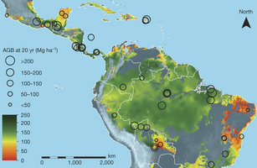

Slide 5
Proposed analysis
Split data into groups based on location
Run statistical analysis to test correlation between age and biomass for each location, plot the biomass vs age as well for each location
Run statistical analysis and plotting on all the data at once to see overall trends
Acquire the climate data for the locations and run statistical tests to see if it is more significant than the age data.

