Slide 1
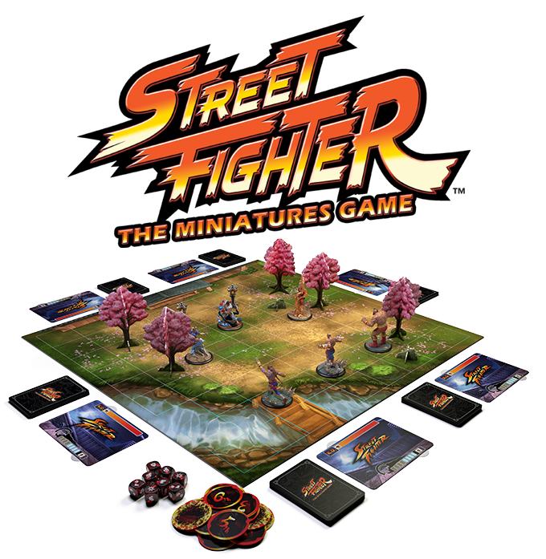
Street fight game
Ram Bharati (Bex027)
Pukar Giri (Bex025)
Sushil Khadka(Bex046)
Rikrish Shrestha(Bex030)

Slide 2

Time Allotment
10 min Presentation
5 min QnA session and Project Demo

Slide 3
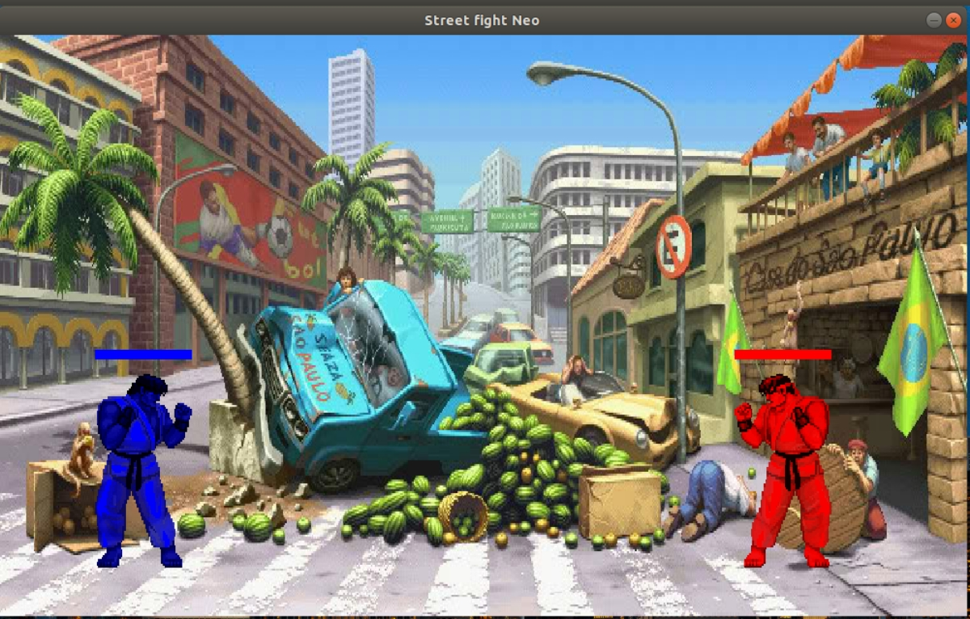
Overview
Fighting games as we know them nowadays emerged during the golden period of arcade halls. Fighting games short play sessions, player versus player and competitive nature suited well into the dark rooms of arcades. During the downfall of arcade halls, fighting games also saw a drop in popularity. This lead into a decade of obscurity and silence as the genre saw few new games.

Slide 4
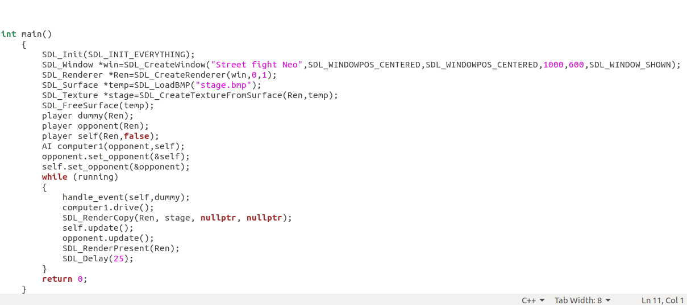
SDL(Simple DirectMedia Layer)
Simple DirectMedia Layer is a cross-platform software development library designed to provide a hardware abstraction layer for computer multimedia hardware components.
#include<SDL2/SDL.h> we have include this library to get different abstraction layer to interface with harware and to provide low level access to audio, keyboard, mouse, joystick, and graphics hardware via OpenGL and Direct3D. ... SDL 2.0 is distributed under the zlib license..

Slide 5
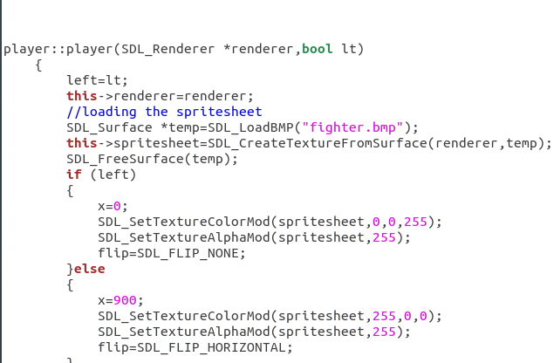

Slide 6
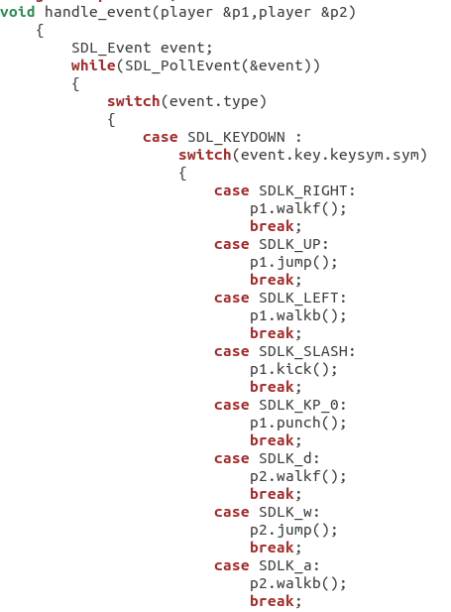
Event Handling
Event Handling: Any program that uses GUI (graphical user interface) such as Java application written for windows, is event driven. Event describes the change in state of any object. For Example : Pressing a button, Entering a character in Textbox, Clicking or Dragging a mouse, etc.
Here, we have given different event like right, left, up, down which help us to put different features to our object.

Slide 7
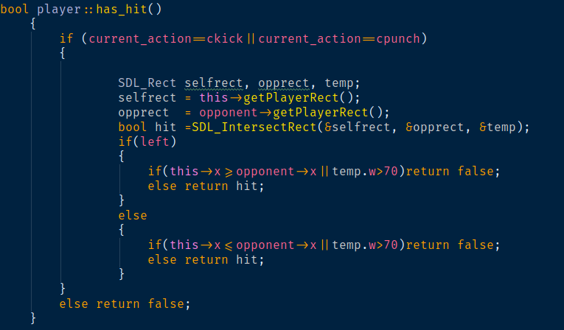
Collision Detection
Collision detection is the computational problem of detecting the intersection of two or more objects. While collision detection is most often associated with its use in video games and other physical simulations, it also has applications in robotics.

Slide 8
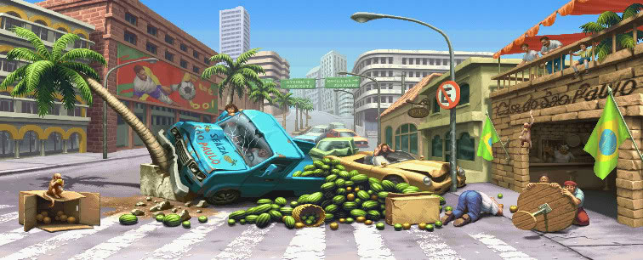
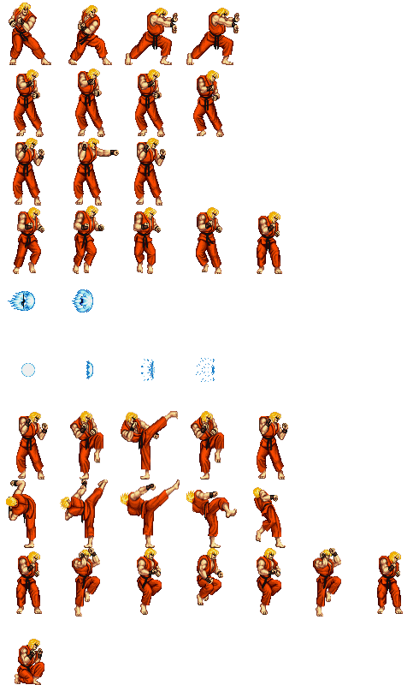
sprites
A sprite sheet is a bitmap image file that contains several smaller graphics in a tiled grid arrangement. By compiling several graphics into a single file, you enable Animate and other applications to use the graphics while only needing to load a single file.

Slide 9
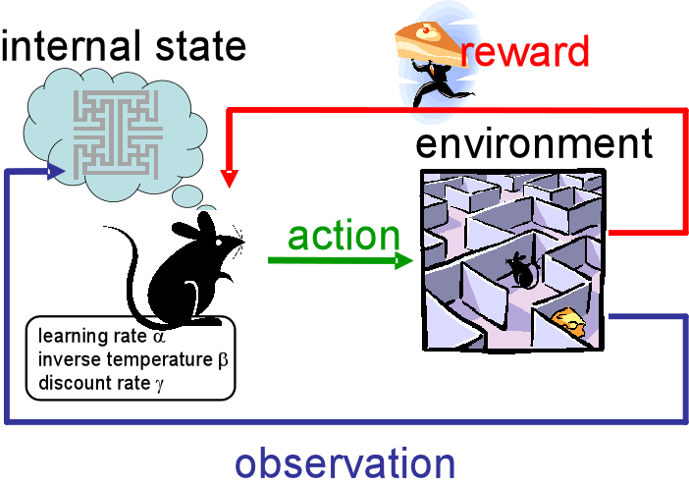
Artificial Intelegence
As machine learning technique we have used the Reinforcement learning algorithm to let the AI learn depending on how the user plays the game.

Slide 10
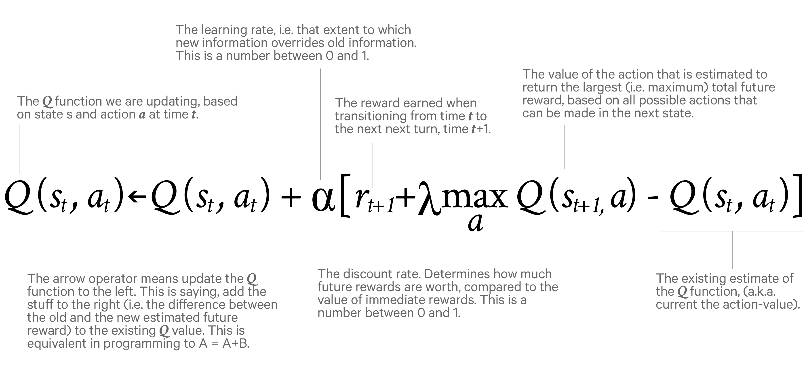
Reinforcement learning
Reinforcement learning is an area of machine learning concerned with how software agents ought to take actions in an environment so as to maximize some notion of cumulative reward.
Q learning Q-learning is a model-free reinforcement learning algorithm. The goal of Q-learning is to learn a policy, which tells an agent what action to take under what circumstances. It does not require a model of the environment, and it can handle problems with stochastic transitions and rewards, without requiring adaptations.

Slide 11
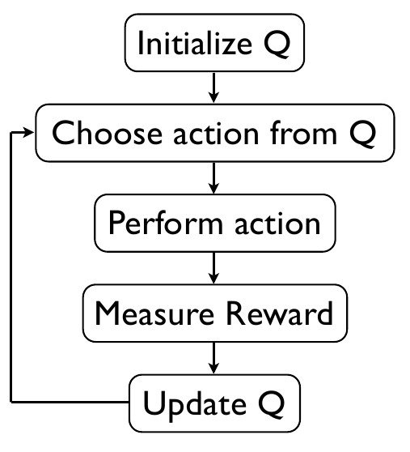

Slide 12
Networking
UDP broadcast is a technique that allows sending UDP datagram from a single source to all computers in a LAN. In order to send a UDP datagram addressed to all computers in the local area network it needs to be sent to a special address called the Broadcast address.
The process by which two devices initiate communications. Handshaking begins when one device sends a message to another device indicating that it wants to establish a communications channel. The two devices then send several messages back and forth that enable them to agree on a communications protocol.
Broadly speaking, there are two ways to handle concurrent requests to a server. Threaded servers use multiple concurrently-executing threads that each handle one client request, while evented servers run a single event loop that handles events for all connected clients

Slide 13
Thank you
Any Questions?

