Slide 1
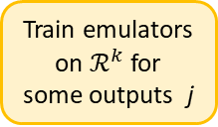
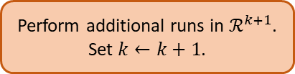
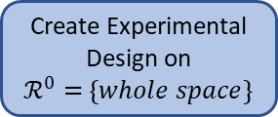
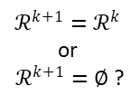
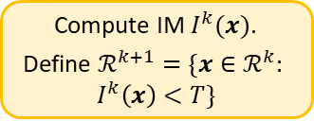

Obtain instantaneous predictions of model outputs
Quantify MD and OE for all outputs of interest
What for?
Train emulators on $ℛ^{k}$ for some outputs j
Compute IM $I^{k}(x)$.
Define $ℛ^{k+1}=\{x∈ℛ^{k}:$
$$I^{k}\left(x\right)<T\}$$
STOP
At step $k≥0$
$ℛ^{k+1}=ℛ^{k}$
or
$ℛ^{k+1}=∅$ ?
YES
Create Experimental Design on
$ℛ^{0}=$ $\{whole space\}$
NO
Perform additional runs in $ℛ^{k+1}$.
Set $k←k+1$.

