Slide 1

Graph Neural Networks For Next Point Of Interest Recommendation
Deep Learning
Dario Loi Elena Muiá Martina Doku
1940839 1938610 1938629
Academic Year 2023/24

Slide 2


Table Of Contents
Context
Data
Proposed Solution
Results
Conclusions

Slide 3
Context ●
Next POI Prediction
The objective of this work is to create a neural network that predicts the next set of POIs suitable for a user.
This work exploits users’ historical check-ins including temporal and spatial information
The prediction utilizes different spatial resolutions (hierarchical levels)

Slide 4
Table Of Contents
Context
Data
Proposed Solution
Results
Conclusions

Slide 5
Data ●○○
Preprocessing
The preprocessing follows the same steps as in the original paper, which are:
Filter out users with visit counts less than 20 and more than 50
Remove POIs visited by less than 10 users
Sort the timestamps in chronological order
Divide the data into training and testing sets keeping the first 80% of the visits for training and the last 20% for testing

Slide 6
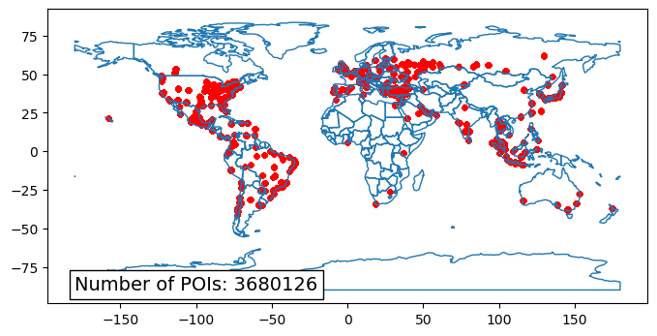
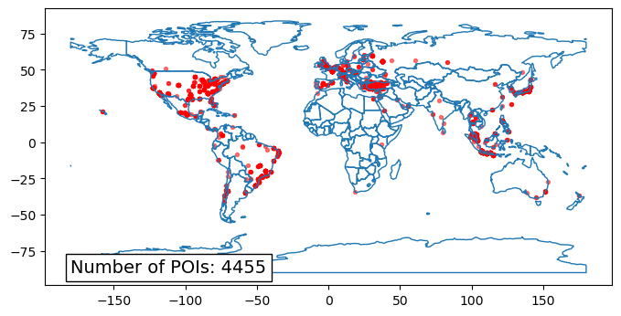
Data ○●○
Preprocessed Data

Slide 7


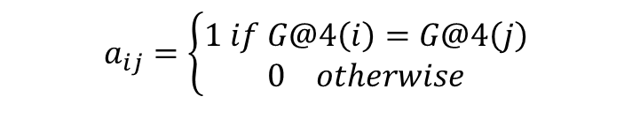
Data ○○●
Graph construction
Spatial Graph
$$a_{ij}=\left\{\begin{matrix}1 if G@4\left(i\right)=G@4\left(j\right) \\ 0 otherwise\end{matrix}\right.$$

Slide 8

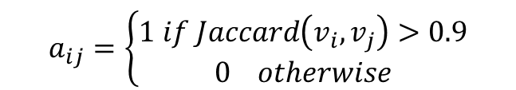
Data ○○●
Graph construction
Temporal Graph
$$a_{ij}=\left\{\begin{matrix}1 if Jaccard\left(v_{i},v_{j}\right)>0.9 \\ 0 otherwise\end{matrix}\right.$$
$$Jaccard\left(v_{i}^{slot},v_{j}^{slot}\right)=\frac{\left|v_{i}^{slot}∩vj^{slot}\right|}{\left|v_{i}^{slot}Uvj^{slot}\right|}$$

Slide 9
Table Of Contents
Context
Data
Proposed Solution
Results
Conclusions

Slide 10
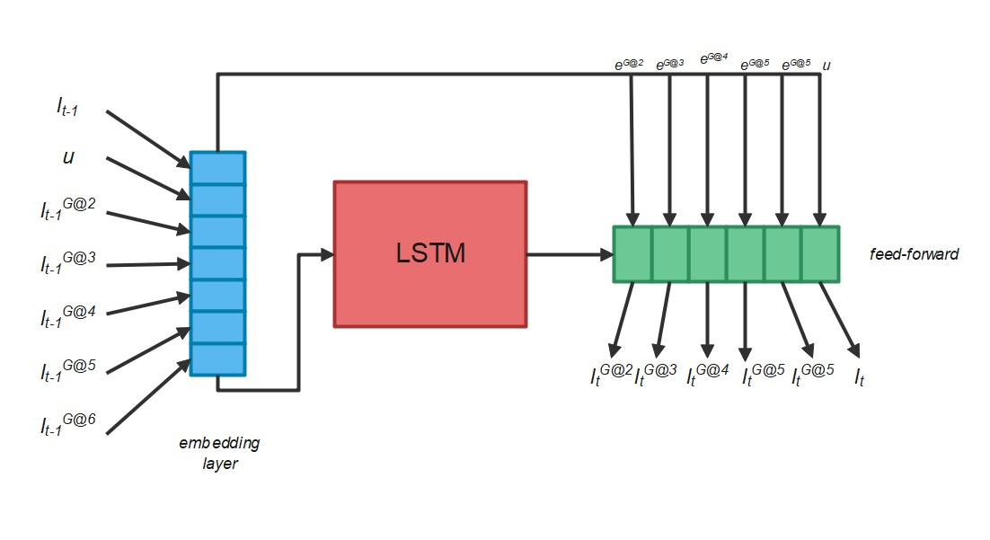
Proposed Solution ●○○
Baseline
Multi-task learning for hierarchical spatial data
Embedding layers for users, POIs, geo-hash levels
LSTM layer captures temporal dependencies
Linear layers predict hierarchical elements
Dropout layer to prevent overfitting
Cross-entropy loss for padded sequences

Slide 11
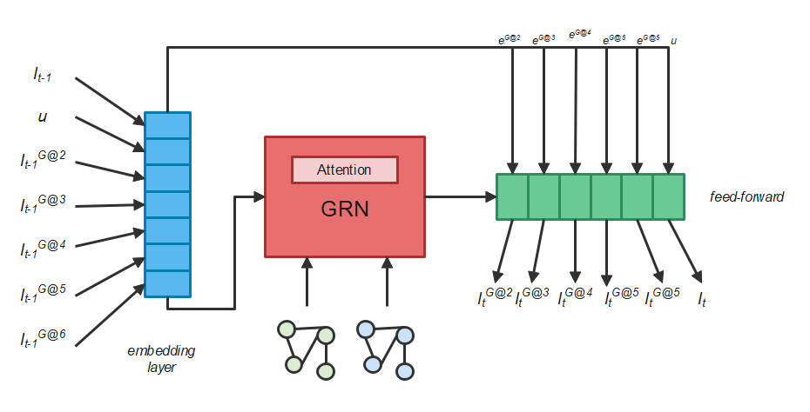
Proposed Solution ○●○
GNN
Enhanced predictive capabilities via spatial and temporal graphs
Attentional LSTM captures temporal dependencies
Linear Layers predict sequence elements across hierarchical levels
Dropout Regularization
Cross-entropy loss

Slide 12
Proposed Solution ○○●
GNN Keypoints
Self-Attention Mechanism:
  Utilizes multi-head attention for enhanced contextual understanding.
Advanced LSTM Gates:
  Integration of multiple data sources (embeddings, hidden states, spatial, and temporal data).
Spatio-temporal neighbor aggregation:
  Robust neighbor extraction and padding for uniform processing.

Slide 13
Table Of Contents
Context
Data
Proposed Solution
Results
Conclusions

Slide 14
Results ●○○○
Metrics
$$Acc@k=\frac{1}{N}\sum_{i=1}^{N}{δ\left(i∈topk\right)}$$
$$MRR=\frac{1}{N}\sum_{i=1}^{N}{\frac{1}{{rank}_{i}}}$$

Slide 15
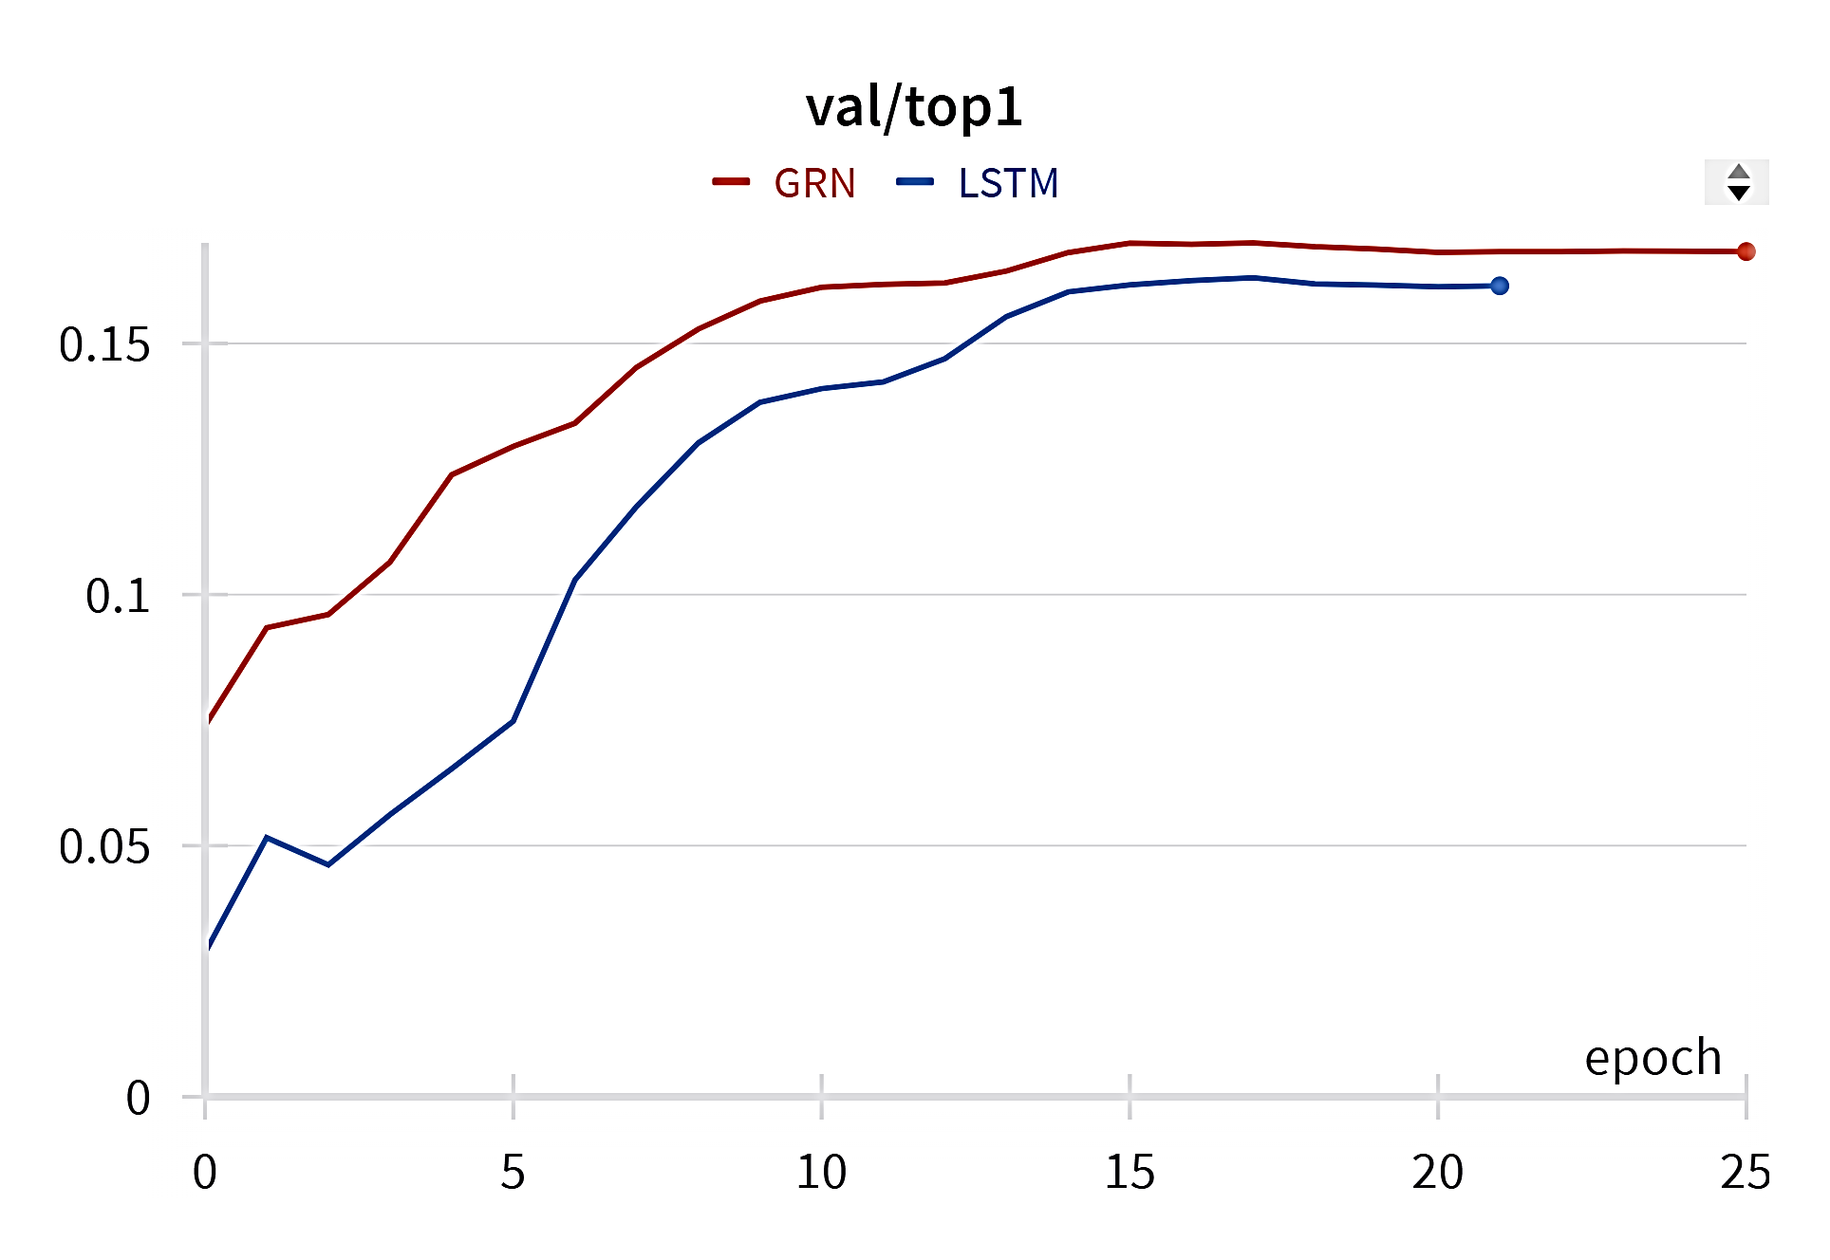
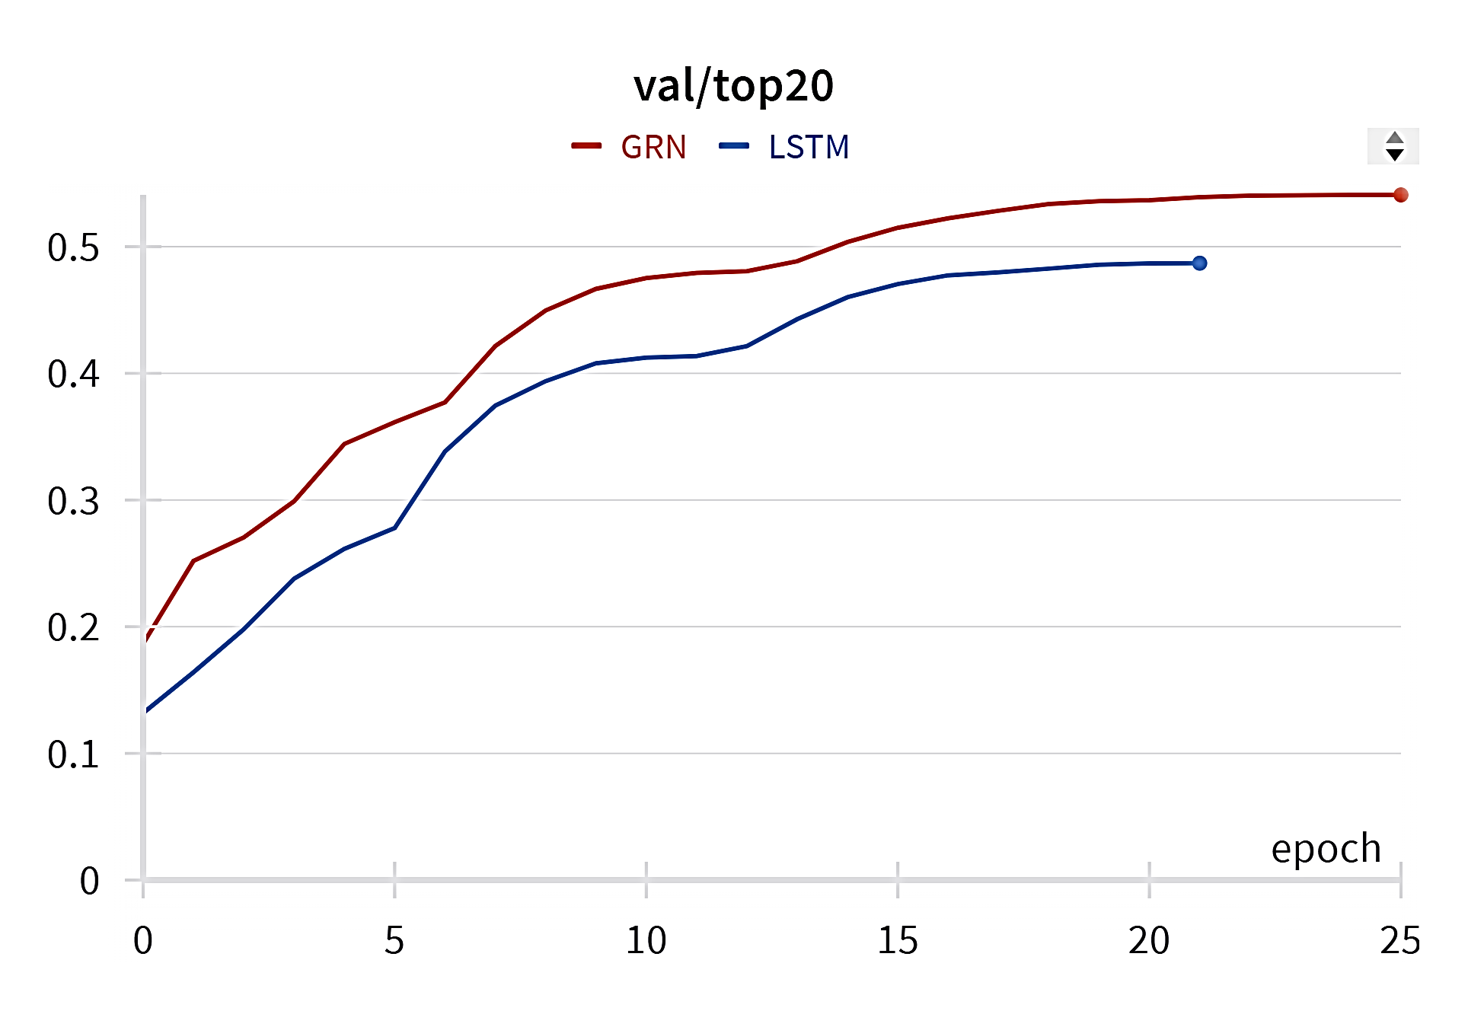
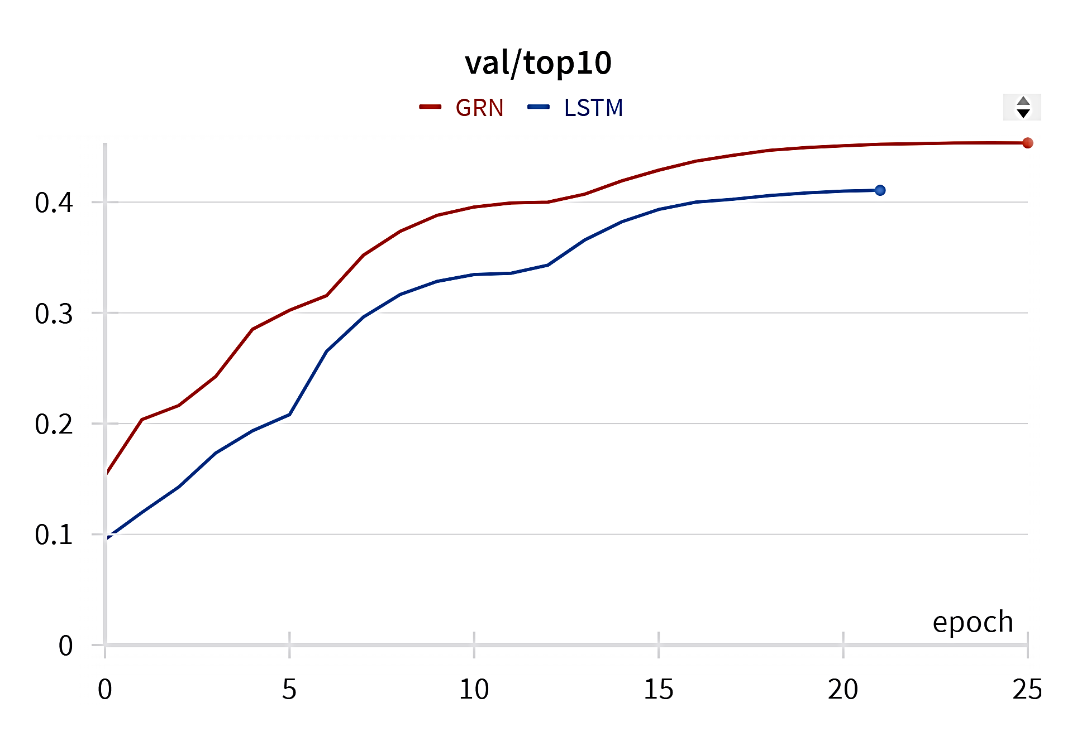
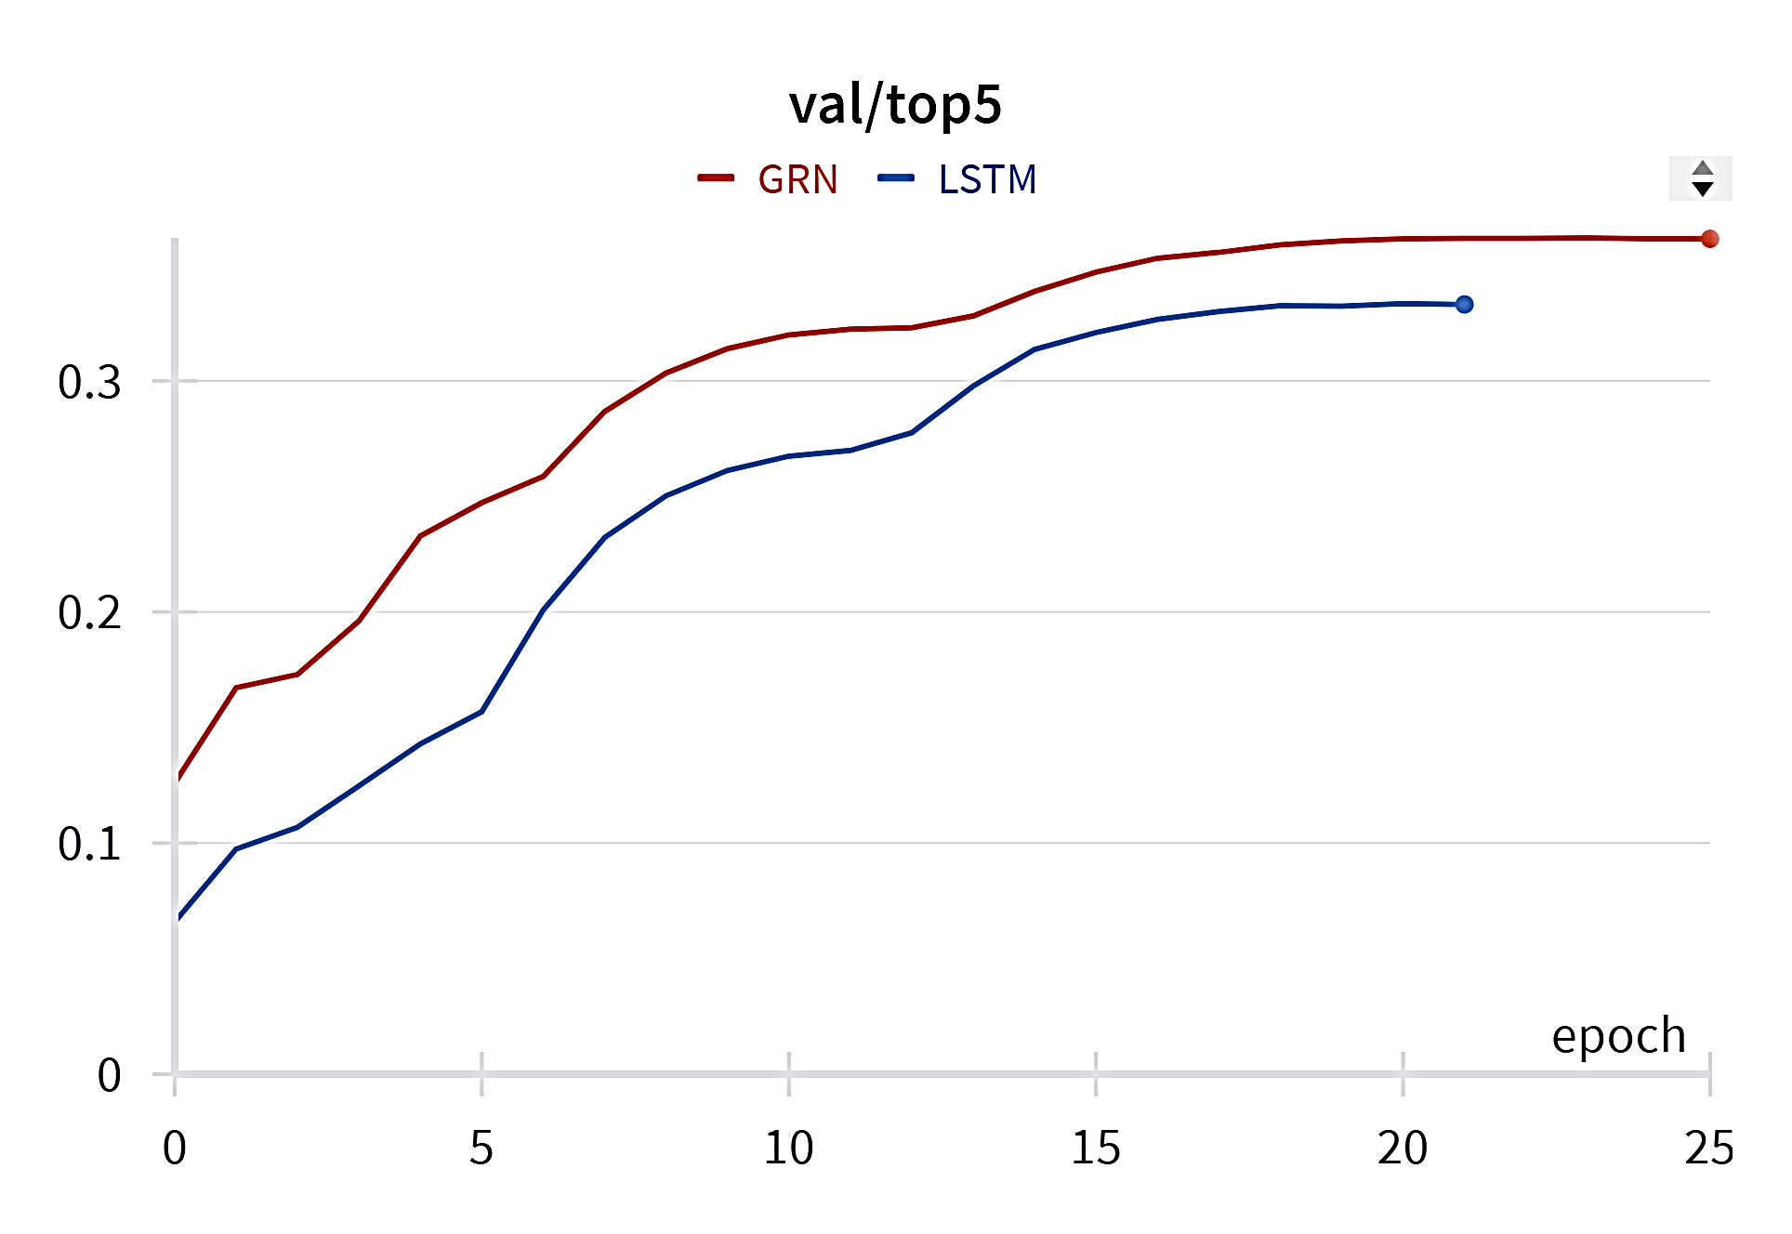
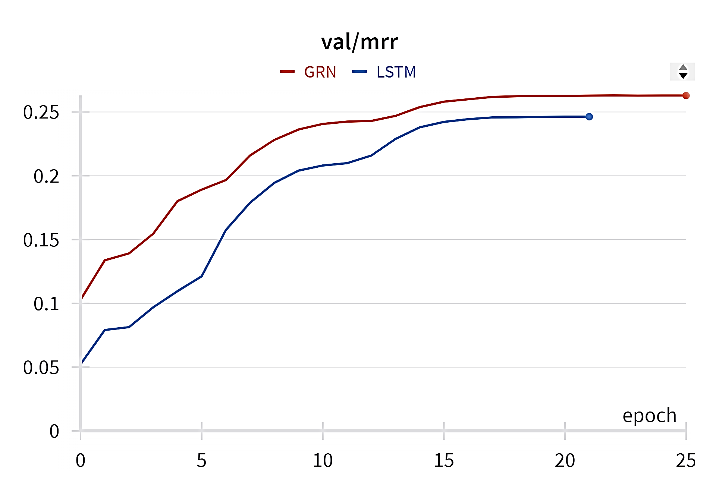
Results ○●○○
Graphs

Slide 16
Results ○○●○
Hyperparameters Tuning
Batch Size Scaling:
Performing a search by progressively increasing the batch size until the GPU memory is saturated or the performance begins to degrade
This helps in maximizing the efficiency of GPU usage and can lead to faster training times without compromising model accuracy
Learning Rate Finder:
Conducting a learning rate range test by training the model over a range of exponentially increasing learning rates

Slide 17
Results ○○○●
Results
Model | Acc@1 | Acc@5 | Acc@10 | Acc@20 | MRR
HMT-RN | 0.143 | 0.267 | 0.321 | 0.378 | 0.205
GRN | 0.145 | 0.278 | 0.339 | 0.403 | 0.212
HMT-RN (ours) | 0.161 | 0.333 | 0.410 | 0.486 | 0.246
GRN (ours) | 0.168 | 0.361 | 0.435 | 0.540 | 0.262

Slide 18
Table Of Contents
Context
Data
Proposed Solution
Results
Conclusions

Slide 19
Conclusions ●
Future work
Our proposal demonstrates results fully comparable to the current state-of-the-art
Leveraging superior hardware will enable us to push the boundaries of what our approach can achieve
We are committed to continuous improvement and staying at the forefront of technological advancements

Slide 20
Graph Neural Networks For Next Point Of Interest Recommendation
Thank you for listening!
Any questions?

