Slide 1
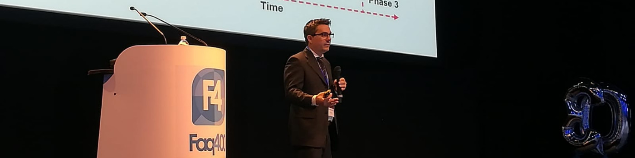
MCP server on IBMi
Dario Carnevale Schianca
https://www.linkedin.com/in/dario-carnevale-schianca-69a9748a/

Slide 2
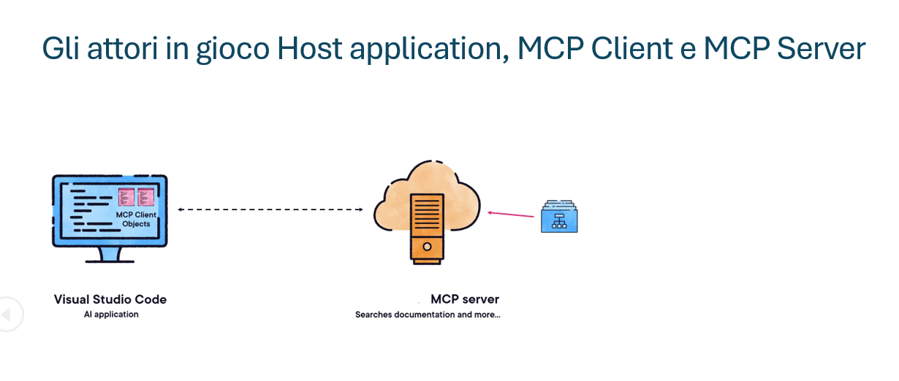

Slide 3
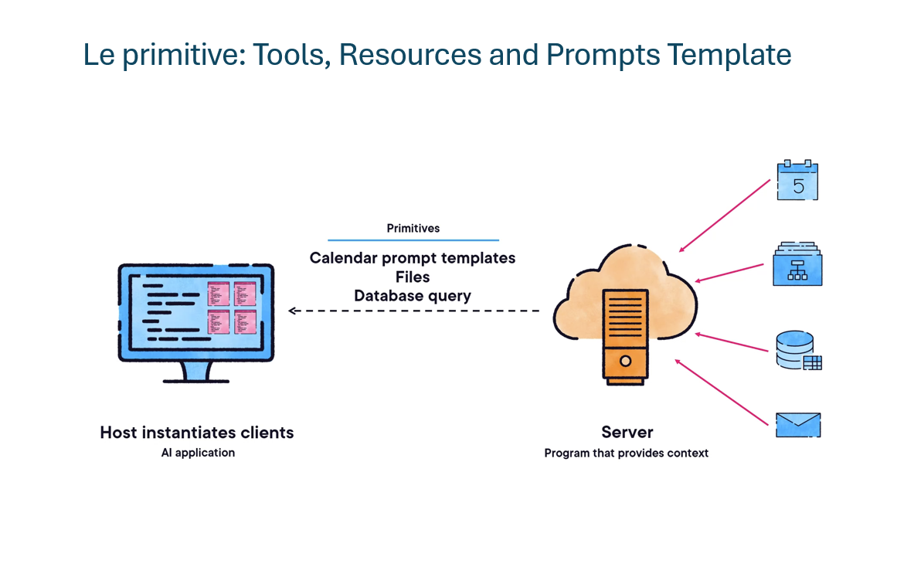

Slide 4
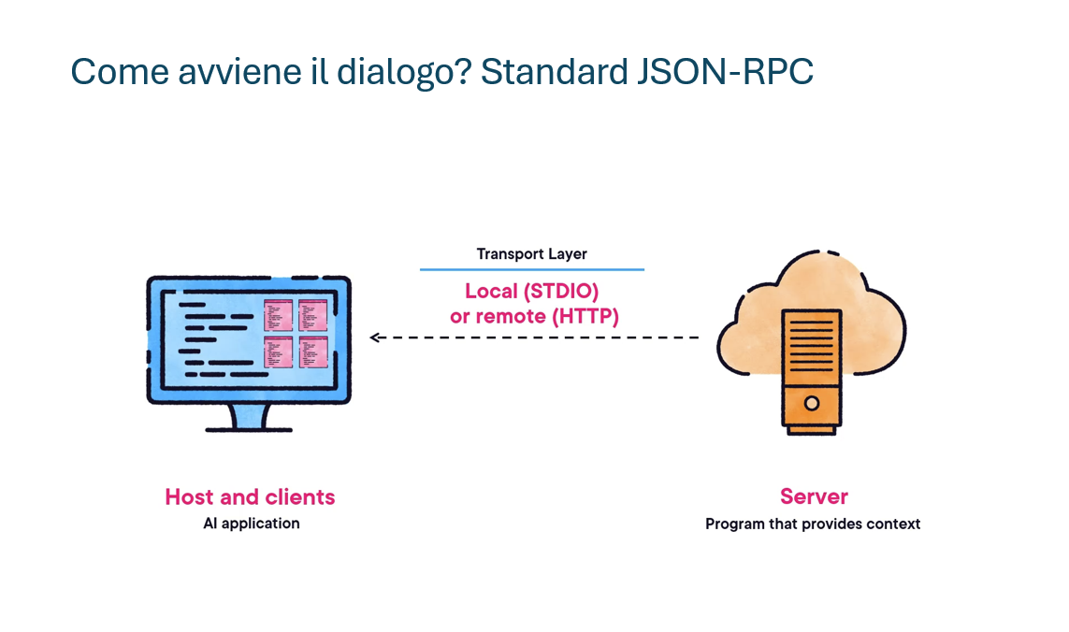

Slide 5
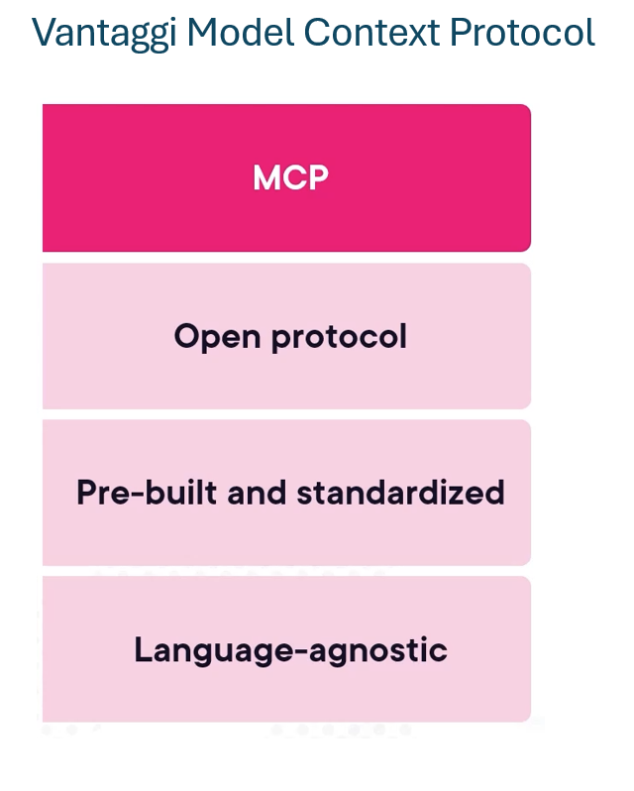

Slide 6
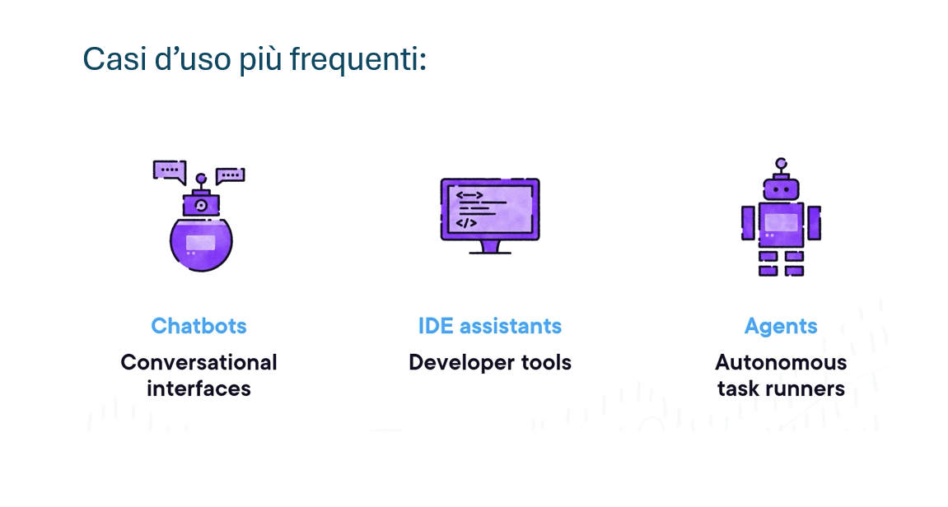

Slide 7
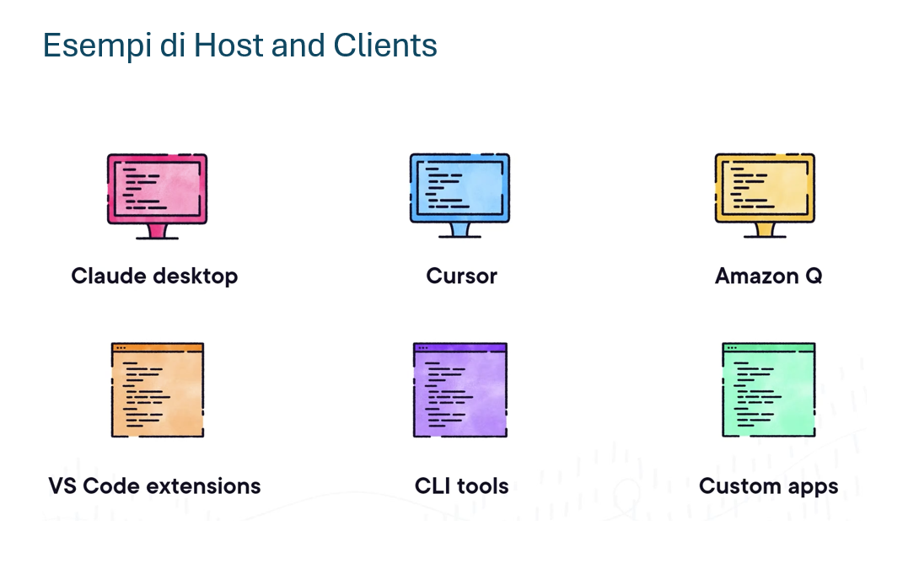

Slide 8
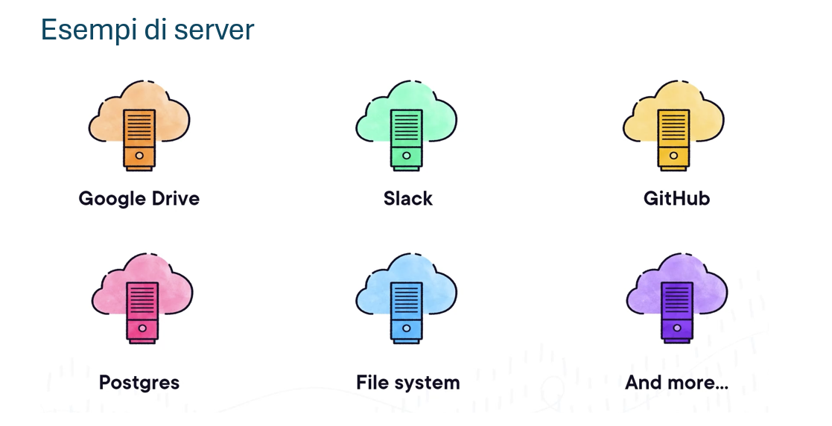

Slide 9
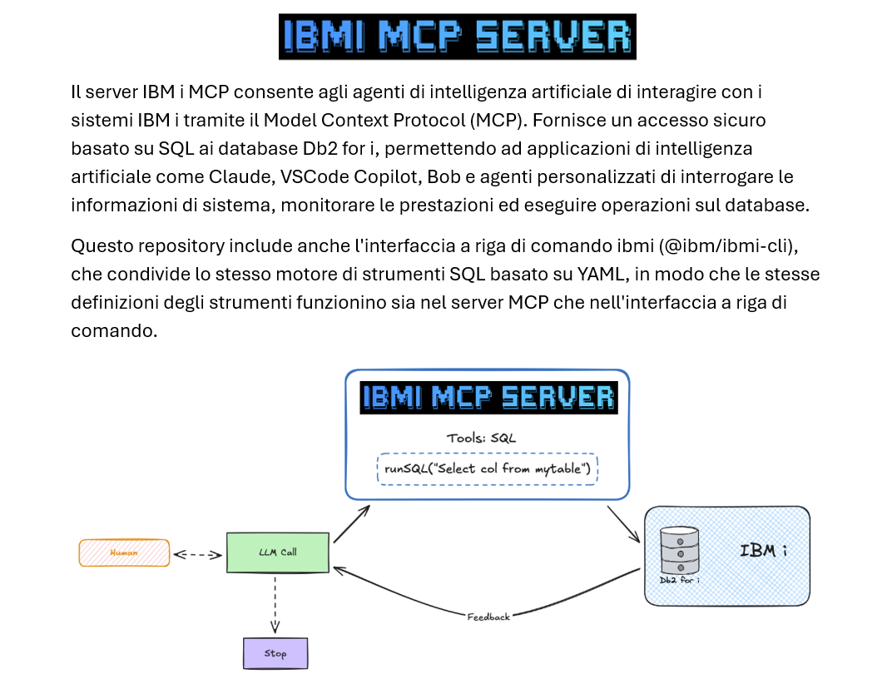

Slide 10

Risorse e documentazione
https://github.com/IBM/ibmi-mcp-server
https://github.com/dariocs/botCF
https://www.itjungle.com/2026/05/04/the-big-easy-connecting-the-dots-on-big-blues-ai-strategy-for-ibm-i/

