Slide 1
Efficient computer vision models for silkworm feeding prediction and habitat analysis
Ana del Río; 2183763 (NIF: 71752954Y)
Darío González; 2186338 (NIF: 71978438F)
Computer Vision (24/25), Sapienza Università di Roma

Slide 2
Outline
Problem statement
State of the art
Proposed method
Dataset
Experimental setup
Model evaluation
Conclusions
References

Slide 3
Problem statement
Automating silkworm feeding monitoring is essential for modern silk farming.
Manual observation is time-consuming and error-prone.
We aim to:
Predict feeding needs (binary classification).
Segment habitat elements (unsupervised segmentation).
Generalize across lighting and environmental variability.

Slide 4
State of the art
CNN-based architectures (MobileNetV2, EfficientNet) are widely used for low-resource classification tasks.
Unsupervised segmentation methods: autoencoders, K-means, IIC, and clustering on embeddings.
Challenges: similar colors between worms and background, shadows, and lack of pixel-wise ground truth.
Few works combine both binary classification and segmentation in silkworm settings.

Slide 5
Proposed method
Binary Classification:
Lightweight CNN (MobileNetV2) + data augmentation + F1-based thresholding.
Unsupervised Segmentation Method:
Convolutional Autoencoder: encodes the image into a latent space
Light Data Augmentation: color jitter + horizontal flip
Embeddings + (X,Y) coordinates used as clustering features
KMeans (k=3): segments silkworms, leaves, and background
Cluster class assignment:
Brightest → silkworms
Greenest → leaves
Remaining → background
Output: segmented image with semantic colors

Slide 6
Dataset
1351 labeled images for feeding classification.
200 unlabeled images sampled for unsupervised segmentation.
All images captured in real silkworm farming environments.
Challenges: occlusion, variable lighting, overlapping objects.

Slide 7
Experimental setup
Classification:
Train/val split: 70/30.
BCEWithLogitsLoss with pos_weight=2.0.
Augmentations: flip, jitter, normalization.
Segmentation:
Unsupervised convolutional autoencoder trained on augmented images
KMeans clustering on embeddings + (X, Y) spatial features
Heuristic-based classification into silkworms, leaves, and background

Slide 8
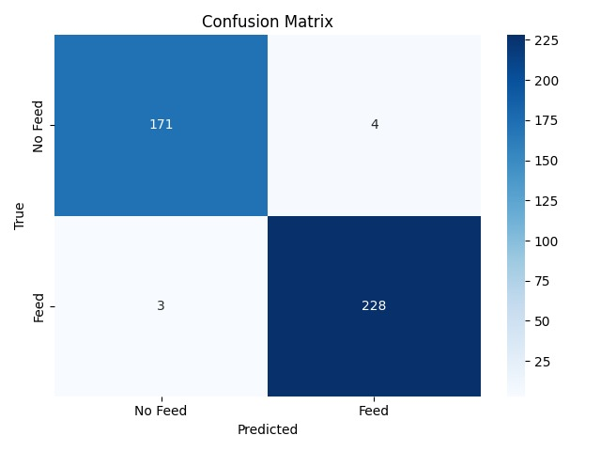
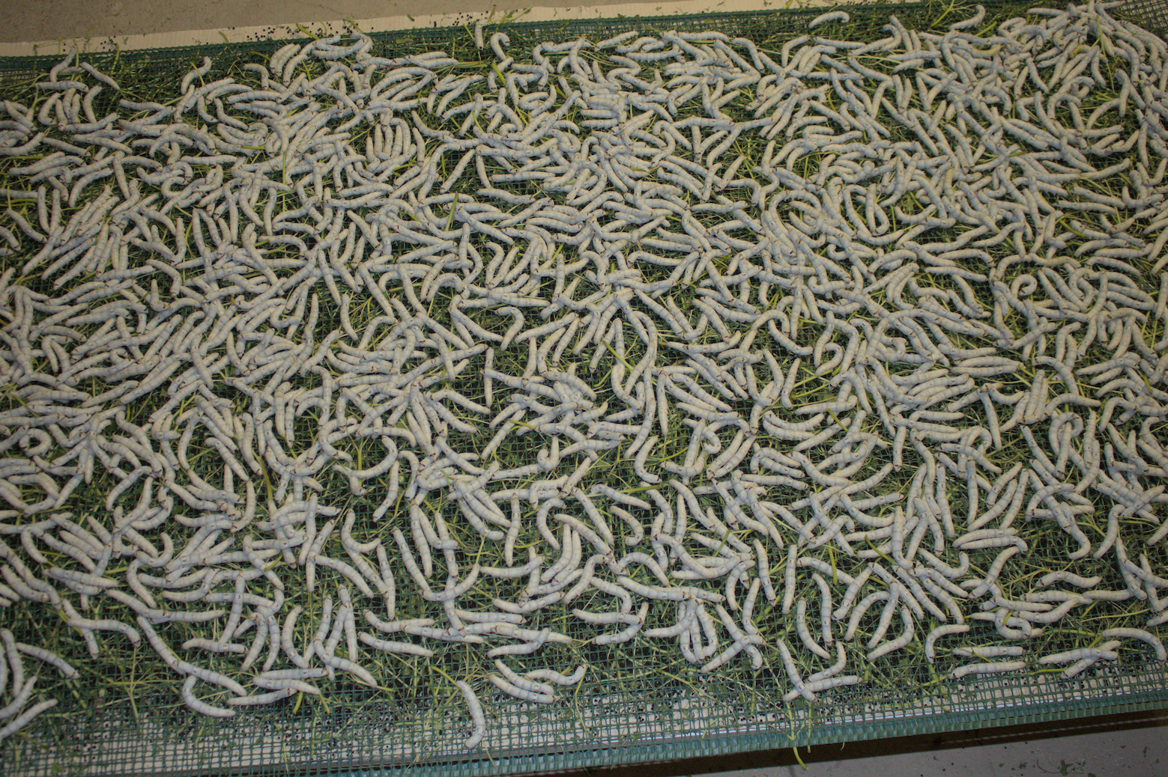
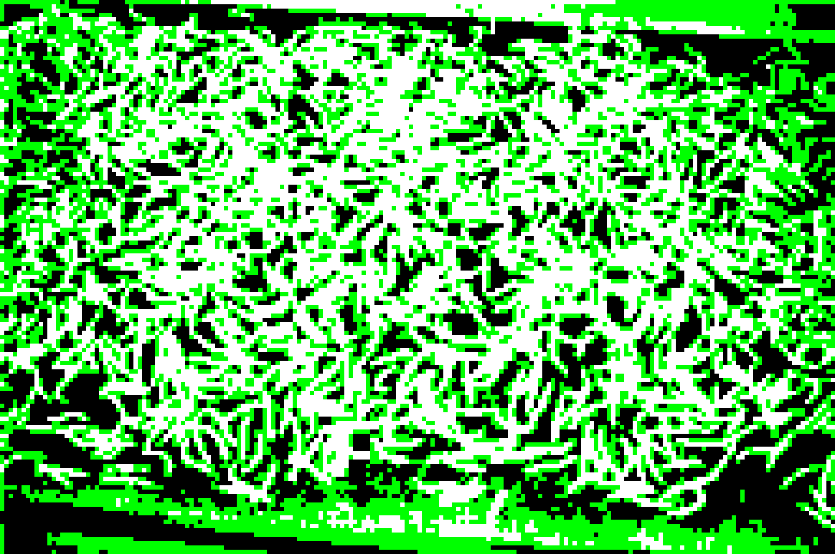
Model evaluation
Classification:
Best F1-score: 0.98 at threshold 0.30.
Precision: 0.98 | Recall: 0.99 | Accuracy: 0.98
Segmentation:
Visual evaluation of masks.
Clear distinction achieved between worms, leaves, and background.
Remaining noise mitigated via morphological filters.

Slide 9
Conclusion
Successfully built a lightweight pipeline for silkworm feeding monitoring.
Unsupervised segmentation works reasonably well even without labels.
Augmentations were crucial for generalization.
Future work: refine segmentation, scale to more data, or introduce self-supervised methods.

Slide 10
References
RepNeXt, EfficientNetV2, MobileViT papers (arXiv).
Semantic segmentation (SLIC, IIC, U-Net references).
Course materials and project guidelines.
2412.04678

