Slide 1


Predict Cancellations: Using Machine Learning to Optimize Hotel Bookings
By: Bryce Chevallier
Dario Melconian
Notes:
Dario

Slide 2

The Dataset
Booking Status - (Canceled / Not Canceled)
Predicted By 17 Potential Predictors
~30k Bookings
The dataset provided uses Brescia Norton’s hotel booking records including multiple variables that might have an impact on our dependent variable – Booking Status.
Notes:
Bryce

Slide 3
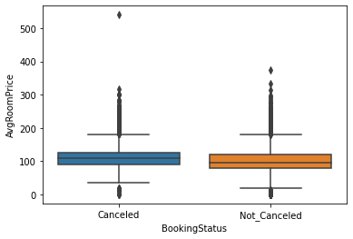
Data Cleaning/Processing
Checked all distribution for validity
Checked NA values - None
Removed an outlier with high room price
Removed 5 bookings who ordered “Meal Plan 3”
Boxplot of Booking Status vs. Avg Room Price
Notes:
Bryce

Slide 4
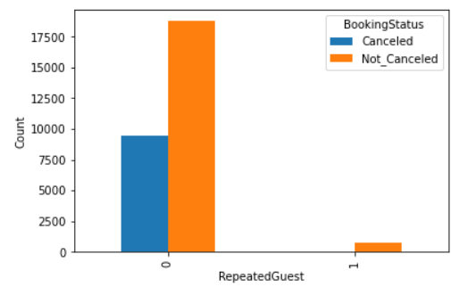
Exploratory Insights
Histogram of Booking Status Count with Repeated Guests
1.8% of repeated guests have cancelled
33.6% of non-repeated guests have cancelled
Notes:
Dario

Slide 5
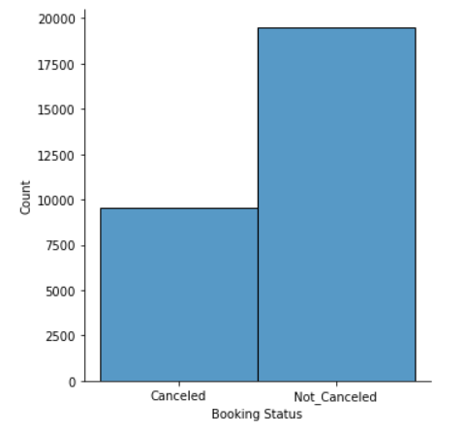
Exploratory Insights
Bar Graph of Booking Status Counts with Cancellations
No prior upsampling or downsampling was required due to a balanced sample of the response variable
Notes:
Dario

Slide 6

Feature Engineering
One-Hot-Encoding for Categorical Data
Meal Plan & Market Segment
Removed one column from encoding to restrict multicollinearity
Label Encoder to convert categorical data into numerical format
Booking Status - ‘Not_Canceled’ , 'Canceled' = ‘0’, ‘1’
Removed Room Type as a Predictor based on Low Importance
Removed Booking ID as a Predictor based on No Importance
Notes:
Bryce

Slide 7
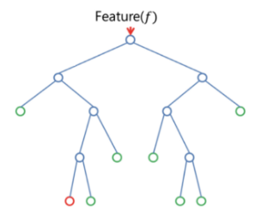
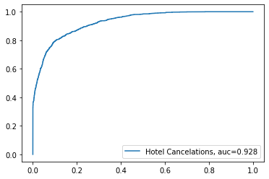
1) Random Forest Classifier
Split data into - training set and validation set
Test size of 20%
Area Under the ROC Curve Graph
Out of Bag score measures the prediction accuracy of our model i.e. 85.8%
Our ROC curve was 92.8%, which shows a very good ability to distinguish between the positive and negative classes
Notes:
Dario

Slide 8
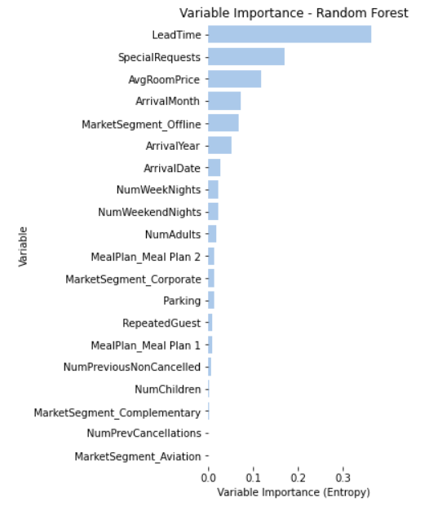
Feature Importance -
Random Forest
4-5 variables with negligible entropy importance
Notes:
Dario

Slide 9
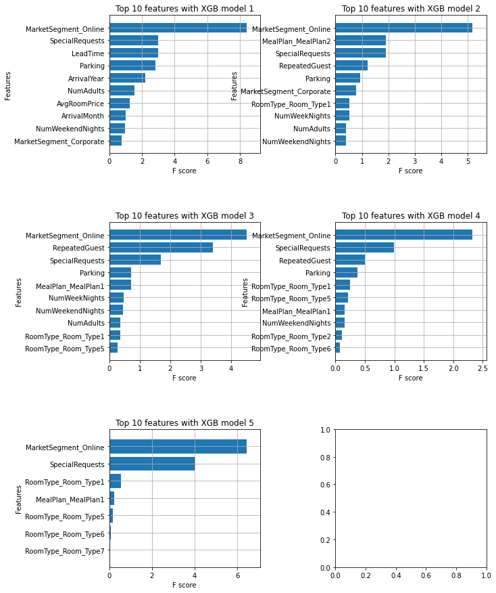

2) AutoML Random Forest
Utilizing Auto ML we generated new features via engineering feature selection
5 recursive XGBoost models yielded 6 important existing classifiers
Generated a lower prediction score of 82.6% than previously used Random Forest Classifier
Notes:
Dario

Slide 10
XGBoost Classifier
Made an XGBoost model attempting to improve results from random forest and AutoML
Notes:
Bryce

Slide 11

Hyperparameter Tuning
Used Grid Search Cross Validation
Cross validates using the validation set
Found optimal parameters by searching a predetermined grid of options for:
n_estimators
max_depth
learning_rate
subsample
colsample_bytree
min_child_weight
gamma
reg_alpha
reg_lambda
scale_pos_weight
Notes:
Bryce

Slide 12
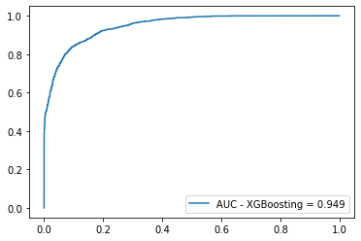
Results - ROC Curve
Shows the False and True Positive Rates On Validation Set for Varying Decision Thresholds
The Model has an accuracy of 94.9% in distinguishing between positive and negative cases
Very Good!
Area Under the ROC Curve Graph
Notes:
Bryce

Slide 13

Results - Precision, Recall, F1
High Precision indicates the model predicts a positive case 81.28% of the time
High Recall indicates that the model correctly identifies 83.67% of all positive cases
Balanced F1 Score of 82.45% is the harmonic mean of precision and recall
Notes:
Bryce

Slide 14
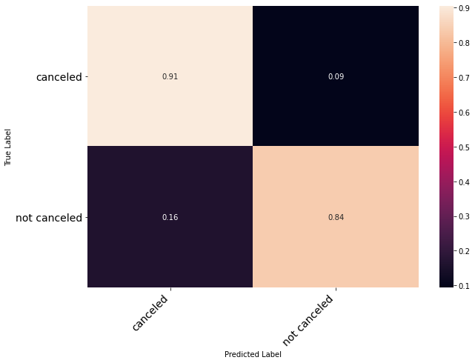
Results - Confusion Matrix
True Positive and True Negative rates are 91% and 84%
These high numbers show the model does well in predicting outcomes
False Positive score of 16% focuses on minimizing hotel’s risk of ruining reputation
Notes:
Dario

Slide 15
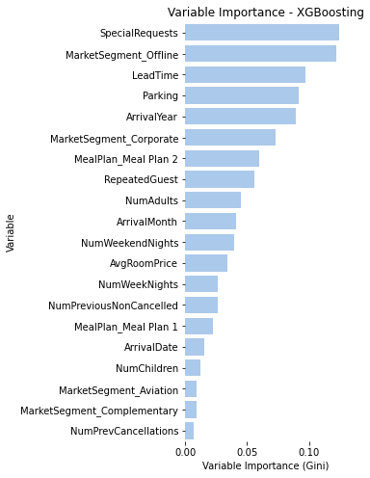
Feature Importance -
XGBoosting
More Special Requests = Less Canceling
Online/Offline Bookings = More Canceling Then Corporate Bookings
Higher Lead Time = More Canceling
No Parking = More Canceling
Notes:
Dario

Slide 16

Implications
Encourage Special Requests For Customers
Target Corporate Clients
Limit How Early Bookings Can Be Done
Promote Parking Passes
Can predict with good accuracy - must beware of False Positives
Notes:
Bryce

Slide 17
Thank you!

