Slide 1

Safestreets
Mandatory Project
Academic year: 2019 – 2020
Dario Miceli Pranio, Pierriccardo Olivieri

Slide 2
OUTLINE
RASD
Goals of the System
Phenomena & Boundaries
Use Cases
Requirements & Assumptions
Alloy Model
DD
Overview
Components View
Runtime View
Architectural Styles & Pattern
Implementation, Testing Plan

Slide 3
OUTLINE
RASD
Goals of the System
Phenomena & Boundaries
Use Cases
Requirements & Assumptions
Alloy Model
DD
Overview
Components View
Runtime View
Architectural Styles & Pattern
Implementation, Testing Plan

Slide 4
Goal of the System
Allow Citizens to report parking violations.
Must provide a visualization of the areas with high frequency of violations to Users.
Must provide a visualization of vehicles that commit the most violations to Authorities.
Must ensure the chain of custody of the information sent by Citizens.
Authorities can retrieve traffic violations’ in order to generate traffic tickets.
Users must be able to see statistics built from issued tickets.

Slide 5
Phenomena & Boundaries
World Phenomena
Citizen sees a parking violation and wants to report it.
Shared Phenomena
A Citizen reports a violation.
Track position of the violation.
Mark areas with an high rate of violations.

Slide 6
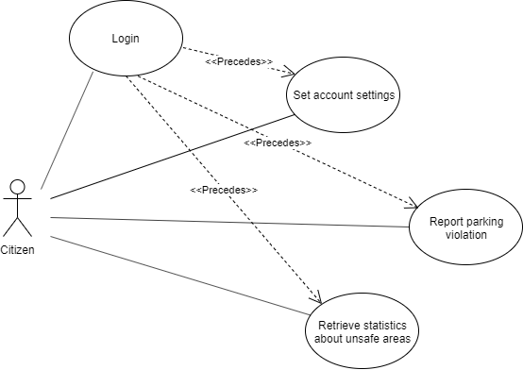
Use Case Citizen

Slide 7
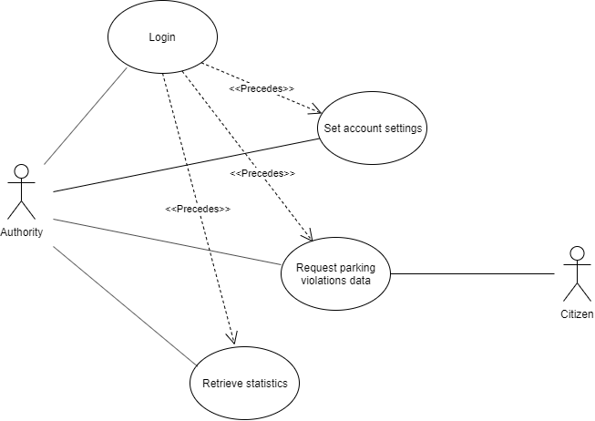
Use Case Authority

Slide 8
Requirements & Assumptions - General
[R1]: Account can be created if and only if User provides unique email and password.
[R2]: The System allow Guest to create Citizen or Authority account.
[R3]: The System allow User to modify his settings.
[D1]: Users can’t make more than one account.
[D2]: The personal informations provided by User are valid and belongs to him.

Slide 9
Requirements & Assumptions - Violation
[R5]: The System allows Citizen to input some violation’s data.
[R6]: The photo taken must be recognizable by the System.
[R7]: The Citizen has to be able to discard the photo taken.
[R10]: Citizen can change the license plate if it isn’t recognised properly.
[R11]: Citizen has to be able to choose the correct type of violation.
[D6]: Permission to take a photo is always allowed.

Slide 10
Requirements & Assumptions - Statistics
[R12]: Users can change the area of visualization.
[R13]: Users can change the date of visualization.
[R15]: Authority can search for a specific license plate.
[R19]: The System must update the statistics with the most recent data.
[D4]: The System can access internet whenever needs it.
[D5]: Permission to access GPS data is always allowed.

Slide 11
Requirements & Assumptions - Security
[R4]: The Citizen has to take the violation’s photo with the application.
[R8]: The System has to be able to attach the correct date, time and position to the report.
[R9]: The Citizen can’t change date, time and position in the report.
[R16]: Violations sent must be digitally signed.
[R17]: The System must use HTTPS to safely communicate.
[D3]: Position data has an accuracy of 10 meters.
[D4]: The System can access internet whenewer needs it.
[D5]: Permission to access GPS data is always allowed.

Slide 12
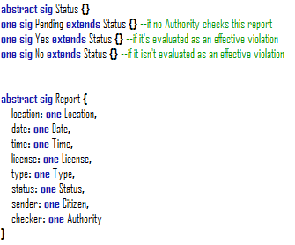
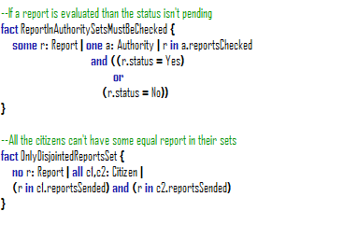
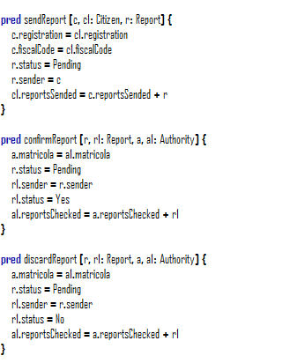
Alloy Model

Slide 13
OUTLINE
RASD
Goals of the System
Phenomena & Boundaries
Use Cases
Requirements & Assumptions
Alloy Model
DD
Overview
Client
Server
Database
Implementation, Testing Plan

Slide 14
Design Document Overview
3-Tier Architecture
Proxy between client and server
Architecture choosen for application server is NginX
REST API
MVC pattern
Message routing through Network Manager

Slide 15
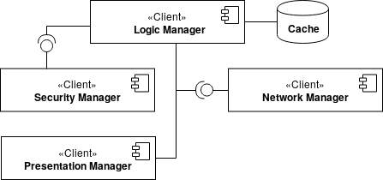
Client
Thin Client
interfaces iOs, Android (Adapter Pattern)
All the logic is handled by Logic Manager
A digital signature is applied to each report
cache to save momentaneously data
External Services

Slide 16
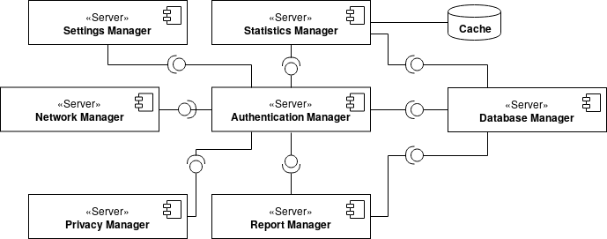
Server
1 … n application servers
Manager Division (settings, statistics, report)
Authentication Manager
Cache to store statistics

Slide 17
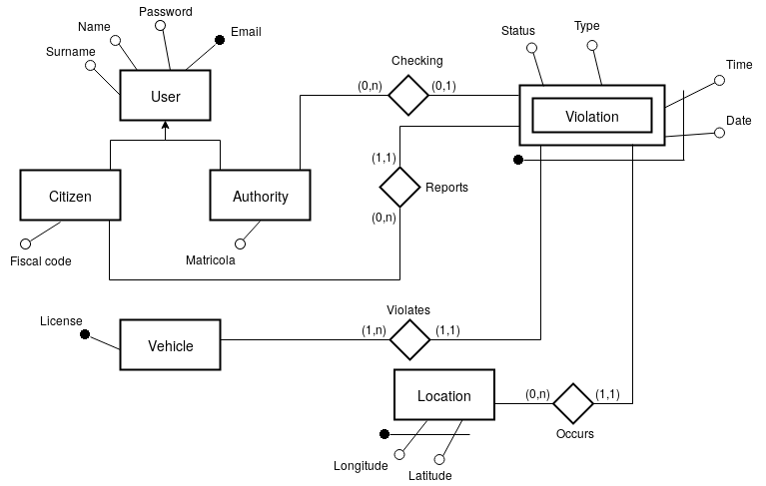
Database
External
ORM
SQL
Database Manager

Slide 18
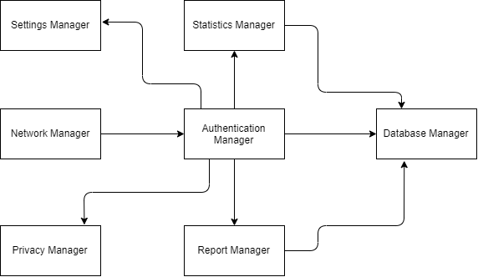
Implementation, Integration, Test Plan
Agile Strategy
Bottom-up approach
REST are simple to simulate
Stubs are used to simulated software not yet written

Slide 19
Thanks for the attention!

