Slide 1
ŠAHOVSKA IGRA
Dario Mihelčić
Damian Svirac

Slide 2
KLASE
ChessBoard
ChessRules
ChessMain
ChessAI

Slide 3
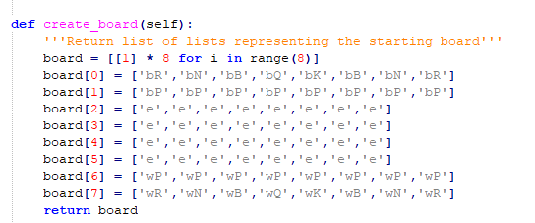
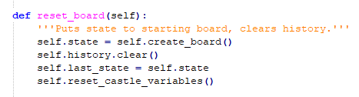
ChessBoard

Slide 4
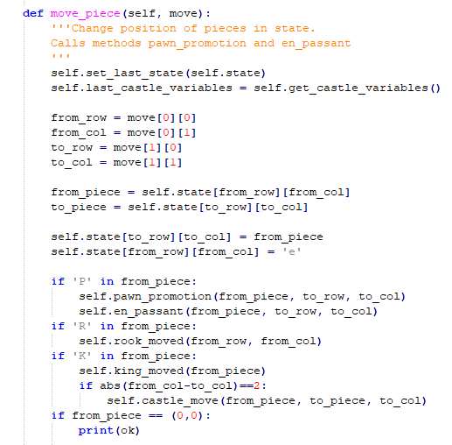

Slide 5
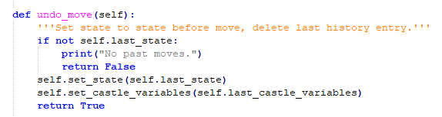

Slide 6
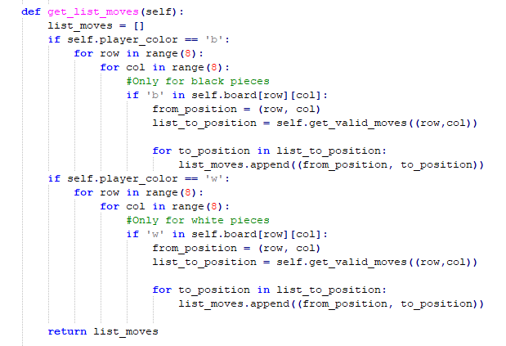
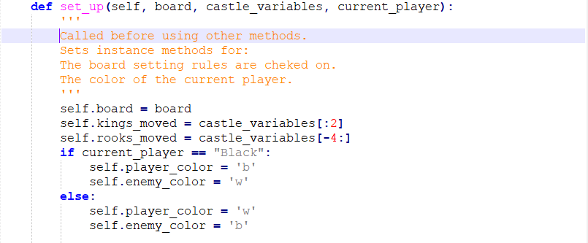
ChessRules

Slide 7
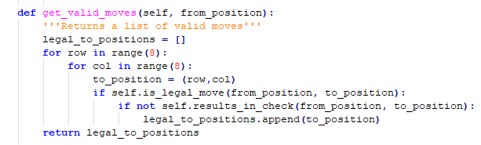

Slide 8
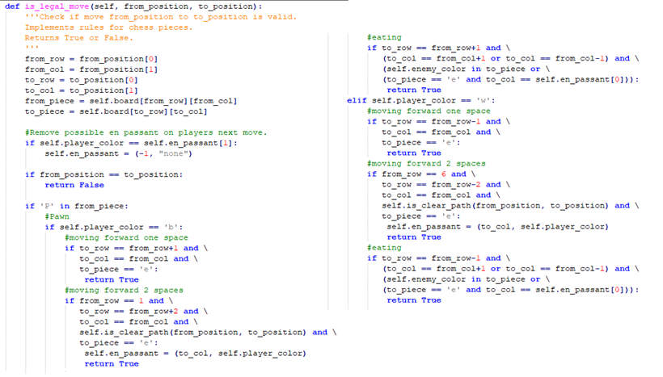

Slide 9
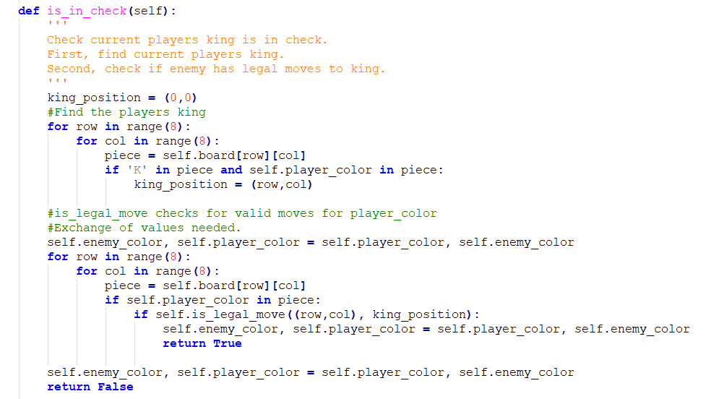

Slide 10
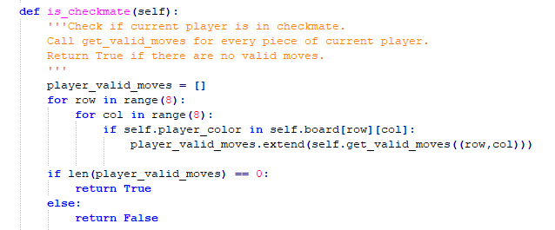

Slide 11
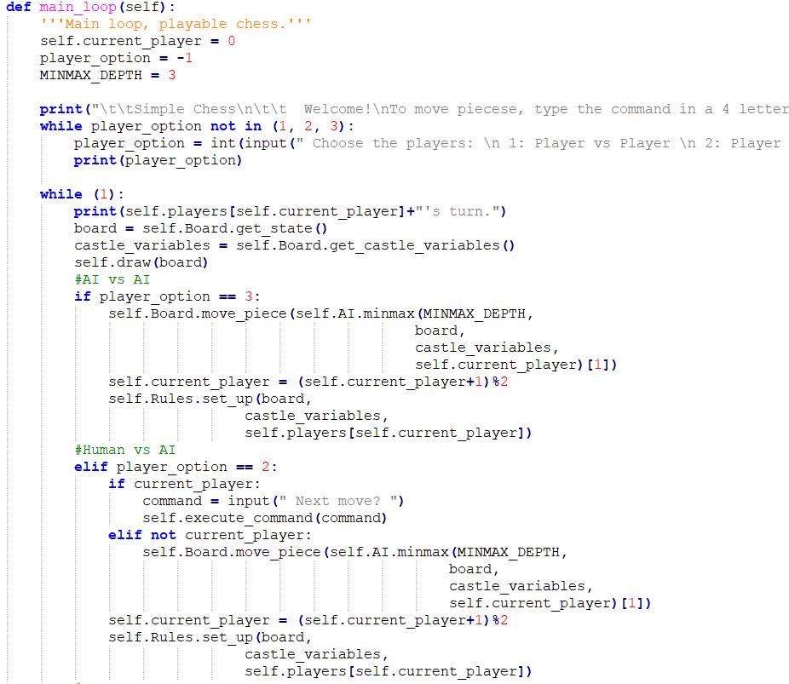
ChessMain

Slide 12
Šahovski računalni program
ChessAI

Slide 13
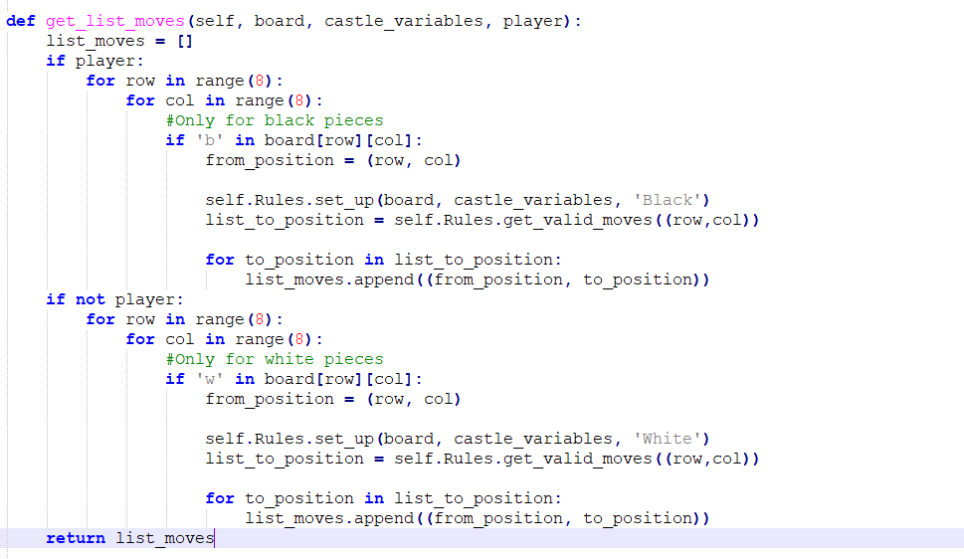
get_list_moves

Slide 14

SillyBot

Slide 15
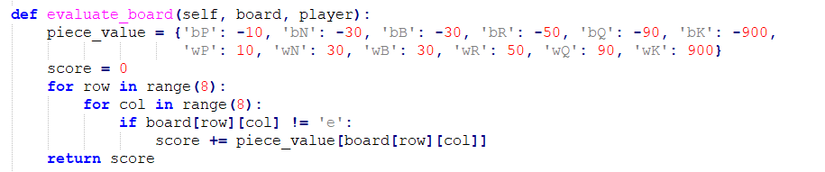
EatingBot

Slide 16
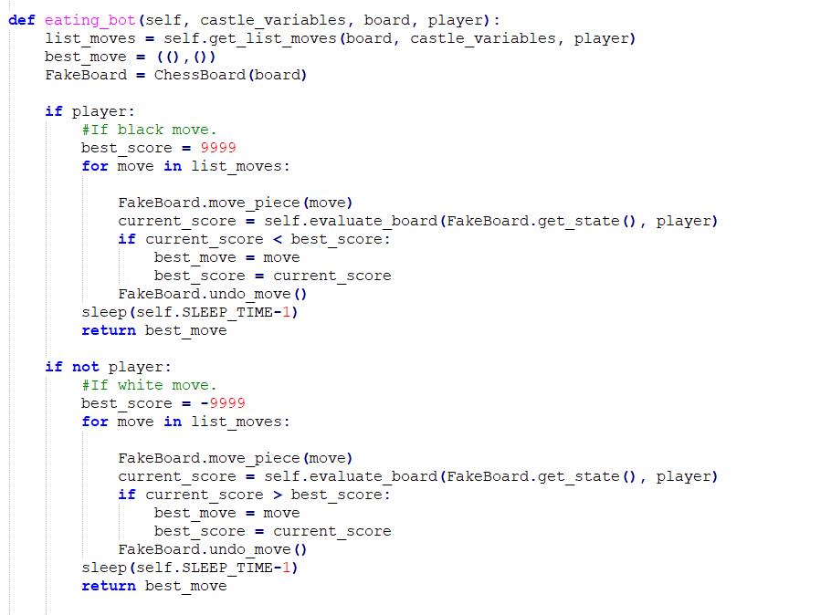
EatingBot

Slide 17
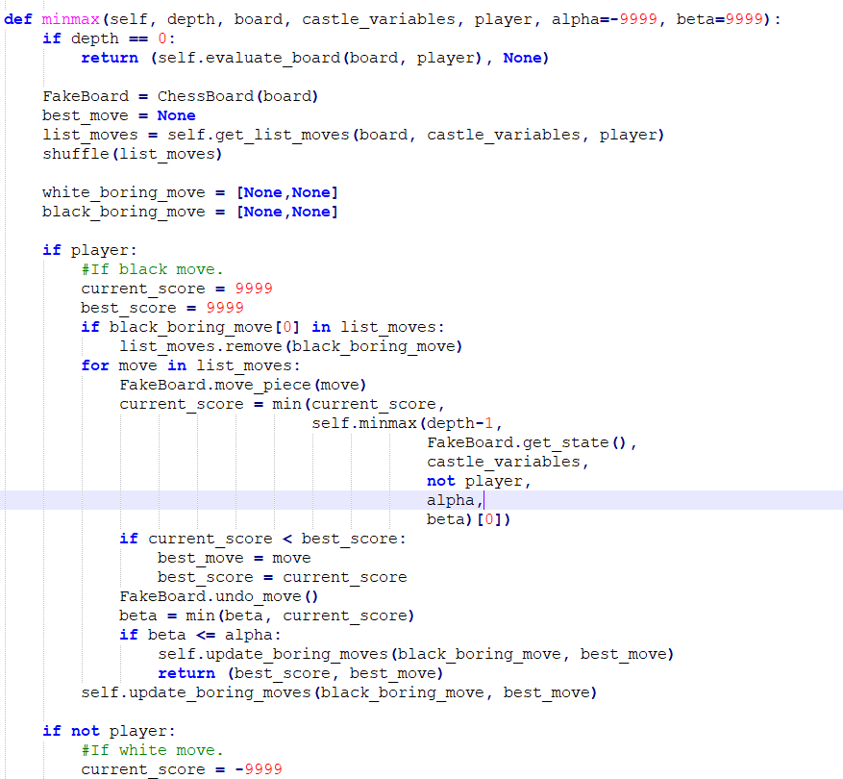
MinMaxBot

Slide 18
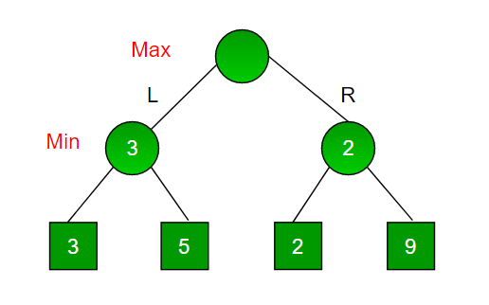
minimax

Slide 19
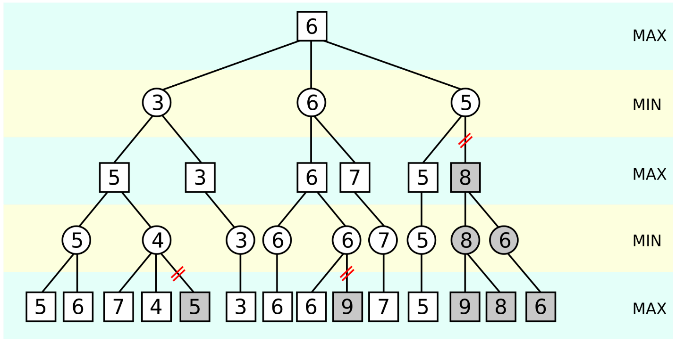
Alpha–beta obrezivanje

