Slide 1
SchoolBytes
A Price Comparison Platform for School Food Procurement

Slide 2
Significance: School Foods
>7 billion school meals were served in 2024 in public schools
4.8 bn lunches for 29.7m students (72.5% free/ reduced price)
2.5 bn breakfasts for 15.5m students (80% free/ reduced price)
Critical source of nutrition for low-income children
Approximately 17.3% of U.S. households with children were food insecure in 2023
Healthy foods and better academic performance
Ongoing efforts to improve nutritional contents (Healthy, Hunger-Free Kids Act (2010) +limits on added sugars, sodium and increased whole grains NSLP + local/state level initiatives)
Providing healthy/nutritious meals is costly and threatened by propose federal cuts
Federal gov: 23bn/year in cash/commodities
States pitch in extra: CA spent 1.8bn in 2024

Slide 3
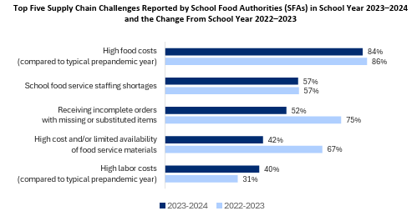
95% of School Food Authorities (SFAs) experienced one or more supply chain related challenges
Primary challenge: High Food Costs!

Slide 4
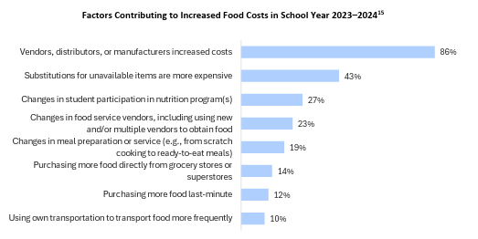
Factors Contributing to Increased Food Costs
Of those SFAs that identified increased food costs as a challenge in SY 2023–2024, the primary driver of increased food costs was identified as cost increases by vendors, distributors, or manufacturers (86 percent, down from 89 percent in SY 2022–2023). About 4-in-10 SFAs said that using more expensive items as substitutions for unavailable items was a factor (43 percent, down from 70 percent in SY 2022–2023).

Slide 5
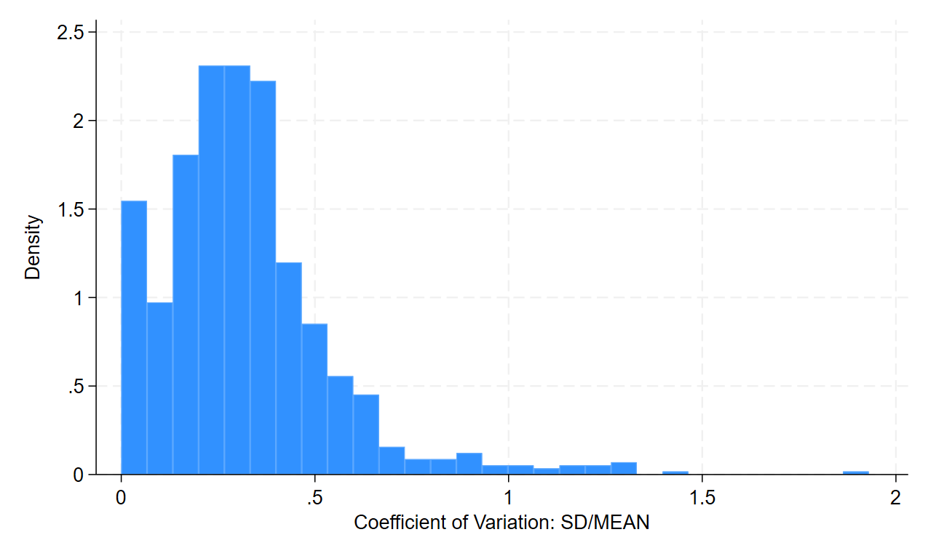
Variation in price per pound within narrowly defined Item Categories across SFAs (USDA,2010)
Average coefficient of variation: 34%

Slide 6
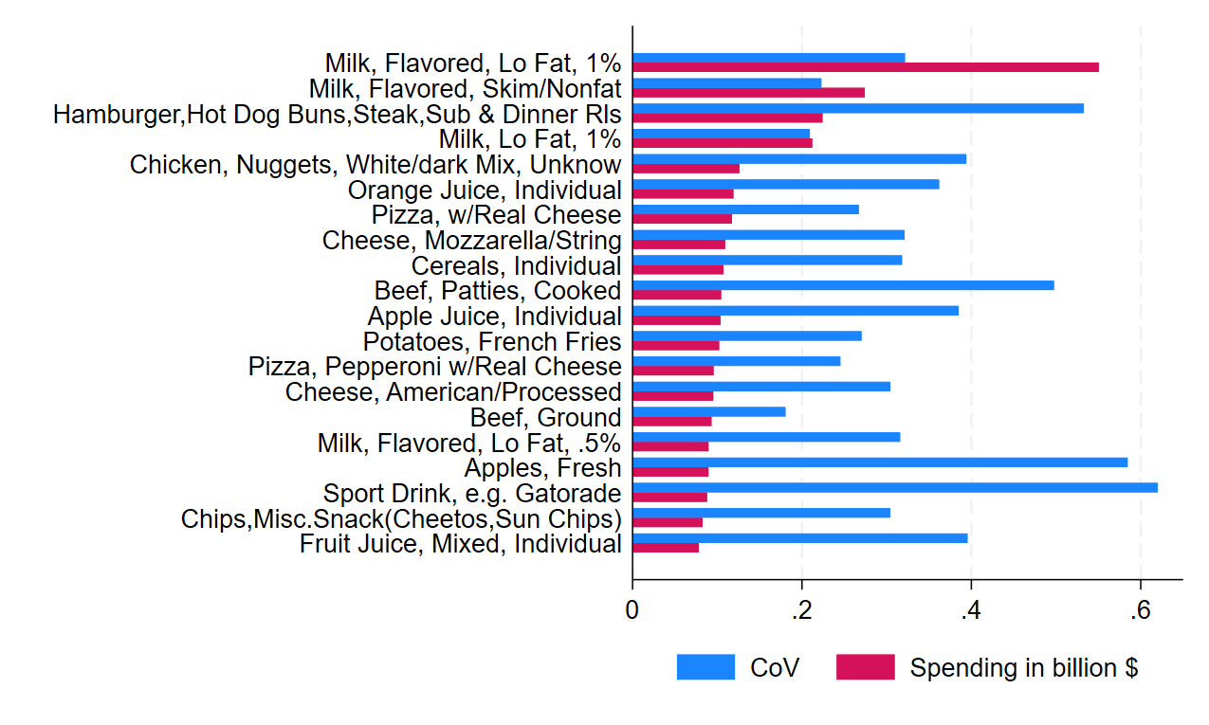
Price Variation and Spending on Top Spending Item Categories (USDA,2010)

Slide 7
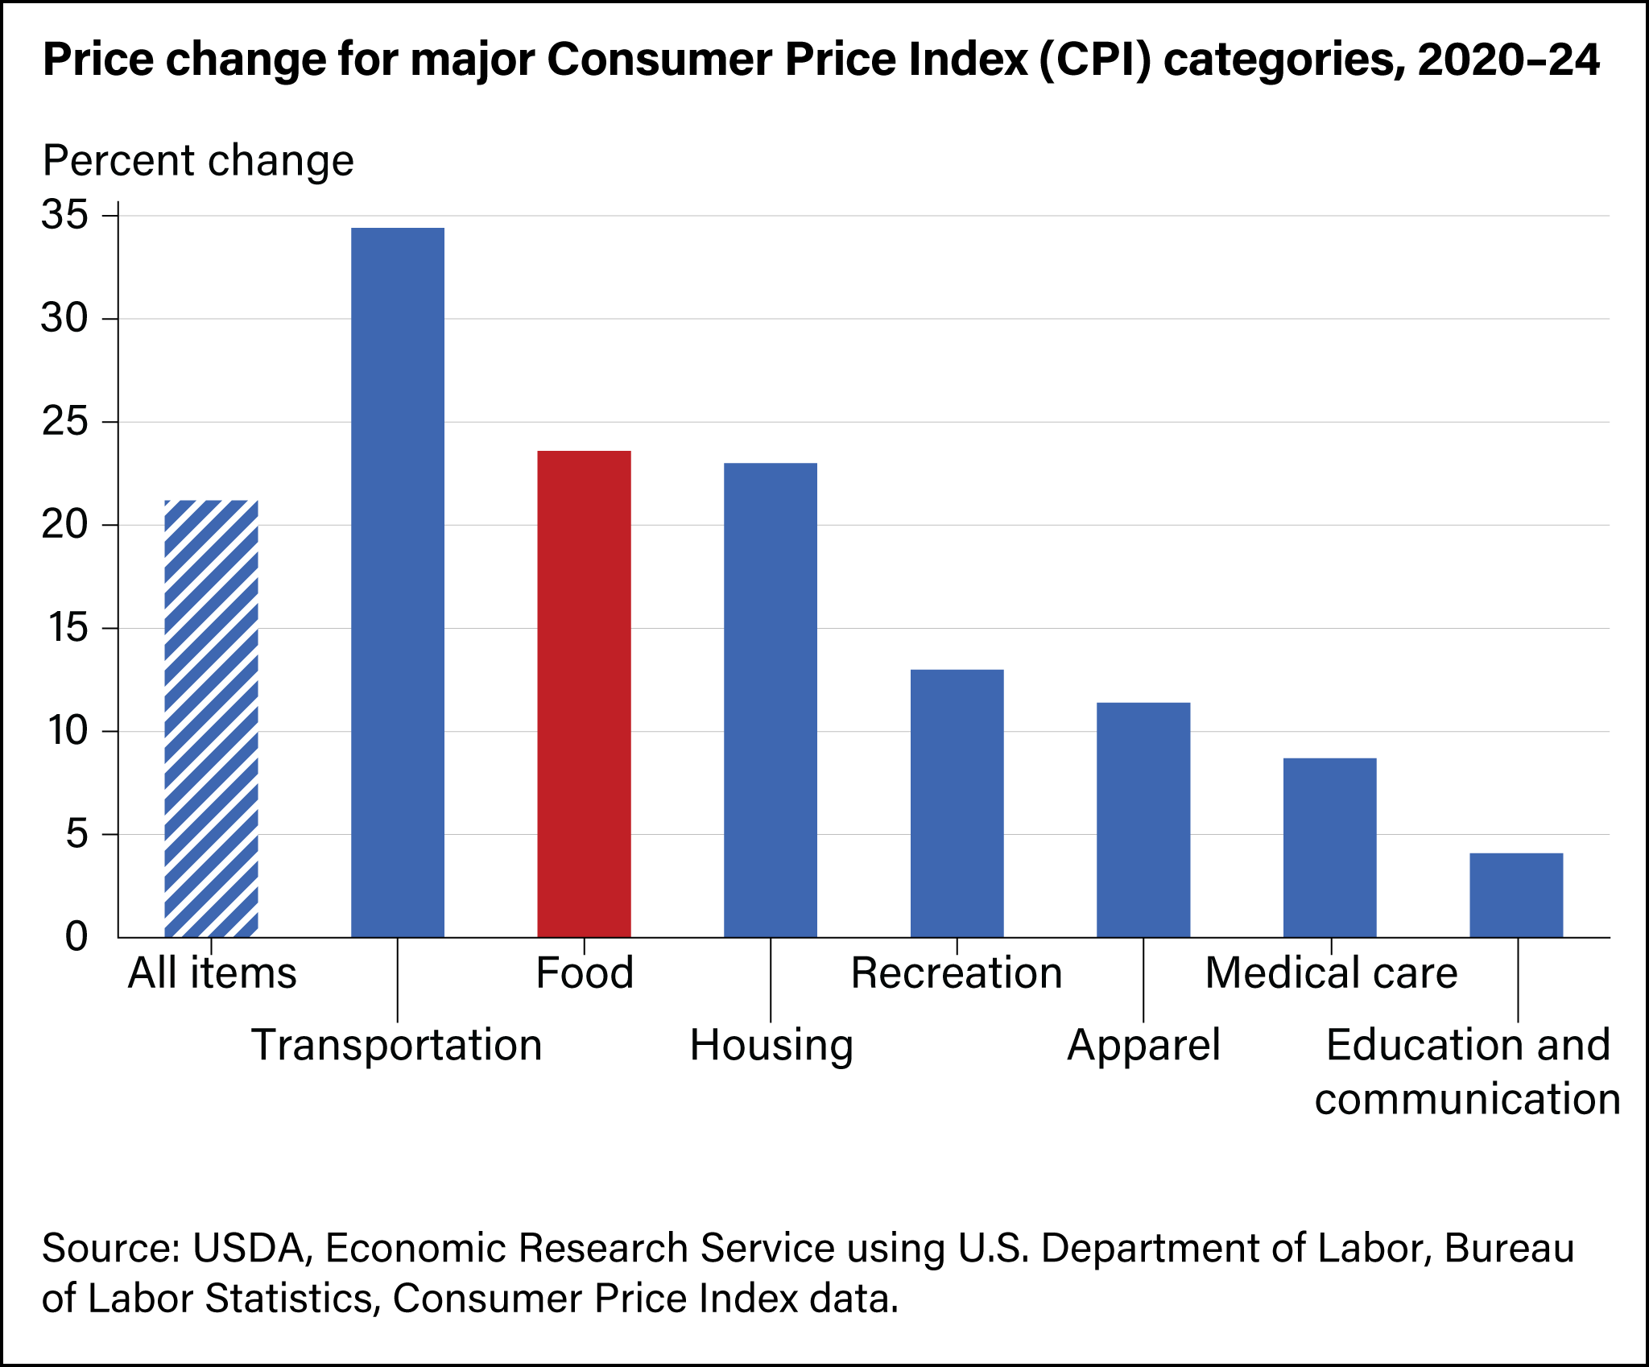
Food Prices Have Grown Substantially in Recent Years
How has that affected the school districts and has it increased price dispersion?

Slide 8
Food Procurement Data Collection
This project seeks to build a real-time database on procurement prices to:
Document price dispersion within standardized food categories
Highlight cost-savings to SFAs by pointing them to cheaper vendors
Challenges:
Data decentrally stored by SFAs
Data not digitized and need to be harmonized to compare across SFAs
Solution:
Crowdsourcing approach, SFAs share their data and in return get to see prices from neighboring SFAs
Use artificial intelligence to digitize and structure procurement record
Use data from 2009/2010 and data already collected from 40 SFAs in Los Angeles as training data

Slide 9
Resources needed:
Full time computer science pre-doc 100k annual salary
Part-time economics pre-doc 50k annual salary

Slide 10
Upsides
Short-run: Price comparison platform can allow SFAs to save millions per year
Middle-run: Platform can become a market platform for school food procurement, where vendors can advertise their products
Long-run: conduct school food procurement on behalf of schools

Slide 11
Progress thus far:

Slide 12
Quotes
“The vendors that I have had said the reason [they] don't want to bid on schools is because of the products they have to carry and it doesn't sell enough of the product to justify selling the whole-grain products.” – Small rural SFA
“Food cost is a major factor in my school meal program. It is obviously directly tied to meal participation and revenues. Giving students free meals was a great idea. It increased participation and removed the old stigmas from School Food Programs . . . Then we returned to ‘normal’ meal operations and unfortunately nothing about returning was ‘normal’ . . . With minimal paid meal revenue being received and paid reimbursements for paid meals at $0.42 with $0.08 for HHFKA. This compounds the food cost, placing districts in a difficult situation financially. The Supply Chain Assistance funds [we] have received has kept us ‘afloat’.” – Medium-sized rural SFA
“I budgeted a 10 percent increase across the board for my staff this year, including substitute Food Service workers, retention and recruitment purposes, and also to acknowledge the dedication of my staff through the last few years. My sub food service worker budget lines have been consistently overspent due to the need for extra people in kitchens as well as difficulties filling permanent positions due to lack of applications.” – Medium-sized suburban SFA
“Lack of vendors and procurement requirements are driving cost. We are a medium size school district […] and when we went out for bid according to the federal requirements, only two vendors would respond and of those two vendors only one complied with bid specs. For milk we only have one vendor in our area so they are able to set the milk price for as high as they would like.” – Large rural SFA

Slide 13
References
https://www.fns.usda.gov/pd/child-nutrition-tables
https://www.bakerinstitute.org/research/address-child-hunger-through-free-school-meals-all
https://www.timesunion.com/education/article/free-school-meals-threatened-proposed-federal-cuts-20202664.php?
https://fshn.illinois.edu/news/what-are-benefits-free-school-meals-heres-what-research-says?
https://www.fns.usda.gov/cn/school-nutrition-standards-updates?utm_source=
Cohen, Juliana, and Marlene B. Schwartz. "Documented success and future potential of the Healthy, Hunger-Free Kids Act." Journal of the Academy of Nutrition and Dietetics 120, no. 3 (2020): 359.
Chandran, Aruna, Mohamad Burjak, Joshua Petimar, Ghassan Hamra, Melissa M. Melough, Anne L. Dunlop, Brittney M. Snyder et al. "Changes in body mass index among school-aged youths following implementation of the Healthy, Hunger-Free Kids Act of 2010." JAMA pediatrics 177, no. 4 (2023): 401-409.
Richardson, Andrea S., Margaret M. Weden, Irineo Cabreros, and Ashlesha Datar. "Association of the Healthy, Hunger-Free Kids Act of 2010 with body mass trajectories of children in low-income families." JAMA Network Open 5, no. 5 (2022): e2210480-e2210480.
https://fns-prod.azureedge.us/sites/default/files/resource-files/ops-sfa3-scd-participation-121824a.pdf

Slide 14
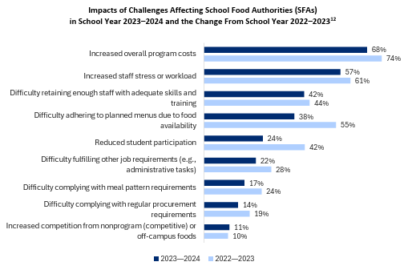
Biggest Challenge in School Food Programs: High Program Costs
Source: USDA, 2024 (Food and Nutrition Service-Administered School Food Authority Survey III on Supply Chain Disruption and Student Participation )

Slide 15
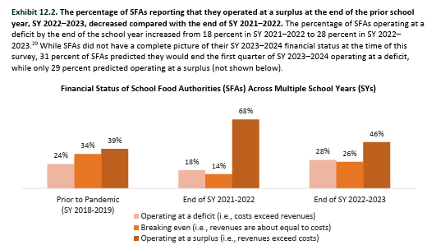
School Food Program Profitability

