Slide 1
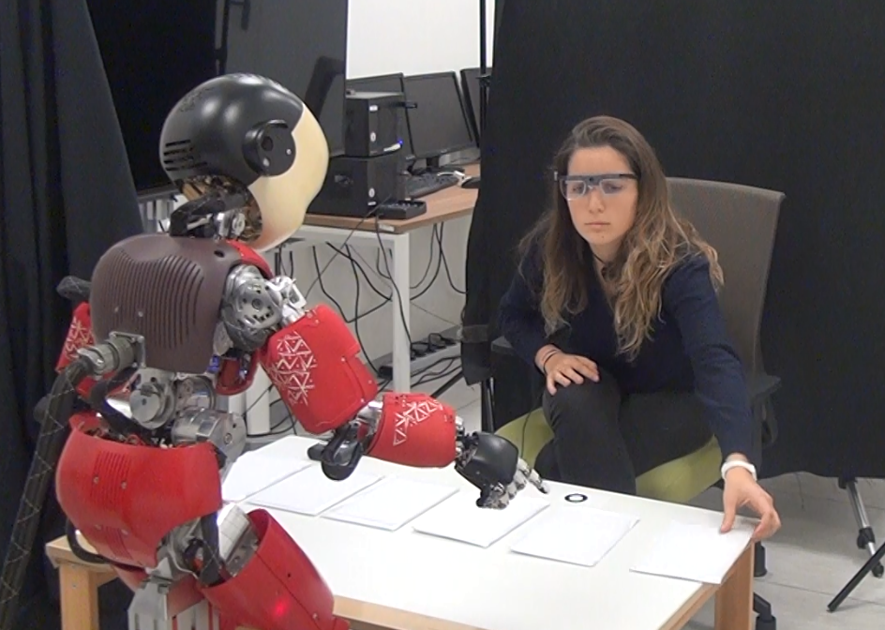

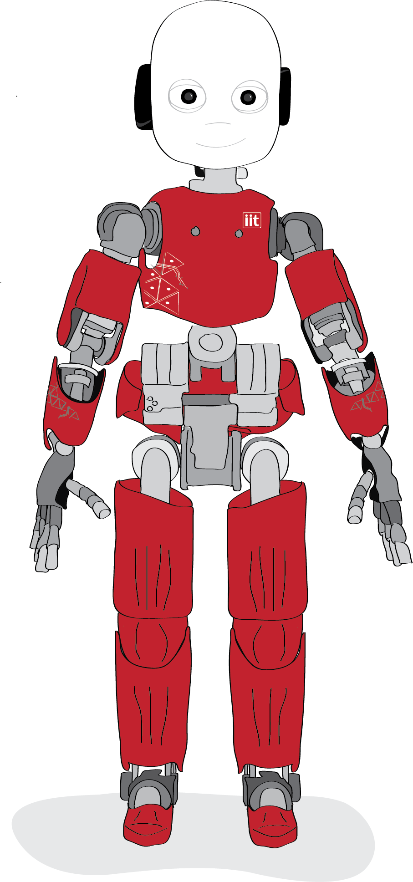

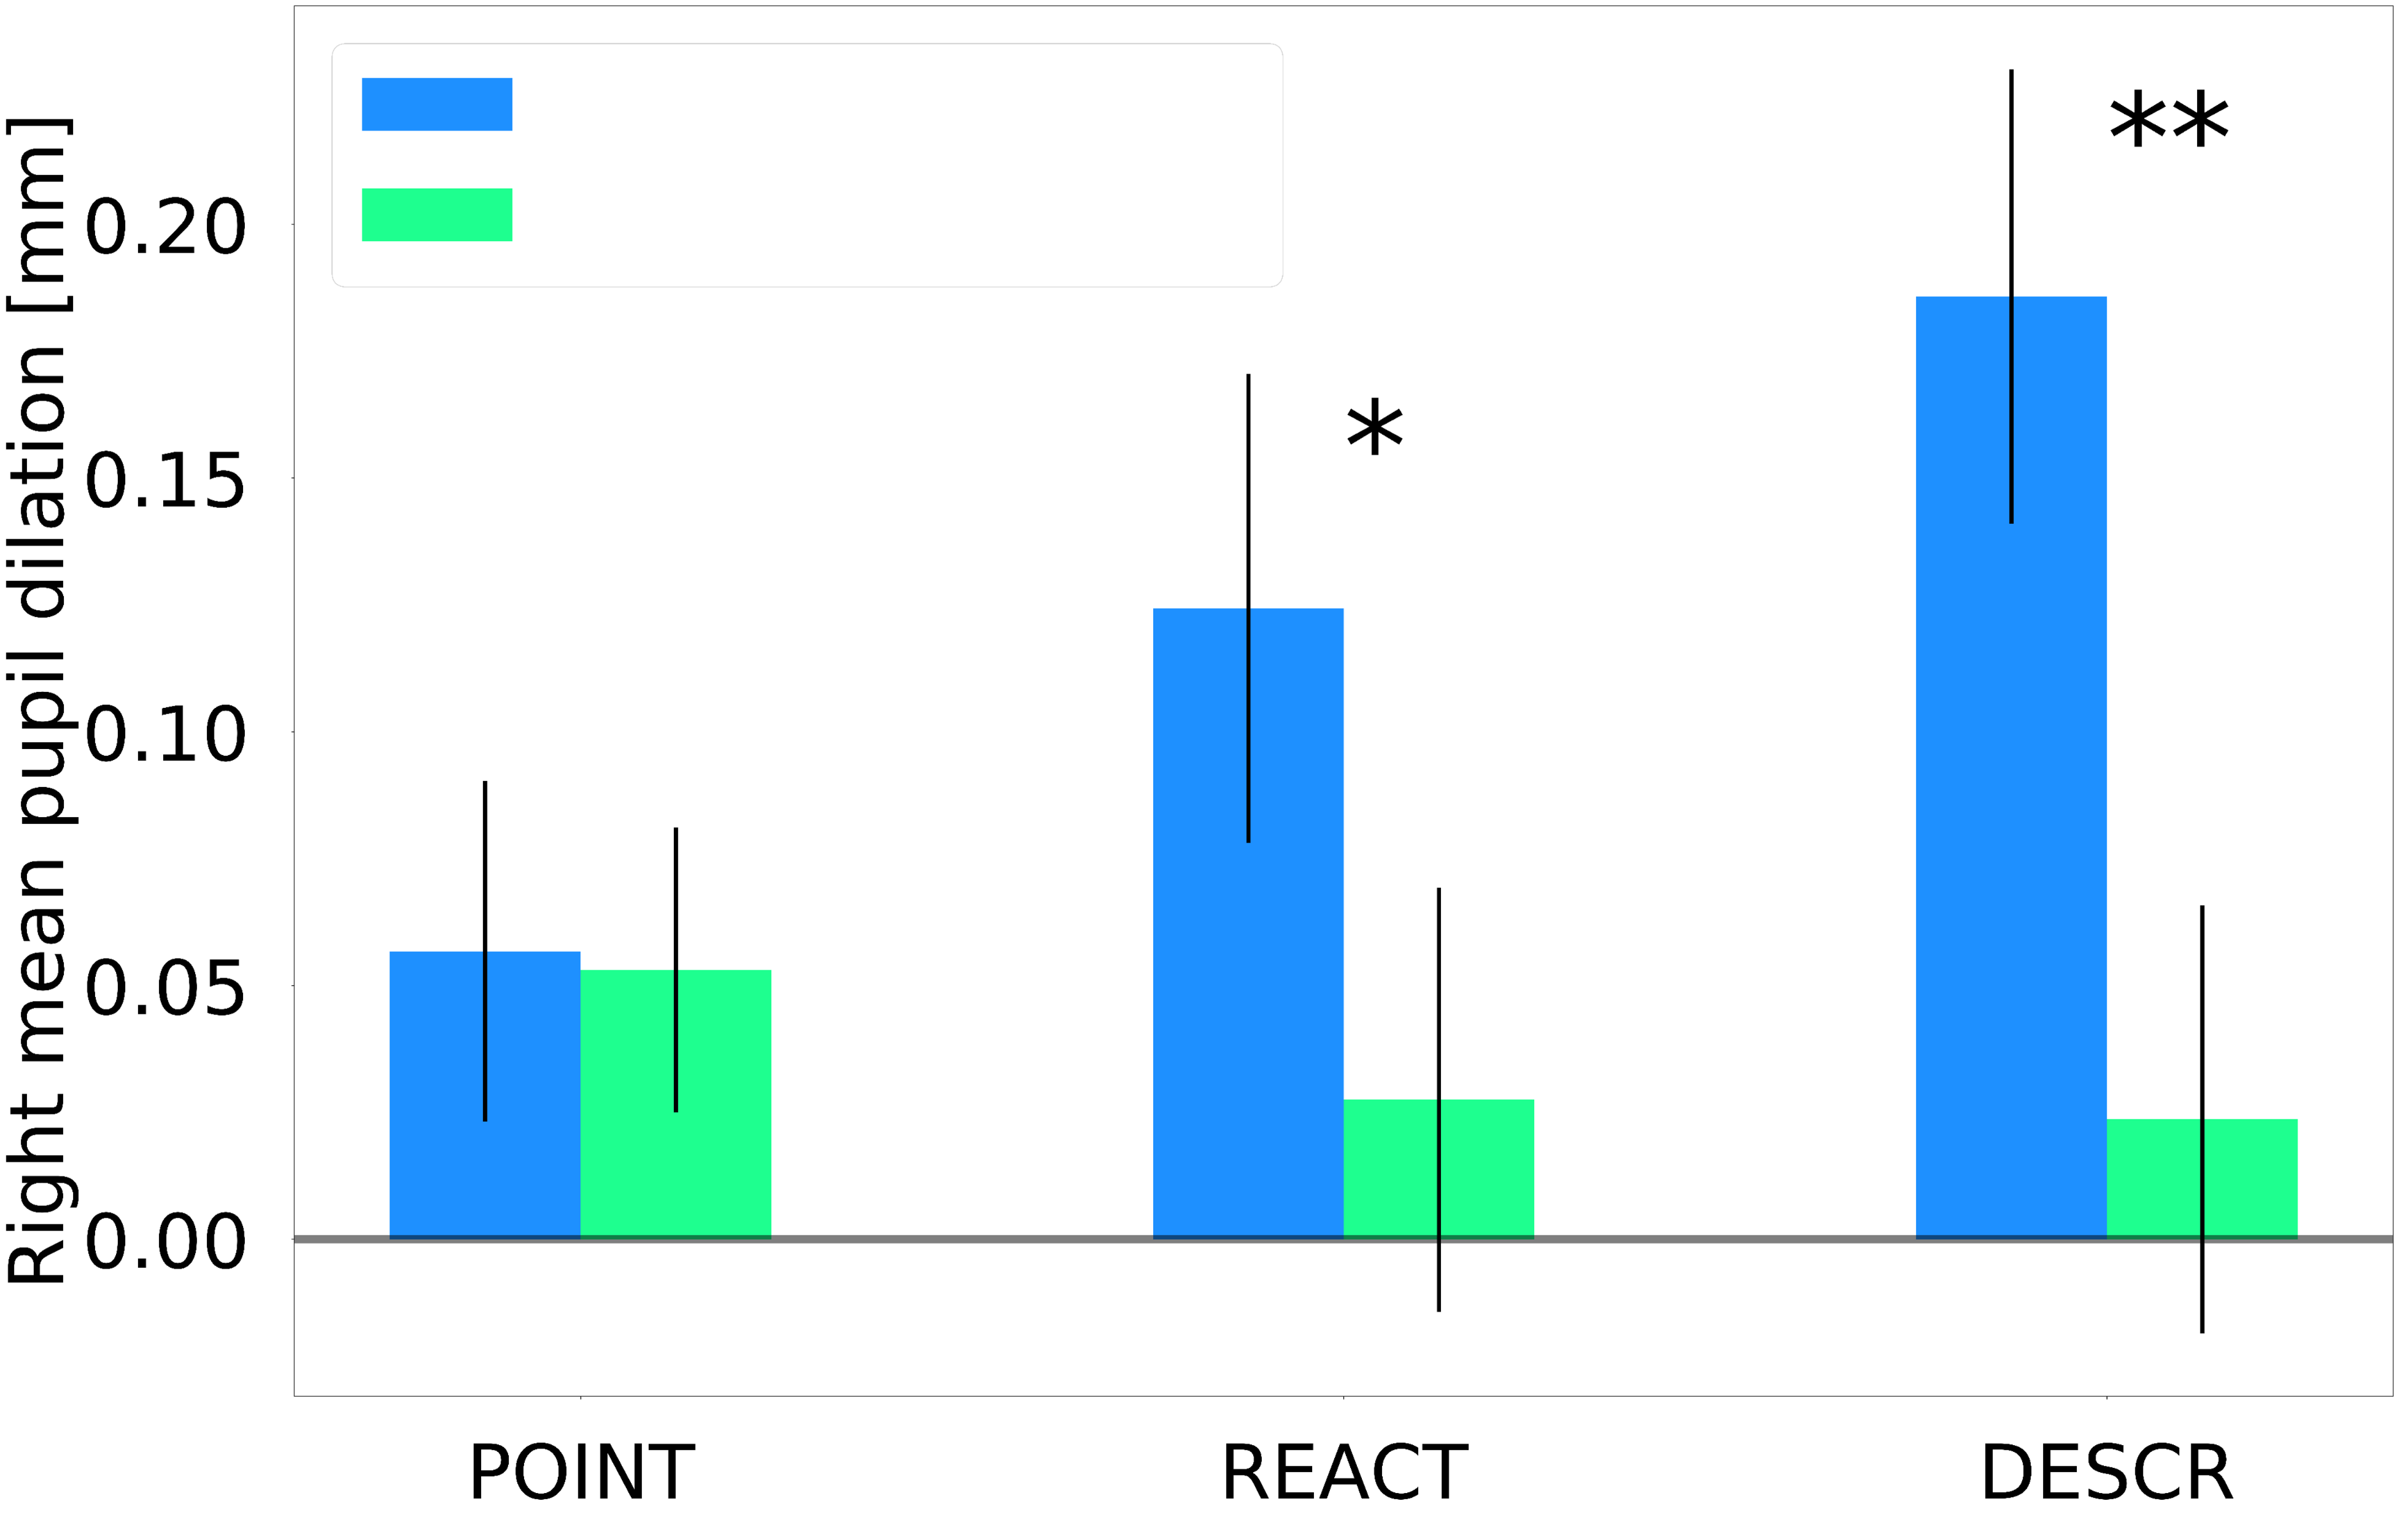
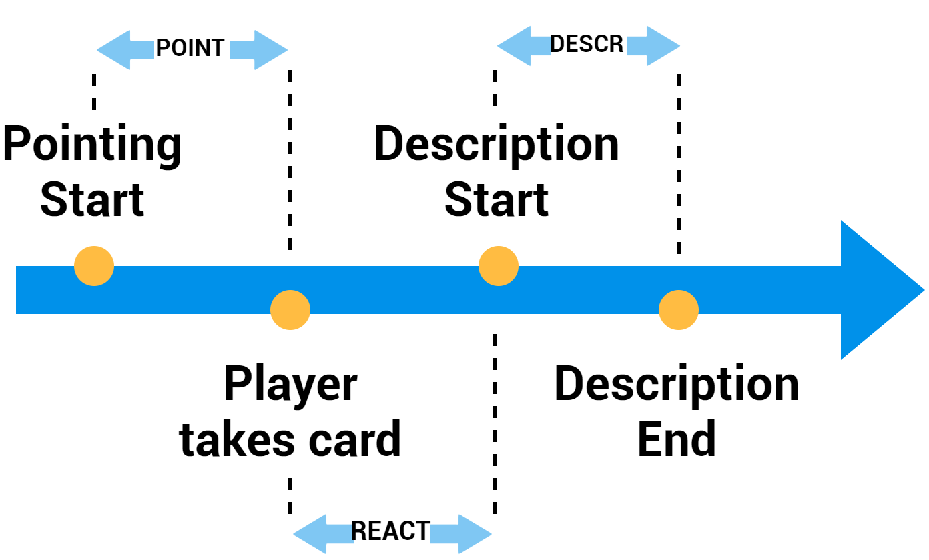
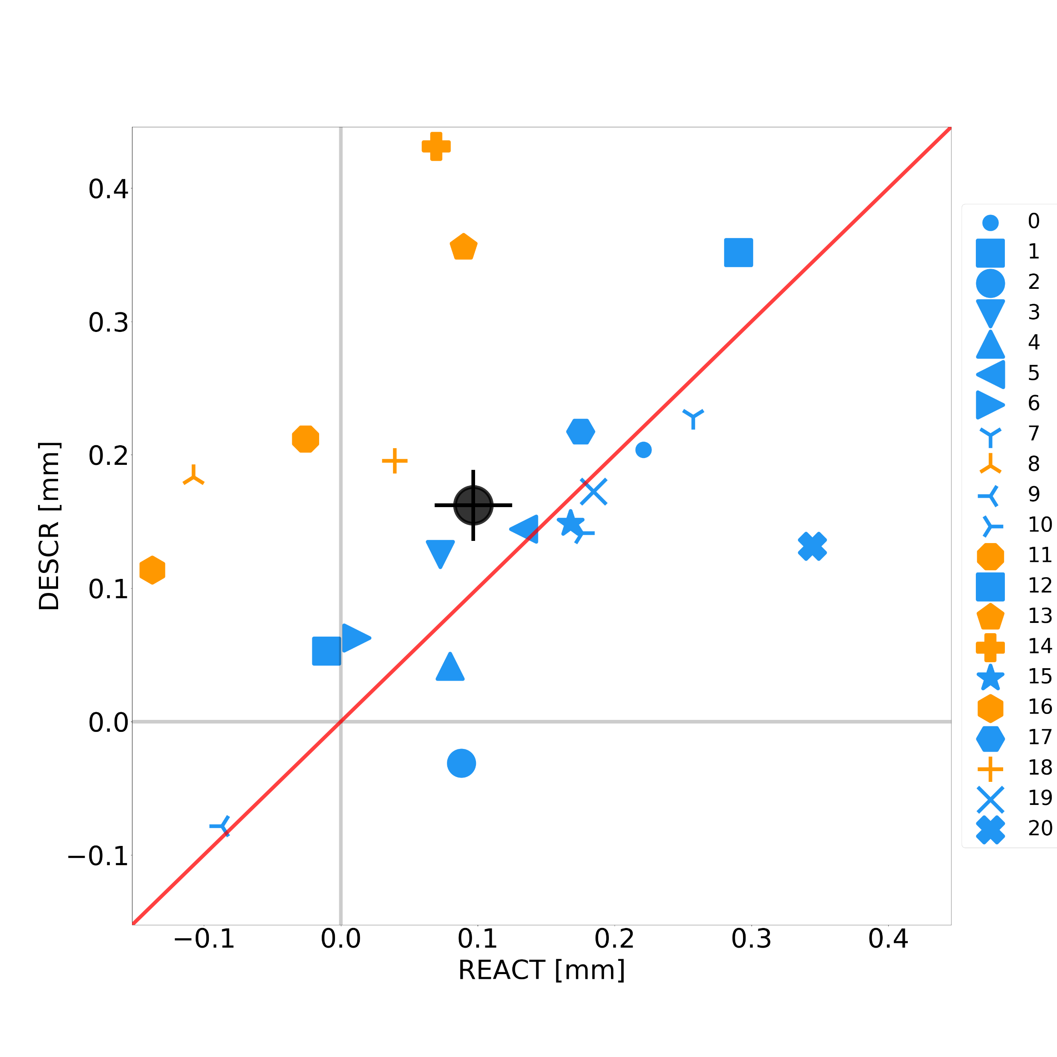





ICub detects your lies during a quick and entertaining Magic Trick
Your Eyes Never Lie:
A Robot Magician Can Tell if You Are Lying
PARTICIPANTS
N = 28 participants – all Italians, 9 males, 17 females, age M=24 SD=5.
Pasquali D., Aroyo A. M., Gonzalez-Billandon J., Rea F., Sandini G., Sciutti A,
MATERIALS
Tobii Pro Glasses 2 (100 Hz)
Six playing cards (cartoon figures over a white background)
RESEARCH QUESTION
Is it possible to detect lies during a quick ecological interaction with a humanoid robot?
Large Pupil
High Cognitive Load
Lie !
EXPERIMENT
The player knows only one card (out of 6)
iCub asks to describe the cards one by one
The players has to:
Describe deceitfully and creatively the known card
Describe truly the other cards
Pupil Dilations
6 playing cards
RESULTS
HEURISTIC FUNTION
Higher mean pupil dilation = Player’s card
Accuracy = 75%
DATA PREPARATION
Posthoc segmentation of pupil dilations in three intervals per card.
Fake Description
Real Description
Mean Pupil Dilation [mm]
RANDOM FOREST
126 datapoints x 13 features
SMOTE + per subject normalization
F1 = 83,3%, AUCROC = 89,6% (SD=0,7)
PREMEDITATION
Mean pupil (Fake) – Mean pupil (Real)
DISUSSION
It’s possible to detect lies during a quick card game with iCub robotic platform preserving the informality of the interaction
The system can be automatized based on iCub’s movements
Tobii Eyetracker is a limitation for the portability of the system
FUTURE WORKS
Develop an autonomous framework to lead the game
Enlarge the dataset
Improve the heuristic function and the random forest classifier
DESCR [mm]
REACT [mm]
Take a picture to get contacts and download full paper

Slide 2
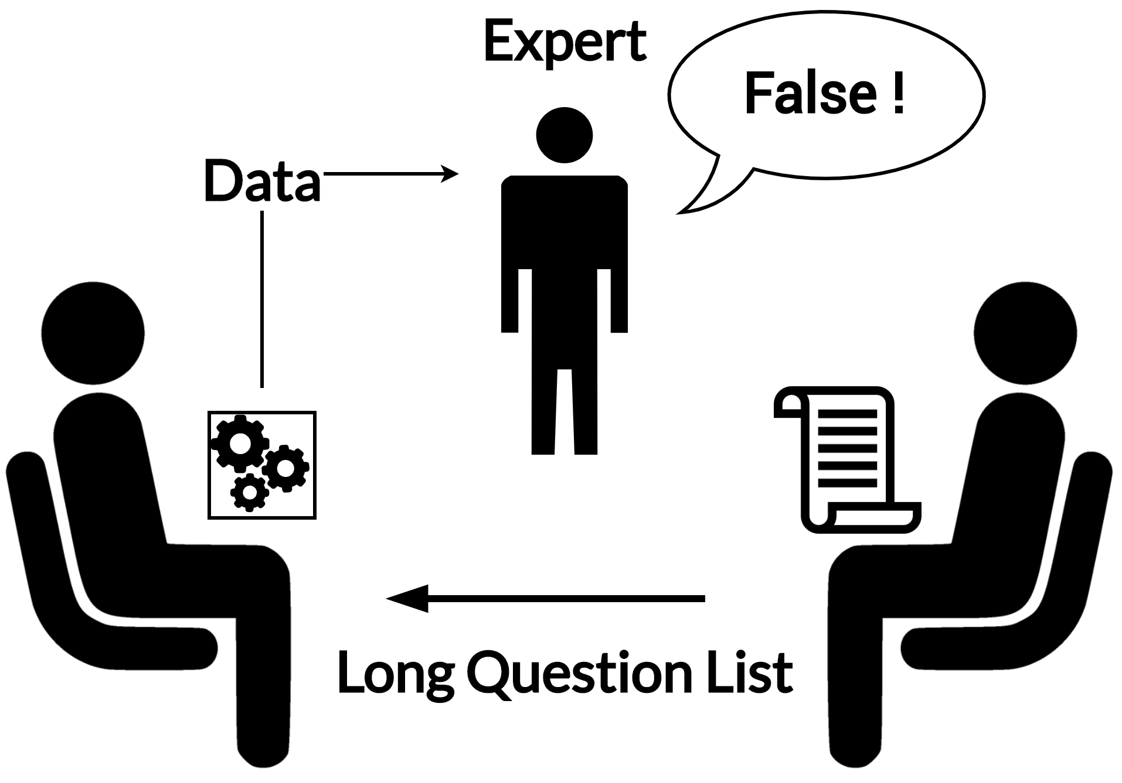
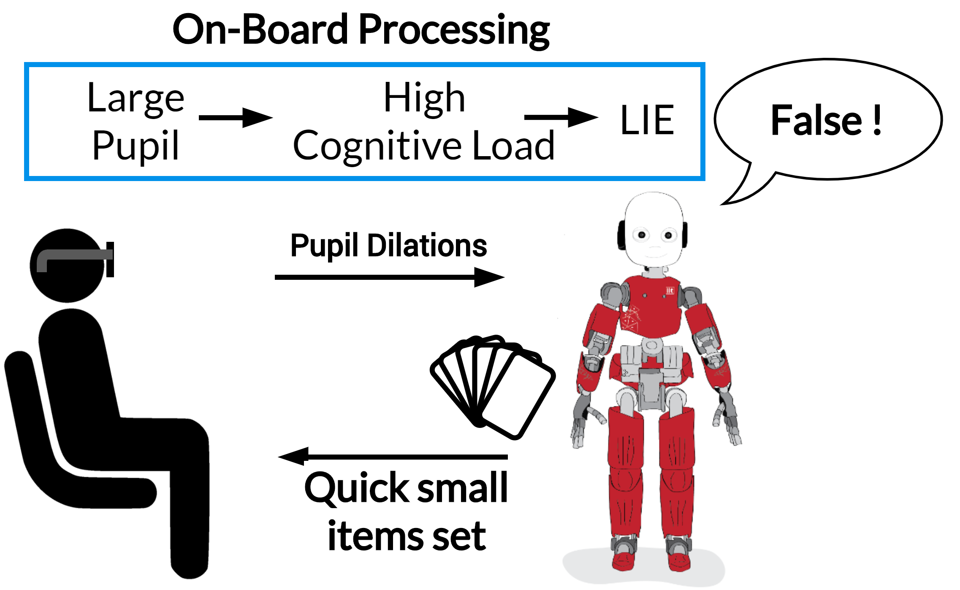
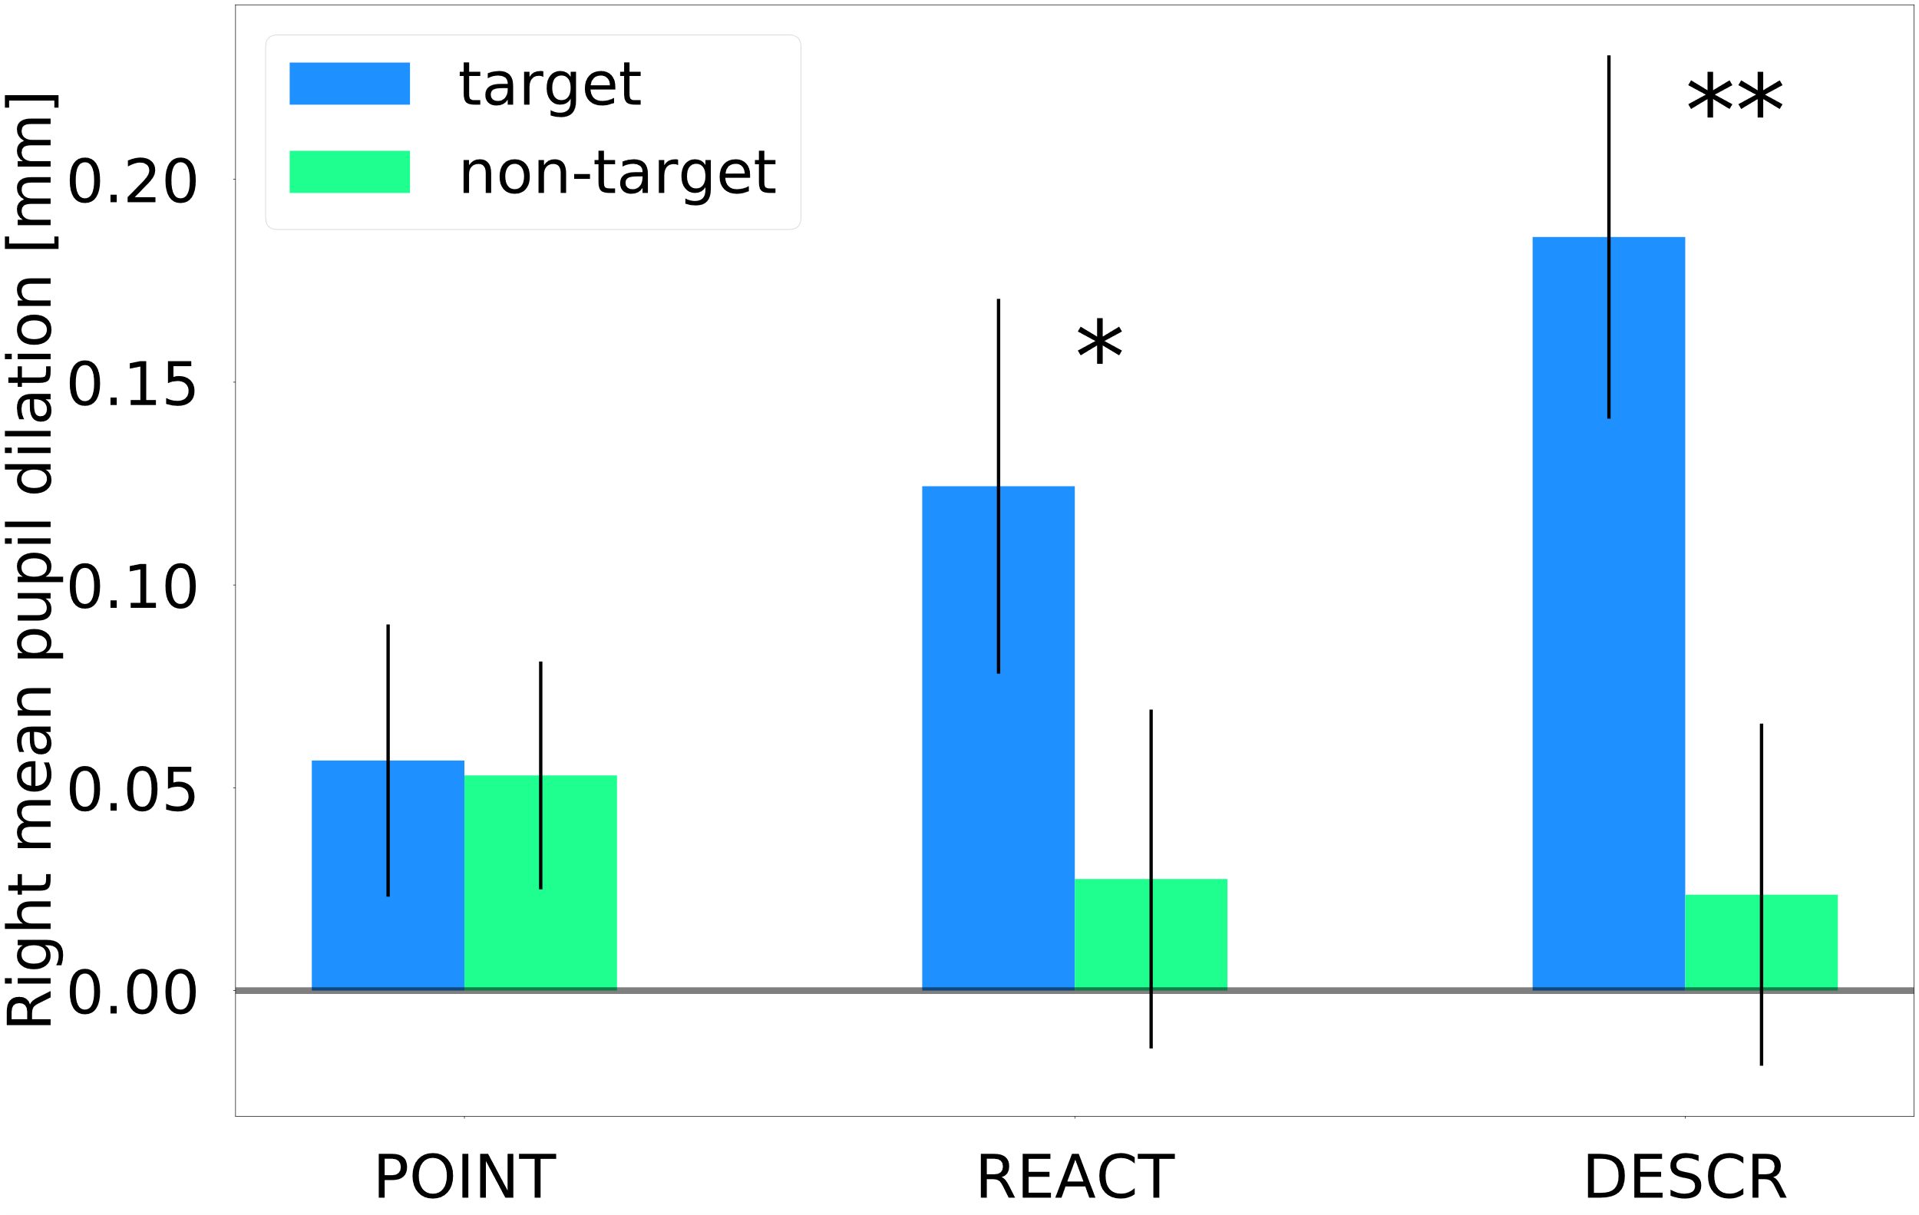
ICub detects your lies during a quick and entertaining Magic Trick
Your Eyes Never Lie: A Robot Magician Can Tell if You Are Lying
Pasquali D., Aroyo A. M., Gonzalez-Billandon J., Rea F., Sandini G., Sciutti A,
INTRO
Detecting lies in a real-world scenario is an important skill for a humanoid robot that acts in fields where is important to preserve an informal and pleasant interaction. However, lie detection is usually performed in highly controlled settings comparable to interrogatories.
MATERIALS
Tobii Pro Glasses 2 (to record pupil dilations at 100 Hz)
Six playing cards with a figure over a white background
iCub robotic platform (controlled via Wizard of Oz)
PARTICIPANTS
N = 28 participants – all Italians, 9 males and 17 females, average age of 24 years old (SD=5) – 7 removed due to Tobii malfunctions
BEFORE THE EXPERIMENT
The Player draws out and memorize a card (target card)
EXPERIMENT
The player shuffles the cards and put them covered on the table
iCub points each card. The player describes it
Target Card “Creative and Deceitful description”
Other Cards “Describe what you see”
TRADITIONAL SCENARIO
TRADITIONAL SCENARIO
DATA ANALYSIS
Mean pupil dilation posthoc computed during POINT, REACT and DESCR intervals for each card
RESULTS
DISCUSSION
It’s possible to detect lies in a quick Human-Robot Interaction.
Need to wear a Tobii Pro Glasses 2 eye tracker
The heuristic function is effective only if the presence of a fake description is a priori known between a finite set of items
The normalization makes the random forest effective only among the observations of the same individual
RANDOM FOREST CLASSIFIER
126 datapoints x 13 features
Normalization per subject
SMOTE to balance the dataset
F1 = 83.3%, AUCROC = 89.6 (SD=0.7)
HEURISTIC FUNCTION
Max Mean Pupil Dilation = Target Card
Accuracy = 75%
FUTURE WORKS
Autonomously detect lies in real-time
Enlarge the dataset
Take a picture to get contacts and full paper

