Slide 1


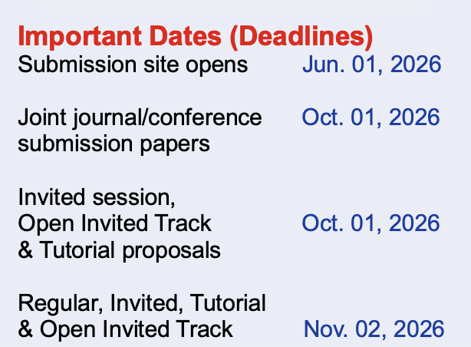

Submission site already open
More info: https://conferences.ifac-control.org/sysid2027/
Recent topics in system identification: learning models for decision and control
- Special Issue from IFAC SYSID 2027
Submission deadline: 01 October 2026
This special issue highlights leading papers from the IFAC SYSID 2027 Symposium
Executive guest editor: Dario Piga

