Slide 1



Deep learning for state-space identification
Exercises
Marco Forgione, Dalle Molle Institute for Artificial Intelligence, Lugano, Switzerland
Lugano, April, 23rd, 2024

Slide 2
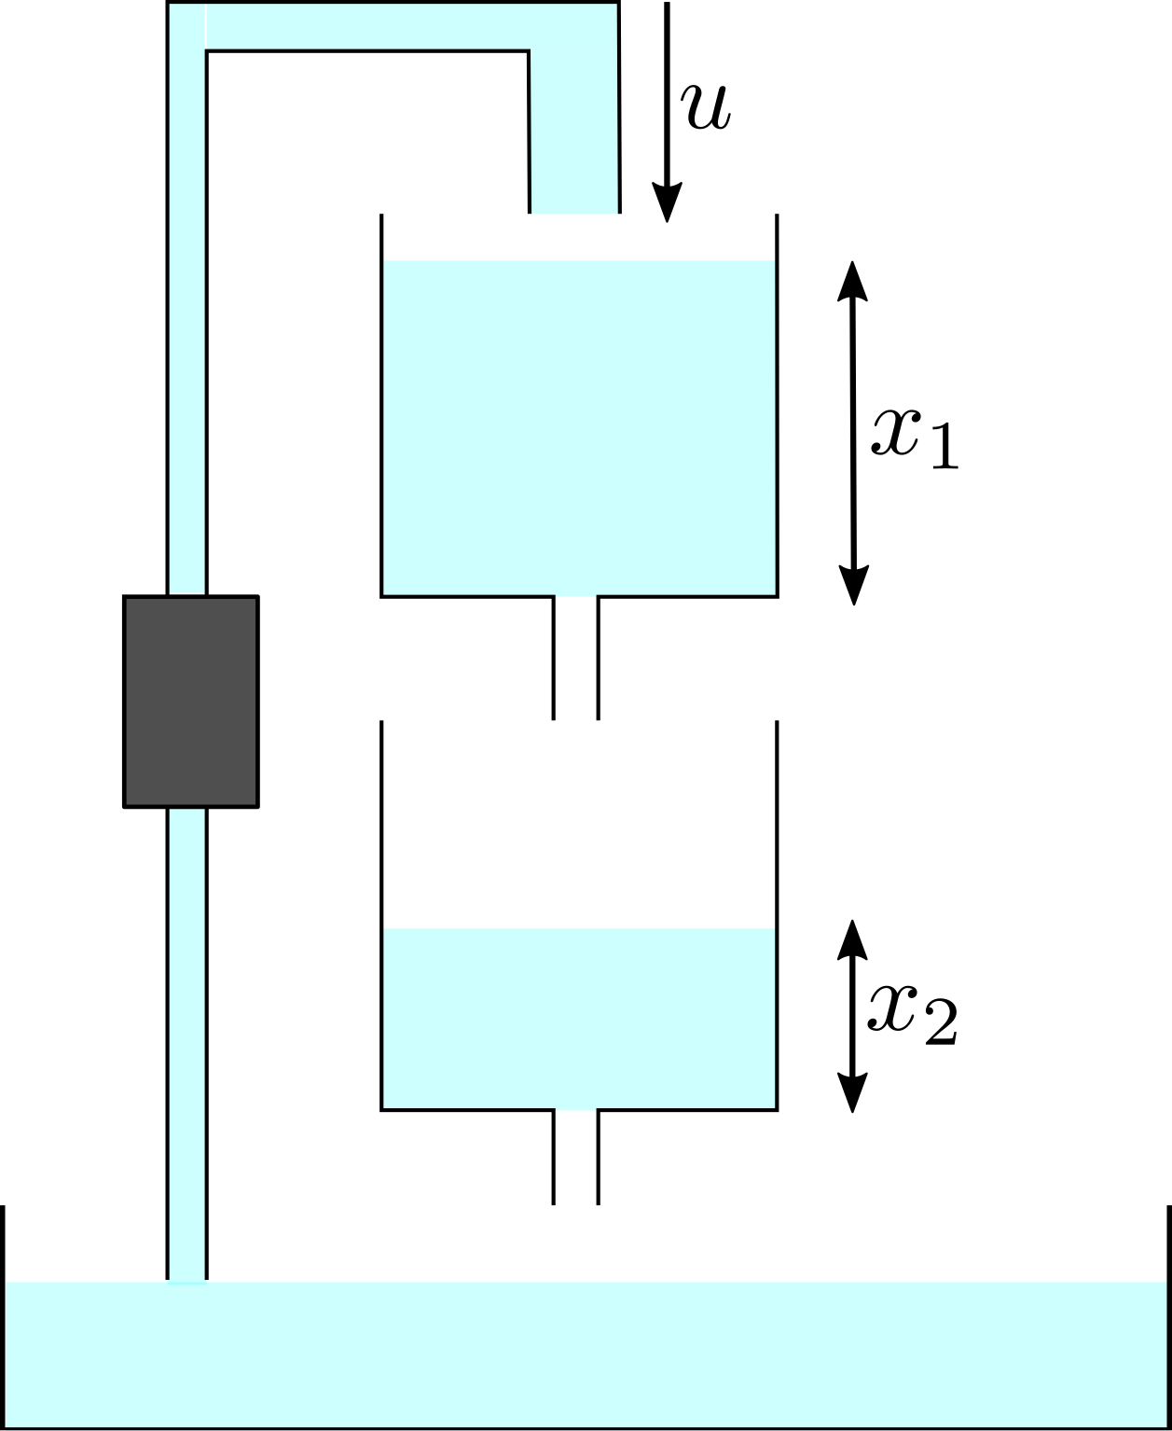
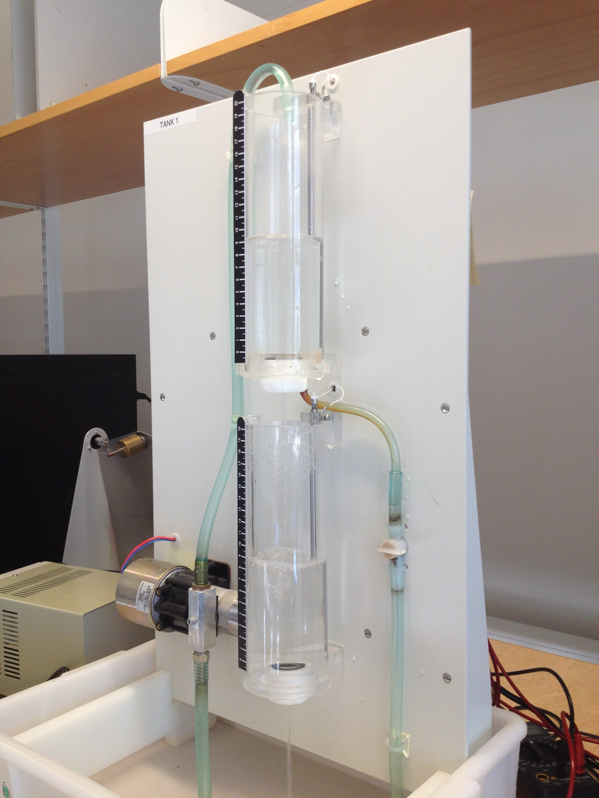
Physics-inspired neural state-space models
Cascaded tanks system. Input: upper tank inlet flow u. Output: lower tank level.
The dataset has just 1024 time points. We implement full simulation error minimization.
Schoukens, M. et al. "Cascaded tanks benchmark combining soft and hard nonlinearities." Workshop on nonlinear system identification benchmarks, 2016.

Slide 3
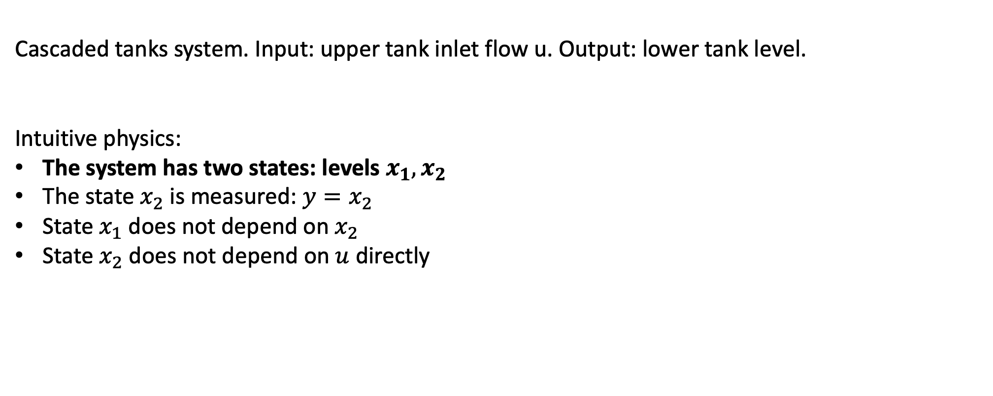
Physics-inspired neural state-space models – model #1
Cascaded tanks system. Input: upper tank inlet flow u. Output: lower tank level.
Intuitive physics:
The system has two states: levels $x_{1},x_{2}$
The state $x_{2}$ is measured: $y=x_{2}$
State $x_{1}$ does not depend on $x_{2}$
State $x_{2}$ does not depend on $u$ directly

Slide 4
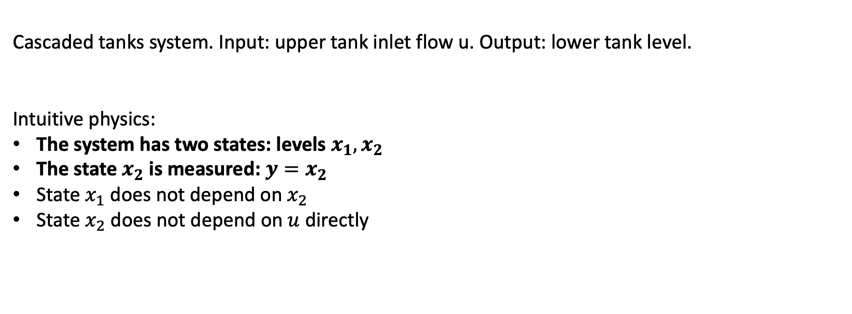
Physics-inspired neural state-space models – model # 2
Cascaded tanks system. Input: upper tank inlet flow u. Output: lower tank level.
Intuitive physics:
The system has two states: levels $x_{1},x_{2}$
The state $x_{2}$ is measured: $y=x_{2}$
State $x_{1}$ does not depend on $x_{2}$
State $x_{2}$ does not depend on $u$ directly

Slide 5
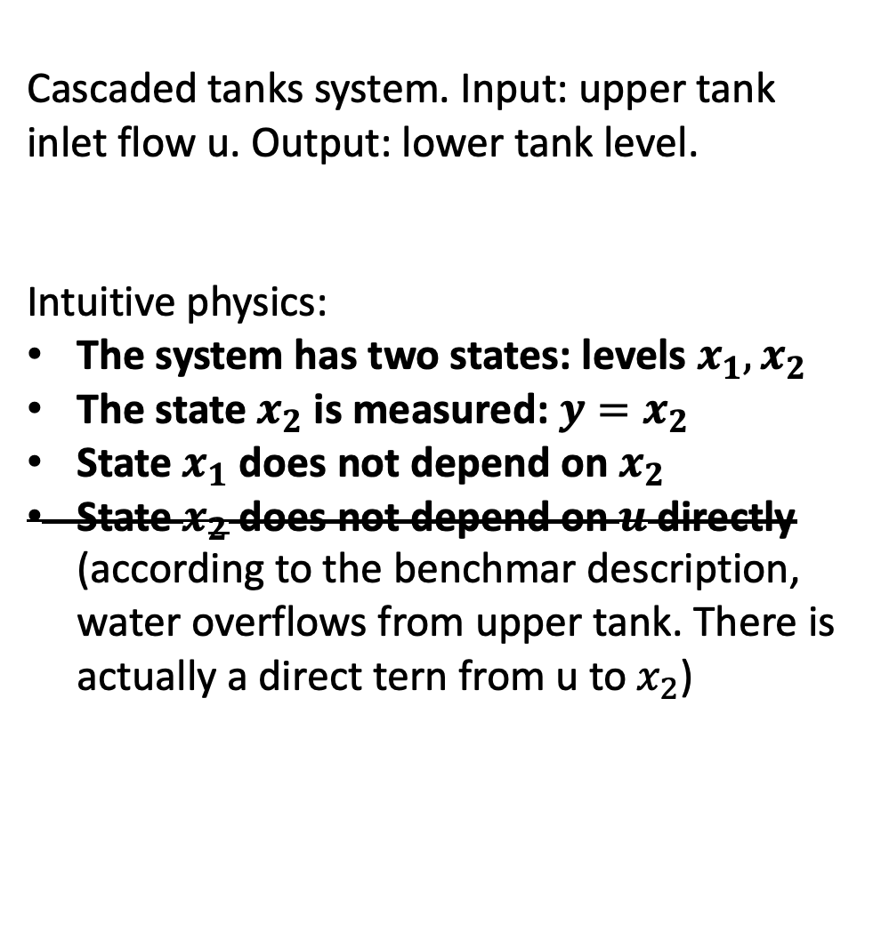
Physics-inspired neural state-space models – model #3
Cascaded tanks system. Input: upper tank inlet flow u. Output: lower tank level.
Intuitive physics:
The system has two states: levels $x_{1},x_{2}$
The state $x_{2}$ is measured: $y=x_{2}$
State $x_{1}$ does not depend on $x_{2}$
State $x_{2}$ does not depend on $u$ directly (according to the benchmar description, water overflows from upper tank. There is actually a direct tern from u to $x_{2}$)

Slide 6
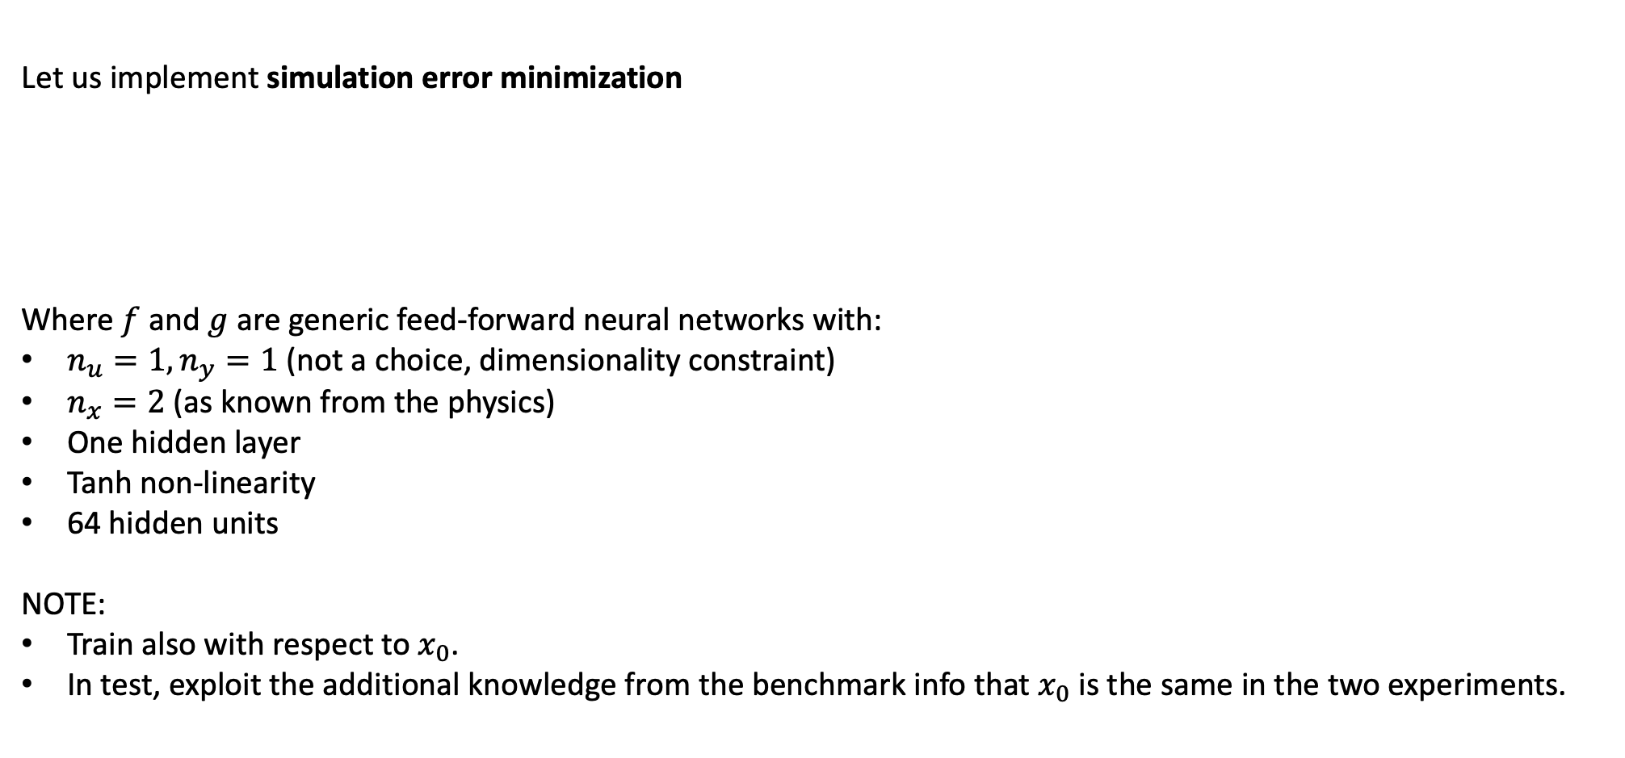
Simulation error minimization – model #1
Let us implement simulation error minimization
Where $f$ and $g$ are generic feed-forward neural networks with:
$n_{u}=1, n_{y}=1$ (not a choice, dimensionality constraint)
$n_{x}=2$ (as known from the physics)
One hidden layer
Tanh non-linearity
64 hidden units
NOTE:
Train also with respect to $x_{0}$.
In test, exploit the additional knowledge from the benchmark info that $x_{0}$is the same in the two experiments.

Slide 7
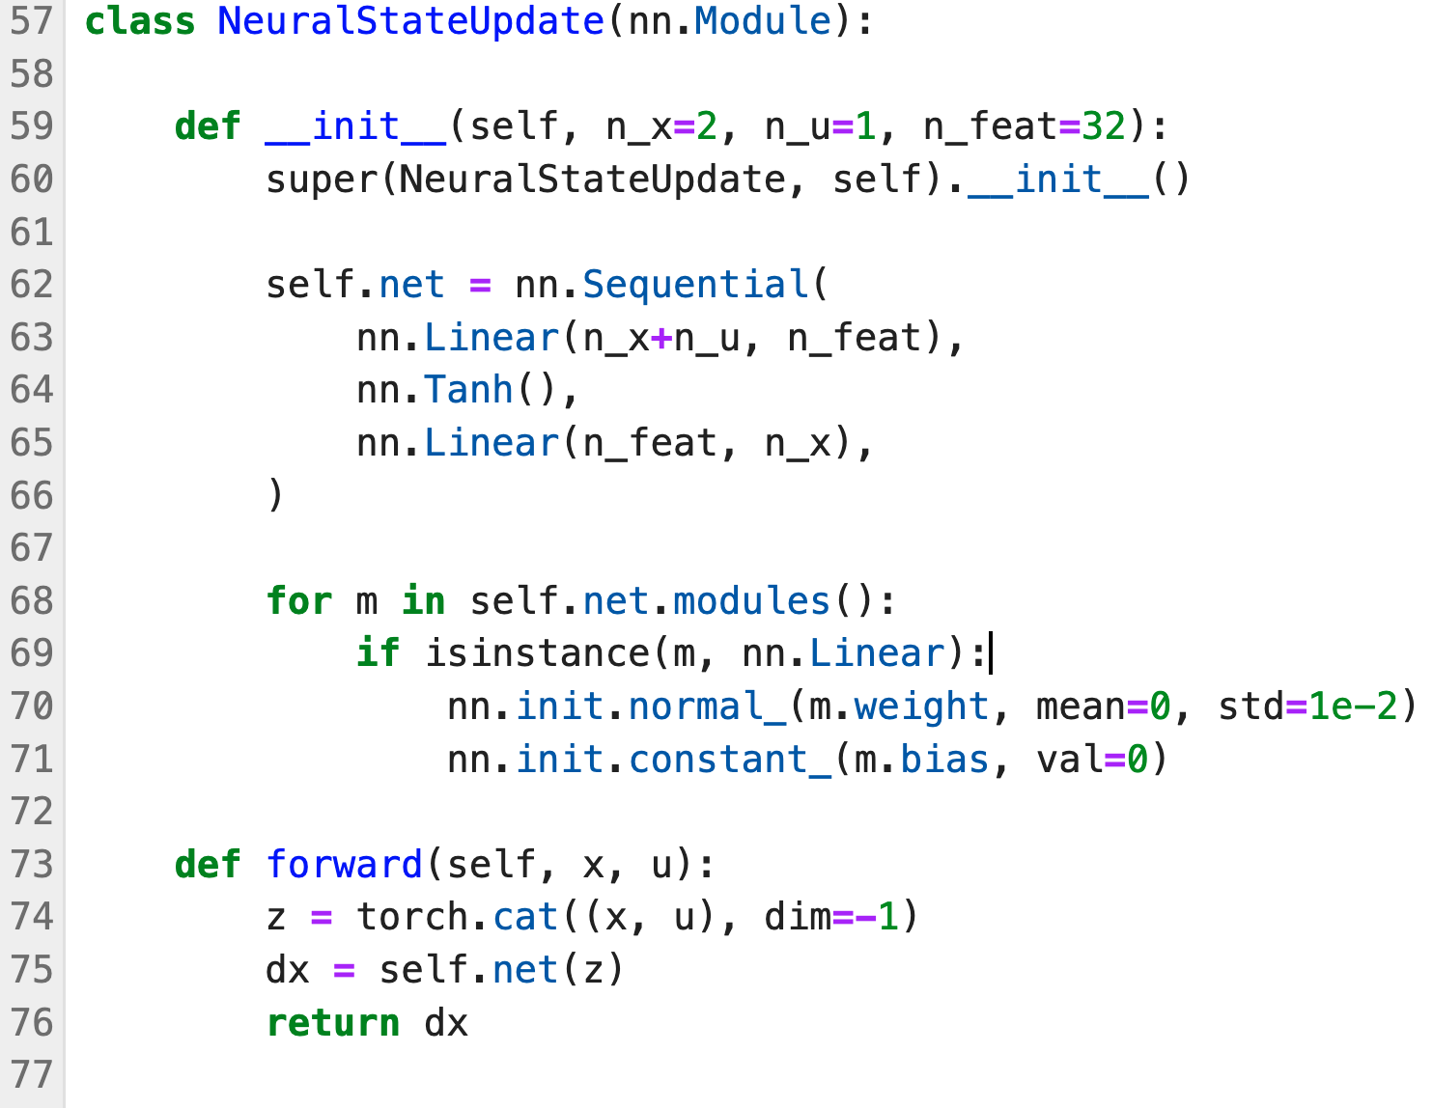
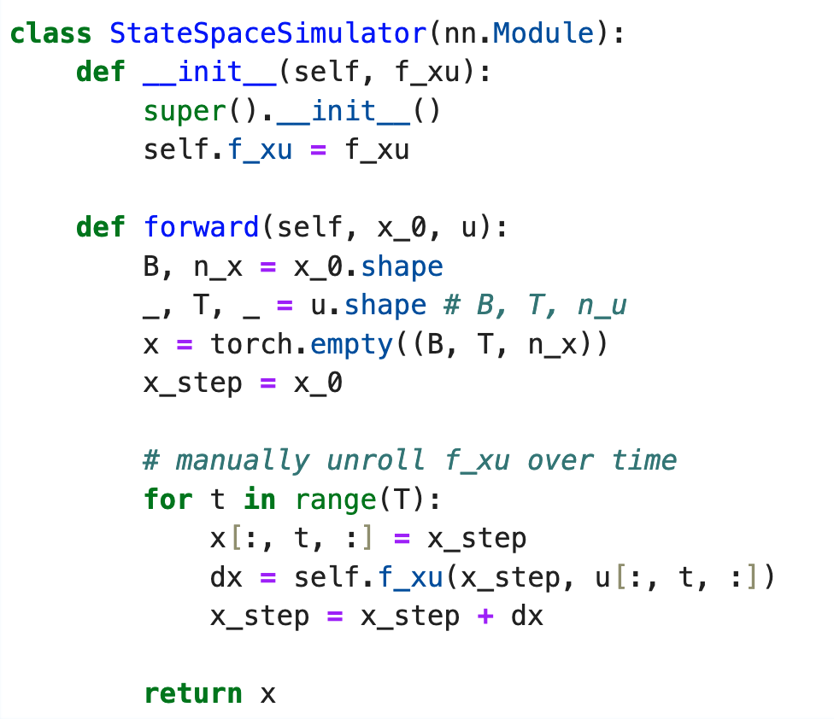


PyTorch Implementation (hints)
Code adapted from https://github.com/forgi86/pytorch-ident
Custom state-update function $f(x,u)$
Custom code to unroll $f(x,u)$ over time
Notes:
https://github.com/pytorch/examples/blob/main/word_language_model/main.py

Slide 8
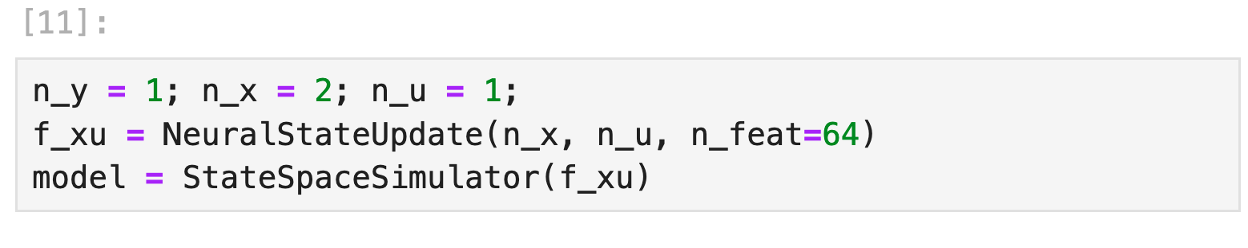
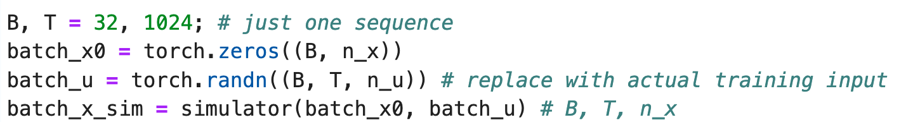
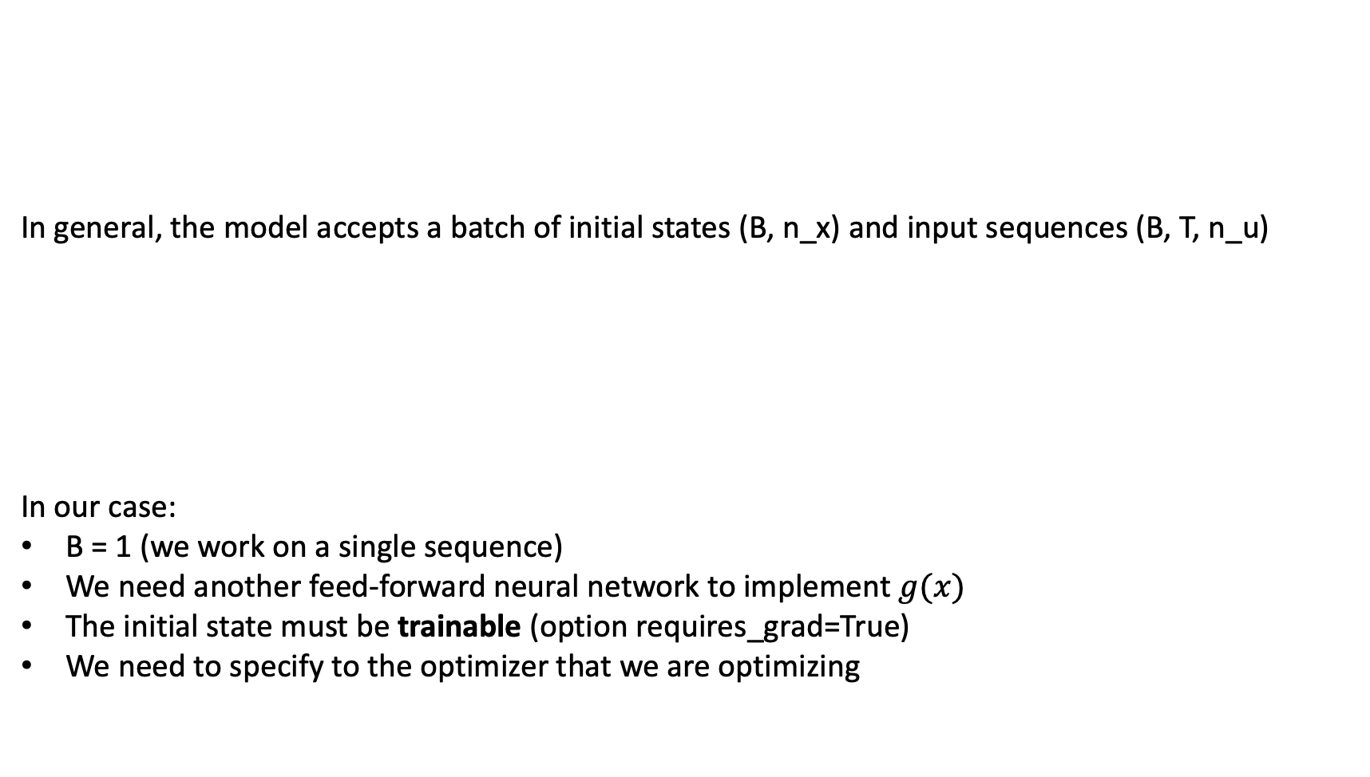
PyTorch Implementation (hints)
In general, the model accepts a batch of initial states (B, n_x) and input sequences (B, T, n_u)
In our case:
B = 1 (we work on a single sequence)
We need another feed-forward neural network to implement $g(x)$
The initial state must be trainable (option requires_grad=True)
We need to specify to the optimizer that we are optimizing
Notes:
https://github.com/pytorch/examples/blob/main/word_language_model/main.py

Slide 9
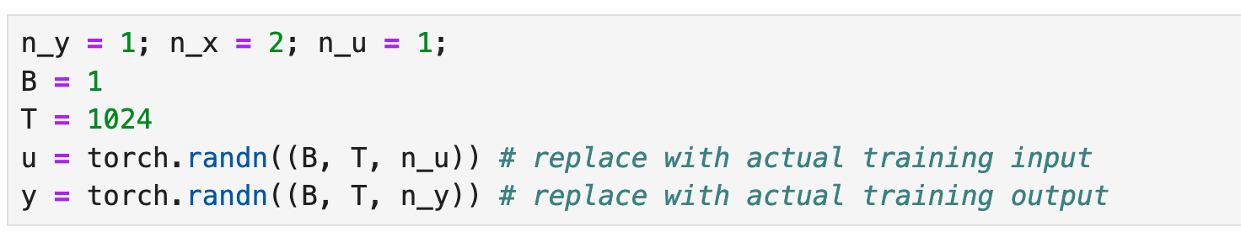
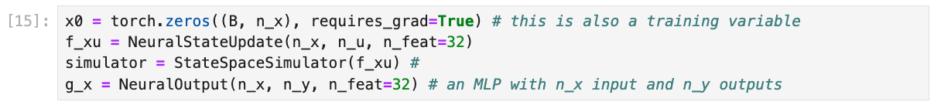
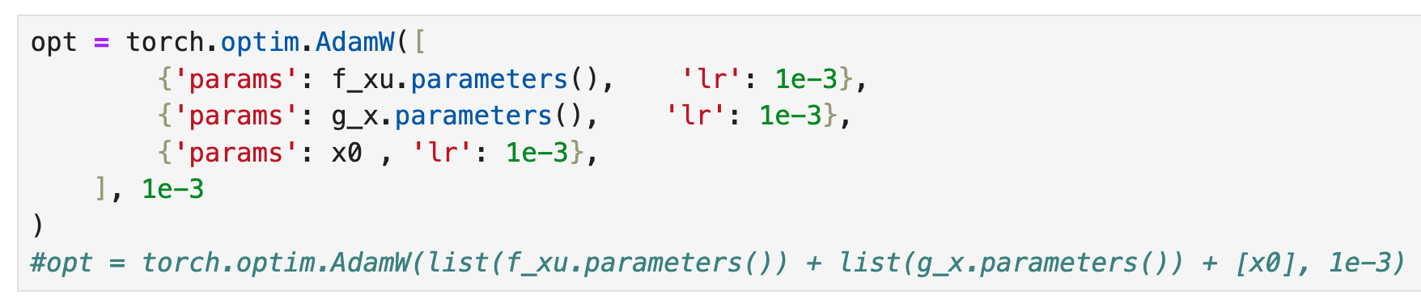
PyTorch Implementation (hints)
Initializations
Define model and initial state
Define optimizer
Compute loss (in a trainig loop…)
Notes:
https://github.com/pytorch/examples/blob/main/word_language_model/main.py

Slide 10
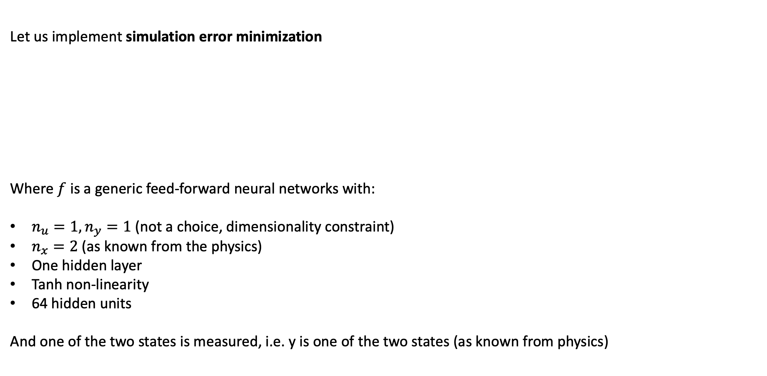
Simulation error minimization – model #2
Let us implement simulation error minimization
Where $f$ is a generic feed-forward neural networks with:
$n_{u}=1, n_{y}=1$ (not a choice, dimensionality constraint)
$n_{x}=2$ (as known from the physics)
One hidden layer
Tanh non-linearity
64 hidden units
And one of the two states is measured, i.e. y is one of the two states (as known from physics)

Slide 11
Simulation error minimization – model #3
Let us implement simulation error minimization
Implement and train a tailor-made architecture consistent with all the physics constraints assumed for model #3:

Slide 12
Thank you for your attention

