Slide 1



Deep learning for state-space identification
Exercises
Marco Forgione, Dalle Molle Institute for Artificial Intelligence, Lugano, Switzerland
Lugano, April, 23rd, 2024

Slide 2
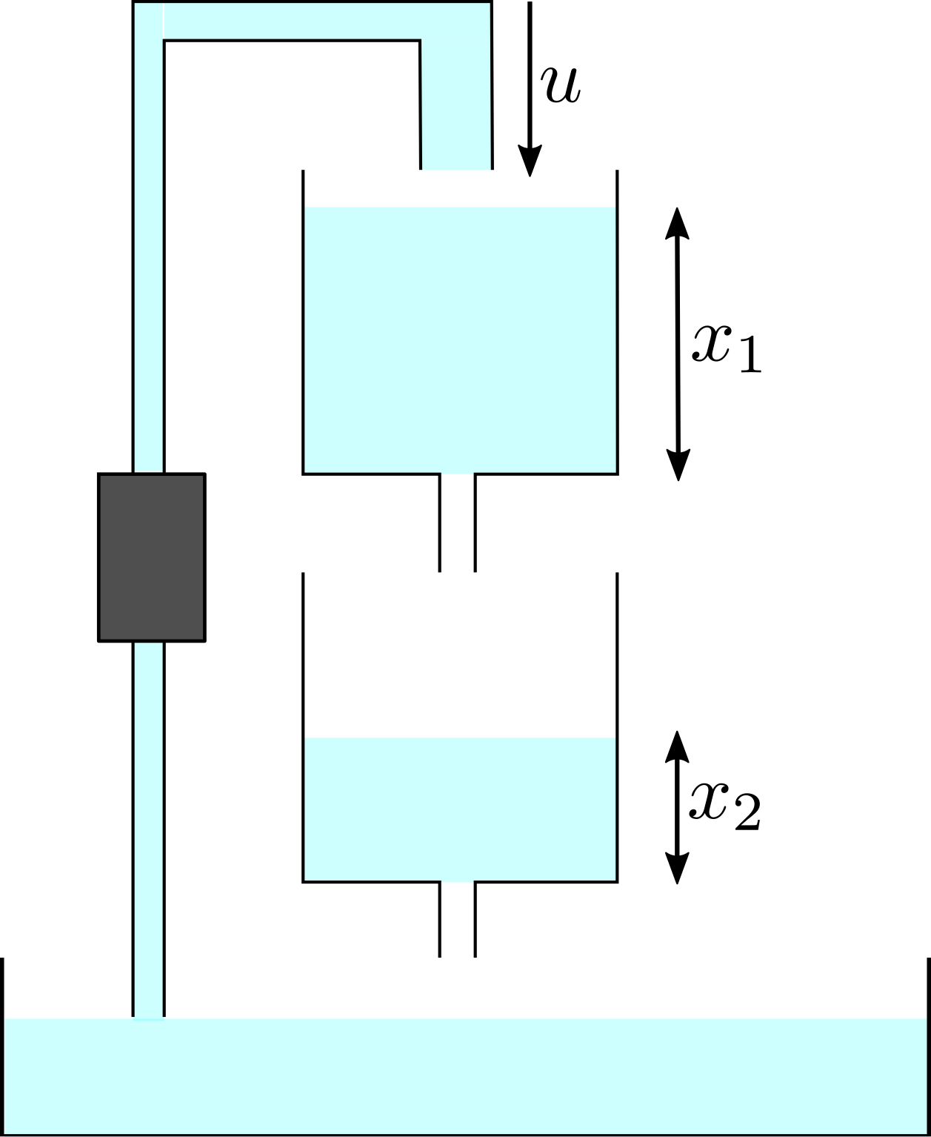
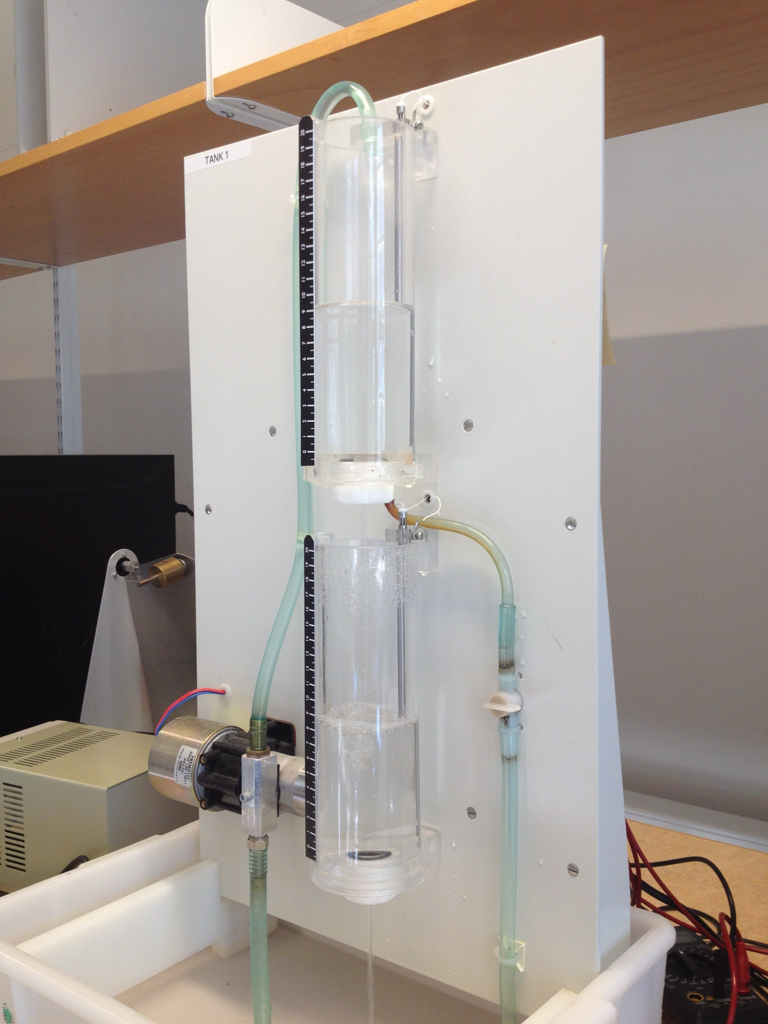
Physics-inspired neural state-space models
Cascaded tanks system. Input: upper tank inlet flow u. Output: lower tank level.
The dataset has just N=1024 time points. We implement full simulation error minimization.
Schoukens, M. et al. "Cascaded tanks benchmark combining soft and hard nonlinearities." Workshop on nonlinear system identification benchmarks, 2016.

Slide 3
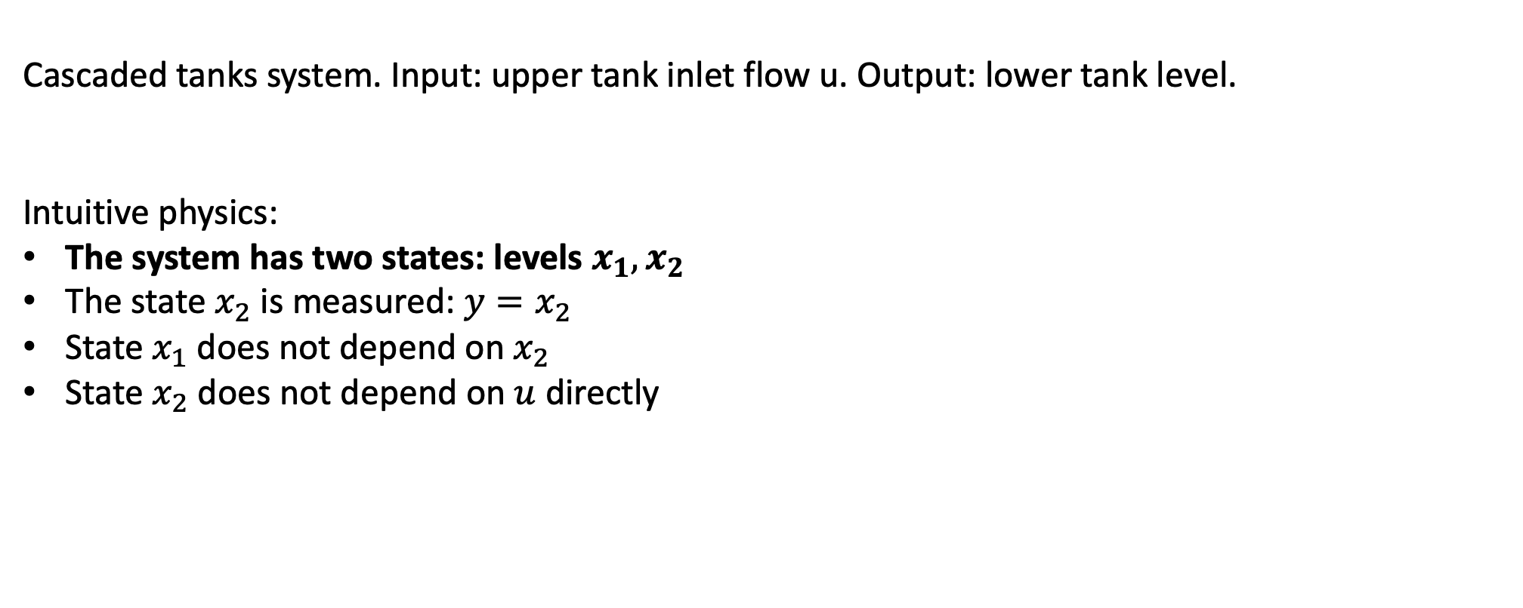
Physics-inspired neural state-space models – model #1
Cascaded tanks system. Input: upper tank inlet flow u. Output: lower tank level.
Intuitive physics:
The system has two states: levels $x_{1},x_{2}$
The state $x_{2}$ is measured: $y=x_{2}$
State $x_{1}$ does not depend on $x_{2}$
State $x_{2}$ does not depend on $u$ directly

Slide 4
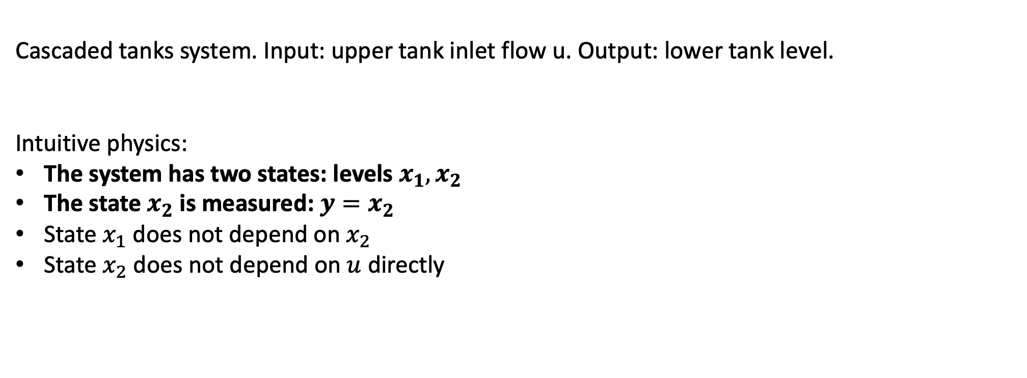
Physics-inspired neural state-space models – model #2
Cascaded tanks system. Input: upper tank inlet flow u. Output: lower tank level.
Intuitive physics:
The system has two states: levels $x_{1},x_{2}$
The state $x_{2}$ is measured: $y=x_{2}$
State $x_{1}$ does not depend on $x_{2}$
State $x_{2}$ does not depend on $u$ directly

Slide 5
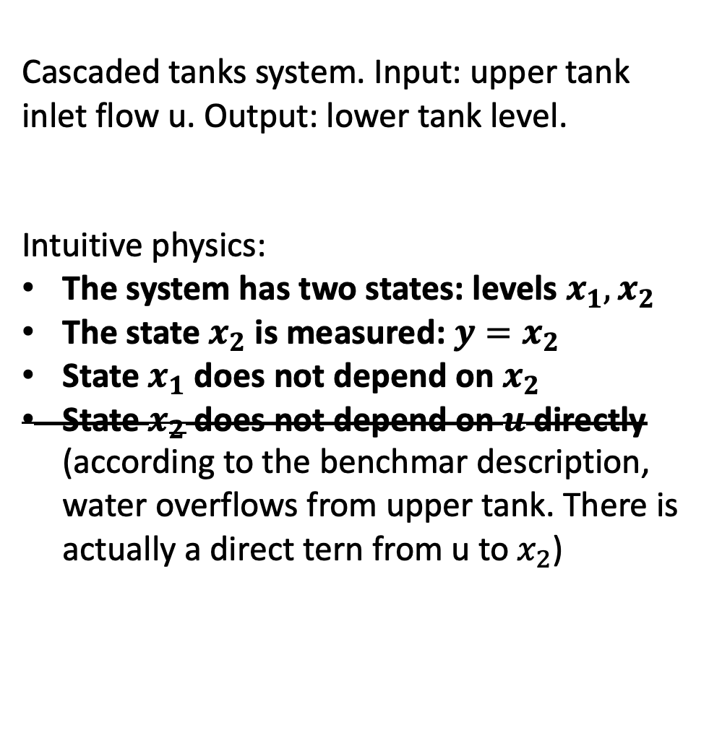
Physics-inspired neural state-space models – model #3
Cascaded tanks system. Input: upper tank inlet flow u. Output: lower tank level.
Intuitive physics:
The system has two states: levels $x_{1},x_{2}$
The state $x_{2}$ is measured: $y=x_{2}$
State $x_{1}$ does not depend on $x_{2}$
State $x_{2}$ does not depend on $u$ directly (according to the benchmar description, water overflows from upper tank. There is actually a direct tern from u to $x_{2}$)

Slide 6
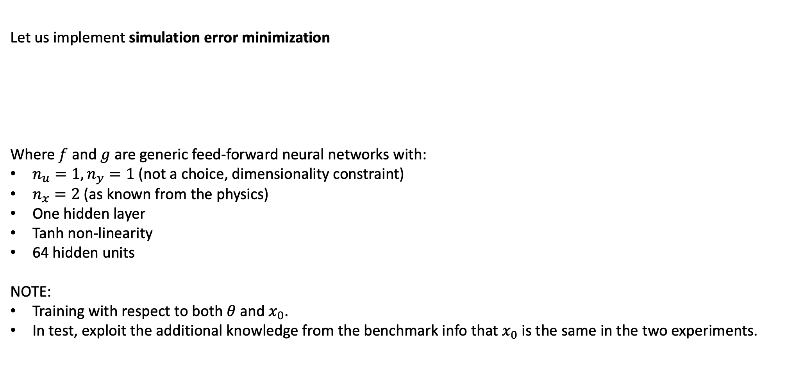
Simulation error minimization – model #1
Let us implement simulation error minimization
Where $f$ and $g$ are generic feed-forward neural networks with:
$n_{u}=1, n_{y}=1$ (not a choice, dimensionality constraint)
$n_{x}=2$ (as known from the physics)
One hidden layer
Tanh non-linearity
64 hidden units
NOTE:
Training with respect to both $θ$ and $x_{0}$.
In test, exploit the additional knowledge from the benchmark info that $x_{0}$is the same in the two experiments.

Slide 7
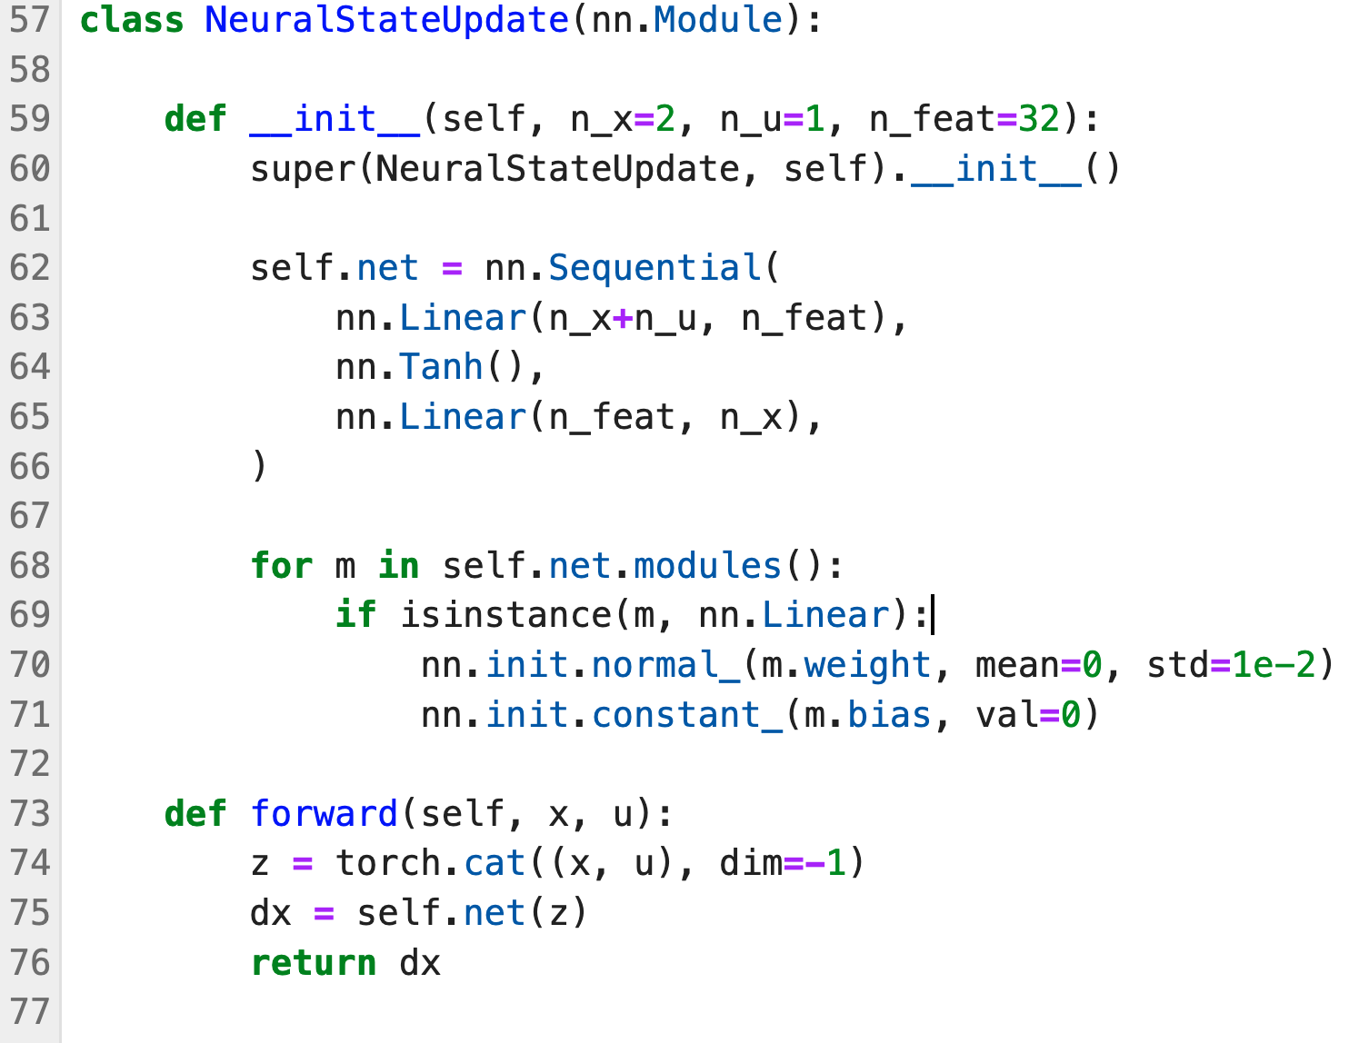
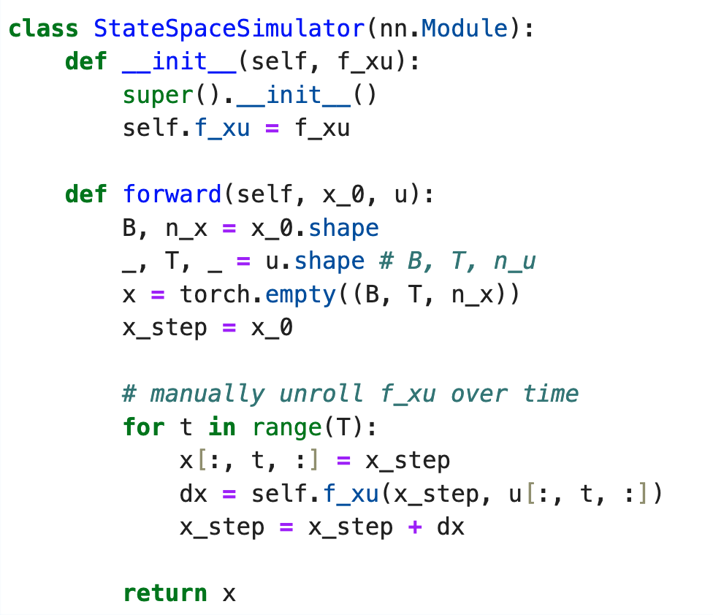


PyTorch Implementation (hints)
Code adapted from https://github.com/forgi86/pytorch-ident
Custom state-update function $f(x,u)$
Custom code to unroll $f(x,u)$ over time
Notes:
https://github.com/pytorch/examples/blob/main/word_language_model/main.py

Slide 8
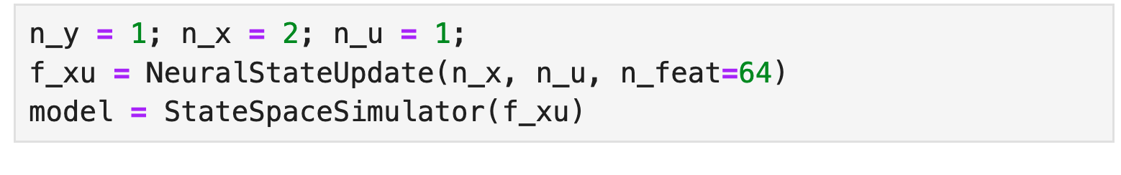
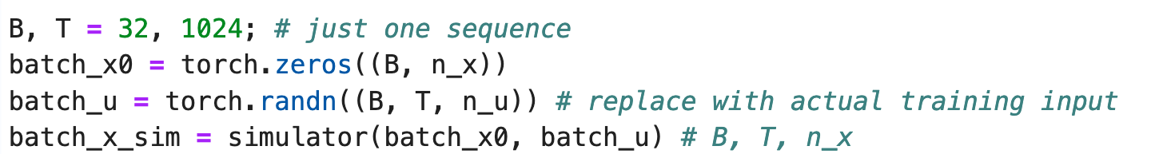
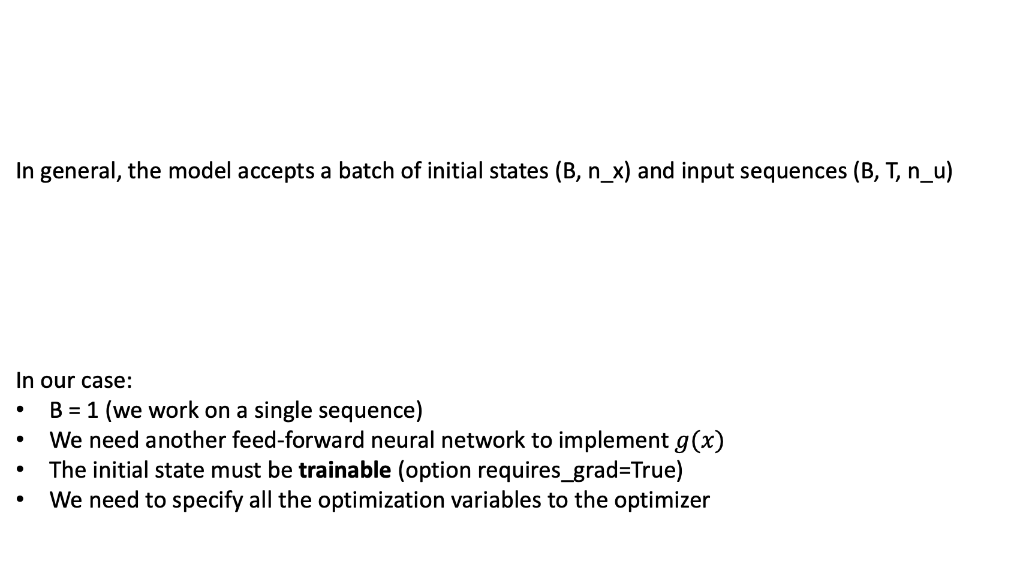
PyTorch Implementation (hints)
In general, the model accepts a batch of initial states (B, n_x) and input sequences (B, T, n_u)
In our case:
B = 1 (we work on a single sequence)
We need another feed-forward neural network to implement $g(x)$
The initial state must be trainable (option requires_grad=True)
We need to specify all the optimization variables to the optimizer
Notes:
https://github.com/pytorch/examples/blob/main/word_language_model/main.py

Slide 9
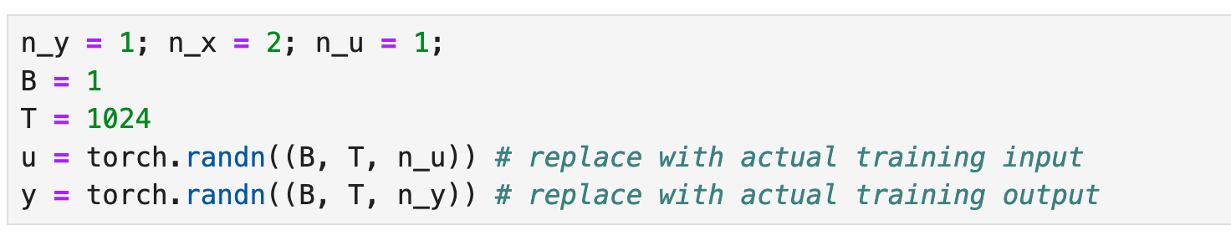
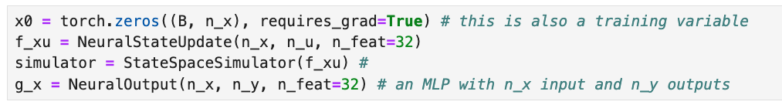
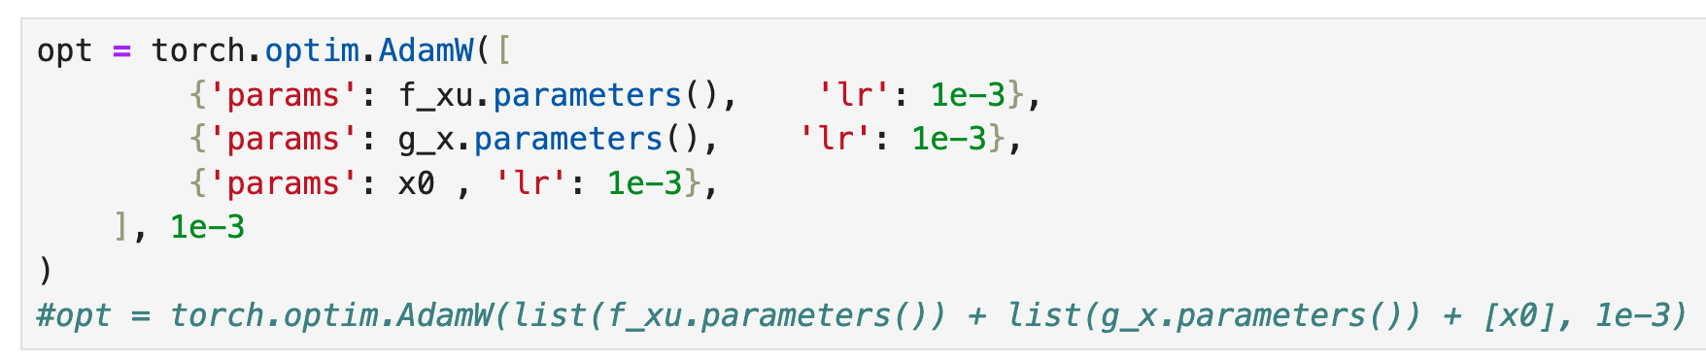
PyTorch Implementation (hints)
Initializations
Define model and initial state
Define optimizer
Compute loss (in a trainig loop…)
Notes:
https://github.com/pytorch/examples/blob/main/word_language_model/main.py

Slide 10
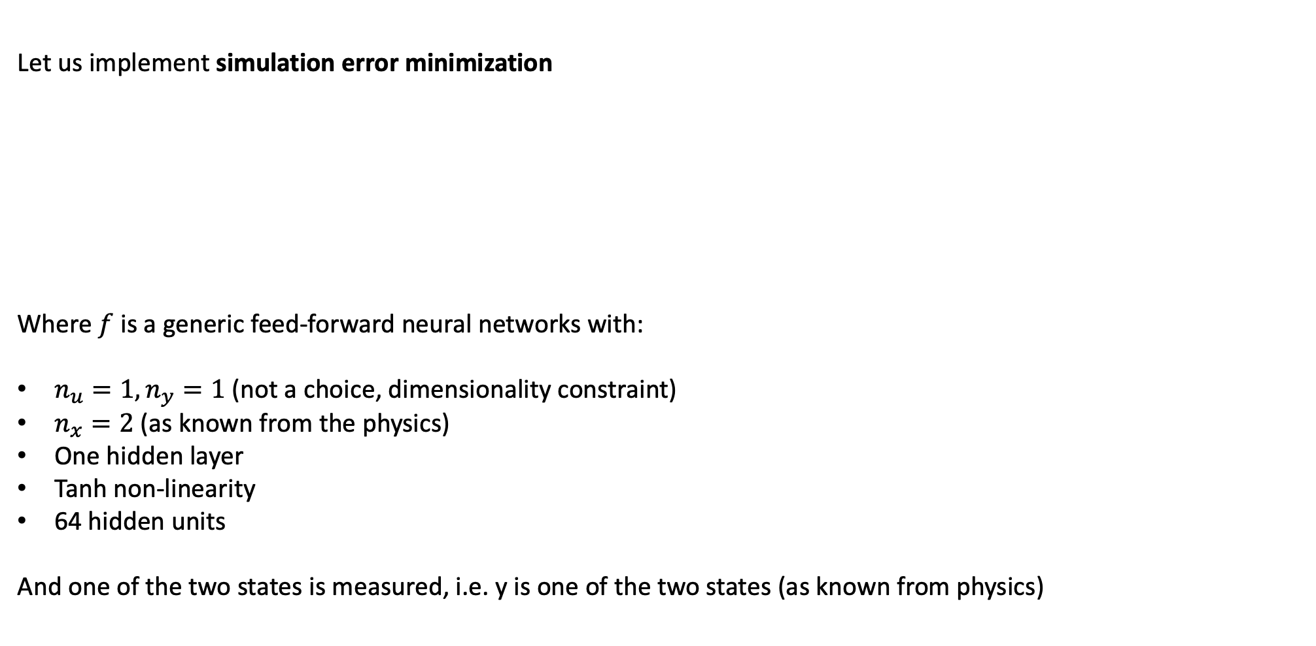
Simulation error minimization – model #2
Let us implement simulation error minimization
Where $f$ is a generic feed-forward neural networks with:
$n_{u}=1, n_{y}=1$ (not a choice, dimensionality constraint)
$n_{x}=2$ (as known from the physics)
One hidden layer
Tanh non-linearity
64 hidden units
And one of the two states is measured, i.e. y is one of the two states (as known from physics)

Slide 11
Simulation error minimization – model #3
Let us implement simulation error minimization
Implement and train a tailor-made architecture consistent with all the physics constraints assumed for model #3:

Slide 12
Thank you for your attention

