Slide 1
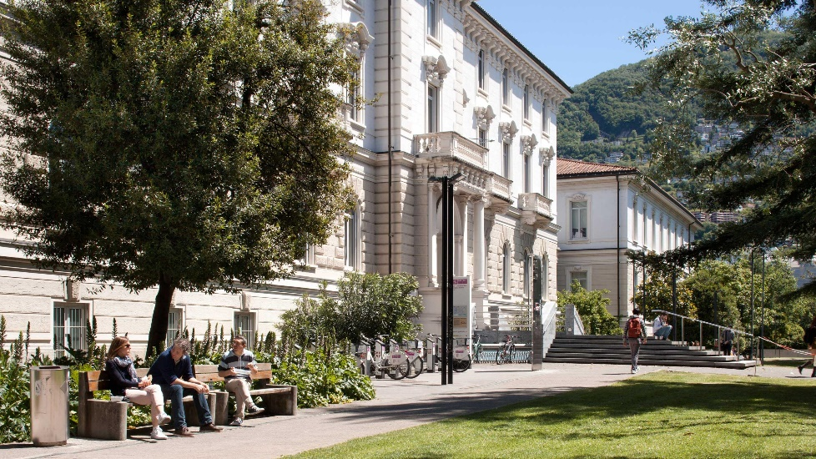

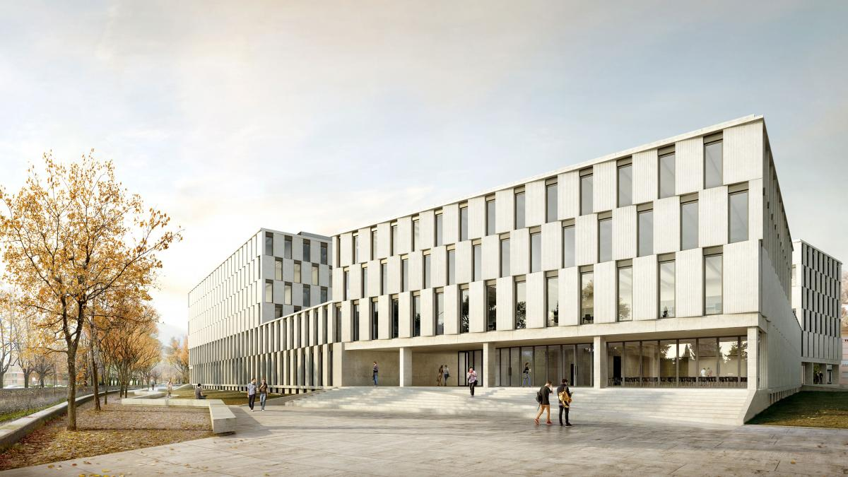
dynoNet: transfer functions in deep learning
Dario Piga, Marco Forgione, Dalle Molle Institute for Artificial Intelligence, Lugano, Switzerland

Slide 2
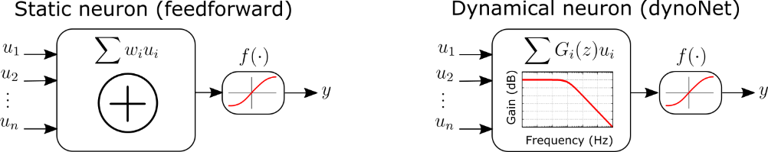
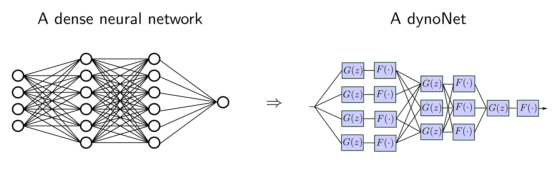
dynoNet: main idea
feedforward NN
dynoNet

Slide 3
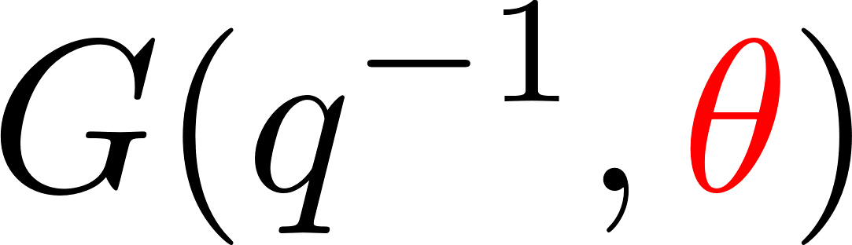
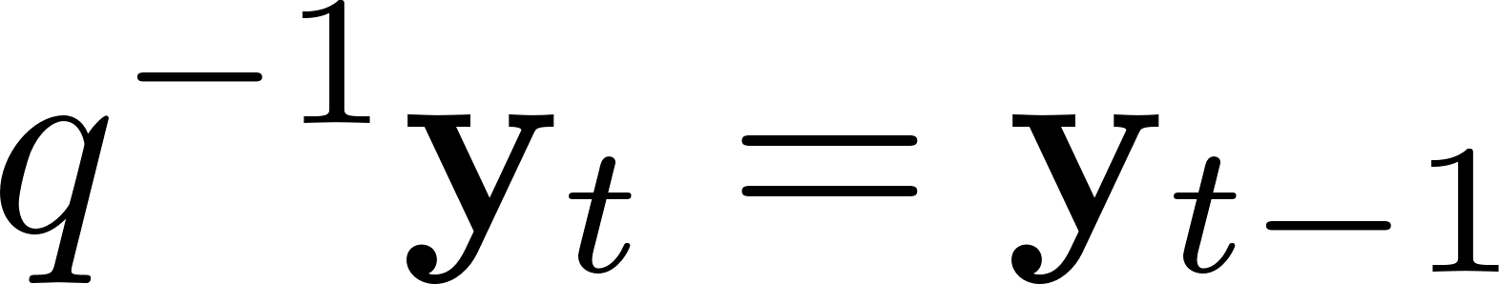
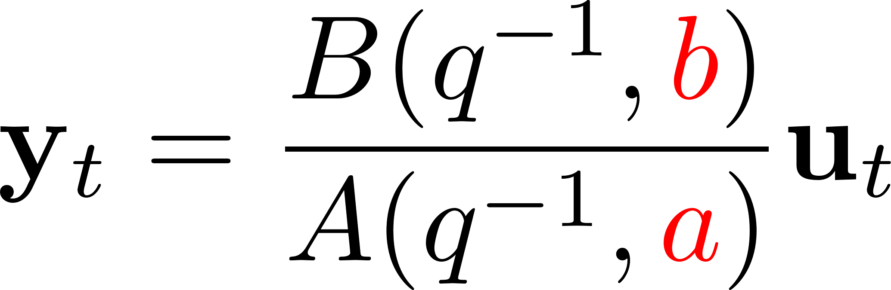
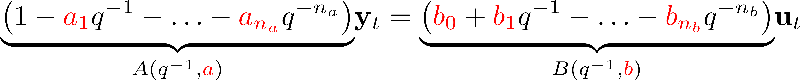
dynoNet: LTI operator
LTI linear operator
u
G(q)
y
recurrence equation

Slide 4
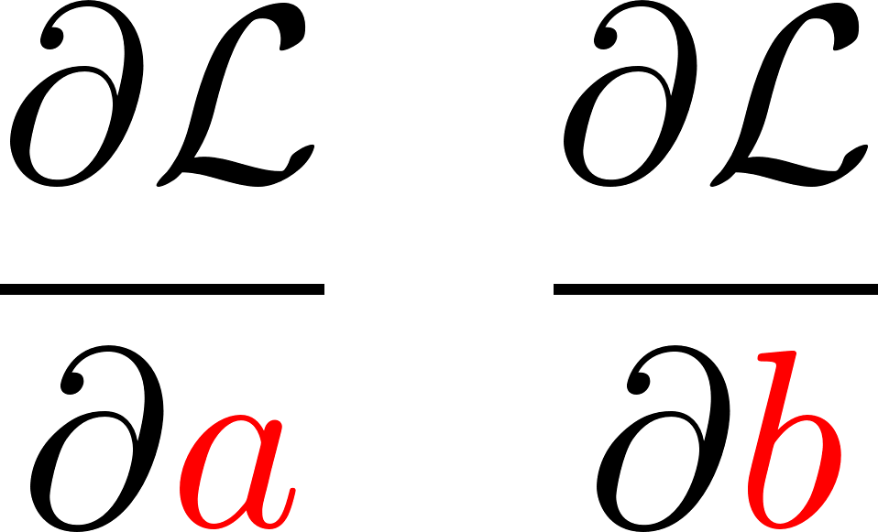
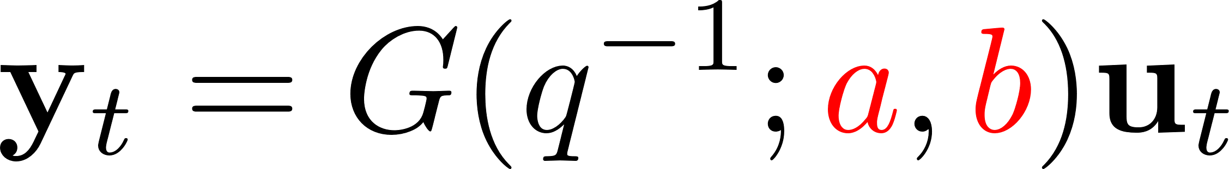
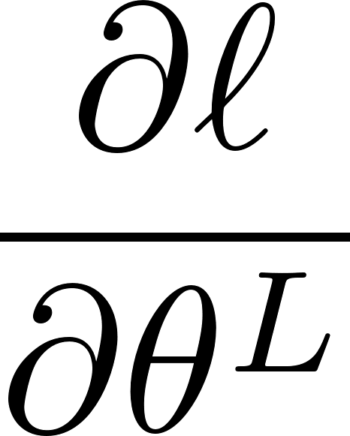
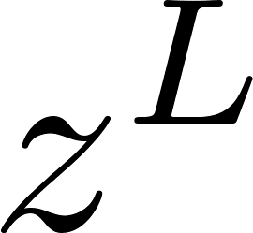
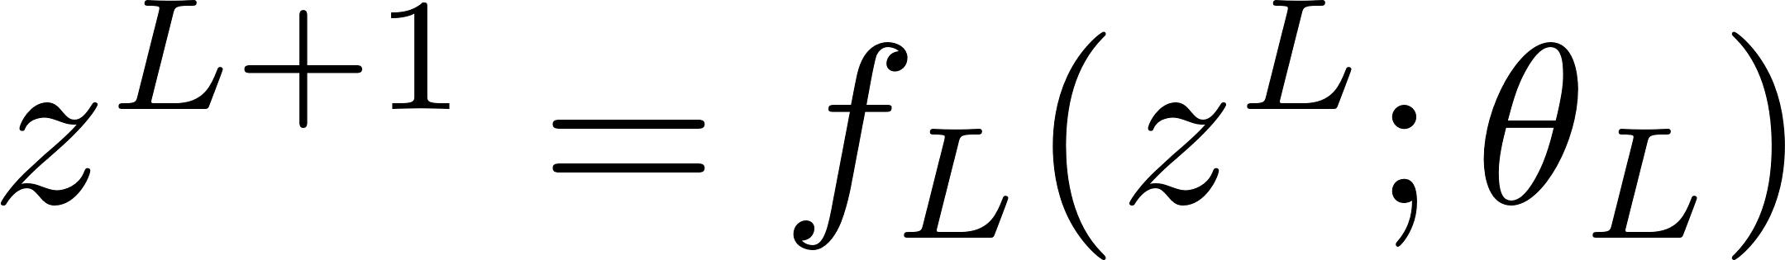
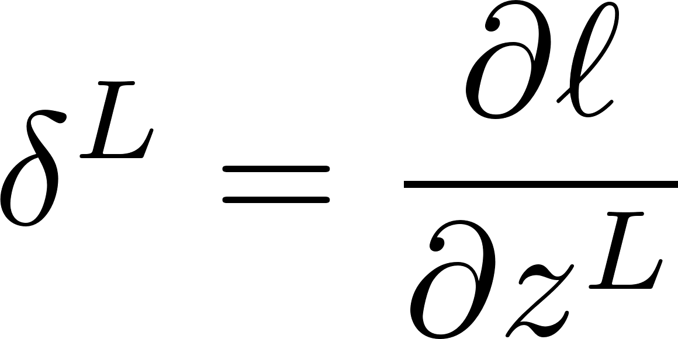

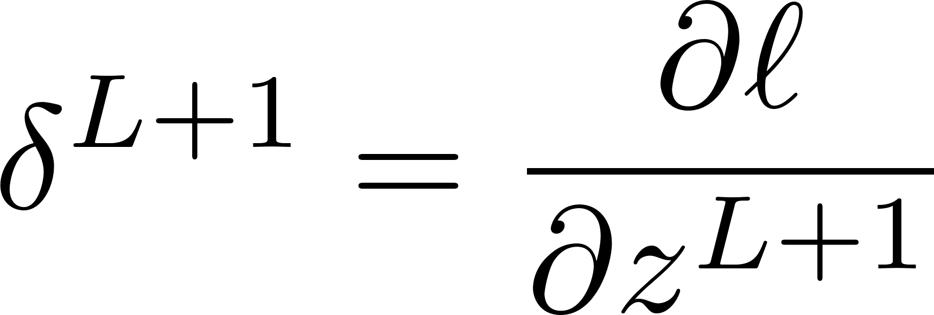
Integration in a DL framework
What do we need to integrate the LTI dynamic block in a neural network architecture?
u
y
G(q)
We need derivatives!
More in general, we need to transfor the G operator into a differentiable layer!
Layer L

Slide 5
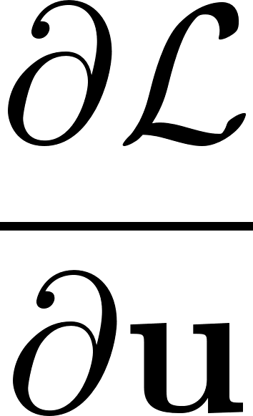


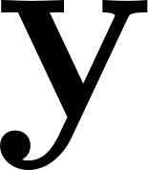
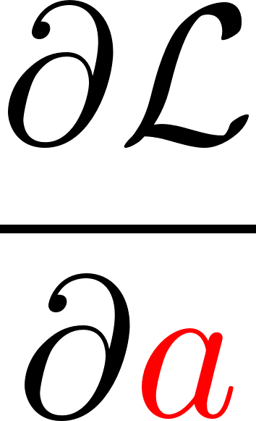
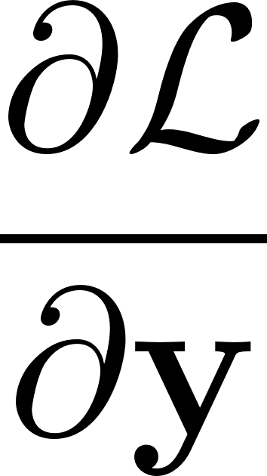

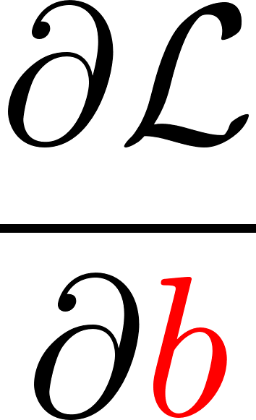
Transforming G into a differentiable layer
Layer L
Forward pass
Backward pass
Easy: O(T)
Differentiating dynamical blocks

Slide 6
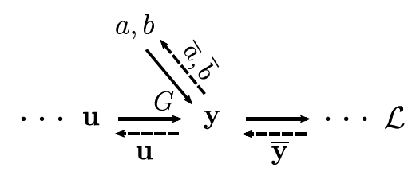
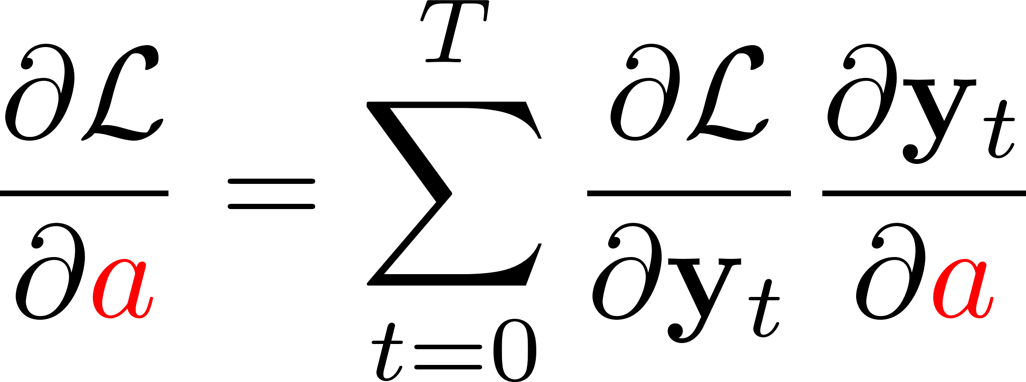
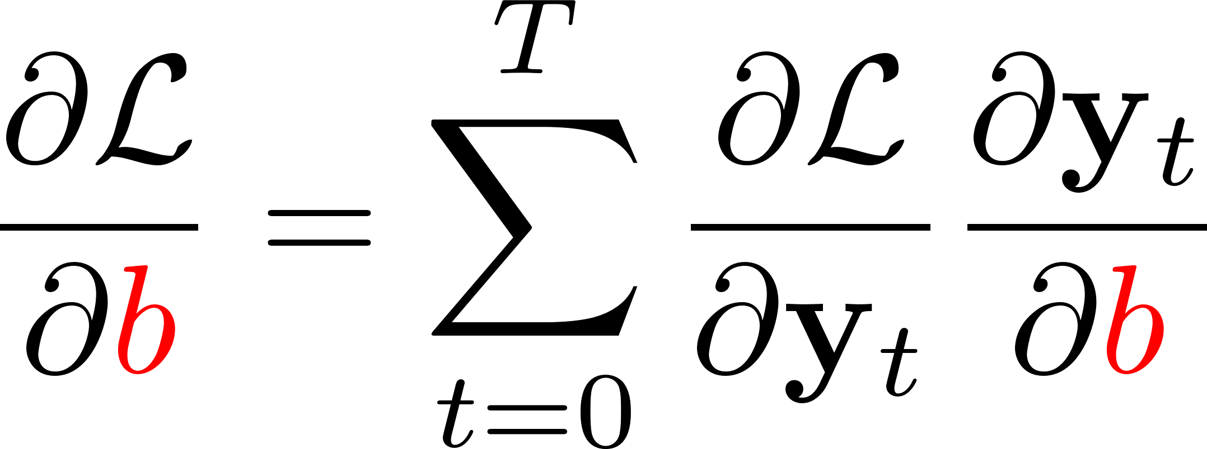
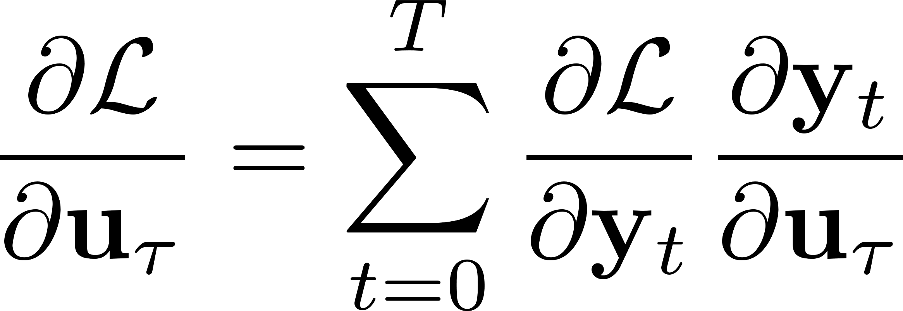
Backward pass
here’s what we really need

Slide 7
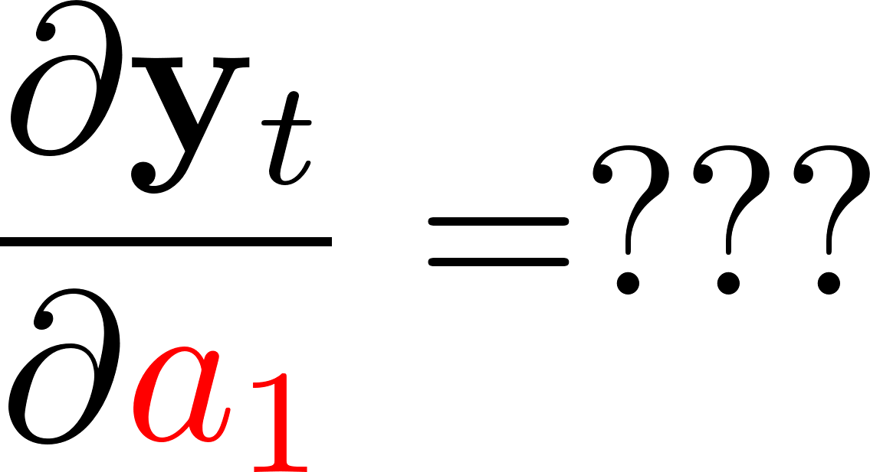
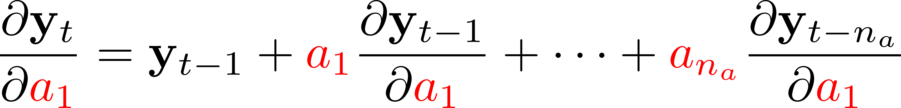
Backward pass
recurrence equation
Complexity: O(T)

Slide 8
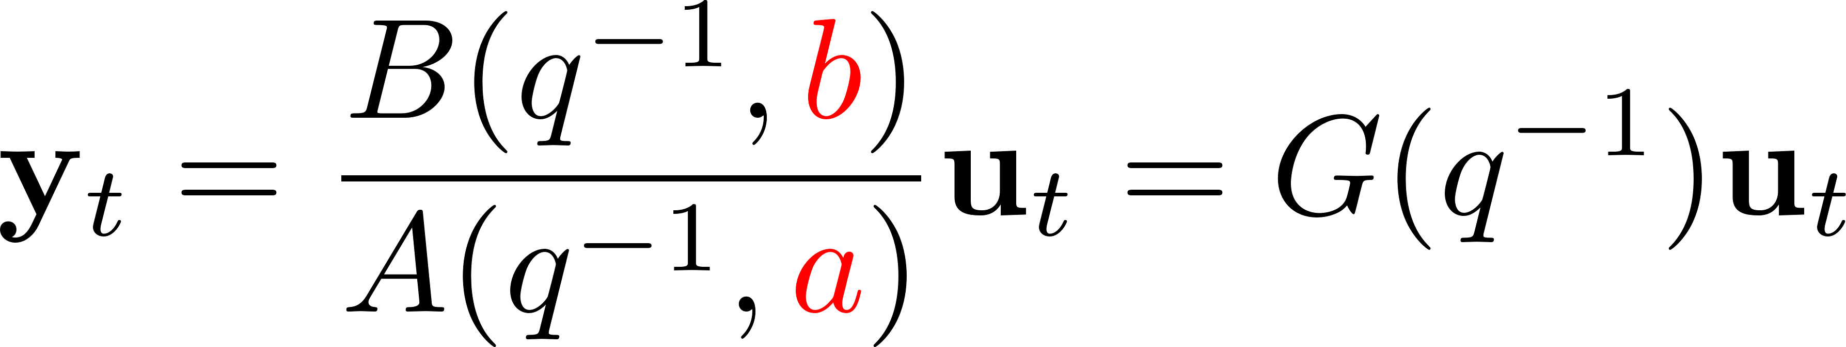
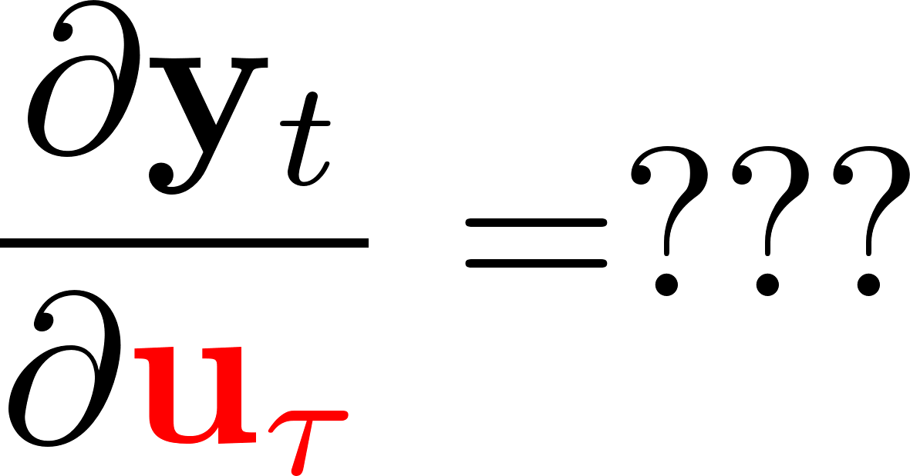
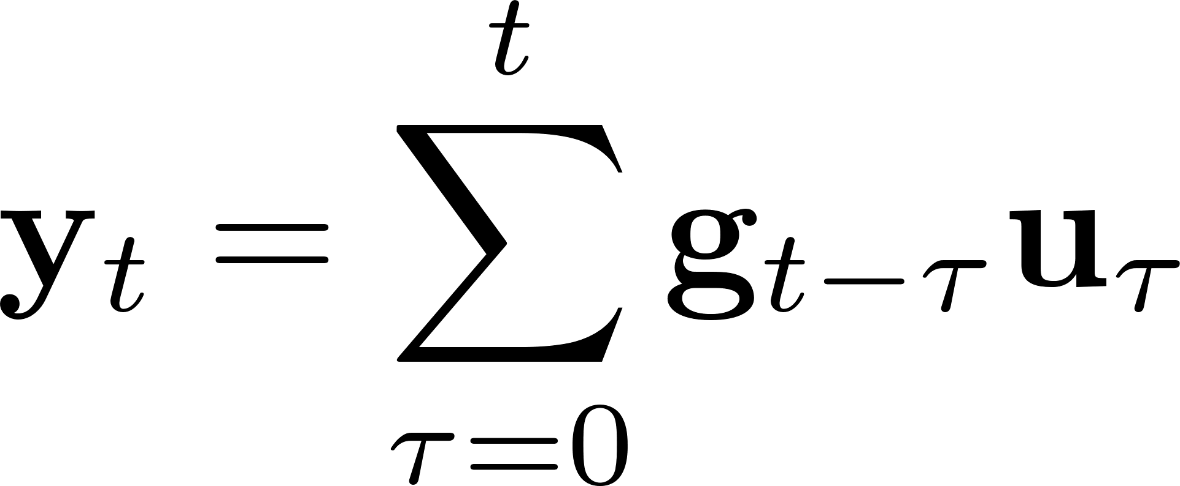
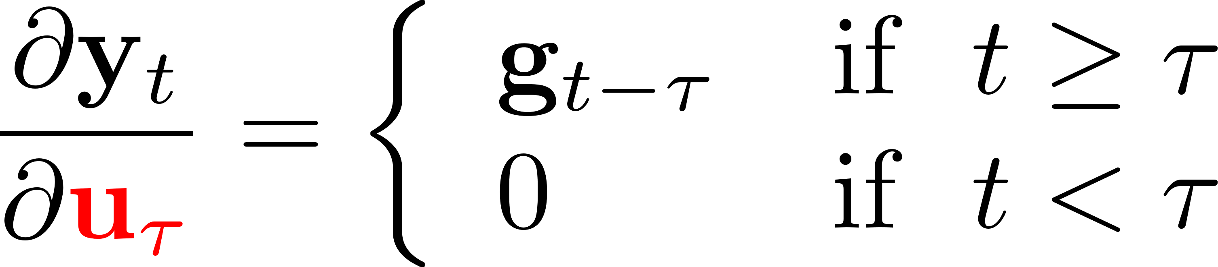
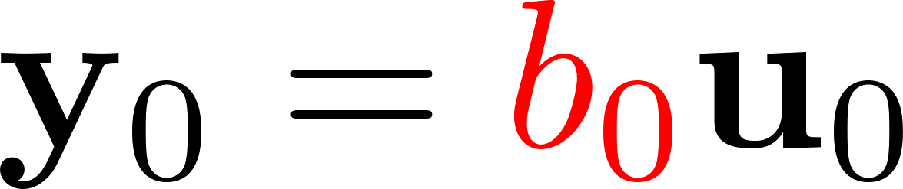
Backward pass
Impulse response

Slide 9
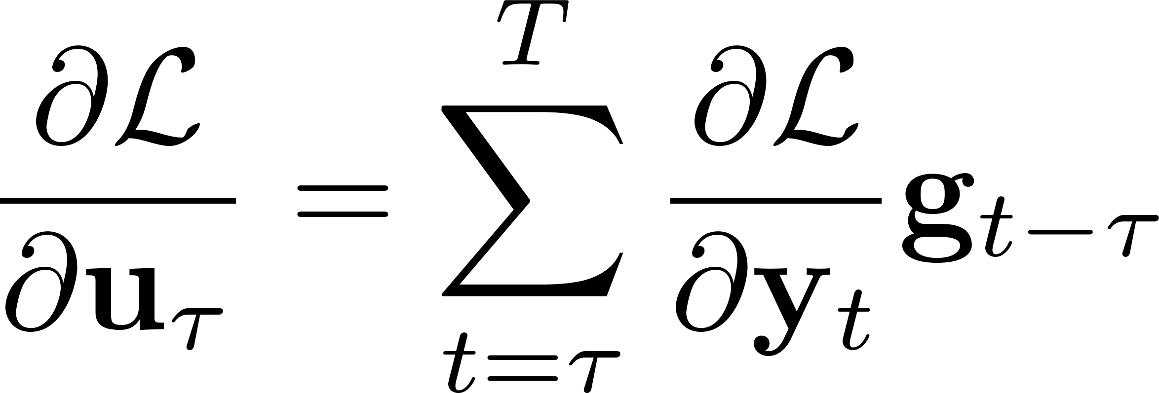
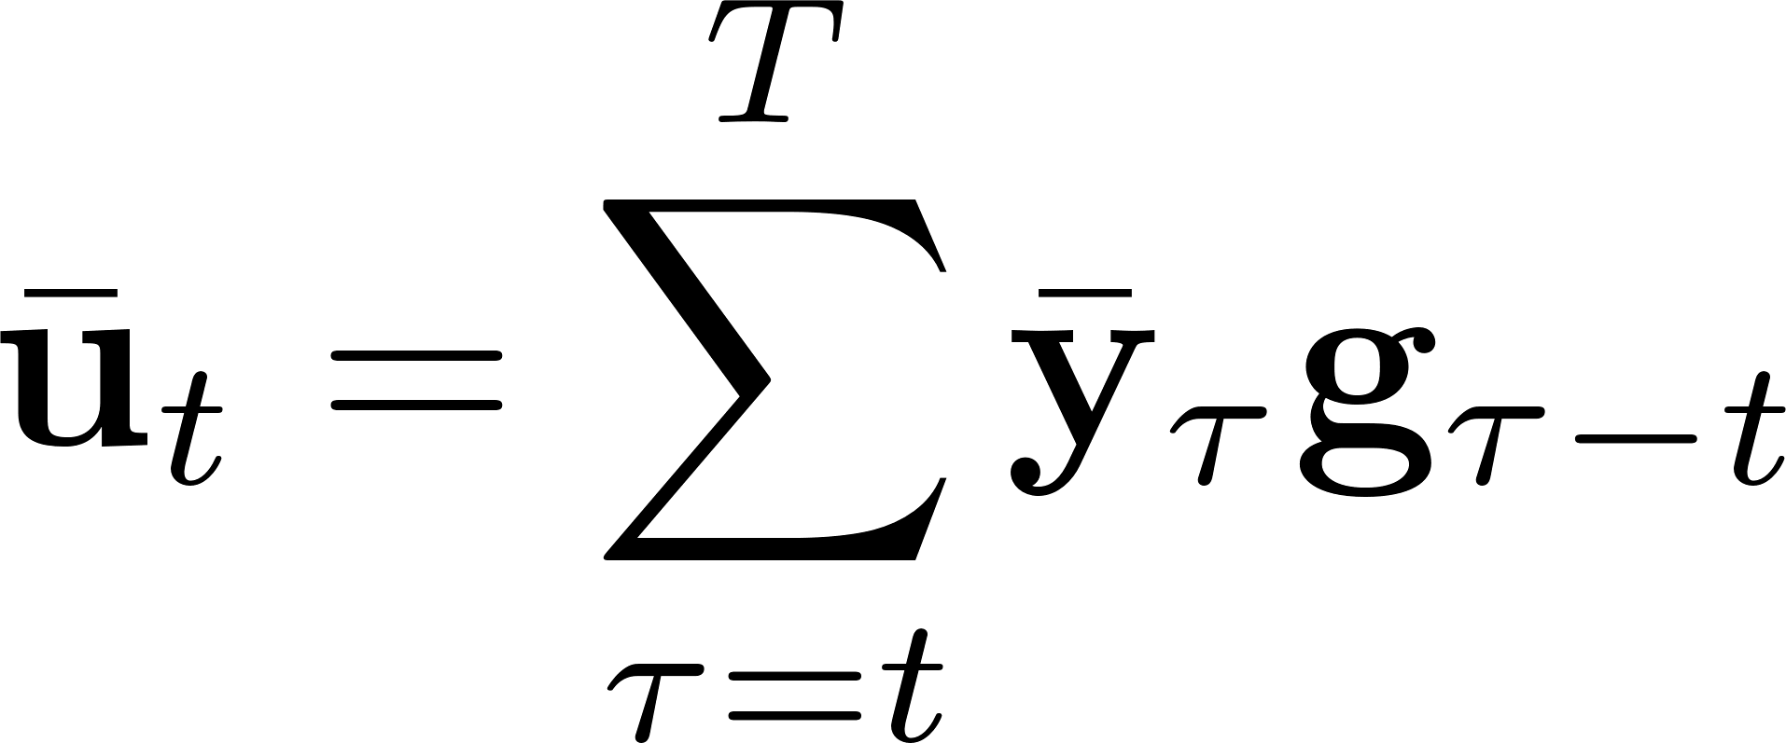
Backward pass: computational complexity
Complexity: O(T), τ=0,…,T
O(T²)
Change of notation

Slide 10
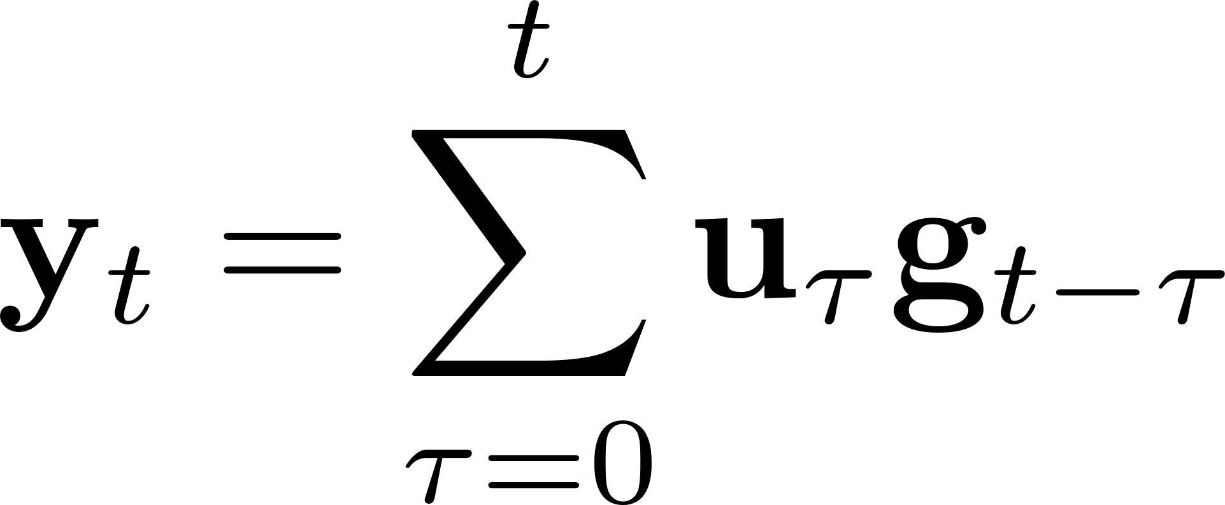
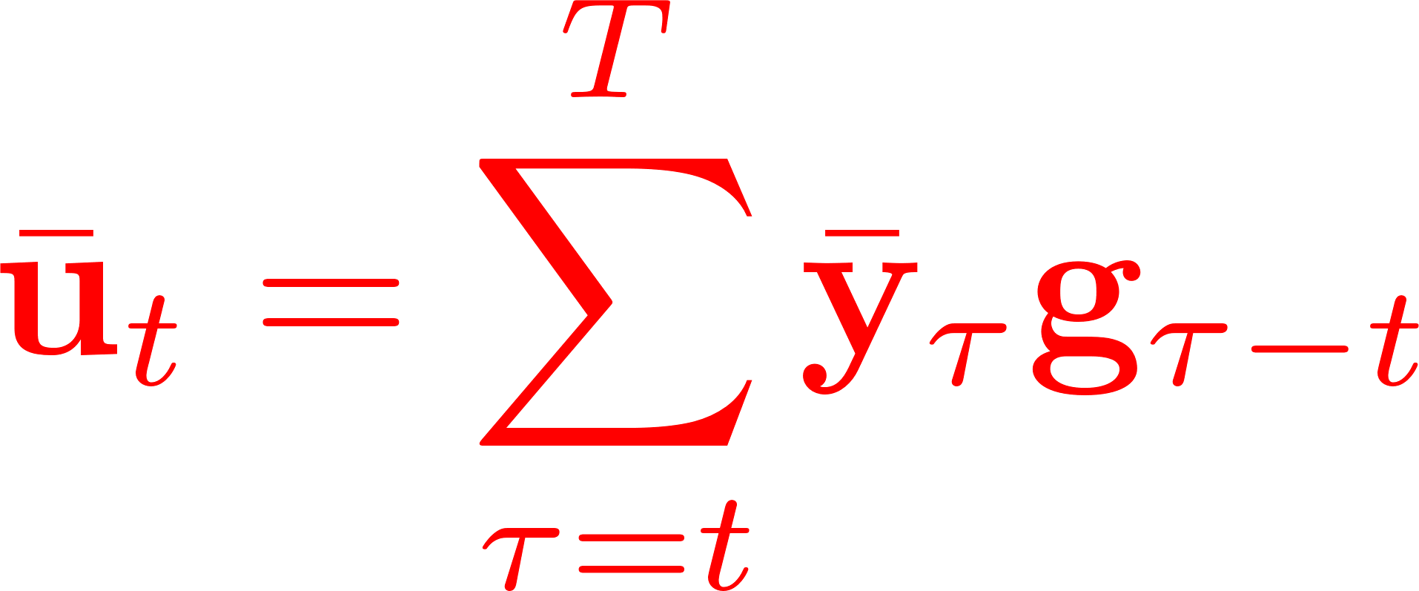
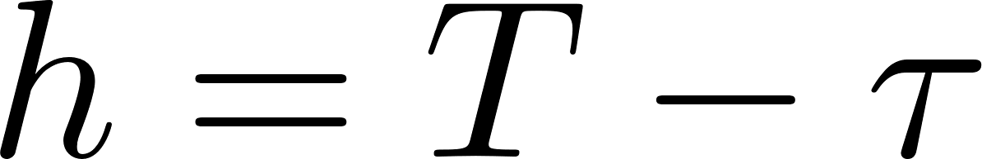
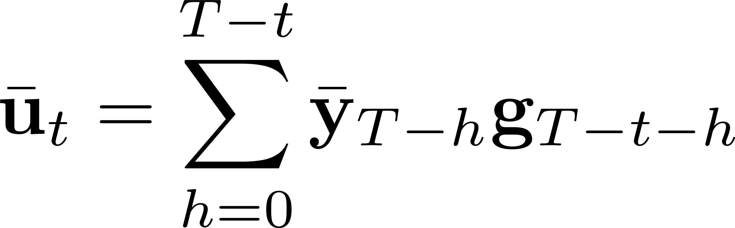

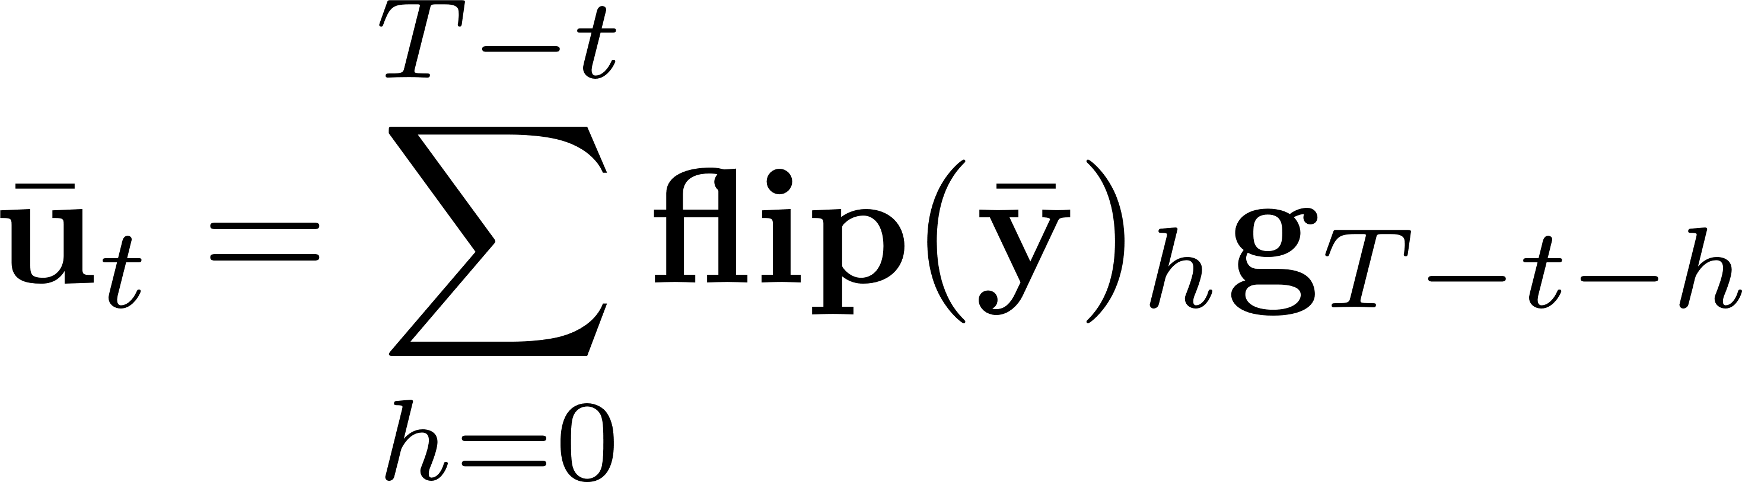
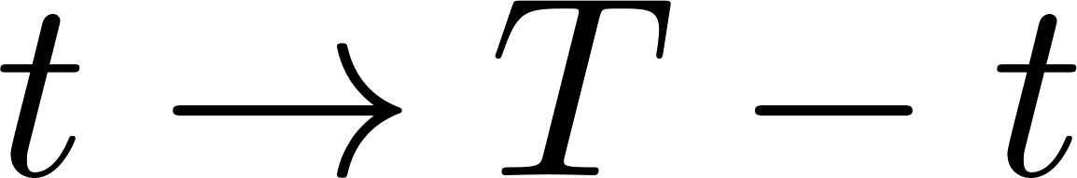
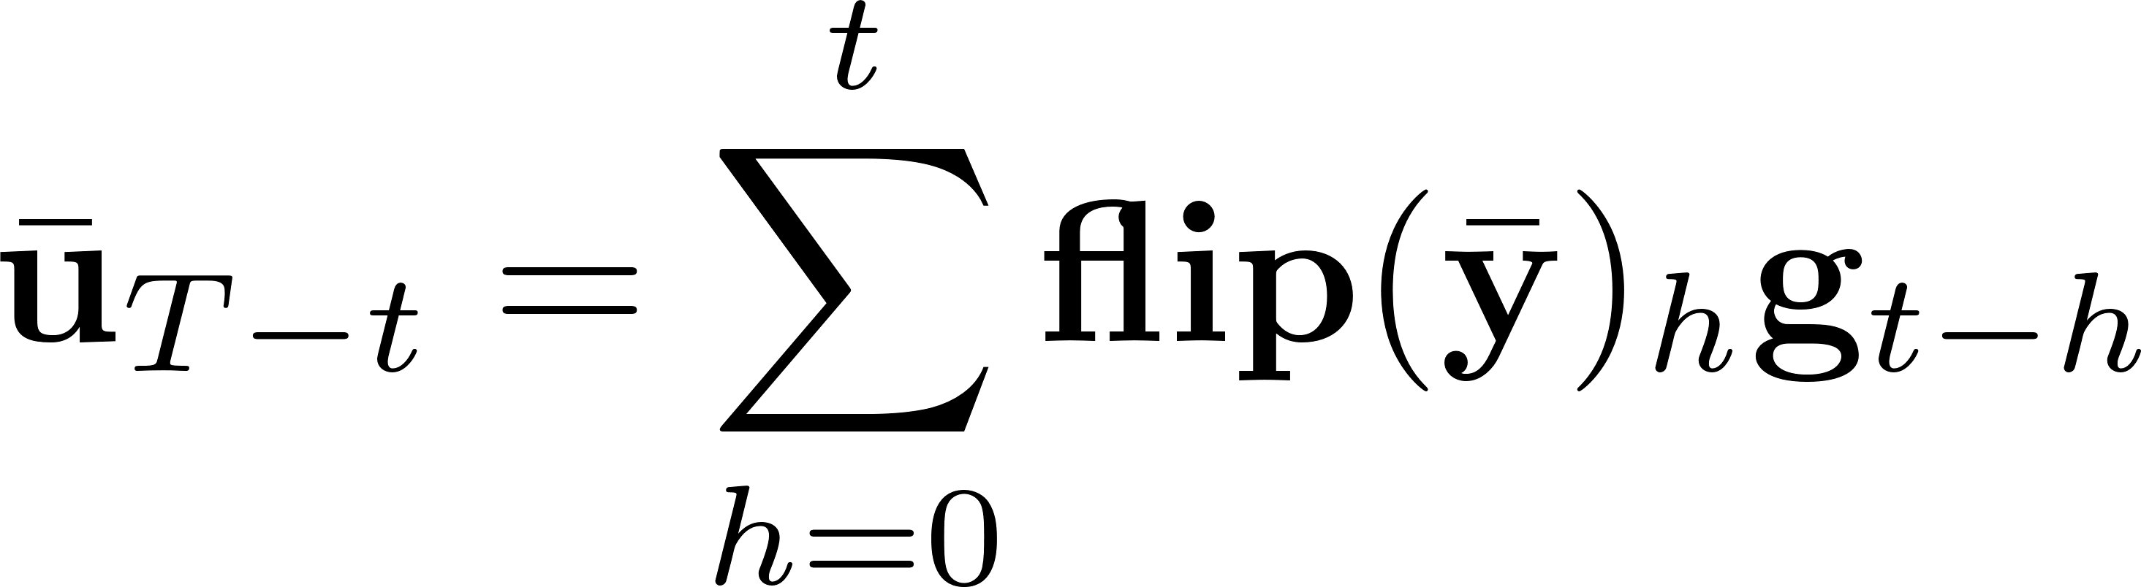
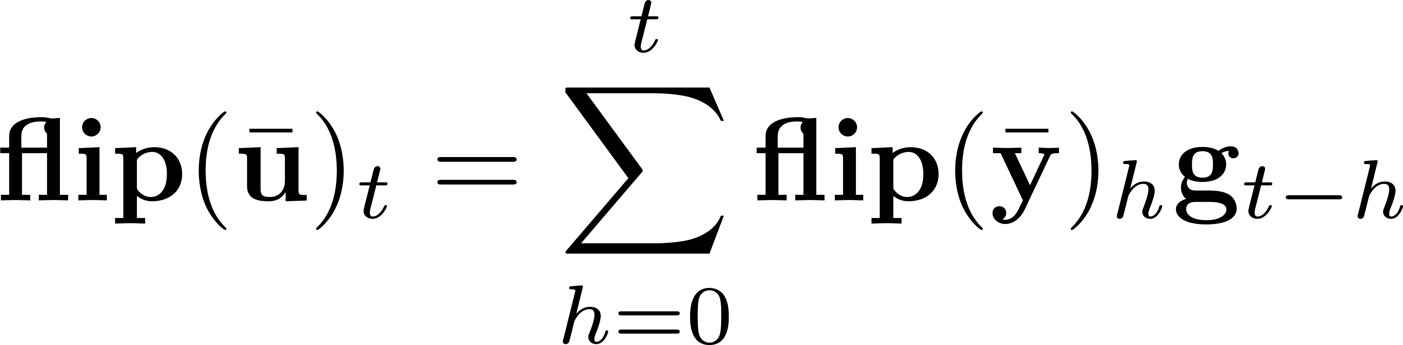
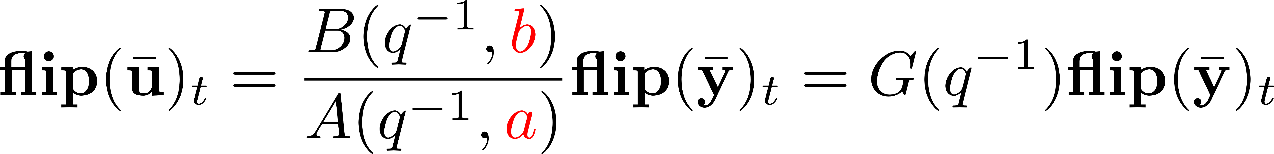
Backward pass: computational complexity
Can we also compute recursively?
Complexity: O(T)

Slide 11
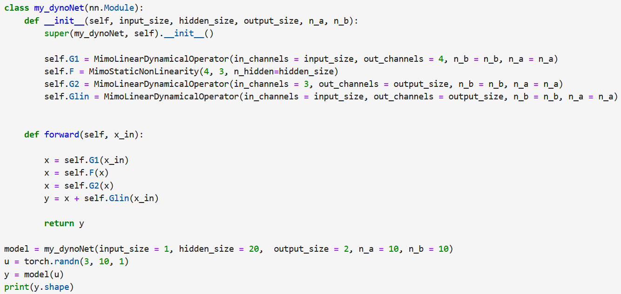
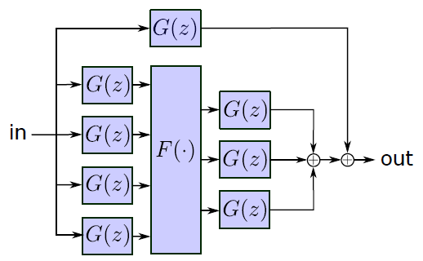

PyTorch implementation
PyTorch implementation of the G-block in the repository: https://github.com/forgi86/dynonet
dynoNet architecture
Python code
Any gradient-based optimization algorithm can be used to train the network, with gradients readily obtained through back-propagation

Slide 12
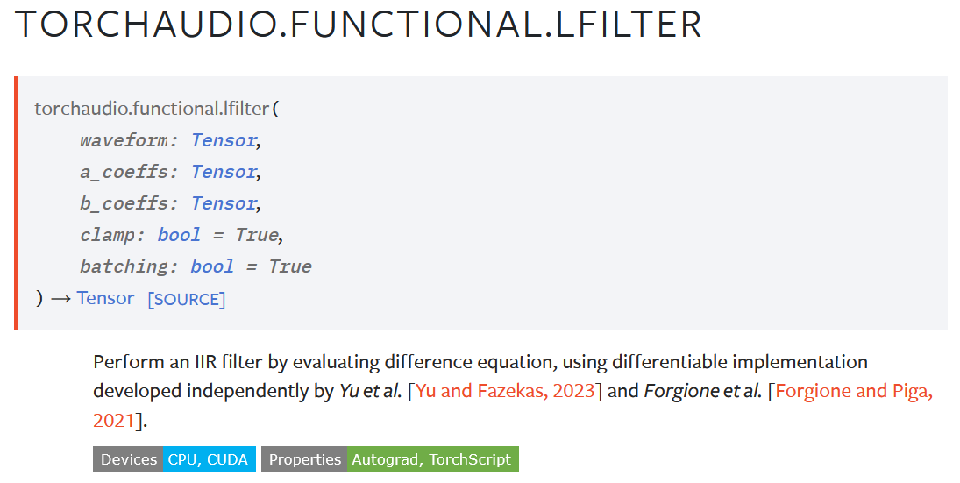

dynoNet in TorchAudio

Slide 13
dynoNet: conclusions
Key takeaways
Differentiable dynamic neuron
Extension of block-oriented models with arbitrary interconnections
Training through back-propagation at a cost O(T). No specialized algorithm required
Current work
System analysis and model reduction through linear tools
M. Forgione, D. Piga, dynoNet: A neural network architecture for learning dynamical systems, IJACSP, 2021
https://github.com/forgi86/dynonet

