Slide 1
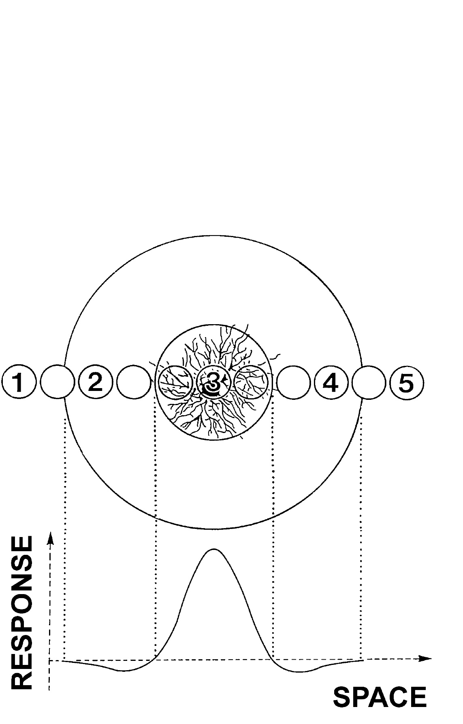


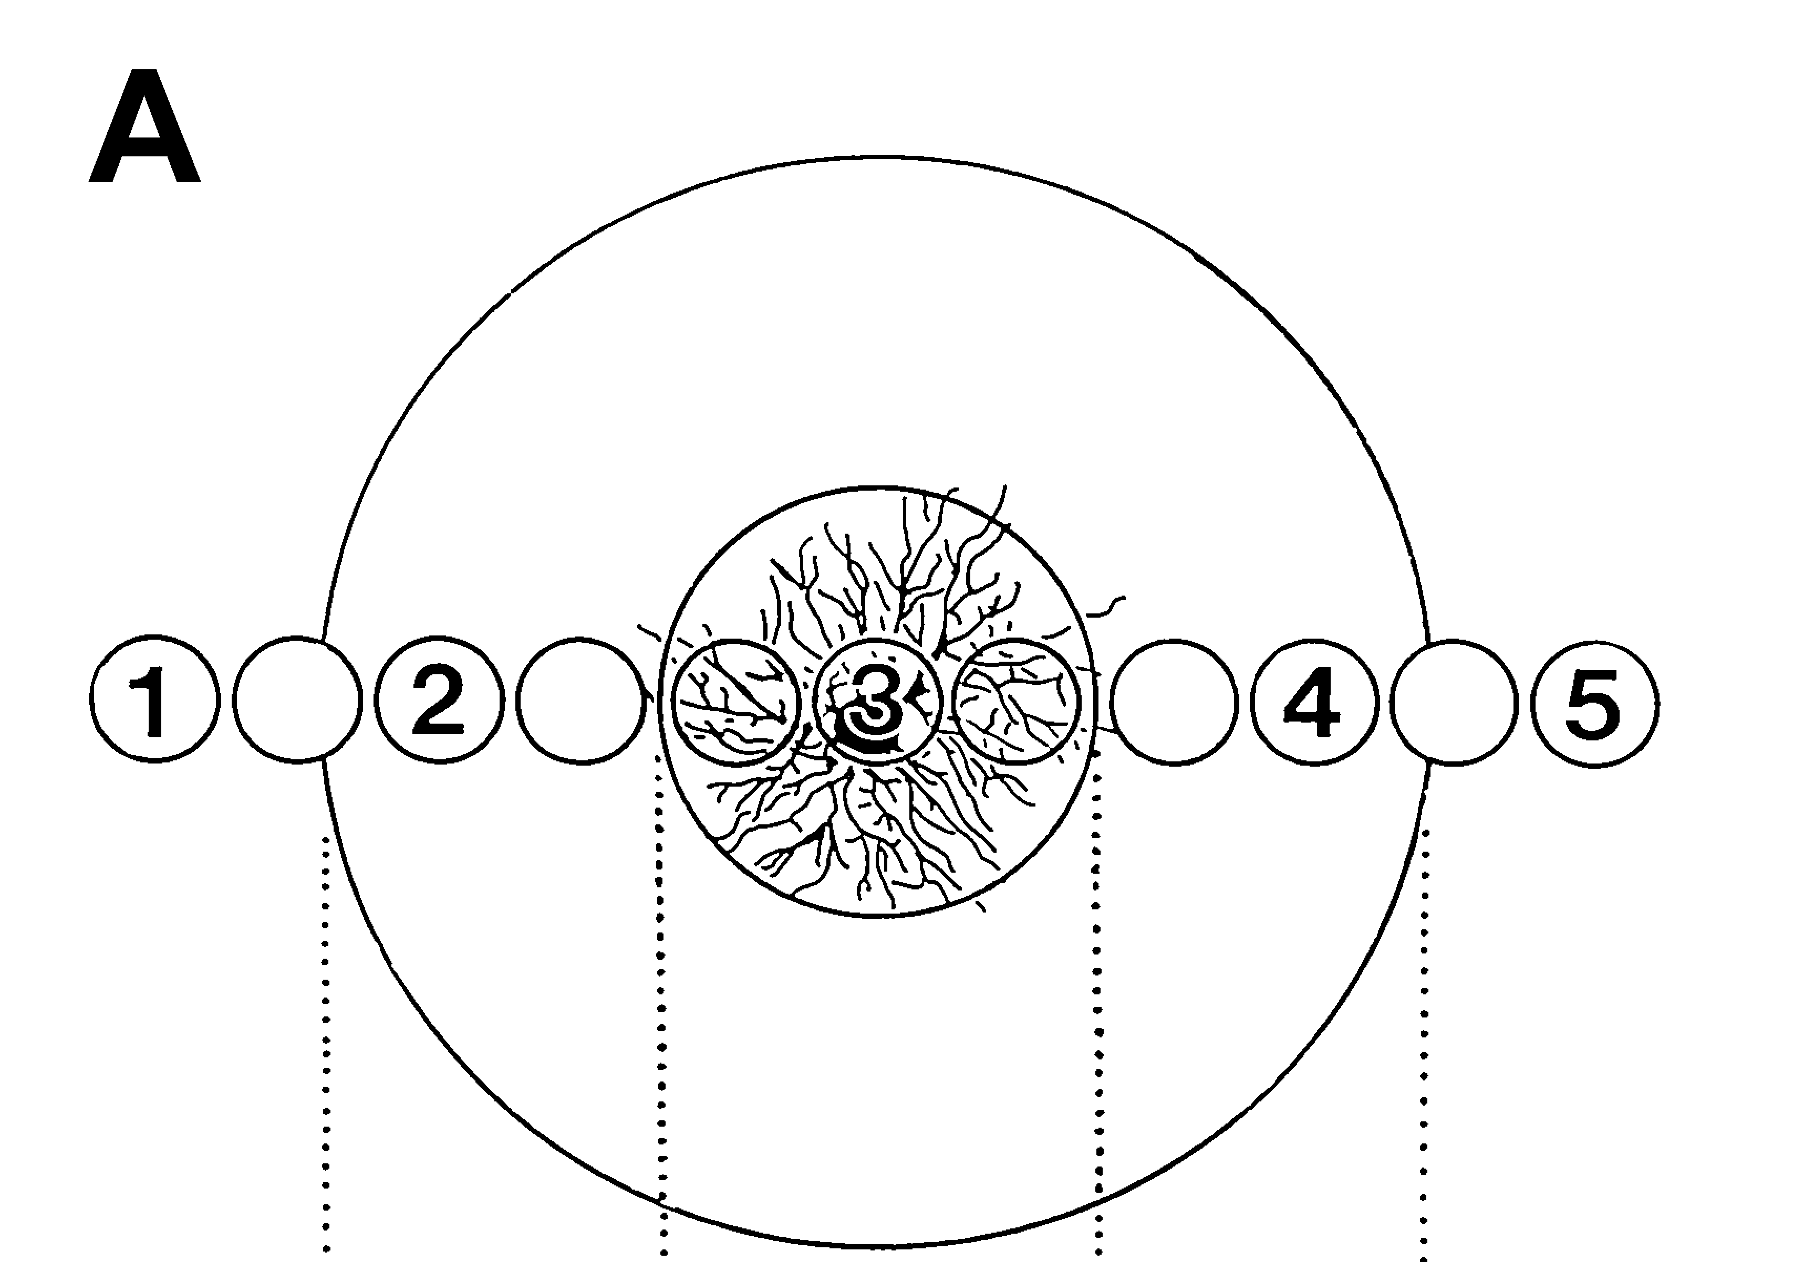




Receptive Field
Light-evoked
action potentials
Receptive fields in retinal ganglion
cells are typically circular and have
an ON and an OFF area
Exc.
Center
V
V
t
500 ms
t
Inhibitory Surround
Spot Mapping

