Slide 1
Project: IEEE P802.15 Working Group for Wireless Personal Area Networks (WPANs)
Submission Title: TDOA Localization Techniques
Date Submitted: 4 October 2004
Source: Rick Roberts Company: Harris Corporation
Address: MS: 22/3234, POB 37, Melbourne, Fl. 32902-0037
Voice: 321-729-3018 FAX: 321-729-7157 E-Mail: rrober14@harris.com
Re:
Abstract: This document describes TDOA ranging / localization algorithms
Purpose: In support of TG4a Ranging Subcommittee work.
Notice: This document has been prepared to assist the IEEE P802.15. It is offered as a basis for discussion and is not binding on the contributing individual(s) or organization(s). The material in this document is subject to change in form and content after further study. The contributor(s) reserve(s) the right to add, amend or withdraw material contained herein.
Release: The contributor acknowledges and accepts that this contribution becomes the property of IEEE and may be made publicly available by P802.15.

Slide 2
Where is TDOA (time difference of arrival) used?
e911 … cell phone location techniques
Loran C Navigation System (circ. 1957)

Slide 3
Loran-C … early example of Hyperbolic Location Technique based upon TDOA
(accuracy about ¼ mile)

Slide 4
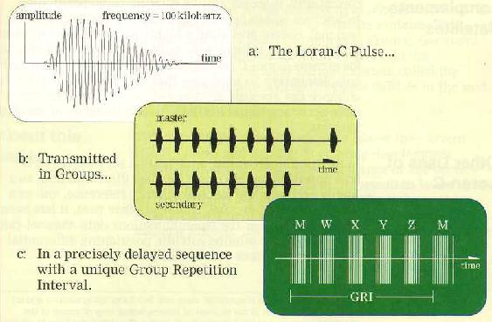
Reference: http://webhome.idirect.com/~jproc/hyperbolic/loran_c.html
Loran-C transmits wavelets that are used for timing. Both the time of arrival and carrier phase are used to extract information.
To identify individual Loran-C transmitters, codes are formed by grouping pulses into code words.
Pulse Position Modulation (PPM) can be used to carry additional information.

Slide 5
http://www.uscg.mil/d8/lorsta/malone/Malone%20Web%20Page-All%20About%20Loran-C.htm
Loran-C Basics
The basic “Loran-C like” system consists of three or more reference transmitting stations, each separated by a minimum amount of distance (TBD). Within the transmitting chain, one station is designated as Master while the rest are secondaries. The Master and Secondary stations transmit at precise time intervals. The receiver of interest measures the slight differences in the time that it takes for these signals to reach the receiver.
In general, you could say that when the Master signal is received, it is the "Start" of the Stopwatch. When a secondary station is received it is the "Stop" for one TD. Again, the time difference from the receipt of the Master signal to a second secondary is measured¹. This gives you your second line of the TD. So, when the Master signal is received, it took so many nanoseconds until the receipt of the first secondary signal. It then took another so many nanoseconds until the receipt of the second secondary, and so forth.
The user can now plot their position on charts especially generated for Hyperbolic Location. Obviously, the position would actually be determined via algorithms that will convert the TD's to a more common coordinate system.
Note 1: This important concept will be revisited on page 11 of this contribution.

Slide 6
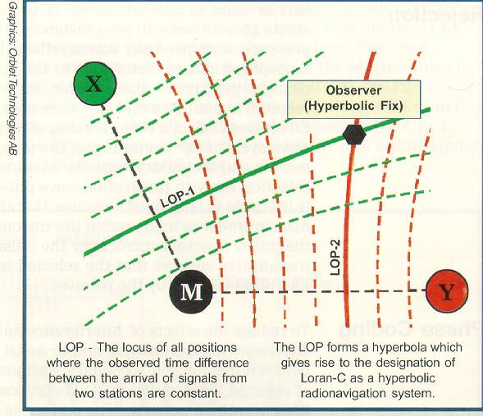
Reference: http://webhome.idirect.com/~jproc/hyperbolic/loran_c.html
TIME DIFFERENCE MEASUREMENTS
The basic measurements made by Loran-C receivers are to determine the difference in the time-of-arrival (TD) between the master signal and the signals from each of the secondary stations of a chain. In Loran-C, each TD value is measured to a precision of about 100 nanoseconds or better. As a rule of thumb, 100 nanoseconds corresponds to about 30 meters. The principle of time difference measurements in hyperbolic mode is illustrated in the adjacent figure.

Slide 7
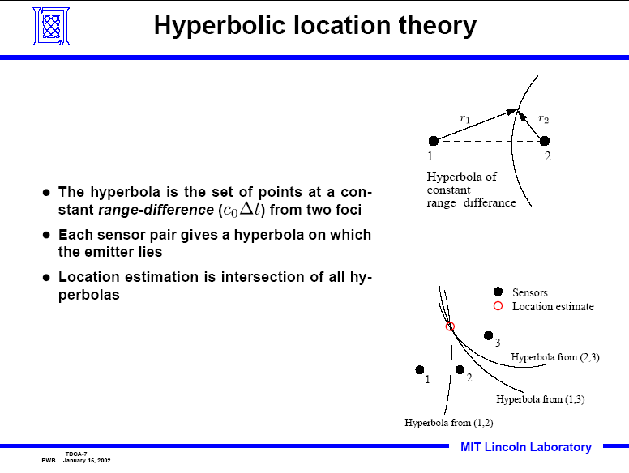

Slide 8

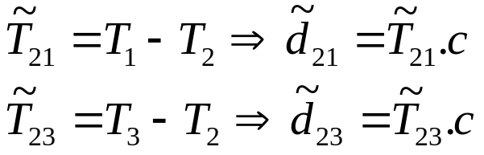
Ref: 15-04/418r0, Benoit Denis
Time Difference Of Arrival (TDOA) & One Way Ranging (OWR)
Mobile TX
TDOA Estimation
TOA Estimation
T_{o}
Anchor 1 RX
T_{OF,1}
Anchor 1
T₁
Info T₂
Isochronous
T_{OF,2}
Info T₃
Info T₂
Anchor 2 RX
T₂
Mobile
T_{OF,3}
Info T₃
Anchor 3 RX
Anchor 2
T₃
Anchor 3
Passive Location
Isochronous
TOA Estimation
TDOA Estimation

Slide 9
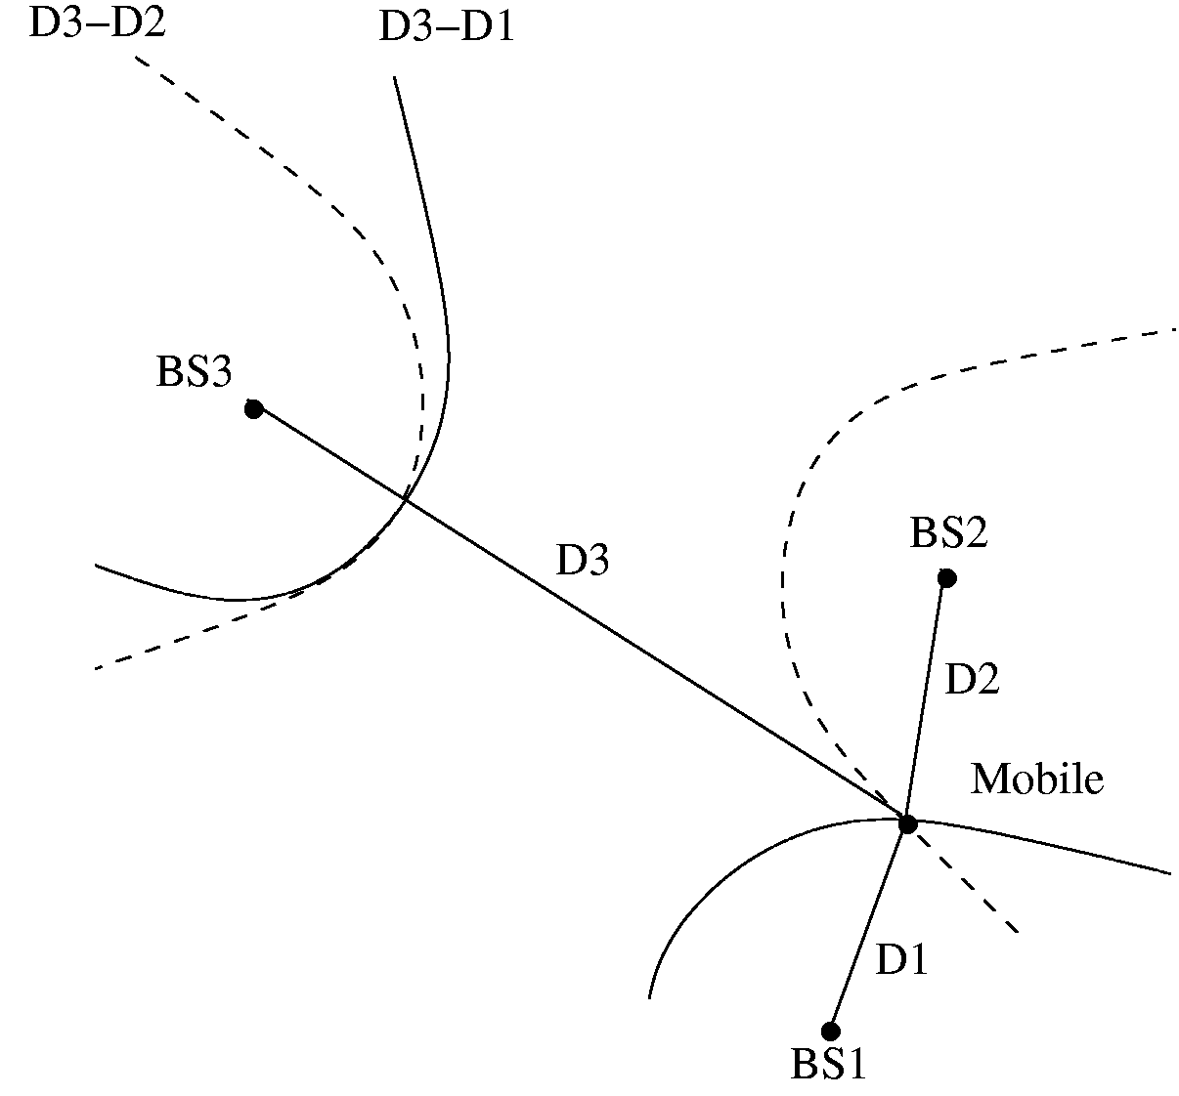
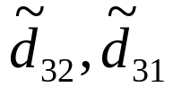

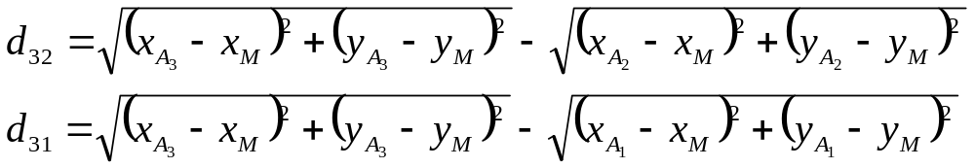
Ref: 15-04/418r0, Benoit Denis
Positioning from TDOA
3 anchors with known positions (at least) are required to find a 2D-position from a couple of TDOAs
Anchor 3 (x_{A3},y_{A3})
Anchor 2 (x_{A2},y_{A2})
Mobile (x_{m},y_{m})
Measurements
Estimated Position
Specific Positioning Algorithms
Anchor 1 (x_{A1},y_{A1})

Slide 10
But TDOA can operate in one of two modes …
Mode 1 – The station of interest (SOI) receives multiple reference pulses and calculates the TDOA
  LORAN-C type operation and the processing burden is on the receiver to run the hyperbolic location algorithms
Mode 2 – The station of interest transmits a reference pulse which is received by multiple fixed nodes
  The fixed nodes must forward the TDOA information to a workstation which then runs the hyperbolic location algorithms²
reference node
reference node
SOI
SOI
Note: The sync pulse accuracy determines the TDOA accuracy and hence the sync pulse requires a wideband transmission
Key:
Sync Pulse
Location Pulse
Position Report
Key:
Sync Pulse
Location Pulse
TDOA backhaul
controller
controller
Mode 1
Mode 2
Note 2: The mathematics of mode 2 are discussed in a paper by Gustafsson and Gunnarsson, POSITIONING USING TIME-DIFFERENCE OF ARRIVAL MEASUREMENTS, www.control.isy.liu.se/~fredrik/ reports/03icasspgustafsson.pdf

Slide 11
Impact on PHY SAP and PLME in IEEE802.15.4a
The PHY is the only layer that has accurate knowledge of pulse arrival and carrier phase; hence, the actual TD calculation should be located in the PHY layer
As implied on page 5, the PHY will have to have a stop watch that can be used to determine the TD between the master and the slave pulses. This would be in the form of a high speed counter clocked at GHz rates.
The suggested metrics that are sent to higher layers by the PHY are:
  Elasped Count (events per unit time – EPUT)
  Time Resolution (dependent on high rate clock frequency)
This information would then be collected and used by higher layer applications to calculate hyperbolic location information
Multiple packet exchanges will have to be used to calculate the TD’s as shown in slide 8. The implication here is that a MAC command set will have to be added such that the DME initiates the ranging event and then the MAC autonomously completes the packet exchange.
It appears at first glance that TDOA is rather similar to TOA at the PHY layer and it is anticipated that the same PHY SAP interface should service both TOA and TDOA ranging/location techniques.

