Slide 1

Mini Piano
By
R.Shaanal D.Manogna
2022102071 2022102021
Our Own Mini Ablaze Piano

Slide 2
A Brief Overview
A Portable Mini Piano made using a 555 timer IC.
The principle of the 555 timer, used with different resistances.
Adding a finishing RAINBOW touch to the arrived product.
Equipping the circuit with a slide switch to overall complete the circuit.

Slide 3
Components Required
Push buttons -7
PCB -2
Slide switch -1
555 timer IC -1
1k-ohm resistors -7
100-ohm resistor -1
220-ohm resistors -7
4.7k-ohm resistor -1
8-ohm Speaker -1
10 (micro)F capacitor -1
100 nF capacitor -1
RGB LED’s -7
5V Battery -1

Slide 4
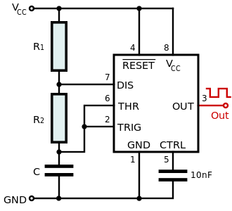
Step 1:
The principle behind the 7-Notes
The 555 timer is used in Astable mode in this circuit.
The original circuit is shown below, and in our circuit, we modify it for tone generation.
We disconnect the circuit at the node connecting the resistance R2 and capacitor C.
One terminal of the capacitor C is connected to the Speaker instead of Ground and the other is connected to the push button.
We connect the 7 momentary push buttons such that for each push button is connected with a different resistance in place of R2 to the circuit.
This creates a different frequency for when each push button is pressed.
Node

Slide 5
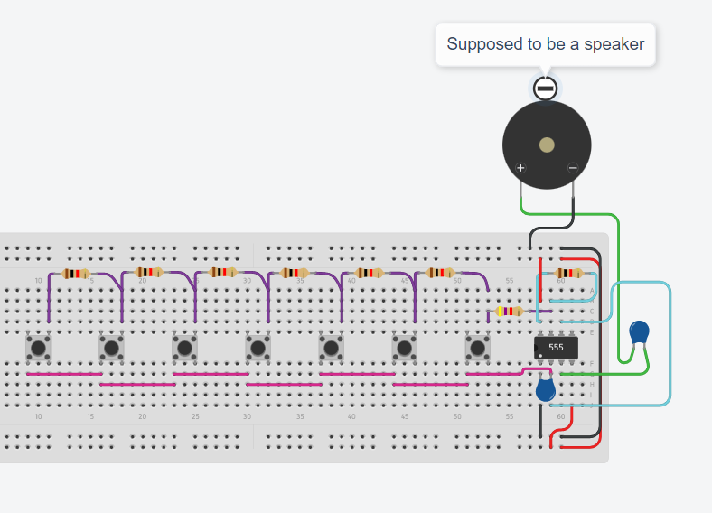
Prerequisite of the tuning part of the circuit:

Slide 6
The different frequencies are produced as per the calculations made below:
R2 (k-ohm) | Time constant τ (= RC) | Frequency f (=1/τ)
4.7 | 47ms | 21.27Hz
4.7+1=5.7 | 57ms | 17.54Hz
4.7+1+1=6.7 | 67ms | 14.92Hz
4.7+1+1+1=7.7 | 77ms | 12.98Hz
4.7+1+1+1+1=8.7 | 87ms | 11.49Hz
4.7+1+1+1+1+1=9.7 | 97ms | 10.30Hz
4.7+1+1+1+1+1+1=10.7 | 107ms | 9.34Hz
As we see the frequency decreases for increasing resistance.
This frequency is observed in the speaker as the 555 timer gives output pulses through the capacitor.
*C=(10 micro-F)

Slide 7
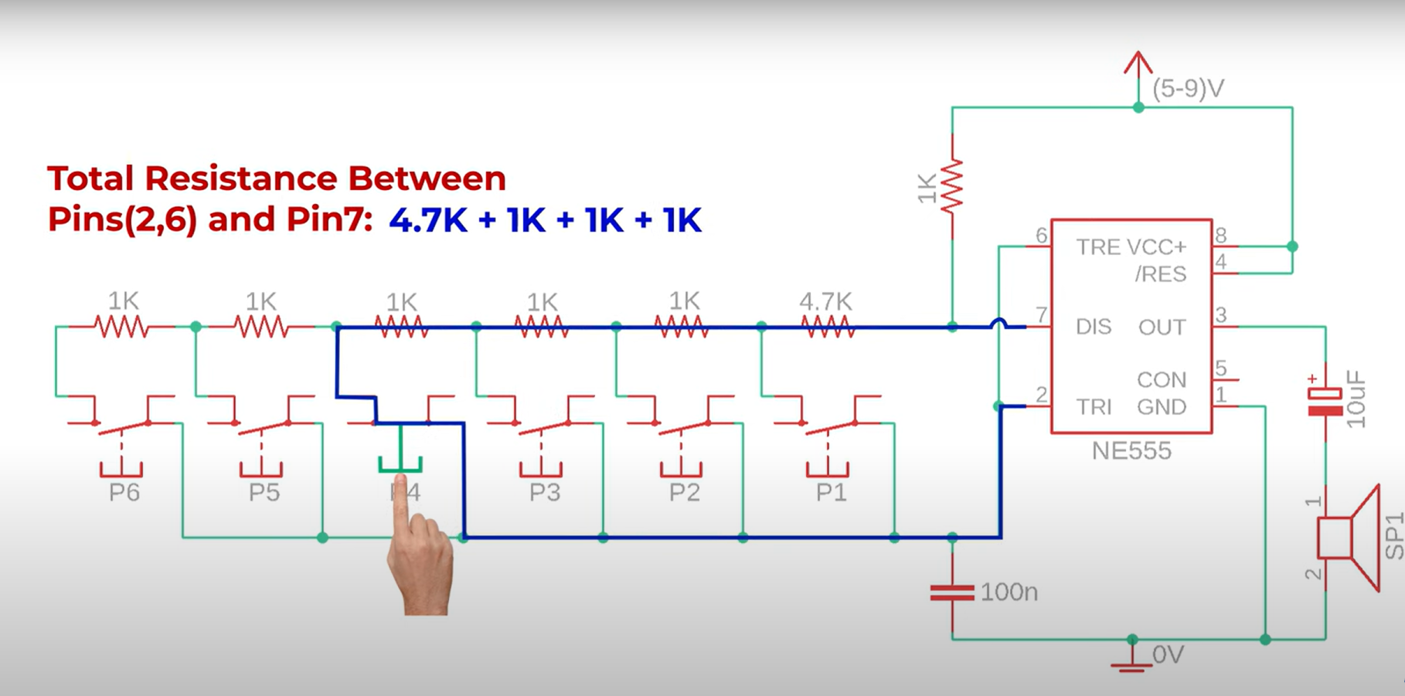
Illustration of one of the cases:

Slide 8
Step 2:
The “Ablaze” part
Ablaze here just refers to the RAINBOW
To add a finishing touch to the piano we use RGB LEDs to give a rainbow coloring to the product. The RGB LEDs are given each a color of the rainbow by giving the right combination of inputs to its pins. The whole circuit is then completed with adding a sliding switch and a battery power supply.
The next slide shows the finished circuit.

Slide 9

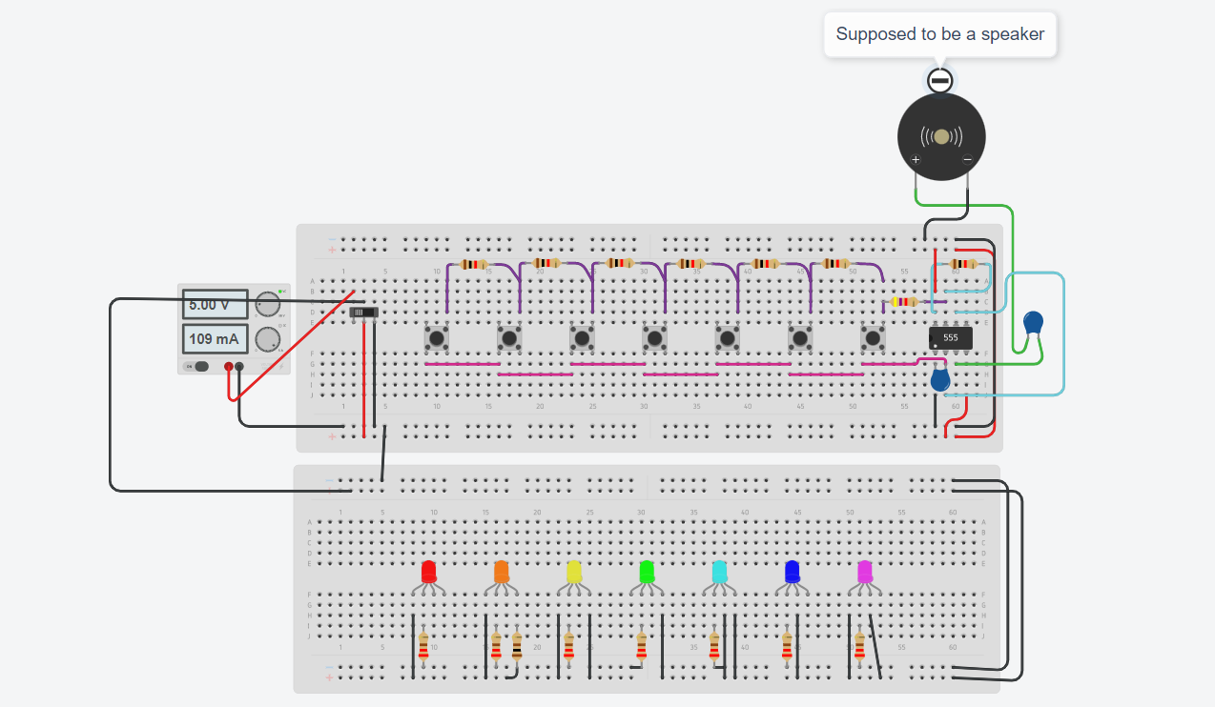

Slide 10
Tinker Cad Simulation to
better understand the product and output:
https://www.tinkercad.com/things/ffr8i1Za3Ce-mini-ablaze-piano/editel?sharecode=cO8lKeTaFe_6_SuRkwj0_yi6RZiGrI-Go5L3rWbEKJ0

Slide 11
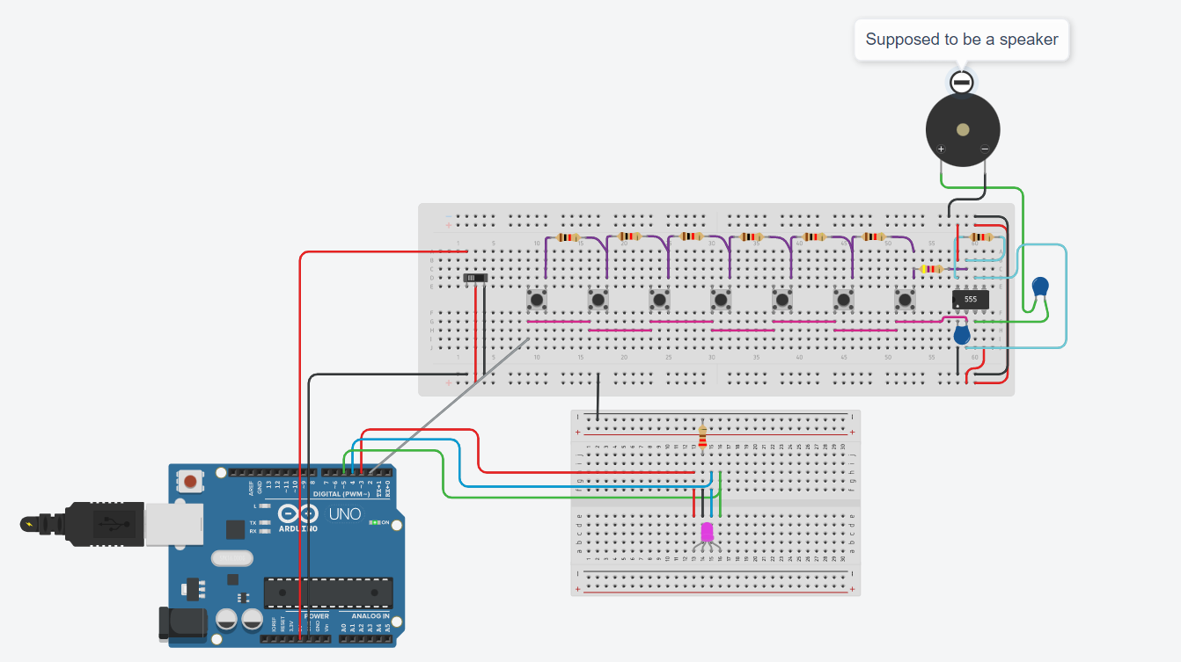
Not enough Complexity?
We can expand the project to use only one RGB LED and Arduino Uno to make the LED glow in he colors of the Rainbow every time a push button is pressed.
The solution is in the picture as shown: The circuit for that is still a work in progress….
Tinker cad link:
https://www.tinkercad.com/things/4qn3X7LPGpx-copy-of-mini-ablaze-piano/editel?sharecode=W4h6bTU21-TfKQEYvdw0GKixrxnaX-yvqkAs-hbLrwQ

Slide 12
Thank
you!

