Slide 1
Retail Marketing and Analytics: Omnichannel Marketing and the VAR Model
Optimizing Budget Allocation for Marketing Channels

Slide 2
Introduction
The digitisation and development of online channels have shaken up retailers’ business models in recent years. This first initiated the advancement of marketing strategies towards multichannel methods with the integration of new channels into the current marketing mix to cater to customers’ evolving media consumption. Nevertheless, further digitisation complexified the customer journey and promoted the move to a new phase, omnichannel marketing, which put more emphasis on the “interplay between channels and brands”.
We will explore omnichannel marketing and how a company can optimally allocate their budget across marketing channels to maximise sales.
First, we will outline the context of this report to understand the marketing opportunity at hand as well as the data used to leverage such opportunity.
Then, we will build a vector autoregressive (VAR) model to outline the interaction between the variables and analyse the impulse response functions (IRF) and Granger causality tests to identify the intermediate and long-term effects for each channel.
Finally, the budget will be optimally reallocated to maximise marketing outcomes.

Slide 3
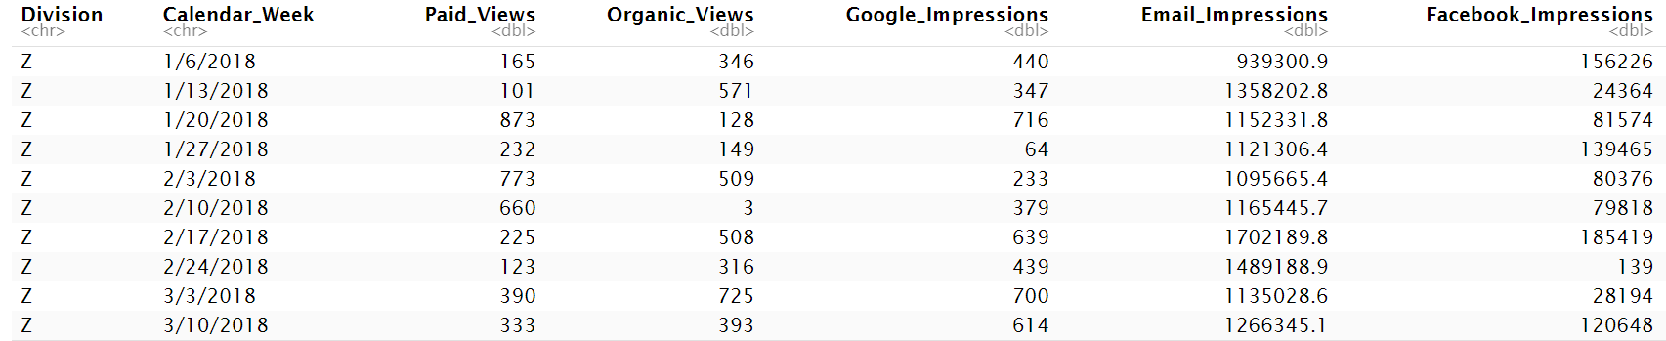
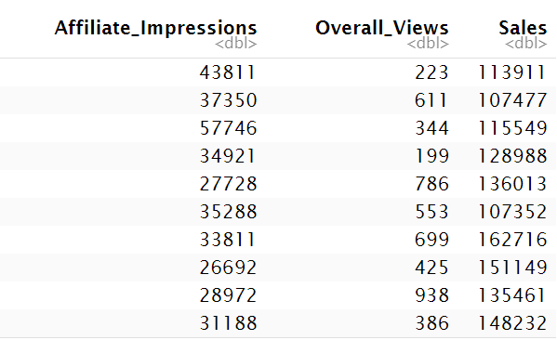
Understanding the context
Data Overview
The dataset consists of 113 rows and 10 columns, tracking marketing spending over 113 weeks and 26 regions from January 2018 to February 2020.
Current budget allocated across 6 channels: paid views, organic views, Google impressions, email impressions, Facebook impressions, and affiliate impressions.
Paid views and organic views represent views achieved through YouTube, while Google, email, Facebook, and affiliate impressions refer to ad displays.
Organic views, although not directly controllable through paid marketing, can be crucial for traffic and engagement.

Slide 4
Marketing Opportunity
Despite being in a world where companies are presented with a growing variety of channels to market their products, these channels remain unequal in their reach. Therefore, there exists an opportunity for the company to optimise their marketing spend and avoid over or underinvesting in relevant channels. The use of the VAR model to analyse the relationship between channels and sale outcomes can help identify which channels are most effective, and thus whether increasing spending necessarily drives sales.
Omnichannel marketing analysis through the VAR model also allows for obtaining a holistic view of the customer journey by visualising the interaction between channels. Indeed, one can use this analysis to understand how spending on one channel affects the outcomes of other channels and thus increase the efficiency of the company’s marketing efforts. This can help them identify areas where they can improve the synergy between channels and maximise combined impact.

Slide 5
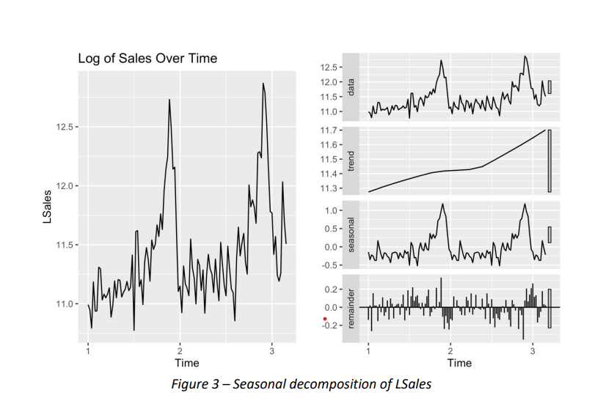
Stationarity of the data

Slide 6
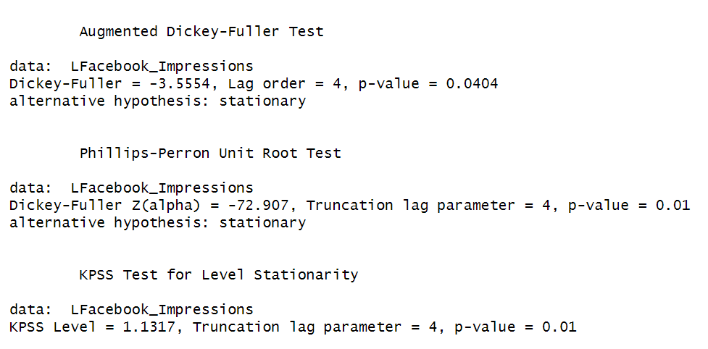
Steps for making data stationary:
Take log-transformed data to stabilize their variance over time.
Ensure data stationarity to use VAR model effectively using Augmented Dickey-Fuller test, PP test and KPSS tests.
If all the tests give different results on stationarity, we use the result with majority test in favour.
Apply first-order and seasonal differencing if needed.
Both the ADF and PP tests suggest the data is stationary, unlike the KPSS test. Taking the majority rule and our prior analysis, here, we choose to apply first-order differencing.
ADF, PP, KPSS test on Facebook Impression data

Slide 7
The var model for optimal budget allocation
VAR Model Overview
The VAR model assumes stationary time series variables.
Stationarity ensures statistical properties stay constant over time.
Seasonal decomposition analyses data for stationarity.
Impulse Response Functions (IRF) shows the impact progression over time.
Budget Optimization Techniques
Optimal budget allocation through VAR model and IRF analysis.
Current budget allocation analysis from the data set.
Long-term elasticities determine optimal resource allocation.
Granger causality tests indicate predictive power for budget optimization.

Slide 8
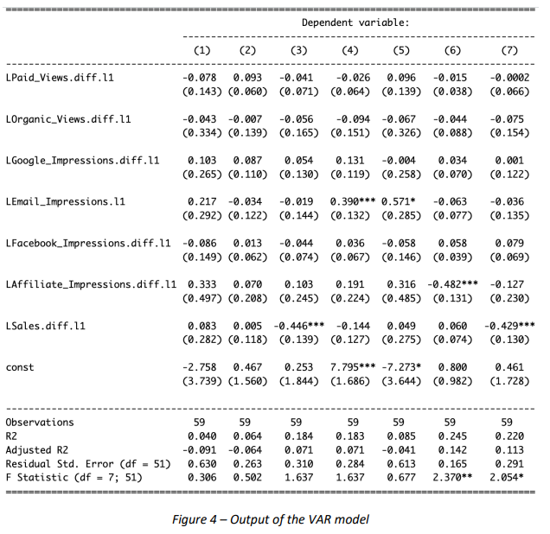
Construction of the model and identification of the different effects
This strategy goes beyond the direct effects and considers phenomena such as the cross effects between different touchpoints or channels, carryover effects, performance feedback effects, and the direct impact of channels on sales.

Slide 9
Carryover effects
From the above output, one can identify a majority of negative carryover effects created by marketing spending. Thus, if there is an increase in a channel’s views or impressions in one period, it will see a decrease in the next. Specifically, a unit increase in paid views in this period will decrease them by 0.078 units in the next, similarly for organic views, Facebook impressions, and affiliate impressions, which will be reduced by 0.007, 0.058, and 0.482 units respectively. Nevertheless, a unit increase in Google impressions will increase them by 0.054 units, and a 1% increase in email impressions will increase them by 0.390% in the next period.
Cross-over effects
Spending on one marketing channel can also affect others. Positive cross-over effects indicate there may be complementarity between channels where customers who engage with one channel are more likely to engage with another. On the contrary, negative cross-over effects indicate there may be a substitution, where customers who engage with one are less likely to engage with another.
Although most carryover effects are significant at the 1% level, few cross-over effects are significant. Indeed, in numerical terms, only email impressions have a significant positive effect on Facebook impressions, where a 1% increase in email impressions increases Facebook impressions by 0.571 units. The company should therefore be particularly mindful of the impact investing in a channel will have on another channel in the above-described case.
Feedback Effects
Sales can also impact channel growth in the next period through feedback effects. Here, a unit increase in past sales growth impacts paid views, organic views, Facebook impressions positively, and affiliate impressions in the following period by 0.083 units, 0.005 units, 0.049 units, and 0.060 units, while it negatively impacts Google and email impressions by 0.446 units and 0.144%. The effect of sales on Google impressions is significant at the 1% level. The company may therefore want to optimize their Google impressions to mitigate the negative feedback effects.

Slide 10
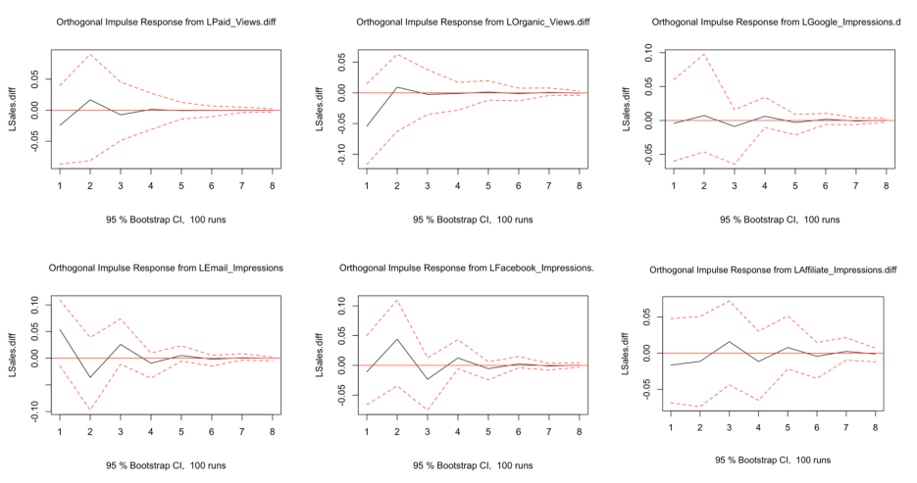
Impulse Response Function

Slide 11
Analysis of the IRF plots
1. Interpreting IRF plots
2. Impact Analysis
IRF plots show the impact of impulse series on response series
Analysis extends up to 7 periods for a comprehensive understanding
Email impressions yield immediate revenue boost, while Facebook impressions have a delayed positive effect
Caution in allocating resources needed due to limited impact of other channels
Granger causality tests reveal no evidence of channels causing sales
Feedback effects indicate past sales impact future channel growth
Significant carryover effects observed, especially with email and affiliate impressions
Cross-over effects minimal, except for a positive effect of email impressions on Facebook impressions

Slide 12
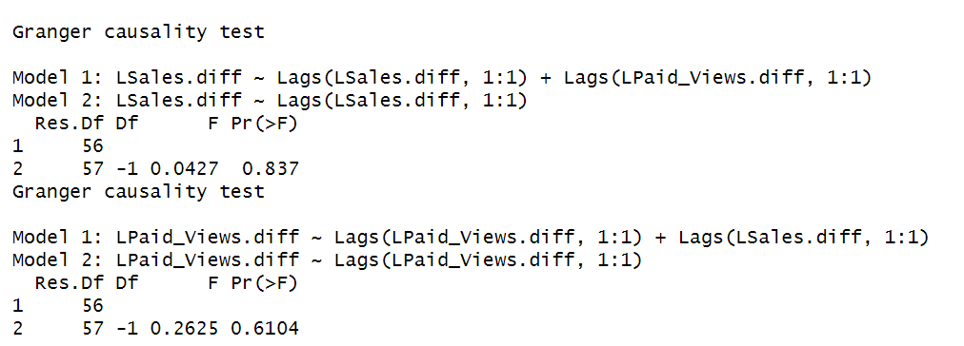
Tests of Granger Causality
Causal Relationship Testing
Granger causality tests reveal key insights on causal relationships between marketing channels and sales
The tests show that marketing channels do not Granger-cause sales, indicating a need for strategic optimization of marketing efforts
Fig: Example Test between Sales and Paid_Views

Slide 13
Explanatory Power of the Model
Model Accuracy Evaluation
The VAR model used achieved satisfactory residuals with a mean of 0
Adjusted R2 values range from -0.091 to 0.142, indicating low explanatory power, because important factors like macroeconomic conditions or competitor actions not accounted for in the model
Despite limitations, the model is a good fit for predicting sales
Limitations and Recommendations
The VAR model does not consider external factors that could influence sales
Interactions among channels may not fully capture complex market dynamics
Need for more variables to enhance the model's accuracy and explanatory power
Generalizability limited to region A, further research needed to apply findings to other regions

Slide 14
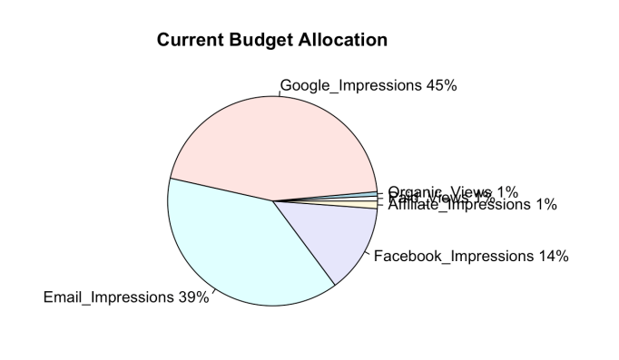
Current budget allocation
Distribution Analysis
Current budget allocation is distributed across 6 channels: paid views, organic views, Google impressions, email impressions, Facebook impressions, and affiliate impressions.
Paid views and organic views represent YouTube views achieved through paid and non-paid means respectively.
Google, email, Facebook, and affiliate impressions reflect the number of times ads were displayed or sent.
Organic views are essential for traffic and engagement despite not being directly controllable through paid efforts.
Current Spending Trends

Slide 15
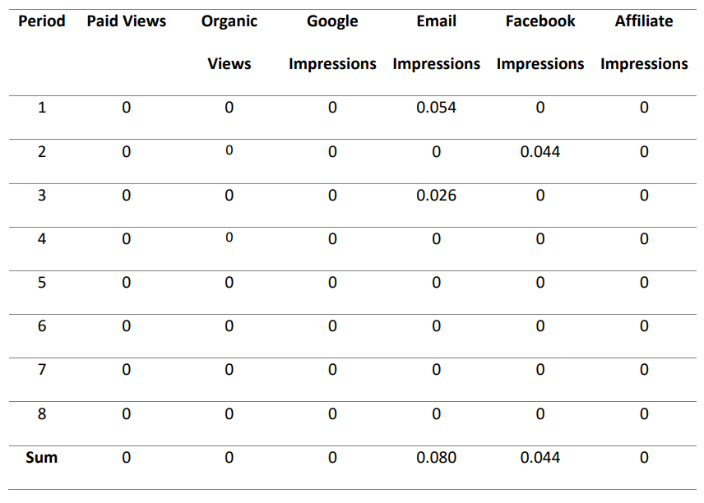
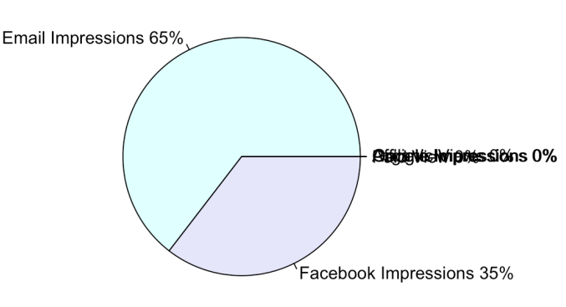
Optimal Budget Allocation
VAR model analysis is used to identify the most effective marketing channels for maximizing sales.
Reallocation of the budget based on VAR model insights can significantly impact marketing outcomes.

Slide 16
Conclusion
Analysis through the VAR model showed no significant impact of paid views, organic views, Google impressions, and affiliate impressions on sales in the studied periods.
Email impressions had a positive impact in periods 1 and 3, while Facebook impressions showed impact in period 2 according to the t>2 criteria.
The VAR model identified negative carryover effects on most channels, but positive effects for Google impressions and email impressions.
Email impressions had the largest impact in the long-term elasticities analysis, leading to an optimal budget allocation.
The VAR model provided valuable insights despite low explanatory power due to unaccounted external factors.
Final Recommendations : To conclude, we used the VAR model with IRF and Granger causality analysis to optimally reallocate company marketing resources. Email and Facebook impressions should make majority of the reallocated budget.
This can be done by dividing the budget allocated to each impression channel in proportion to their respective IRF (sort of a long term elasticity), capturing how a shock in any one of the channel affects the sales over a long term.
Code repo : VAR_Analysis_On_Omnichannel_Marketing

Slide 17
Thank you!
Team Members:
Aditya Kumar (2101ME05)
Aryan Kothiyal (2101MC10)
Devansh Rai (2101CE17)
Devendra Rathore (2101CE18)
Hardik Singh (2101MC18)
Kanishka Singh Solanki (2101PH17)
Mohd Darish Khan (2101MC29)
Shrey Sinha (2101AI31)
References:
Sources and Citations:
YR, Y. (2020) Omni-Channel Marketing: How Can We Evaluate Its Impact? https://towardsdatascience.com/omni-channel-marketing-how-can-we-evaluate-its-impact-922949458682
Eric. (2021) The Intuition Behind Impulse Response Functions and Forecast Error Variance Decomposition. https://www.aptech.com/blog/the-intuition-behind-impulse-response-functions-and-forecast-error-variance-decomposition/
Eloriaga, J. (2020) A Deep Dive on Vector Autoregression in R. https://towardsdatascience.com/a-deep-dive-on-vector-autoregression-in-r-58767ebb3f06
Agrawal, Y. (2021) Sample Media Spends Data. Version
https://www.kaggle.com/datasets/yugagrawal95/sample-media-spends-data

