Slide 1


Eating with a Conscience
Toward a Visual and Contextual Nutrition Facts Label
Darius Coelho, Helen He, Maxim Baduk, and Klaus Mueller
Notes:
Hello everyone, I am Darius Coelho and I will be presenting our work on designing a visual and contextual nutrition facts label. This work was conducted by myself, two talented high school students Helen He and Maxim Baduk and my adviser Klaus Mueller

Slide 2
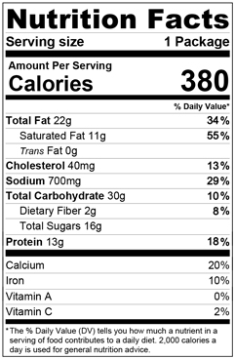
Nutrition Label
Difficult to understand and make comparisons.
Miscalculation when performing computations to estimate nutrient contribution to one’s diet.
Difficult to compare products with this label.
As per US FDA Specifications
Notes:
So let’s start off by taking a look at the current nutrition label design.
This is an example of a nutrition label design as specified by the US Food and Drug Administration or FDA. It is a textual label that uses font styling such as font size and making text bold to emphasize important nutritional content of a food product.
However, recent studies show that is still difficult for a large number of consumers to understand and make comparisons between food products.
They often make errors when computing and estimating the contribution of a food’s nutritional content to their daily nutrient requirement
They also find it difficult t

Slide 3
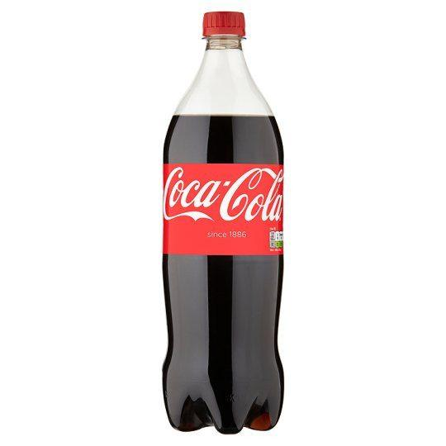


Goals
Visual representation to:
Clearly communicate quantity or level of individual nutrients
Indicating where this quantity is placed within the range of quantities in similar products.
Sugar
Notes:
We attempt to over come some of these limitations by designing a food label that makes use of a visual representation to communicate nutritional information.
Specifically, we aim to clearly communicate the level of quantity of a nutrient in a food product as well as indicate where this quantity is placed within the range of quantities of this nutrient in similar products
For example, when considering the amount of sugar in drinks on a scale of water to coca-cola, we would place juice closer to coca-cola.

Slide 4
Design
Must be able to show exact values as well as a range for reference.
Should be compact to fit into the current size of nutrition labels.
Should have some level of similarity to the current design.
Notes:
Thus our visual label is required to show exact values of nutrients, be compact enough to be similar in size to the current labels, and should have some level of similarity to the current design so as to fit in with FDA regulations as well as minimize the learing curve for viewers.

Slide 5
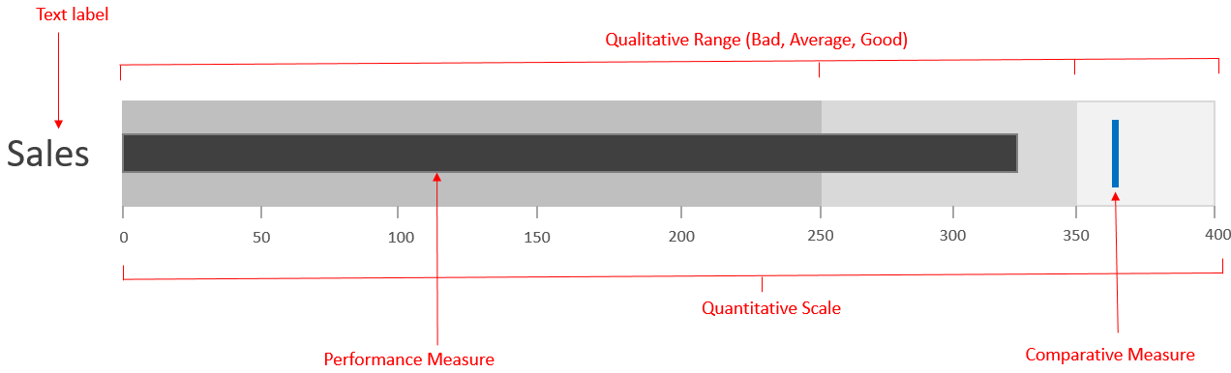
Core Design
Based on the bullet graph developed by Stephen Few
Notes:
Thus we chose to base our design on the bullet chart developed by Stephen Few shown here.
It has a small footprint and is based on bar charts it also has some resemblance to progress bars which we believe would make it easily understandable to the general public.

Slide 6


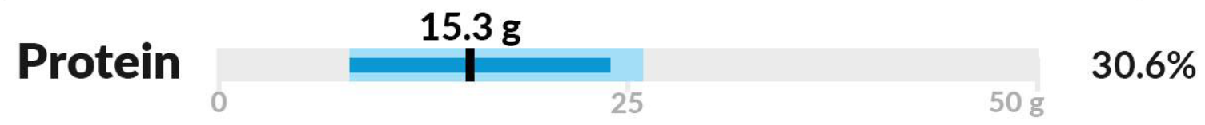
Core Design
Required daily value (DV)
Notes:
I will explain our modified design with an example.
Consider we are looking at the product Spinach and feta Chicken and Turkey sausage. According to the FDA’s database it falls in the Sausage Category which in turn is in the sausages and luncheon meat food group.
We represent each nutrient with a single modified bullet chart such as this. Here we show the Protein content of this sausage
The extent of the entire range is required daily value for an average adult on a 2000 Calorie diet.

Slide 7
Core Design
Range of food group
Notes:
The light blue bar represents the range of protein content across items in the sausages and luncheon meat food group

Slide 8
Core Design
Range of food category
Notes:
Similarily the darker blue bar represents the range of protein content across items sausage category

Slide 9
Core Design
The actual value of the nutrient
Notes:
And the level of protein in the current food, spinach and feta chicken sausage, is shown with a black marker and the level is labeled above, her 15.3 gms.

Slide 10
Core Design
The actual value of the nutrient
Value as a percentage of DV
Notes:
We also report the level of the nutrient in terms of the percentage of the daily requirement. In this case it fulfills 30.6 % of the daily requirement.

Slide 11
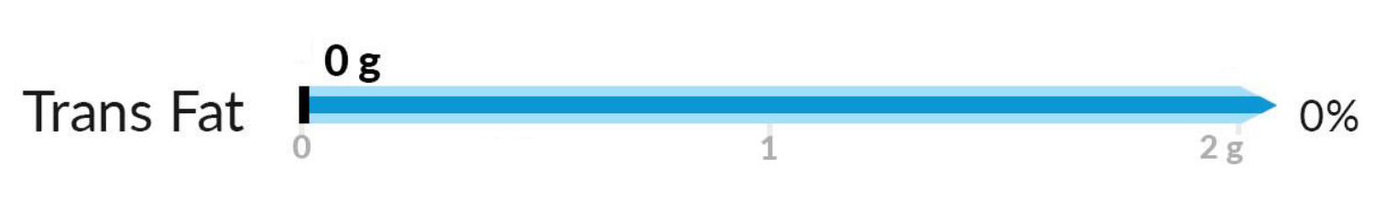
Core Design
Notes:
If a range or value goes beyond the daily requirement we indicate this by adding an arrow head to the end of the range.
It should be noted that we also follow the FDA font and unit guidelines when labeling the bullet graph.
Foods contain multiple nutrients each of which we represent with a bullet graph.
However there is a limited amount of real-estate on food packages.

Slide 12
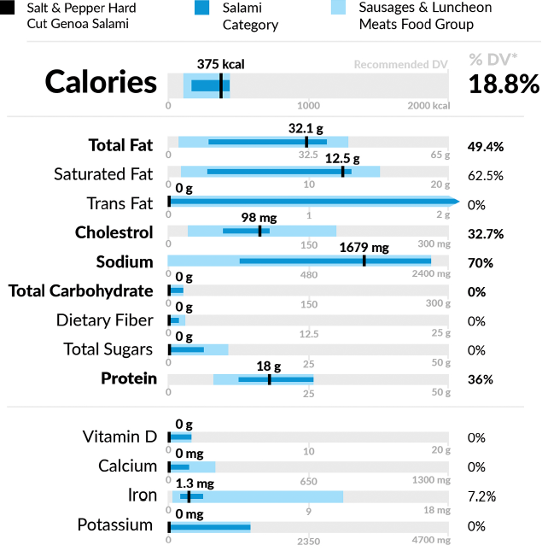
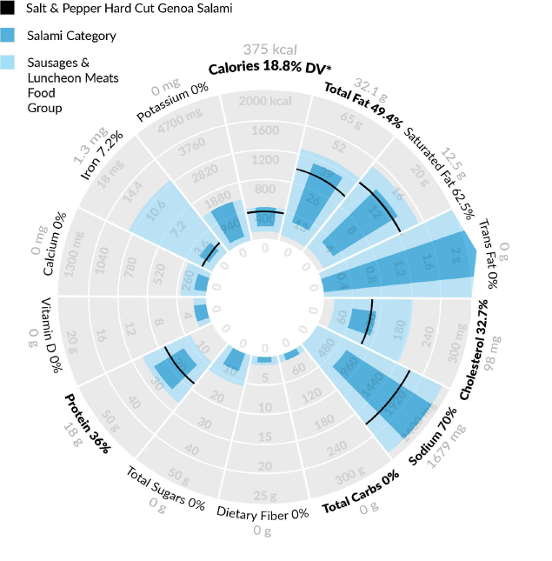
Layouts
Linear
Radial
Notes:
Thus we consider two layouts.
The first is the linear layout and where the bullet charts are laid out sequentially from top to bottom and follow the sequence specified by the FDA
The second is a radial layout that arranges the bullet charts in a clock-wise manner following the sequence specified by the FDA.

Slide 13

Unit Encoding
Continuous
Discrete
Notes:
In addition to considering two layouts, we consider two unit encodings.
The first is the standard continuous encoding the range of the nutrient values is represented as a continuous bar.
While the second is the discrete encoding where we each bar is divided into ten individual segments each representing 10% of the range.
We expect that the discrete encoding will help users to easily approximate the quantity of a nutrient and compare values.

Slide 14
Pilot Studies
Two studies:
Preferred layout
Effective unit encoding
Notes:
Having designed different visual labels, we conducted two pilot studies to test which layout viewers prefer and which unit encoding is more effective.

Slide 15
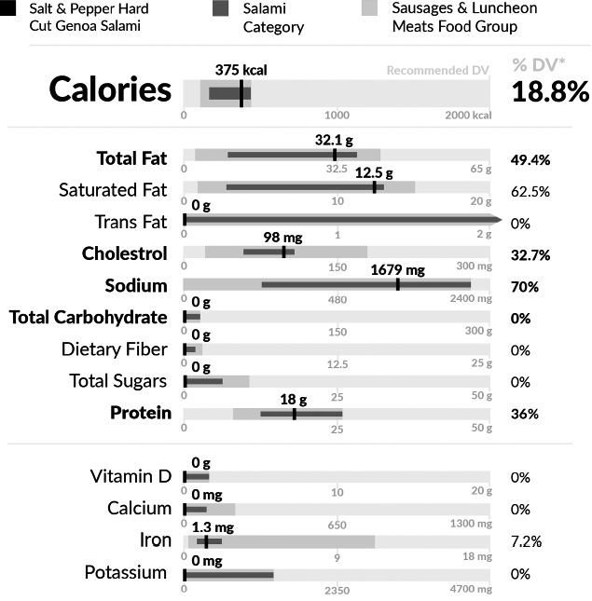
Layout Preference
Linear A
Linear B
Radial A
Radial B
Standard
20 participants - students
Received a brief explanation of each label
Rank them based on their preference
Notes:
We start with the layout prefer
We tested both the linear and radial layout, we add an additional variation of each that primarily differed in label positioning and coloring, and we add the standard label to the test.
For the study we recruited 20 participants who were students on our campus.
Each participant received a brief explanation of the labels.
After which they were asked to rank them based on which they prefer to use when reading nutritional content of foods.
It should be noted that we used gray scaled version of the labels so as to avoid engaging users with color.

Slide 16
Layout Preference
Notes:
We used the rankings generated by the participants and computed a rank score for each label. Higher rank scores indicate higher preference.
Here we found that participants preferred the linear designs over the standard design, however the radial designs were the least preferred.
This is in line with previous studies that show that radial layouts are generally not preferred.

Slide 17
Unit Encoding Performance
15 participants – recruited through social media.
Each participant received one of three label types.
Answered 13 questions – read value (4), read range (5), compare values (2), and compare ranges (2).
Each participant had to evaluate 2 randomly selected food products.
Continuous
Discrete
Standard
Notes:
Next we tested the performance of the unit encoding.
We test a linear layout with continuous encoding, a linear layout with discrete encoding, and a standard label.
For this study we recruited 15 participants via social media.
Each participant used only used one of the three label types to answer 13 questions about the food label.
These questions tested the users ability to read values and ranges and compare values and ranges.
Each participant evaluated two randomly selected food products.

Slide 18
Unit Encoding Performance
Continuous
Discrete
Standard
Reading Values
92.5%
95.0%
62.5%
Comparing Values
100%
85.0%
65.0%
Reading Ranges
52.0%
50.0%
Comparing Ranges
80.0%
85.0%
Notes:
The results showed that
When it comes to reading values, the visual labels perform significantly better than the standard label. However the difference between the two encoding types was marginal.
But when comparing values, the continuous encoding performed significantly better than the discrete encoding and both out performed the standard label.
When reading ranges, again the difference between the two encoding types was marginal. This was also the case when users compared ranges.

Slide 19
Summary
Designed a visual food label based on the bullet chart.
We found that users tend to prefer the linear layout.
Discretized encoding might be better for reading values but may cause problems with ranges.
Our studies demonstrate the potential of visual food labels but further testing is required to develop a concrete conclusion.
Notes:
To summarize, we designed variations of a visual food label based on the bullet chart.
We conducted pilot studies that showed user preferred our linear layout visual label.
However, there were no significant differences between the two types if unit encoding.
While our studies demonstrate that potential of visual food labels, further testing on a large diverse set of participants is required.

Slide 20
Visual and Contextual Nutrition Facts Label
Darius Coelho
Helen He
Maxim Baduk
Klaus Mueller
Notes:
Thank you.

