Slide 1

Unsupervised Sentiment Analysis
FACULTY OF AUTOMATION AND COMPUTER SCIENCE
COMPUTER SCIENCE DEPARTMENT
Students
Alexandru Cristian COSMA
Darius Andrei SUCIU
Vlad Vasile ITU
Supervisors
Prof. Dr. Eng. Rodica POTOLEA
Assoc. Prof. Dr. Eng. Mihaela DINSOREANU

Slide 2
Contents
Introduction
Motivation
The proposed solution
Pre-processing step
Target and opinion word extraction
Polarity assignment
Results
Improvements
Bibliography

Slide 3
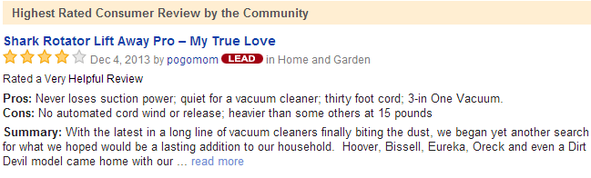
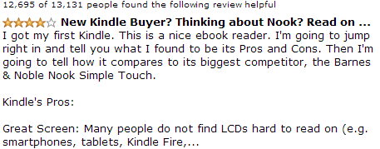
Typical reviews
Introduction
Notes:
Edo period advertising flyer from 1806 for a traditional medicine called Kinseitan.
Bill Cosby in 1982 Texas Instruments TI-99 advertisement.

Slide 4

Introduction

Slide 5
Introduction
Input
Texts
People express opinions regarding just about everything, whether they are
product-related
touristic attractions-related
…
UFO sightings
The easiest way to express opinions is to use dedicated websites
Seeds
SYSTEM
Output

Slide 6
Motivation
Tons of information
Increasing budgets and attention towards gathering information regarding certain subjects
Why unsupervised?
Easier to use – no more manual annotations!
Faster
Cross-domain

Slide 7
The proposed solution
Based on the Double propagation algorithm
Three main steps:
Pre-processing
Target and opinion words extraction
Polarity assignment

Slide 8
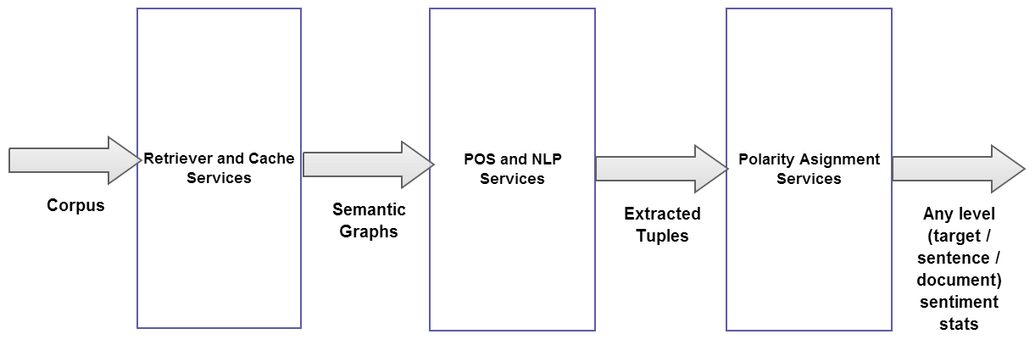
General Architecture Overview
The proposed solution

Slide 9
Step 1
Pre-processing
Input format: any text files containing sentences
Output format: Semantic Graphs
Semantic Graph Generation = MOST TIME CONSUMING PROCESS
Ex: 2000 line text file = 10< minutes to generate SGs
→ The need to cache results for future use

Slide 10
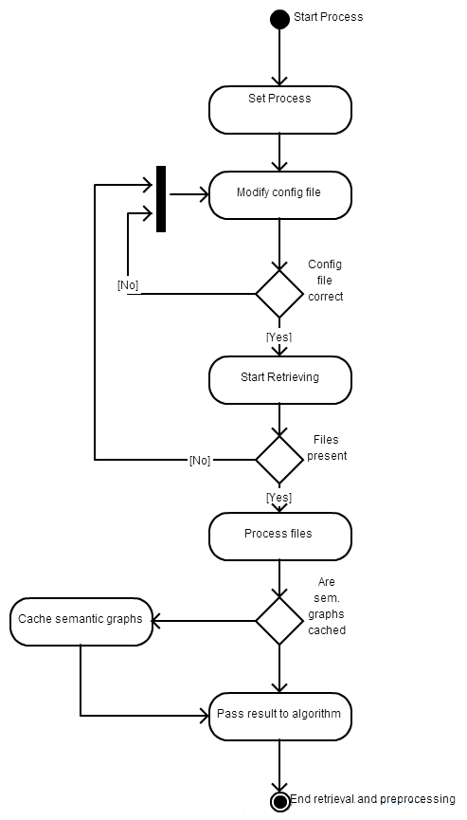
Step 1 – Flow
Pre-processing

Slide 11
Step 2
Extraction
“Hardcore” step
Where the Double Propagation Algorithm is applied
Input: Sematic Graphs
Output: Tuples
Tuple = pair/triple of words which are obtained from certain patterns

Slide 12
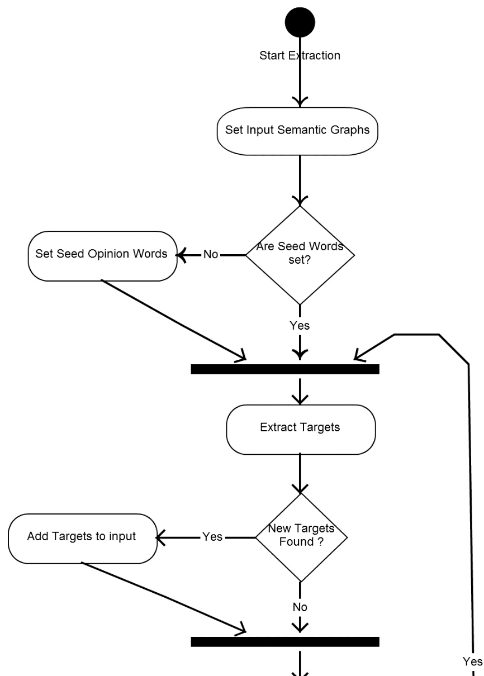
Step 2 Flow
Extraction

Slide 13
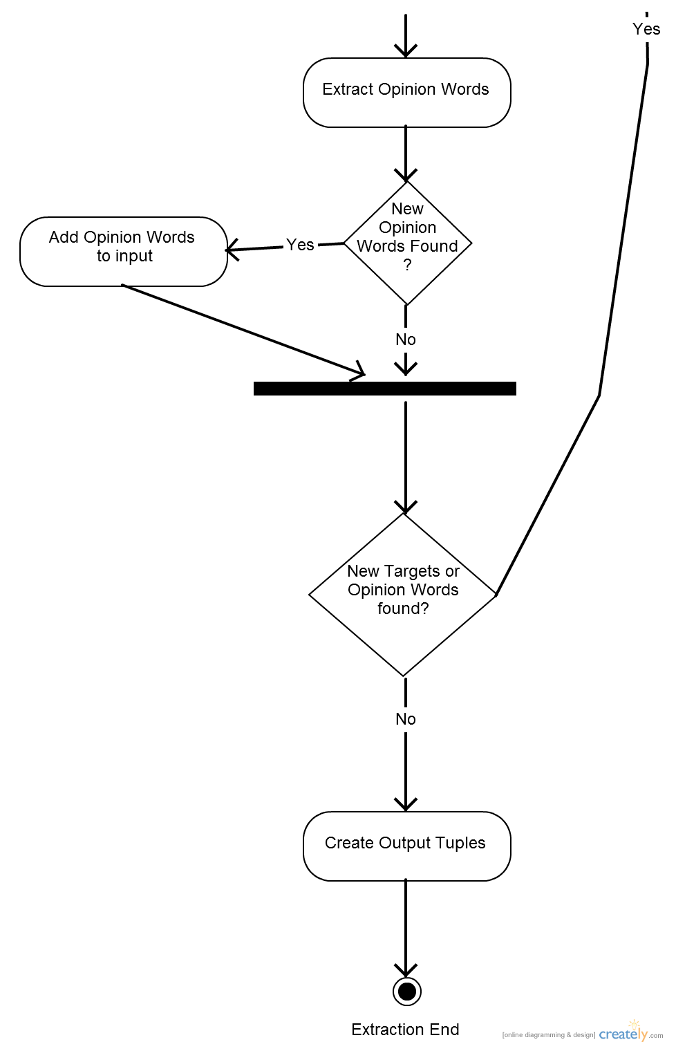
Step 2 Flow Continued
Extraction

Slide 14
Double Propagation based sentiment extraction (Unsupervised)
Extraction
Based on “Opinion Word Expansion and Target Extraction through Double Propagation, 2011” by Bing Liu.
Using seed words
Domain independence given by those seed words
No learning involved

Slide 15
Double Propagation – Steps
Extraction
Step 1 – Text Retrieval, Preprocessing and Semantic Graph generation + caching
For each input file, generate an annotated SG for all sentences and save that graph in another file for possible later use (caching)

Slide 16
Double Propagation step
Extraction
Step 2 – Opinion Word and Target Extraction
For each semantic graph, the Double Propagation algorithm is used to extract the opinion and the targets, using the rules which will be presented shortly.

Slide 17
Double Propagation – Steps
Extraction
Step 3 – Sentiment Polarity Assignment
For the extracted words, assign a polarity from a source like SentiWordNet

Slide 18
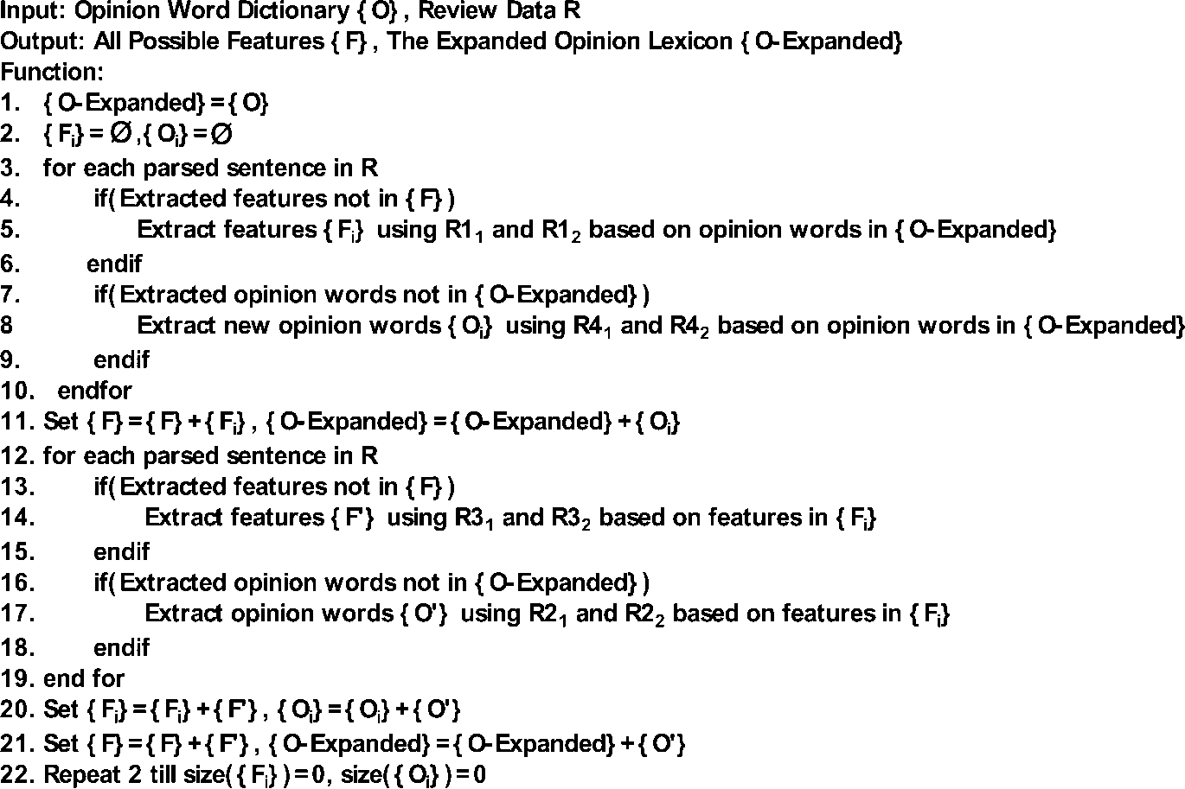
Step 2 – D.P.A
Extraction

Slide 19
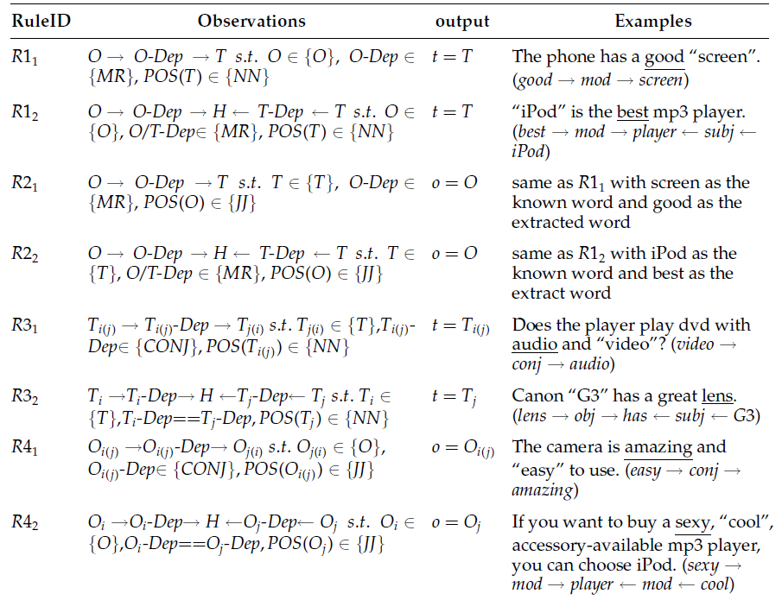
Step 2 – Extraction Rules
Extraction

Slide 20
Step 3
Polarity assignment
Scoring is based on the guidelines proposed in “Opinion Word Expansion and Target Extraction through Double Propagation, 2011” by Bing Liu.
Same principle as the Double Propagation algorithm
Assigns same scores to
> Target (known) → Opinion (unknown)
> Opinion (known) → Target (unknown)
> Target (known) → Opinion (unknown)
> Opinion (known) → Target (unknown)

Slide 21
Polarity assignment
2. Homogeneous rule: For opinion words extracted by known opinion words and targets extracted by known targets, assign the same score as the known word.
3. Intra-review rule: Polarities are transmitted only in the same review and not between reviews. For instance if we know the polarity of a word from a previous review and find the same word in the current review, we have to assign a new polarity to it. Likewise, same words in the same review have the same polarity.

Slide 22
Results
results
Input Data Used:
The input text used consists of the first 100 sentences from (Nikon coolpix 4300.txt) review file provided by Professor Bing Liu.
The seed words are also taken from Professor Bing Liu, and consist of 4783 negative and 2006 positive opinion words.

Slide 23
Accuracy
results
From 104 manually annotated opinion words, 61 were found by the system and 43 were not found.
This makes for an accuracy of 0.58% for the extraction of the opinion words.

Slide 24
Improvements – Step 1
improvements
Save processed data in a NoSQL DB
Create several crawlers for mining text
Social Crawlers: mine Facebook comments
Review Crawlers: mine reviews
Geo-political Crawlers: mine forums and discussion boards on different subjects

Slide 25
Improvements – Step 2
improvements
Improve the DP algorithm by adding rules
See Turney’s article (“add reference here”)
Refine DP by meddling with POS
Ask Grammar experts for help
Add the following modules:
Negation detection
Sarcasm detection
Opinion Word Prunning using SentiWordNet
Etc

Slide 26
Improvements – Step 3
improvements
Try other sentiment scoring sources and algorithms
Add Opinion Word modifiers

