Slide 1
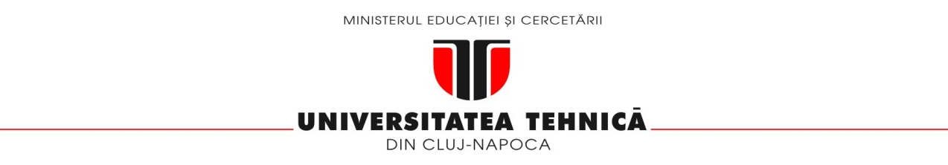
Unified Context-Behavioral Ad Recommendation System
FACULTY OF AUTOMATION AND COMPUTER SCIENCE
COMPUTER SCIENCE DEPARTMENT
Students
Alexandru Cristian COSMA
Darius Andrei SUCIU
Vlad Vasile ITU
Supervisors
Prof. Dr. Eng. Rodica POTOLEA
Assoc. Prof. Dr. Eng. Mihaela DINSOREANU

Slide 2
Contents
Introduction
Motivation
Related Work
Analysis and Design
Implementation status
Current Results
Bibliography

Slide 3
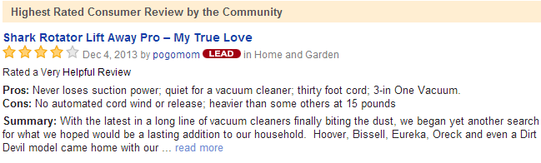
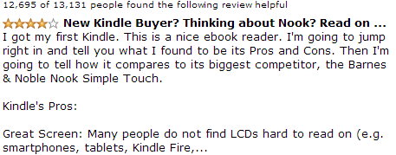
Typical reviews
Introduction
Notes:
Edo period advertising flyer from 1806 for a traditional medicine called Kinseitan.
Bill Cosby in 1982 Texas Instruments TI-99 advertisement.

Slide 4
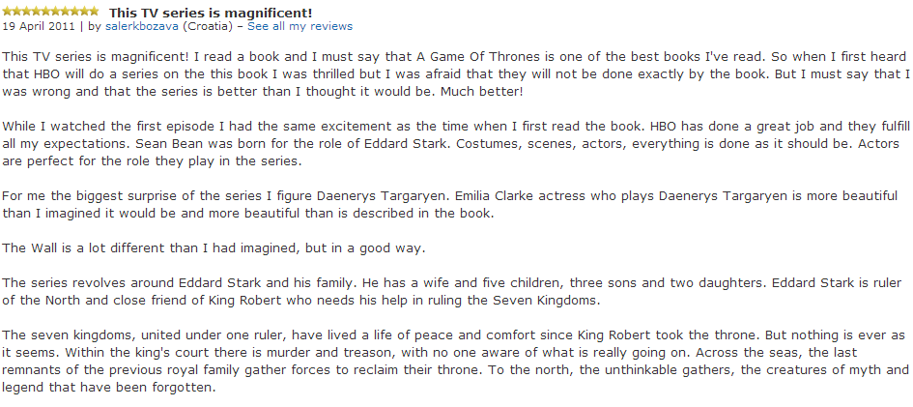
Introduction

Slide 5
Introduction
Input
Texts
Introduction text
Seeds
SYSTEM
Output

Slide 6
Definitions and terms
Introduction
Sentiment analysis: using NLP to identify and extract subjective information
Corpus: large and unstructured set of texts
Supervised: using machine learning to train classifiers – domain dependent!
Unsupervised: (in this case) domain independent and without the use of supervised learning techniques
POS: part of speech

Slide 7
Approach nr. 1 – GATE (Supervised)
Introduction
GATE: General Architecture for Text Engineering
Java based open source framework

Slide 8
Gate Pipeline used
Introduction
Document Reset PR
Annotation Set Transfer
ANNIE English Tokeniser
ANNIE Sentence Splitter
ANNIE POS Tagger
GATE Morphological Analyser
Batch Learning PR

Slide 9
Approach nr. 2 – Double Propagation based sentiment extraction (Unsupervised)
Introduction
Based on “Opinion Word Expansion and Target Extraction through Double Propagation, 2011” by Bing Liu.
Using seed words
Domain independence given by those seed words
No learning involved

Slide 10
Double Propagation – Steps
Introduction
Step 1 – Text Retrieval, Preprocessing and Semantic Graph generation + caching
For each input file, generate an annotated SG for all sentences and save that graph in another file for possible later use (caching)

Slide 11
Double Propagation step
Introduction
Step 2 – Opinion Word and Target Extraction
For each semantic graph, the Double Propagation algorithm is used to extract the opinion and the targets, using the rules which will be presented shortly.

Slide 12
Double Propagation – Steps
Introduction
Step 3 – Sentiment Polarity Assignment
For the extracted words, assign a polarity from a source like SentiWordNet

Slide 13
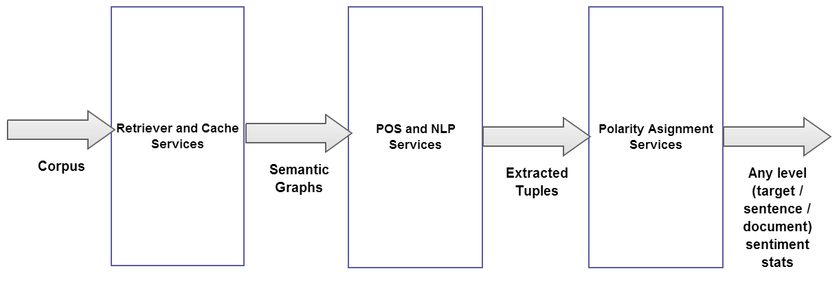
General Architecture Overview
Introduction

Slide 14
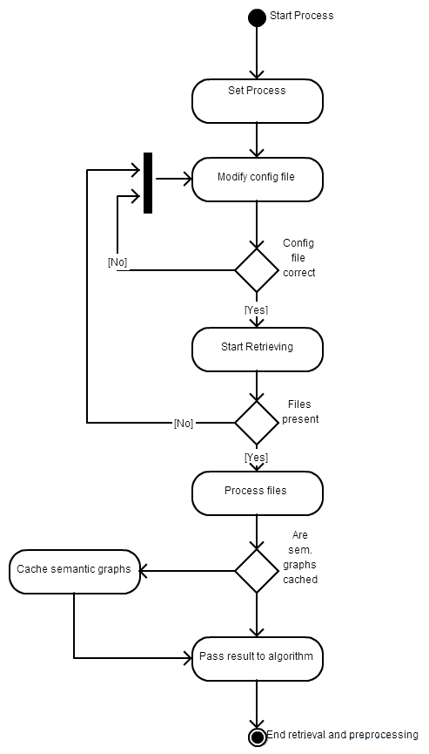
Step 1 – Flow
Introduction

Slide 15
Step 1
Introduction
Input format: any text files containing sentences
Output format: Semantic Graphs
Semantic Graph Generation = MOST TIME CONSUMING PROCESS
Ex: 2000 line text file = 10< minutes to generate SGs
→ The need to cache results for future use

Slide 16
Step 2
Introduction
“Hardcore” step
Where the Double Propagation Algorithm is applied
Input: Sematic Graphs
Output: Tuples
Tuple = pair/triple of words which are obtained from certain patterns

Slide 17
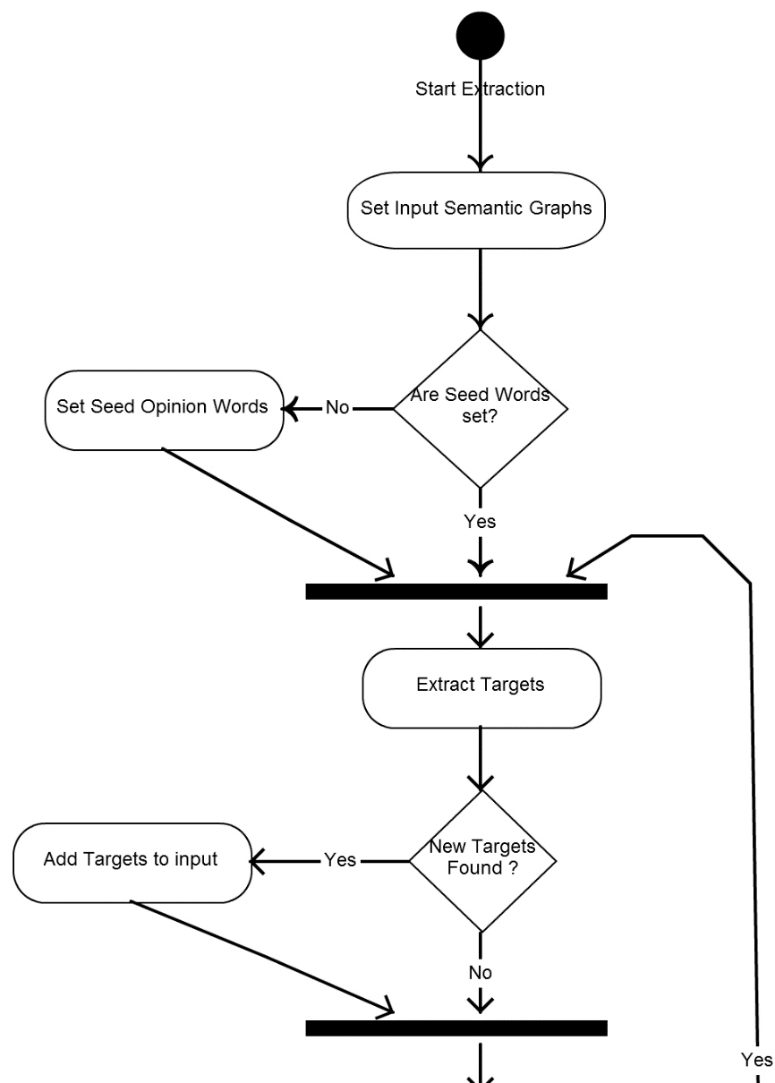
Step 2 Flow
Introduction

Slide 18
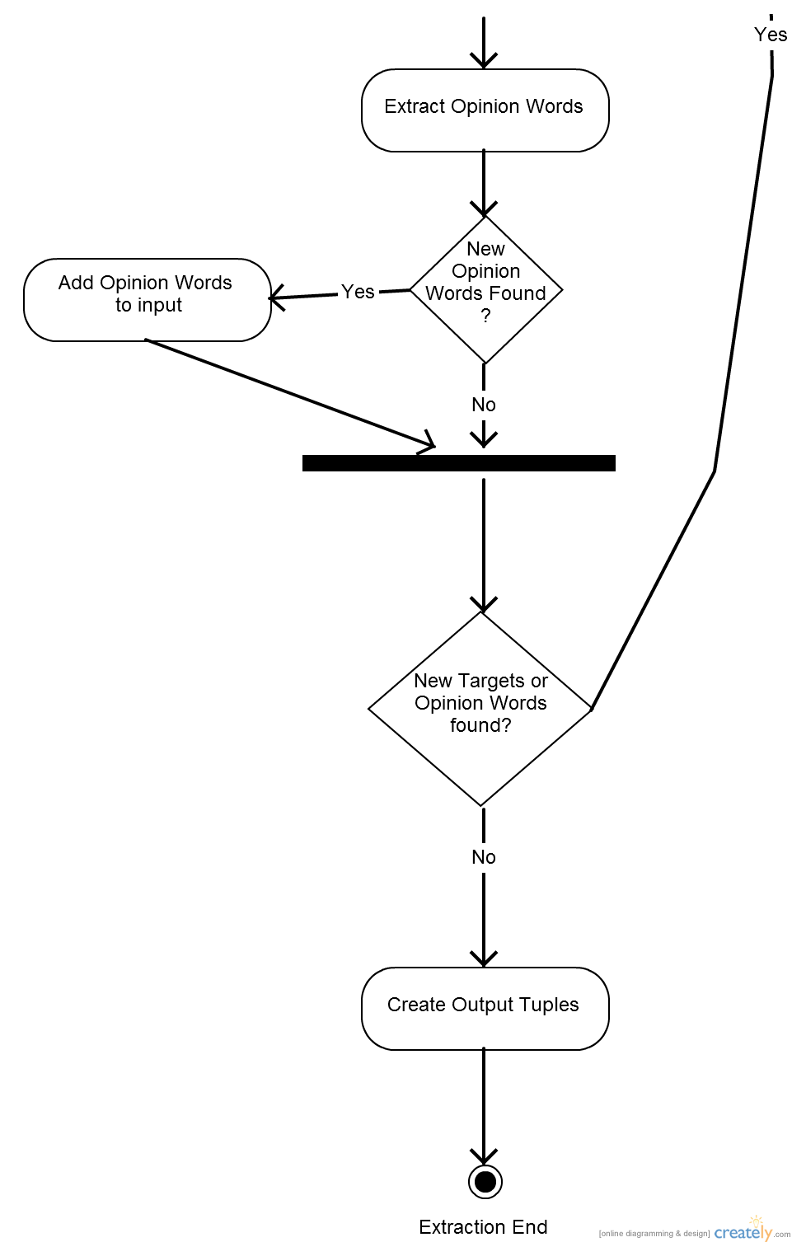
Step 2 Flow Continued
Introduction

Slide 19
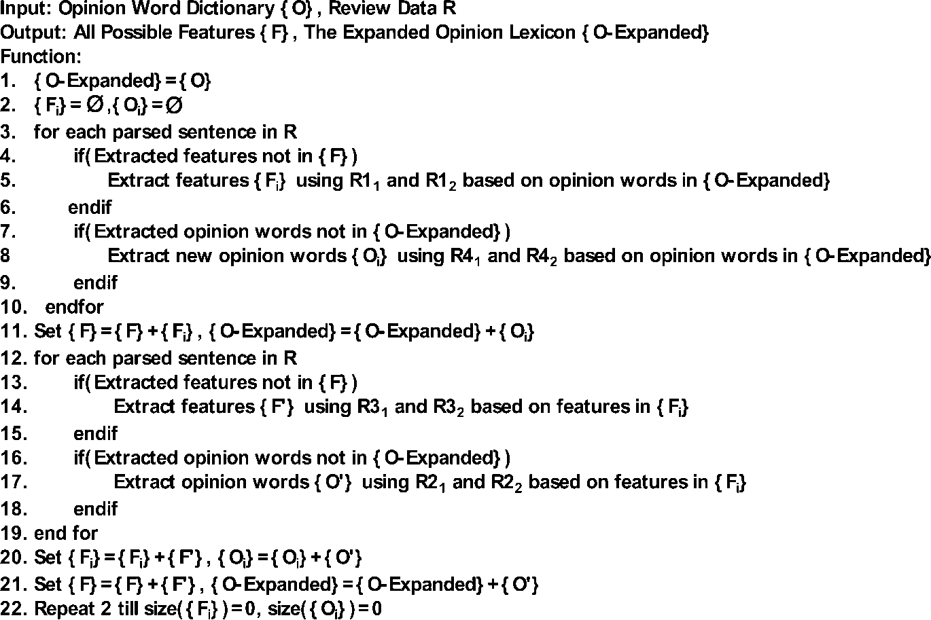
Step 2 – D.P.A
Introduction

Slide 20
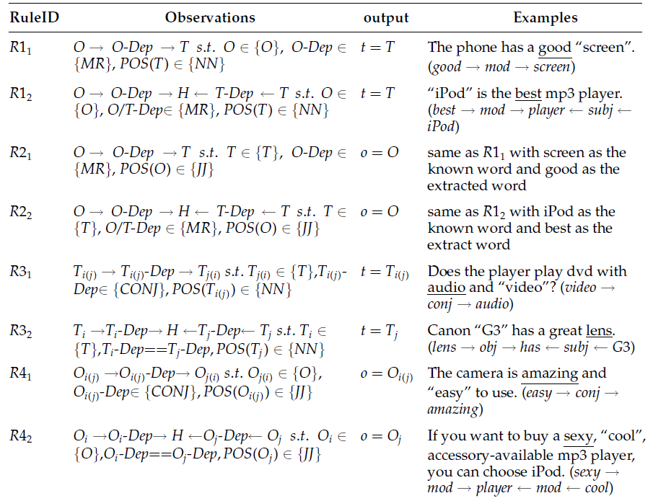
Step 2 – Extraction Rules
Introduction

Slide 21
Step 3
Introduction
Vlad..?

Slide 22
Results
Introduction
Input Data Used:
The input text used consists of the first 100 sentences from (Nikon coolpix 4300.txt) review file provided by Professor Bing Liu.
The seed words are also taken from Professor Bing Liu, and consist of 4783 negative and 2006 positive opinion words.

Slide 23
Accuracy
Introduction
From 104 manually annotated opinion words, 61 were found by the system and 43 were not found.
This makes for an accuracy of 0.58% for the extraction of the opinion words.

Slide 24
Improvements – Step 1
Introduction
Save processed data in a NoSQL DB
Create several crawlers for mining text
Social Crawlers: mine Facebook comments
Review Crawlers: mine reviews
Geo-political Crawlers: mine forums and discussion boards on different subjects

Slide 25
Improvements – Step 2
Introduction
Improve the DP algorithm by adding rules
See Turney’s article (“add reference here”)
Refine DP by meddling with POS
Ask Grammar experts for help
Add the following modules:
Negation detection
Sarcasm detection
Opinion Word Prunning using SentiWordNet
Etc

Slide 26
Improvements – Step 3
Introduction
Vlad..? :D
Add Opinion Word modifiers

