Slide 1
Creating the database
First the database needs to be created. I did this simply via the create database command:
CREATE DATABASE airbnb;
use airbnb;

Slide 2
Structure
With the database created, it is time to create, alter and insert into the entity tables. Each entity will be presented according to the following structure:
Create Statements
Alter Statements
Example Insert Statements for Test Case
Screenshot of Test Case Data within the Database

Slide 3

Accessibility. An entity containing data on how fast public transport hotspots can be reached from the property (with public transport)?
1.
CREATE TABLE Accessibility
(
accessibilityID INT NOT NULL AUTO_INCREMENT,
airport INT NULL ,
train INT NULL ,
bus INT NULL ,
PRIMARY KEY (accessibilityID)
);
2. No alter statements
3.
INSERT INTO Accessibility (airport, train, bus)
VALUES (17, 8, 2);

Slide 4
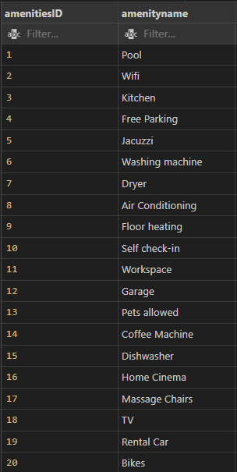
Amenities. An entity containing what kind of amenities are available to pick from on the website.
1.
CREATE TABLE Amenities
(
amenitiesID INT NOT NULL AUTO_INCREMENT,
amenityname VARCHAR(100) NOT NULL,
PRIMARY KEY (amenitiesID)
);
2. No alter statements
3.
INSERT INTO Amenities (amenityname)
VALUES ('Pool'), ('Wifi'), ('Kitchen'), ('Free Parking'), ('Jacuzzi'), ('Washing machine'), ('Dryer'), ('Air Conditioning'), ('Floor heating'), ('Self check-in’), ('Workspace'), ('Garage'), ('Pets allowed'), ('Coffee Machine'), ('Dishwasher'), ('Home Cinema'), ('Massage Chairs'), ('TV'), ('Rental Car'), ('Bikes’);

Slide 5
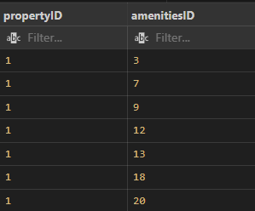
AmenitiesAndProperties. A relational table that links the amenities to the property.
1.
CREATE TABLE AmenitiesAndProperties
(
propertyID INT NOT NULL,
amenitiesID INT NOT NULL
);
2.
ALTER TABLE AmenitiesAndProperties
ADD CONSTRAINT FK_Amenities_TO_AmenitiesAndProperties
FOREIGN KEY (amenitiesID)
REFERENCES Amenities (amenitiesID);
ALTER TABLE AmenitiesAndProperties
ADD CONSTRAINT FK_Properties_TO_AmenitiesAndProperties
FOREIGN KEY (propertyID)
REFERENCES Properties (propertyID);
3.
INSERT INTO AmenitiesAndProperties (propertyID, amenitiesID)
VALUES (1, 3), (1, 7), (1, 9), (1, 12), (1, 13), (1, 18), (1, 20);

Slide 6
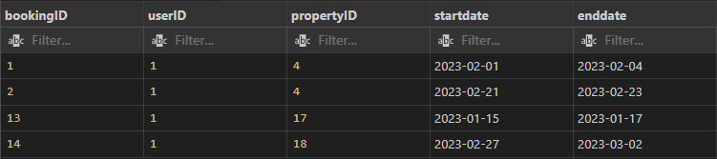
Bookings. An entity containing important booking data (property, guest and the booking dates).
1.
CREATE TABLE Bookings
(
bookingID INT NOT NULL AUTO_INCREMENT,
userID INT NOT NULL,
propertyID INT NOT NULL,
startdate DATE NOT NULL,
enddate DATE NOT NULL,
PRIMARY KEY (bookingID)
);
2.
ALTER TABLE Bookings
ADD CONSTRAINT FK_GuestDetails_TO_Bookings
FOREIGN KEY (userID)
REFERENCES GuestDetails (userID);
ALTER TABLE Bookings
ADD CONSTRAINT FK_Properties_TO_Bookings
FOREIGN KEY (propertyID)
REFERENCES Properties (propertyID);
3.
INSERT INTO Bookings (userID, propertyID, startdate, enddate)
VALUES (1, 4, STR_TO_DATE('2023-02-01', '%Y-%m-%d'), STR_TO_DATE('2023-02-04', '%Y-%m-%d’)), (1, 4, STR_TO_DATE('2023-02-21', '%Y-%m-%d'), STR_TO_DATE('2023-02-23', '%Y-%m-%d')),(1, 17, STR_TO_DATE('2023-01-15', '%Y-%m-%d'), STR_TO_DATE('2023-01-17', '%Y-%m-%d')), (1, 18, STR_TO_DATE('2023-02-27', '%Y-%m-%d’);

Slide 7
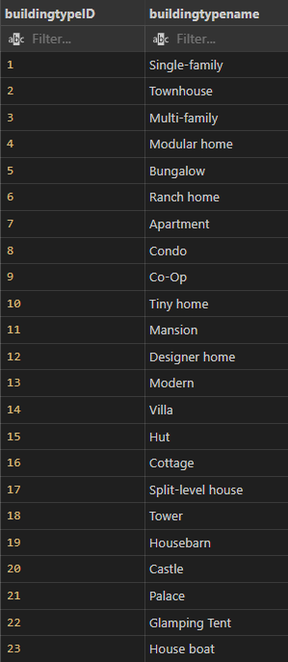
BuildingType. An entity containing a collection of building types to select from.
1.
CREATE TABLE BuildingType
(
buildingtypeID INT NOT NULL AUTO_INCREMENT,
buildingtypename VARCHAR(100) NOT NULL,
PRIMARY KEY (buildingtypeID)
);
2. No alter statements
3.
INSERT INTO BuildingType (buildingtypename)
VALUES ('Single-family'), ('Townhouse'), ('Multi-family'), ('Modular home'), ('Bungalow'), ('Ranch home'), ('Apartment'), ('Condo'), ('Co-Op'), ('Tiny home'), ('Mansion'), ('Designer home'), ('Modern'), ('Villa'), ('Hut'), ('Cottage'), ('Split-level house'), ('Tower'), ('Housebarn'), ('Castle'), ('Palace'), ('Glamping Tent'), ('House boat');

Slide 8
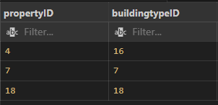
BuildingTypeAndProperties. A relational table that links the properties to their building type.
1.
CREATE TABLE BuildingTypeAndProperties
(
propertyID INT NOT NULL,
buildingtypeID INT NOT NULL
);
2.
ALTER TABLE BuildingTypeAndProperties
ADD CONSTRAINT FK_Properties_TO_BuildingTypeAndProperties
FOREIGN KEY (propertyID)
REFERENCES Properties (propertyID);
ALTER TABLE BuildingTypeAndProperties
ADD CONSTRAINT FK_BuildingType_TO_BuildingTypeAndProperties
FOREIGN KEY (buildingtypeID)
REFERENCES BuildingType (buildingtypeID);
3.
INSERT INTO BuildingTypeAndProperties (propertyID, buildingtypeID)
VALUES (4, 16), (7, 7), (18, 18);

Slide 9
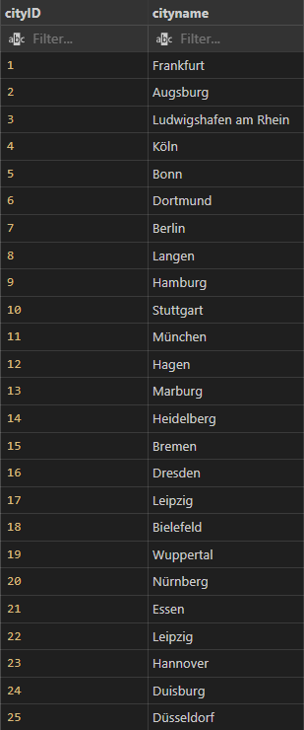
Cities. An entity containing the names of all cities in which the business operates.
1.
CREATE TABLE Cities
(
cityID INT NOT NULL AUTO_INCREMENT,
cityname VARCHAR(100) NOT NULL,
PRIMARY KEY (cityID)
);
2. No alter statements
3.
INSERT INTO Cities (cityname)
VALUES ('Frankfurt'), ('Augsburg'), ('Ludwigshafen am Rhein'), ('Köln'), ('Bonn'), ('Dortmund'), ('Berlin'), ('Langen'), ('Hamburg'), ('Stuttgart’), ('München'), ('Hagen'), ('Marburg'), ('Heidelberg'), ('Bremen'), ('Dresden'), ('Leipzig'), ('Bielefeld'), ('Wuppertal'), ('Nürnberg'), ('Essen'), ('Leipzig'), ('Hannover'), ('Duisburg'), ('Düsseldorf');

Slide 10
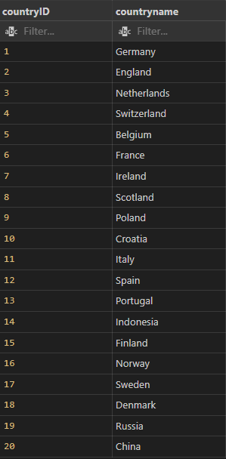
Countries. An entity containing the names of all countries in which the business operates.
1.
CREATE TABLE Countries
(
countryID INT NOT NULL AUTO_INCREMENT,
countryname VARCHAR(100) NOT NULL,
PRIMARY KEY (countryID)
);
2. No alter statements
3.
INSERT INTO Countries (countryname)
VALUES ('Germany'), ('England'), ('Netherlands'), ('Switzerland'), ('Belgium'), ('France'), ('Ireland'), ('Scotland'), ('Poland'), ('Croatia'), ('Italy'), ('Spain'), ('Portugal'), ('Indonesia'), ('Finland'), ('Norway'), ('Sweden'), ('Denmark'), ('Russia'), ('China');

Slide 11
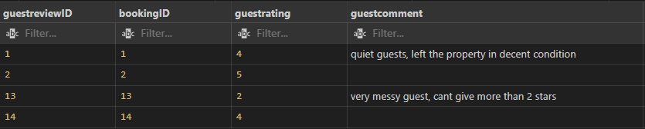
GuestReviews. An entity containing reviews of the guest(s) and how they treated the property.
1.
CREATE TABLE GuestReviews
(
guestreviewID INT NOT NULL AUTO_INCREMENT,
bookingID INT NOT NULL,
guestrating INT NOT NULL,
guestcomment TEXT NULL ,
PRIMARY KEY (guestreviewID)
);
2.
ALTER TABLE GuestReviews
ADD CONSTRAINT FK_Bookings_TO_GuestReviews
FOREIGN KEY (bookingID)
REFERENCES Bookings (bookingID);
3.
INSERT INTO GuestReviews (bookingID, guestrating, guestcomment)
VALUES (1, 4, 'quiet guests, left the property in decent
condition'), (2, 5, ''), (13, 2, 'very messy guest, cant give more than 2
stars'), (14, 4, '');

Slide 12
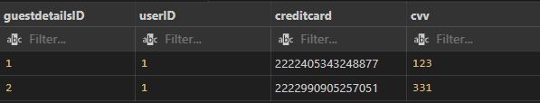
GuestDetails. An entity containing additional info about users that want to book properties.
1.
CREATE TABLE GuestDetails
(
guestdetailsID INT NOT NULL AUTO_INCREMENT,
userID INT NOT NULL,
creditcard BIGINT NOT NULL,
cvv INT NOT NULL,
PRIMARY KEY (guestdetailsID)
);
2.
ALTER TABLE GuestDetails
ADD CONSTRAINT FK_Users_TO_GuestDetails
FOREIGN KEY (userID)
REFERENCES Users (userID);
3.
INSERT INTO GuestDetails (userID, creditcard, cvv)
VALUES (1, 2222405343248877, 123), (1, 2222990905257051, 331)

Slide 13

HostDetails. An entity containing additional information about users that want to host properties.
1.
CREATE TABLE HostDetails
(
hostdetailsID INT NOT NULL AUTO_INCREMENT,
userID INT NOT NULL,
bankaccount VARCHAR(100) NOT NULL,
PRIMARY KEY (hostdetailsID)
);
2.
ALTER TABLE HostDetails
ADD CONSTRAINT FK_Users_TO_HostDetails
FOREIGN KEY (userID)
REFERENCES Users (userID);
3.
INSERT INTO HostDetails (userID, bankaccount)
VALUES (1, 'DE02120300000000202051’);

Slide 14
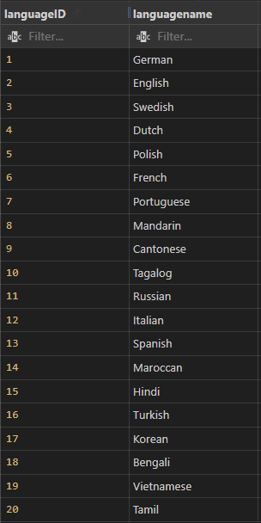
Languages. An entity containing all languages available to link to your profile.
1.
CREATE TABLE Languages
(
languageID INT NOT NULL AUTO_INCREMENT,
languagename VARCHAR(100) NOT NULL,
PRIMARY KEY (languageID)
);
2. No alter statements
3.
INSERT INTO Languages (languagename)
VALUES ('German'), ('English'), ('Swedish'), ('Dutch'), ('Polish'), ('French'), ('Portuguese'), ('Mandarin'), ('Cantonese'), ('Tagalog'), ('Russian'), ('Italian'), ('Spanish'), ('Maroccan'), ('Hindi'), ('Turkish'), ('Korean'), ('Bengali'), ('Vietnamese'), ('Tamil');

Slide 15
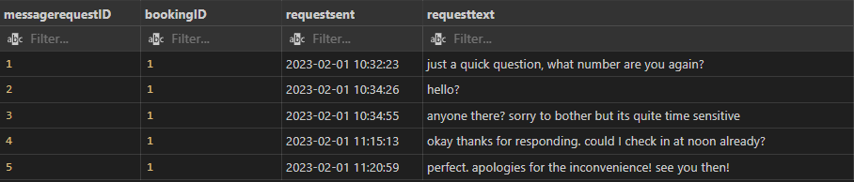
MessageRequests. An entity containing messages sent from guests to their hosts.
1.
CREATE TABLE MessageRequests
(
messagerequestID INT NOT NULL AUTO_INCREMENT,
bookingID INT NOT NULL,
requestsent DATETIME NOT NULL,
requesttext TEXT NOT NULL,
PRIMARY KEY (messagerequestID)
);
2.
ALTER TABLE MessageRequests
ADD CONSTRAINT FK_Bookings_TO_MessageRequests
FOREIGN KEY (bookingID)
REFERENCES Bookings (bookingID);
3.
INSERT INTO MessageRequests (bookingID, requestsent, requesttext)
VALUES (1, STR_TO_DATE('2023-02-01 10:32:23', '%Y-%m-%d %H:%i:%s'), 'just a quick question, what number are you again?'), (1, STR_TO_DATE('2023-02-01 10:34:26', '%Y-%m-%d %H:%i:%s'), 'hello?'), (1, STR_TO_DATE('2023-02-01 10:34:55', '%Y-%m-%d %H:%i:%s'), 'anyone there? sorry to bother but its quite time sensitive'), (1, STR_TO_DATE('2023-02-01 11:15:13', '%Y-%m-%d %H:%i:%s'), 'okay thanks for responding. could I check in at noon already?'), (1, STR_TO_DATE('2023-02-01 11:20:59', '%Y-%m-%d %H:%i:%s'), 'perfect. apologies for the inconvenience! see you then!’);

Slide 16
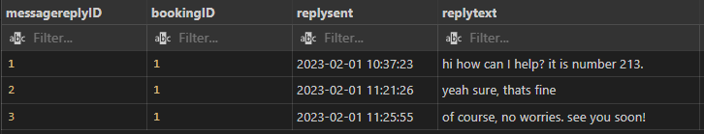
MessageReplies. An entity containing messages sent from host back to the guest, answering any questions or requests.
1.
CREATE TABLE MessageReplies
(
messagereplyID INT NOT NULL AUTO_INCREMENT,
bookingID INT NOT NULL,
replysent DATETIME NOT NULL,
replytext TEXT NOT NULL,
PRIMARY KEY (messagereplyID)
);
2.
ALTER TABLE MessageReplies
ADD CONSTRAINT FK_Bookings_TO_MessageReplies
FOREIGN KEY (bookingID)
REFERENCES Bookings (bookingID);
3.
INSERT INTO MessageReplies (bookingID, replysent, replytext)
VALUES (1, STR_TO_DATE('2023-02-01 10:37:23', '%Y-%m-%d %H:%i:%s'), 'hi how can I help? it is number 213.'), (1, STR_TO_DATE('2023-02-01 11:21:26', '%Y-%m-%d %H:%i:%s'), 'yeah sure, thats fine'), (1, STR_TO_DATE('2023-02-01 11:25:55', '%Y-%m-%d %H:%i:%s'), 'of course, no worries. see you soon!’);

Slide 17

Payment. An entity containing the payment details of each booking.
1.
CREATE TABLE Payment
(
paymentID INT NOT NULL AUTO_INCREMENT,
bookingID INT NOT NULL,
received DATETIME NULL ,
forwarded DATETIME NULL ,
PRIMARY KEY (paymentID)
);
2.
ALTER TABLE Payment
ADD CONSTRAINT FK_Bookings_TO_Payment
FOREIGN KEY (bookingID)
REFERENCES Bookings (bookingID);
3.
INSERT INTO Payment (bookingID, received, forwarded)
VALUES (1, STR_TO_DATE('2023-01-28 09:17:25', '%Y-%m-%d %H:%i:%s’),
STR_TO_DATE('2023-02-02 12:17:52', '%Y-%m-%d %H:%i:%s’));

Slide 18
Price. An entity containing basic price per night and modifiers for each individual month.
1.
CREATE TABLE Price
(
priceID INT NOT NULL AUTO_INCREMENT,
basicprice INT NOT NULL ,
january INT NULL ,
february INT NULL ,
march INT NULL ,
april INT NULL ,
may INT NULL ,
june INT NULL ,
july INT NULL ,
august INT NULL ,
september INT NULL ,
october INT NULL ,
november INT NULL ,
december INT NULL ,
PRIMARY KEY (priceID)
);
2. No alter statements
3.
INSERT INTO Price (basicprice, january, february, march, april, may, june, july, august, september, october, november, december)
Values (50, -10, -5, 0, 5, 5, 10, 15, 15, 10, 5, 5, 10);

Slide 19

ProfileImages. An entity containing the paths to all uploaded profile pictures.
1.
CREATE TABLE ProfileImages
(
profileimageID INT NOT NULL AUTO_INCREMENT,
profileID INT NOT NULL,
profileimage VARCHAR(100) NOT NULL,
PRIMARY KEY (profileimageID)
);
2.
ALTER TABLE ProfileImages
ADD CONSTRAINT FK_Profiles_TO_ProfileImages
FOREIGN KEY (profileID)
REFERENCES Profiles (profileID);
3.
INSERT INTO ProfileImages (profileID, profileimage)
VALUES(1, 'portrait1.jpg'),

Slide 20
Profiles. An entity containing users' profiles along with a (short) bio.
1.
CREATE TABLE Profiles
(
profileID INT NOT NULL AUTO_INCREMENT,
userID INT NOT NULL,
bio TEXT NULL ,
PRIMARY KEY (profileID)
);
2.
ALTER TABLE Profiles
ADD CONSTRAINT FK_Users_TO_Profiles
FOREIGN KEY (userID)
REFERENCES Users (userID);
3.
INSERT INTO Profiles (userID, bio)
VALUES (1, 'Hi, I love traveling and renting out my home as airbnb! Check it out and come visit!’);

Slide 21
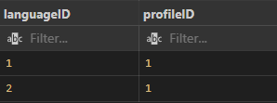
ProfilesAndLanguages. A relational entity that links the profile ID with the user's language capabilities.
1.
CREATE TABLE ProfilesAndLanguages
(
languageID INT NOT NULL,
profileID INT NOT NULL
);
2.
ALTER TABLE ProfilesAndLanguages
ADD CONSTRAINT FK_Languages_TO_ProfilesAndLanguages
FOREIGN KEY (languageID)
REFERENCES Languages (languageID);
ALTER TABLE ProfilesAndLanguages
ADD CONSTRAINT FK_Profiles_TO_ProfilesAndLanguages
FOREIGN KEY (profileID)
REFERENCES Profiles (profileID);
3.
INSERT INTO ProfilesAndLanguages (languageID, profileID)
VALUES (1, 1), (2, 1);

Slide 22
Properties. An entity containing links to all entities related to the property, as well as a listing name, description and size attribute.
1.
CREATE TABLE Properties
(
propertyID INT NOT NULL AUTO_INCREMENT,
addressID INT NOT NULL,
roomsID INT NOT NULL,
accessibilityID INT NOT NULL,
userID INT NOT NULL,
priceID INT NOT NULL,
propertyname VARCHAR(100) NOT NULL,
propertydescription TEXT NULL ,
size INT NULL ,
PRIMARY KEY (propertyID)
);
2.
ALTER TABLE Properties
ADD CONSTRAINT FK_PropertyAddress_TO_Properties
FOREIGN KEY (addressID)
REFERENCES PropertyAddress (addressID);
ALTER TABLE Properties
ADD CONSTRAINT FK_Rooms_TO_Properties
FOREIGN KEY (roomsID)
REFERENCES Rooms (roomsID);
ALTER TABLE Properties
ADD CONSTRAINT FK_Accessibility_TO_Properties
FOREIGN KEY (accessibilityID)
REFERENCES Accessibility (accessibilityID);
ALTER TABLE Properties
ADD CONSTRAINT FK_HostDetails_TO_Properties
FOREIGN KEY (userID)
REFERENCES HostDetails (userID);
ALTER TABLE Properties
ADD CONSTRAINT FK_Price_TO_Properties
FOREIGN KEY (priceID)
REFERENCES Price (priceID);

Slide 23
Properties. P2.
3.
INSERT INTO Properties (addressID, roomsID, accessibilityID, userID, priceID, propertyname, propertydescription, size)
VALUES (1, 2, 4, 1, 1, 'small cosy house', '', 42),

Slide 24
PropertyAddress. An entity containing the address of a property.
1.
CREATE TABLE PropertyAddress
(
addressID INT NOT NULL AUTO_INCREMENT,
countryID INT NOT NULL,
cityID INT NOT NULL,
postalcode VARCHAR(10) NOT NULL,
streetname VARCHAR(100) NOT NULL,
housenumber VARCHAR(10) NOT NULL,
PRIMARY KEY (addressID)
);
2.
ALTER TABLE PropertyAddress
ADD CONSTRAINT FK_Countries_TO_PropertyAddress
FOREIGN KEY (countryID)
REFERENCES Countries (countryID);
ALTER TABLE PropertyAddress
ADD CONSTRAINT FK_Cities_TO_PropertyAddress
FOREIGN KEY (cityID)
REFERENCES Cities (cityID);
3.
INSERT INTO PropertyAddress (countryID, cityID, postalcode, streetname, housenumber)
VALUES (1, 11, '80333', 'Prinz-Ludwig Straße', '6'),

Slide 25

PropertyImages. An entity containing the file path to the property image.
1.
CREATE TABLE PropertyImages
(
propertyimageID INT NOT NULL AUTO_INCREMENT,
propertyID INT NOT NULL,
propertyimage VARCHAR(100) NOT NULL,
PRIMARY KEY (propertyimageID)
);
2.
ALTER TABLE PropertyImages
ADD CONSTRAINT FK_Properties_TO_PropertyImages
FOREIGN KEY (propertyID)
REFERENCES Properties (propertyID);
3.
INSERT INTO PropertyImages (propertyID, propertyimage)
VALUES (1, 'property1.jpg'),

Slide 26
PropertyReviews. An entity containing reviews of properties including rating and comments.
1.
CREATE TABLE PropertyReviews
(
propertyreviewID INT NOT NULL AUTO_INCREMENT,
bookingID INT NOT NULL,
propertyrating INT NOT NULL,
propertycomment TEXT NULL ,
PRIMARY KEY (propertyreviewID)
);
2.
ALTER TABLE PropertyReviews
ADD CONSTRAINT FK_Bookings_TO_PropertyReviews
FOREIGN KEY (bookingID)
REFERENCES Bookings (bookingID);
3.
INSERT INTO PropertyReviews (bookingID, propertyrating, propertycomment)
VALUES (1, 5, 'super clean, everything as promised, would love to come visit again!’);

Slide 27

Rooms. An entity containing the number of rooms and beds of a property.
1.
CREATE TABLE Rooms
(
roomsID INT NOT NULL AUTO_INCREMENT,
bedrooms INT NOT NULL,
bathrooms INT NOT NULL,
singlebeds INT NOT NULL,
doublebeds INT NOT NULL,
PRIMARY KEY (roomsID)
);
2. No alter statements
3.
INSERT INTO Rooms (bedrooms, bathrooms, singlebeds, doublebeds)
VALUES (1, 1, 1, 0);

Slide 28

Users. An entity containing the basic user details.
1.
CREATE TABLE Users
(
userID INT NOT NULL AUTO_INCREMENT,
email VARCHAR(100) NOT NULL,
firstname VARCHAR(100) NOT NULL,
lastname VARCHAR(100) NOT NULL,
phonenumber VARCHAR(100) NOT NULL,
PRIMARY KEY (userID)
);
2. No alter statements
3.
INSERT INTO Users (email, firstname, lastname, phonenumber)
VALUES ('a.fischer@gmail.com', 'Anna', 'Fischer', '01751834928'),

Slide 29

VacationTypeAndProperties. A relational entity linking a property and its vacationtype.
1.
CREATE TABLE VacationTypeAndProperties
(
vacationtypeID INT NOT NULL,
propertyID INT NOT NULL
);
2.
ALTER TABLE VacationTypeAndProperties
ADD CONSTRAINT FK_VacationType_TO_VacationTypeAndProperties
FOREIGN KEY (vacationtypeID)
REFERENCES VacationType (vacationtypeID);
ALTER TABLE VacationTypeAndProperties
ADD CONSTRAINT FK_Properties_TO_VacationTypeAndProperties
FOREIGN KEY (propertyID)
REFERENCES Properties (propertyID);
3.
INSERT INTO VacationTypeAndProperties (vacationtypeID, propertyID)
VALUES (5, 1);

Slide 30
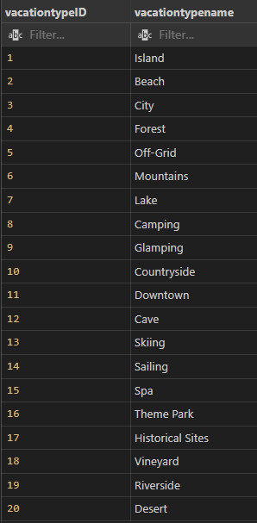
VacationType. An entity containing all offered vacationtypes.
1.
CREATE TABLE VacationType
(
vacationtypeID INT NOT NULL AUTO_INCREMENT,
vacationtypename VARCHAR(100) NOT NULL,
PRIMARY KEY (vacationtypeID)
);
2. No alter statements
3.
INSERT INTO VacationType (vacationtypename)
VALUES ('Island'), ('Beach'), ('City'), ('Forest'), ('Off-Grid'), ('Mountains'), ('Lake'), ('Camping'), ('Glamping'), ('Countryside'), ('Downtown'), ('Cave'), ('Skiing'), ('Sailing'), ('Spa'), ('Theme Park'), ('Historical Sites'), ('Vineyard'), ('Riverside'), ('Desert');

