Slide 1

Executive Summary, Introduction, and Methodology
Final Presentation PDF • GitHub repository contains all completed notebooks and Python files.
Executive Summary: 90 model-ready launches; landing success was 66.7%; top test accuracy was 83.3%.
Introduction: predict Falcon 9 first-stage landing success because recovery can reduce launch cost.
Data Collection & Wrangling: SpaceX API and Wikipedia; cleaned records; binary Class label.
EDA/Data Visualisation & Classification: charts and SQL assessed site, orbit, payload and time; four models were evaluated.
GitHub repository: https://github.com/darizek-art/ibm-data-science-capstone

Slide 2
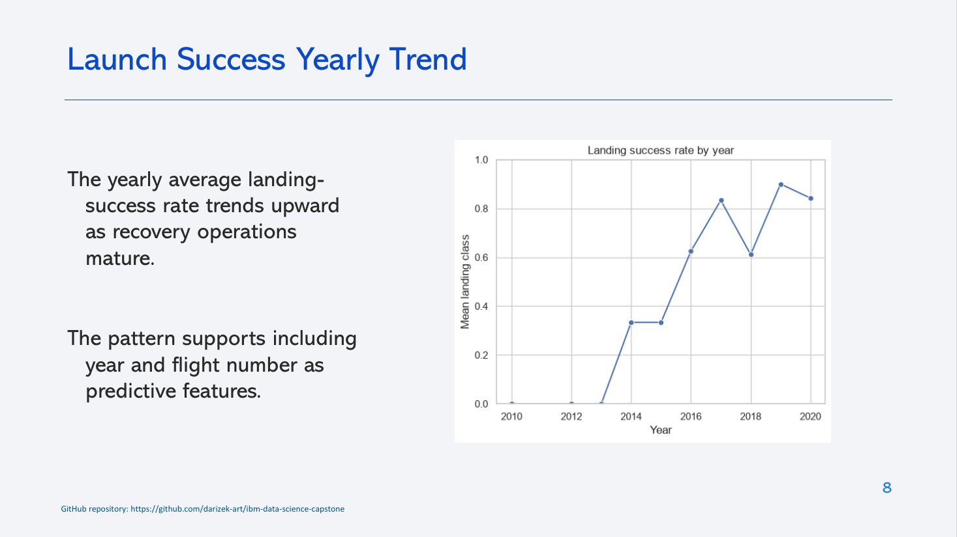
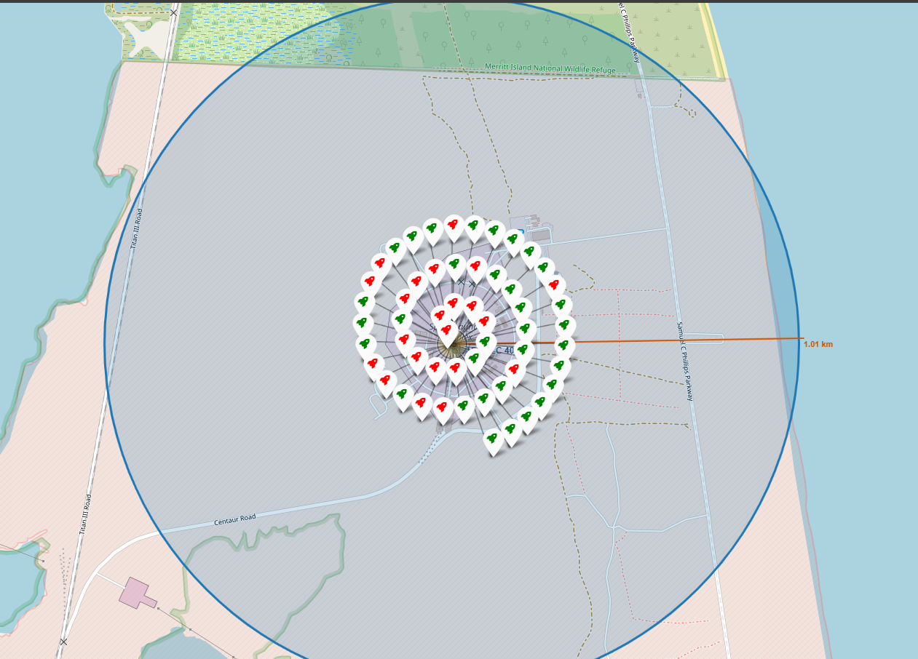
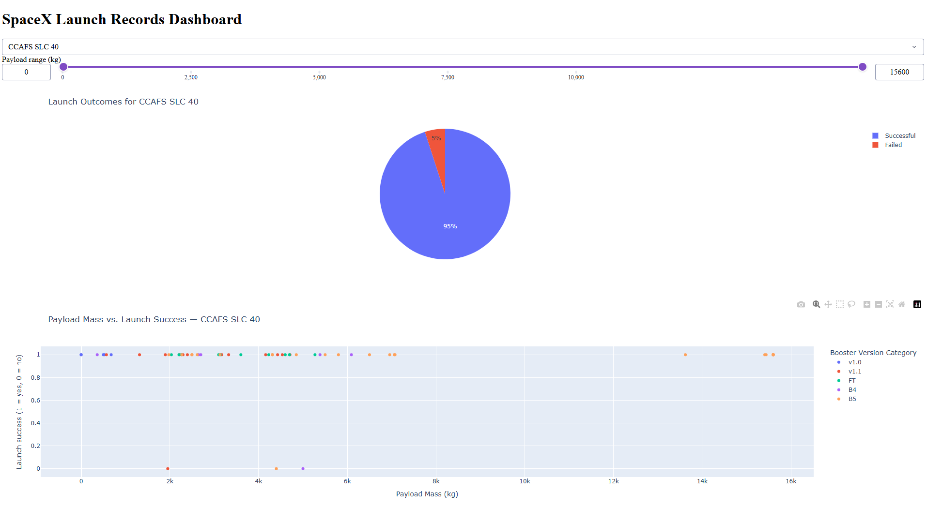
EDA, SQL, Folium & Dash Results
EDA: landing success rose as operations matured.
SQL: four successful drone-ship recoveries were identified at 4,000–6,000 kg.
Folium: green/red outcomes and a 0.08 km proximity measurement were mapped.
Plotly Dash: CCAFS SLC 40 showed 95% successful and 5% failed launches.
GitHub repository: https://github.com/darizek-art/ibm-data-science-capstone

Slide 3
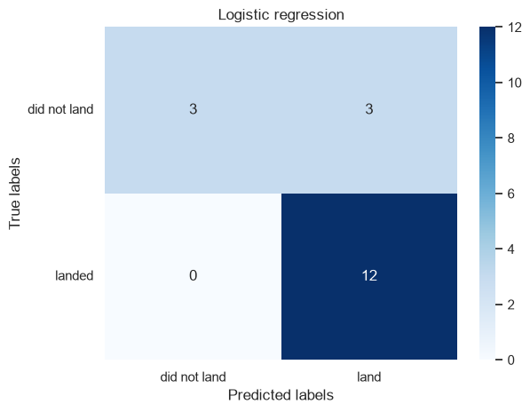
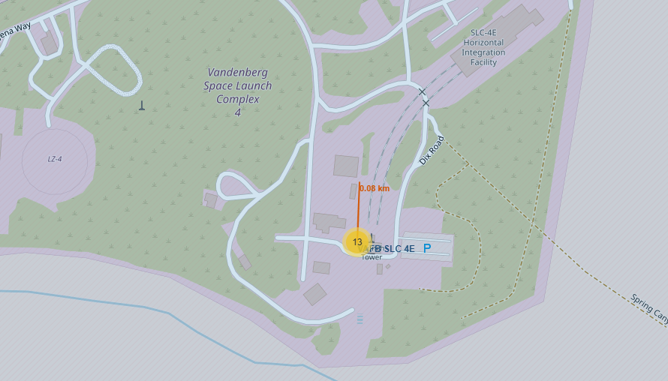
Prediction Results, Creativity, and Conclusion
Predictive Analysis (Classification): Logistic Regression, SVM and KNN tied at 83.3%.
Confusion matrix: 12 correct landings; 3 missed non-landings; 3 false landing predictions.
Creativity: Folium proximity and Plotly Dash linked geography, payload and outcomes.
Innovative insight: success rose with maturity; site, orbit, payload and flight number mattered.
Conclusion: useful signal, but the small test set warrants caution.
GitHub repository: https://github.com/darizek-art/ibm-data-science-capstone

