Slide 1

GitHub Repository and Completed Files
Completed repository artefacts:
• 01_spacex_api_data_collection.ipynb • spacex_web_scraping.ipynb
• spacex_data_wrangling.ipynb • spacex_eda_visualization.ipynb
• spacex_eda_sql.ipynb • lab_jupyter_launch_site_location.ipynb
• spacex_dash_app.py • spacex_machine_learning.ipynb
All eight files contain completed code and/or saved outputs.
Repo: github.com/darizek-art/ibm-data-science-capstone | Evidence source: all eight completed files listed above

Slide 2


Final PDF Presentation
Jack • July 2026
Repo: github.com/darizek-art/ibm-data-science-capstone | Evidence source: final presentation PDF

Slide 3
Executive Summary
A data-driven assessment of Falcon 9 first-stage recovery.
Historic data show a 66.7% landing-success rate in the predictive dataset.
Three classifiers tied for the highest test accuracy: 83.3%.
Repo: github.com/darizek-art/ibm-data-science-capstone | Evidence source: spacex_data_wrangling.ipynb + spacex_machine_learning.ipynb

Slide 4
Introduction
Can Falcon 9 first-stage landing success be predicted from launch characteristics?
Successful recovery matters because reused first stages can reduce launch cost.
Repo: github.com/darizek-art/ibm-data-science-capstone | Evidence source: 01_spacex_api_data_collection.ipynb

Slide 5
Methodology
• Collected launch, payload, booster, and launch-site data from SpaceX sources and Wikipedia tables.
• Cleaned records, created the binary landing-success label, and prepared model features.
• Used visual and SQL analysis to identify relationships among payload, orbit, site, and outcomes.
• Built and evaluated classification models using a held-out test set.
Repo: github.com/darizek-art/ibm-data-science-capstone | Evidence source: collection, scraping, and wrangling notebooks listed on slide 1

Slide 6
EDA with Data Visualization
Scatter plots compared payload, flight number, launch site, and orbit type.
Bar charts measured orbit-level landing success, while a line chart showed the yearly trend.
These views exposed important feature relationships before modelling.
Repo: github.com/darizek-art/ibm-data-science-capstone | Evidence source: spacex_eda_visualization.ipynb

Slide 7
Predictive Analysis (Classification)
• Standardised features and split the data into training and test sets.
• Evaluated Logistic Regression, SVM, Decision Tree, and KNN classifiers.
• Compared test accuracy and confusion matrices to select the strongest result.
Repo: github.com/darizek-art/ibm-data-science-capstone | Evidence source: spacex_machine_learning.ipynb

Slide 8
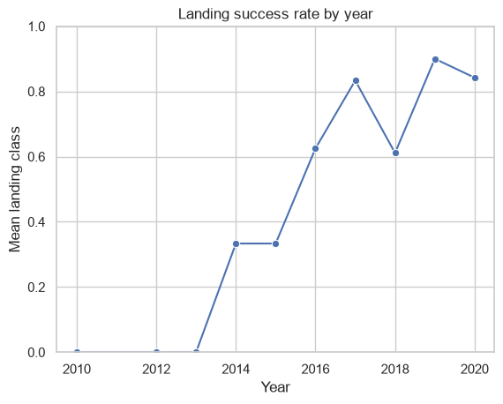
Launch Success Yearly Trend
The yearly average landing-success rate trends upward as recovery operations mature.
The pattern supports including year and flight number as predictive features.
Repo: github.com/darizek-art/ibm-data-science-capstone | Evidence source: spacex_eda_visualization.ipynb

Slide 9
EDA with SQL Queries and Results
SQL query filter: successful drone-ship outcomes with payload mass between 4,000 and 6,000 kg.
Result: F9 FT B1026 (4,600 kg), B1022 (4,696 kg), B1031.2 (5,200 kg), and B1021.2 (5,300 kg).
Repo: github.com/darizek-art/ibm-data-science-capstone | Evidence source: spacex_eda_sql.ipynb

Slide 10
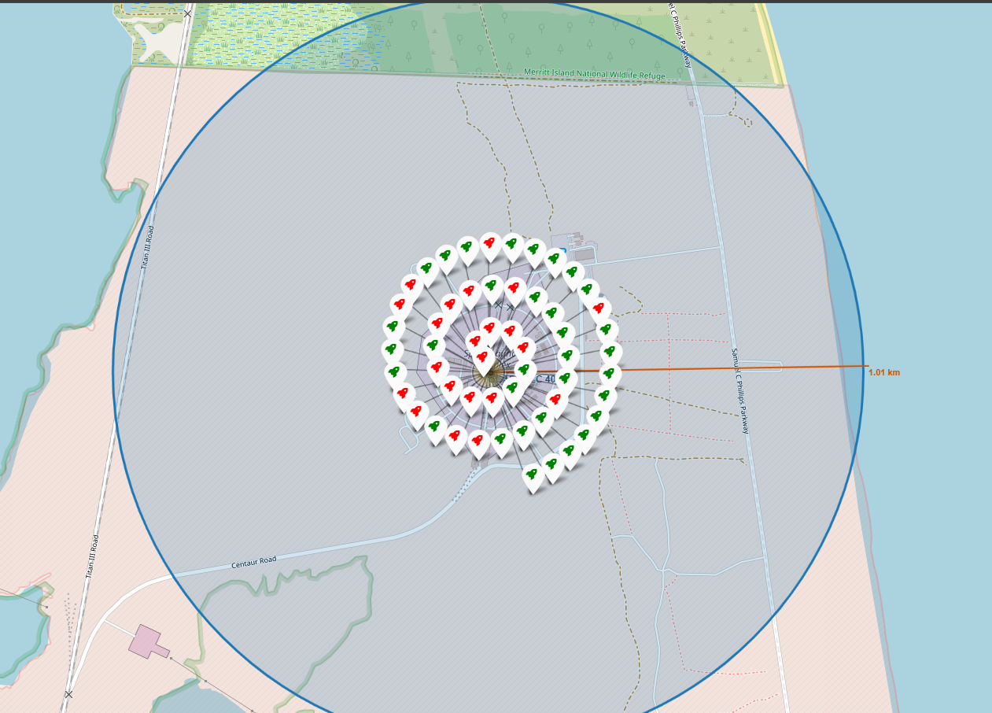
Landing Outcomes by Launch Site
Green = success; red = failure.
Repo: github.com/darizek-art/ibm-data-science-capstone | Evidence source: lab_jupyter_launch_site_location.ipynb

Slide 11
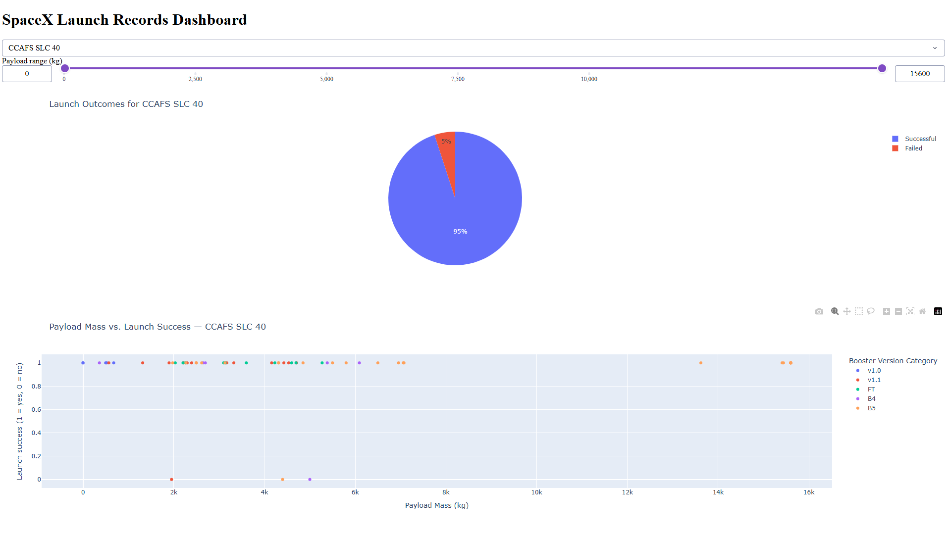
Dash: Launch-Site Success Comparison
CCAFS SLC 40: 95% successful, 5% failed.
Repo: github.com/darizek-art/ibm-data-science-capstone | Evidence source: spacex_dash_app.py

Slide 12
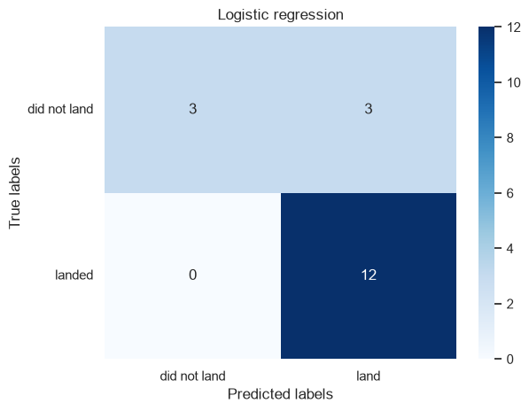
Predictive Analysis Results
Test accuracy by model:
• Logistic Regression — 83.3%
• Support Vector Machine — 83.3%
• Decision Tree — 77.8%
• K-Nearest Neighbours — 83.3%
Three models tied for the highest observed test accuracy.
Repo: github.com/darizek-art/ibm-data-science-capstone | Evidence source: spacex_machine_learning.ipynb

Slide 13
Conclusions
• Falcon 9 landing success rose as operations matured.
• Launch site, orbit, payload, and flight number are informative features.
• Historic landing data supported useful classification performance.
• The 83.3% top test score should be interpreted cautiously because the dataset is small and the best models were tied.
Repo: github.com/darizek-art/ibm-data-science-capstone | Evidence source: completed analysis files listed on slide 1

Slide 14
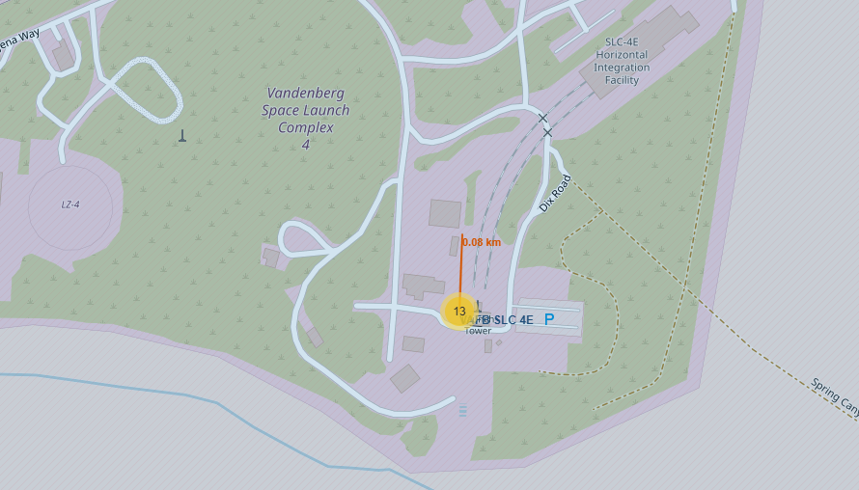
Creativity: Folium Proximity Analysis
Measured coast distance: 0.08 km.
Repo: github.com/darizek-art/ibm-data-science-capstone | Evidence source: lab_jupyter_launch_site_location.ipynb

Slide 15
Innovative Insights
Key results
• Landing success in the modelling dataset: 66.7%
• EDA showed outcome patterns by orbit, site, payload, and time
• Interactive tools supported geographic and launch-site exploration
• Best test accuracy: 83.3%
Repo: github.com/darizek-art/ibm-data-science-capstone | Evidence source: EDA, SQL, and machine-learning notebooks listed on slide 1

