Slide 1


PROJECT
CAR SPEED PREDICTION
using Linear Regression • Machine Learning
Submitted To:
Submitted By:
Ritik Sir
Abhay Singh
Roll No. 40 | BCA | 2026–27
Notes:
Namaste! Main Abhay Singh, aur mera project hai Car Speed Prediction using Linear Regression. Isme hum driving aur engine ke inputs se gaadi ki speed predict karte hain.

Slide 2


Project Roadmap
Data Preparation
Explore & Split
Model & Predict
1
Import Libraries
4
Features & Target
7
Model Performance
Pandas, NumPy, sklearn
6 inputs, y = speed
MAE, MSE, RMSE, R²
2
Inspect Dataset
5
Visualization
8
Example Prediction
head, shape, info
Throttle & RPM scatter
46.51 km/h on new input
3
Check Data Quality
6
Train–Test Split & Model
Missing & duplicates
80% train, 20% test
Notes:
Pehle roadmap: project 3 phases me hai. Data Preparation: libraries, dataset inspect, quality check. Explore & Split: features aur target, graphs, train-test split aur model. Model & Predict: performance aur ek example prediction.

Slide 3








1. Import Libraries & Upload File
Pandas (pd)
NumPy (np)
Matplotlib (plt)
Joblib
Load & manage tabular data
Numerical calculations
Create the graphs
Save model as .pkl
train_test_split
LinearRegression
sklearn.metrics
Google Colab
Split data into train & test
Build the regression model
Calculate MAE, MSE, RMSE, R²
Notebook to run everything
import pandas as pd | import numpy as np | import matplotlib.pyplot as plt | import joblib
from sklearn... import train_test_split, LinearRegression, metrics
Notes:
Sabse pehle libraries import ki. Pandas data load karne ke liye, NumPy calculations ke liye, Matplotlib graphs ke liye aur Joblib se trained model .pkl me save hota hai. scikit-learn se train_test_split, LinearRegression aur metrics. Sab kuch Google Colab notebook me chalaya.

Slide 4





2. Inspect the Dataset
1
2
3
4
5
.head()
.shape
.columns
.info()
.describe()
First 5 rows: quick look at the data
20,000 rows × 14 columns
Names of all the columns
Data types & non-null counts
Speed spans 0.00 – 124.02 km/h
data.head() | data.shape | data.columns | data.info() | data.describe()
Target = vehicle_speed_kph (km/h), predicted from 6 input columns.
Notes:
Dataset samajhne ke liye 5 basic checks. head() se pehli rows, shape se 20,000 rows aur 14 columns, columns se naam, info() se data types, describe() se summary. Speed 0 se 124.02 km/h tak hai.

Slide 5




3. Check Data Quality
Dataset
Missing Values?
Duplicate Rows?
Clean Data
1. Missing Values
0
2. Duplicate Rows
0
Any blank / NaN in a column?
Same record repeated?
found
found
data.isnull().sum()
data.duplicated().sum()
Data is clean: duplicate rows are dropped and required columns are checked before training.
Notes:
Data quality me do checks: missing values aur duplicate rows. isnull().sum() aur duplicated().sum() dono me 0 mila, matlab data clean hai. Training se pehle duplicates drop aur required columns check hote hain.

Slide 6



4. Define Features & Target
FEATURES (X)
Inputs used to estimate speed
engine_rpm
throttle_pos_percent
brake_pressure_percent
engine_load_percent
Linear
Regression
Model
TARGET (y)
vehicle_
speed_kph
gear
road_slope_percent
km/h
X = data[feature_columns]
y = data['vehicle_speed_kph']
Required feature and target columns are checked before training.
Notes:
Features yaani inputs: RPM, throttle, brake pressure, engine load, gear aur road slope. Target hai vehicle_speed_kph, jo model ko predict karna seekhna hai.

Slide 7
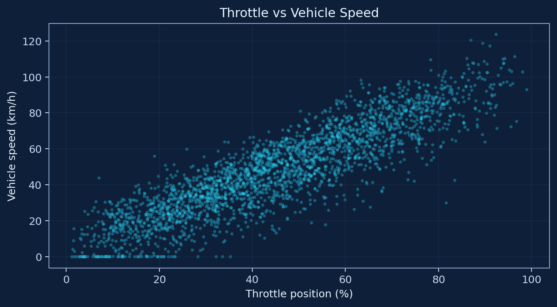
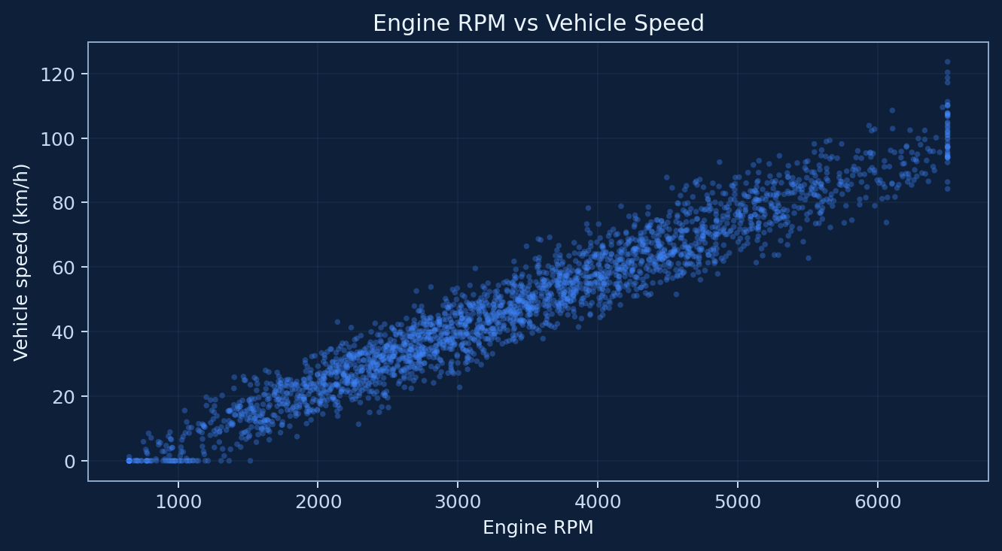

5. Data Visualization
Scatter: Throttle vs Speed
Scatter: Engine RPM vs Speed
Clear upward trend: more throttle, higher speed.
Tight, near-linear band: RPM tracks speed closely.
Graphs show strong linear patterns before training, so Linear Regression is a suitable baseline.
Notes:
Model train karne se pehle graphs dekhe. Throttle aur RPM dono ka speed ke saath seedha linear relation dikhta hai, isliye Linear Regression ek achha baseline hai.

Slide 8


6. Train–Test Split & Create the Model
FULL DATASET (X, y) – 20,000 rows
Training Data 80% (16,000 rows)
Test 20%
Teaches the model
Checks performance
Learns the pattern between the 6 inputs and speed.
4,000 rows the model has never seen.
Why Linear Regression? Speed is continuous: ŷ = β₀ + β₁x₁ + β₂x₂ + … + β₆x₆
train_test_split(X, y, test_size=0.2, random_state=42)
model = LinearRegression()
model.fit(X_train, y_train)
Notes:
Dataset ko 80 aur 20 percent me toda: 16,000 rows training ke liye aur 4,000 test ke liye. random_state 42 se har baar same split milta hai. Linear Regression isliye kyunki speed continuous value hai. model.fit() se model training data par seekhta hai.

Slide 9
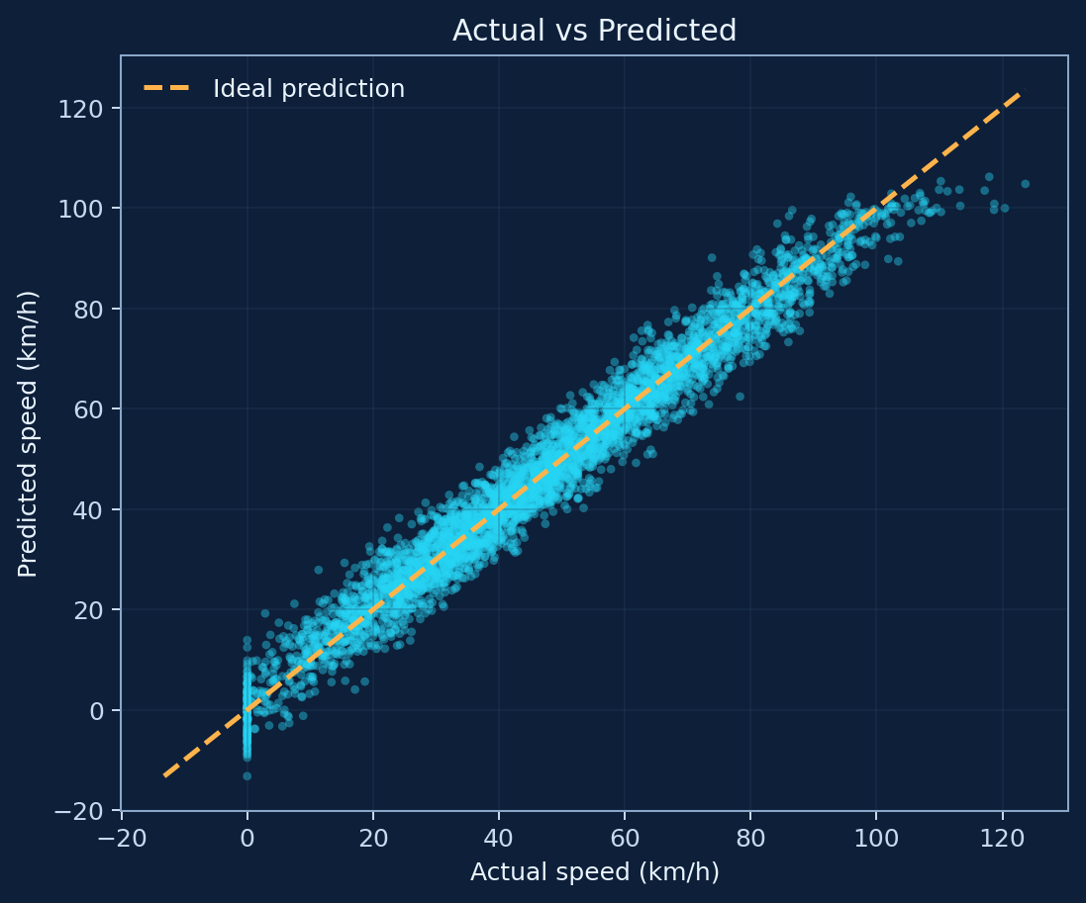
7. Model Performance
X_test
model.predict()
y_pred
Compare with y_test
MAE
MSE
3.6541 km/h
21.1736
Mean Absolute Error
Mean Squared Error
RMSE
R²
4.6015 km/h
0.9647
Root Mean Squared Error
96.47% variance explained
Lower MAE / RMSE and R² near 1 = a better model.
Actual vs Predicted
Points hug the diagonal = accurate predictions.
Notes:
X_test par model.predict() chalaya to y_pred mila, aur usse y_test se compare kiya. MAE 3.65 km/h, RMSE 4.60 km/h, R-squared 0.9647, yaani 96.47 percent variance explain hota hai. Actual vs predicted graph me points diagonal ke paas hain. Ye test data par hai, jo training me use nahi hua.

Slide 10





8. Example: Predict Speed
New Input
Trained Model
Predicted Speed
RPM 3000 | Throttle 45%
Brake 0% | Load 40%
Gear 3 | Slope 0%
Applies the line learned from 16,000 training rows
46.51 km/h
predicted_speed = model.predict(new_data)
Clean data
Train on 80%
Evaluate (R² 0.9647)
Predict new speed
Example from the fitted model on synthetic demo data, not a real-world measurement.
Notes:
Aakhri step: naya input diya, RPM 3000, throttle 45 percent, brake 0, load 40 percent, gear 3, slope 0. model.predict(new_data) se 46.51 km/h mila. Summary: data clean kiya, 80 percent par train kiya, R-squared 0.9647 se evaluate kiya aur ab nayi speed predict kar sakte hain. Data synthetic hai, isliye real-world validation future scope hai.

Slide 11

THANK YOU
Any questions?
Car Speed Prediction using Linear Regression
Abhay Singh | Infopark Institute
Notes:
Itna hi tha mera project: Car Speed Prediction using Linear Regression. Dhanyavaad! Ab aap koi sawaal pooch sakte hain.

