Slide 1

Introduction to
Git & GitHub

Slide 2
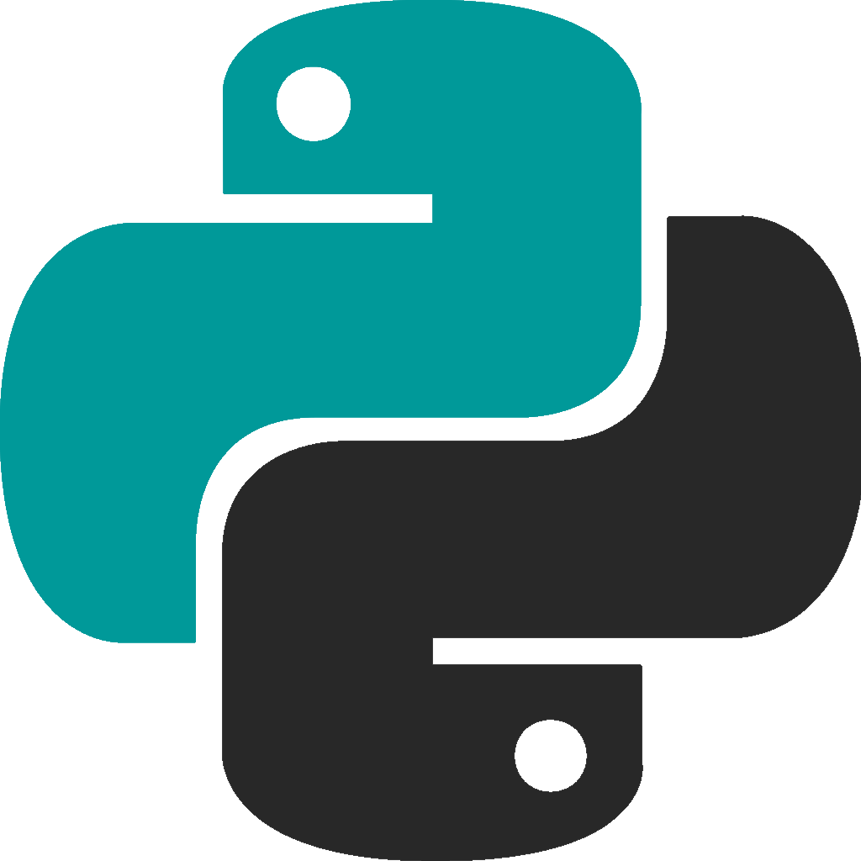
Crash Course on Python

