Slide 1
ANNAMALAI UNIVERSITY
FACULTY OF ENGINEERING AND TECHNOLOGY
DEPARTMENT OF COUMPUTER SCIENCE AND ENGINEERING
Design and Implementation of Sorting Algorithm Visualizer
by
Under the Guidance of
Dr. C. Anbuananth, M.E., Ph.D.,
Associate Professor
Team No.: 18
Name | Reg. No.
Venkatesh A | 211008072
Barathraj B | 212008004
Chithukati Balaji | 212008006
Mohamed Akram M N | 212008015

Slide 2
OBJECTIVES
The aim of this project is to develop an interactive Sorting Algorithm Visualizer that enhances the understanding of sorting algorithms through visual and interactive means.
Enhance Learning Through Visualization: Enable users to visually observe how sorting algorithms operate on data step by step.
Promote User Interaction: Provide users with the ability to control input array size, adjust sorting speed, and choose among multiple sorting algorithms to better understand their differences.
Offer a Responsive and Accessible Platform: Ensure the visualizer is accessible across various devices and platforms through modern web technologies, requiring no additional installations.
Support Self-paced Learning: Empower users to explore sorting algorithms at their own pace, fostering deeper understanding through experimentation and interaction.

Slide 3
INTRODUCTION
This project focuses on creating an interactive Sorting Algorithm Visualizer that uses modern web technologies to visually demonstrate the internal operations of popular sorting algorithms.
Purpose: Enhance understanding of sorting algorithms through visual demonstrations.
Functionality: Users can select algorithms, adjust array sizes, and modify sorting speeds.
Real-time Feedback: Provides instant visual feedback on data sorting processes.
Applications: Useful in educational settings, online learning platforms, and workshops.
Goal: Improve comprehension of sorting algorithms and foster algorithmic thinking.

Slide 4
APPLICATIONS
Educational Institutions: Helps students understand sorting algorithms through interactive visualizations.
Online Learning Platforms: Enhances the learning experience with engaging, visual content.
Workshops and Seminars: Useful for demonstrating sorting algorithms in a clear and interactive manner.
Self-paced Learning: Allows individuals to explore and understand sorting algorithms at their own pace..

Slide 5
Literature Review
Title | Year | Published By | Methodology | Pros | Cons
Algorithm Visualization: A Report on the State of the Field | 2022 | Clifford A. Shaffer, Matthew Cooper, Stephen H. Edwards | Traces the evolution of algorithm visualization, highlights milestones, and discusses challenges such as lack of standardized evaluation methods. | Emphasizes the importance of visual tools in enhancing algorithm education. | Identifies obstacles like difficulty in creating universally effective visualizations.
Effective Features of Algorithm Visualizations | 2021 | Purvi Saraiya | Evaluates interactive features of algorithm visualizations, focusing on user engagement and understanding. | Highlights the value of integrating pseudocode and real-time feedback. | Calls for further research to refine interactive elements.

Slide 6
Literature Review
Title | Year | Published By | Methodology | Pros | Cons
A Literature Review on Algorithm Visualizers | 2022 | Sweeta Bansal, Karan Kohli, Krishna Kumar, Kush Gupta | The research uses the iBUG 300-W dataset, which includes 7,764 images with 68 facial landmarks. The system focuses on the eye region to speed up calculations and improve accuracy. | High Accuracy , Real-Time Detection, Efficient Processing | Limited Performance in Low Light,
Driver Drowsiness Detection Model Using Convolutional Neural Networks Techniques for Android Application | 2020 | Rateb Jabbary, Mohammed Shinoy, Mohamed Kharbeche, Khalifa Al-Khalifax, Moez Krichenz, Kamel Barkaoui | The proposed solution involves a Deep Learning model based on Convolutional Neural Networks (CNN) and Facial Landmark Detection (D2CNN-FLD). | High Accuracy, High Accuracy, Cost-effective | Dependency on Lighting Conditions,

Slide 7
Literature Review
Title | Year | Published By | Methodology | Pros | Cons
Algorithm Visualization: A Report on the State of the Field | 2022 | ResearchGate, Hafsa Sidaq, Faisal Bukhari, Waheed Iqbal | The research uses the iBUG 300-W dataset, which includes 7,764 images with 68 facial landmarks. The system focuses on the eye region to speed up calculations and improve accuracy. | High Accuracy , Real-Time Detection, Efficient Processing | Limited Performance in Low Light,
Driver Drowsiness Detection Model Using Convolutional Neural Networks Techniques for Android Application | 2020 | Rateb Jabbary, Mohammed Shinoy, Mohamed Kharbeche, Khalifa Al-Khalifax, Moez Krichenz, Kamel Barkaoui | The proposed solution involves a Deep Learning model based on Convolutional Neural Networks (CNN) and Facial Landmark Detection (D2CNN-FLD). | High Accuracy, High Accuracy, Cost-effective | Dependency on Lighting Conditions,

Slide 8
Literature Review
Title | Year | Published By | Methodology | Pros | Cons
Algorithm Visualization: A Report on the State of the Field | 2022 | ResearchGate, Hafsa Sidaq, Faisal Bukhari, Waheed Iqbal | The research uses the iBUG 300-W dataset, which includes 7,764 images with 68 facial landmarks. The system focuses on the eye region to speed up calculations and improve accuracy. | High Accuracy , Real-Time Detection, Efficient Processing | Limited Performance in Low Light,
Driver Drowsiness Detection Model Using Convolutional Neural Networks Techniques for Android Application | 2020 | Rateb Jabbary, Mohammed Shinoy, Mohamed Kharbeche, Khalifa Al-Khalifax, Moez Krichenz, Kamel Barkaoui | The proposed solution involves a Deep Learning model based on Convolutional Neural Networks (CNN) and Facial Landmark Detection (D2CNN-FLD). | High Accuracy, High Accuracy, Cost-effective | Dependency on Lighting Conditions,

Slide 9
Literature Review
Title | Year | Published By | Methodology | Pros | Cons
Algorithm Visualization: A Report on the State of the Field | 2022 | ResearchGate, Hafsa Sidaq, Faisal Bukhari, Waheed Iqbal | The research uses the iBUG 300-W dataset, which includes 7,764 images with 68 facial landmarks. The system focuses on the eye region to speed up calculations and improve accuracy. | High Accuracy , Real-Time Detection, Efficient Processing | Limited Performance in Low Light,
Driver Drowsiness Detection Model Using Convolutional Neural Networks Techniques for Android Application | 2020 | Rateb Jabbary, Mohammed Shinoy, Mohamed Kharbeche, Khalifa Al-Khalifax, Moez Krichenz, Kamel Barkaoui | The proposed solution involves a Deep Learning model based on Convolutional Neural Networks (CNN) and Facial Landmark Detection (D2CNN-FLD). | High Accuracy, High Accuracy, Cost-effective | Dependency on Lighting Conditions,

Slide 10
Tools AND Technologies
.
ReactJS: Builds dynamic, reusable UI components for SPAs.
Material UI: Provides customizable, pre-designed UI components.
GSAP: Creates smooth, high-performance animations.
HTML & CSS/SCSS: Structures content and styles the application.
JavaScript: Implements sorting algorithms and handles interactions.
Vite: Offers fast builds and hot module reloading.
Git & GitHub: Tracks changes and facilitates collaboration.

Slide 11
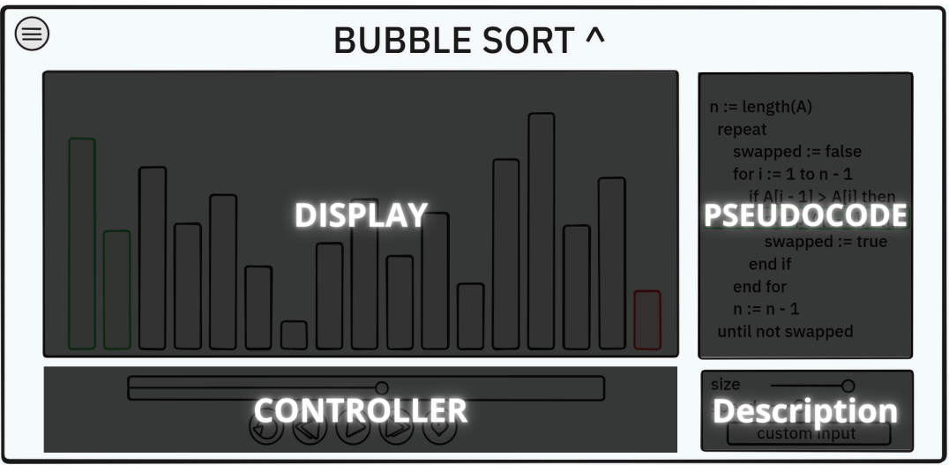
IMPLEMENTATION DETAILS
Modular Design

Slide 12
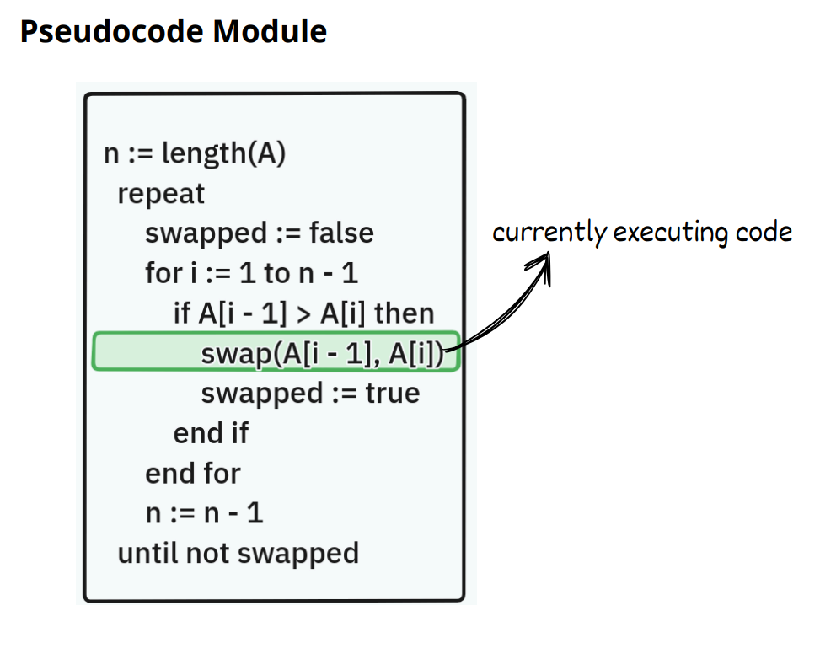
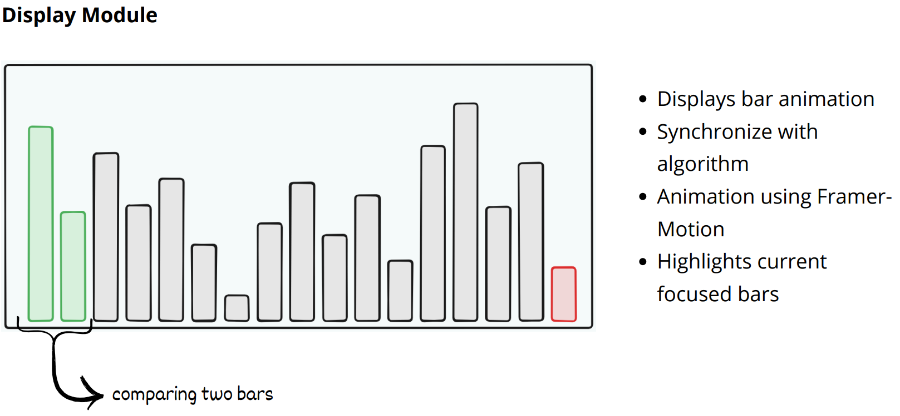
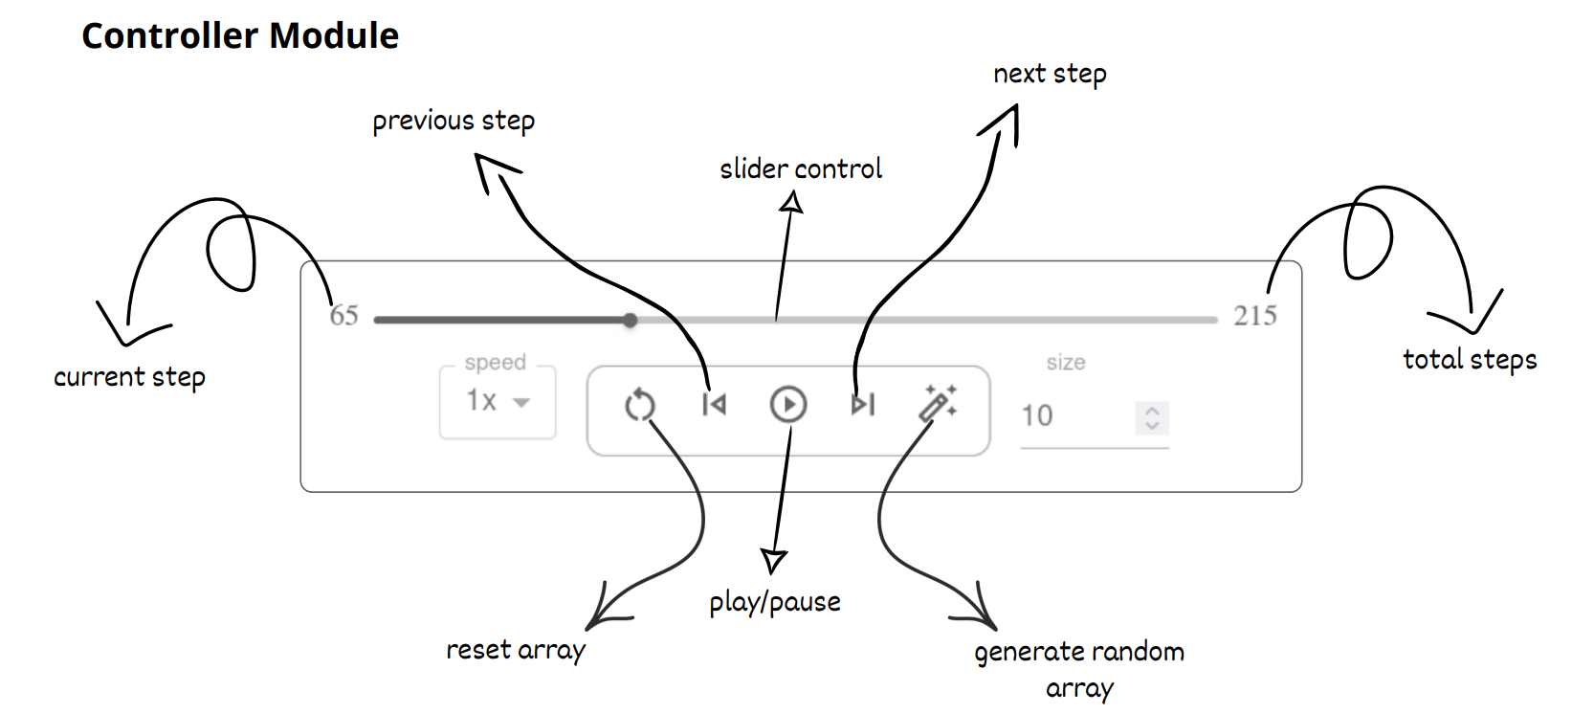
IMPLEMENTATION DETAILS

Slide 13
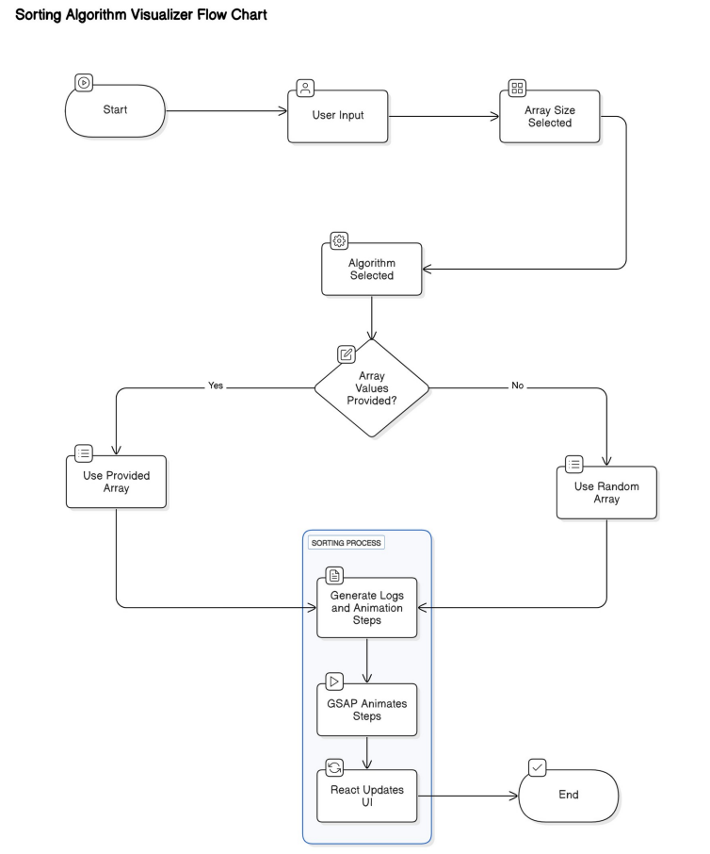
BLOCK DIAGRAM OF THE PROPOSED SYSTEM
User Input: Provide array size, select sorting algorithm, input array values.
Array Determination: Use provided array or generate random array.
Log Generation: Create logs and animation steps based on sorting algorithm.
Animation: GSAP animates sorting steps smoothly.
UI Updates: React updates the interface in real-time.
Completion: Marks end of sorting visualization.

Slide 14
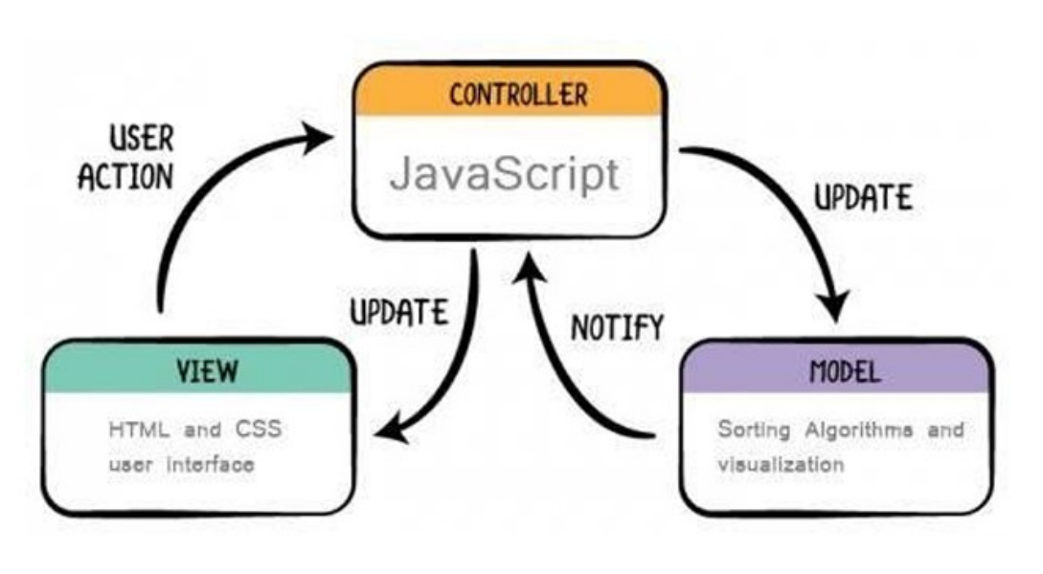
DESIGN ARCHITECTURE
The Sorting Algorithm Visualizer uses the Model-View-Controller (MVC) architecture for modularity, maintainability, and scalability.
Model: Manages data and business logic, implements sorting algorithms, notifies Controller of changes.
View: Handles presentation layer, uses HTML, CSS, UI components to display data and pseudocode.
Controller: Intermediary, handles user input, updates Model and View, uses JavaScript to synchronize data.

Slide 15
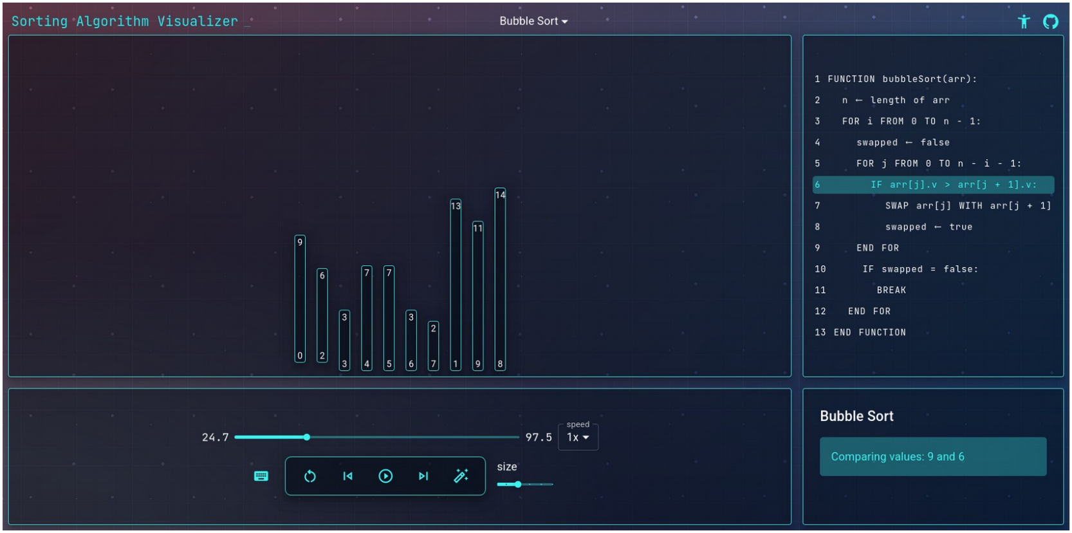
DEMO SCREENSHOTS

Slide 16
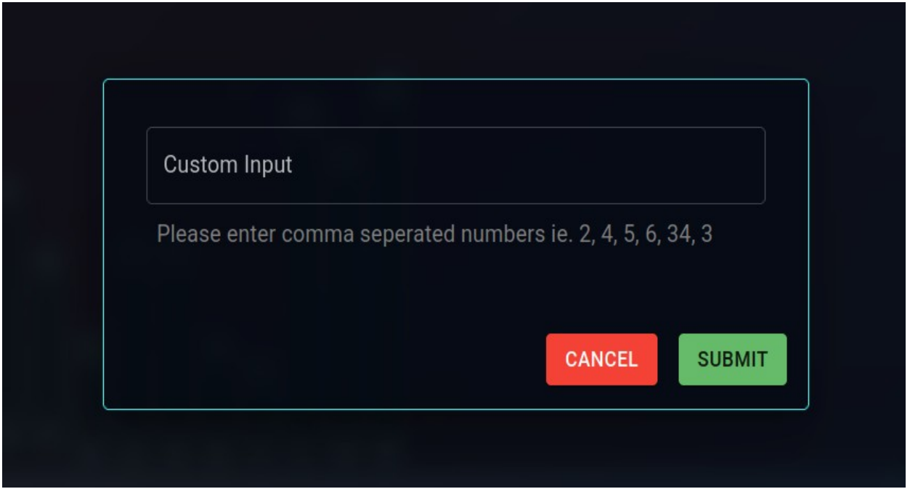
DEMO SCREENSHOTS
Custom Input: Users enter array values as comma-separated numbers.
Interface: User-friendly text box labeled "Custom Input."
Processing: Parses, validates, and converts input into array format.
Flexibility: Allows personalized data input for visualization.

Slide 17
FUTURE SCOPE
Additional Algorithms: Integrate Merge Sort, Quick Sort, Heap Sort, Radix Sort for broader comparison.
Side-by-Side Comparison: Highlight efficiency differences with performance metrics.
Interactive Elements: Add gamified challenges, quizzes, algorithmic puzzles for engagement.
Mobile Support: Ensure compatibility with mobile and tablet devices.
Accessibility: Include keyboard navigation and screen reader features.
Dynamic Learning: Transform into a personalized learning ecosystem.

Slide 18
CONCLUSION
The Sorting Algorithm Visualizer uses ReactJS, Material UI, and GSAP to provide an intuitive platform for real-time exploration of sorting algorithms. It integrates visualization techniques with educational features like pseudo-code highlighting, explanation panels, and speed control, offering a tailored learning experience.
Step-by-step execution, custom input handling, and animated transitions make complex algorithmic logic accessible. Visualizing Bubble Sort, Selection Sort, and Insertion Sort allows effective comparison of their characteristics.
Real-time manipulation and user interactivity address common learning challenges. The responsive, user-friendly interface enhances educational value across devices. This approach demystifies algorithms, improving understanding and serving as a valuable tool for students, educators, and enthusiasts.

Slide 19
REFERENCE

Slide 20
Thank you

