Slide 1
FK
FALKRONA
AGENTIC MARKETING FOR SMALL BRANDS
Good design should not
be reserved for brands
with a design team.
Falkrona turns a brand’s identity into a week of distinct, on-brand social content.
An impact story from a graphic designer building for small business owners
Notes:
Opening: I built Falkrona as a graphic designer after seeing small businesses rely on general-purpose image tools without the design principles that make a brand feel coherent. The project turns that design thinking into a guided workflow for the owner.

Slide 2
FK
FALKRONA
The gap is design judgment
AI made image-making easy.
It did not give every owner a brand system.
In my work as a graphic designer, I saw small brands use Gemini or GPT without clear rules for color, type, composition, or campaign consistency.
A useful tool needs to carry design intent forward, not just place words on an image.
The result can look cheap or feel like a different brand from post to post.
Falkrona · Impact
02
Notes:
The problem is based on my experience as a graphic designer, not a market survey. Image generation is accessible, but a strong ad still needs decisions about hierarchy, typography, color, composition, and consistency. Many owners are not trained to make those decisions or encode them in prompts.

Slide 3
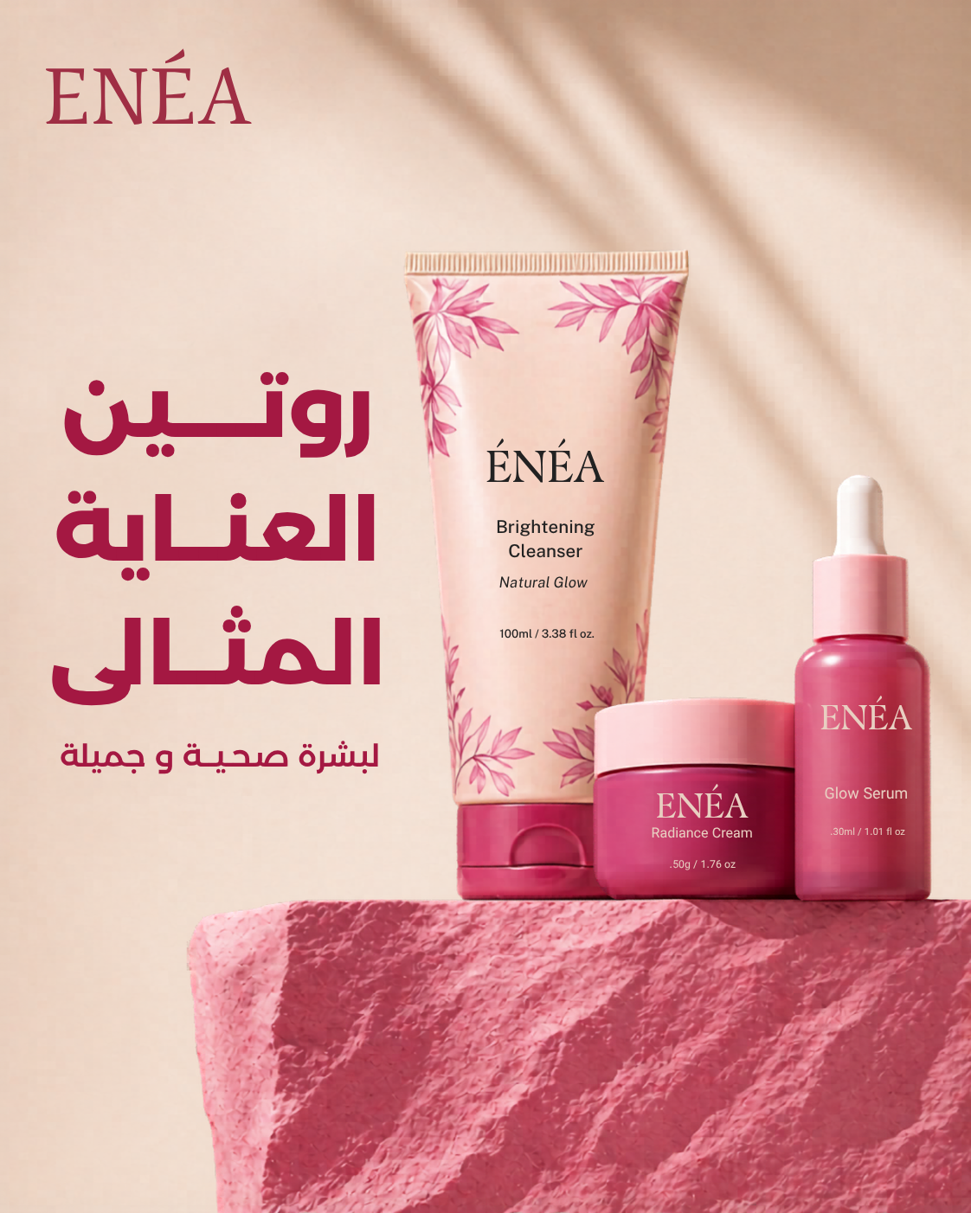
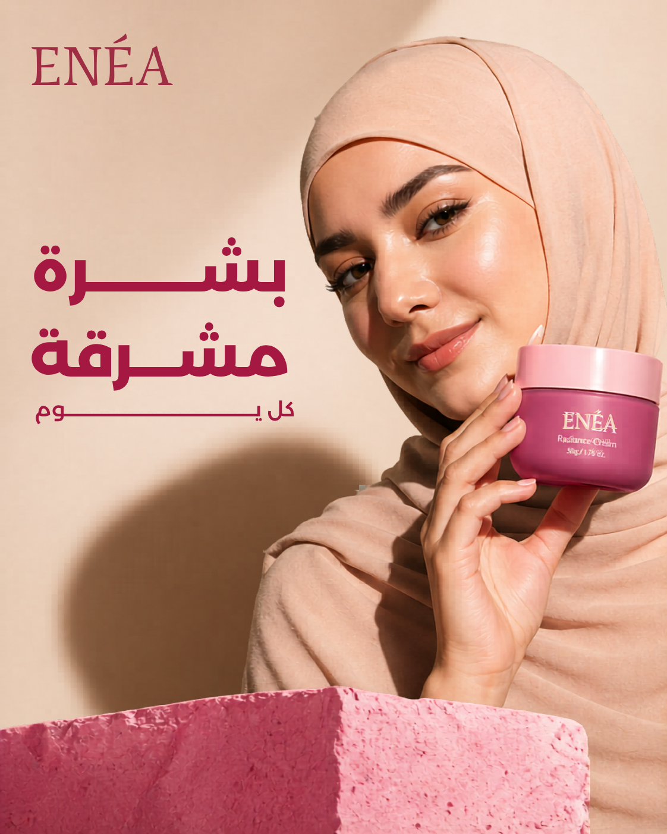
FK
FALKRONA
A brand system can stay consistent while ideas change
Same identity. Different creative idea.
These ENEA designs keep the warm palette and visual character while changing the subject and composition.
That is the balance Falkrona aims to support: recognisable brand rules with a fresh concept for each post.
Falkrona · Impact
03
Notes:
The two ENEA designs were supplied by the project owner. They show the principle clearly: repeated palette and identity do not require repeating the same layout. The product still life and the model-led ad serve different creative ideas.

Slide 4
FK
FALKRONA
Falkrona gives every post a clear creative brief
Brand anchors
Creative choices
Logo, palette, typography,
and CTA style and position
A new message, setting,
subject, and composition
Gemini plans the week and writes a distinct image prompt for each post.
A product photo tells the model what the product looks like. It does not dictate the ad’s background or layout.
Falkrona · Impact
04
Notes:
Falkrona stores brand information and asset roles so the creative prompt can preserve what should stay fixed while changing what should be new. The user's product photo supplies product identity only. An optional reference can guide style, while the prompt should avoid copying its exact composition.

Slide 5
FK
FALKRONA
A simpler weekly workflow for the owner
01
02
03
04
Set up the brand
Draft the week
Review once
Approve and schedule
Answer a short survey and upload the logo.
Gemini creates post ideas and design direction.
Check the finished designs, captions, and dates.
Falkrona schedules approved Facebook posts.
The owner guides the brand and approves the work. Falkrona handles the planning and follow-through.
Falkrona · Impact
05
Notes:
Falkrona is designed around ease of use. The owner should not need to become a prompt engineer or direct every visual decision. Once the brand is set up, the weekly loop is plan, review, and approve. Publishing currently targets Facebook; Instagram is outside this test scope.

Slide 6
FK
FALKRONA
Direct image generation is the intended next step
Today
Ideal workflow
Gemini plans and writes the prompt. The browser helper passes the prompt and assets to a signed-in ChatGPT or Gemini image app.
Falkrona sends the brand brief and product assets to an OpenAI or Gemini image-generation API, then receives the finished design directly.
Fewer steps for the owner. A more dependable generation flow. The same design goal: consistency with fresh ideas.
FALKRONA / AGENTIC MARKETING FOR SMALL BRANDS
Notes:
The browser helper is the current bridge because Falkrona sends the prompt into an image app where the user is already signed in. The ideal product experience is a direct image-generation API from OpenAI or Gemini, where Falkrona can send the approved prompt and relevant assets and receive the image without the user managing a separate browser step. This depends on available API capabilities, access, and product fit.

