Slide 1
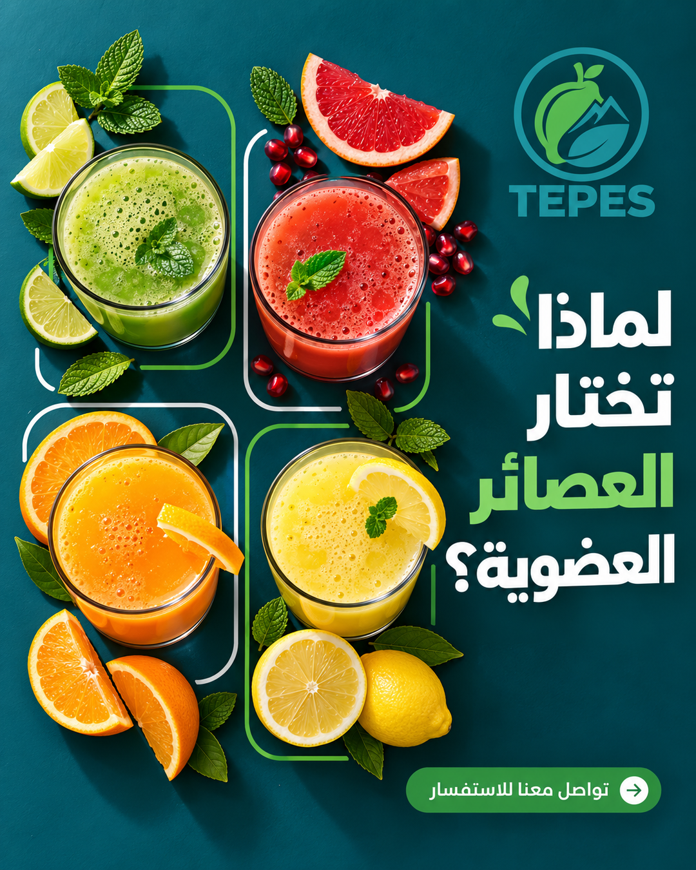
FALKRONA
Your brand’s marketing agent
An agentic marketing assistant for small business owners.
Build your brand profile once. Falkrona drafts a weekly plan, creates the designs, and schedules Facebook posts after your approval.
BUILT BY A GRAPHIC DESIGNER
Actual Falkrona-generated artwork
For owners who want consistent marketing
without directing every design detail.
Arabic and English designs
Facebook publishing in the current scope
Notes:
Falkrona is an agentic marketing assistant built for SME owners. The owner provides a brand brief and product assets, and Falkrona carries that context through planning, finished design generation and approved scheduling. I built it as a graphic designer because the owners I had in mind needed a creative process they could use without managing all the technical or design choices themselves. The image on the right is actual project output, not a decorative mockup.
Sources: C:\Users\Admin\Downloads\Projects\Falkrona\.runtime\storage\workspaces\54f976ac-b020-4ef9-bc8f-8af72cf99faf\agent-runs\d159233a-1bb7-4817-b333-896e32bbcf03\external-14b7eebe5200ec3e2ad0b1b3d9f69492f2400fe31ac718a81752cc3b96ac6367.png; README.md

Slide 2
FALKRONA
THE SME PROBLEM
01
Image tools are easy
to access. Design
direction is missing.
Inconsistent identity
Colors, typography and logo treatment drift between posts.
02
As a graphic designer, I kept seeing small businesses use Gemini or GPT without clear design principles or a consistent brand identity.
Weak visual hierarchy
Text competes with the product instead of helping the message.
03
A fragmented process
The result often looks cheap, inconsistent,
or disconnected from the business.
The owner still manages ideas, prompts, revisions and posting.
Notes:
This is the problem I observed through my work as a graphic designer. Many SME owners already use powerful image tools, but they lack a design system to guide them. A post may look attractive in isolation while failing to represent the same brand as the next post. The issue also includes the work around the image: choosing a purpose, writing the prompt, managing revisions and getting the post online. This is a founder observation rather than a quantified market study.

Slide 3
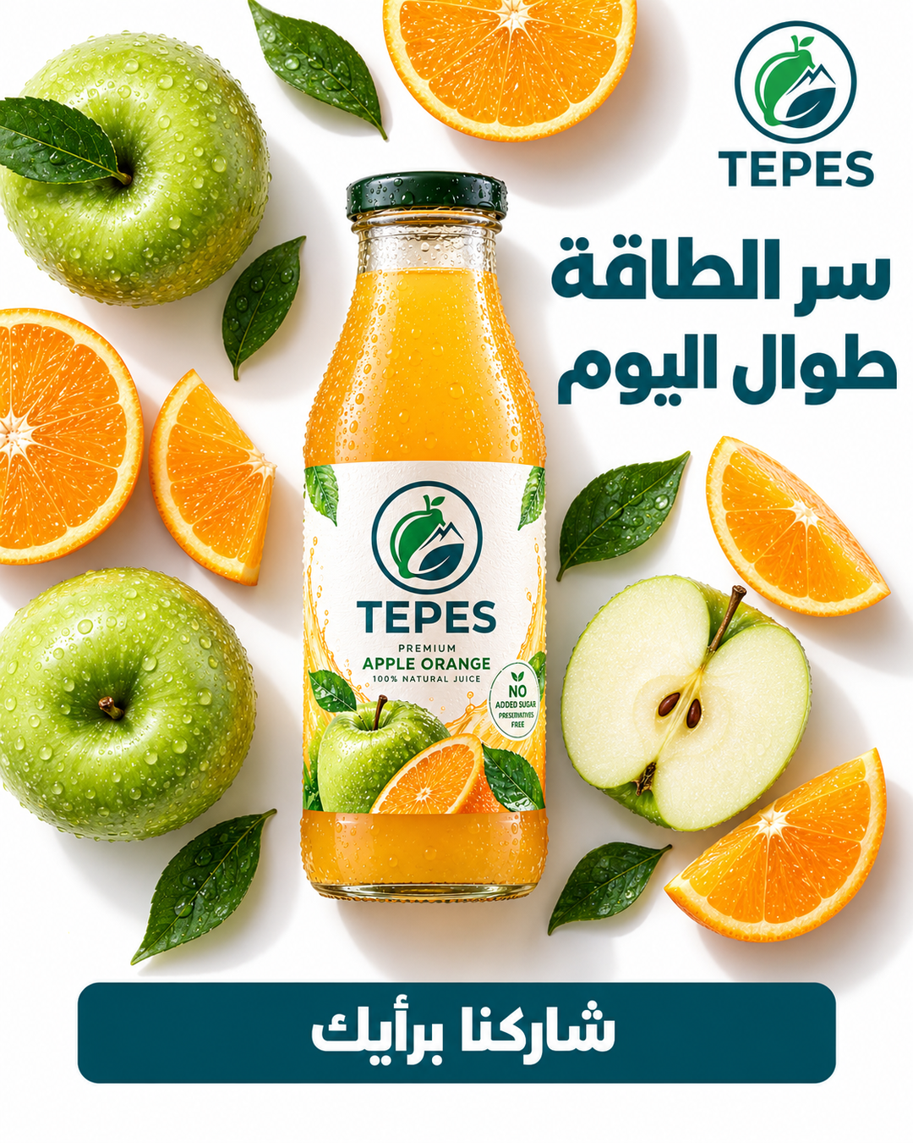

FALKRONA
THE SOLUTION
03
A consistent brand, with different creative ideas
ACTUAL TEPES OUTPUTS
Falkrona saves the
brand brief.
Gemini uses the audience, brand colors, typography, logo and CTA rules in every design direction.
Each post gets its own
concept and composition.
Product photos preserve product identity. Their backgrounds do not become the ad template.
Product-focused concept
Human-led concept
Shared palette, type and CTA treatment. A different idea in each post.
Notes:
Falkrona treats consistency and variety as separate design decisions. The profile and campaign direction define what stays consistent, such as the brand palette, typography, logo treatment and CTA. Gemini chooses a distinct visual route and composition for each post. The product photo provides identity evidence only; its original scene is explicitly excluded from the new layout. These are actual TepeS generated artifacts. They show a product-led composition and a human-led scene, with similar brand colors and a consistent bottom CTA treatment. Visual review remains necessary because image models can still deviate.
Sources: C:\Users\Admin\Downloads\Projects\Falkrona\.runtime\storage\workspaces\54f976ac-b020-4ef9-bc8f-8af72cf99faf\agent-runs\81e5be4d-fc61-449c-a029-7c5e1486b202\external-d6b14d7a2854b047e23b39e9df485e3a95d558940e2a3dc26c7fc1b39c485ddb.png; C:\Users\Admin\Downloads\Projects\Falkrona\.runtime\storage\workspaces\54f976ac-b020-4ef9-bc8f-8af72cf99faf\agent-runs\beec8e28-cf3f-4989-a0fd-96760511e9dc\external-833e0086e1548c7bc8f8a1aef8caa802275ad7bb8555695bbf7055ab7fb8f5cd.png; docs/evidence/creative-variety-2026-10-02.md; docs/evidence/owner-design-controls-2026-10-03.md

Slide 4
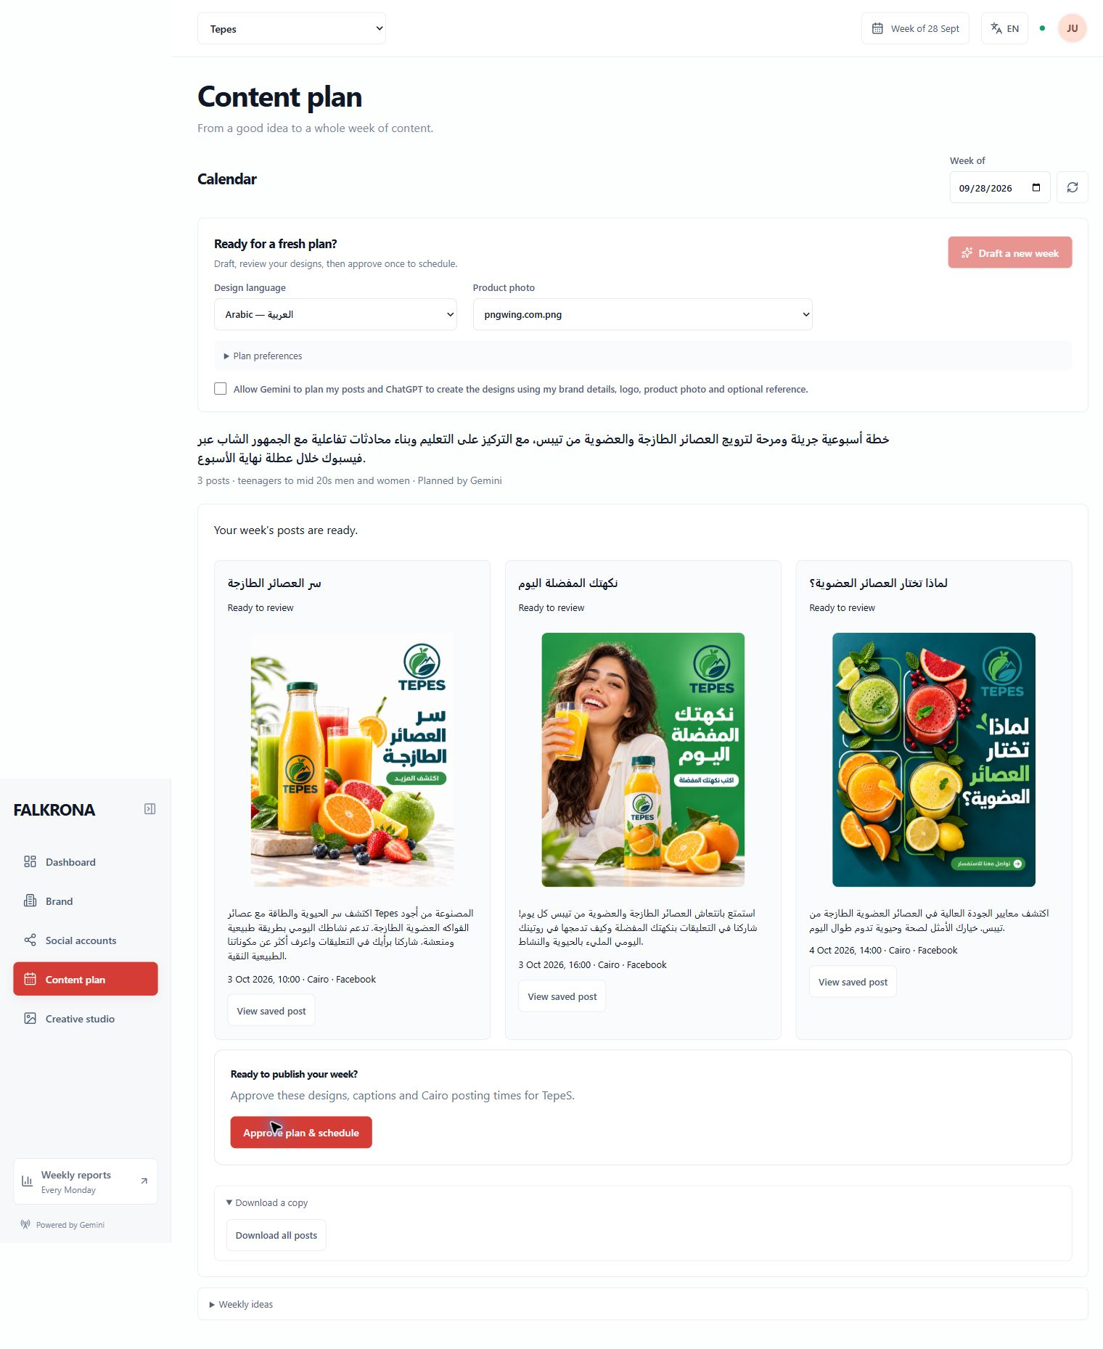
FALKRONA
OWNER EXPERIENCE
04
A short setup. One weekly approval.
01
Set up the brand
Answer a short survey. Upload the logo and product photo, with an optional style reference.
02
Draft the week
Gemini plans the posts and writes detailed prompts. The image tool creates the designs.
03
Review and approve
Check designs, captions and dates. Regenerate if needed, then approve the whole schedule.
A real Arabic content plan, ready for one approval
Notes:
The owner experience stays simple. Brand setup happens once, and the owner chooses Arabic or English for the designs. Draft a plan initiates the weekly plan, the individual creative directions and image generation, rather than making the owner approve each prompt before generation. The owner reviews the finished work and can change dates, regenerate a design or delete an unwanted post. One approval schedules the reviewed Facebook plan. The screenshot shows the completed Arabic batch and its approval action.
Sources: C:\Users\Admin\Downloads\Projects\Falkrona\.runtime\arabic-three-posts-ready.png; docs/HACKATHON_LOCAL_SETUP.md

Slide 5
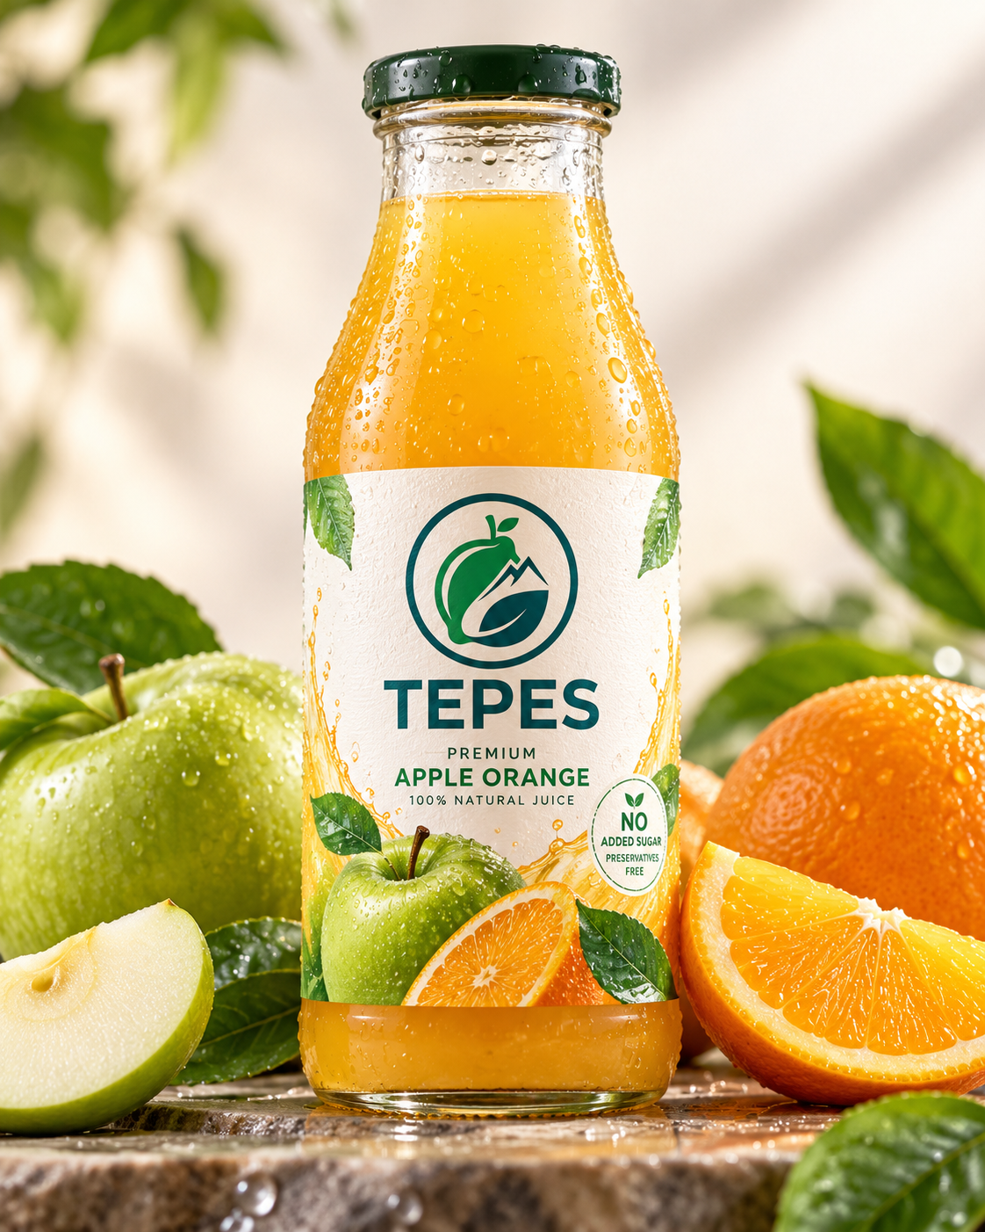
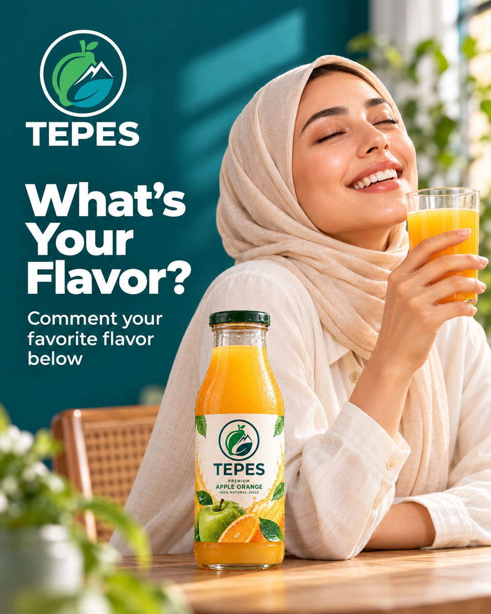
FALKRONA
AGENT WORK
05
The agent coordinates the work between the clicks
Gemini through Hermes
Chooses post purposes and creative concepts, then writes captions and detailed design prompts.
Image generation tools
Send the approved brand assets and prompts, then bring the generated images back to Falkrona.
Falkrona application
Validates model output, saves progress and recovers interrupted jobs without losing finished work.
Uploaded product photo
New generated design
Publishing and reporting
The bottle’s identity carries into a new setting.
The source photo does not dictate the composition.
Workers deliver approved Facebook posts on schedule and collect engagement for weekly reports.
Notes:
The agent does more than ask an image model for a poster. Gemini reasons over confirmed brand facts to create a weekly plan and distinct directions. Hermes runs the scoped planning turns. The application validates structured responses, stores job state and binds the returned image to the correct post. The authorized browser helper currently performs attachment, submission and image return with ChatGPT. Separate durable workers handle publishing after the owner approves, and engagement collection feeds weekly reports when the connected account grants the needed access and data. The product photo and generated design on this slide are real project assets.
Sources: C:\Users\Admin\Downloads\Projects\Falkrona\.runtime\storage\workspaces\54f976ac-b020-4ef9-bc8f-8af72cf99faf\assets\0c481a37-2e3b-46b4-a784-88cd4c468638\original.png; C:\Users\Admin\Downloads\Projects\Falkrona\.runtime\tepes-distinct-design-2.png; README.md; docs/BROWSER_IMAGE_WORKFLOW.md

Slide 6
FALKRONA
EXPECTED IMPACT
06
What changes for a small business owner
A repeatable creative process with fewer tasks to coordinate.
Task | Doing it manually | Using Falkrona
Brand briefing | Re-explain the brand in each new prompt | Save a profile that guides the whole campaign
Content creation | Plan and direct one asset at a time | Review a generated week of designs and captions
Publishing | Move posts and dates across separate tools | Approve one schedule and see weekly results
The owner focuses on whether the work represents the business.
A user pilot still needs to measure time saved, design quality and business results.
Notes:
These are the intended workflow benefits, rather than measured commercial outcomes. Falkrona reduces repeated briefing, centralizes campaign review and connects approved work to scheduling. Its contribution is to make a design process easier for an owner to follow. A user pilot would measure time to approve a week, design consistency, the number of revisions and reliable publication. Sales or revenue improvements require separate evidence. Real weekly engagement reports also depend on the authorized connection and sufficient post history.
Sources: README.md

Slide 7
FALKRONA
THE IDEAL WORKFLOW
Today
A direct image API
should complete
the creative flow.
The browser helper transfers prompts and assets to a signed-in image app and returns the finished design.
ChatGPT is exercised in the current build.
Gemini website verification remains pending.
Gemini writes the creative brief.
An OpenAI or Gemini image-generation API creates the artwork directly inside Falkrona.
Proposed next version
Falkrona calls the image API directly and stores the returned artwork with its post.
This removes extension installation and reduces dependence on changing website controls.
No separate extension setup
in the intended experience.
Notes:
The browser helper is the current image-generation bridge, and website changes can break that integration. The ideal product workflow uses an OpenAI or Gemini image-generation API. Gemini still creates the campaign plan and detailed creative brief, then Falkrona sends the brief and relevant brand assets directly to the image API and saves the returned image. The aim is a smoother experience for the owner and a more stable integration. This is the proposed next version, not a capability already implemented.
Sources: docs/BROWSER_IMAGE_WORKFLOW.md; User-requested roadmap

Slide 8
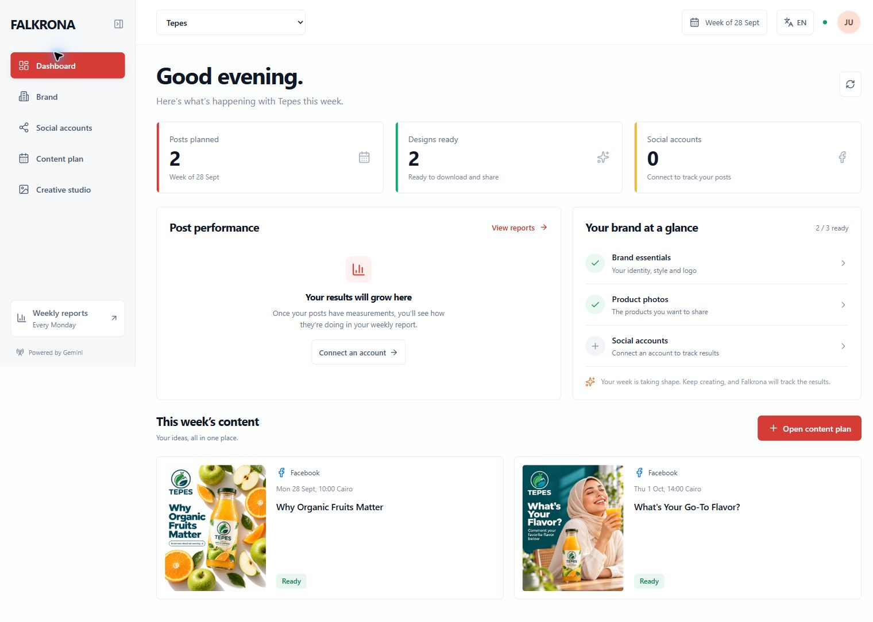
FALKRONA
THE PROJECT
08
Design knowledge inside an owner’s weekly workflow
Working prototype
Gemini planning, ChatGPT image generation and approved Facebook scheduling.
Next phase
Direct image APIs, SME user pilots and Instagram verification.
github.com/dark0danger/Falkrona
Runnable source and full setup guide
Notes:
The project is a runnable prototype in a public GitHub repository. It has live Gemini planning and ChatGPT image generation, Arabic and English designs, owner controls and Facebook scheduling after approval. The owner reports successful publication testing. The next work is to integrate a direct image API, run user pilots and verify Instagram. The purpose remains the same: put design knowledge into a process a small business owner can use each week.
Sources: C:\Users\Admin\Downloads\Projects\Falkrona\.runtime\falkrona-polished-dashboard.jpg; README.md; https://github.com/dark0danger/Falkrona

