Slide 1

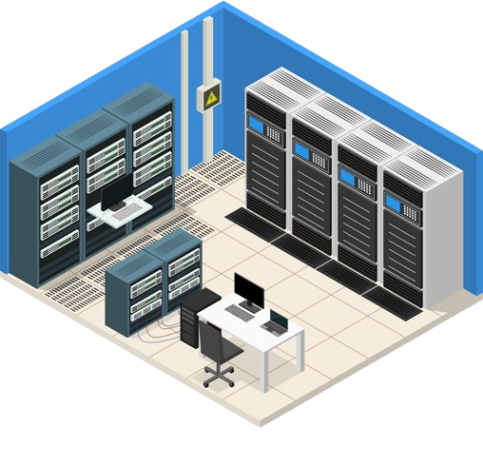
Network Monitoring System Using Flask & GNS3
A Multi-Department University Network Design with Web-Based Device Monitoring
By: Isam Muwhaid & Mosab Basheer
IDs: 12505049 · 12400328
Supervised By:
Eng. Ibrahim Fathi Mahmoud Amria & Dr. Jihad Mahmoud Amin Hamamra

Slide 2

Introduction & Problem Statement
Why Monitoring Matters
The Problem
Networks are essential in modern systems
Monitoring ensures reliability and uptime
Helps detect failures early before they escalate
Multiple devices spread across different labs
No easy way to track device status
Manual checking is slow and inefficient

Slide 3
Project Objectives & Proposed Solution
🎯 Build a Monitor
📡 Ping-Based Detection
🖥️ Simple Dashboard
Design a real-time device status monitoring system for a simulated campus network
Use ICMP ping to automatically check if each device is UP, UNSTABLE, or DOWN
Provide a clean web interface accessible via browser — no manual CLI needed

Slide 4


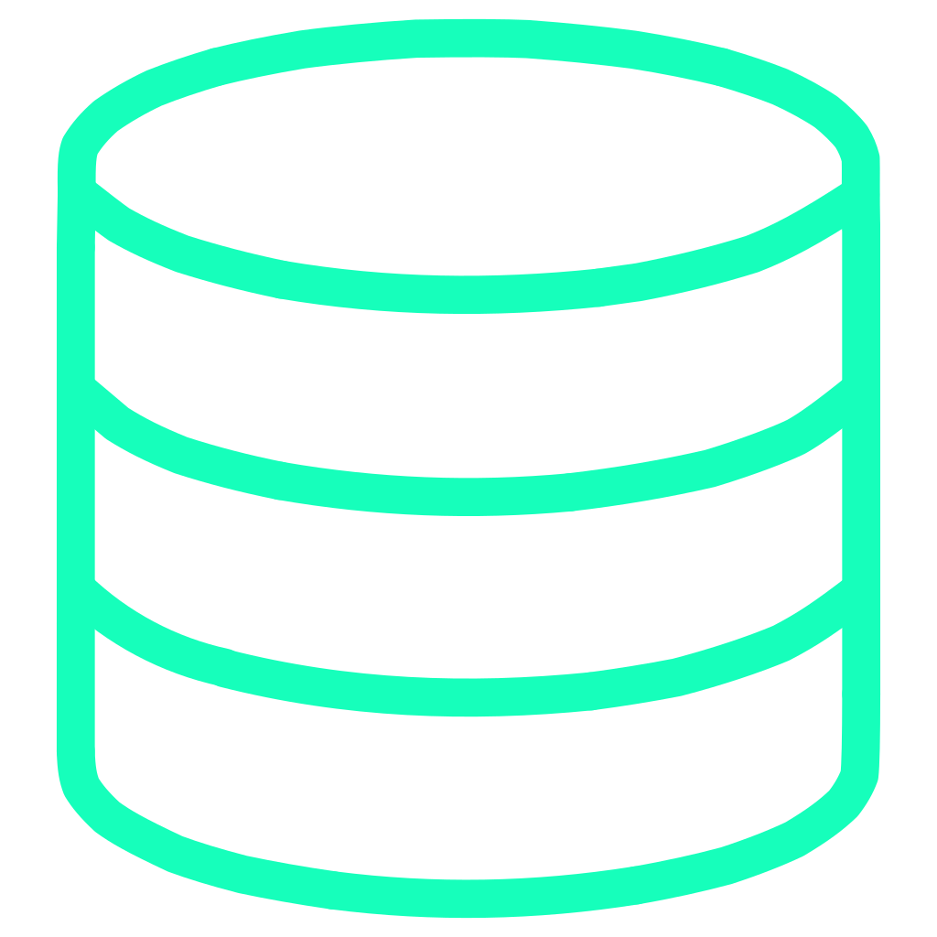

Tools & Technologies
GNS3 + Cisco IOS
Python / Flask
Simulates routers, switches, and end devices in a virtual campus environment
Backend server and web framework powering the monitoring dashboard
SQLite
VMware + Ubuntu
Lightweight database storing device records, logs, and status history
Ubuntu VM hosts the Flask server; VMware bridges GNS3 and the web app

Slide 5
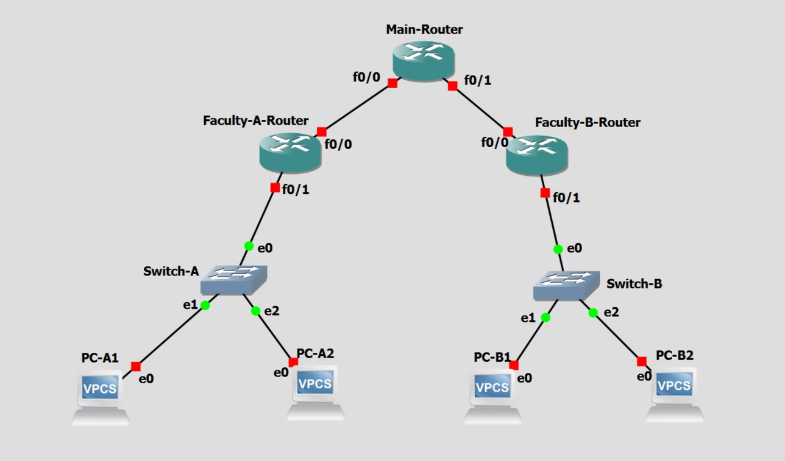
Network Topology
Topology Structure
Main Router (R1) — core of the network
Faculty-A Router (R2) → Switch-A → PC-A1, PC-A2
Faculty-B Router (R3) → Switch-B → PC-B1, PC-B2
Devices Used
3× Cisco 3745 Routers
2× Ethernet Switches
4× VPCS End Devices

Slide 6

IP Addressing & Routing Plan
Address Scheme
Static Routing
Each router is configured with static routes so all faculties can communicate through the Main Router.
Segment
Subnet
Lab A (Faculty A)
192.168.10.0/24
All interfaces verified with show ip interface brief and show ip route
Lab B (Faculty B)
192.168.20.0/24
R1 ↔ R2 Link
10.0.12.0/30
R1 ↔ R3 Link
10.0.13.0/30

Slide 7
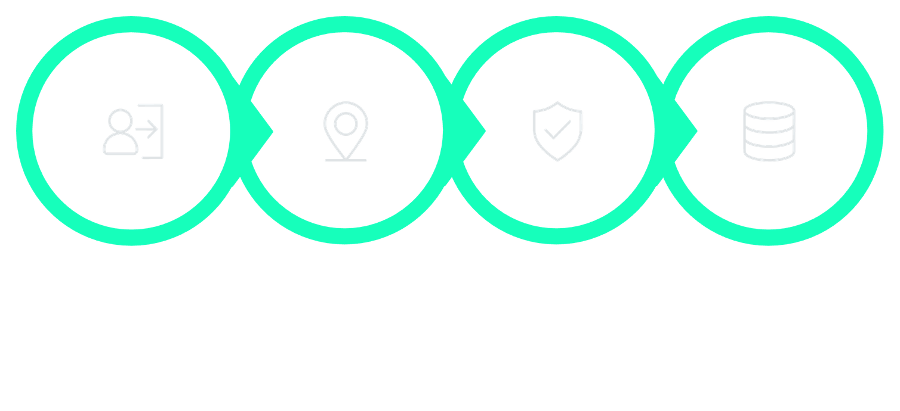




System Architecture & How It Works
Login
Send Ping
Evaluate Reply
Update DB
Architecture Layers
Device Status Logic
Frontend: HTML dashboard in browser
Backend: Flask (Python) on Ubuntu VM
Database: SQLite for logs & device records
UP — ping succeeds consistently
UNSTABLE — partial ping success
DOWN — ping fails; retry logic avoids false alarms

Slide 8
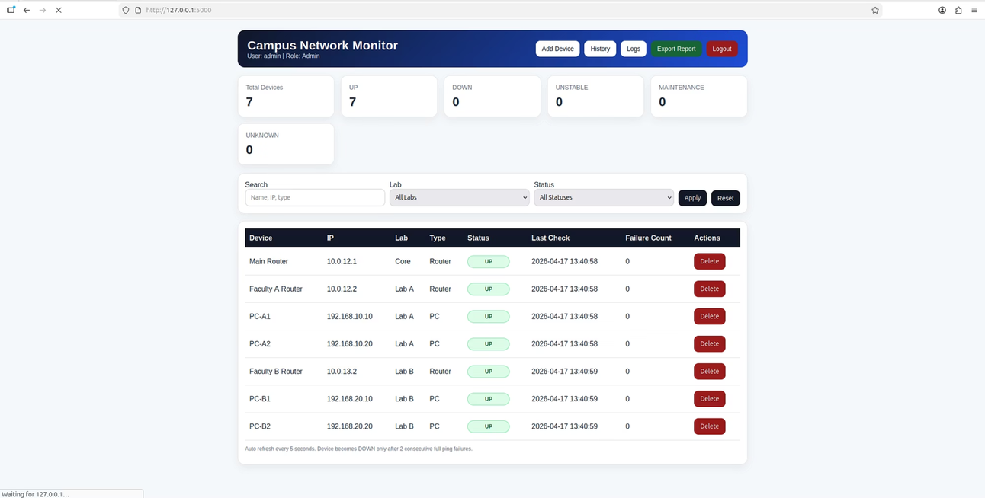

The Watcher Dashboard
Dashboard Features
View all devices with IP, Lab, Type & Status
Add or delete devices dynamically
History and logs for each device
Auto-refresh every 30 seconds
Export report functionality
Access at http://127.0.0.1:5000 — first run: visit /init to seed users

Slide 9
Problems We Faced & Solutions
VNet/Hyper-V Conflict
Zabbix Failure
GNS3 VM failed to start — fixed by disabling virtualization checkboxes in VMware processor settings
Zabbix couldn't store or display device stats — replaced with a custom Flask app built with Claude 3.5
Switch Compatibility
VPCS Config Not Saving
GNS3 switches caused persistent errors — workaround: replaced switches with routers (Layer 3)
Always type save after assigning IPs — configs are lost on restart otherwise

Slide 10

Conclusion & Future Improvements
What We Achieved
Planned Improvements
Simulated a real campus network in GNS3
Built a live web monitoring dashboard with Flask
Combined networking concepts with full-stack development
Switch to real switches + VLANs on Linux
DHCP for automatic IP assignment
Role-based login for students, doctors & tech support
Auto-ping and live status updates
Thank you! — Questions are welcome 🎓

