Slide 1


A Cornerstone Project
AI Resume Analyzer
Presented by
Anurag Nayak (24B11AI014)
Satish Maneddy (24B11AI243)
G Sai Ram (25B21AI047)
Guide: Mr. G Siva Sankar
Department of Artificial Intelligence & Machine Learning
Notes:
Team and guide details are from the project report.

Slide 2

Presentation Outline
Project overview
Problem and objectives
System architecture
Input and preprocessing
Skill recognition
Vector scoring
Scoring example
3D skill map
Upload screen
Matched and missing skills
Verification and limitations
Conclusion
Notes:
The deck follows the same visual format as the Aditya University reference presentation.

Slide 3
PROJECT OVERVIEW
Abstract
Matchspace compares named technical skills in an uploaded job description and resume. It embeds each recognized label with a pretrained sentence model, assigns one-to-one matches, and returns a scored explanation with a rotatable 3D view.
Introduction
A user supplies a UTF-8 JD text file and a selectable-text resume PDF. The result shows matched and missing JD skills, point credit for each selected pair, and the overall score. The tool supports document review; it does not assess a person’s competence.
Notes:
Source: README.md, matcher.py, server.py.

Slide 4
PROBLEM STATEMENT & OBJECTIVES
Problem statement
Direct keyword search can miss related terms, while a single percentage hides which requirements were recognized. The project needs a visible, repeatable comparison of technical skills across a JD and a resume.
Objectives
Accept a JD text file and selectable-text resume PDF.
Recognize distinct technical skills and known aliases.
Compare skill embeddings with cosine similarity.
Assign each resume skill to at most one JD skill.
Show the score, matched pairs, and missing skills.
Display both skill sets in a rotatable 3D map.
Notes:
Source: project report, Chapters 1 and 2.

Slide 5
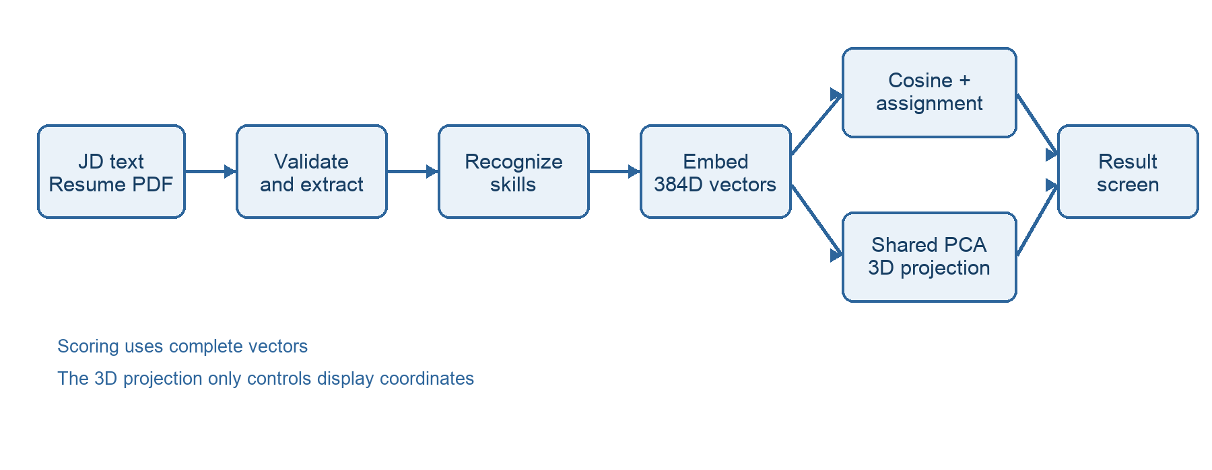
SYSTEM ARCHITECTURE
Notes:
Source: project report, Figure 4.1. Scoring uses 384-dimensional vectors; the three-dimensional projection controls display only.

Slide 6
INPUT & PREPROCESSING
Accepted files
The upload screen accepts a UTF-8 .txt job description up to 250 KB and a selectable-text .pdf resume up to 5 MB. The server validates file types, sizes, and readable content before analysis. An image-only PDF receives a clear OCR-related error.
Document focus
When the JD has a Required Qualifications or Requirements section, that section supplies the scored requirements. Otherwise the matcher prefers a named technical-skills section. The resume reader uses PDF layout extraction and skips contact or URL-like lines.
Notes:
Source: server.py and matcher.py. OCR is not implemented.

Slide 7
SKILL RECOGNITION
Curated vocabulary
The matcher searches for supported technical names and aliases, including Python, Docker, Kubernetes, CI/CD, Terraform, observability, and SRE terms. It deduplicates repeated mentions under a canonical skill name while keeping a readable label for the result.
Recognition boundary
Known variants such as K8s and Kubernetes count as one skill. Unknown or ambiguous skills may be missed because the vocabulary is finite. The system extracts named terms; it does not infer every skill from unrestricted resume prose.
Notes:
Source: SKILL_ALIASES and extract_items in matcher.py.

Slide 8
VECTOR MATCHING
Embedding and similarity
The pretrained all-MiniLM-L6-v2 model converts each recognized skill label into a 384-dimensional vector. The matcher compares JD and resume vectors with cosine similarity. Opaque abbreviations are expanded before encoding, while visible labels remain unchanged.
Points and assignment
Pair credit is clamp((cosine − 0.60) / 0.40, 0, 1). A one-to-one assignment selects the set with the highest total credit, so one resume skill cannot score twice. The percentage is 100 × earned credit / recognized JD-skill count.
Notes:
Source: embed_items and score in matcher.py. The 0.60 floor is the current local calibration, not a hiring probability.

Slide 9
SCORING EXAMPLE
Synthetic demonstration
A repeatable test JD lists seven technical skills. The synthetic resume shares five labels and includes two additional skills. The browser run shows five exact pairs, two missing JD skills, and a score of 71.43%.
Observed result
Python, Bash, Docker, Kubernetes, and CI/CD earn 1.00 point each.
Terraform and Observability remain unmatched.
Total credit is 5.00 out of seven possible skill points.
The displayed percentage is 100 × 5 / 7 = 71.43%.
Purple markers show the selected scored pairs.
This is a functional example with synthetic files.
Notes:
Source: synthetic run documented in the project report, Chapter 7. This is not a real hiring outcome.

Slide 10
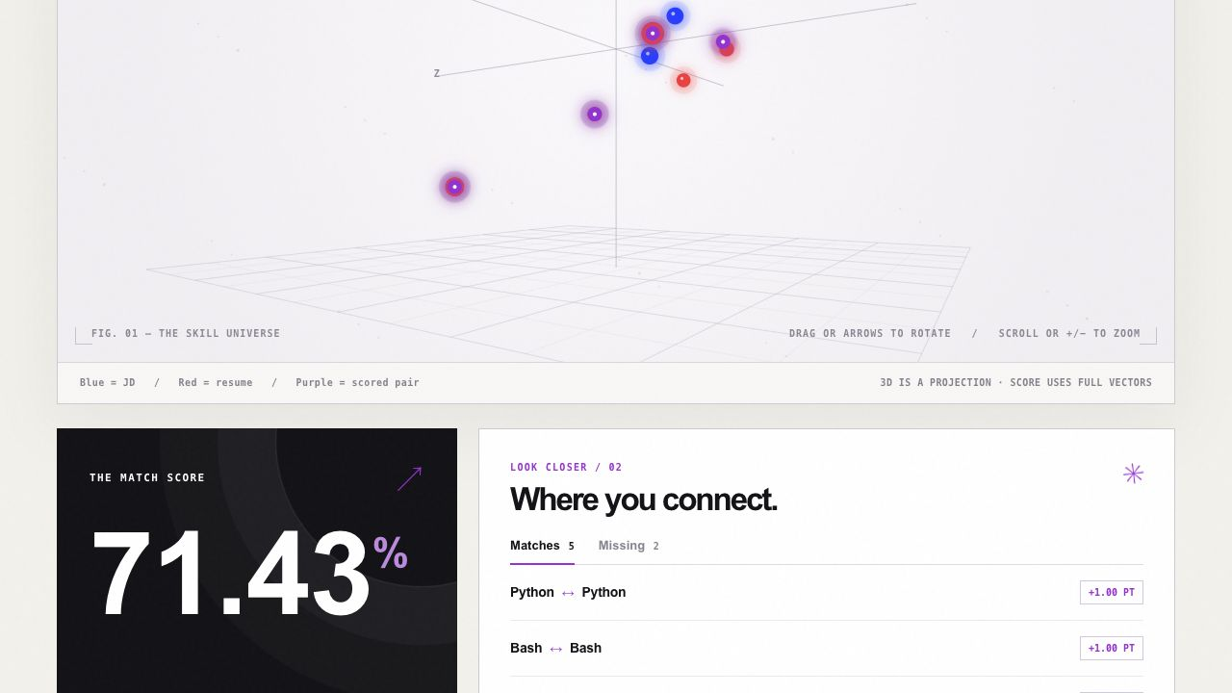
3D SKILL MAP
Notes:
Source: screenshot from the running local frontend. The map uses shared PCA coordinates; it does not determine score.

Slide 11
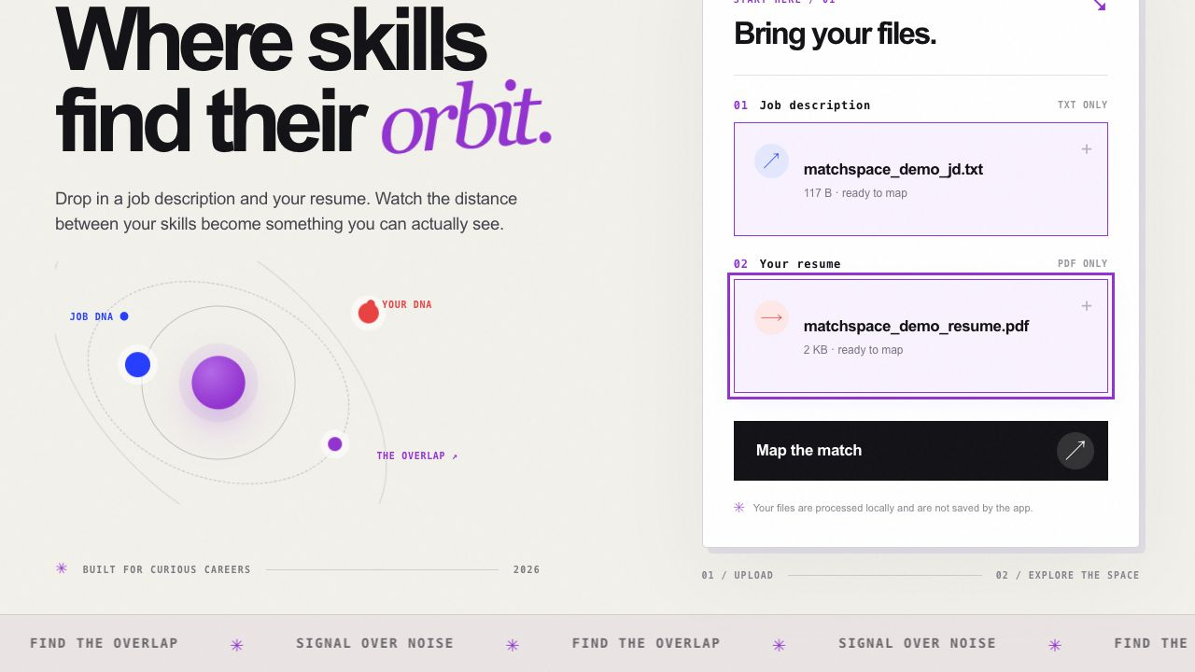
UPLOAD SCREEN
Notes:
Source: screenshot from the running local frontend with synthetic demonstration files.

Slide 12
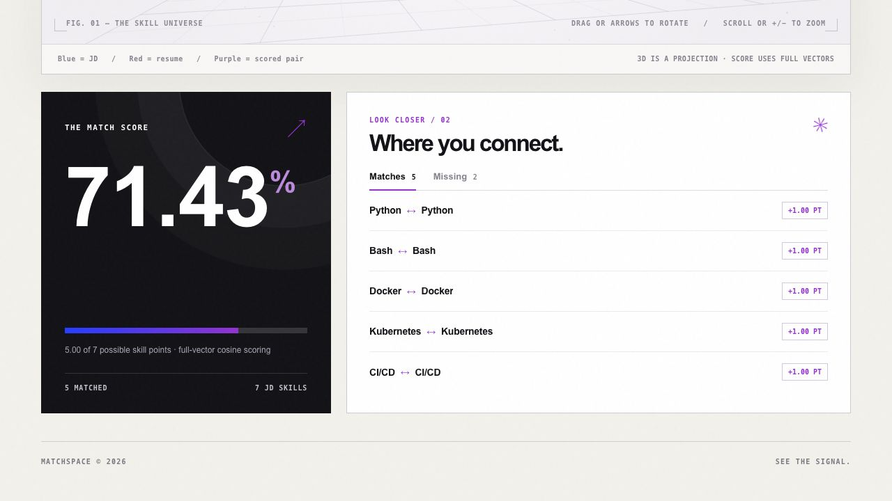
MATCHED SKILLS
Notes:
Source: screenshot from the running local frontend. Five of seven JD skills receive credit.

Slide 13
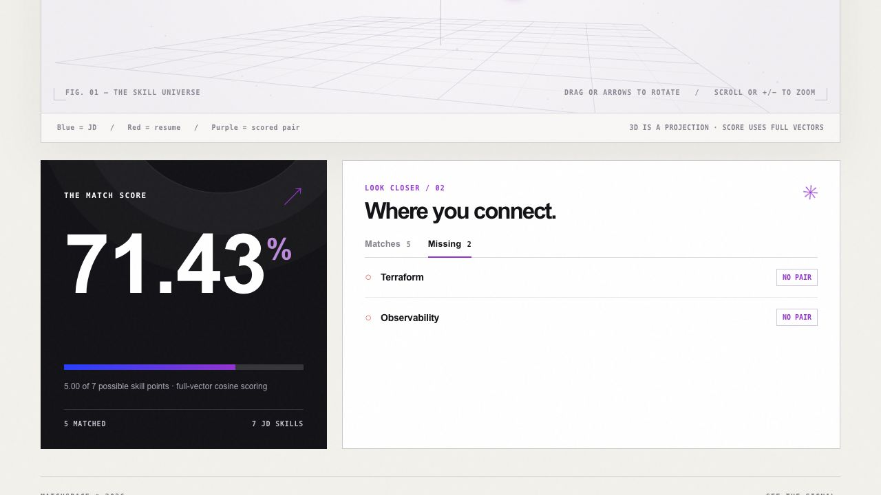
MISSING SKILLS
Notes:
Source: screenshot from the same synthetic run. A missing label means no selected positive-credit pair.

Slide 14
VERIFICATION & LIMITATIONS
Functional checks
The repository has 31 Python tests for extraction, scoring, projection, and API errors, plus six JavaScript tests for the map and score display. The local browser flow was exercised with synthetic files and its upload, score, and detail views were captured.
Current limits and next step
The curated vocabulary can miss unfamiliar terms. Image-only PDFs need OCR, and a 3D projection can distort visual distance. An editable preview of extracted skills and an annotated evaluation set would improve review and support measured calibration.
Notes:
Source: tests/, project report, and current implementation. No real-resume accuracy or hiring benchmark is claimed.

Slide 15




CONCLUSION
The app accepts a JD text file and selectable-text resume PDF.
It scores recognized skills with embeddings and one-to-one matching.
The result explains the score through points, pairs, and missing JD skills.
The frontend displays the same result in a rotatable 3D map.
Human review remains necessary for experience, context, and hiring decisions.
Notes:
Source: project report, Conclusion. The prototype is a document comparison aid.

